Slide 1
Multi-GPU Training
Peer-to-peer memory transfers between GPUs can either be instigated by the host or by a device. Host-initiated memory access is performed by explicit copy commands; whereas device-initiated memory access is supported by virtual addressing, which maps all host and device memory to a single, NUMA-based address space. Although the latter method is easy to program, it may incur high overhead due to the multitude of memory transfers in small chunks over the interconnect.
Therefore, optimized multi-GPU applications typically invoke large, host-initiated peer-to-peer memory transfers. The host-level component is responsible for multi-GPU kernel partitioning, automatic memory allocation, scheduling and exchanging boundaries. The device-level component provides an iterator-based interface, which allows the programmer to access data in an index-free fashion. This component automatically performs advanced optimizations such as global memory write caching and instruction-level parallelism.

Slide 2
Multi-GPU Training
Memory-oriented parallel programming paradigm for efficient utilization and automatic partitioning of GPU applications to multiple devices.
The paradigm consists of many-threaded Tasks; where each thread accesses disjoint N-dimensional data structures, called Datum objects, using programmer-provided input and output memory access patterns per datum. Below, we describe the abstractions on which an automatic partitioning framework can be built.

Slide 3
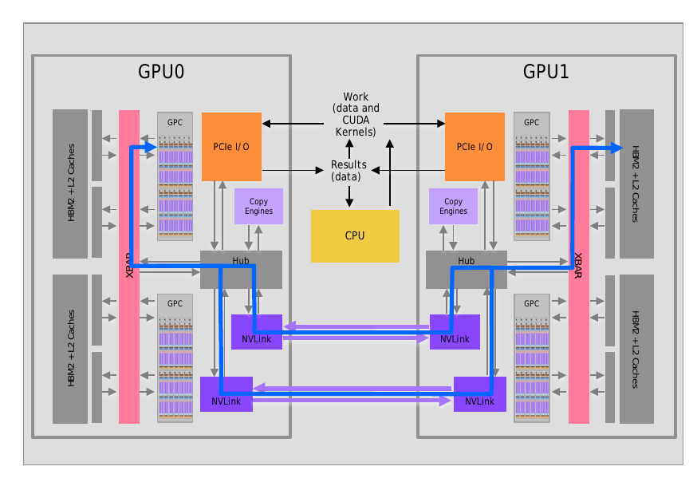

Slide 4
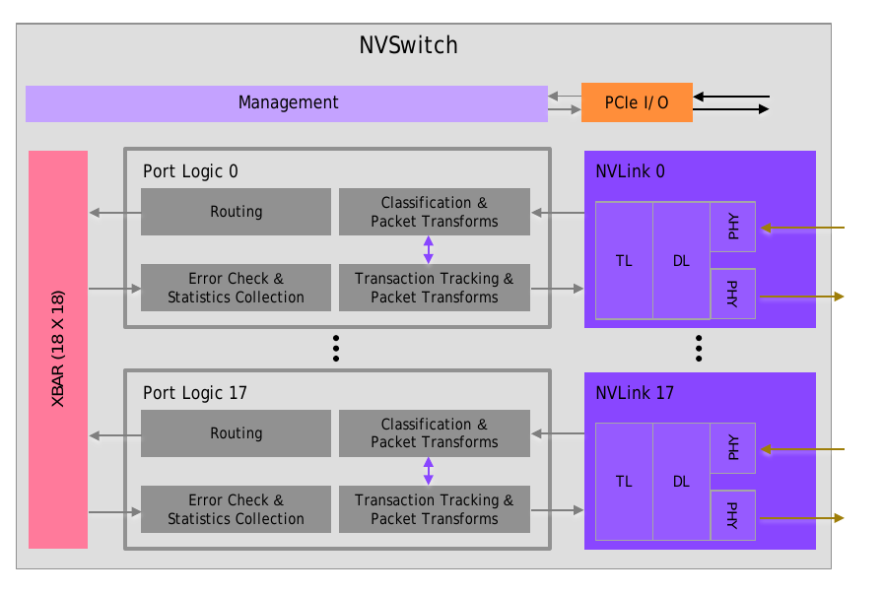

Slide 5
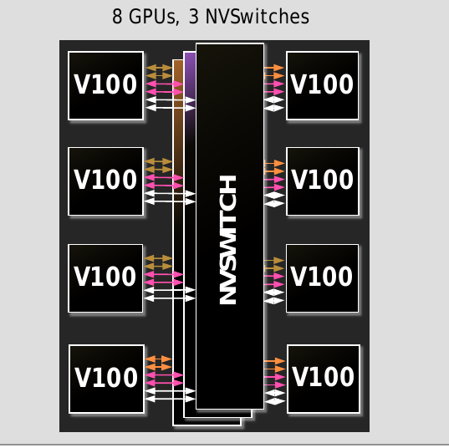
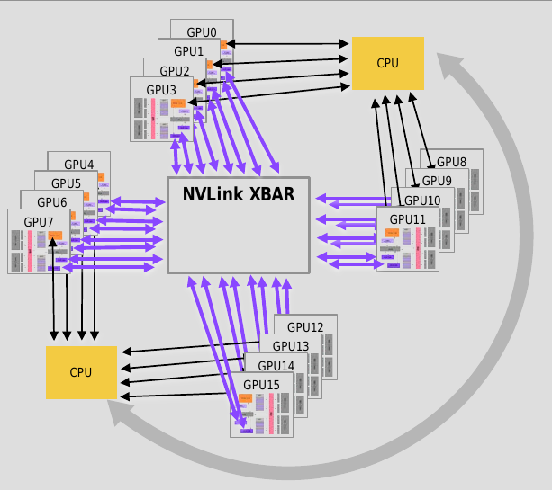

Slide 6
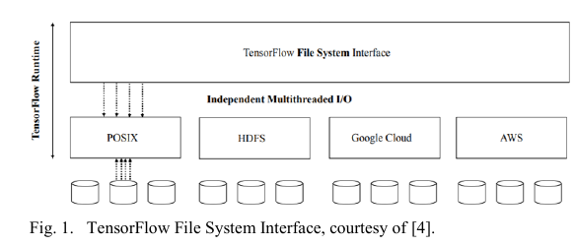
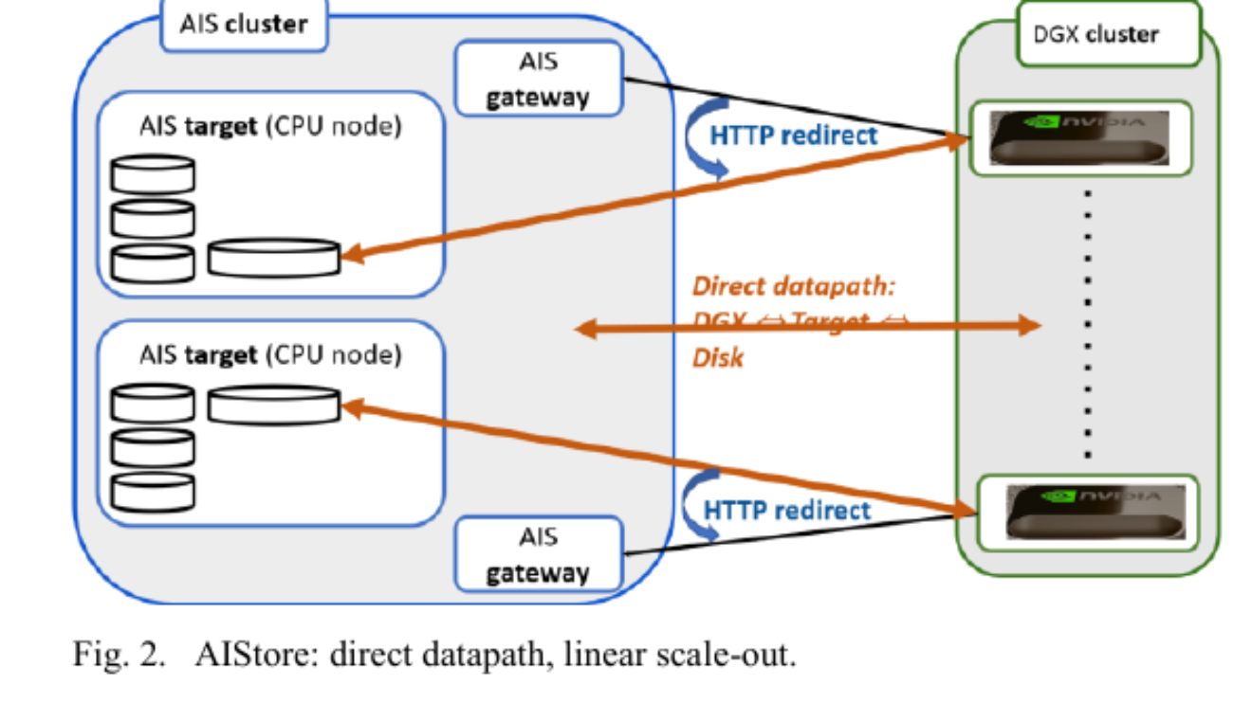

Slide 7
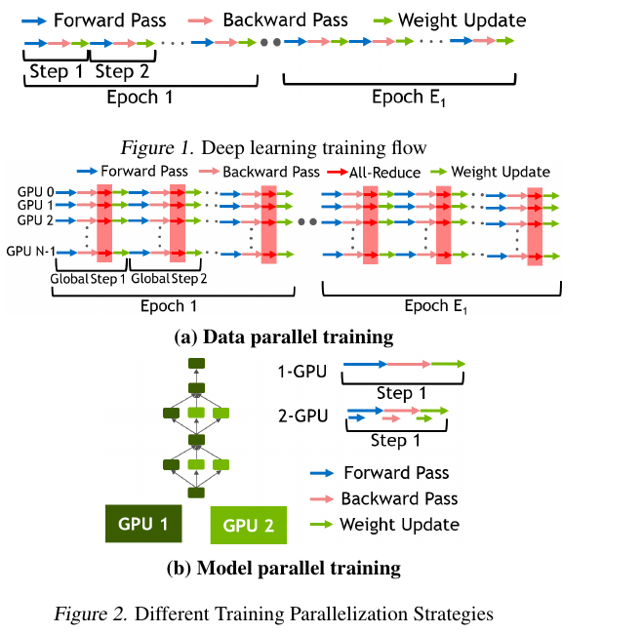

Slide 8
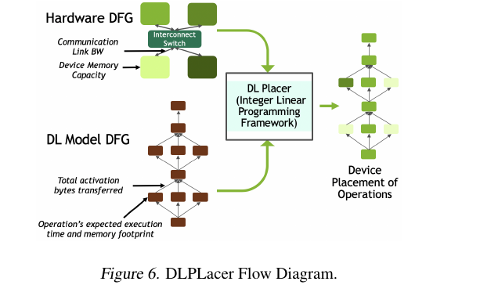

Slide 9
