Slide 1
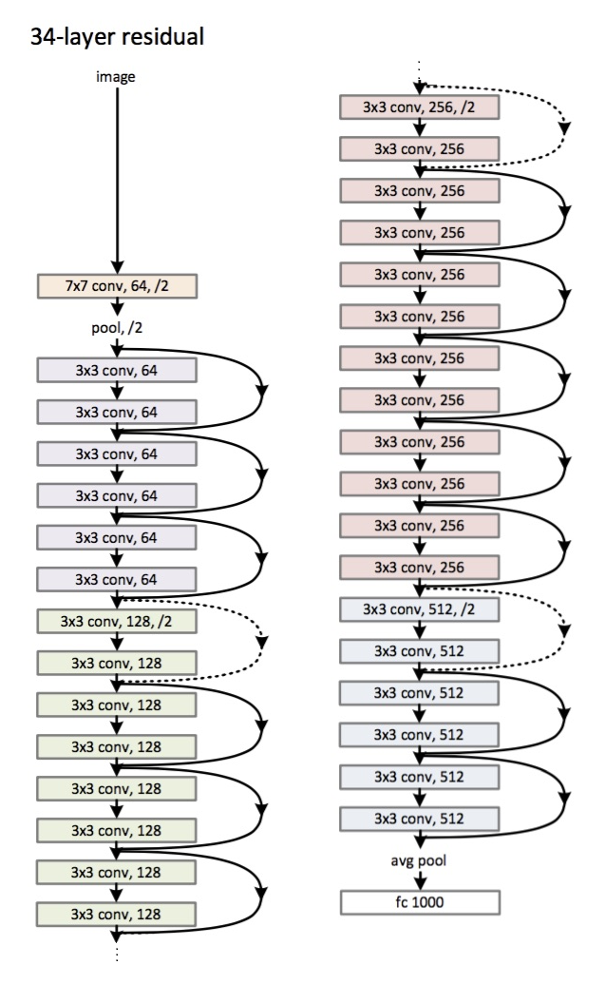
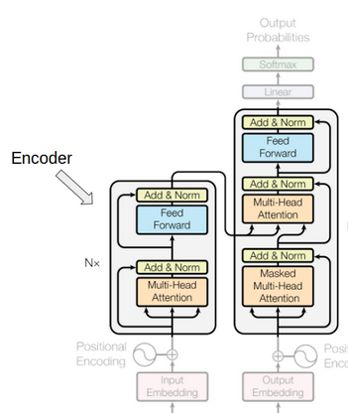
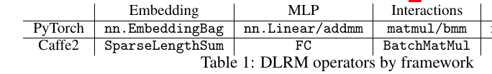
MLPerf Benchmarks (Feed Forward)

Slide 2
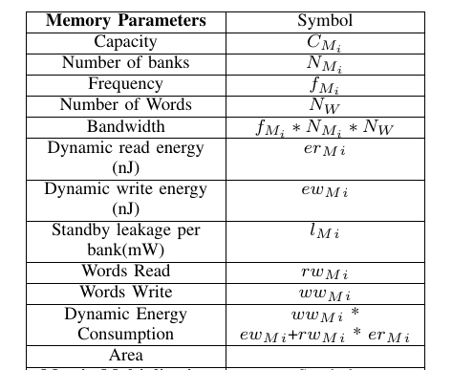
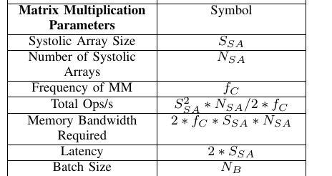
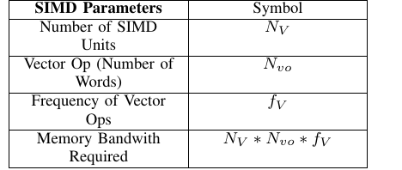

Slide 3
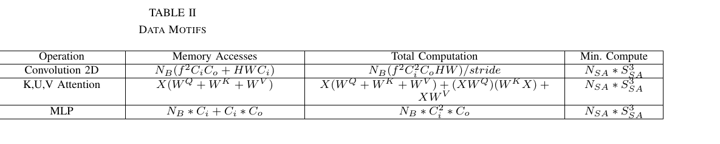
Feed Forward Requirements (For Inference)

Slide 4
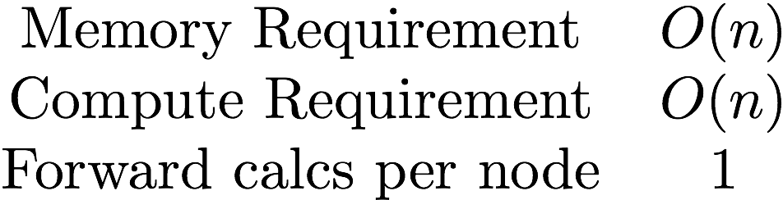
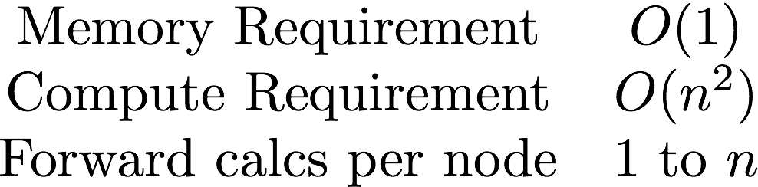
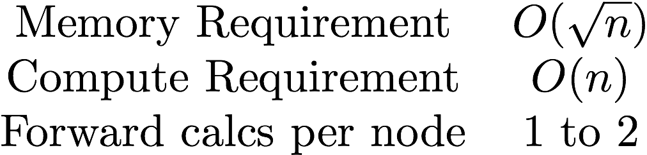
MLPerf Benchmarks (Backprop)
Default
Memory Poor
Gradient Checkpointing

Slide 5
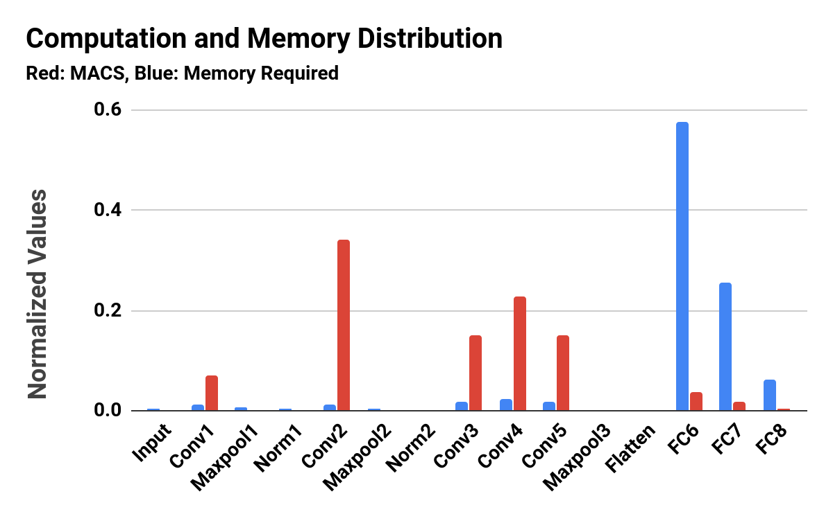

Slide 6
Memory Requirements
Parallelism fraction > 0.99, increases with Batch Size and Model-level Parallelism
 | Resnet (CIFAR -10 in MB) | Transformer (in MB) | DLRM
Model | 5.8 | 155 | 3566
Optimizer (Batch Size =1) | 11.7 | 464 | 2.9
Activations (Batch Size =1) | 387.3 | 2,278 | 32

Slide 7
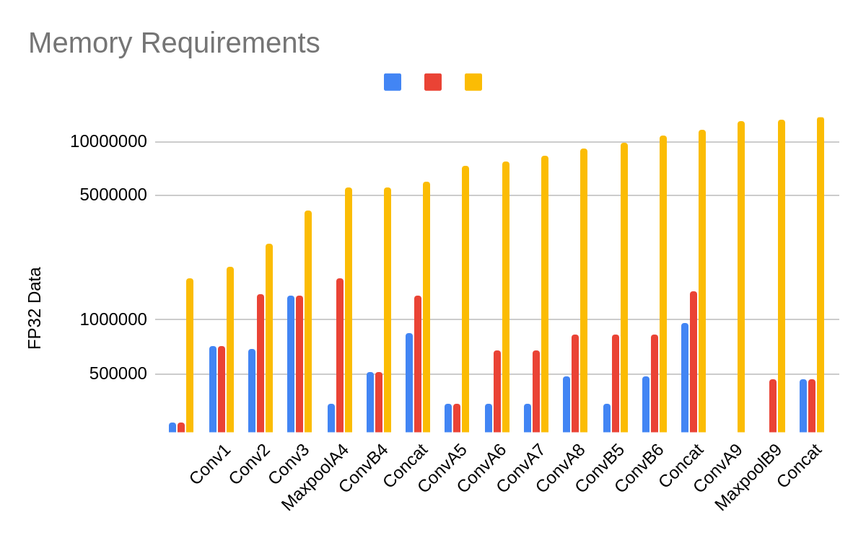
Memory Requirements
Blue : ResNet without Branching
Red : ResNet saving residuals
Yellow: ResNet in Backpropagation
For all layers : Layer 1 to L, all the intermediate output memory requirements,
Sum of all intermediate outputs
Computation Remaining Same, Memory Requirements become much larger in Backpropagation

Slide 8
3D Architectures
Constraints will be :
Temperature : Thermal-Hotspots (r/ Power Density)
On-chip Traffic : Routing (NoC Design Problem)
Reconfiguration Time : Reconfigurability and Compilation Time (CGRAs)
Computation and Memory (Depending on the Chip Size : r/ Yield)
Optimization Problem :
Graph (V,E) of the Data Flow can be scheduled on the primitive nodes , the data distributed is edge e, then the Hardware Graph H scheduling efficiency can be determined by the amount of time resources are free.
So, memory bandwidth bottleneck in 2-D architectures is related to the compute nodes being free and memory resources completely busy.
At optimal sizing of the application both the resources will be completely busy, in reconfiguration also -> total time of execution is minimized given the above constraints.

Slide 9
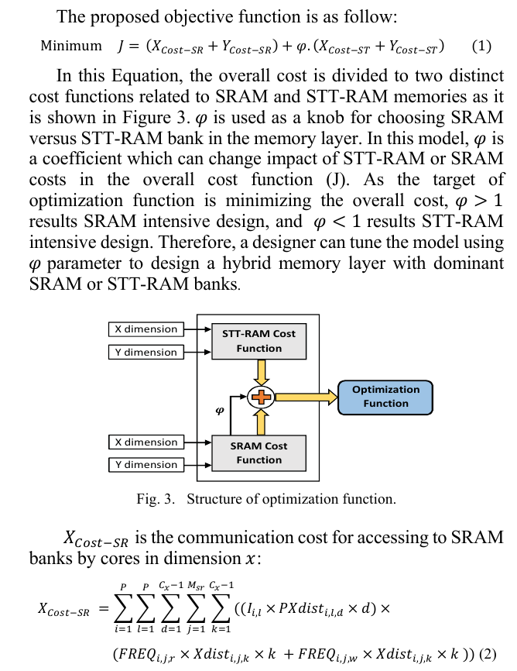
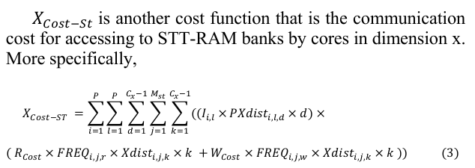

Slide 10
3D Architectures : Effective Routing b/w the Layers
The on chip traffic becomes the bottleneck when there is enough memory bandwidth
Parallelism fraction > 0.99, increases with Batch Size and Model-level Parallelism
Memory fetch in routing to compute nodes -> Compute Outputs Store -> Redistribute the outputs
New bottlenecks of On-chip routing : 3D Placement of Memory Banks and Compute Nodes and Efficient Routing Mechanisms
Data Reshaping Units
Address Remapping Units

Slide 11
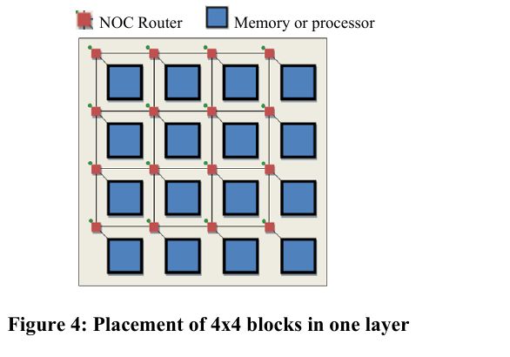
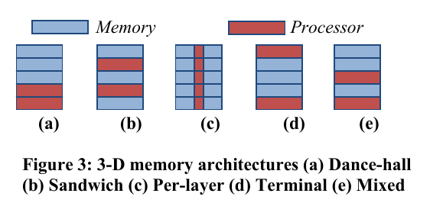
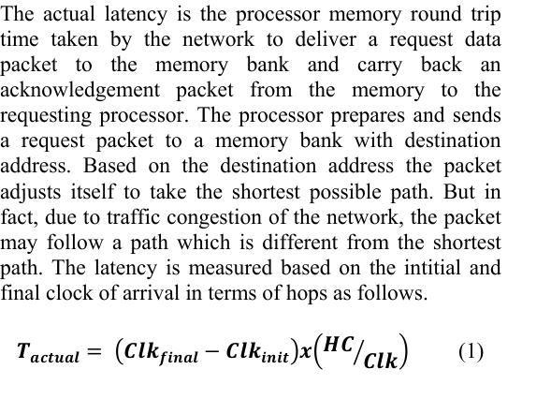

Slide 12
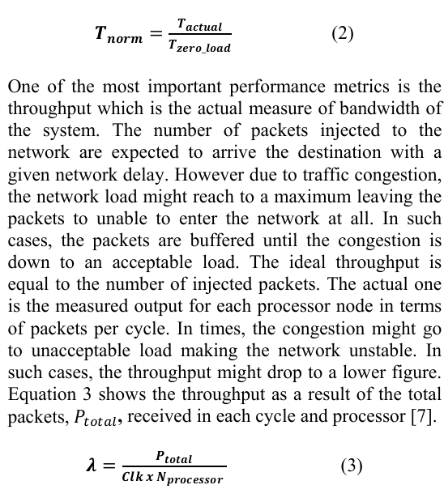
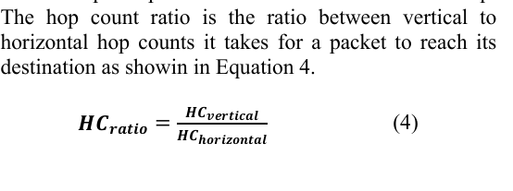

Slide 13
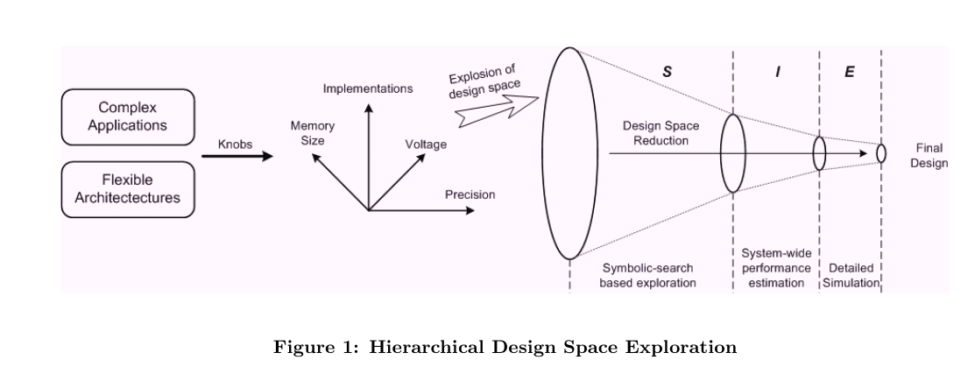

Slide 14
Meeting Points
Tf-Sim Implementation
NoC Reconfiguration during Execution
Paper - “DNN Dataflow choice is overrated”

Slide 15
TF-Sim
Ops scheduled on the Graph
Ops include -> ForOp, WhileOp, IfOp, GradientOp, Symbolic-GradientOp, FunctionOp
Schedules the MetaOp from Tensorflow
Graph Optimizer rewrite Graph in several manners to allow for execution

Slide 16
Analytical-based Framework
Cacti Memory Model : Area and Performance Model
Pytorch JIT Graph
Graph Optimization using the Fuse Nodes
Analytical Approach by traversing on the graph
Thermal Model :
NoC Model : Orion

Slide 17
Analysis
For all different types of deep learning models
For single chip and cluster configurations
Finding optimal architecture by minimizing the wait time and maximizing the parallelism (in compute)
In-Memory Compute and Near-Memory Compute Algorithms without obvious changes in quantization
3D Architectures
Considerations for Chip size and Yield

Slide 18
Considerations
Constant folding optimizer - Statically infers the value of tensors when possible by folding constant nodes in the graph and materializes the result using constants.
Arithmetic optimizer - Simplifies arithmetic operations by eliminating common subexpressions and simplifying arithmetic statements.
Layout optimizer - Optimizes tensor layouts to execute data format dependent operations such as convolutions more efficiently.
Remapper optimizer - Remaps subgraphs onto more efficient implementations by replacing commonly occuring subgraphs with optimized fused monolithic kernels.
Memory optimizer - Analyzes the graph to inspect the peak memory usage for each operation and inserts CPU-GPU memory copy operations for swapping GPU memory to CPU to reduce the peak memory usage.
Dependency optimizer - Removes or rearranges control dependencies to shorten the critical path for a model step or enables other optimizations. Also removes nodes that are effectively no-ops such as Identity.

Slide 19
Considerations
Pruning optimizer - Prunes nodes that have no effect on the output from the graph. It is usually run first to reduce the size of the graph and speed up processing in other Grappler passes.
Function optimizer - Optimizes the function library of a TensorFlow program and inlines function bodies to enable other inter-procedural optimizations.
Shape optimizer - Optimizes subgraphs that operate on shape and shape related information.
Autoparallel optimizer - Automatically parallelizes graphs by splitting along the batch dimension. This optimizer is turned OFF by default.
Loop optimizer - Optimizes the graph control flow by hoisting loop-invariant subgraphs out of loops and by removing redundant stack operations in loops. Also optimizes loops with statically known trip counts and removes statically known dead branches in conditionals.
Scoped allocator optimizer - Introduces scoped allocators to reduce data movement and to consolidate some operations.
Pin to host optimizer - Swaps small operations onto the CPU. This optimizer is turned OFF by default.
Auto mixed precision optimizer - Converts data types to float16 where applicable to improve performance. Currently applies only to GPUs.

