Slide 1

INTRODUCTION TO DATA SCIENCE AND MACHINE LEARNING
BAKERY SALES PREDICTION
Authors: ANTHONY AKO SOWAH
&
HAMMAM HRAESHA

Slide 2
SELF CREATED VARIABLES
Variable | Description
KielerWoche | Binary indicator (1/0) for whether the date falls within the Kieler Woche event
Warengruppe_1–6 | One-hot encoded variables indicating the product group
weekday_sin | Sine transformation of weekday to capture cyclical weekly patterns
weekday_cos | Cosine transformation of weekday for modeling cyclic behavior
month_sin | Sine transformation of month to model seasonal sales behavior
month_cos | Cosine transformation of month to model seasonal effects
is_off(is_holiday +is_weekend) | Binary indicator for public holidays or non-business days

Slide 3
These variables enhance the model by:
Handling cyclic data (sin/cos features)
Encoding categorical data (Warengruppe_*)
Incorporating event data (KielerWoche, is_off)
Why These Variables
Cyclical Encoding (weekday_sin, weekday_cos, month_sin, month_cos) Captures the periodic nature of sales behavior across days and months (e.g., weekdays vs weekends, seasonal shopping patterns).
Event Feature (KielerWoche) Helps model special spikes in demand caused by the local festivals.
Categorical Handling (Warengruppe_1–6) Allows the model to distinguish between product categories using one-hot encoding (instead of a single numerical code which may mislead the model).
Holiday Indicator (is_off) Accounts for the effect of non-working days (typically drop or spike in sales).
It is a combination of weekends and holidays in Germany withing the period under consideration

Slide 4
Handling Missing data
When merging the KielerWoche data with the training dataset, we replaced missing values with 0 such that the KielerWoche column is either 0 or 1.

Slide 5
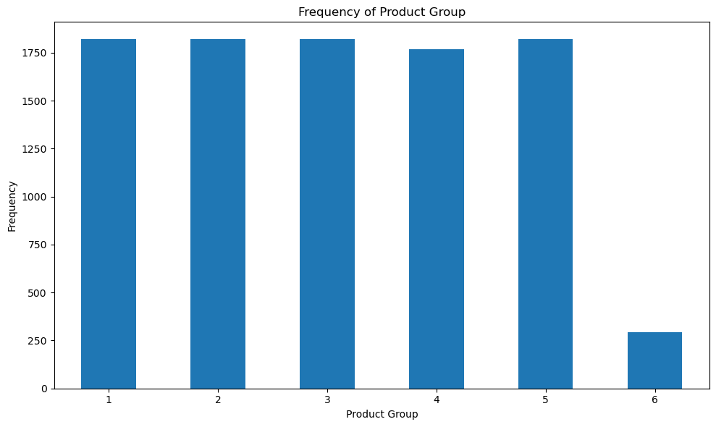
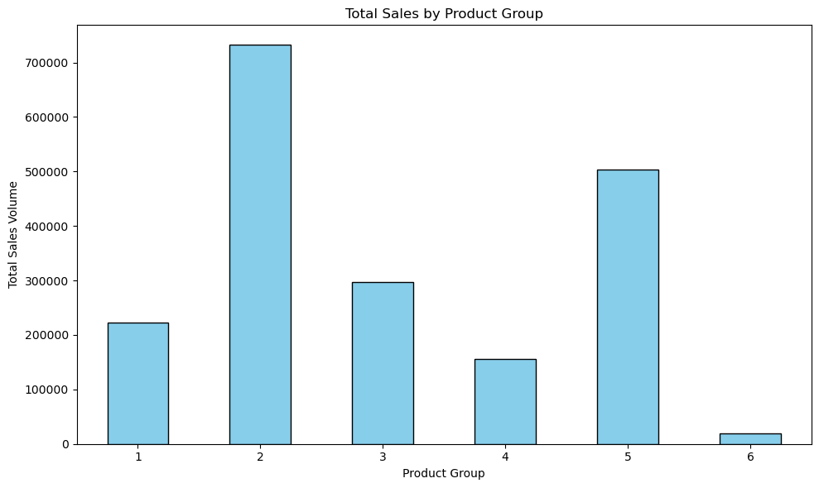

Slide 6
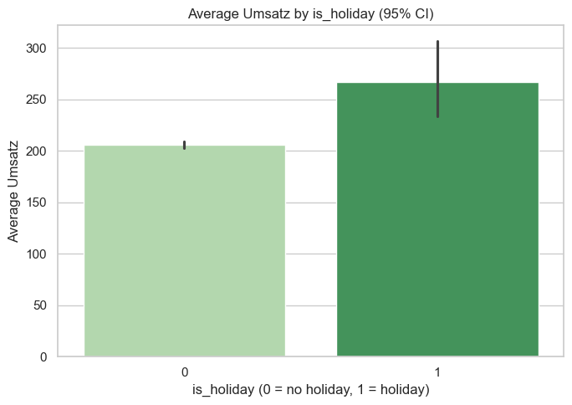
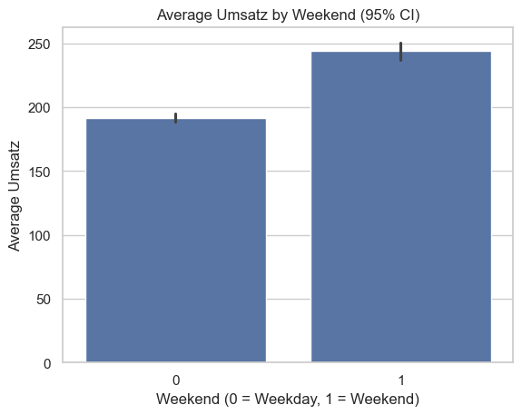
Error bars represent 95% confidence intervals, providing statistical reliability for the observed mean sales.
Sales tend to be higher on weekends with consistent patterns, as shown by the tight confidence intervals. Holidays also show increased average Umsatz, though with greater variability, suggesting more uncertainty in the effect.
These engineered variables (‘weekend’ and ‘is_holiday’) reveal key consumer behavior trends impacting revenue — essential for predictive modelling.

Slide 7
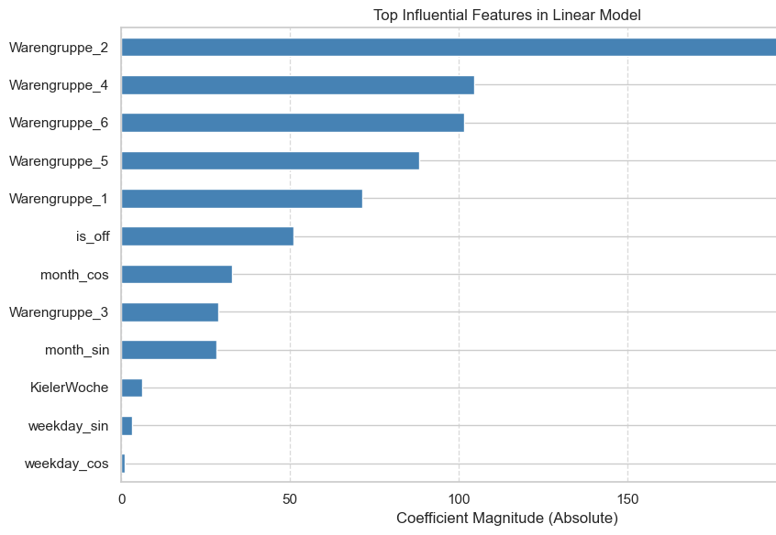
This chart shows the top variables that most strongly influenced predicted sales (Umsatz) in our linear regression model.
Product groups (especially Warengruppe_2, 4, and 6) had the strongest impact, indicating large variations in sales between product types.
Temporal patterns like month and weekday encoding (sin/cos) had much smaller effects, likely due to their cyclical nature.
KielerWoche and is_off had moderate influence.

Slide 8
Final Linear Regression Equation
Umsatz (Sales) = 176.30 + 6.22 × KielerWoche – 71.43 × Warengruppe_1
217.83 × Warengruppe_2 – 28.62 × Warengruppe_3 – 104.49 × Warengruppe_4
88.13 × Warengruppe_5 – 101.42 × Warengruppe_6 – 3.24 × weekday_sin – 0.89 × weekday_cos – 28.09 × month_sin – 32.74 × month_cos
50.94 × is_off
Model Fit
R²: 0.722087923572818
Adjusted R²: 0.7216792839737405 This indicates that approximately 72% of the variation in sales can be explained by the selected variables.
MAPE for Linear model= 0.33
Interpretation
The model shows strong predictive power using both seasonal, event-based, and product-specific features.
Variables like Warengruppe_2, is_off, and Warengruppe_6 have high impact on predicted sales.
Weekday and month encodings add subtle seasonal nuance.

Slide 9
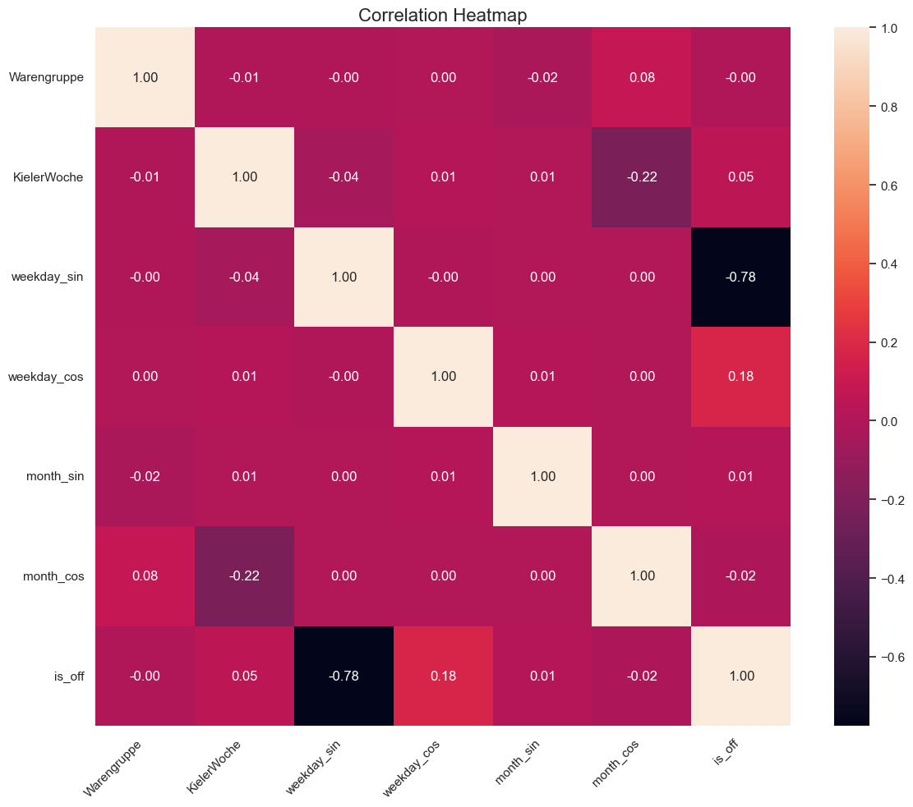
Multicollinearity Check: Correlation Matrix
Key Insights
Low multicollinearity overall between features.Most correlation values are close to zero.
Strong negative correlation between weekday_sin and is_off (-0.78) which indicates weekends/off-days have a clear cyclical pattern.
month_cos and KielerWoche have a slight negative correlation (-0.22), possibly tied to specific times of year.
No extreme positive correlation (i.e., > 0.9), suggesting feature redundancy is minimal.
Conclusion:
The model does not suffer from severe multicollinearity.
Feature selection appears balanced and interpretable.

Slide 10
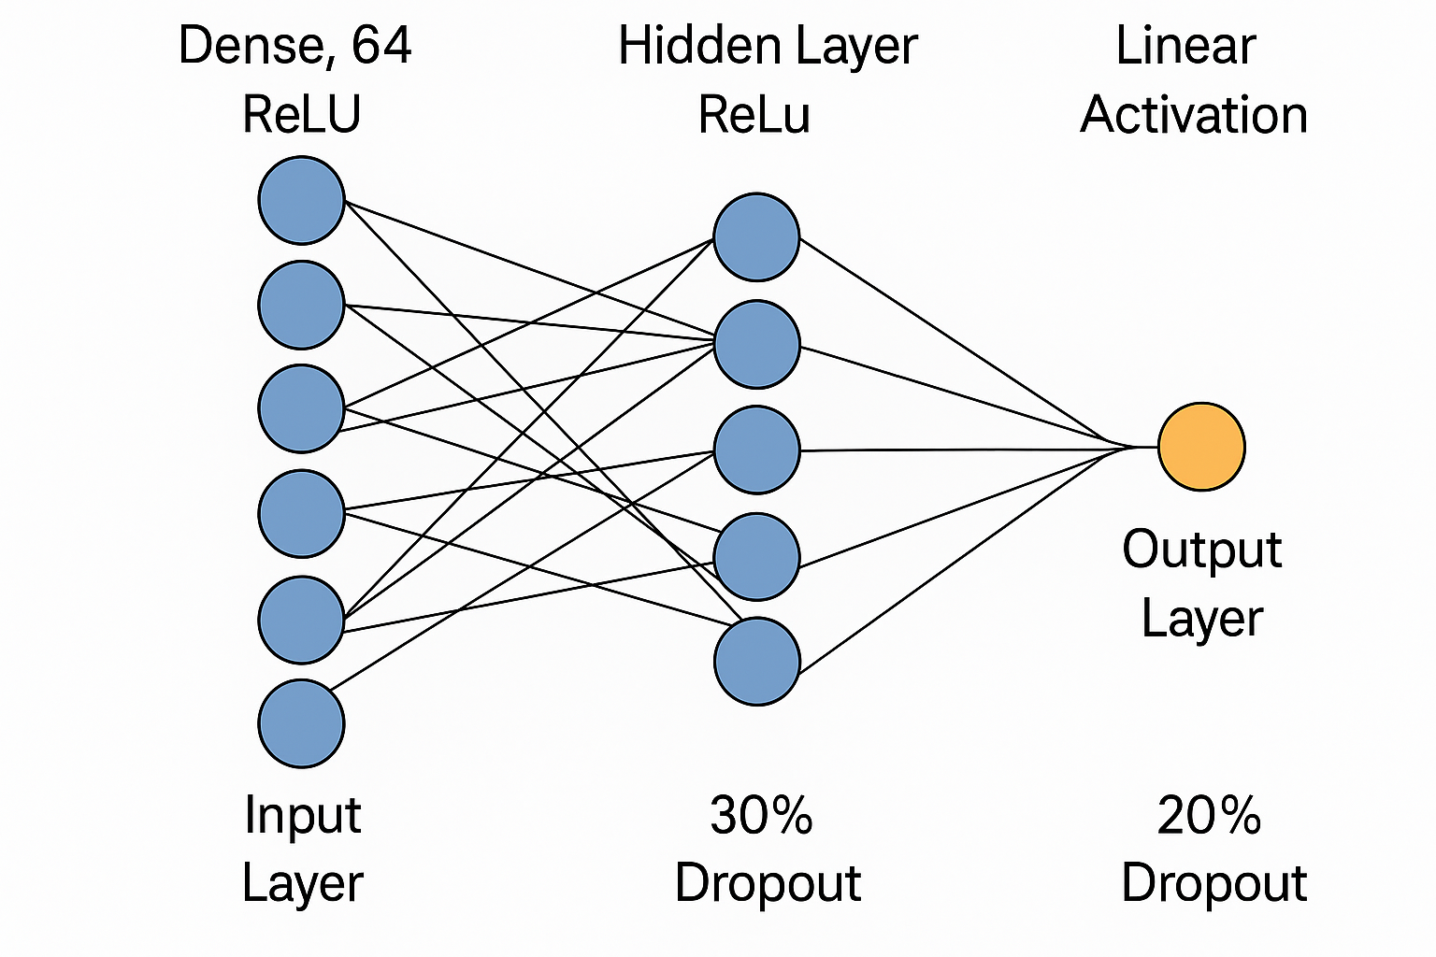
NEURAL NETWORK OPTIMIZATION
model = Sequential([
Dense(64, activation='relu', input_shape=(12,), name='dense_1'),
Dropout(0.3),
Dense(32, activation='relu', name='dense_2'),
Dropout(0.2),
Dense(1, activation='linear', name='output') ]
)
model.compile(
optimizer='adam',
loss='mape',
metrics=['mape']
)

Slide 11
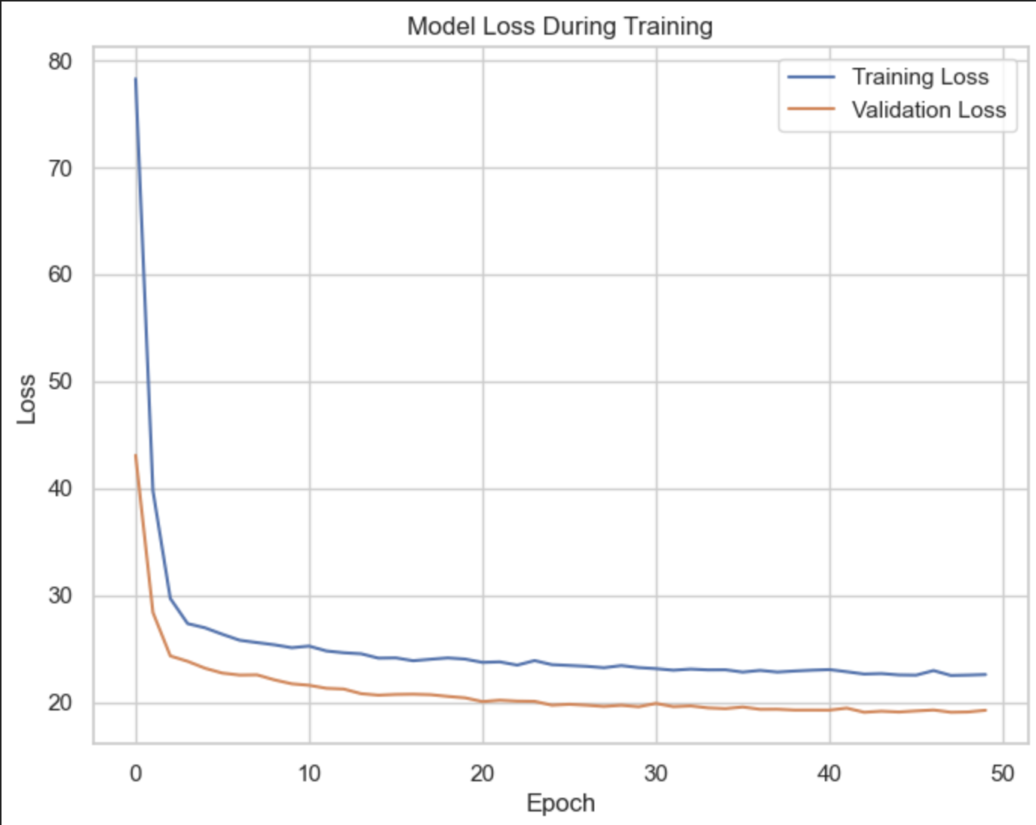
Training and Validation Loss
The plot shows the model's loss decreasing steadily across 50 training epochs.
Training Loss and Validation Loss both decline rapidly at the beginning, then plateau.
Validation Loss remains consistently below Training Loss, indicating good generalization.
No significant overfitting observed—Dropout layers likely contributed to this stability.
Loss metric used: Mean Absolute Percentage Error (MAPE)= 0.19
R^2 = 0.81

Slide 12
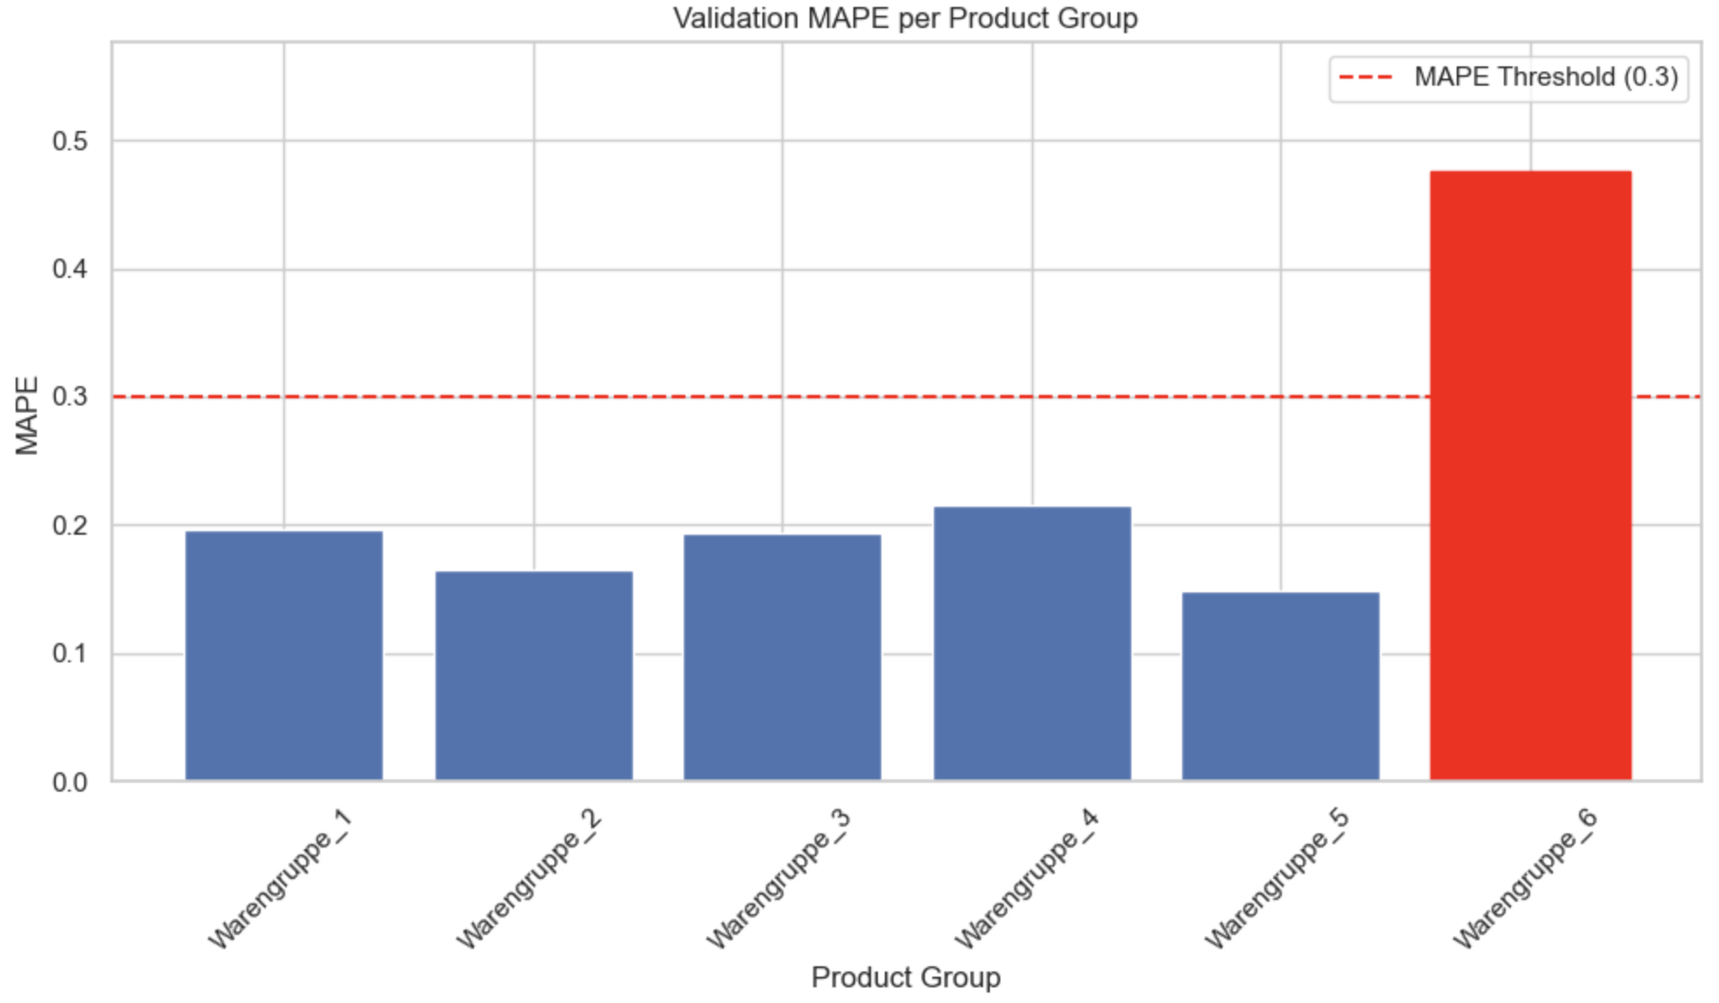
MAPE Scores for each Product group
Sample count per product group:
Warengruppe_1 1462
Warengruppe_2 1462
Warengruppe_3 1462
Warengruppe_4 1409
Warengruppe_5 1462
Warengruppe_6 236

Slide 13
Fails and Improvements
Issue: Warengruppe_6 has far fewer samples (~236) compared to others.
Improvement:
Assign higher loss weight to Warengruppe_6 samples to penalize errors more
Artificially increase the sample count for Warengruppe_6

Slide 14
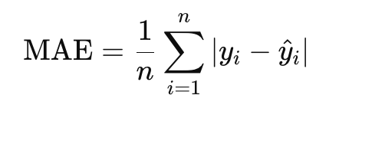
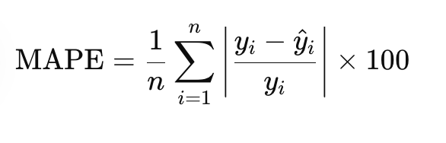
Issue: MAPE Penalizes Small Values Heavily
When actual values () are small, even minor prediction errors produce large percentage errors.
Leads to biased error interpretation, especially in low-sales categories (e.g., Warengruppe_6).
Improvements
MAE (Mean Absolute Error):
Uniform error treatment
Less biased toward small values

Slide 15
Issue: Although our architecture is fairly balanced, performance may be limited by the simplicity of the model.
Improvement: We can use more expressive models like:
Deeper networks
LSTM or GRU for temporal dependencies

Slide 16


