Slide 1
Online Examination System
Project Presentation
By
Mustafa Hasan
B.Sc Information Technology
Session 2019-2020
BRD College
HNB Garwal University

Slide 2
Introduction to the Project:
In an online examination system examine get their user id and password with his/her admit card. This id is already saved in the examination server. When examine login to the server he/she get his/her profile already register. On the certain time examine gets the message to start the examination. All answers given by examine are saved into the server with his/her profile information. Online examination system also allows to correct the answer if the examine needed to change any answer in the examination time duration, however, after the time duration any change will not allow. This also makes c checking the answer easy and error proof as computers are more accurate than man and provide fast results too. Php is a web base language so we can create an online examination system in PHP.

Slide 3
System Feature
Login system must be present and secured by password.
Ability to save the answer given by the candidate along with the question.
Answer checking system should be available.
Could Update Profile
Log out after the over.
Admin Panel

Slide 4
Project Scope:
Today Online Examination System has become a fast growing examination method because of its speed and accuracy. It is also needed less manpower to execute the examination. Almost all organizations now-a-days, are conducting their objective exams by online examination system, it saves students time in examinations. Organizations can also easily check the performance of the student that they give in an examination. As a result of this, organizations are releasing results in less time. It also helps the environment by saving paper.According to today’s requirement, online examination project in php is very useful to learn it

Slide 5
Project Objective:
Online examination system is a non removable examination pattern of today’s life. We need more time saving and more accurate examination system as the number of applicants is increasing day by day. For all IT students and professionals, it is very important to have some basic understanding about the online examination system. On this site you will get source code with the running project. It will help you to understand the concept of the project.

Slide 6
Software Tools & Technologies:
Front end: HTML, CSS, JavaScript
HTML: HTML is used to create and save web document. E.g. Notepad/Notepad++
CSS : (Cascading Style Sheets) Create attractive Layout
JavaScript: it is a programming language, commonly use with web browsers.
Back end: PHP, MySQL
PHP: Hypertext Preprocessor (PHP) is a technology that allows software developers to create dynamically generated web pages, in HTML, XML, or other document types, as per client request. PHP is open source software.
MySQL: MySql is a database, widely used for accessing querying, updating, and managing data in databases.

Slide 7
Software Requirement
XAMPP Server
.NET Framework
Php
Oracle SqL

Slide 8
Hardware Requirements Name of component specification
Processor: Intel dual core or above
Processor Speed: 1.0GHZ or above
RAM: 2 GB RAM or above
Hard Disk: 300GB hard disk or above

Slide 9


UML Diagrams:
Actor: A coherent set of roles that users of use cases play when interacting with the use `cases.
Use case: A description of sequence of actions, including variants, that a system performs that yields an observable result of value of an actor.

Slide 10
UML Diagrams:
There are various kinds of methods in software design:
They are as follows:
Use case Diagram
Sequence Diagram
Collaboration Diagram
Activity Diagram
State chat Diagram

Slide 11
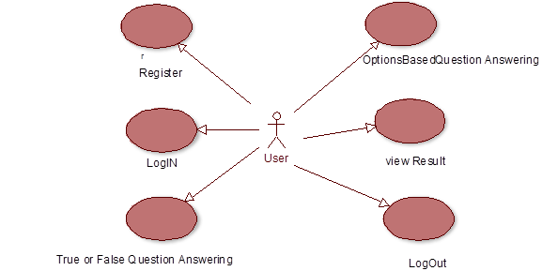
Use Case Diagrams: For admin

Slide 12
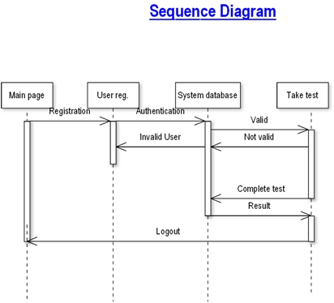
Sequence Diagram:

Slide 13
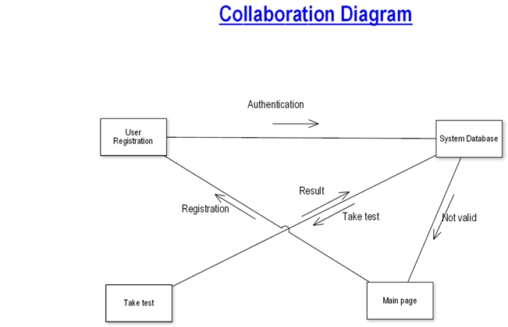
Collaboration Diagram

Slide 14
DFD

Slide 15
User Registration

Slide 16
Taking Test

