Slide 1

EldrenHomes

Slide 2
Team Members
SHREYASH JOSHI (21BCE5469)
SUYASH AGRAWAL (21BCE5417)
MAYANK PATHAK (21BCE5238)

Slide 3
Roles
Team Leader: Shreyash Joshi
Logic Developer: Shreyash Joshi & Suyash Agrawal
Program Developer: Shreyash Joshi
Tester and UI Developer: Mayank Dutt Pathak
Document Writer: Suyash Agrawal

Slide 4
Software Technologies Used
HTML
CSS
JavaScript
Bootstrap

Slide 5

Screenshots

Slide 6
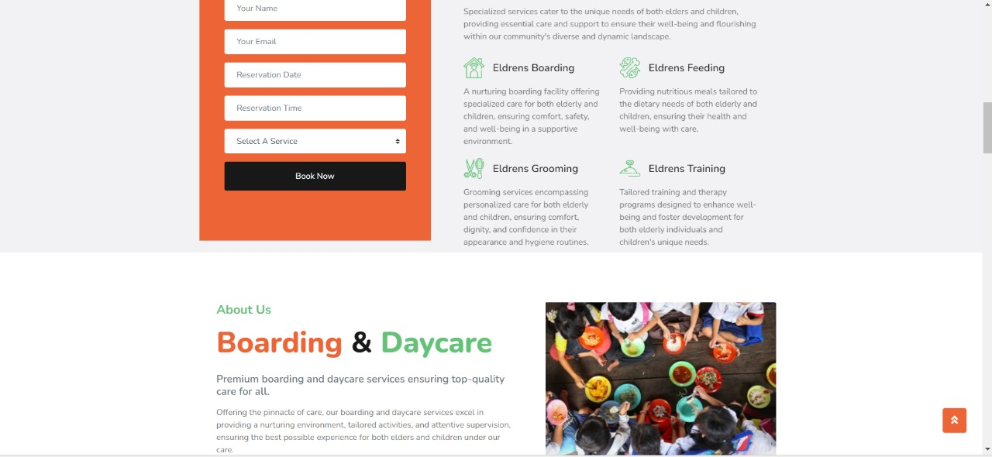

Slide 7
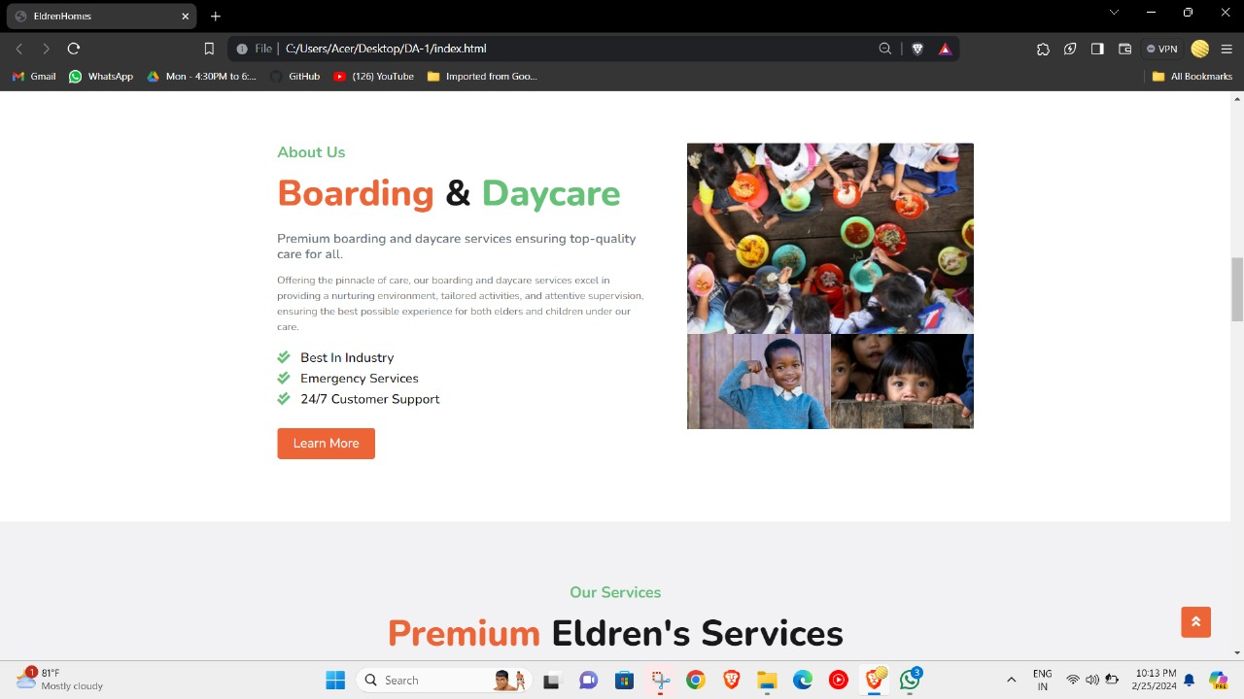

Slide 8

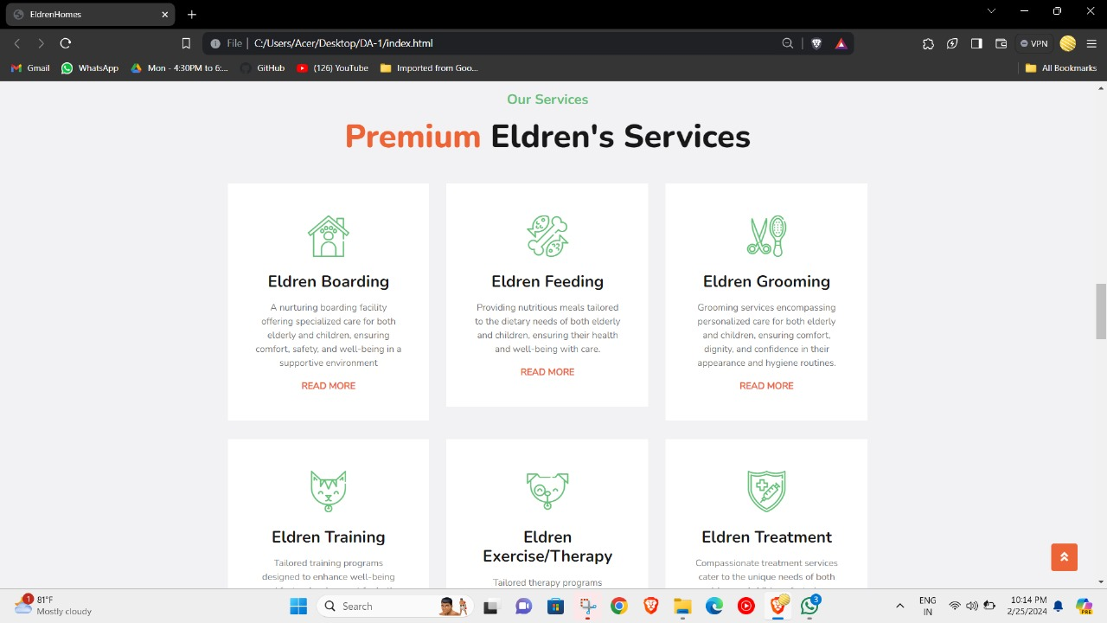

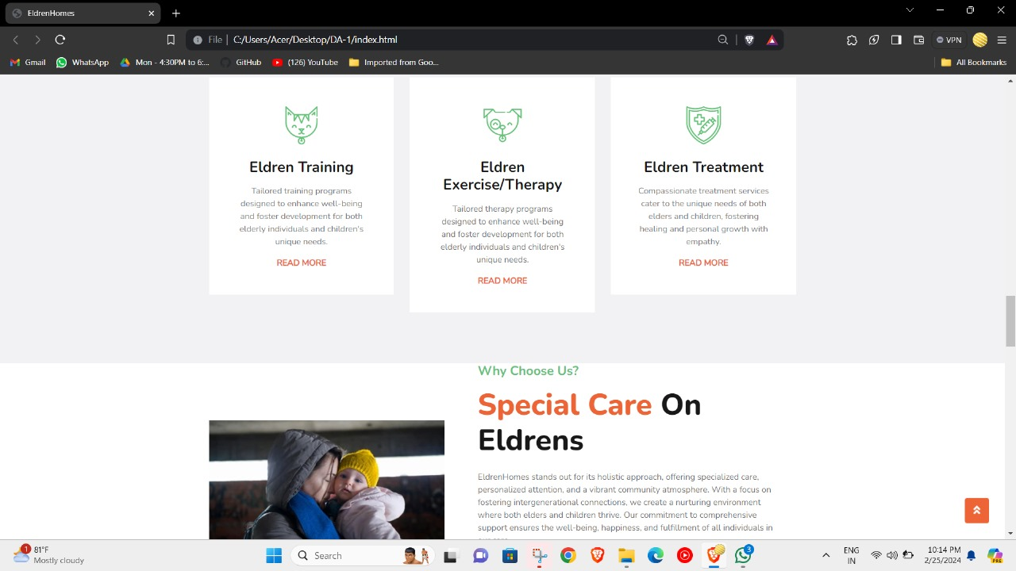

Slide 9
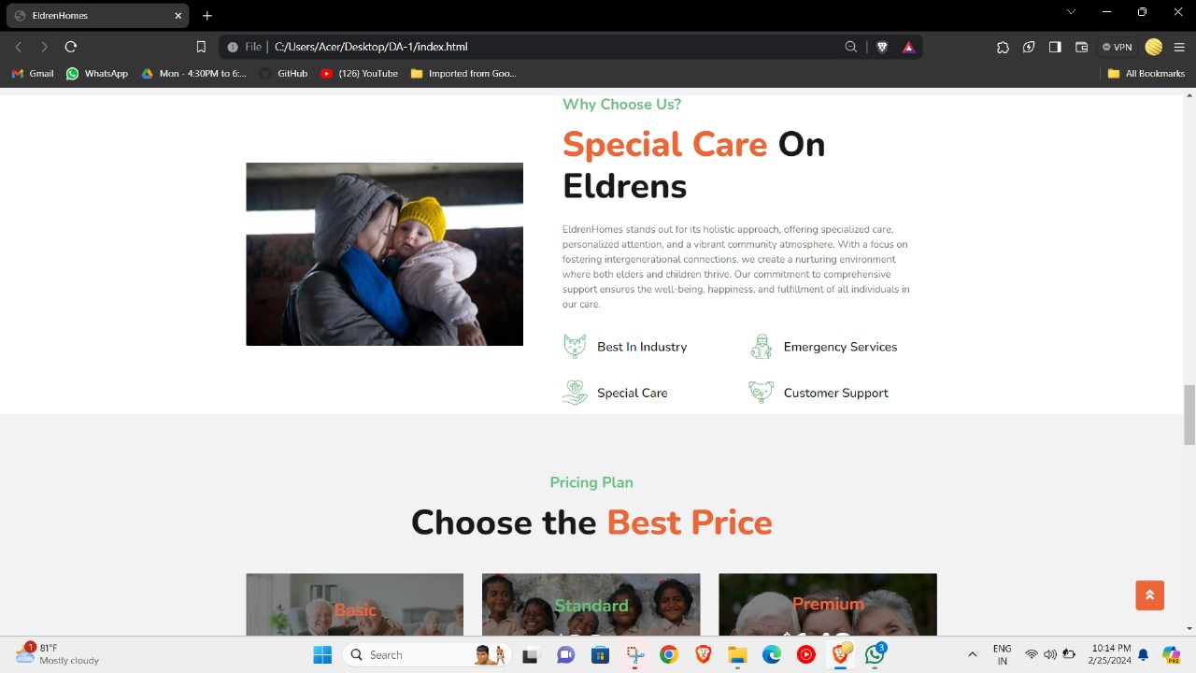

Slide 10
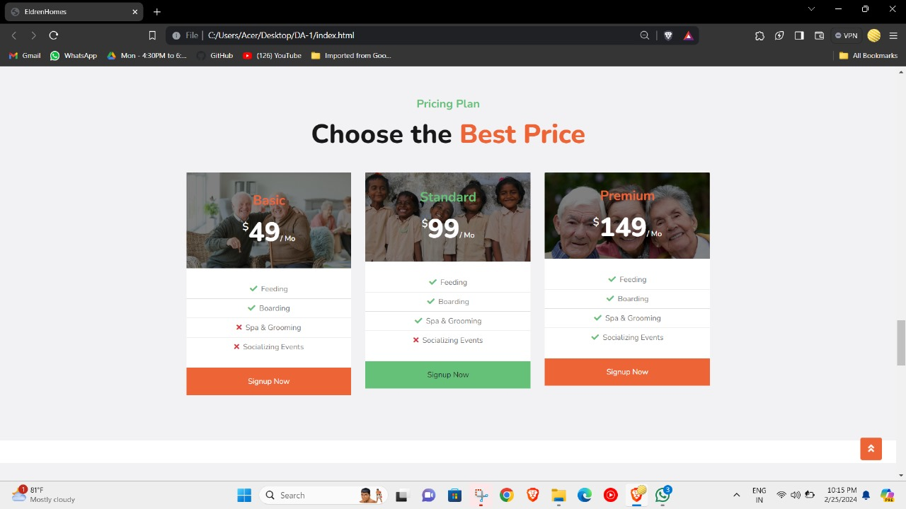

Slide 11
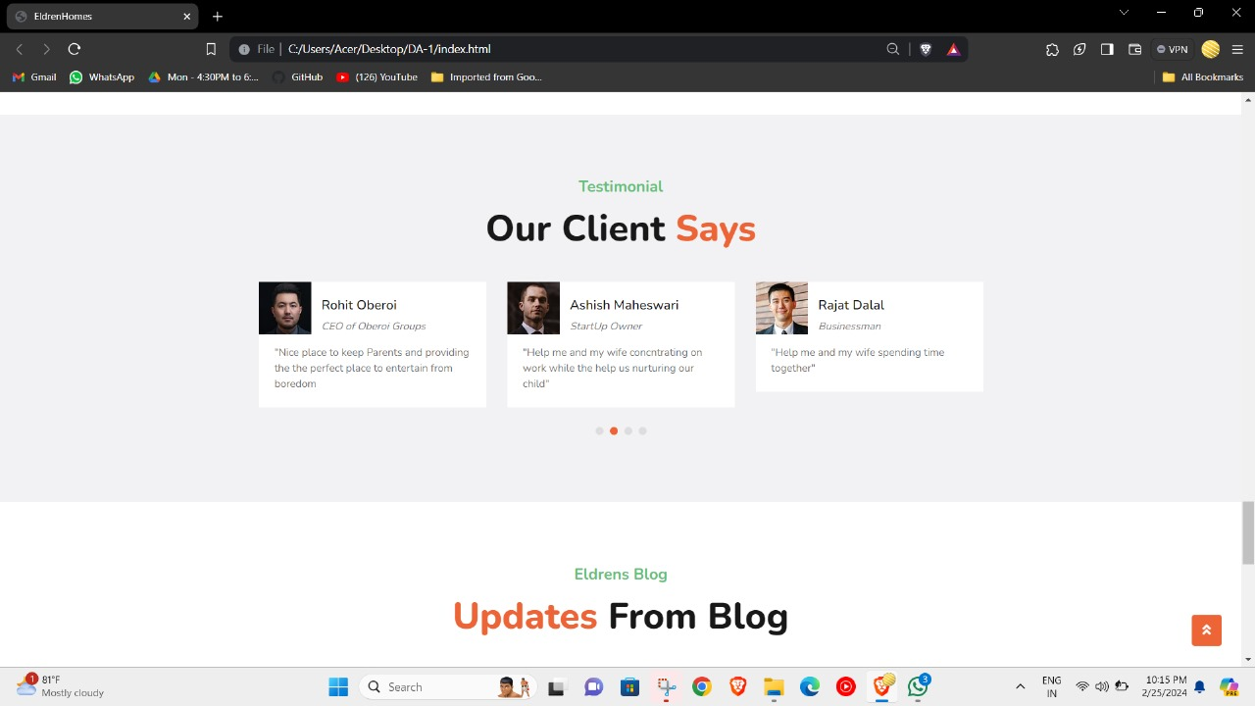

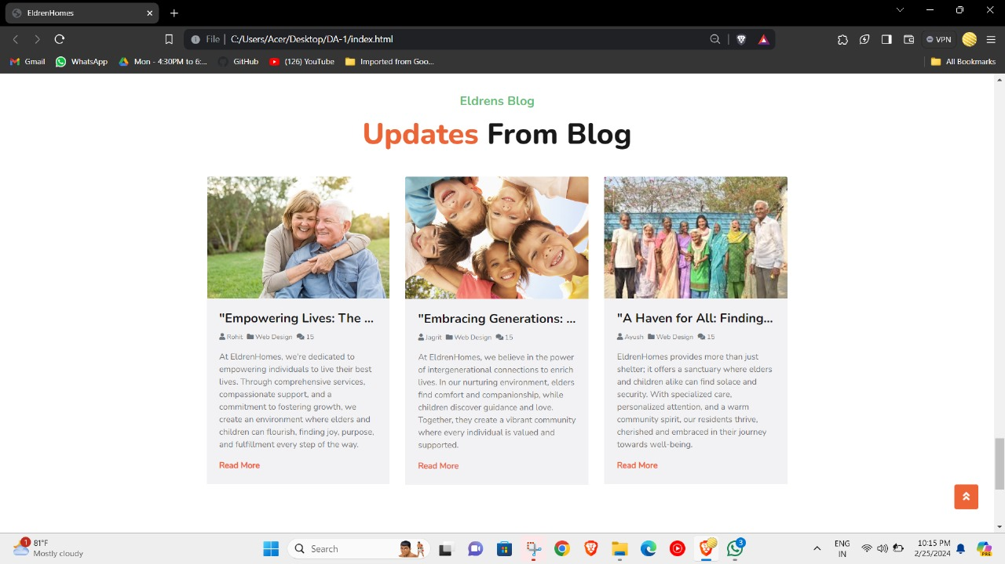

Slide 12
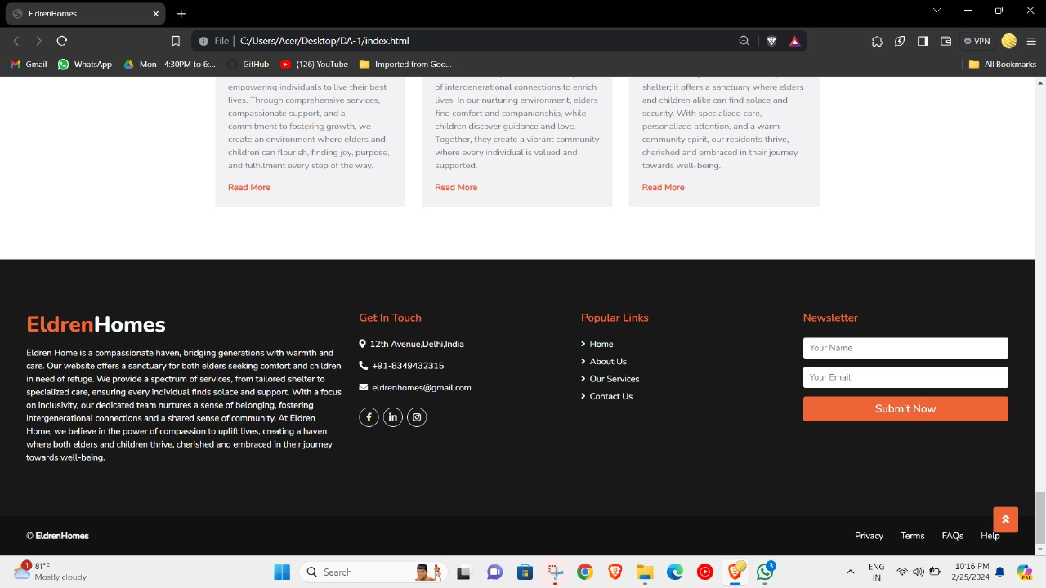

Slide 13
Future Outcomes
Connecting Backend
Deployment of Website
Fully Functional
Network Traffic for public use

Slide 14


