Slide 1

DEPARTMENT OF COMPUTER APPLICATIONS
GAYATRI VIDYA PARISHAD COLLEGE OF ENGINEERING (AUTONOMOUS)
MINI PROJECT DRC - 1 PRESENTATION ON
Meet Minutes – Web based application
By
Godha Ganesh Viswanadham
325203320046
III Semester MCA II year
Under the Guidance of
Mrs. V. Lakshmi
Assistant Professor
VISAKHAPATNAM – 530048
2026-27
Notes:
Good afternoon everyone.
Respected faculty members and my dear friends, my name is Godha Ganesh Viswanadham, from the Department of Computer Applications, Gayatri Vidya Parishad College of Engineering.
Today I am going to present my mini project titled “Meet Minutes – Web Based Application.”
The main purpose of this project is to summarize meetings, extract important minutes and action items, and manage the tasks generated from meetings.

Slide 2
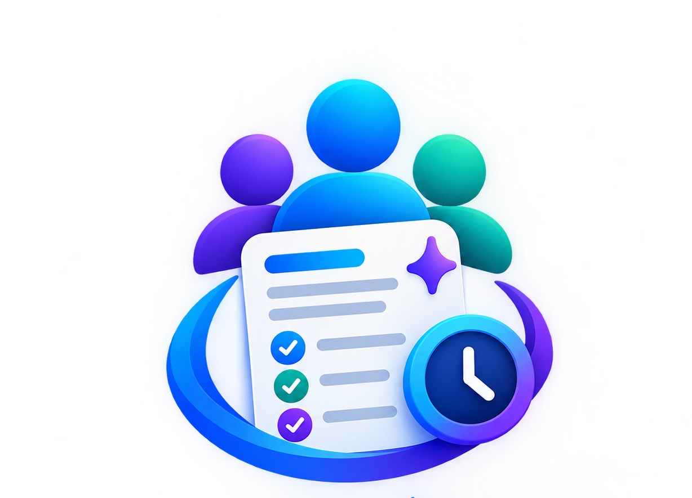
Meet Minutes
Summarize - Extract Minutes - Manage Tasks
Notes:
The name of our application is Meet Minutes.
The application mainly focuses on three things: summarizing meetings, extracting meeting minutes, and managing tasks.
The main purpose of this project is to summarize meetings, extract important minutes and action items, and manage the tasks generated from meetings.

Slide 3
Problem Statement
Meet Minutes
Summarize - Extract Minutes - Manage Tasks
Meetings often generate large amounts of information that is difficult to organize and track. Manually preparing meeting minutes, identifying decisions, assigning action items, and tracking deadlines can be time-consuming and may lead to missed or inaccurate information. Existing approaches often require users to listen to or review the entire meeting before preparing minutes. Therefore, there is a need for an intelligent system that can automatically convert meeting conversations into structured minutes, extract important decisions and action items, identify responsible participants and deadlines, and help users track tasks efficiently.
Notes:
Now coming to the problem statement.
Meetings generate a large amount of information such as discussions, decisions, responsibilities, and deadlines.
Traditionally, someone has to listen to the meeting and manually prepare the meeting minutes.
This process has several problems.
First, it is time-consuming.
Second, while preparing notes manually, some important discussions or decisions may be missed.
Third, action items may not be properly identified or assigned to the responsible person.
And finally, tracking deadlines and task progress becomes difficult.
For example, suppose during a meeting three tasks are assigned to three different people. If these tasks are only mentioned verbally, there is a possibility that someone may forget their responsibility or deadline.
Therefore, our project aims to automatically convert meeting conversations into structured meeting minutes, extract decisions and action items, identify participants and deadlines, and help users track those tasks.

Slide 4
Abstract
Meet Minutes
Summarize - Extract Minutes - Manage Tasks
Meet Minutes is an AI-powered web application designed to automate the process of documenting meetings and managing tasks.
Traditional meeting documentation requires manual note-taking, which can be time-consuming and may result in the loss of important information. The Proposed system allows users to create and manage meetings, add participants, record or provide meeting transcripts, and generate organized meeting minutes. The AI component analyses the meeting content and identifies key information such as the meeting summary, important discussion points, decisions made, action items, assigned participants, and deadlines. The extracted action items can then be converted into tasks and tracked through different stages such as pending, in progress, and completed.
The system integrates a React.js frontend, Java Spring Boot backend, PostgreSQL database, and Whisper-based speech transcription. It provides a centralized platform for managing meeting records and tracking tasks.
Notes:
Meet Minutes is an AI-powered web application designed to automate meeting documentation and task management.
The user can create and manage meetings, add participants, and provide meeting transcripts or audio.
If audio is provided, the system uses Whisper-based speech transcription to convert speech into text.
Then the meeting content is analyzed using AI.
The system extracts information such as the meeting summary, discussion points, decisions, action items, assigned participants, and deadlines.
These action items can then be converted into tasks and tracked through different stages such as pending, in progress, and completed.
Coming to the technology stack, the frontend is developed using React JS, the backend uses Java and Spring Boot, and PostgreSQL is used as the database. For AI processing, the project uses the Gemini API, along with Whisper for speech transcription

Slide 5
Introduction
Meet Minutes
Summarize - Extract Minutes - Manage Tasks
Meetings are an important part of academic institutions, organizations, and businesses. Important decisions, discussions, and responsibilities are often shared during meetings.
However, manually documenting meeting information can create several challenges:
  Difficulty in recording all important discussions.
  Time-consuming manual documentation.
  Important action items may be forgotten.
  Lack of centralized meeting records.
  Difficulty tracking task assignments and deadlines.
Meet Minutes aims to simplify this process by combining meeting documentation, speech transcription, and task management in a single web-based application.
Notes:
Meetings are an important part of organizations, businesses, and even academic institutions.
Important decisions, discussions, and responsibilities are usually communicated during meetings.
But manually documenting this information creates several challenges.
It can be difficult to record every important discussion. Documentation takes time, action items can be forgotten, and meeting records may not be centralized.
Another important problem is task tracking.
Even if we identify a task, we need to know who is responsible, what the deadline is, and whether the task is completed or still in progress.
Meet Minutes addresses these problems by combining meeting documentation, speech transcription, AI processing, and task management into a single web application.

Slide 6
Existing System
Meet Minutes
Summarize - Extract Minutes - Manage Tasks
In the existing approach, meeting information is generally documented using manual notes, text documents, or separate communication and task-management tools.
  Manual note-taking
  Separate document storage
  Information distributed across communication platforms
  Manual task tracking
Limitations
Requires considerable manual effort.
Meeting notes may be incomplete or inconsistent.
Extracting action items is a manual process.
Task ownership and deadlines may not be tracked effectively.
Meeting information may be distributed across multiple applications.
Audio recordings are not automatically converted into structured minutes.
Notes:
Now let's look at the existing system.
In the existing approach, meeting information is generally maintained using manual notes, text documents, or different communication and task-management applications.
For example, one person may take notes in a document, another person may communicate tasks through a messaging application, and deadlines may be tracked somewhere else.
This creates a problem because the information becomes distributed across multiple places.
The existing approach also requires considerable manual effort.
Meeting notes may be incomplete, action-item extraction has to be done manually, and task ownership may not be properly tracked.
Also, audio recordings are generally not automatically converted into structured meeting minutes.
These limitations created the motivation for developing our proposed system.

Slide 7
Proposed System
Meet Minutes
Summarize - Extract Minutes - Manage Tasks
The proposed Meet Minutes system provides a centralized platform for managing meetings, participants, transcripts, minutes, and tasks.
Key features
User registration and login.
JWT-based authentication.
Meeting creation and management.
Participant invitation and participation status.
Audio-to-text transcription using Whisper.
Meeting summary and action-item extraction.
Task assignment and status tracking.
Centralized meeting information.
Benefits
Reduces manual documentation effort.
Organizes meeting-related information.
Improves task visibility.
Supports structured meeting records.
Provides a foundation for AI-assisted meeting management.
Notes:
To overcome these limitations, we proposed the Meet Minutes system.
It provides a centralized platform for managing meetings, participants, transcripts, minutes, and tasks.
The system starts with user registration and login. We use JWT-based authentication to secure the application.
Users can create meetings and invite participants.
The meeting audio can be processed using Whisper, which converts speech into text.
The transcript is then sent for AI analysis. The AI identifies the important information from the transcript, such as the summary, discussions, decisions, action items, participants, and deadlines.
Finally, the extracted action items can be converted into tasks.
Users can track these tasks through different stages.
So, instead of using separate applications for meeting notes and task tracking, our proposed system brings these functionalities together in one platform.

Slide 8
Functional Requirements
Meet Minutes
Summarize - Extract Minutes - Manage Tasks
User Authentication: Secure registration and login using JWT authentication.
Meeting Management: Create, view, update, and manage meetings.
Speech-to-Text: Convert meeting audio into text using Whisper.
AI-Based Summarization: Generate concise summaries and key discussion points.
Task Management: Track tasks through different stages and monitor their progress.
Participant Management: Add participants and manage their meeting participation.
Meeting Records: Store and retrieve meeting minutes and extracted information.
Non - Functional Requirements
Performance: Process meeting transcripts and generate results within a reasonable time.
Security: Protect user data and API keys using authentication and authorization.
Reliability: Ensure accurate data storage and consistent system operation.
Scalability: Support increasing numbers of users, meetings, and tasks.
Usability: Provide a simple, intuitive, and user-friendly interface.
Maintainability: Use modular and well-structured code for easy maintenance.
Availability: Ensure the application is accessible whenever required.
Data Privacy: Protect meeting transcripts, minutes, and participant information.
Notes:
Now coming to the system requirements.
Our application has several functional requirements.
The first is user authentication, where users can securely register and log in.
The second is meeting management, which allows users to create, view, update, and manage meetings.
Another requirement is speech-to-text, which converts meeting audio into text using Whisper.
We also have AI-based summarization, which generates a concise summary and identifies important discussion points.
Another major requirement is task management, where extracted tasks can be assigned and tracked.
Finally, we have participant management and meeting records, so that information related to meetings can be stored and retrieved.
Apart from functional requirements, we also consider non-functional aspects such as performance, security, reliability, scalability, usability, maintainability, availability, and data privacy.

Slide 9
System Architecture
Meet Minutes
Summarize - Extract Minutes - Manage Tasks
User
Login/Register
Create Meetings
View Minutes & Tasks
Manage Participants
Presentation Layer (Frontend)
UI Components
Meeting Dashboard
Forms & Validation
Web Application
  Google Gemini API (Cloud AI)
  Analyze Transcript
  Generate Summary
  Extract Decisions
  Extract Actionitems
  Identify Deadlines
HTTPS
External AI Service
(JSON)
REST API
(JSON)
HTTPS
(JSON)
Application Layer (Backend)
REST Controllers
Business Logic
Service Layer
Authentication
Validation & Error handling
Auth Service
JWT Generation
Token Validation
User Management
Meeting Service
Create / Update
Manage Meetings
Participants
Whisper Service
Audio Processing
Speech to text
Generate Transcriptions
AI Analysis Service
Send to Gemini API
Parse JSON Response
Validate Data
Task Service
Create Task
Assign Participants
Track Status
JPA
(SQL)
Data Layer
Postgres SQL (Database)
Users
Meetings
Participants
MeetingMinutes
Decisions
ActionItems
Notes:
Now I will explain the system architecture, which is one of the important parts of our project.
Our architecture can be divided into three major layers: the presentation layer, application layer, and data layer.
First, we have the presentation layer, which is our React JS frontend.
This layer provides the user interface. Users can register or log in, create meetings, manage participants, and view minutes and tasks.
Next is the application layer, which is our Java Spring Boot backend.
The frontend communicates with the backend through REST APIs.
The backend contains different services such as the authentication service, meeting service, participant management, AI analysis service, Whisper service, and task service.
For authentication, we use JWT. The backend generates and validates the token so that protected resources can only be accessed by authenticated users.
For AI processing, the backend sends the transcript to the Gemini API, receives the response, parses the structured information, and validates it.
For audio processing, the Whisper service converts the meeting audio into a transcript.
Finally, we have the data layer, where PostgreSQL stores users, meetings, participants, meeting minutes, decisions, and action items.
So the overall flow is:
React frontend → Spring Boot REST API → services → PostgreSQL and external AI services

Slide 10
Data Flow Diagram (DFD)
Meet Minutes
Summarize - Extract Minutes - Manage Tasks
Start
User Accesses Application
User Authenticated?
No
Show Login / Register Page
User Logs In / Registers
Yes
User Dashboard
Transcript Ready
View Generated Minutes
Track Tasks and Update Status
Create / Manage Meeting
  Meeting Details
  Transcript
  Summary
  Discussion Points
  Decisions
  Action Items
  Participants
  Task Status
End
Send Transcript to Gemini API
Database (Postgres SQL)
Invite Participants
AI Processes & Analyzes
  View Minutes
  Manage Tasks
  Edit if needed
Display Results
Upload Meeting Audio
Parse & Validate Response
Whisper Service
Structured Output
Notes:
This slide represents the Data Flow Diagram, or DFD.
First, the user accesses the application and goes to the login or registration page.
After authentication, the user reaches the dashboard.
From the dashboard, the user can create or manage a meeting and invite participants.
The user can then upload the meeting audio.
The audio is sent to the Whisper service, which converts it into a transcript.
Once the transcript is ready, it is sent to the Gemini API for analysis.
Gemini processes the transcript and generates structured information such as:
summary, discussion points, decisions, action items, participants, and deadlines.
The backend parses and validates the AI response and stores the structured information in PostgreSQL.
Finally, the user can view the generated meeting minutes and manage the extracted tasks.
If required, the user can also edit the generated information.
So the DFD basically explains how information moves from the user → application → AI services → database → back to the user

Slide 11
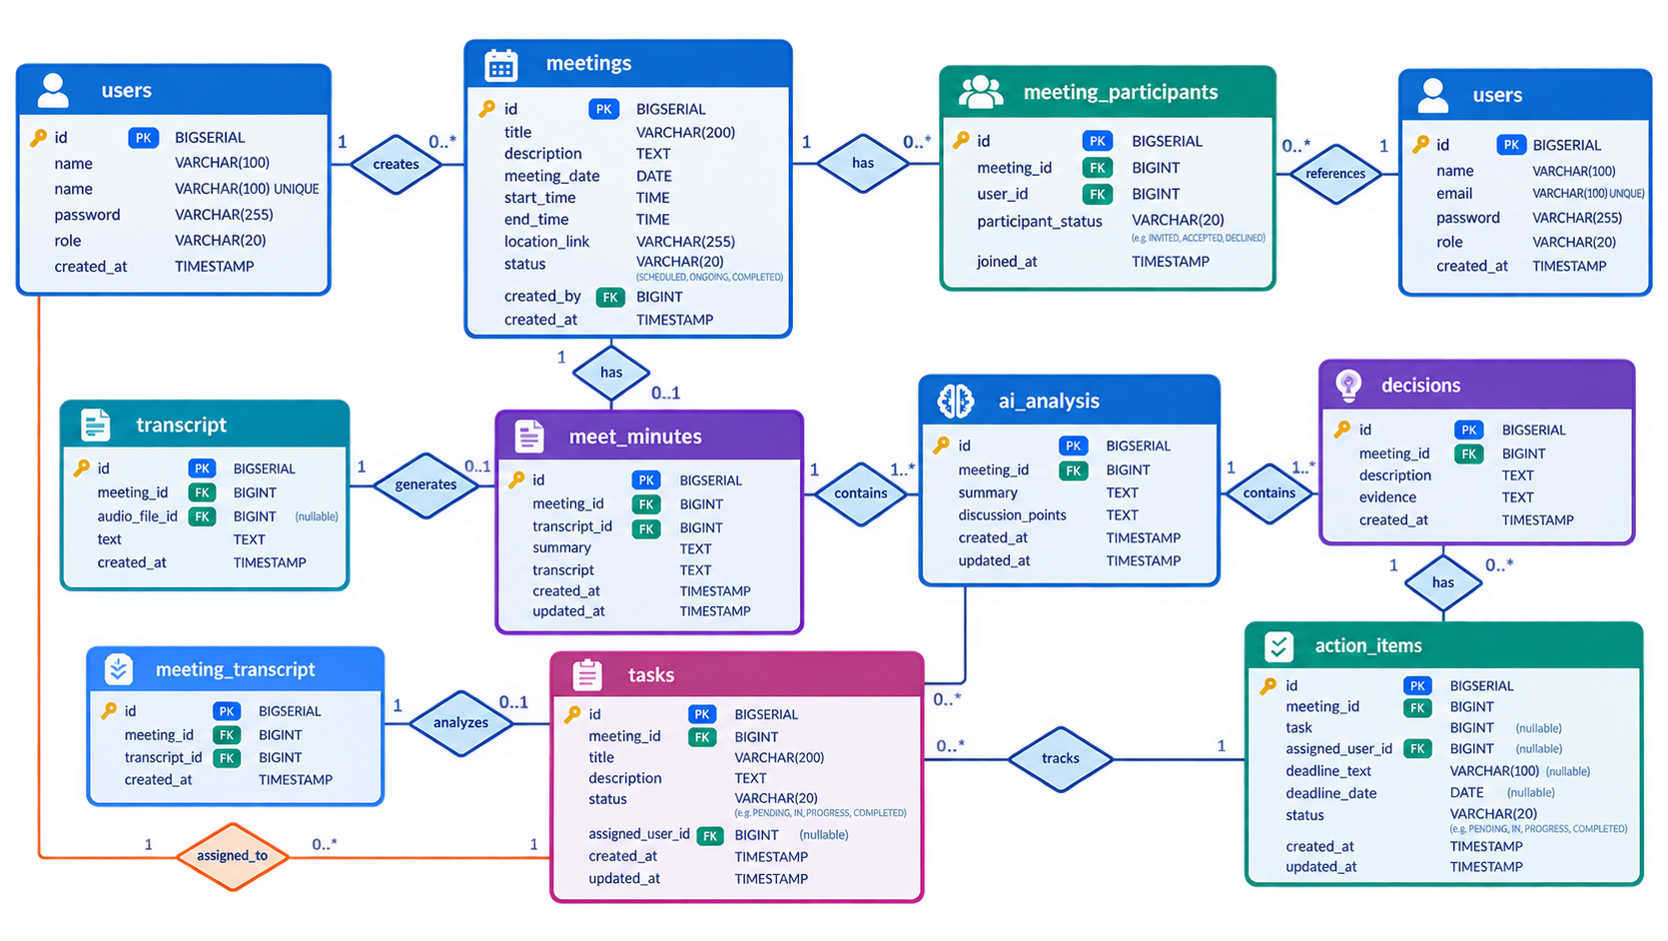
Database Design
Meet Minutes
Summarize - Extract Minutes - Manage Tasks
Notes:
This slide represents the database design of our application.
PostgreSQL is used as our relational database.
We maintain different entities for different types of information.
For example, we have a Users entity to store user information.
Meetings are stored separately, and participants are associated with meetings.
We also maintain information related to meeting minutes, decisions, and action items.
The purpose of separating these entities is to maintain structured data and relationships between different parts of the system.
For example, one meeting can have multiple participants and multiple action items.
This database structure helps us retrieve and manage meeting information efficiently.

Slide 12
Conclusion
Meet Minutes
Summarize - Extract Minutes - Manage Tasks
Meet Minutes simplifies the process of managing meetings and meeting outcomes.
It helps summarize meeting discussions and extract important decisions, action items, participants, and deadlines.
The system provides task management and tracking, making responsibilities clear to each participant.
React JS, Spring Boot, Java, and PostgreSQL provide a scalable and reliable application architecture.
It reduces manual effort, information loss, and time spent preparing meeting minutes.
Overall, Meet Minutes helps teams stay organized, accountable, and focused on their tasks
Notes:
To conclude, Meet Minutes is an AI-powered web application designed to simplify the process of meeting documentation and task management.
The main idea is to reduce the amount of manual effort required after a meeting.
Thank you for listening to my presentation.

Slide 13
Thank You

