Slide 1
Human computer Interaction Dr. Syed Muhammad Shehram Shah
shehram.shah@faculty.muet.edu.pk

Slide 2
Human Computer Interaction (HCI)
COURSE LEARNING OUTCOMES: Upon successful completion of the course, you will be able to:
CLOs | Description | Taxonomy level | PLO
1 | Identify various interaction mechanisms and purpose of a variety of interfaces along with their application areas. | C2 | 1
2 | Distinguish modules that cover the entire user-centered design and evaluation process - from understanding user needs, to designing interactive systems that meet those needs. | C4 | 2

Slide 3
Human Computer Interaction (HCI)
Commonly referred to as HCI
It is the study of the interaction between humans and computers, particularly it pertains to the design of technology.
HCI overlaps user-centered design, UI, and UX to create intuitive products and technologies.
People who specialize in HCI think about how to design and implement computer systems that satisfy human users.
Most research in this field aims to improve human–computer interaction by improving how an interface is used and understood by humans.

Slide 4
Human Computer Interaction (HCI)
The definition of Human-Computer Interaction (HCI) needs to remain quite broad, as it now covers almost all forms of information technology (IT).
HCI is the study of designing computers and machines so that they best serve their users (i.e. humans).
Human–computer interaction is research in the design and the use of computer technology, which focuses on the interfaces between people and computers.
HCI researchers observe the ways humans interact with computers and design technologies that allow humans to interact with computers in novel ways (usability studies).

Slide 5
Introduction
Human-computer interaction (HCI) is a multi/interdisciplinary field of study focusing on the design of computer technology and, in particular, the interaction between humans (the users) and computers.
HCI is interdisciplinary, meaning it combines research methods and tools from computer science, behavioral science, design, and media studies.
While initially concerned with computers, HCI has since expanded to cover almost all forms of information technology design.
Multidisciplinary: Involves people from multiple disciplines.
Example applications: Health, finance, differently abled users, military, space, extreme computing scenarios
Common disciplines: computer science, behavioural sciences, design, and media studies.

Slide 6
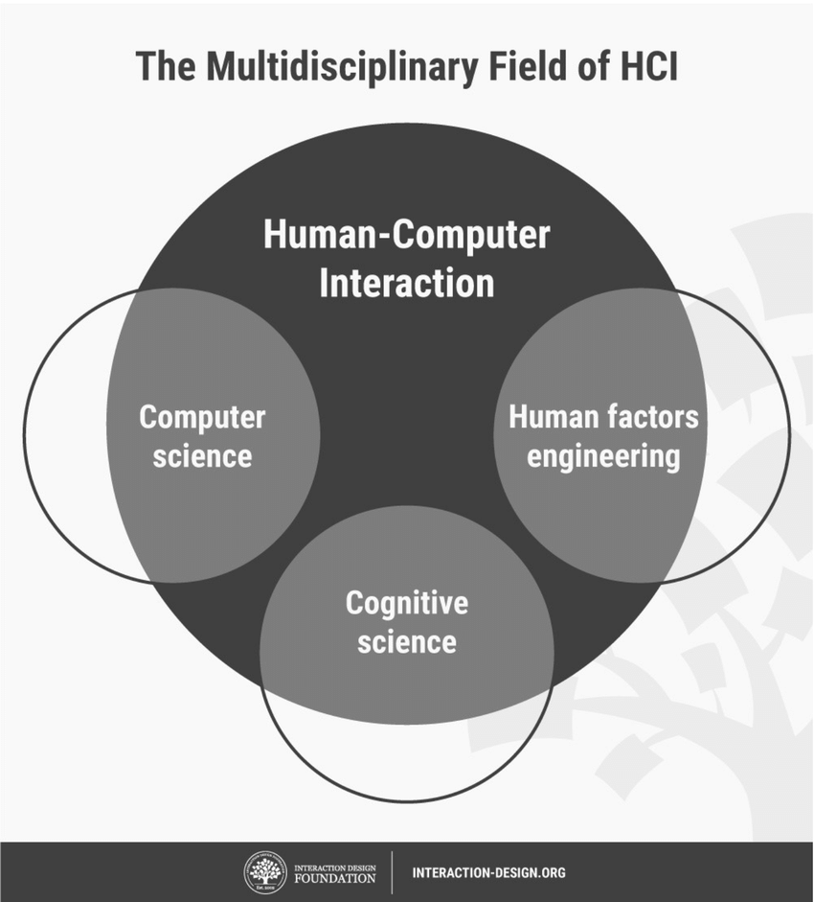
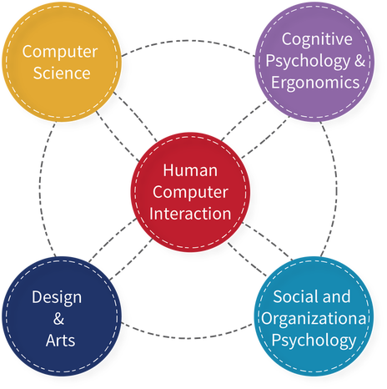
Multidisciplinary FIELD OF SCIENCE

Slide 7
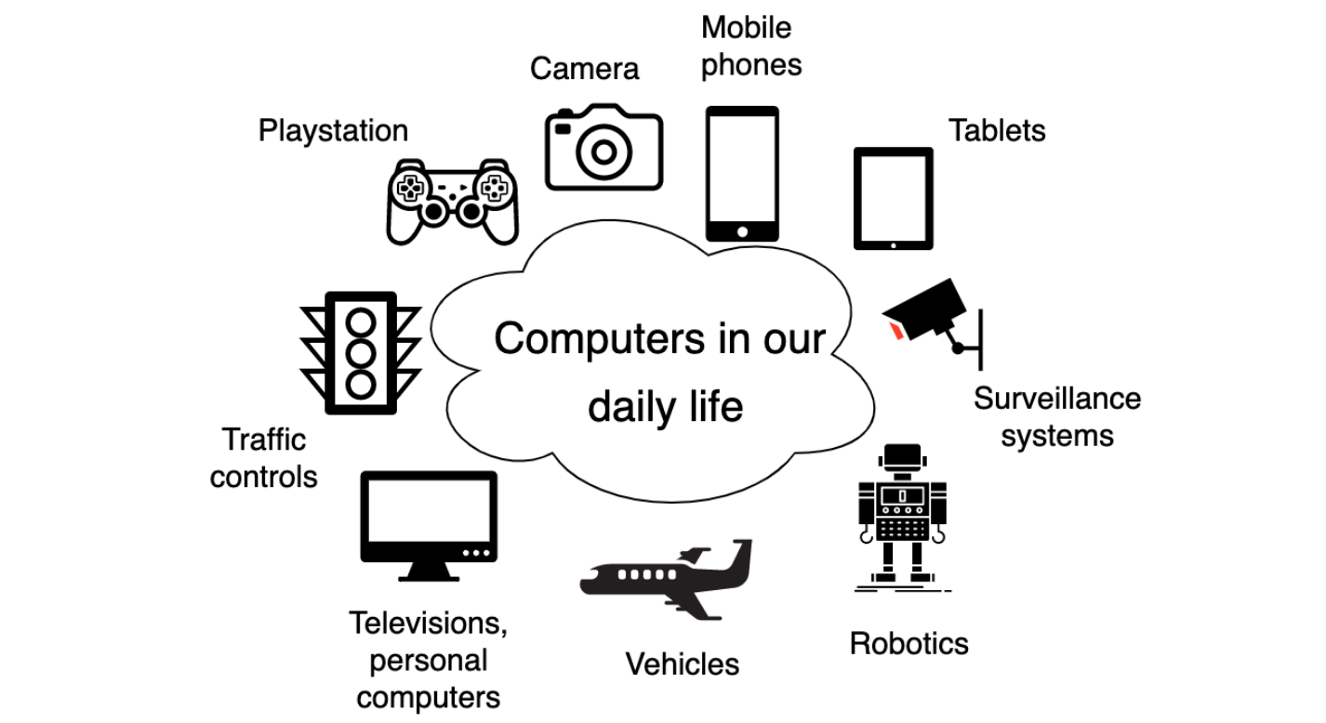
How many computing devices can you think of?
usability, learnability, findability, the efficiency of use

Slide 8
How many computing devices can you think of?
Any analogue device that has gone digital is now a computing device.
Computing: An electronic device that can perform some degree of computing.
Examples: Calculator, Car entertainment System, Smart Watch, Laptop, Tablet etc
How do you interact with these device?
Interface is our medium of interaction between that device
Interfaces which revolutionised the way we communicate/interact with machines (Interaction paradigms)
Command Line Interface → Graphical User Interface → voice, gesture based

Slide 9
Interface: conduit between two entities
Because human–computer interaction studies a human and a machine in communication, it draws from supporting knowledge on both the machine and the human side.
Factors on the machine side, techniques in computer graphics, operating systems, programming languages, and development environments are relevant.
Factors on the human side, communication theory, graphic and industrial design disciplines, linguistics, social sciences, cognitive psychology, social psychology, and human factors such as computer user satisfaction are relevant.
And, of course, engineering and design methods are relevant.

Slide 10
Discussion
The Association for Computing Machinery (ACM) defines human–computer interaction as "a discipline that is concerned with the design, evaluation, and implementation of interactive computing systems for human use and with the study of major phenomena surrounding them".
HCI helps to make interfaces that increase productivity, enhance user experience, and reduce risks in safety-critical systems. Poorly designed machines lead to many unexpected problems, sometimes just user frustration, but sometimes, chaotic disasters.
An important facet of HCI is user satisfaction (or End-User Computing Satisfaction).
Usability is key metric of end user satisfaction or end user computing satisfaction.

Slide 11
Discussion
The definition of usability in the ISO 9241 standard is: "The extent to which a product can be used by specified users to achieve specified goals with effectiveness, efficiency, and satisfaction in a specified context of use“
This definition can be expanded, and made more comprehensive, by including five characteristics which must be met for the users of a product:
Effective
Efficient
Engaging
Error Tolerant
Easy to Learn

Slide 12
Discussion
Effective: Effectiveness is the completeness and accuracy with which users achieve specified goals. It is determined by looking at whether the user’s goals were met successfully and whether all work is correct.
Efficient: Efficiency can be described as the speed (with accuracy) in which users can complete the tasks for which they use the product. ISO 9241 defines efficiency as the total resources expended in a task. Efficiency metrics include the number of clicks or keystrokes required or the total ‘time on task’.
Engaging: An interface is engaging if it is pleasant and satisfying to use. The visual design is the most obvious element of this characteristic.

Slide 13
Discussion
Error Tolerant: The ultimate goal is a system which has no errors. But, product developers are human, and computer systems far from perfect, so errors may occur. An error tolerant program is designed to prevent errors caused by the user’s interaction, and to help the user in recovering from any errors that do occur.
Easy to Learn: An interface which is easy to learn allows users to build on their knowledge without deliberate effort. This goes beyond a general helpfulness to include built-in instruction for difficult or advanced tasks, access to just-in-time training elements, connections to domain knowledge bases which are critical to effective use.

