Slide 1
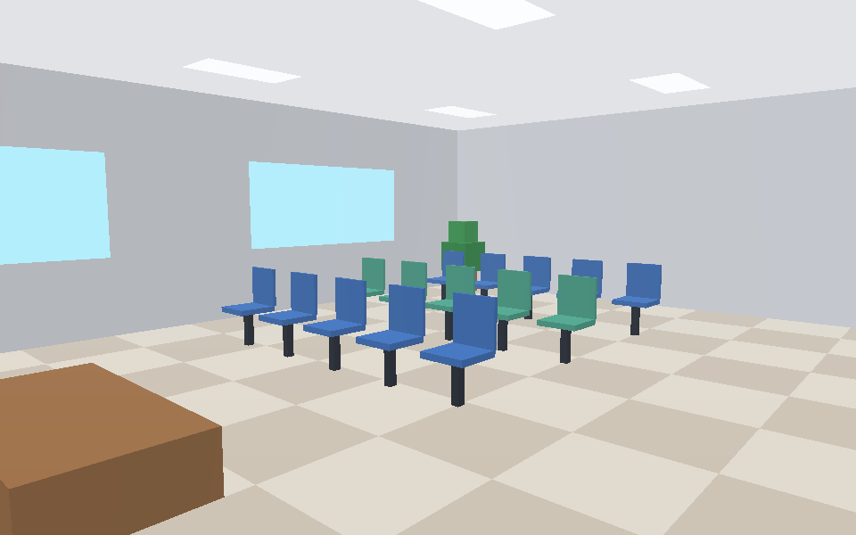
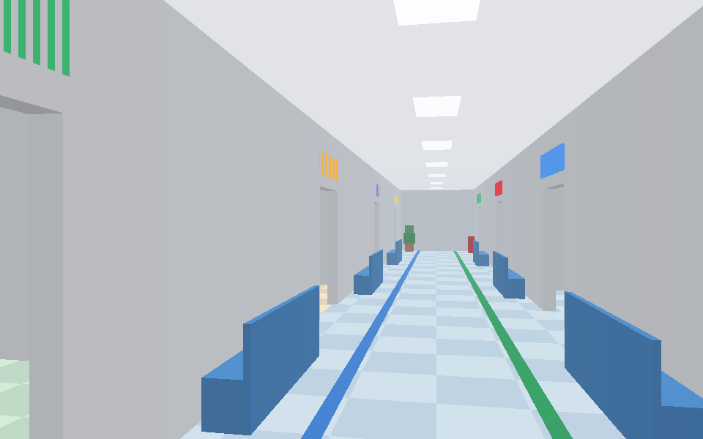
3D Hospital Interior Navigation and Visualization
Perspective Projection + Z-Buffer, built from scratch in Python
Saad Umar Daim
Computer Graphics Project
Notes:
Introduce the project: an interactive 3D hospital whose renderer is written from scratch using perspective projection and a Z-buffer. Both images are frames produced by our own Python renderer.

Slide 2
Objective and expected outcome
10
1
Objective
Develop a 3D hospital environment supporting realistic navigation and depth rendering.
rooms to explore
~4,000
triangles in the model
2
Outcome
An interactive hospital model with correct perspective and hidden-surface rendering.
40 x 24 m
single-storey floor plan
Notes:
The brief: realistic navigation and depth rendering. The outcome is an interactive model with correct perspective and hidden-surface removal.

Slide 3
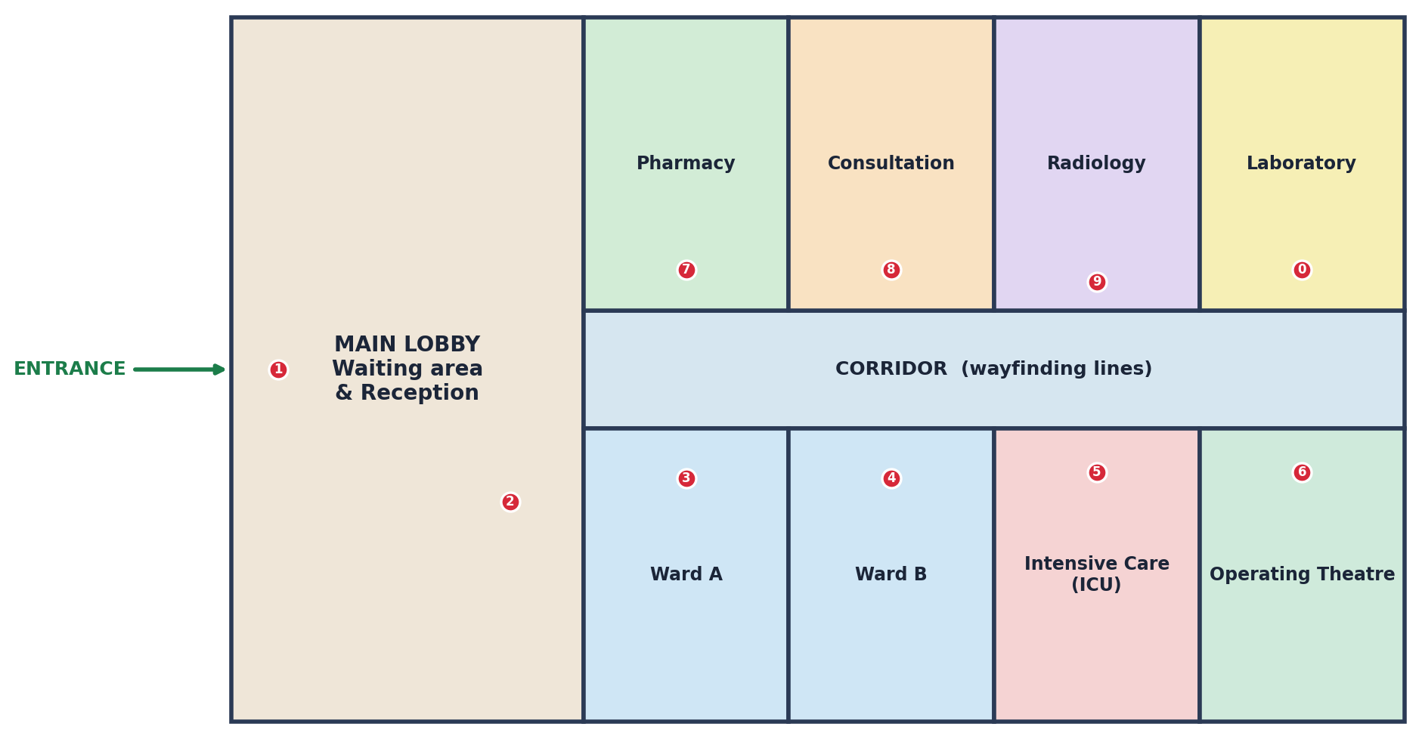
The hospital model
1
Lobby
Entrance, reception desk, waiting chairs, plants
2
South wing
Ward A, Ward B, ICU, operating theatre
3
North wing
Pharmacy, consultation, radiology, laboratory
Floor plan with the 10 teleport points (keys 1 to 9, 0)
4
Details
Beds, monitors, CT gantry, lab benches, signs, wayfinding lines
Notes:
One storey, 40 by 24 metres. Walls, doors, furniture and equipment are all built from boxes, which are split into triangles for rendering.

Slide 4
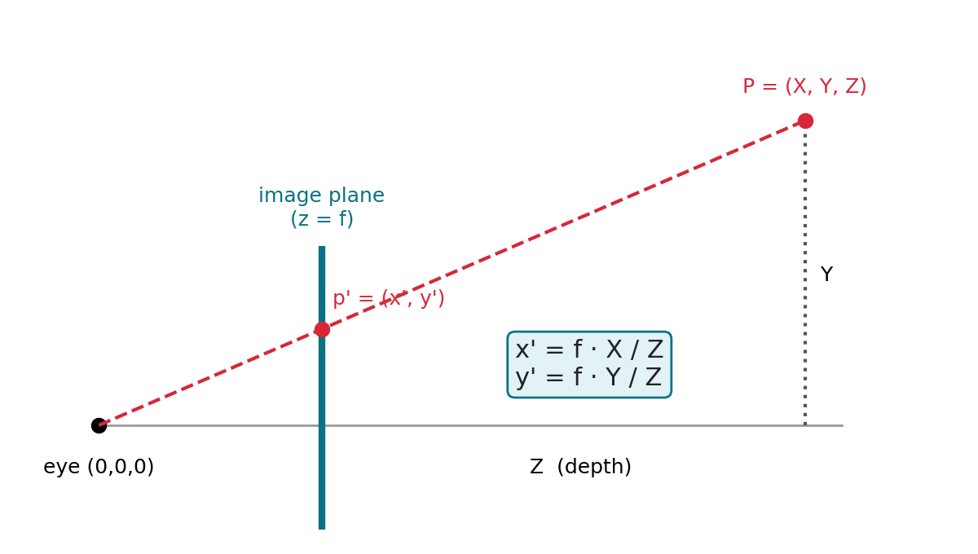
Technique 1: perspective projection
x_s = c_x + f * X / Z
y_s = c_y - f * Y / Z
f = (W/2) / tan(FOV/2) sets the zoom
Dividing by depth Z makes distant objects smaller
Parallel corridor edges meet at a vanishing point
Back-face culling and near-plane clipping (0.08 m) let the viewer stand inside rooms
Pinhole camera: the image plane sits at z = f
Notes:
Every vertex is first moved into camera space using the camera position, yaw and pitch. Then x and y are divided by depth Z. That single division is what creates the perspective effect.

Slide 5
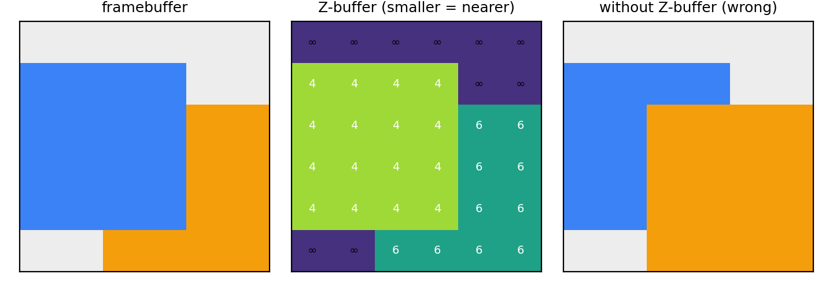
Technique 2: the Z-buffer
Store the depth of the nearest surface for every pixel
1/z is linear in screen space, so it is interpolated with barycentric weights
Write a pixel only if it is nearer than what is stored
Result: correct hidden-surface removal in any drawing order
for each triangle:
for each pixel in its bounding box:
if inside and 1/z > zbuf[y][x]:
zbuf[y][x] = 1/z
frame[y][x] = shade(colour, fog)
1/z = l0/z0 + l1/z1 + l2/z2
Notes:
Left panel of the diagram: framebuffer with the correct result. Middle: depth values, smaller means nearer. Right: what happens without the test, where the later triangle always wins.

Slide 6
Rendering pipeline, per frame
1
2
3
Hospital model
View transform
Cull and clip
3,966 triangles with normals, colours and tile patterns
World to camera space using position, yaw and pitch
Drop back faces, clip triangles at the near plane
4
5
6
Perspective projection
Rasterise + Z-test
Shade and display
Divide by depth and map to pixel coordinates
Barycentric fill, keep only the nearest fragment
Lighting, distance fog, mini-map and HUD
Notes:
Red steps are the two techniques named in the brief. Everything runs in Python and NumPy with no graphics library.

Slide 7
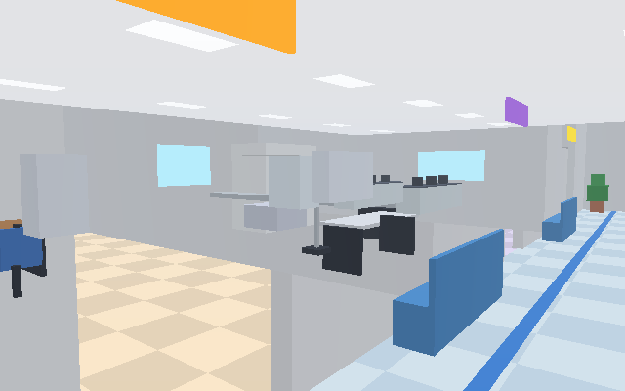
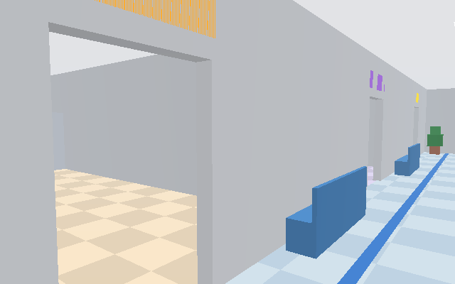
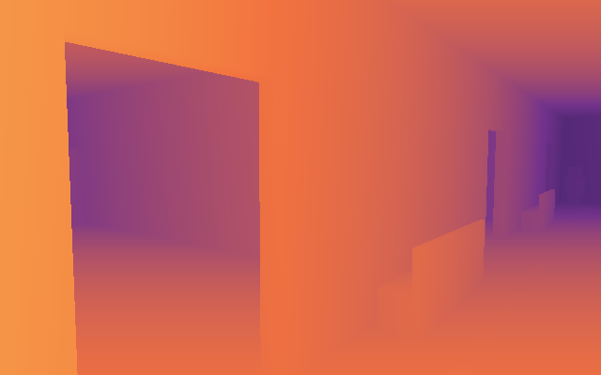
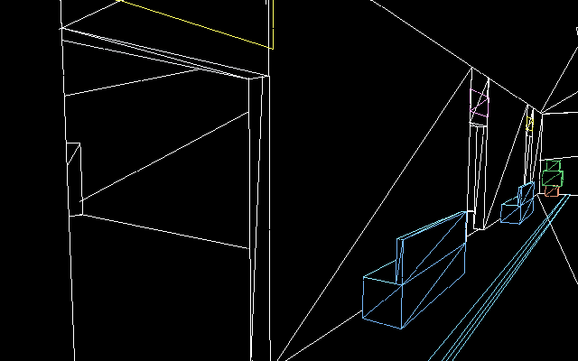
Why the Z-buffer matters
Same camera, same model
Without depth testing, later triangles overwrite nearer ones
With it, order no longer matters
Press Z in the viewer to toggle live
(a) Z-buffer OFF: laboratory shows through walls
(b) Z-buffer ON: correct occlusion
(c) Depth map: near yellow, far blue
(d) Hidden-line wireframe of the mesh
Notes:
Panel (a) is the key evidence. The laboratory behind the wall is drawn on top of the nearer wall because the triangles are drawn in model order. Panel (b) uses identical input with the depth test enabled.

Slide 8
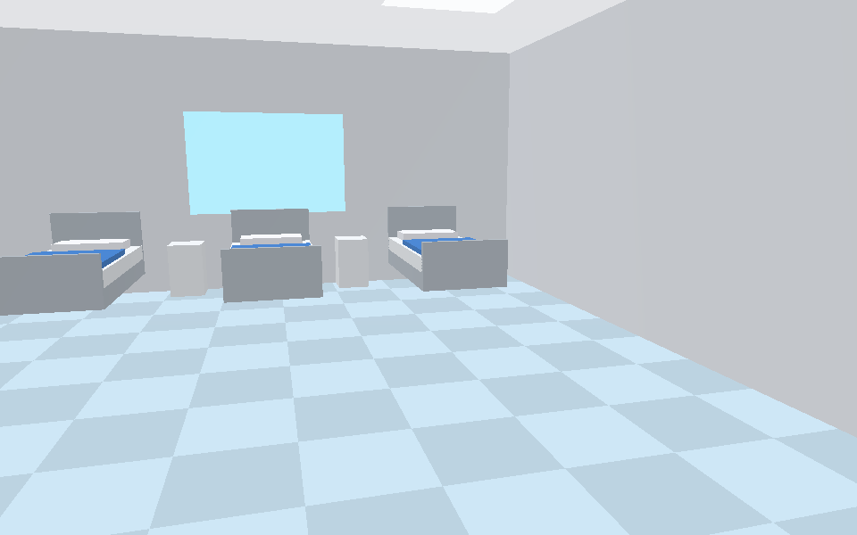
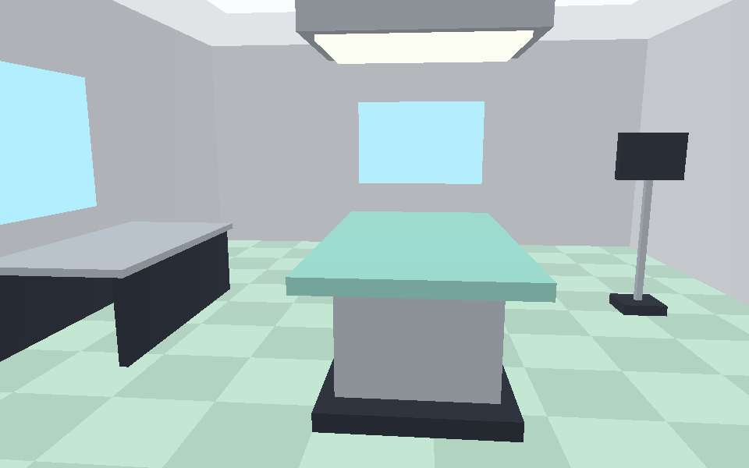
Real-time navigation
Key | Action
W A S D | Walk and strafe (Shift to run)
Arrows / right mouse | Look around
1 to 9, 0 | Teleport to a room
Z | Z-buffer on / off
V | Depth-map view
F | Hidden-line wireframe
C | Ceiling on / off
M | Mini-map
T | Guided tour
[ ] and - = | Resolution and field of view
Notes:
Collision detection stops the camera walking through walls and furniture, and slides along them. The guided tour auto-walks through the main departments.

Slide 9
The working model (Python)
engine.py
Camera, projection, Z-buffer rasteriser, collision, mini-map
# install
pip install numpy pygame pillow
# walk through the hospital
python main.py
# render a frame, e.g. depth map
python main.py --shot out.png \
--pos 15.5 8.3 --yaw 180 --mode depth
# animated guided tour
python main.py --tour tour.gif
hospital.py
Builds the hospital: walls, rooms, furniture, waypoints
main.py
Interactive viewer, screenshots, tour GIF
Needs Python 3, NumPy and Pygame (window only). Pillow for screenshots.
Notes:
The renderer itself needs only NumPy. Pygame just opens the window and shows the frames.

Slide 10
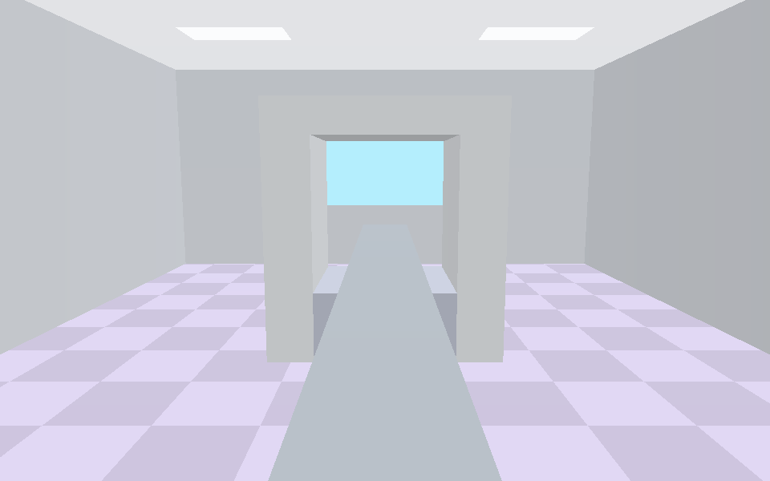
Conclusion and future work
Perspective projection gives correct size and depth cues
The Z-buffer guarantees nearer surfaces hide farther ones
Together: a navigable hospital with a fully self-written renderer
Next: textures, per-pixel lighting, multiple floors, clickable equipment info, GPU port
Notes:
Close by restating: realistic navigation and depth rendering were delivered using projection and a Z-buffer, with correct hidden-surface results.

