Slide 1
Visualization Of The Wave Version Of The Breadth-first Search
Coursework on theme:
Created By: group КС-202, Невмитим О.М.
Head: lecturer of the department SAS, Порубльов І.М.

Slide 2
Purpose of this work
Develop a software product that will read a symbolic version of the maze from a text file and draw it graphically on the screen.

Slide 3
Tasks of coursework FIRST STAGE:
read from the text file symbolic version of the maze
transform the symbolic maze into a matrix
breadth-first search will mark the length of the step, but in general, you can go there
walk along the edges of the maze and find the coordinates of all exits

Slide 4
Tasks of coursework Second STAGE:
draw the frame of the maze, our walls
draw the steps sequentially, marking the shortest path in red and all the others in black
When we reach the exit, we finish drawing, erase all marks and draw only a short way

Slide 5
Algorithm used in this work:
Breadth-first search
The data structures used in this work:
Array
List
Queue

Slide 6
How does “Breadth-First Search” IN OUR work?
This Algorithm iterates until our queue becomes empty, each iteration we find four points around the current (left, right, top, bottom) and add them to the queue if there is a zero mark. We mark each added point with the length of the previous point plus one

Slide 7
Partial use of “BREADTH-FIRST search” in RENDERER
Method in renderer’s class uses the history of the search in the width of the queue to reproduce the sequential marking of the length of the steps in the maze

Slide 8
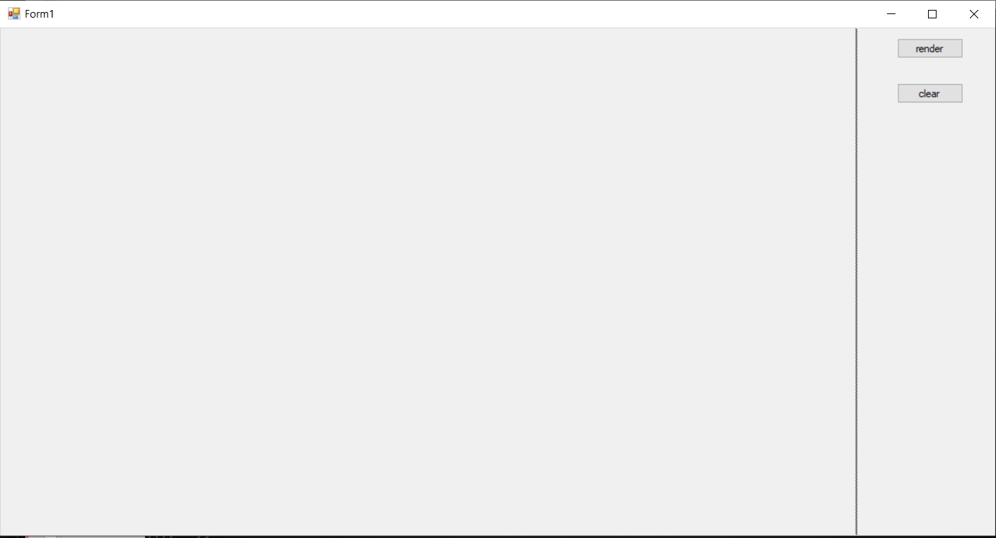
PROGRAM STARTED
When we start the program we have a window where you can click the render button

Slide 9

FIRST STAGE OF RENDER IS STARTED
First, work out a method for painting the walls of the maze

Slide 10
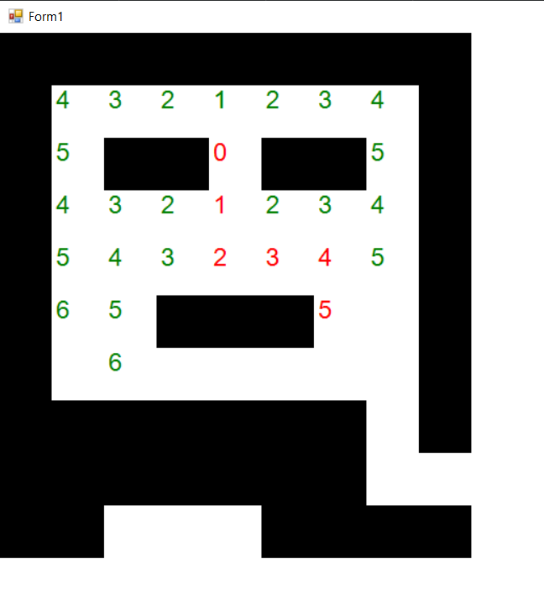
Second stage of rendering
The program draws from the starting point the length of all moves until it finds a way out

Slide 11
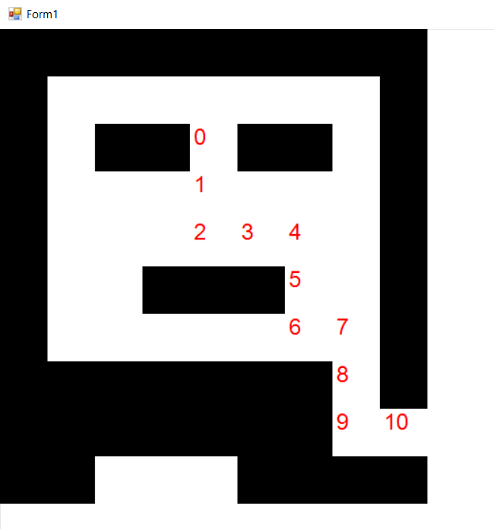
FINAL RESULT OF THE PROGRAM
Once we reach the exit, the program displays only the length of the shortest path

Slide 12
Conclusions
My program can read a maze in the form of a text document. She is find for the shortest way out of the maze. And can display it graphically.

Slide 13
Thanks for your attention!

