Slide 1

Claire Horgan (claire.horgan@staff.ittralee.ie)
1 lecture
2 practical/workshop
Exam 60%
CA 40%
X://SW_Testing

Slide 2

International Software Testing Qualifications Board (ISTQB)
Certified Tester – Foundation Level
Why – From the ISTQB website

Slide 3
Software systems are omnipresent. It is not infrequent that the life of people depends on the frictionless and reliable functioning of the programs; a point in case is medical technology. Professional verifying and testing of software therefore becomes an increasingly important task which requires well-founded education.
This is why software testing professionals from all over the world have come together in order to work out and define standardized contents for further education.

Slide 4

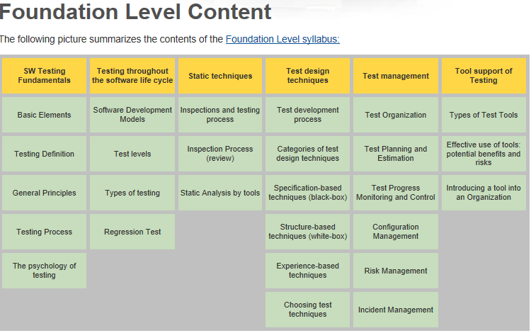
http://www.istqb.org/

Slide 5

“Foundations of Software Testing”
Dorothy Graham ….
Published by Thomson Learning
“Junit in Action” 2ed
Tahchiev ….
Published by Manning.

Slide 6
Software Testing Module
Principles
Test throughout the Lifecycle
Static Testing Techniques
Dynamic Test Techniques
Test Management
Tools

Slide 7


Why do pilots bother doing pre-flight checks when the chances are that the plane is working fine?
http://www.wired.com/software/coolapps/news/2005/11/69355?currentPage=all

Slide 8

Software Testing
Software testing is an investigate process to measure the quality of software.
Test techniques include, but are not limited to, the process of executing a program or application with the intent of finding software bugs.

Slide 9
Software Testing Methods

Slide 10



Box Approach

Slide 11

Black Box Testing
Black box testing treats the software as a "black box"—without any knowledge of internal implementation.
Black box testing methods include:
  equivalence partitioning,
  boundary value analysis,
  all-pairs testing,
  fuzz testing,
  model-based testing,
  exploratory testing and
  specification-based testing.

Slide 12

White Box Testing
White box testing is when the tester has access to the internal data structures and algorithms including the code that implement these.
White box testing methods include:
  API testing (application programming interface) - testing of the application using public and private APIs
  Code coverage - creating tests to satisfy some criteria of code coverage (e.g., the test designer can create tests to cause all statements in the program to be executed at least once)
  Fault injection methods - improving the coverage of a test by introducing faults to test code paths
  Mutation testing methods
  Static testing - White box testing includes all static testing

Slide 13

Grey Box Testing
Grey Box Testing involves having knowledge of internal data structures and algorithms for purposes of designing the test cases, but testing at the user, or black-box level.
The tester is not required to have a full access to the software's source code.
Grey box testing may also include reverse engineering to determine, for instance, boundary values or error messages.

Slide 14
An Exercise

Slide 15
Here's the algorithm – follow exactly!!
Draw a diagonal line
Draw another diagonal line connected to the top of the first one
Draw a straight line from the point where the diagonal lines meet
Draw a horizontal line over the straight line
At the bottom of the straight line, draw a curvy line
Draw a diagonal line from the bottom of the first diagonal to the straight line
Draw a diagonal line from the bottom of the second diagonal to the straight line

Slide 16
How did the pictures turn out?
Compare your picture with others' pictures…
  Were they different?
  Why?
  What was difficult about following the instructions
  What was missing from the instructions?

Slide 17
It was meant to be a kite!!
Draw a diagonal line
Draw another diagonal line connected to the top of the first one
Draw a straight line from the point where the diagonal lines meet
Draw a horizontal line over the straight line
At the bottom of the straight line, draw a curvy line
Draw a diagonal line from the bottom of the first diagonal to the straight line
Draw a diagonal line from the bottom of the second diagonal to the straight line

Slide 18
It was meant to be a kite!!
Now write a set of instructions that work!
Ensure only one way to interpret each step
  unambiguous
… and enough detail in each step

Slide 19
Putting all this together…
This time:
  write an Algorithm
  test it yourself
  get someone else to try it out…
Can you be sure your algorithm will work ok?

Slide 20
(a) Write & test your algorithm
The task/problem:
  make a shape out of paper – one sheet of A4
Write the algorithm
  Write a set of instructions that explains how to make a paper shape from 1 sheet of A4 paper
Test it
  Try out your algorithm – does it work?
  Note: follow your instructions as closely as possible
  Adjust the instructions if necessary
…
Notes:
Need 3 sheets of paper each ( 1 to make shape, 1 to write algorithm, 1 to test )

