Slide 1
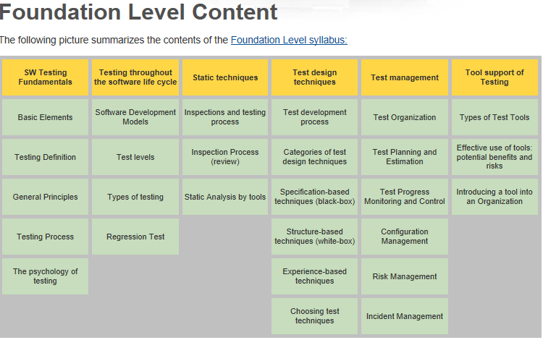
http://www.istqb.org/

Slide 2
Software Testing - Lifecycle
Contents
Models for testing, economics of testing
High level test planning
Component Testing
Integration testing
System testing
Integration testing in the large
Acceptance testing
Maintenance testing
Software Testing - Lifecycle

Slide 3
Life Cycle Models
A life cycle model is simply a description of the complete process of developing and delivering software.
Ususally depicted in graphic form.
Some ‘standard’ models are used.
Software Testing - Lifecycle

Slide 4
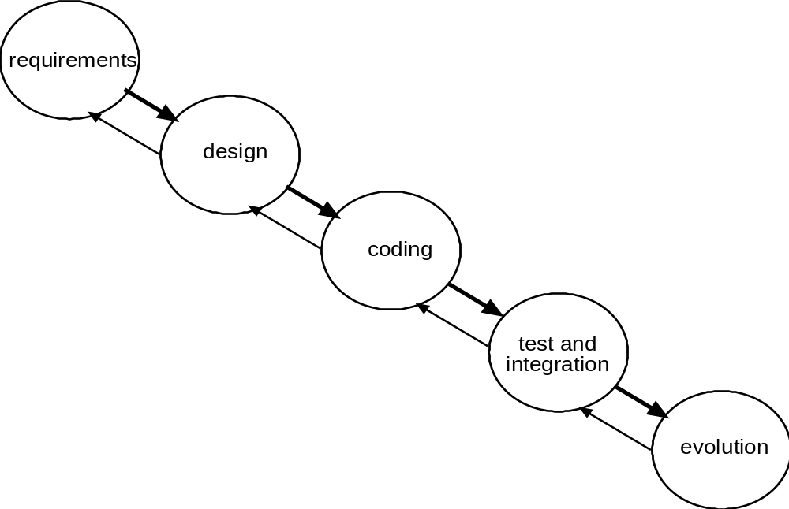
Classic Waterfall Model
Software Testing - Lifecycle

Slide 5
The waterfall life cycle
The earliest and best known of the life cycle models.
The main disadvantage of this model is its sequential nature. Testing is left to a late stage of the project, when error correcting is expensive and time consuming.
Various modifications have attempted to emphasise the iterative nature of software development - sequence & linearity prevail.
Software Testing - Lifecycle

Slide 6
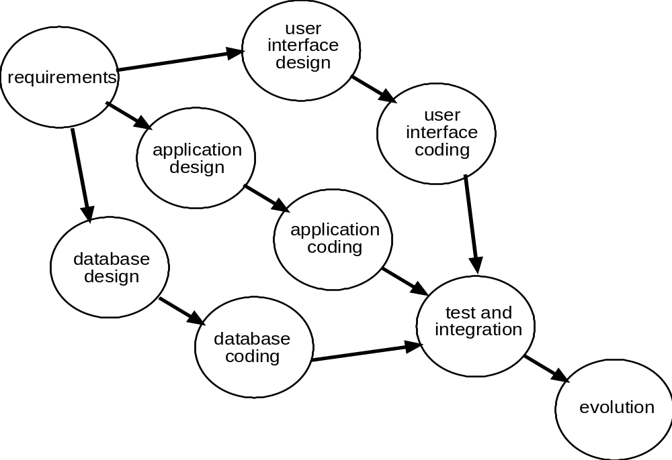
Allow some parallelism (RUP)
Software Testing - Lifecycle

Slide 7
The Vee life cycle
The most significant of the modifications made to the waterfall produced the Vee life cycle.
This redraws the sequence of the waterfall in a form that emphasises the relationship between early and late stages in a project.
This provides the opportunity to plan and define tests at an early stage.
Software Testing - Lifecycle

Slide 8
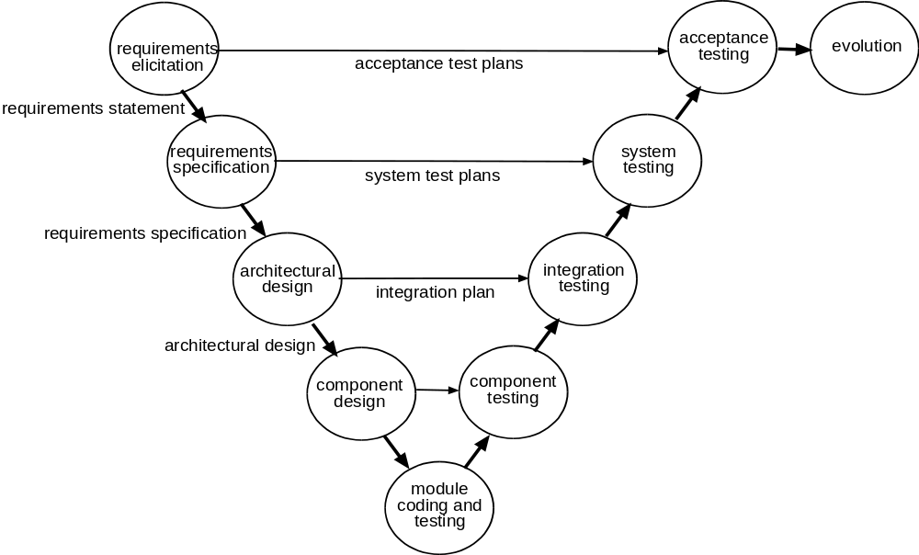
the Vee model
Software Testing - Lifecycle

Slide 9
This model helped to emphasise verification and validation in achieving quality products.
The verification and validation model could be applied to every deliverable ie. Output from every stage of the life cycle.
Software Testing - Lifecycle

Slide 10
VV&T
Verification
    the process of evaluating a system or component to determine whether the products of the given development phase satisfy the conditions imposed at the start of that phase [BS 7925-1]
Validation
    determination of the correctness of the products of software development with respect to the user needs and requirements [BS 7925-1]
Testing
    the process of exercising software to verify that it satisfies specified requirements and to detect faults
Software Testing - Lifecycle

Slide 11
The 2 main advantages of this modification:
More objectivity in testing
Use test process to find and remove errors in requirements, specification and high-level design documents
However, this life cycle is still essentially linear and emphasises a stage by stage approach.
Software Testing - Lifecycle

Slide 12
Incremental process model
These models are all sequential in nature.
Next step was the recognition that not every aspect of the system needs to be delivered at the same time.
The system may be delivered as a succession of releases with each containing more functions and corrections to earlier ones
This was formalised as the incremental process model.
Software Testing - Lifecycle

Slide 13
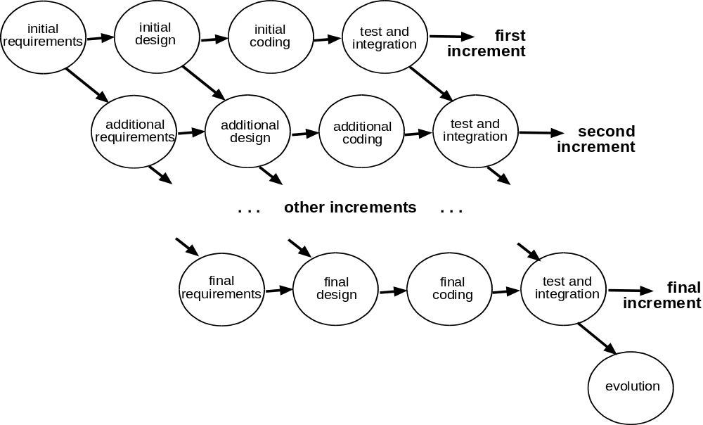
develop in increments
Software Testing - Lifecycle

Slide 14
It may not be clear at the start what the needs of the organisation are, these needs may change with the passage of time, and new technologies may offer new opportunities.
Iterative and evolutionary methods are a response to this need.
Software Testing - Lifecycle

Slide 15
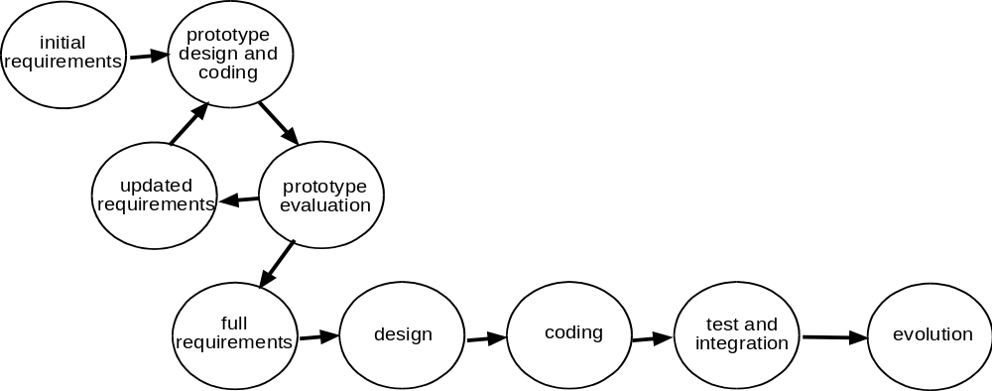
uncertain about what is needed
=> prototyping
Software Testing - Lifecycle

Slide 16
Prototyping used in this way to clarify requirements.
Still leaves a normal development at the end.
Why not use the prototype ?
This leads us to the evolutionary process model
Software Testing - Lifecycle

Slide 17
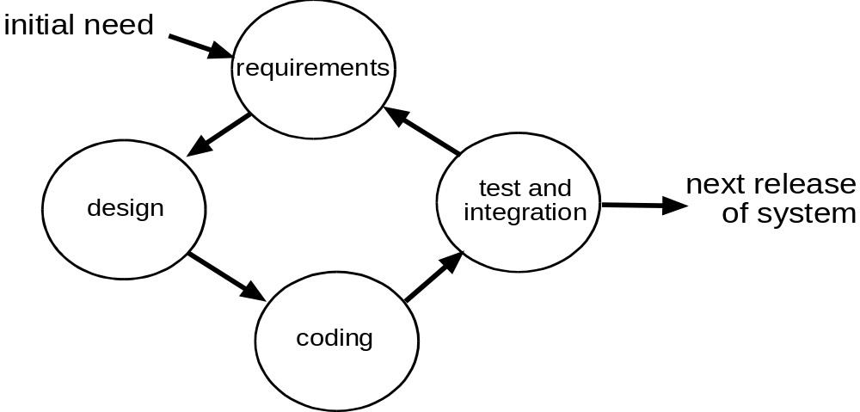
full iteration to find a solution
involves users
may iterate
several times
before making
the next release
- evolutionary
Software Testing - Lifecycle

Slide 18
The Spiral Life Cycle
This model is somewhat more radical than either the waterfall or the V models.
Tried to characterise the iterative and evolutionary nature of software development.
The spiral is harder to manage than linear life cycles but is a more accurate characterisation of the process.
Has promoted the development of rapid prototyping approaches.
Software Testing - Lifecycle

Slide 19
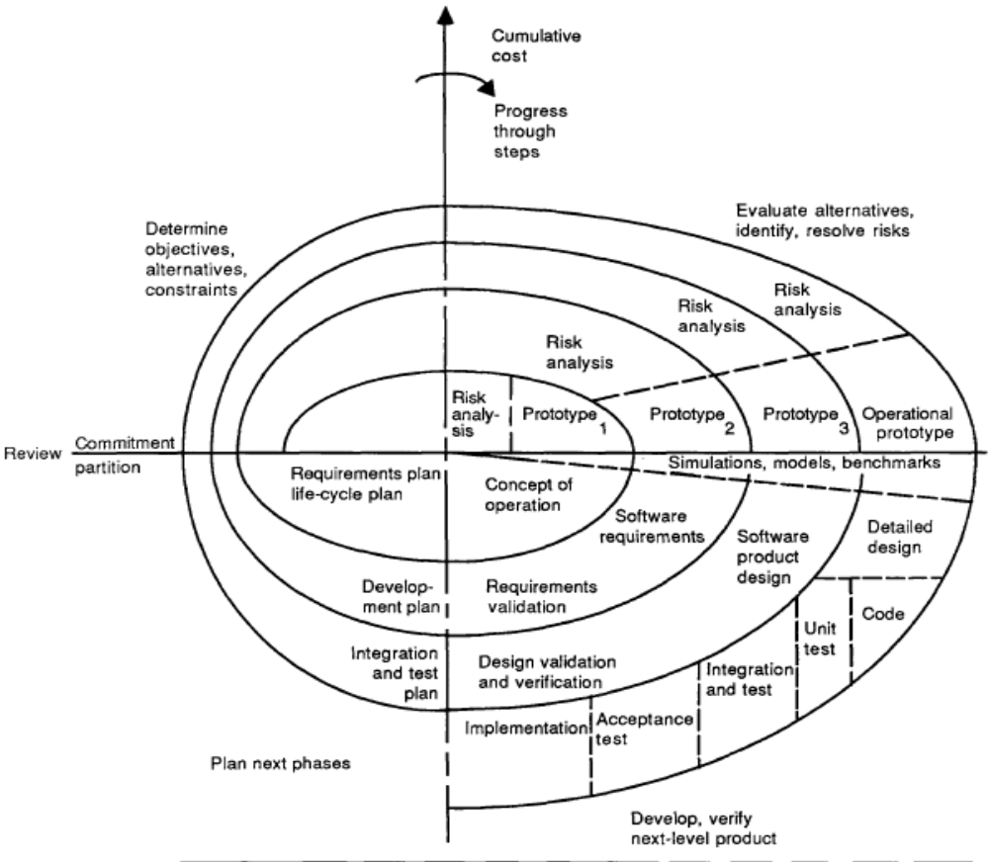
Boehm’s Spiral
Iterate to reduce risk
Software Testing - Lifecycle

Slide 20
Agile Processes
Proprietary “methodologies” have significant overheads.
Unpopular with engineers. Distracts from developing software.
Response = Agile Methods
Small teams develop quality software at low costs.
Software Testing - Lifecycle

Slide 21
Agile Alliance
liberate software engineers’ energy and creativity reduce bureaucracy to the minimum
make the technical work exciting
engage the best engineers you can
Software Testing - Lifecycle

Slide 22
Manifesto for Agile Development
highest priority to satisfy the customer
welcome changing requirements
deliver working software frequently
business people and developers work together
build projects around motivated individuals
face-to-face conversation
working software is measure of progress
maintain a constant pace indefinitely
attend to technical excellence and good design
simplicity essential, not doing work is good
the best emerges from self-organizing teams
regularly reflect on becoming more effective
Software Testing - Lifecycle

Slide 23
Agile Methods
The best know of these is Extreme Programming (XP) by Kent Becks
Test-Driven Development(TDD) was added later.
Software Testing - Lifecycle

Slide 24
Extreme Programming (XP)
-each release a small increment on previous
-metaphor or story about how system works
-design as simple as possible
-tests must be passed in order to proceed
-pair programming sharing a single computer
-code to enhance communication
-new code is immediately integrated
-team includes customer
-all code owned collectively, can be changed by anybody
-people only work the normal 40 hour week
Software Testing - Lifecycle

Slide 25
Test Driven Development - TDD
write test case for next functionality to be implemented
test current version of software on this – it should fail!
update software so that it will pass this test case
reengineer code to incorporate the new code elegantly
re-test everything so far.
Software Testing - Lifecycle

Slide 26
consider agile method if new to software development,
or move there if have an ineffective bureaucratic process
Software Testing - Lifecycle

Slide 27
Some developers have defined their own model which accurately reflects their approach to development.
The life cycle model in use must be appropriate for the project to which it is being applied.
Each organisation must recognise and agree its own life cycle model(s).

Slide 28
“Testing is expensive”
Compared to what?
What is the cost of NOT testing, or of faults missed that should have been found in test?
  Cost to fix faults escalates the later the fault is found
  Poor quality software costs more to use
    users take more time to understand what to do
    users make more mistakes in using it
    morale suffers
    => lower productivity
Software Testing - Lifecycle

Slide 29
Software Testing - Lifecycle
Contents
Models for testing, economics of testing
High level test planning
Component Testing
Integration testing
System testing
Integration testing in the large
Acceptance testing
Maintenance testing
Software Testing - Lifecycle

Slide 30
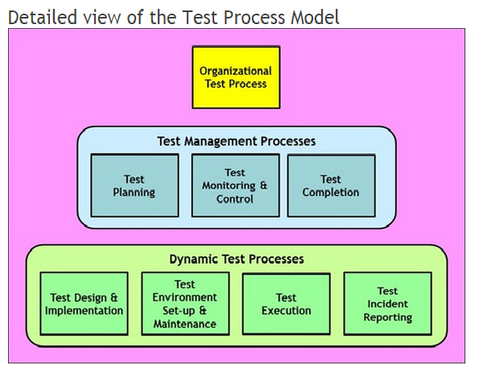
ISO/IEC/IEEE 29119 Software Testing
http://www.softwaretestingstandard.org/
Software Testing - Dynamic Tests

Slide 31
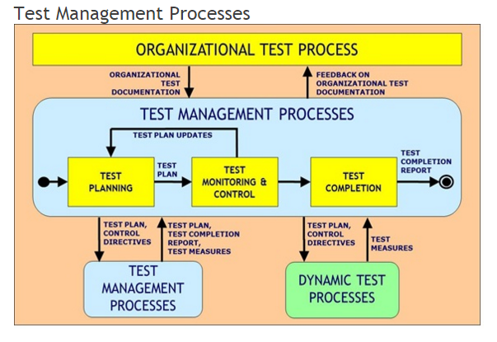
Software Testing - Lifecycle

Slide 32
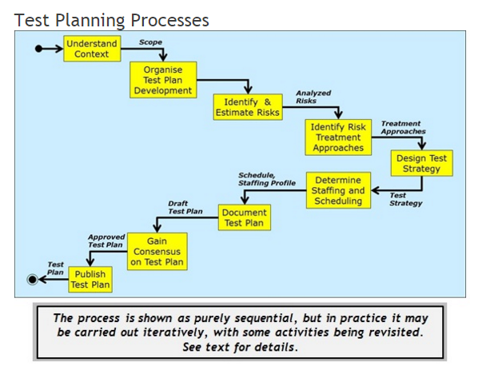
Software Testing - Lifecycle

Slide 33
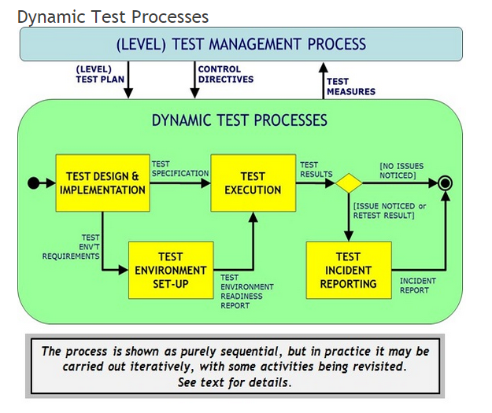
Software Testing - Dynamic Tests

Slide 34
High level test planning
What is the purpose of a high level test plan?
  Who does it communicate to?
  Why is it a good idea to have one?
What information should be in a high level test plan?
  What is your standard for contents of a test plan?
  Have you ever forgotten something important?
  What is not included in a test plan?
Software Testing - Lifecycle

Slide 35
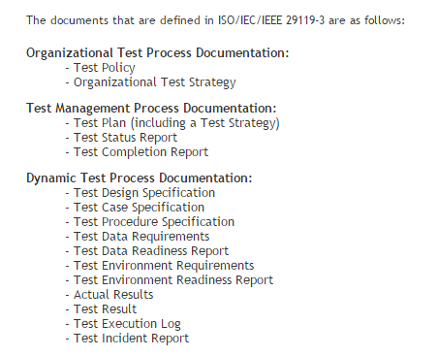
Software Testing - Lifecycle

Slide 36
Testing Levels
Unit (Component) Testing
Integration testing
System testing
Integration testing in the large
Acceptance testing
Maintenance testing
Software Testing - Lifecycle

Slide 37
the Vee model (Test levels)
Software Testing - Dynamic Tests

Slide 38
Software Testing - Lifecycle
Contents
Models for testing, economics of testing
High level test planning
Component Testing
Integration testing
System testing
Integration testing in the large
Acceptance testing
Maintenance testing
Software Testing - Lifecycle

Slide 39
Component testing - Unit testing
lowest level
tested in isolation
most thorough look at detail
  error handling
  interfaces
usually done by programmer
also known as unit, module, program testing
Software Testing - Lifecycle

Slide 40
Component test process
BEGIN
Component
Test Planning
Component
Test Specification
Component
Test Execution
Component
Test Recording
Checking for
Component
Test Completion
END
Software Testing - Lifecycle

Slide 41
Component test process
Component test planning
- how the test strategy and
project test plan apply to
the component under test
- any exceptions to the strategy
- all software the component
will interact with (e.g. stubs
and drivers
BEGIN
Component
Test Planning
Component
Test Specification
Component
Test Execution
Component
Test Recording
Checking for
Component
Test Completion
END
Software Testing - Lifecycle

Slide 42
Component test process
BEGIN
Component
Test Planning
Component test specification
- test cases are designed
using the test case design
techniques specified in the
test plan (Section 3)
- Test case:
objective
initial state of component
input
expected outcome
- test cases should be
repeatable
Component
Test Specification
Component
Test Execution
Component
Test Recording
Checking for
Component
Test Completion
END
Software Testing - Lifecycle

Slide 43
Component test process
BEGIN
Component
Test Planning
Component
Test Specification
Component test execution
- each test case is executed
- standard does not specify
whether executed manually
or using a test execution
tool
Component
Test Execution
Component
Test Recording
Checking for
Component
Test Completion
END
Software Testing - Lifecycle

Slide 44
Component test process
Component test recording
- identities & versions of
component, test specification
- actual outcome recorded &
compared to expected outcome
- discrepancies logged
- repeat test activities to establish
removal of the discrepancy
(fault in test or verify fix)
- record coverage levels achieved
for test completion criteria
specified in test plan
BEGIN
Component
Test Planning
Component
Test Specification
Component
Test Execution
Component
Test Recording
Checking for
Component
Test Completion
Sufficient to show test
activities carried out
END
Software Testing - Lifecycle

Slide 45
Component test process
BEGIN
Component
Test Planning
Checking for component
test completion
- check test records against
specified test completion
criteria
- if not met, repeat test
activities
- may need to repeat test
specification to design test
cases to meet completion
criteria (e.g. white box)
Component
Test Specification
Component
Test Execution
Component
Test Recording
Checking for
Component
Test Completion
END
Software Testing - Lifecycle

Slide 46
Test design techniques
“Black box” Behaviour
  Equivalence partitioning
  Boundary value analysis
  State transition testing
  Cause-effect graphing
  Syntax testing
  Random testing
How to specify other techniques
“White box” Structural
  Statement testing
  Branch / Decision testing
  Data flow testing
  Branch condition testing
  Branch condition combination testing
  Modified condition decision testing
  LCSAJ testing
Software Testing - Lifecycle

Slide 47
Software Testing - Lifecycle
Contents
Models for testing, economics of testing
High level test planning
Component Testing
Integration testing
System testing
Integration testing in the large
Acceptance testing
Maintenance testing
Software Testing - Lifecycle

Slide 48
the Vee model (Test levels)
Software Testing - Dynamic Tests

Slide 49
Integration testing
The process of combining components or systems into larger assemblies.
Testing performed to expose defects in the interfaces and in the interactions between integrated components or system.
integration strategy: big-bang vs incremental (top-down, bottom-up, functional)
done by designers, analysts, or independent testers
Software Testing - Lifecycle

Slide 50
Big-Bang Integration
In theory:
  if we have already tested components why not just combine them all at once? Wouldn’t this save time?
  (based on false assumption of no faults)
In practice:
  takes longer to locate and fix faults
  re-testing after fixes more extensive
  end result? takes more time
Software Testing - Lifecycle

Slide 51
Incremental Integration
Baseline 0: tested component
Baseline 1: two components
Baseline 2: three components, etc.
Advantages:
  easier fault location and fix
  easier recovery from disaster / problems
  interfaces should have been tested in component tests, but ..
  add to tested baseline
Software Testing - Lifecycle

Slide 52
Top-Down Integration
Baselines:
  baseline 0: component a
  baseline 1: a + b
  baseline 2: a + b + c
  baseline 3: a + b + c + d
  etc.
Need to call to lower
level components not
yet integrated
Stubs: simulate missing
components
a
a
b
b
c
c
d
d
e
e
f
f
g
g
h
h
i
i
j
j
k
l
m
n
o
Software Testing - Lifecycle

Slide 53
Stubs
Stub (Baan: dummy sessions) replaces a called component for integration testing
Keep it Simple
  print/display name (I have been called)
  reply to calling module (single value)
  computed reply (variety of values)
  prompt for reply from tester
  search list of replies
  provide timing delay
Software Testing - Lifecycle

Slide 54
Pros & cons of top-down approach
Advantages:
  critical control structure tested first and most often
  can demonstrate system early (show working menus)
Disadvantages:
  needs stubs
  detail left until last
  may be difficult to "see" detailed output (but should have been tested in component test)
  may look more finished than it is
Software Testing - Lifecycle

Slide 55
Bottom-up Integration
Baselines:
  baseline 0: component n
  baseline 1: n + i
  baseline 2: n + i + o
  baseline 3: n + i + o + d
  etc.
Needs drivers to call
the baseline configuration
Also needs stubs
for some baselines
a
b
b
c
d
d
e
f
g
h
h
i
i
j
j
k
l
m
n
n
o
o
Software Testing - Lifecycle

Slide 56
Drivers
Driver (Baan: dummy sessions): test harness: scaffolding
specially written or general purpose (commercial tools)
  invoke baseline
  send any data baseline expects
  receive any data baseline produces (print)
each baseline has different requirements from the test driving software
Software Testing - Lifecycle

Slide 57
Pros & cons of bottom-up approach
Advantages:
  lowest levels tested first and most thoroughly (but should have been tested in unit testing)
  good for testing interfaces to external environment (hardware, network)
  visibility of detail
Disadvantages
  no working system until last baseline
  needs both drivers and stubs
  major control problems found last
Software Testing - Lifecycle

Slide 58
Minimum Capability Integration
(also called Functional)
Baselines:
  baseline 0: component a
  baseline 1: a + b
  baseline 2: a + b + d
  baseline 3: a + b + d + i
  etc.
Needs stubs
Shouldn't need drivers
(if top-down)
a
a
b
b
c
c
d
d
e
e
f
g
h
h
i
i
j
j
k
l
m
n
n
o
o
Software Testing - Lifecycle

Slide 59
Pros & cons of Minimum Capability
Advantages:
  control level tested first and most often
  visibility of detail
  real working partial system earliest
Disadvantages
  needs stubs
Software Testing - Lifecycle

Slide 60
Thread Integration
(also called functional)
order of processing some event
determines integration order
interrupt, user transaction
minimum capability in time
advantages:
  critical processing first
  early warning of
  performance problems
disadvantages:
  may need complex drivers and stubs
a
b
b
c
c
d
d
e
e
f
f
g
g
h
h
i
i
j
j
k
k
l
l
m
m
n
o
Software Testing - Lifecycle

Slide 61
Integration Guidelines
minimise support software needed
integrate each component only once
each baseline should produce an easily verifiable result
integrate small numbers of components at once
  one at a time for critical or fault-prone components
  combine simple related components
Software Testing - Lifecycle

Slide 62
Integration Planning
integration should be planned in the architectural design phase
the integration order then determines the build order
  components completed in time for their baseline
  component development and integration testing can be done in parallel - saves time
Software Testing - Lifecycle

Slide 63
Software Testing - Lifecycle
Contents
Models for testing, economics of testing
High level test planning
Component Testing
Integration testing
System testing
Integration testing in the large
Acceptance testing
Maintenance testing
Software Testing - Lifecycle

Slide 64
System testing
The process of testing an integrated system to verify that it meets specified requirements.
Functional requirements – A requirement that specifies a function that a component or system must perform.
Non-Functional requirement – A requirement that does not relate to the functionality but to attributes of such as reliability, efficiency, usability, maintainability and portability
Software Testing - Lifecycle

Slide 65
the Vee model (Test levels)
Software Testing - Dynamic Tests

Slide 66
Requirements-based testing
Uses specification of requirements as the basis for identifying tests
  table of contents of the requirements spec provides an initial test inventory of test conditions
  for each section / paragraph / topic / functional area,
    risk analysis to identify most important / critical
    decide how deeply to test each functional area
Software Testing - Lifecycle

Slide 67
Business process-based testing
Expected user profiles
  what will be used most often?
  what is critical to the business?
Business scenarios
  typical business transactions (birth to death)
Use cases
  prepared cases based on real situations
Software Testing - Lifecycle

Slide 68
Non-functional system testing
different types of non-functional system tests:
  usability - configuration / installation
  security - reliability / qualities
  documentation - back-up / recovery
  storage - performance, load, stress
  volume
Software Testing - Lifecycle

Slide 69
Performance Tests
Timing Tests
  response and service times
  database back-up times
Capacity & Volume Tests
  maximum amount or processing rate
  number of records on the system
  graceful degradation
Endurance Tests (24-hr operation?)
  robustness of the system
  memory allocation
Software Testing - Lifecycle

Slide 70
Multi-User Tests
Concurrency Tests
  small numbers, large benefits
  detect record locking problems
Load Tests
  the measurement of system behaviour under realistic multi-user load
Stress Tests
  go beyond limits for the system - know what will happen
  particular relevance for e-commerce
Software Testing - Lifecycle
Source: Sue Atkins, Magic Performance Management

Slide 71
Usability Tests
messages tailored and meaningful to (real) users?
coherent and consistent interface?
sufficient redundancy of critical information?
within the "human envelope"? (7±2 choices)
feedback (wait messages)?
clear mappings (how to escape)?
Who should design / perform these tests?
Software Testing - Lifecycle

Slide 72
Security Tests
passwords
encryption
hardware permission devices
levels of access to information
authorisation
covert channels
physical security
Software Testing - Lifecycle

Slide 73
Configuration and Installation
Configuration Tests
  different hardware or software environment
  configuration of the system itself
  upgrade paths - may conflict
Installation Tests
  distribution (CD, network, etc.) and timings
  physical aspects: electromagnetic fields, heat, humidity, motion, chemicals, power supplies
  uninstall (removing installation)
Software Testing - Lifecycle

Slide 74
Reliability / Qualities
Reliability
  "system will be reliable" - how to test this?
  "2 failures per year over ten years"
  Mean Time Between Failures (MTBF)
  reliability growth models
Other Qualities
  maintainability, portability, adaptability, etc.
Software Testing - Lifecycle

Slide 75
Back-up and Recovery
Back-ups
  computer functions
  manual procedures (where are tapes stored)
Recovery
  real test of back-up
  manual procedures unfamiliar
  should be regularly rehearsed
  documentation should be detailed, clear and thorough
Software Testing - Lifecycle

Slide 76
Documentation Testing
Documentation review
  check for accuracy against other documents
  gain consensus about content
  documentation exists, in right format
Documentation tests
  is it usable? does it work?
  user manual
  maintenance documentation
Software Testing - Lifecycle

Slide 77
Software Testing - Lifecycle
Contents
Models for testing, economics of testing
High level test planning
Component Testing
Integration testing
System testing
Integration testing in the large
Acceptance testing
Maintenance testing
Software Testing - Lifecycle

Slide 78
Integration testing in the large
Tests the completed system working in conjunction with other systems, e.g.
  LAN / WAN, communications middleware
  other internal systems (billing, stock, personnel, overnight batch, branch offices, other countries)
  external systems (stock exchange, news, suppliers)
  intranet, internet / www
  3rd party packages
  electronic data interchange (EDI)
Software Testing - Lifecycle

Slide 79
Approach
Identify risks
  which areas missing or malfunctioning would be most critical - test them first
“Divide and conquer”
  test the outside first (at the interface to your system, e.g. test a package on its own)
  test the connections one at a time first
  (your system and one other)
  combine incrementally - safer than “big bang”
  (non-incremental)
Software Testing - Lifecycle

Slide 80
Planning considerations
resources
  identify the resources that will be needed
  (e.g. networks)
co-operation
  plan co-operation with other organisations
  (e.g. suppliers, technical support team)
development plan
  integration (in the large) test plan could influence development plan (e.g. conversion software needed early on to exchange data formats)
Software Testing - Lifecycle

Slide 81
Software Testing - Lifecycle
Contents
Models for testing, economics of testing
High level test planning
Component Testing
Integration testing
System testing
Integration testing in the large
Acceptance testing
Maintenance testing
Software Testing - Lifecycle

Slide 82
the Vee model (Test levels)
Software Testing - Dynamic Tests

Slide 83
Acceptance testing
The goal of acceptance testing is to establish
confidence in the system.
Is the system fit for purpose ?
- Functional/Business acceptance
(fitness for use by business user)
- Operational acceptance
(system meets the requirements for operation)
Software Testing - Lifecycle

Slide 84
Acceptance testing
Final stage of validation
  customer (user) should perform or be closely involved
  customer can perform any test they wish, usually based on their business processes
  final user sign-off
Software Testing - Lifecycle

Slide 85
Why customer / user involvement
Users know:
  what really happens in business situations
  complexity of business relationships
  how users would do their work using the system
  variants to standard tasks (e.g. country-specific)
  examples of real cases
  how to identify sensible work-arounds
Benefit: detailed understanding of the new system
Software Testing - Lifecycle

Slide 86
Contract acceptance testing
Contract to supply a software system
  agreed at contract definition stage
  acceptance criteria defined and agreed
  may not have kept up to date with changes
Contract acceptance testing is against the contract and any documented agreed changes
  not what the users wish they had asked for!
  this system, not wish system
Software Testing - Lifecycle

Slide 87
Alpha and Beta tests: similarities
Testing by [potential] customers or representatives of your market
  not suitable for bespoke software
When software is stable
Use the product in a realistic way in its operational environment
Give comments back on the product
  faults found
  how the product meets their expectations
  improvement / enhancement suggestions?
Software Testing - Lifecycle

Slide 88
Alpha and Beta tests: differences
Alpha testing
  simulated or actual operational testing at an in-house site not otherwise involved with the software developers (i.e. developers’ site)
Beta testing
  operational testing at a site not otherwise involved with the software developers (i.e. testers’ site, their own location)
Software Testing - Lifecycle

Slide 89
Software Testing - Lifecycle
Contents
Models for testing, economics of testing
High level test planning
Component Testing
Integration testing
System testing
Integration testing in the large
Acceptance testing
Maintenance testing
Software Testing - Lifecycle

Slide 90
What to test in maintenance testing
Test any new or changed code
Impact analysis
  what could this change have an impact on?
  how important is a fault in the impacted area?
  test what has been affected, but how much?
    most important affected areas?
    areas most likely to be affected?
    whole system?
The answer: “It depends”
Software Testing - Lifecycle

Slide 91
Regression Testing
Testing of a previously test program following modification to ensure that defects have not been introduced or uncovered in unchanged areas of the software as a result of changes made.
It is performed when the software or its environment is changed.
Software Testing - Lifecycle

Slide 92
the Vee model (Test levels)
Software Testing - Dynamic Tests

Slide 93
Testing Types
Static
Dynamic
  Functional/Behavioural/Black Box
  Structural/White Box
Software Testing - Lifecycle

Slide 94
Static testing is the testing of a component or system
at specification or implementation level without
execution of that software e.g reviews or static code
analysis
Dynamic testing is testing that involves the execution
of the software of a component or system.
Software Testing - Static Testing

Slide 95
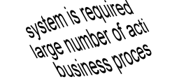
Three types of systematic technique
Static (non-execution)
  examination of documentation,
  source code listings, etc.
Dynamic Testing
Functional (Black Box)
  based on behaviour /
  functionality of software
Structural (White Box)
  based on structure
  of software
Software Testing - Dynamic Tests

Slide 96
Static Testing
Tests
Requirements
Accept. Test
Tests
Functions
System Test
Tests
Design
Integration T
Tests
Code
Unit Test
Software Testing - Static Testing

Slide 97
Some test techniques
Static
Dynamic
Reviews
etc.
Behavioural
Inspection
Static Analysis
Walkthroughs
Structural
Non-functional
Functional
Desk-checking
etc.
etc.
Usability
Equivalence
Partitioning
Control
Flow
Data
Flow
Performance
etc.
Boundary
Value Analysis
etc.
Statement
Symbolic
Execution
Cause-Effect Graphing
Branch/Decision
Arcs
Random
Definition
-Use
Branch Condition
LCSAJ
Branch Condition
Combination
State Transition
Software Testing - Lifecycle
Software Testing - Dynamic Tests

Slide 98
Software Testing - Lifecycle
Contents
Models for testing, economics of testing
High level test planning
Component Testing
Integration testing
System testing
Integration testing in the large
Acceptance testing
Maintenance testing
Software Testing - Lifecycle

