Slide 1
Implementation of deferred snow deformation
Based on the technique used in the Rise of the Tomb Raider

Slide 2
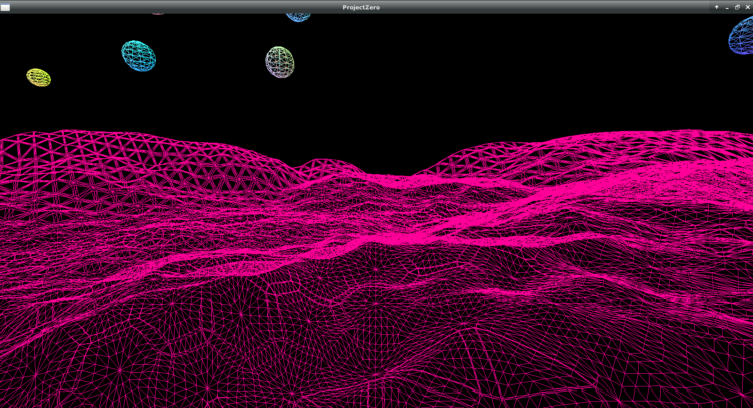
Terrain
Implemented using height-map approach
Dynamic tesselation based on distance from camera

Slide 3
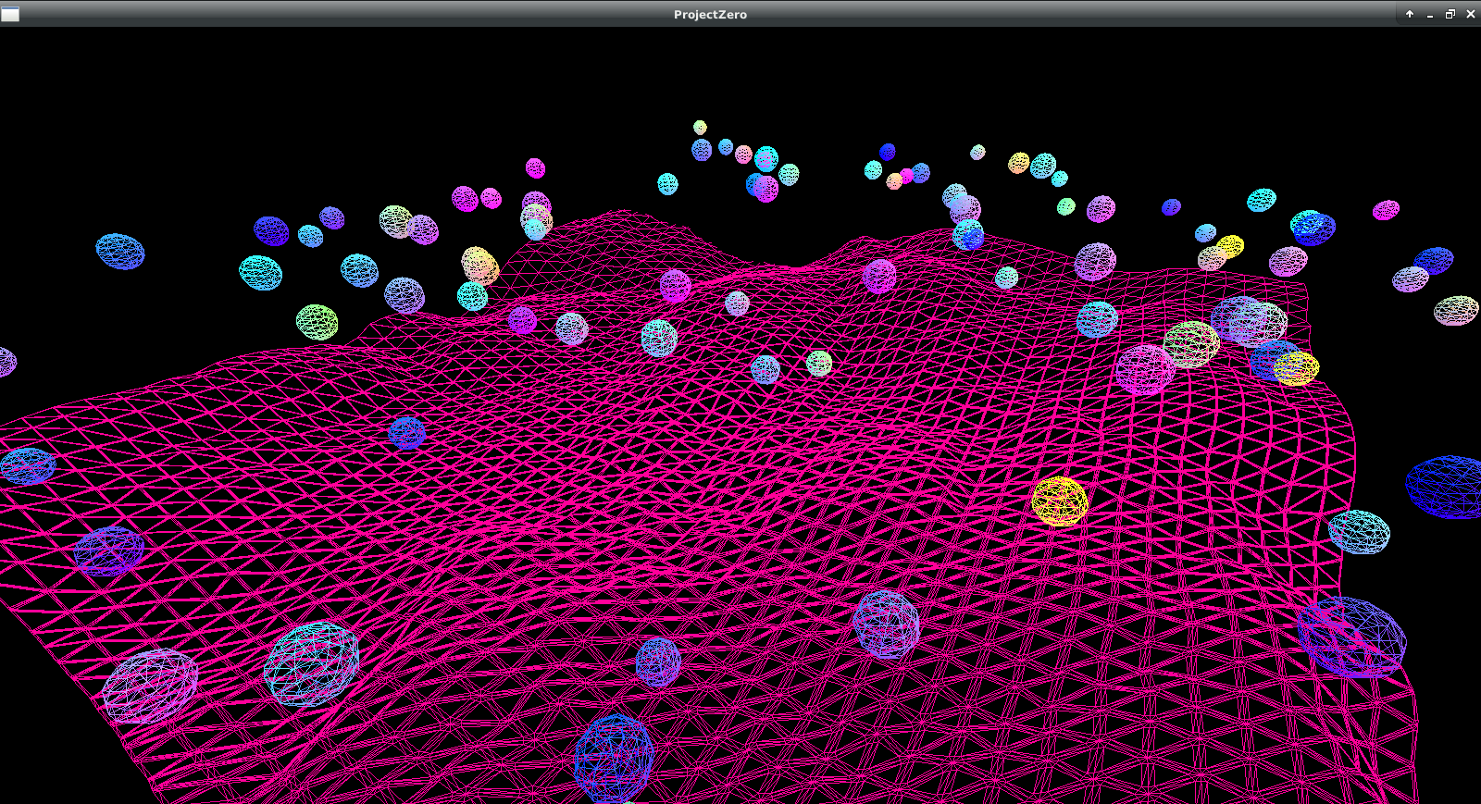
Spheres
Instanced draw
Buffer with info about each sphere
Physics and movement via compute shaders

Slide 4
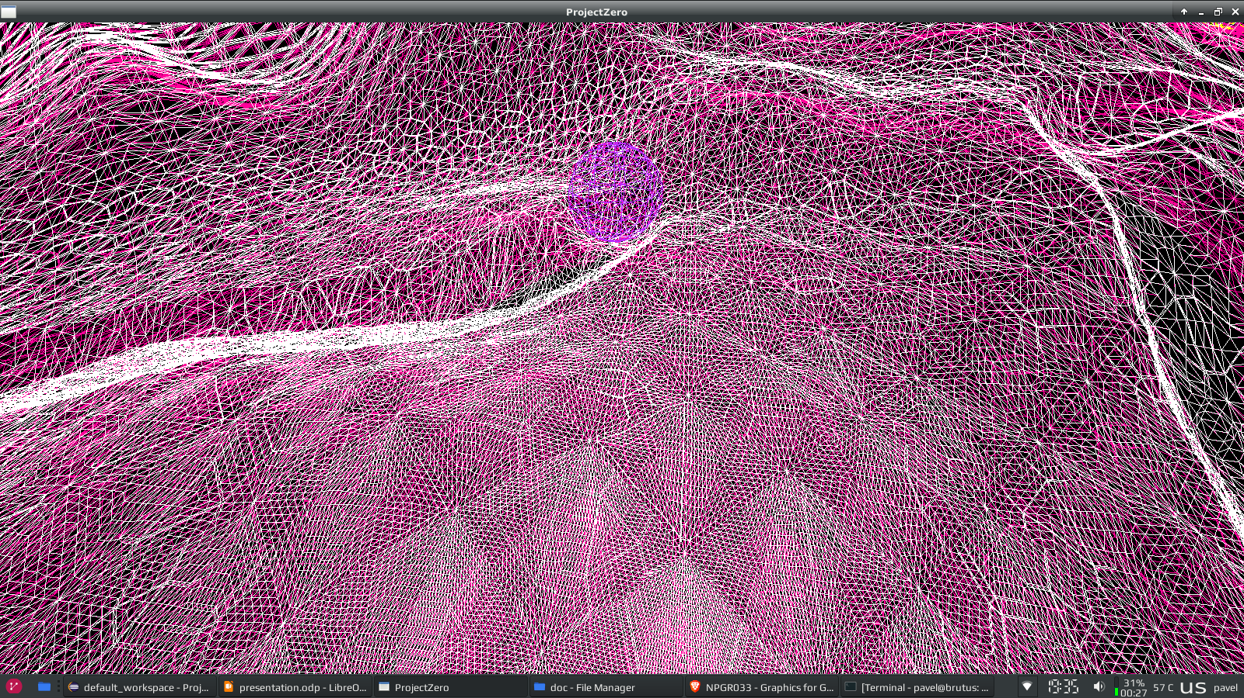
Snow
Reused code from the terrain
Integration with deformation texture

Slide 5
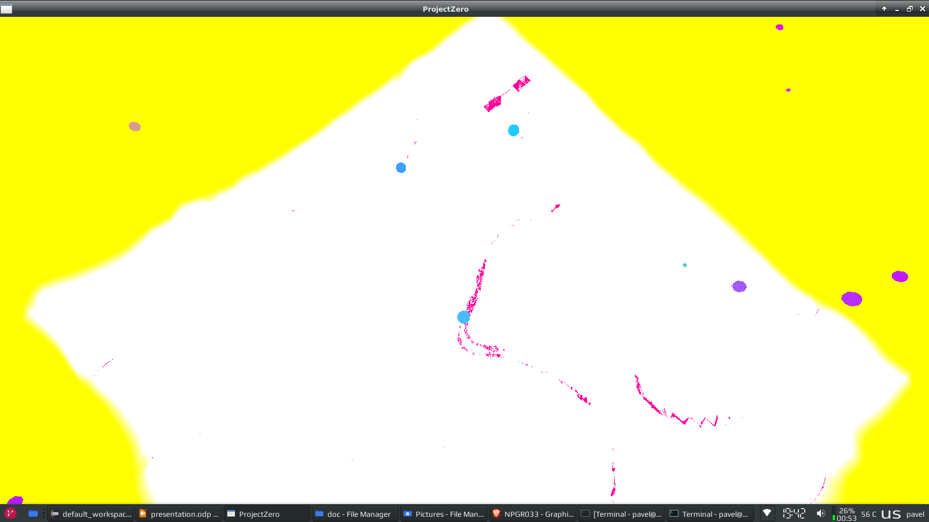
Deformation Texture
Covers square area centered on the camera
Written into by atomic operations in compute shaders
Read from during snow render pass

Slide 6
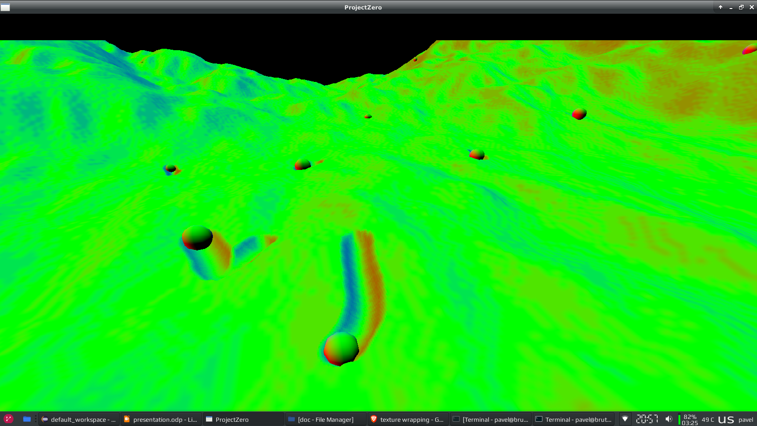
Deffered Pipeline
Position, normal and color is written into texture for each fragment
Possibility of many light sources in the scene

