Slide 1
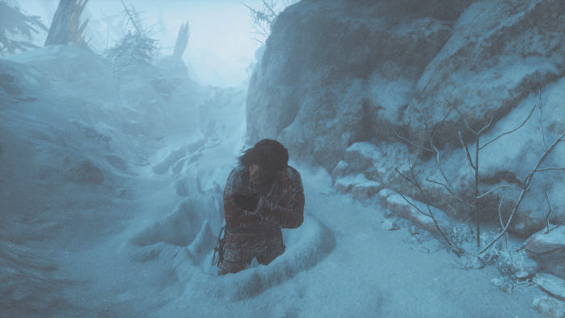
Deferred Snow Deformation in
Rise of the Tomb Raider
Authors of the technique:
Anton Kai Michels and Peter Sikachev

Slide 2
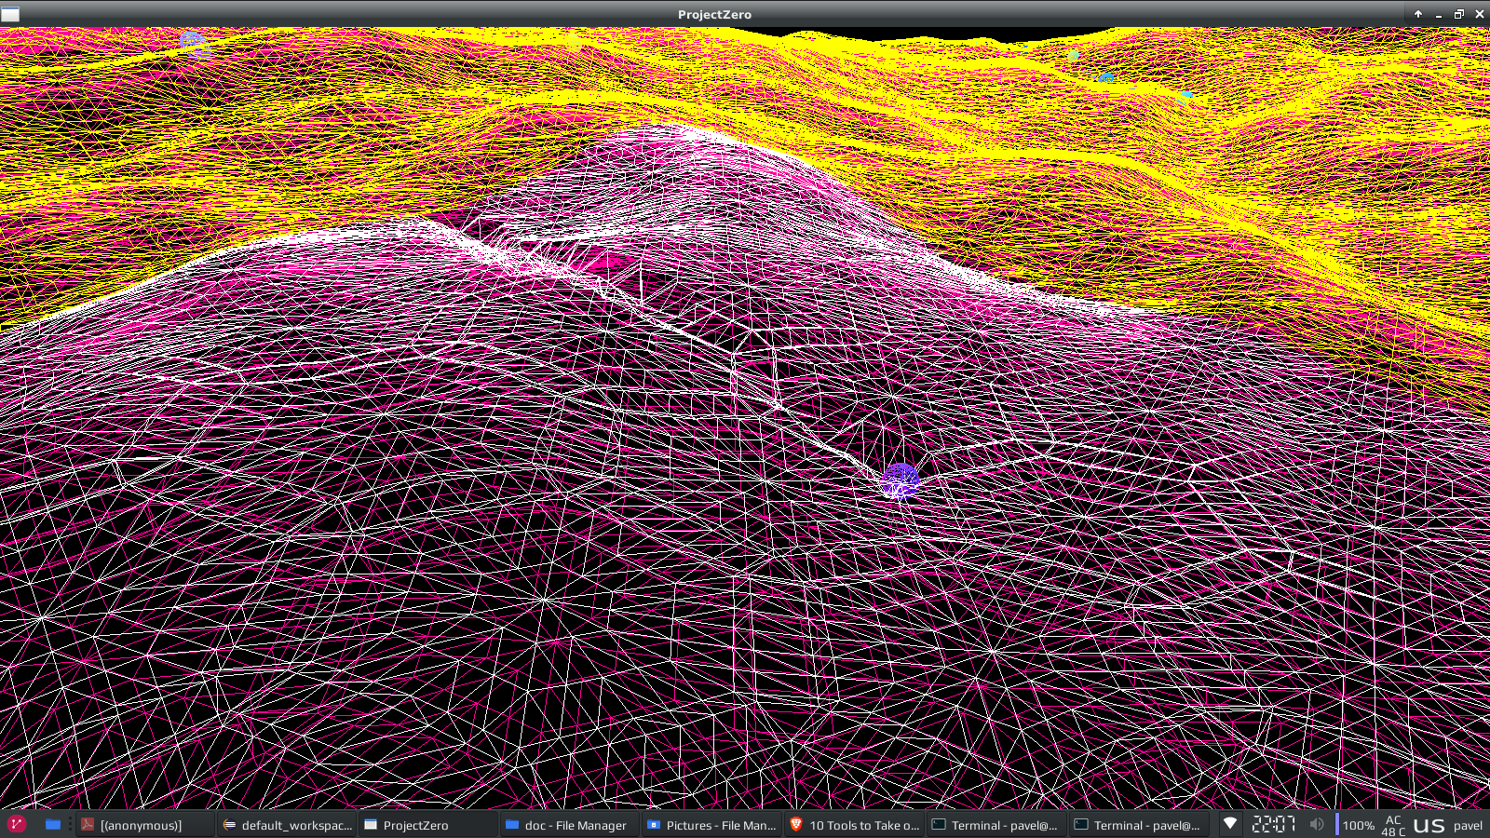
Idea
Decoupling the deformation logic from geometry
Scale well with large amount of objects
Low memory footprint

Slide 3
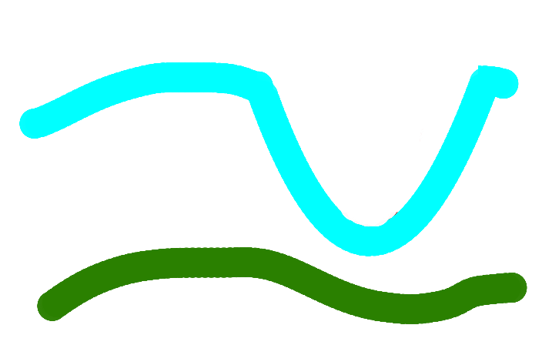

Basic approach
Render terrain and snow into heightmaps
Render dynamic objects into deformation map
During render, clamp the values
Sample the deformation map during snow render

Slide 4


Deferred deformation
Single uint32 texture
Approximate objects by deformation points and quadratic shape
Store deformation point height and deformation height
deformation height = deformation point height + (distance to point)^2 × artist’s scale.

Slide 5
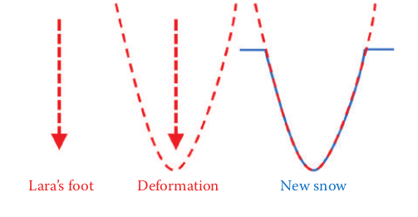
Deferred deformation
Gather all deformation points
Write deformation data around the points into the texture
Compute shader – atomic operations → uint32 texture

Slide 6
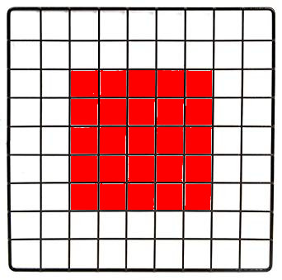
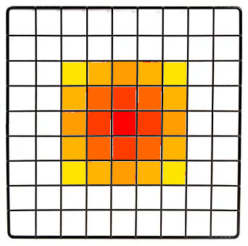

Deferred deformation
Deformation point height
Deformation height
deformation height =deformation point height + (distance to point) 2 × artist’s scale.
Bit allocation in the texture – compatible with atomic minimum

Slide 7
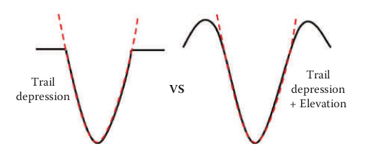
Snow Rendering without elevation
Sample deformation texture during snow render
Snow height = min(deformation height, snow height)
Problems:
Mapping of the texture to the world
Sharp deformation edges on the edge of the texture
No elevation on the edges of the deformation

Slide 8
Elevation
During snow render pass we have three pieces of information:
  snow height, deformation point height and deformation height
  deformation height = deformation point height + (distance to point)^2 × artist’s scale.

Slide 9
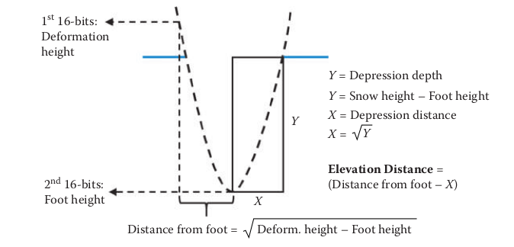
Elevation
deformation height = deformation point height + (distance to point)^2 * artist’s scale
deformation height – deformation point height = (distance to point)^2 * artists scale
distance to point = sqrt(deformation height – deformation point height)/sqrt(artists scale)
snow height – deformation point height = (depression distance)^2 * artists scale
Depression distance = sqrt(snow height – deformation point height)/sqrt(artists scale)

Slide 10
Elevation
We computed: depression distance, depression depth and distance to point
Elevation distance = distance to point – depression distance
Maximum elevation distance = depression depth * artists scale
Max elevation height = maximum elevation distance * artists scale
Ratio = elevation distance / maximum elevation distance
Elevation = ((0.5-2*ratio)^2+1)*height

Slide 11
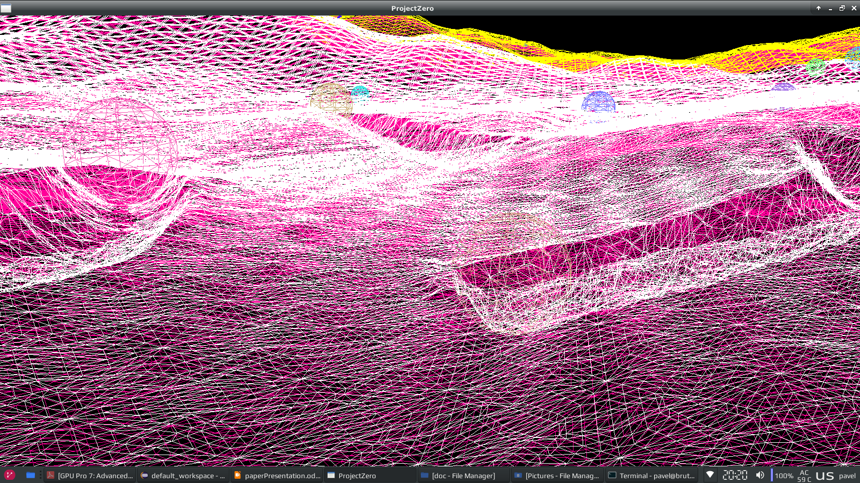
Elevation

Slide 12
Video
https://youtu.be/_35eGiL0TIs?t=18

