Slide 1
PATIENTS SURVIVABILITY PREDICTION AFTER BREAST CANCER SURGERY USING SUPERVISED MACHINE LEARNING TECHNIQUES
By: PATRICK T. TSHIABA Student Number: 1744742
And UZOR G. GOD’SGIFT Student Number: 1654209

Slide 2
Cancer
A cancer is a disease characterized by the presence of
abnormal cells that multiply uncontrollably. The chances
of recovery depend on the type of cancer and its stage of
evolution at the time of treatment.
”Cancer” is a general term referring to several diseases
that share the fact that certain cells of an organism adopt an
abnormal behavior characterized by :
Independence from signals that normally stimulate cell
multiplication;
Insensitivity to anti-proliferative signals and mechanisms;
A proliferative capacity that is no longer limited (growth to infinity);

Slide 3
Cancer 2.
The disappearance of the phenomenon of apoptosis;
An abnormal ability to induce angiogenesis;
And the acquisition of invasiveness and metastasis.
The resulting new so-called ”cancerous” or ”tumor” cells
can form a malignant tumor (a neoplasm) or spread through
the body. Cancer
A cancer is a disease characterized by the presence of
abnormal cells that multiply uncontrollably. The chances
of recovery depend on the type of cancer and its stage of
evolution at the time of treatment.

Slide 4
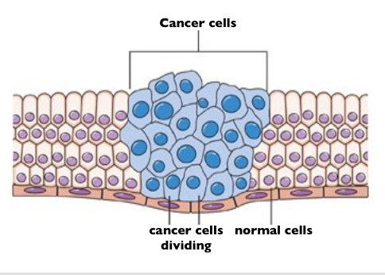
Cancer 3.

Slide 5
Breast Cancer
In the case of breast cancer, cancerous cells can remain in
the breast or spread through the body via the blood or lymphatic
vessels. Most of the time, the progression of breast
cancer takes several months and can even take few years.
Breast cancer is the most diagnosed cancer in women
worldwide, both before and after menopause1. Most often,
breast cancer occurs after 50 years. The 5-year survival rate
after diagnosis ranges from 80% to 90%, depending on age
and type of cancer. One in eight women will develop breast

Slide 6
Breast Cancer 2.
cancer in her lifetime and 1 in 24 women will die from it.
The number of people affected has increased slightly but
steadily over the last 3 decades. On the other hand, the mortality
ate has steadily declined over the same period, thanks
to advances in screening, diagnosis and treatment.
Men also have breasts that are less developed than those
of women. Breast cancer in humans is rare. Less than 1%
of all breast cancers affect men. However, it is important
for men to know that they may be affected by this cancer,
especially in order not to overlook the symptoms.

Slide 7
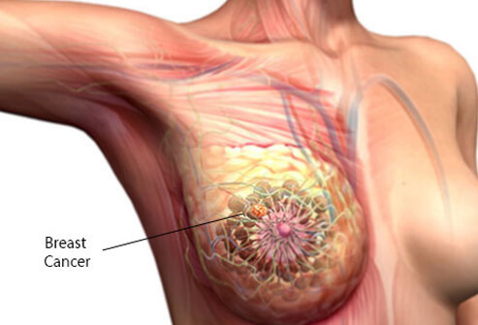
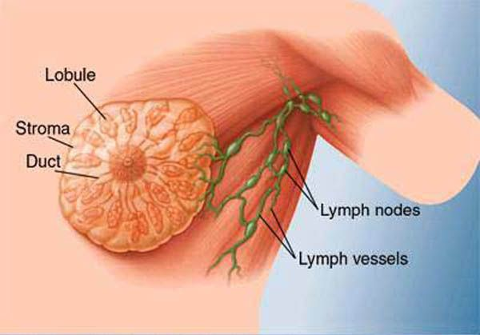
Breast Cancer 3.
Breast cancer

Slide 8
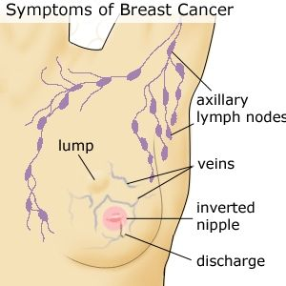
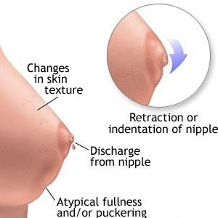
Breast Cancer 4.
Symptoms of breast cancer

Slide 9
Our approach
In this paper we use machine learning techniques over
patients datasets to predict how many of them can survive less or more than 5 years post surgery.
Accurate prediction of breast cancer survivability can scientifically enable healthcare providers to make more informed decisions about a patient’s treatment.

Slide 10
Our aproach 2.
We have used Haberman’s Survival dataset from UCI Machine Learning repository https://archive.ics.uci.edu/ml/datasets/Haberman’s Survival for this paper.

Slide 11
K –NN Algorithm
K-NN uses feature similarity to classify
Using the Eculidean distance to find the K-Neighbor with the lowest error value.
Error = 0.23;
Accuracy = 0.77;

Slide 12
Logistic Regression
The LR is a probabilistic function being developed that can give us a chance for an input to belong to any of the classes we have.
MSE = 0.136;
Accuracy = 0.728;

Slide 13
Random forest
Random forest a network feature similarity builds several decision trees and merges them to get a more accurate and stable prediction.
Error = 0.25;
Accuracy = 0.75;

Slide 14
Conclusion
After we have processed over all the dataset, we come to the conclusion that our classifiers shows us that there are more patients living more than 5 years.
We believe that surgery is a good treatment for breast cancer.

