Slide 1
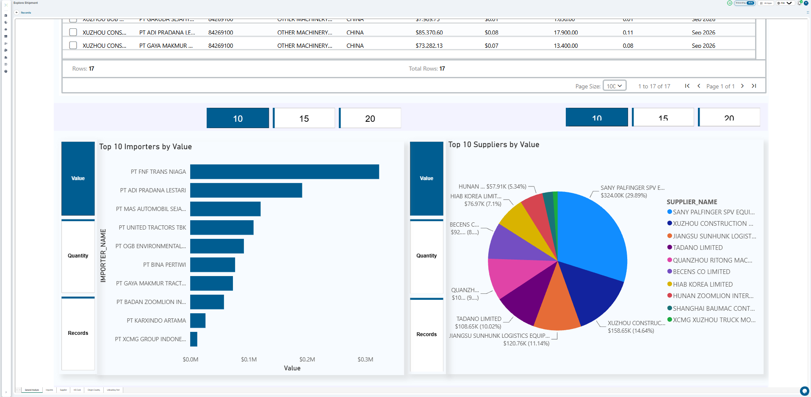
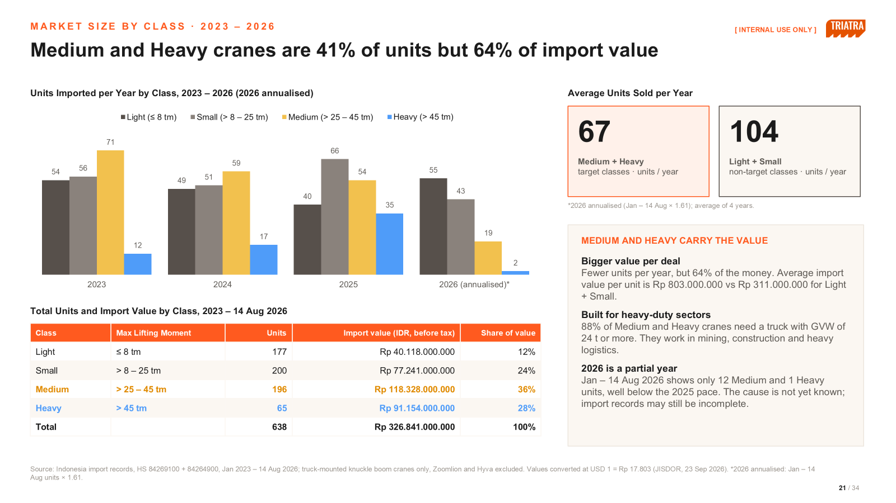
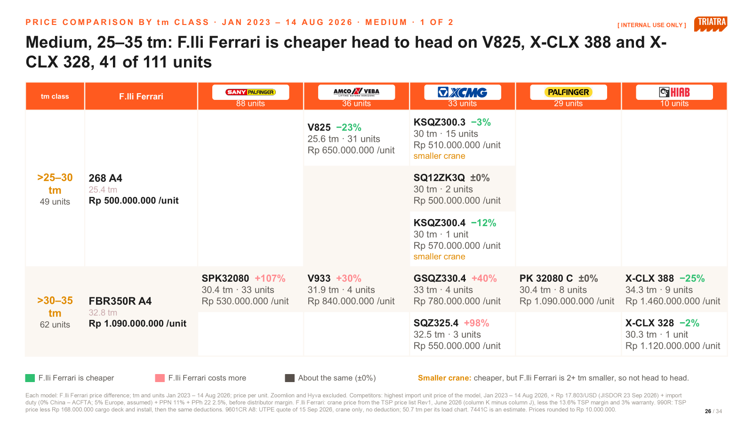
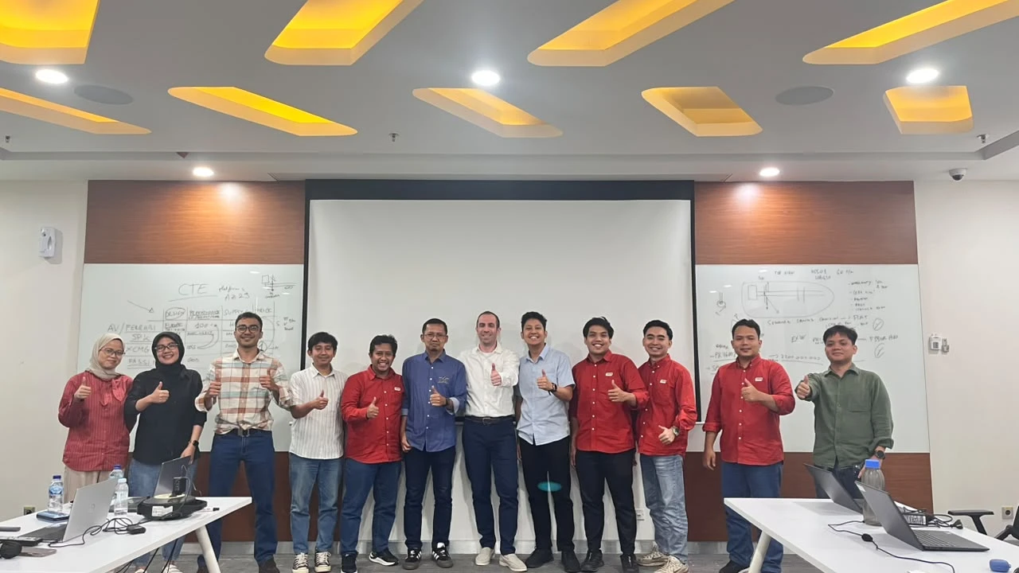
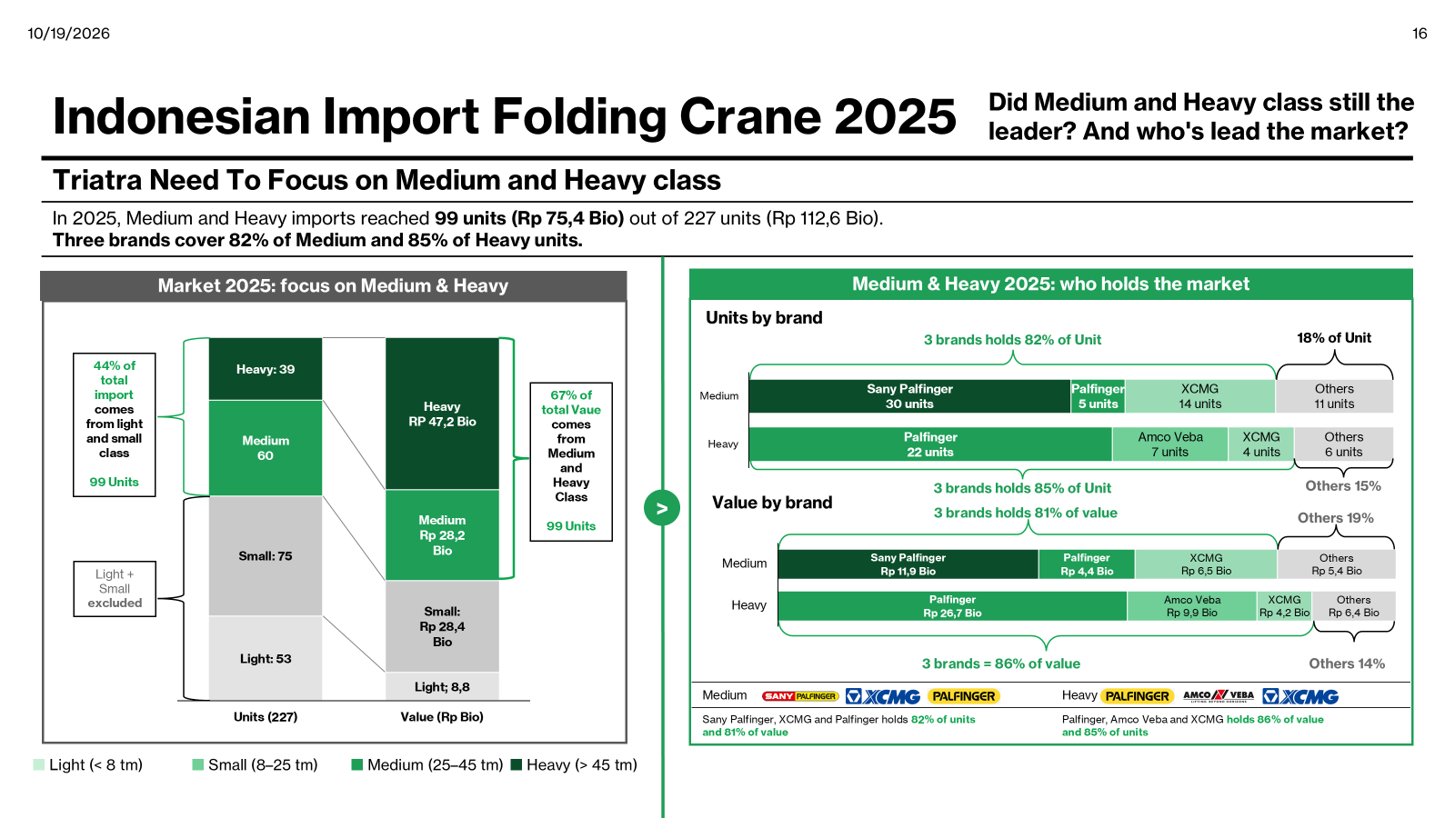
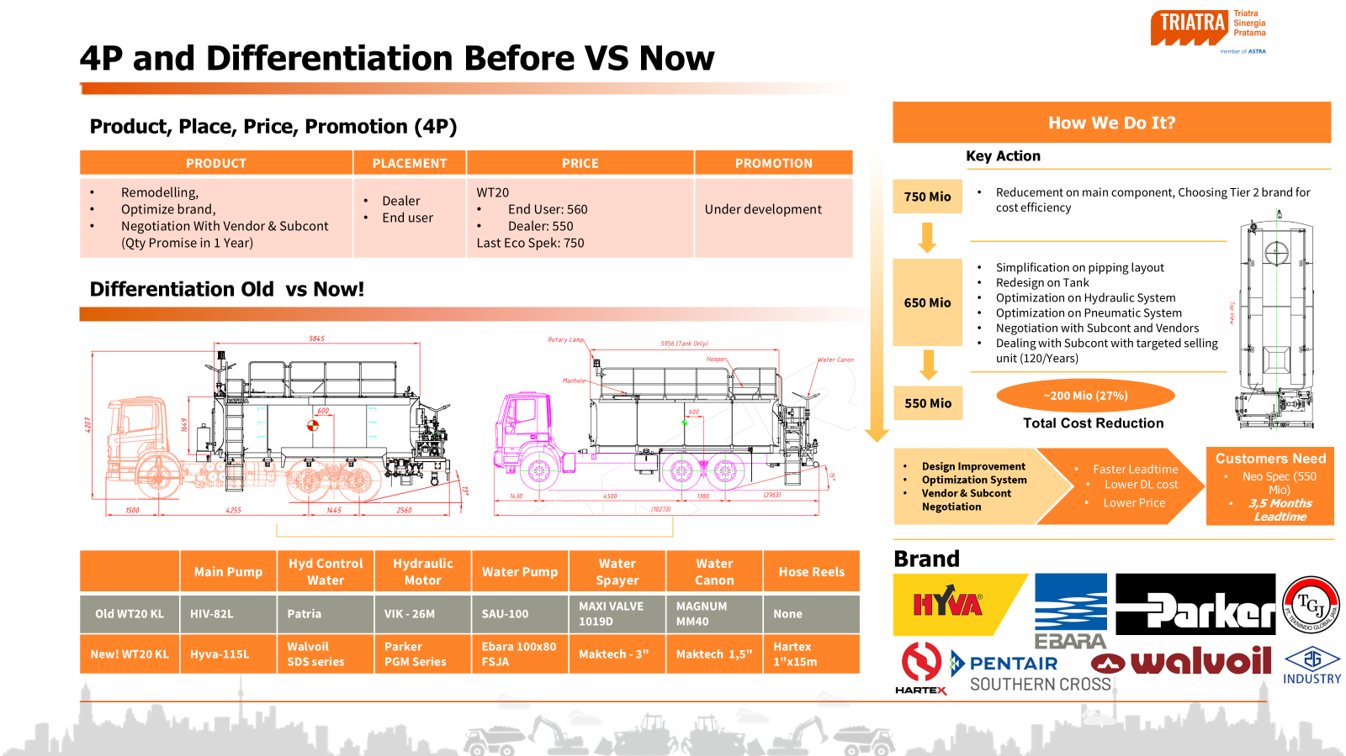
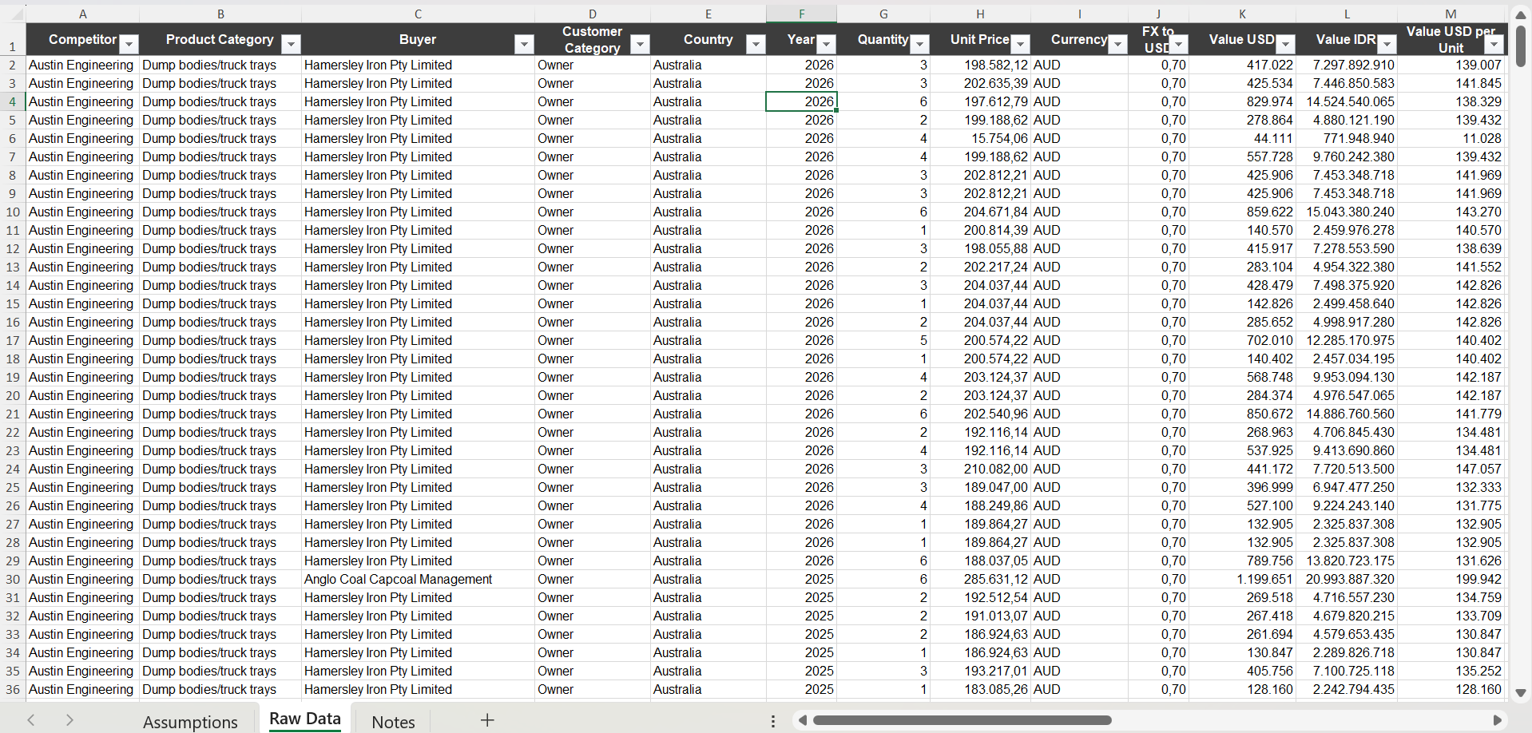
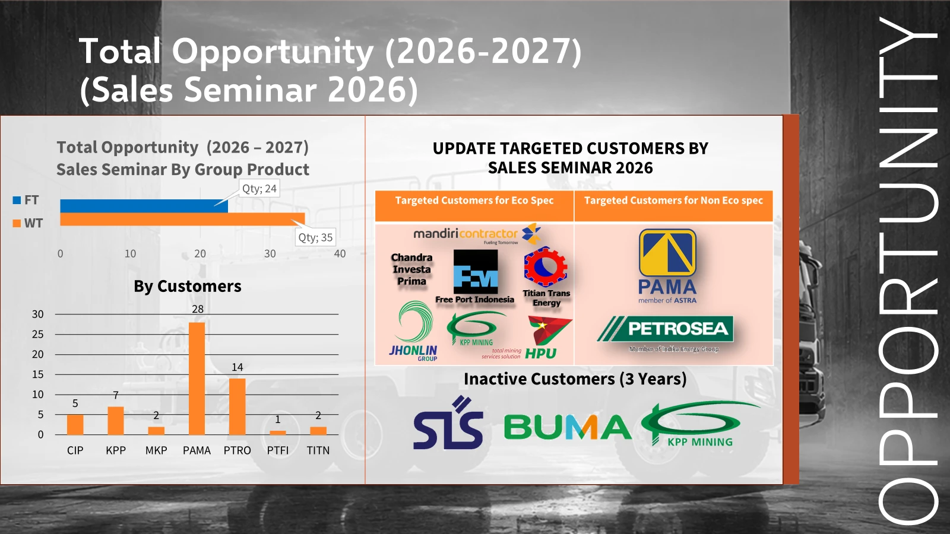
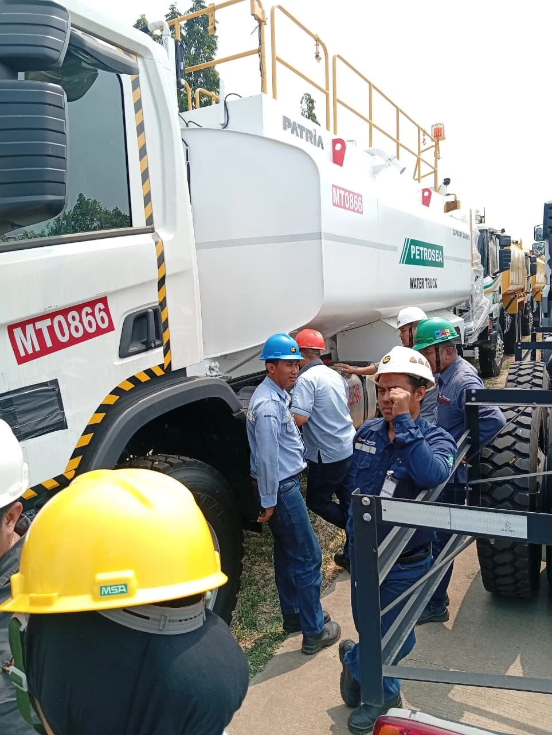
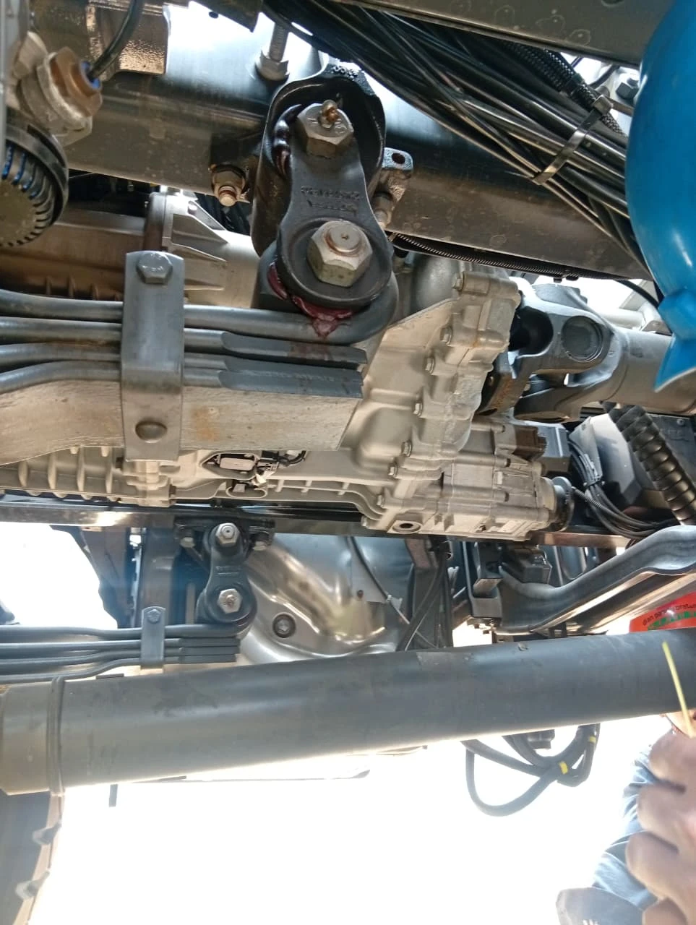

Quote
Where am I involved in strategic marketing?
Strategic Marketing/
I turn market data into strategy, and learn the new products first hand
From data gathering to market analysis, backed by product training.
1. Gathering & Data Processing
2. Market Analysis & Strategy
3. Innovation & Development
• Suppeq unit population at our sites
• Historical sales: suppeq and crane
• GAIKINDO data, 2014–2025
• VOC on Eco Suppeq from the Sales Seminar
• Folding crane imports in Indonesia, 2023–2025
• Market size
• STP and 4P
• Competitor analysis
• Product knowledge training with F.lli Ferrari
• PTO training
Coordination: BC · UTPE · ASC · MSH · CC · AE
Coordination: BC · UTPE · ASC · MSH · CC · AE
Coordination: BC · UTPE · ASC · MSH · CC · AE · PDC
F.lli Ferrari product training
PTO training
Photos: my own work files and training sessions.

