Slide 1
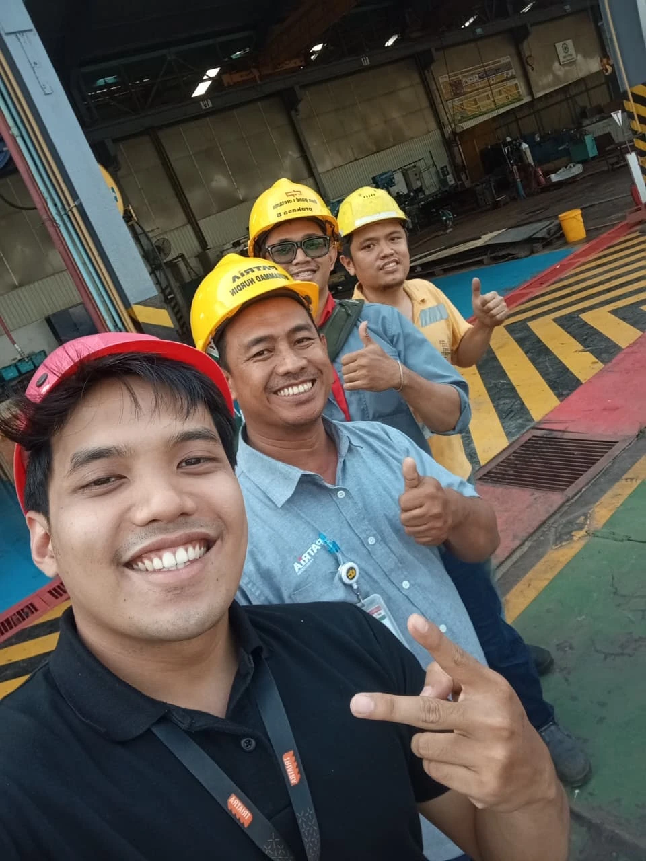
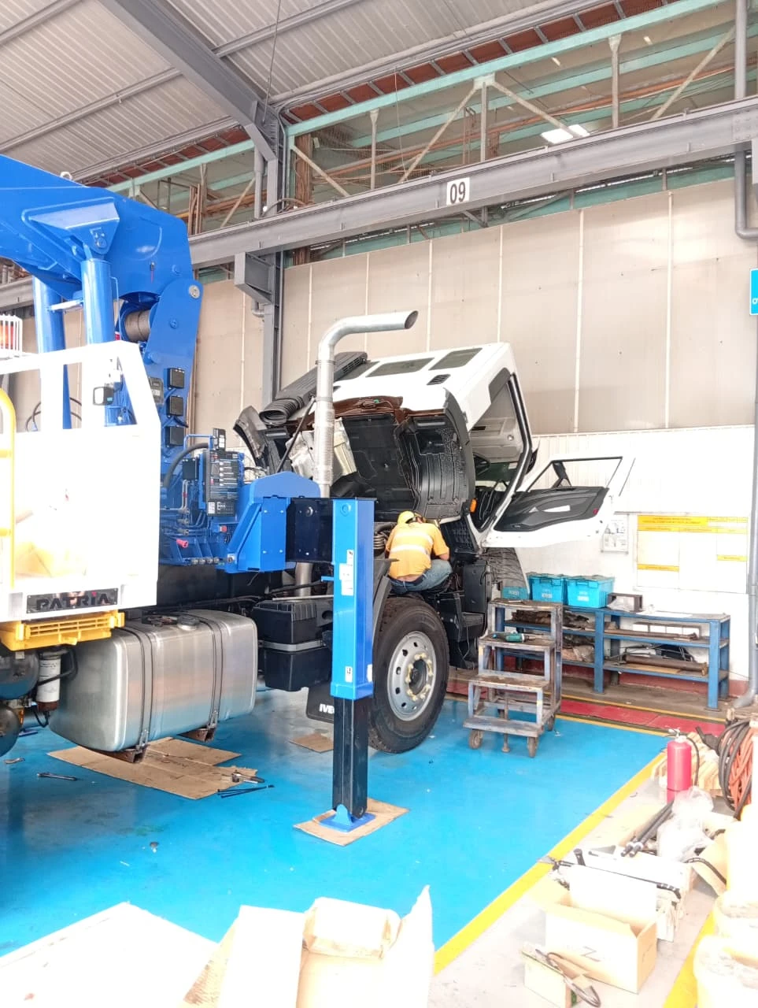
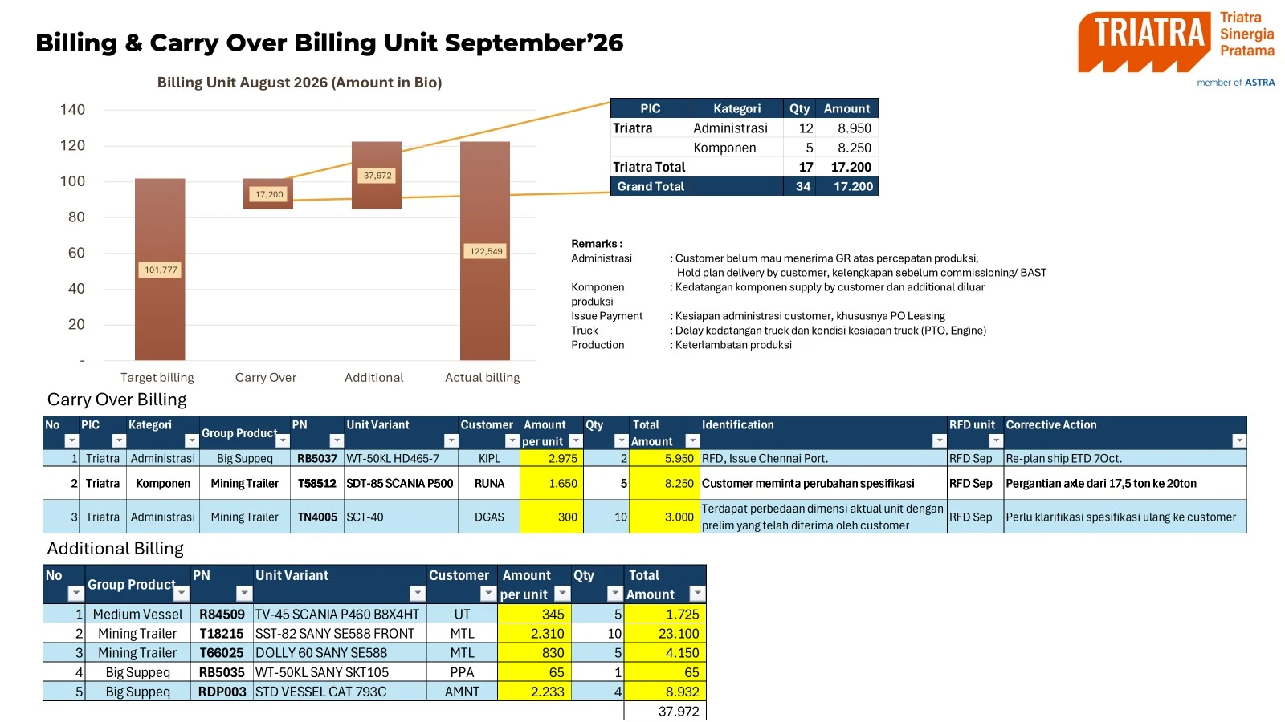
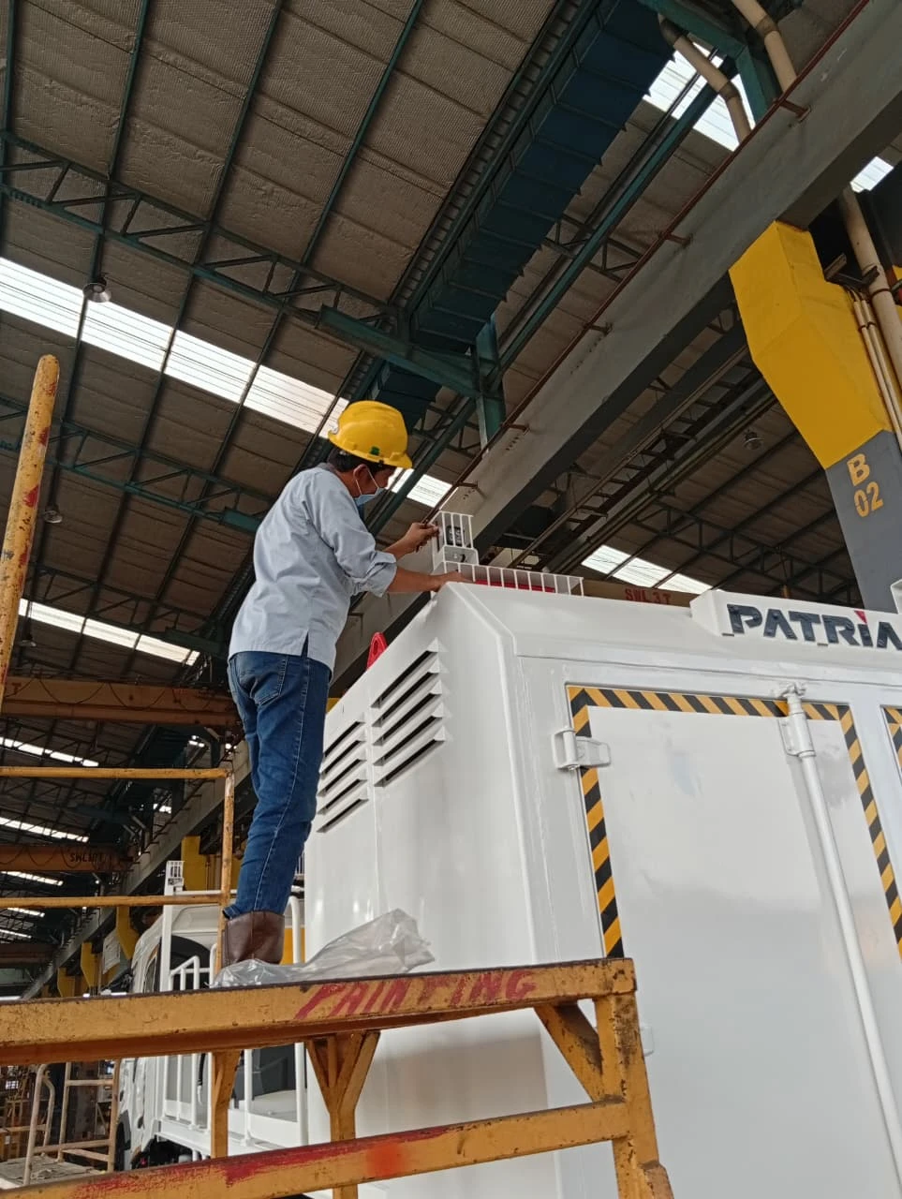
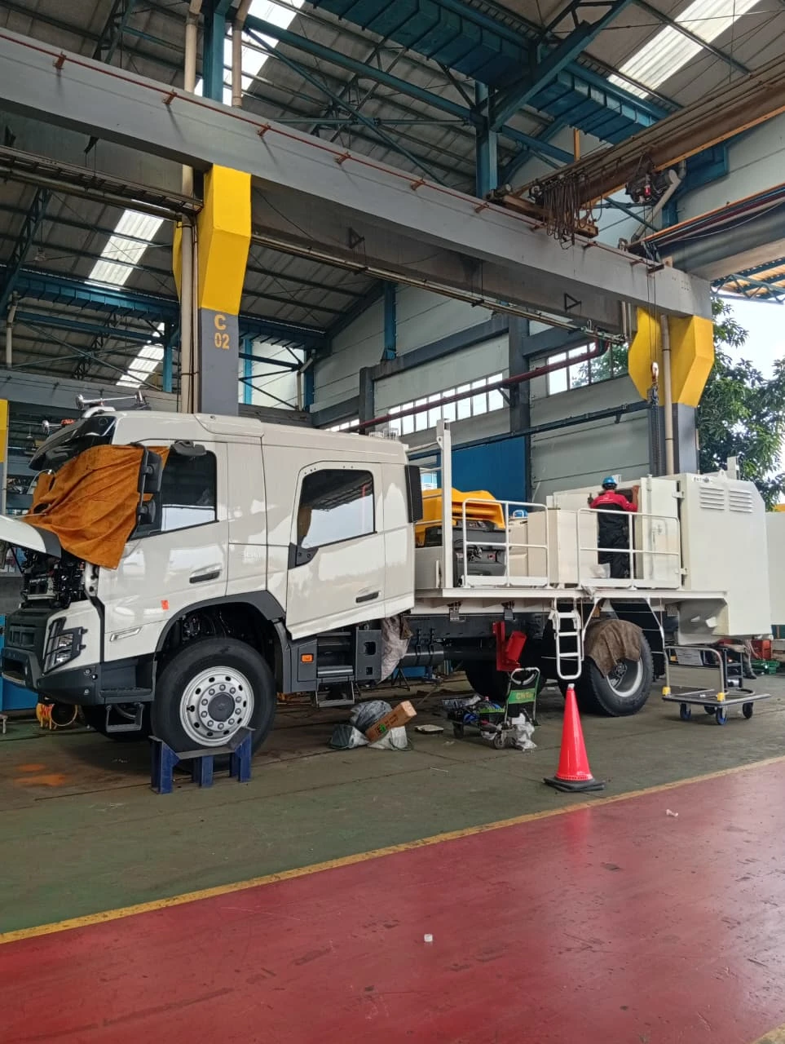
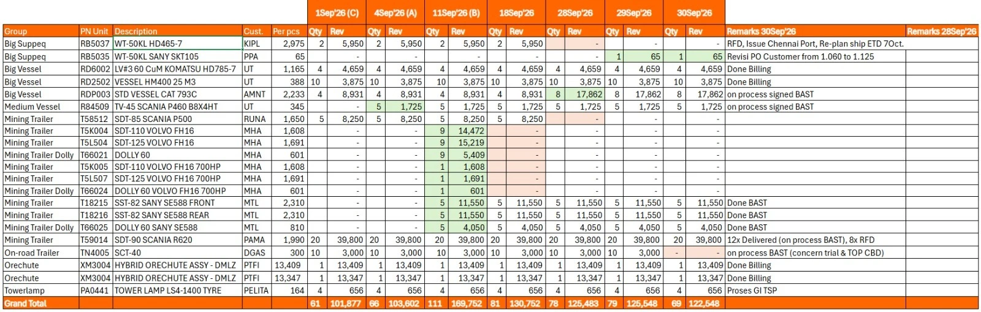
Quote
What happens after the PO comes in?
Sales/
After the PO, I lock the order details, follow production and push billing to invoice
From Close Won to invoice, so the unit reaches the customer on the agreed RFD.
1. Close Won → CPO
2. Production Monitoring
3. Billing
• PO, preliminary drawing and PJB checked in CRM
• QFD requested from UTE; special requests and painting style collected from the Business Consultant
• RFD date in the QFD becomes the due date of the PO Interco
• Production followed regularly: plant visits or photos from Nandu
• QFD plan compared with actual production
• Issues that put the RFD at risk escalated early
• Painting style requested at least one month before RFD
• Customer FAT joined with the Business Consultant
• Weekly billing tracker per unit, up to BAST and invoice
• Monthly report: target, carry over, additional, actual
• PICA on carry-over units: cause and corrective action
• Blockages escalated until the invoice goes out
FYI
CLOSE WON APPROVAL
Sales Manager
→ Marketing Associate
→ Marketing Manager
→ GM Marketing
PO INTERCO APPROVAL
Marketing Manager
→ GM Marketing
→ Marketing Director
Photos: unit production at the UTE plant; billing report with PICA, and weekly billing tracker.

