Slide 1


PART 01 · PERSONAL
Who I am and what I bring to Triatra.
About me · Onboarding journey
NEDP MID YEAR REVIEW 2026
01 / 15

Slide 2
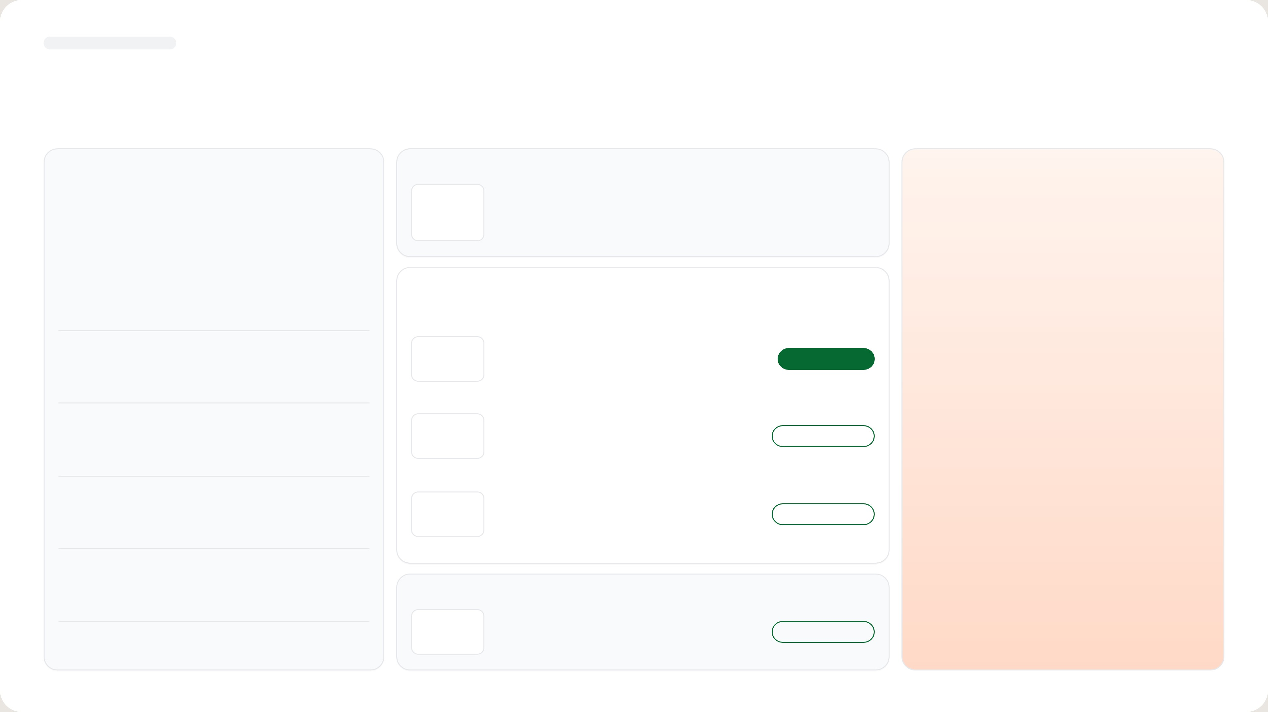

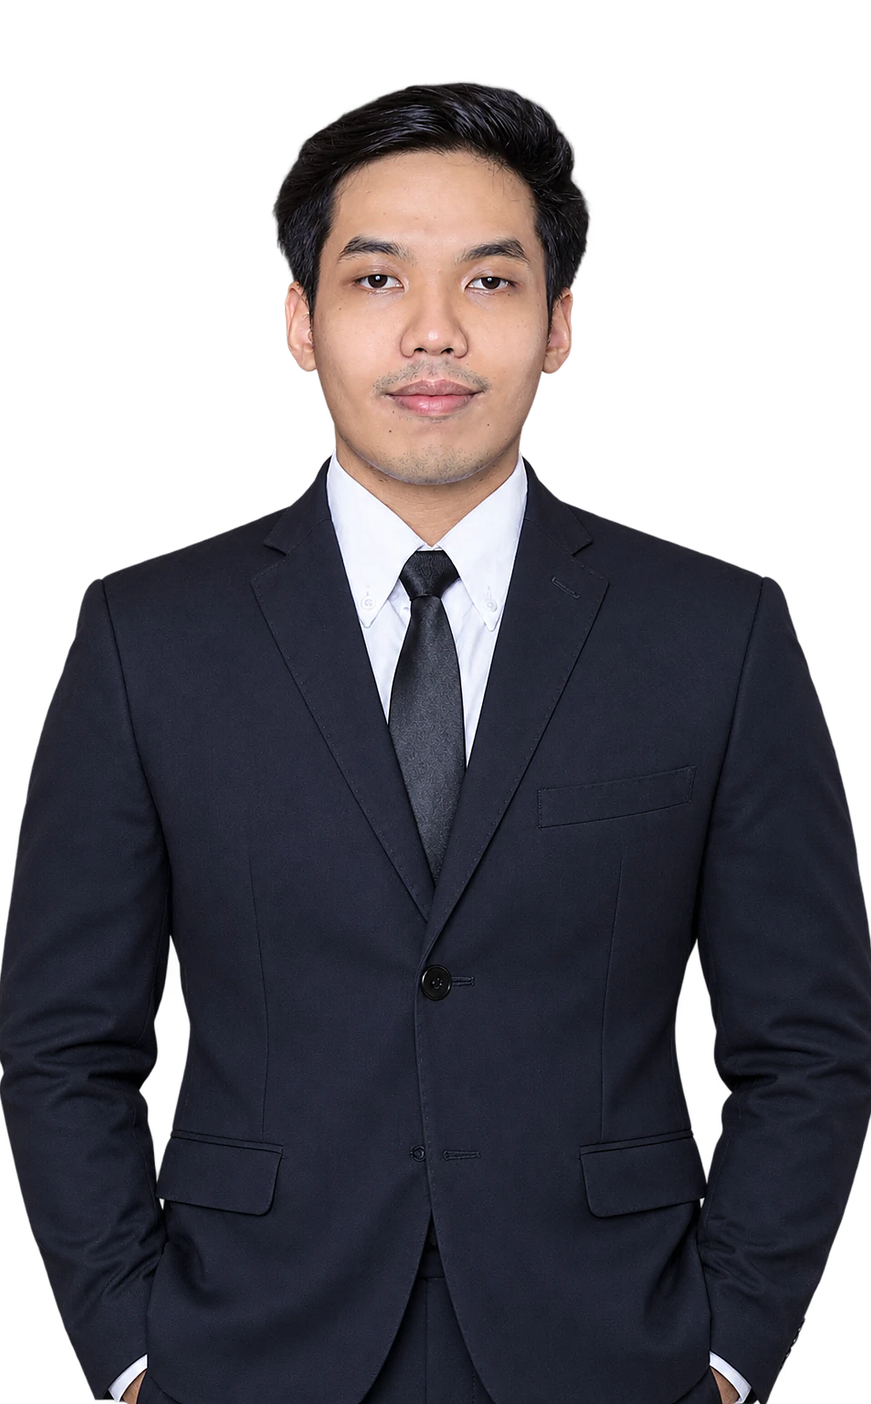





[ INTERNAL USE ONLY ]
PERSONAL INFORMATION
A management graduate now running Small Suppeq and Truck Others
PROFILE
Education
Tiberias Krisgaharu Simu
Universitas Sanata Dharma, Yogyakarta
Bachelor (S1) · Management · Faculty of Economics
PT Triatra Sinergia Pratama
Work Experience
POSITION
PT Triatra Sinergia Pratama
Marketing Strategic 2 Associate
Marketing Strategic 2 Associate
2026 – now
DIVISION
Marketing Unit & Strategic
Outlier
2023 – 2025
Team Lead Data Annotator
PRODUCTS
Small Suppeq · Truck Others
Krishma International
2021 – 2023
Marketing Coordinator
PLACE, DATE OF BIRTH
Kupang, 22 April 2001
Organization
PHONE
HMJM Universitas Sanata Dharma
2021 – 2022
0822 7222 2463
President
NEDP MID YEAR REVIEW 2026
02 / 15

Slide 3
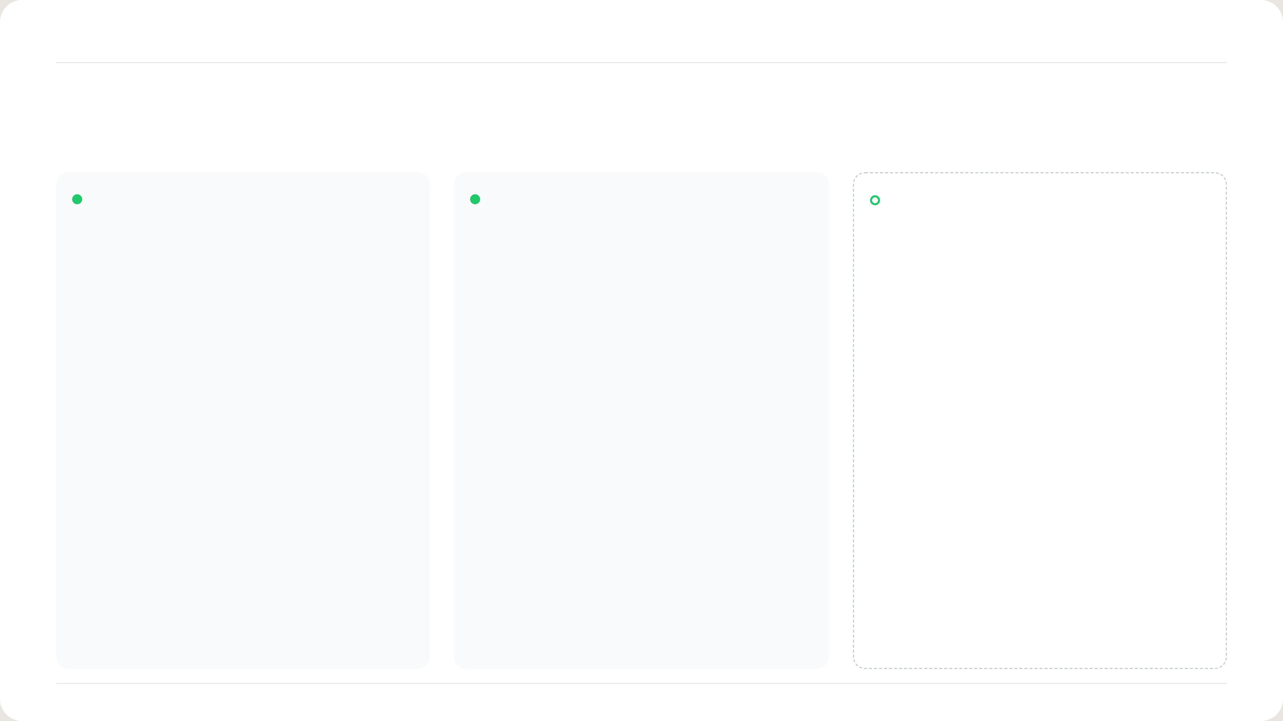
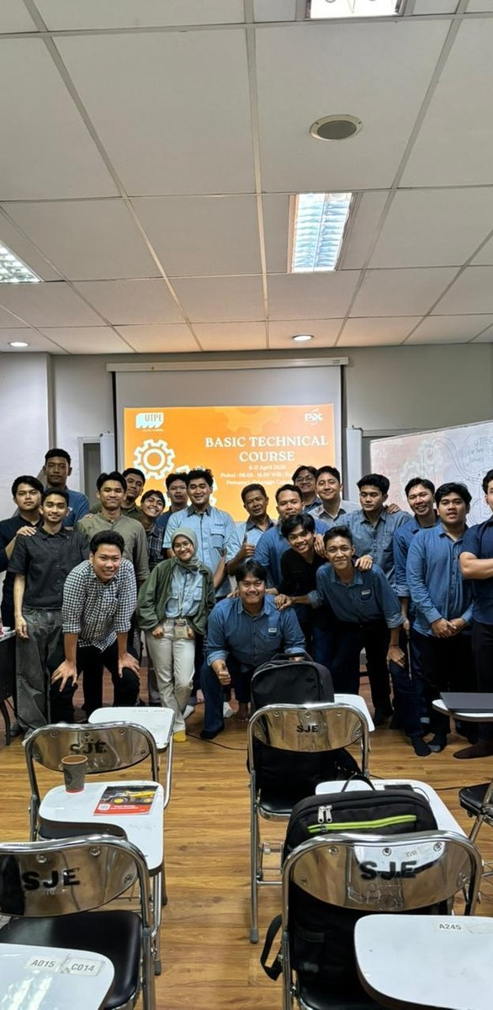
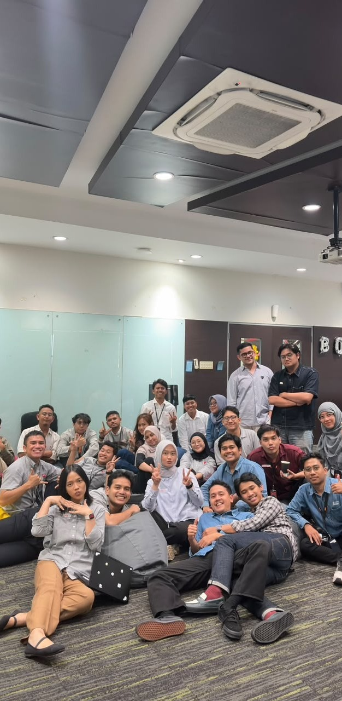
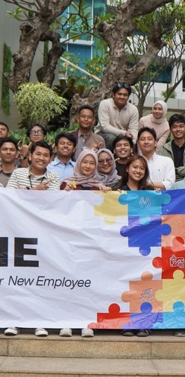
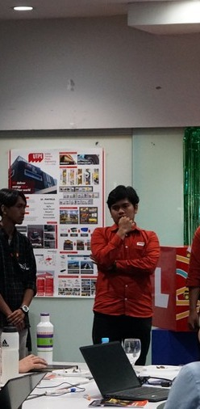
NEDP 6-MONTH REVIEW · ONBOARDING JOURNEY
ONBOARDING JOURNEY
Two programs built my base; AHEMCE comes next
Basic Technical Course
DONE
B-One · Orientation
DONE
AHEMCE
NEXT
Astra Heavy Equipment, Mining,
Construction and Energy
Engine basics
8 Astra competencies
Heavy equipment
Electrical system
AI at work
Mining
Axle, wheel and suspension
Teamwork
Contracting
Final drive and undercarriage
Corporate bootcamp
Energy
NEDP MID YEAR REVIEW 2026 · TIBERIAS K. SIMU
03 / 15

Slide 4
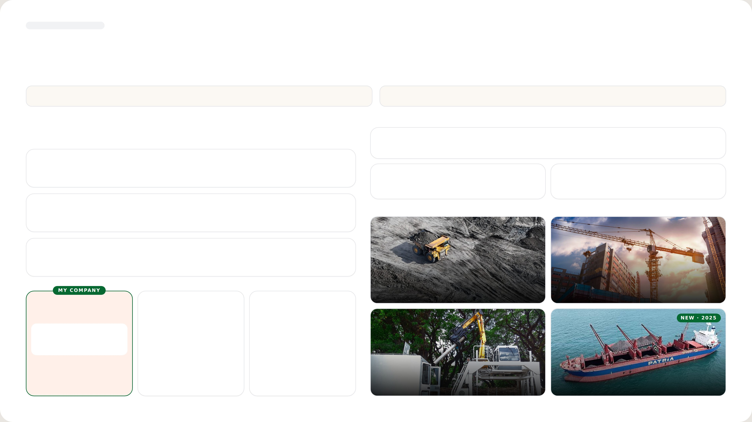








[ INTERNAL USE ONLY ]
COMPANY PROFILE
Triatra sells PATRIA and ULTRA to four industries for the UTPE group
01 Triatra is part of the UTPE Group and AHEMCE, focusing on Distributorship and Trading.
02 Starting in 2025, Triatra develops a new business line in Marine.
CORPORATE ENTITY STRUCTURE
PT TRIATRA SINERGIA PRATAMA
PT Triatra Sinergia Pratama is one of the entities within the UTPE Group, part of the UT Group and the AHEMCE
Distributor of PATRIA and ULTRA products for mining, construction, agriculture, forestry and maritime. Triatra offers
business line of PT Astra International Tbk.
both equipment units and full after-sales support, from spare parts and remanufacturing to maintenance services.
Astra International
Astra Heavy Equipment, Mining, Construction, and Energy
Unit
Part, Component & Services
International & domestic trader of
After-sales maintenance &
UTPE units
remanufacturing
United Tractors
INDUSTRY COVERAGE
Construction Machinery
UTPE
Engineering Solution & Marine
01
Coal & Mineral Mining
02
Construction
Distributorship and Trading
Ship Owner & Operator
Ship Building and Repair
03
Forestry & Agroindustry
04
Maritime
NEDP MID YEAR REVIEW 2026
04 / 15

Slide 5
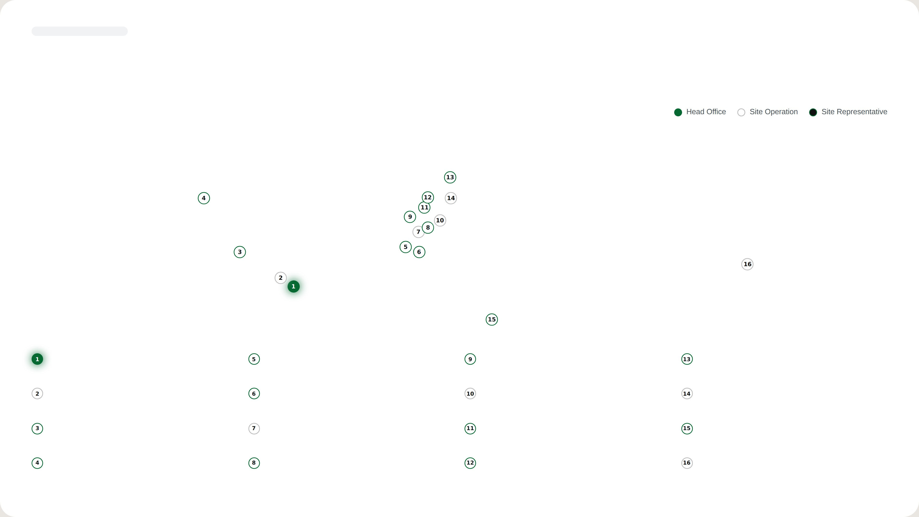

[ INTERNAL USE ONLY ]
SITE OPERATION
Triatra serves customers from 16 points across Indonesia
Triatra covers many areas in Indonesia, with the Head Office in Jakarta, 5 Site Operations and Site Representatives.
Head Office
Banjarmasin
Muara Teweh
Tanjung Redeb
Jl. Raya Bekasi KM 22, Cakung, Jakarta Timur, 13910
Jl. Ahmad Yani KM 13,5 Gambut, Banjarmasin, Kalimantan Selatan,
Jl. Ahmad Yani No. 85, Kel. Melayu, Kab. Barito Utara, Kalimantan
Jl. Gunung Panjang RT.04 No. 101B, Kab. Berau, 77311
70652
Tengah
Jakarta
Sungai Danau
Balikpapan
Sangatta
Jl. Raya Bekasi KM 22, Cakung, Jakarta Timur, 13910
Ds. Karang Indah RT 12/RW 03, Kec. Angsana, Tanah Bambu,
Jl. Jenderal Sudirman No. 844, Balikpapan, Kalimantan Timur, 76114
Jl. HDRS Tango Delta KPC, Mine Site Sangatta, Kutai Timur, 75683
Kalimantan Selatan
Tanjung Enim
Tanjung Tabalong
Melak
Sumbawa
Jl. Lingga Raya 10, Kel. Muara Enim, Sumatera Selatan, 31711
Jl. A. Yani KM 7,5 Maburai, Kec. Murung Pudak, Kab. Tabalong,
D/A PT Tambang Raya Usaha Tama, Hauling Road Trubaindo, Muara
Memco Area Tongo, Sekongkang, West Sumbawa, Nusa Tenggara
Kalimantan Selatan
Lawa, Kutai Barat, Kalimantan Timur
Barat, 84457
Pekanbaru
Batu Kajang
Tabang
Timika
Jl. Soekarno Hatta KM 3,5 No. 151, Pekanbaru, Riau, 28291
Jl. Negara KM 140 Batukajang, Kec. Batu Sopang, Kab. Paser,
Site Indonesia Pratama, Workshop Buma Km 6, Hauling Road
Jl. Kuala Tembaga E-4 LIP Kuala Kencana, Timika, 99920
Kalimantan Timur
Baratabang, Kec. Muara
NEDP MID YEAR REVIEW 2026
05 / 15

Slide 6
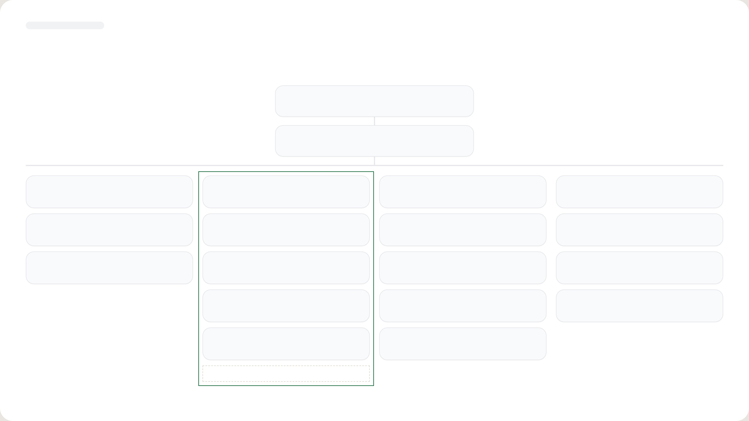
[ INTERNAL USE ONLY ]
ORGANIZATION
I work in Marketing Strategic 2, under Ignatius Indrawan S.
Ceisar Centiaga
DIRECTOR IN CHARGE
Ricardo Tanada
MKT UNIT & STRATEGIC DIV HEAD
Kresnanto A.W.
Ricardo Tanada (c)
Ugik Praseno
Marketing Communication
MKT STRATEGIC 1 HEAD
MKT STRATEGIC 2 HEAD
MKT STRATEGIC 3 HEAD
MARCOMM
Satrio F.R.
Ignatius Indrawan S.
Baihaqi
Karina Audina E.
Big Suppeq, Big Vessel, Bucket
DEPUTY HEAD
Mineral Processing, EPC
M. Fawwaz J.
Ervin Bahar P.
Yuda Prana
Adinda Siti K.
Cabin, Forestry, Agro, Forklift, Towerlamp, Pump
Medium Vessel, Man Hauler, Bus Scania
Maritime, Renewable Energy
Tiberias K.S.
◄ ME
Celine
Rahma
Small Suppeq, Truck Others
Ultra Product Support
Graphic Designer
Eurico
Hanifa
Mining / Non-mining Trailer, Overseas Zone
Automation, EV
Nandu Narpati — Admin
NEDP MID YEAR REVIEW 2026
06 / 15

Slide 7

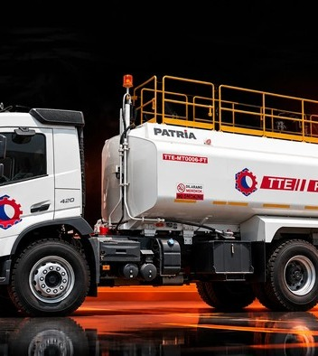
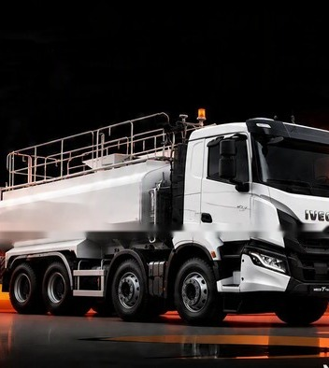
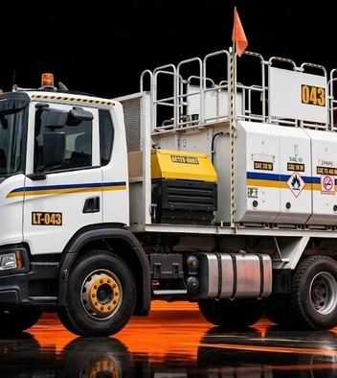
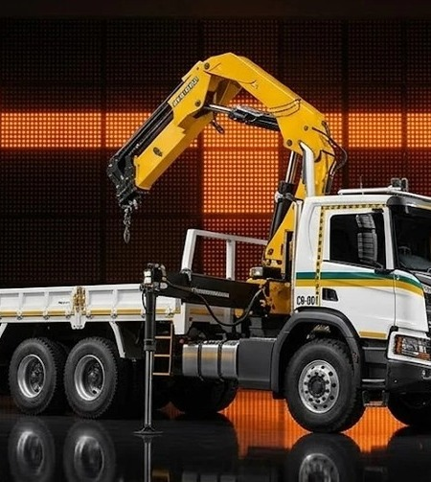
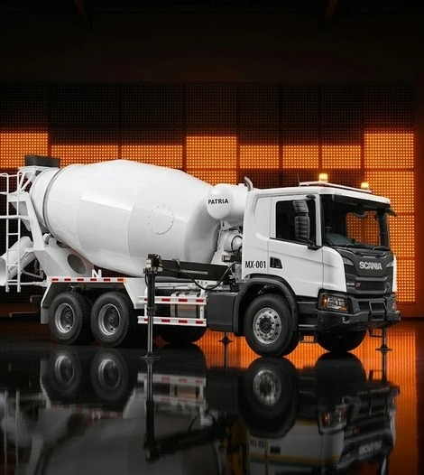
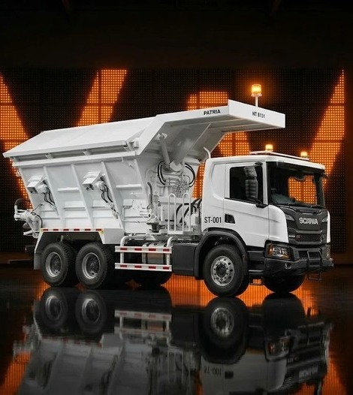
NEDP 6-MONTH REVIEW · ROLES & RESPONSIBILITY · SUPPLY CHAIN
ROLES & RESPONSIBILITY · SUPPLY CHAIN
I take every order from inquiry to delivery for two product lines
BC = Business Consultant · AE = Application Engineering · MKT = Marketing Unit
01
02
03
04
05
Inquiry
Preliminary
Quotation
Negotiation & CPO
Production
BC · AE · MKT
BC · AE · MKT
MKT Triatra · MKT UTPE
BC · MKT Triatra · MKT UTPE
BC · MKT Triatra · MKT UTPE
Spec, buying reason, site
Repeat or new drawing
Quote request to UTE
PO / PJB vs drawing
Build vs QFD
Target price and lead time
→
Unit function
→
Check standard GP
→
PN, QFD, painting style
→
Weekly update to BC
Expected PO date
Critical parts: price, lead time
Track SLA; log PCR in CRM
CPO and PO Interco approval
Escalate issues; run FAT
SMALL SUPPEQ
TRUCK OTHERS
Fuel truck
Water truck
Lube truck
Crane truck
Mixer truck
Stemming truck
NEDP MID YEAR REVIEW 2026 · TIBERIAS K. SIMU
07 / 15

Slide 8
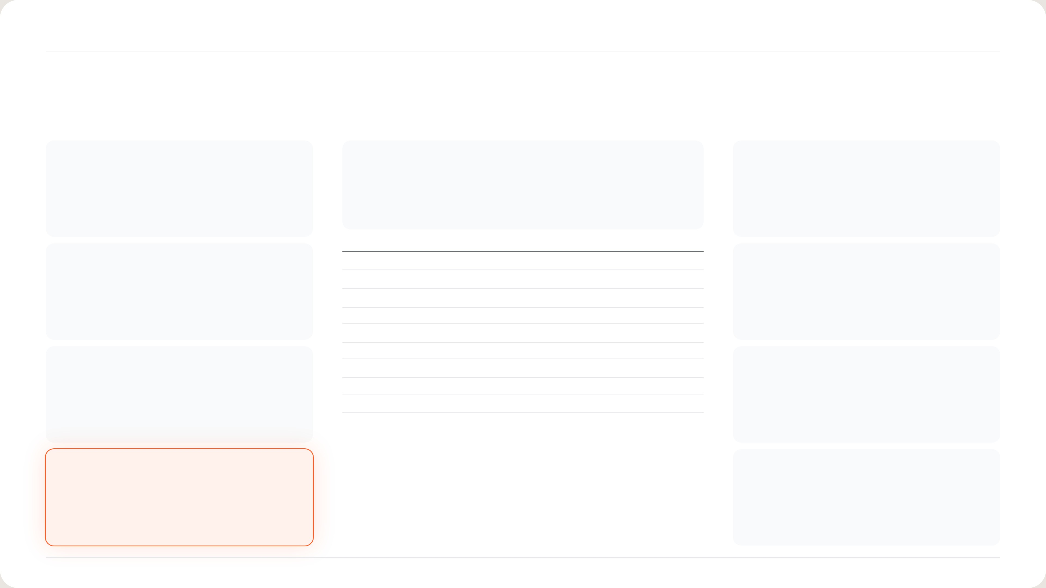
NEDP 6-MONTH REVIEW · STRATEGIC · 4C → STP → 4P
STRATEGIC · 4C → STP → 4P
Sell two challenger brands to take share from Sany Palfinger and Palfinger
CHANGE
STP
PRODUCT
HYVA stopped making cranes. Medium & Heavy hold
S 2 classes, 10 tm tiers
One challenger model per tier; show features the leader
64% of value on 41% of units.
T Top 1 of each tier
lacks.
P XCMG: same capacity, lower price · Ferrari: European features, faster
delivery
tm
Top 1
Challenger
vs Top 1
COMPETITOR
25 – 30
Amco Veba V825
Ferrari 268 A4
−23%
PRICE
2025 leaders: Sany Palfinger 47% of Medium,
30 – 35
Sany Palfinger SPK32080
XCMG SQZ325.4
+4%
XCMG: get a special price. Ferrari: cut price where gap >
Palfinger 62% of Heavy.
35 – 40
Sany Palfinger SPK36080
XCMG SQZ365.4
−9%
30%.
40 – 45
Sany Palfinger SPK42502
Ferrari 746 A4
+48%
→
45 – 50
Amco Veba V950
Ferrari FBR450R A4
−32%
→
50 – 55
Palfinger PK 53002
Ferrari 9601CR A8
+85%
CUSTOMER
60 – 65
Sany Palfinger SPK61502
Ferrari 9661C
TBC
PLACE
Medium buyers pick on price (China 73%). Heavy buyers
70 – 75
Palfinger PK 76002 EH D
Ferrari 990R
+79%
Ferrari stocks units in China (~14 weeks) and parts in
pick on quality (Europe 85%).
80 – 85
Palfinger PK 88002 EH C
Ferrari TBC (price list)
TBC
Malaysia.
COMPANY
PROMOTION
Partner F.lli Ferrari and XCMG to serve both buyer
Crane + flatdeck + install bundle (+2-yr warranty on
types.
Ferrari). Exhibitions with Marcom sales kit.
NEDP MID YEAR REVIEW 2026 · TIBERIAS K. SIMU
08 / 15

Slide 9
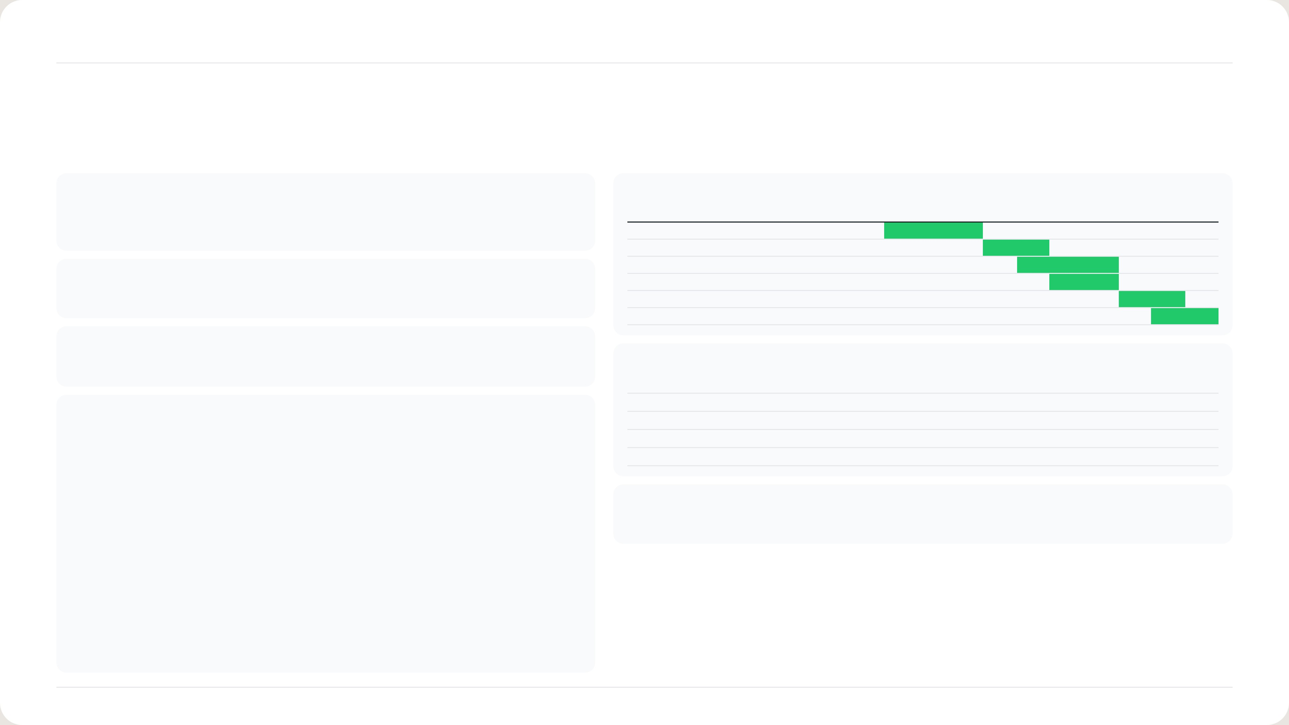
NEDP 6-MONTH REVIEW · PROJECT CHARTER
PROJECT CHARTER
Sell the first Ferrari and XCMG challenger cranes by March 2027
BACKGROUND
TIMELINE · 2026 – 2027
HYVA no longer makes cranes, so Triatra has no crane brand. Medium and Heavy cranes are
Activity
Jun
Jul
Aug
Sep
Oct
Nov
Dec
Jan
Feb
Mar
64% of import value, led by Sany Palfinger and Palfinger.
Market study (4C)
STP and challenger choice
Negotiate with Ferrari and XCMG
GOAL
Sales kit with Marcom
Put a cheaper or faster challenger against the Top 1 in each tm tier, and close the first sale.
Exhibition and customer visits
Quotation → PO → first unit sold
SCOPE
Medium and Heavy (> 25 tm) · 4C → STP → 4P · F.lli Ferrari, XCMG (Fassi for Petrosea only)
TEAM
Executive sponsor
Ricardo Tanada
KPI
TARGET
Advisor
Ricardo Tanada · Ignatius Indrawan
4C, STP, 4P approved
First unit sold
Coordinator
Ignatius Indrawan
Ferrari and XCMG terms signed
Project lead
Tiberias Krisgaharu Simu
Sales kit ready
Mar 2027
Team members
Marketing Unit · Application Engineering · UTPE · Business Consultant
Quotations sent
First unit sold
SUPPORT NEEDED
Marcom (sales kit) · F.lli Ferrari and XCMG (price and stock terms)
NEDP MID YEAR REVIEW 2026 · TIBERIAS K. SIMU
09 / 15

Slide 10
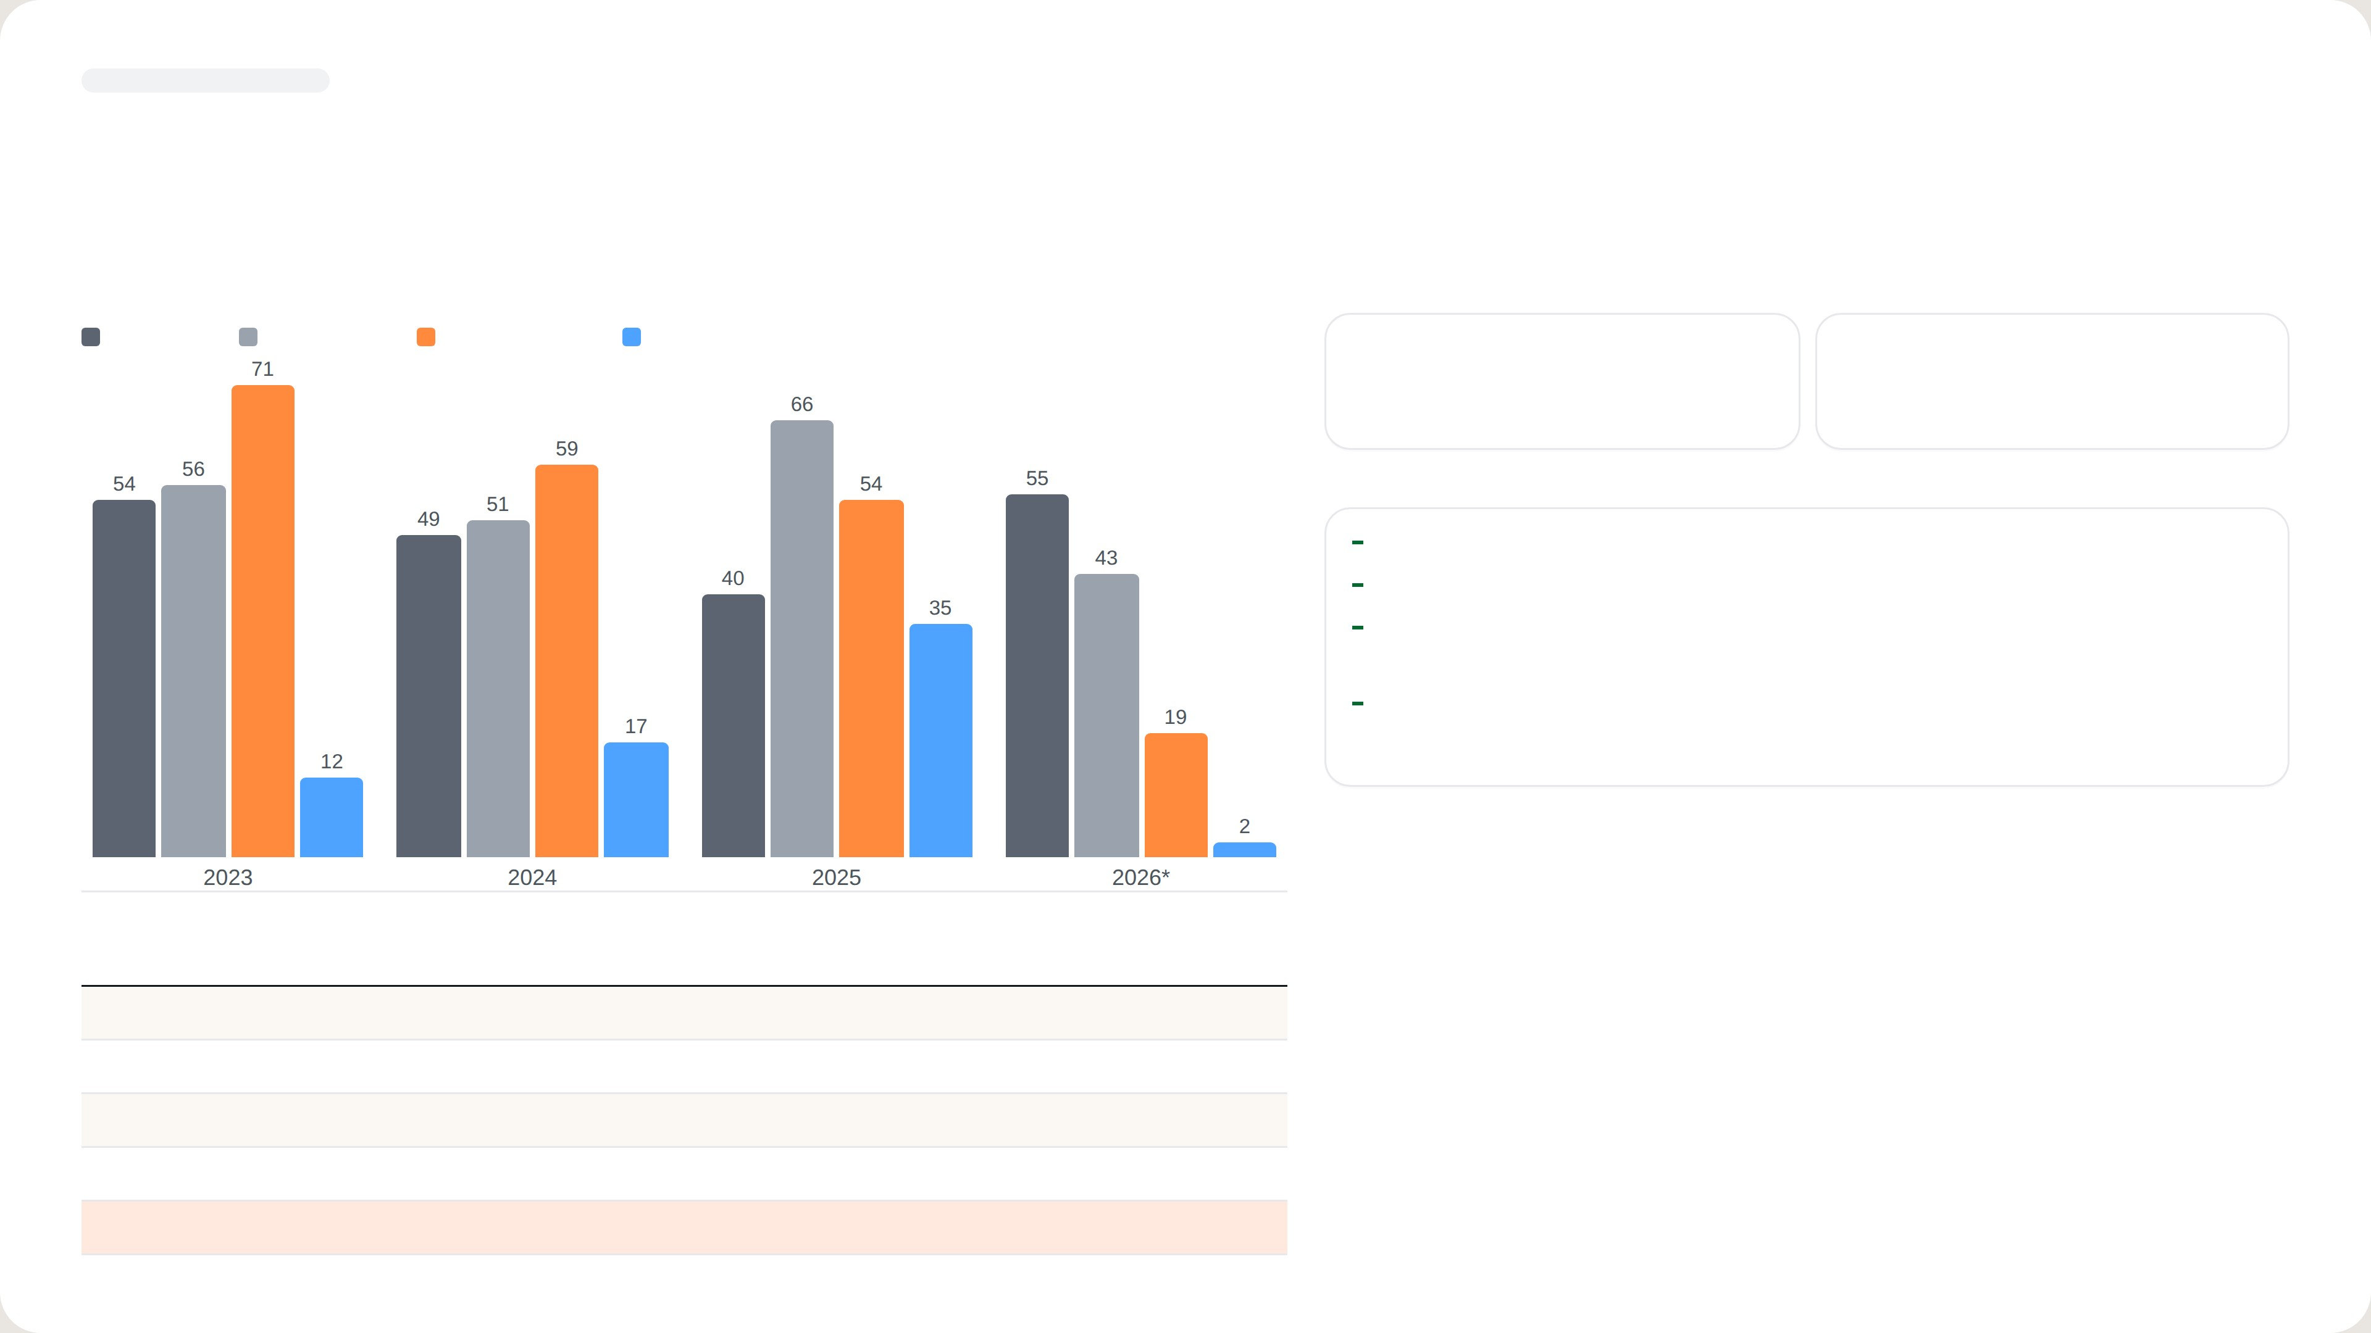
[ INTERNAL USE ONLY ]
STUDY · MARKET SIZE
Focus on Medium and Heavy: 64% of value from 41% of units
UNITS IMPORTED PER YEAR BY CLASS · 2023 – 2026*
AVERAGE UNITS PER YEAR
Light (≤ 8 tm)
Small (8–25 tm)
Medium (25–45 tm)
Heavy (> 45 tm)
67
104
Medium + Heavy · target classes
Light + Small · non-target
KEY POINTS
Medium + Heavy: 41% of units, 64% of import value
Value per unit: Rp 803 Jt vs Rp 311 Jt for Light + Small
Use: 88% of Medium & Heavy cranes need a truck GVW ≥ 24 t — mining,
construction, heavy logistics
2026 is partial: only 12 Medium and 1 Heavy unit to 14 Aug; import records may
be incomplete
*2026 annualised (Jan – 14 Aug × 1.61). Source: Indonesia import records HS 84269100 + 84264900; truck-mounted
knuckle boom cranes; Zoomlion & Hyva excluded; USD 1 = Rp 17.803.
TOTAL UNITS & IMPORT VALUE · 2023 – 14 AUG 2026
CLASS
LIFTING MOMENT
UNITS
IMPORT VALUE (IDR)
SHARE
Light
≤ 8 tm
177
Rp 40.118.000.000
12%
Small
8 – 25 tm
200
Rp 77.241.000.000
24%
Medium
25 – 45 tm
196
Rp 118.328.000.000
36%
Heavy
> 45 tm
65
Rp 91.154.000.000
28%
Total
638
Rp 326.841.000.000
100%
NEDP MID YEAR REVIEW 2026
10 / 15

Slide 11
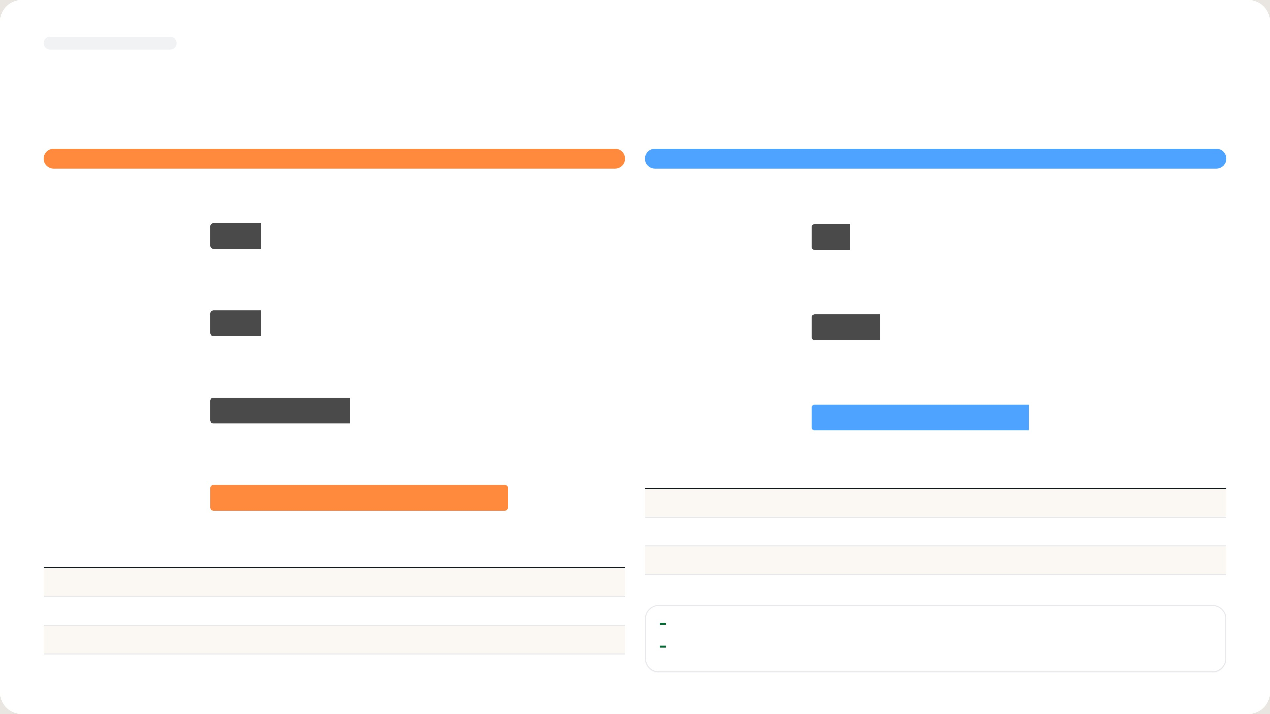
[ INTERNAL USE ONLY ]
STUDY · BRAND LEADERS 2025
Two leaders to beat: Sany Palfinger in Medium, Palfinger in Heavy
MEDIUM · 25 – 45 tm
HEAVY · > 45 tm
UNITS & IMPORT VALUE BY BRAND · 2025
UNITS & IMPORT VALUE BY BRAND · 2025
Amco Veba
5 · Rp 2,7 M
XCMG
4 · Rp 4,6 M
Palfinger
5 · Rp 4,9 M
Amco Veba
7 · Rp 11,1 M
XCMG
14 · Rp 7,2 M
Palfinger
22 · Rp 29,7 M
#
BRAND
UNITS
IMPORT VALUE (IDR)
SHARE
Sany Palfinger
30 · Rp 13,2 M
1
Palfinger
22
Rp 29.738.000.000
62%
2
Amco Veba
7
Rp 11.065.000.000
23%
#
BRAND
UNITS
IMPORT VALUE (IDR)
SHARE
3
XCMG
4
Rp 4.647.000.000
10%
1
Sany Palfinger
30
Rp 13.226.000.000
47%
Total Heavy 2025: 35 units · Rp 48,0 M. Sany Palfinger = Sany–Palfinger JV, made in China.
2
XCMG
14
Rp 7.197.000.000
26%
Both leaders are well ahead of the next brand in value
3
Palfinger
5
Rp 4.869.000.000
17%
Scope: 2025 only, so figures are smaller than the 2023 – 2026 totals
Total Medium 2025: 54 units · Rp 28,0 M
NEDP MID YEAR REVIEW 2026
11 / 15

Slide 12
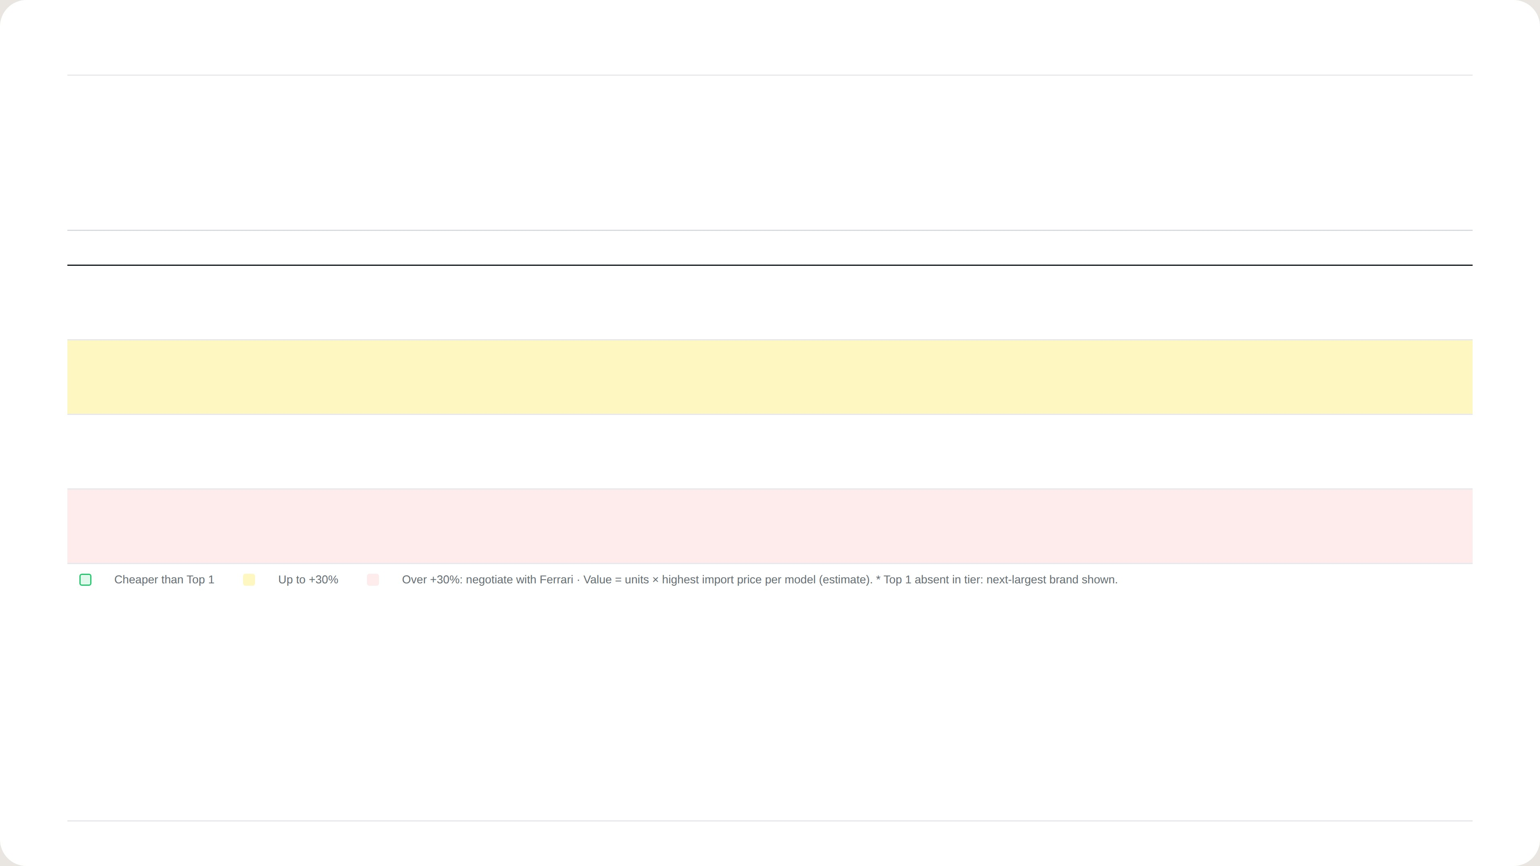
NEDP 6-MONTH REVIEW · STP + 4P · MEDIUM CLASS 25–45 TM
STP + 4P · MEDIUM CLASS 25–45 TM
Use XCMG at 30–40 tm and Ferrari at 25–30 tm; renegotiate Ferrari for 40–45 tm
SEGMENTATION
TARGETING · TOP 1
POSITIONING · CHALLENGER
PRODUCT
PLACE
PROMOTION
TM
QTY
VALUE
BRAND · MODEL
QTY
SHARE
PRICE
BRAND ·
PRICE
VS TOP 1
EQUAL
ONLY CHALLENGER
MODEL
25 –
Amco
Ferrari
Red Power, PB, RS, SDV,
Ferrari stocks units in China (~14 wks), parts
Crane + flatdeck + install + 2-yr
30
49
19%
Veba*
31
69%
Rp 650 jt
268 A4
Rp 500 jt
−23%
–
ECM, Magic Touch
in Malaysia
warranty; exhibition with sales kit
V825
30 –
Sany
XCMG
Parity · wins on
Crane + flatdeck + install; exhibition
35
62
31%
Palfinger
33
36%
Rp 530 jt
SQZ325.4
Rp 550 jt
+4%
Control
price/delivery
Negotiate special price with XCMG
with sales kit
SPK32080
35 –
Sany
XCMG
Parity · wins on
Crane + flatdeck + install; exhibition
40
66
38%
Palfinger
37
41%
Rp 660 jt
SQZ365.4
Rp 600 jt
−9%
Control
price/delivery
Negotiate special price with XCMG
with sales kit
SPK36080
40 –
Sany
Ferrari
Power boost, Ext.
Red Power, SDV, Magic
Negotiate price with Ferrari. Ferrari stocks
Crane + flatdeck + install + 2-yr
45
19
12%
Palfinger
18
93%
Rp 960 jt
746 A4
Rp 1.420 jt
+48%
speed, Control
Touch
units in China (~14 wks), parts in Malaysia
warranty; exhibition with sales kit
SPK42502
NEDP MID YEAR REVIEW 2026 · TIBERIAS K. SIMU
12 / 15

Slide 13
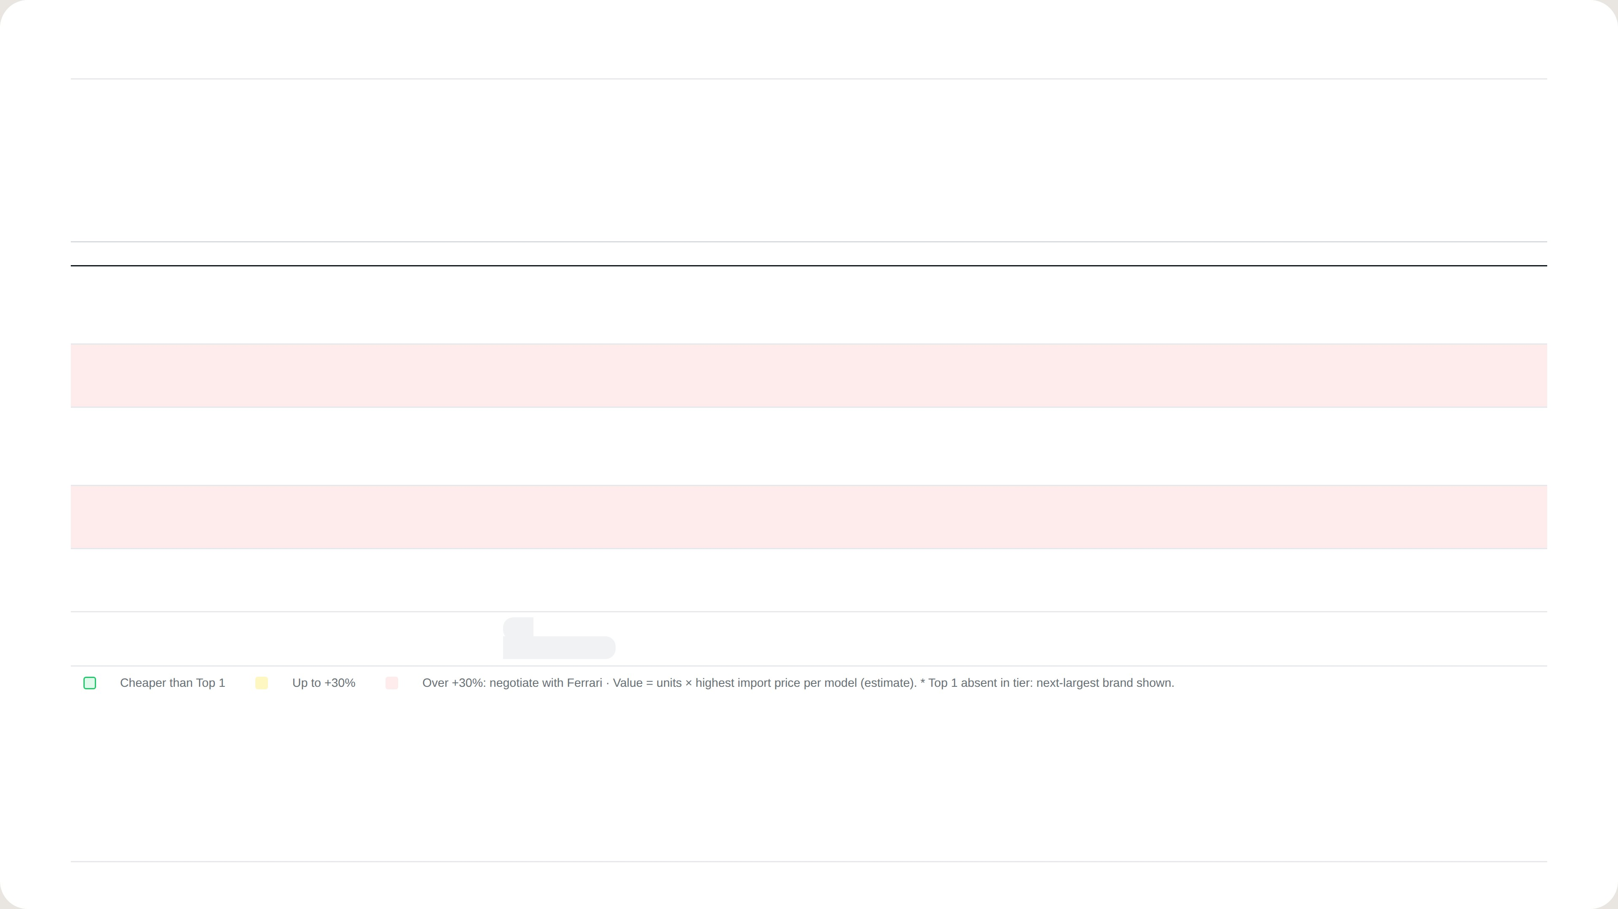
NEDP 6-MONTH REVIEW · STP + 4P · HEAVY CLASS > 45 TM
STP + 4P · HEAVY CLASS > 45 TM
Win Heavy on delivery time; cut Ferrari's price to compete at 50–55 tm
SEGMENTATION
TARGETING · TOP 1
POSITIONING · CHALLENGER
PRODUCT
PLACE
PROMOTION
TM
QTY
VALUE
BRAND · MODEL
QTY
SHARE
PRICE
BRAND · MODEL
PRICE
VS TOP 1
EQUAL
ONLY CHALLENGER
45 –
Amco
Ferrari
Red Power, PB, RS,
Ferrari stocks units in China (~14
Crane + flatdeck + install + 2-yr
50
17
26%
Veba*
12
81%
Rp 1.990 jt
FBR450R A4
Rp 1.350 jt
−32%
–
SDV, ECM, Magic Touch
wks), parts in Malaysia
warranty; exhibition with sales
V950
kit
50 –
40
63%
Palfinger
39
95%
Rp 1.760 jt
Ferrari
Rp 3.260 jt
+85%
Linkage, Power boost, Ext.
Parity · wins on
Negotiate price with Ferrari. Ferrari
Crane + flatdeck + install + 2-yr
55
PK 53002
9601CR A8
speed, Oscillation, Control,
price/delivery
stocks units in China (~14 wks),
warranty; exhibition with sales
Auto fold
parts in Malaysia
kit
60 –
Sany
Ferrari
Red Power, PB, RS,
Ferrari stocks units in China (~14
Crane + flatdeck + install + 2-yr
65
1
1%
Palfinger*
1
100%
Rp 1.400 jt
9661C
TBC
TBC
–
SDV, ECM, Magic Touch
wks), parts in Malaysia
warranty; exhibition with sales
SPK61502
kit
70 –
2
4%
Palfinger
2
100%
Rp 2.290 jt
Ferrari
Rp 4.110 jt
+79%
Linkage, Power boost, Ext.
Parity · wins on
Negotiate price with Ferrari. Ferrari
Crane + flatdeck + install + 2-yr
75
PK 76002 EH D
990R
speed, Oscillation, Control,
price/delivery
stocks units in China (~14 wks),
warranty; exhibition with sales
Auto fold
parts in Malaysia
kit
80 –
1
2%
Palfinger
1
100%
Rp 2.220 jt
Ferrari
TBC
TBC
Linkage, Power boost, Ext.
Parity · wins on
Ferrari stocks units in China (~14
Crane + flatdeck + install + 2-yr
85
PK 88002 EH C
TBC (price list)
speed, Oscillation, Control,
price/delivery
wks), parts in Malaysia
warranty; exhibition with sales
Auto fold
kit
85 –
4
5%
XCMG
2
50%
Rp 1.320 jt
NO
–
–
–
–
–
–
90
GSQZ880.6
CHALLENGER
NEDP MID YEAR REVIEW 2026 · TIBERIAS K. SIMU
13 / 15

Slide 14
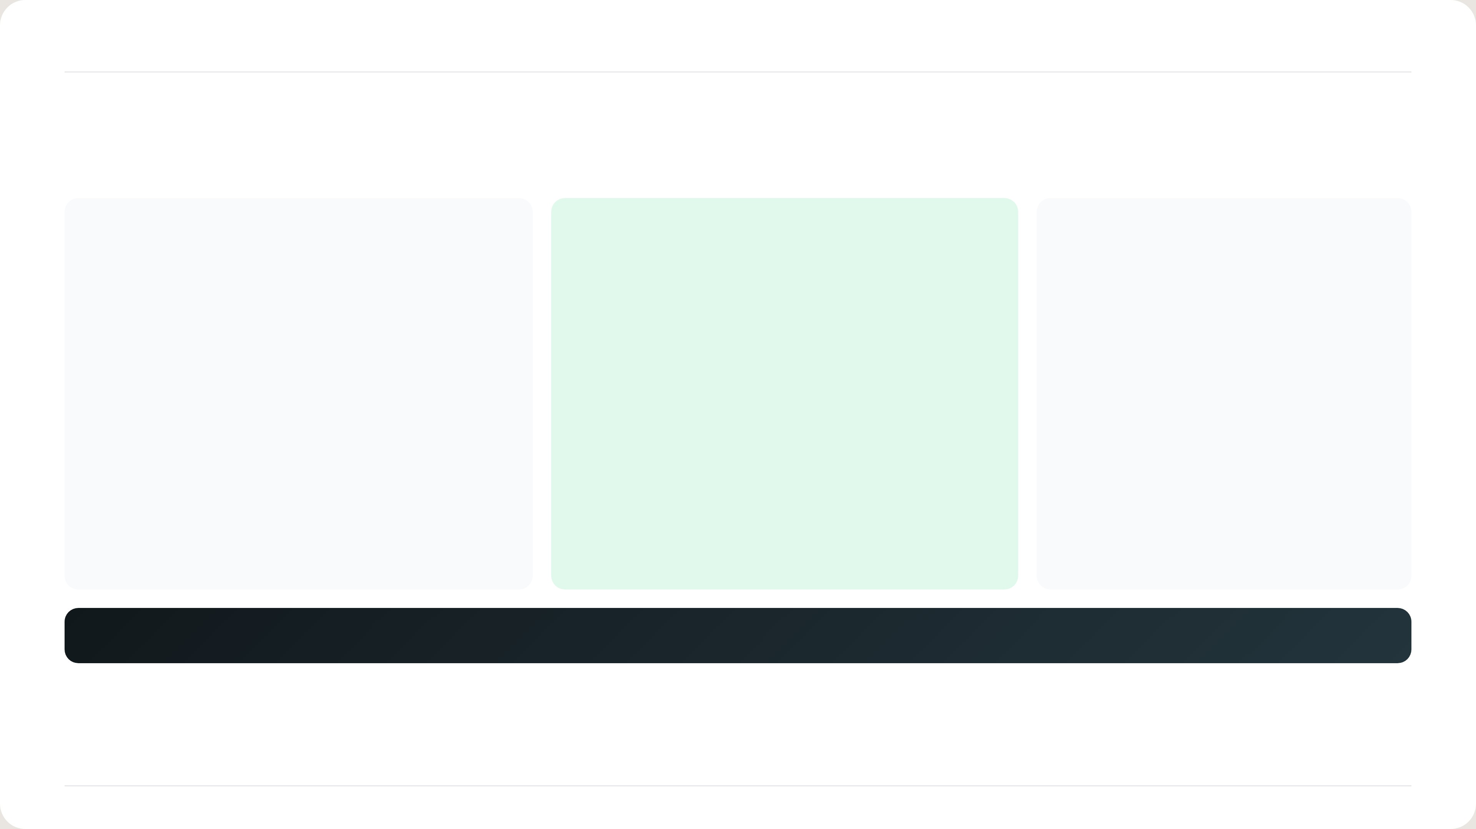
NEDP 6-MONTH REVIEW · CONCLUSION
CONCLUSION
Partner with F.lli Ferrari and XCMG; keep Fassi for Petrosea
XCMG
F.lli Ferrari
Fassi
MEDIUM · PRICE BUYERS
HEAVY · QUALITY BUYERS
KEY ACCOUNT
Challenger at 30–35 and 35–40 tm
Wins 25–30 (−23%) and 45–50 tm (−32%)
Petrosea buys Fassi only
SQZ365.4: −9% vs SPK36080
Stock units in China (~14 weeks), parts in Malaysia
Keep supply for this account
Ask XCMG for a special price
Cut price at 40–45, 50–55, 70–75 tm
Bundle crane + flatdeck + install
Bundle + 2-year warranty
DECISIONS NEEDED
Approve partnership talks with F.lli Ferrari and XCMG
Mandate Ferrari price and stock negotiation
Budget for exhibitions and Marcom sales kit
NEDP MID YEAR REVIEW 2026 · TIBERIAS K. SIMU
14 / 15

Slide 15

THANK YOU
Questions and feedback are welcome.
Tiberias Krisgaharu Simu · Marketing Strategic 2 Associate · PT Triatra Sinergia Pratama
NEDP MID YEAR REVIEW 2026
15 / 15

