Slide 1
New Employee Development Program
MID YEAR REVIEW​
Tiberias Krisgaharu Simu (P0126010)

Slide 2
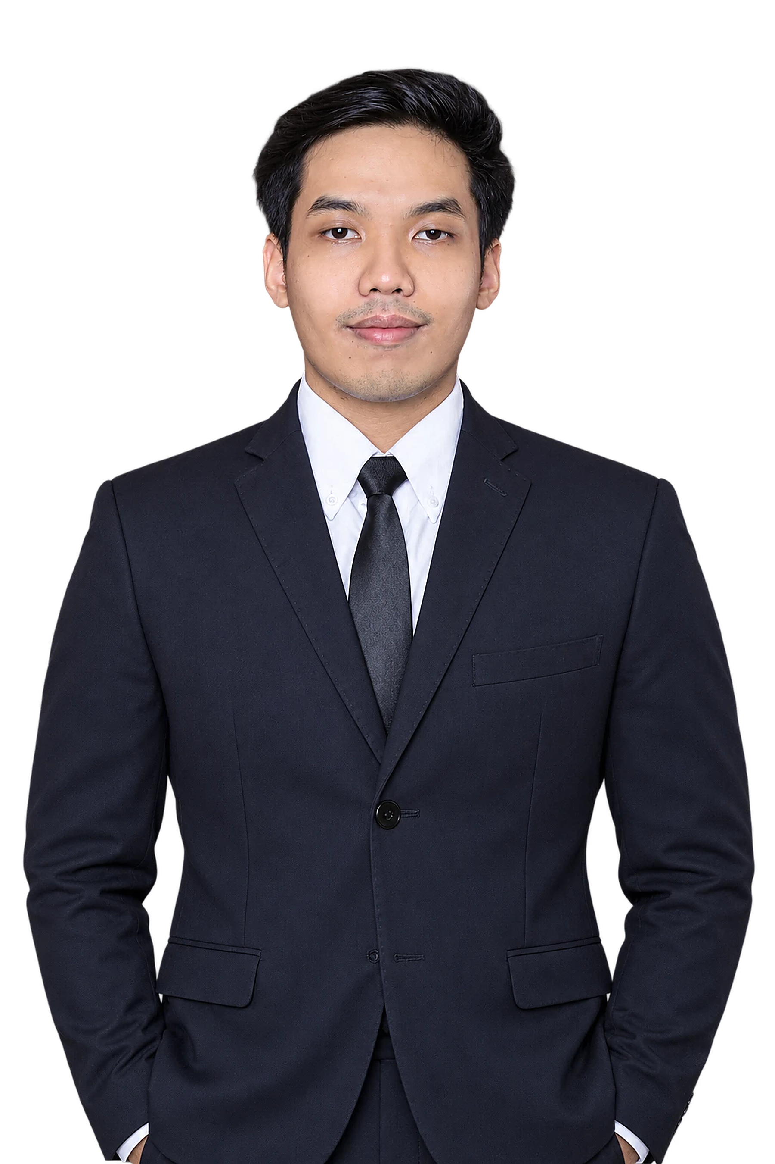





My Education & Working Experience
Holla! I’m Ibe
My position is Marketing Strategic 2 Associate, from Marketing Unit & Strategic
Education
Universitas Sanata Dharma, Yogyakarta
Bachelor (S1) · Management · Faculty of Economics
Working Experiences
PT Triatra Sineria Pratama
2026 - now
Marketing Strategic 2 Associate
Outlier
2023 - 2025
Team Lead Data Annotator
Krishma International
2021 – 2023
Marketing Coordinator
Organization
HMJM Universitas Sanata Dharma
2021 – 2022
President

Slide 3
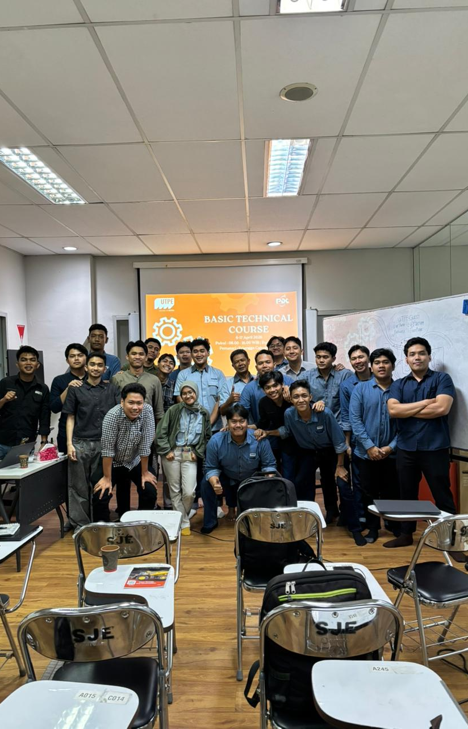
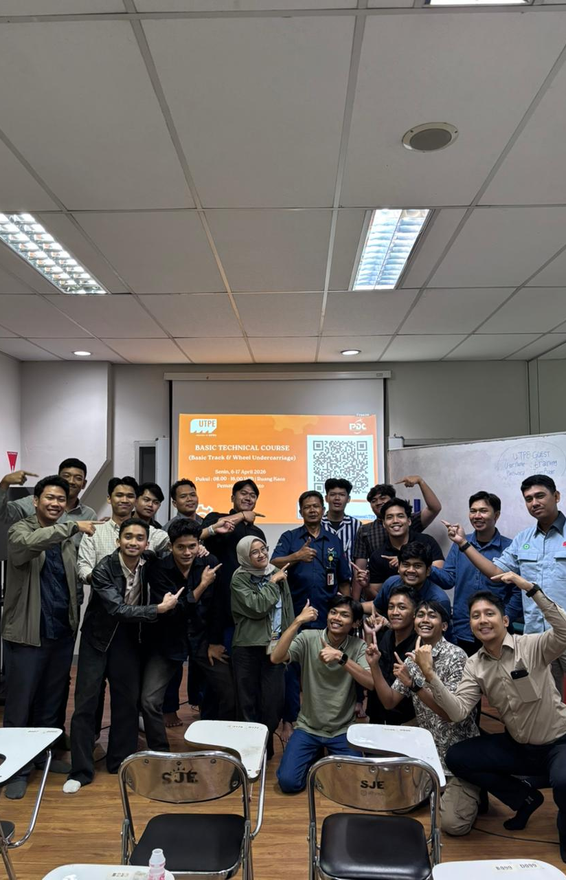
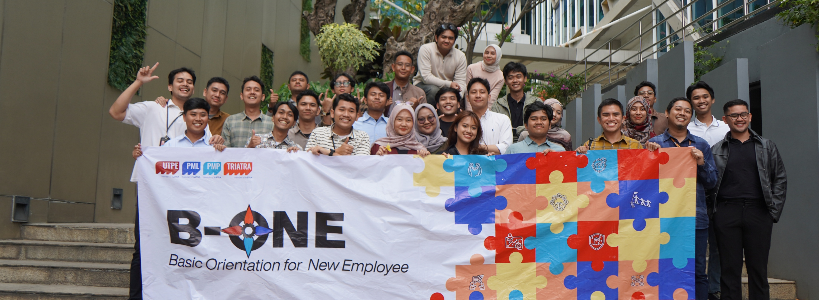
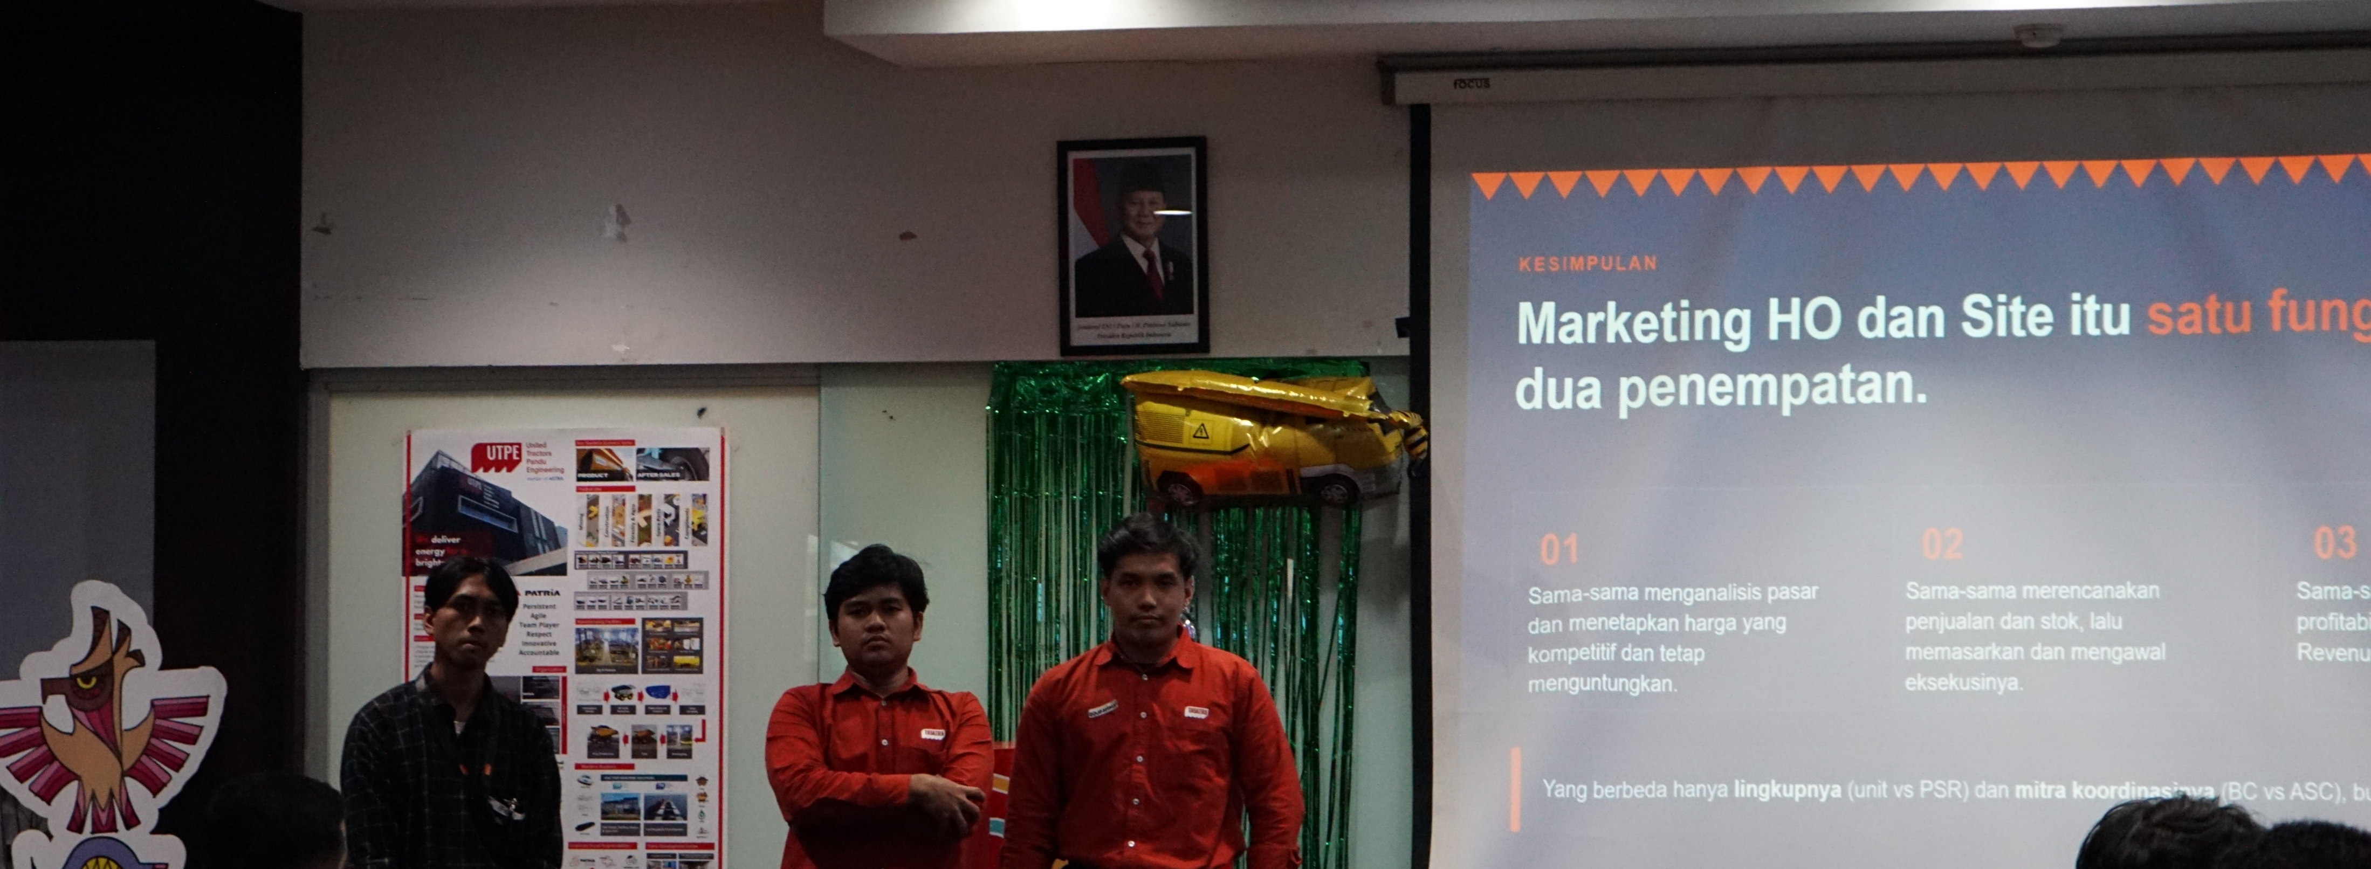
Development program
My on boarding journey
DONE
DONE
NOW
NEXT
NEXT
Basic Technical Course
B-One · Orientation
Mid Year Review
1 Year Review
1,5 Year Review
What I Learned
What I Learned
Engine basics
Electrical system
Axle, wheel and suspension
Final drive and undercarriage
8 Astra competencies
AI at work
Teamwork
Corporate bootcamp

Slide 4

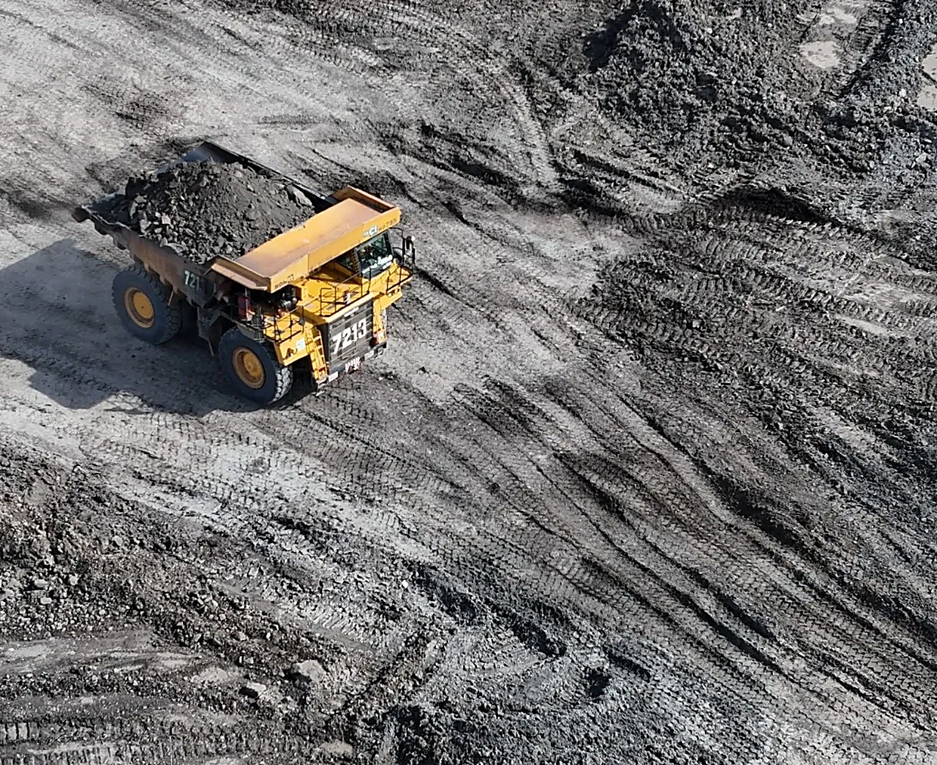






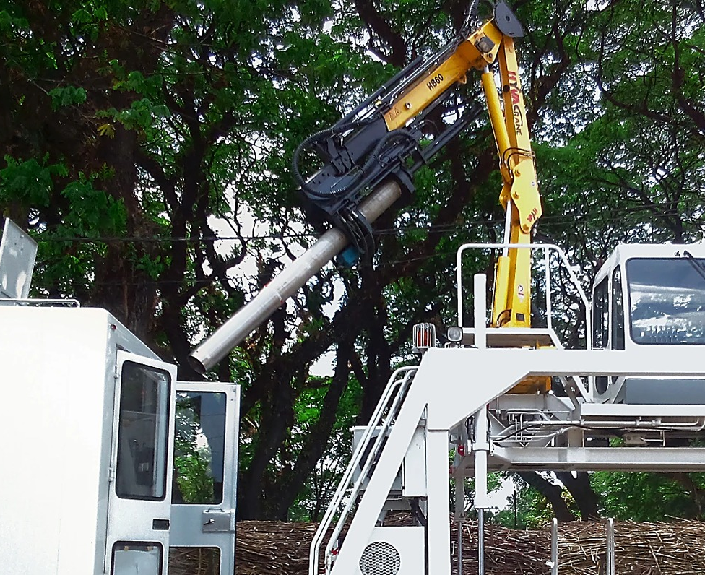
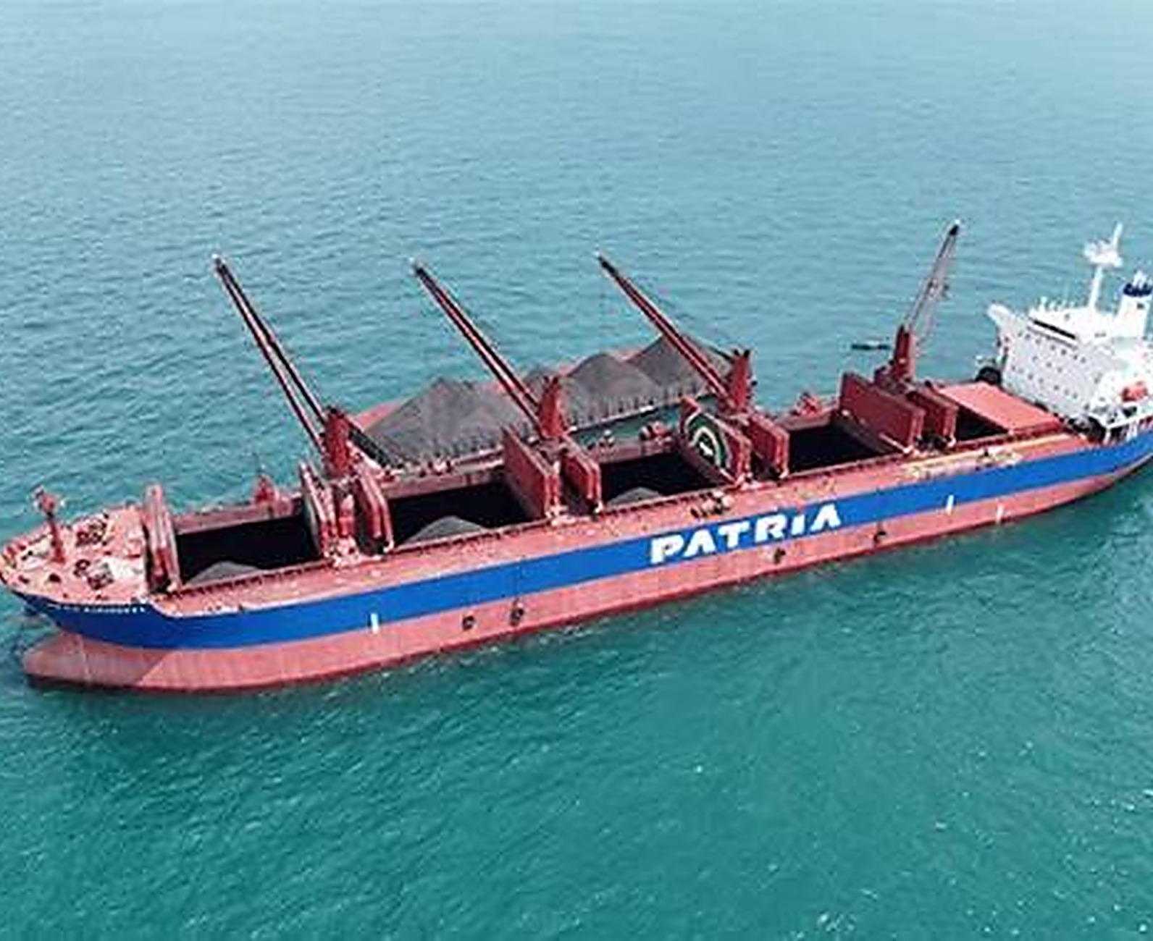



Company profile
CORPORATE ENTITY STRUCTURE
INDUSTRY COVERAGE
Astra International
Heavy Equipment, Mining, Construction and Energy
United Tractors
Construction machinery
UTPE
Engineering solution and marine
01 Coal and mineral mining
02 Construction
MY COMPANY
NEW · 2025
Distribution and trading
Ship owner and operator
Ship building and repair
WHAT TRIATRA DOES
Distributor of PATRIA and ULTRA products for mining, construction, agriculture, forestry and maritime. Sells units and full after-sales support.
Unit
Parts, components and services
Trader of UTPE units, local and export
Maintenance and remanufacturing
03 Forestry and agro-industry
04 Maritime

Slide 5

Triatra serves customers from 16 points across Indonesia
Head Office in Jakarta, 6 Site Operations and 9 Site Representatives.
Head Office
Site Operation
Site Representative
13
4
12
14
11
9
10
7
8
3
5
6
16
2
1
15
# | SITE | TYPE | ADDRESS
1 | Head Office | Head office | Jl. Raya Bekasi KM 22, Cakung, Jakarta Timur
2 | Jakarta | Operation | Jl. Raya Bekasi KM 22, Cakung, Jakarta Timur
3 | Tanjung Enim | Rep. | Jl. Lingga Raya 10, Muara Enim, Sumatera Selatan
4 | Pekanbaru | Rep. | Jl. Soekarno Hatta KM 3,5 No. 151, Riau
5 | Banjarmasin | Rep. | Jl. Ahmad Yani KM 13,5 Gambut, Kalimantan Selatan
6 | Sungai Danau | Rep. | Ds. Karang Indah, Angsana, Tanah Bumbu, Kalsel
7 | Tanjung Tabalong | Operation | Jl. A. Yani KM 7,5 Maburai, Tabalong, Kalsel
8 | Batu Kajang | Rep. | Jl. Negara KM 140, Batu Sopang, Paser, Kaltim
# | SITE | TYPE | ADDRESS
9 | Muara Teweh | Rep. | Jl. Ahmad Yani No. 85, Barito Utara, Kalteng
10 | Balikpapan | Operation | Jl. Jend. Sudirman No. 844, Balikpapan, Kaltim
11 | Melak | Rep. | Hauling Road Trubaindo, Kutai Barat, Kaltim
12 | Tabang | Rep. | Workshop Buma Km 6, Hauling Road, Kaltim
13 | Tanjung Redeb | Operation. | Jl. Gunung Panjang No. 101B, Berau, Kaltim
14 | Sangatta | Operation | Jl. HDRS Tango Delta KPC, Kutai Timur, Kaltim
15 | Sumbawa | Rep. | Memco Area Tongo, Sekongkang, Sumbawa Barat, NTB
16 | Timika | Operation | Jl. Kuala Tembaga E-4, Kuala Kencana, Papua
Notes:
1. Tanjung Redep: harus nya site operation

Slide 6
Organization
Ceisar Centiaga
DIRECTOR IN CHARGE
Ricardo Tanada
Marketing Communication
MKT UNIT & STRATEGIC DIV HEAD
Karina Audina E. · Adinda Siti K. (Marcomm) · Rahma (Graphic Designer)
Kresnanto A.W.
Ignatius Indrawan S.
Ugik Praseno
Kresnanto A.W.
MKT STRATEGIC 1 HEAD
MKT STRATEGIC 2 DEPUTY HEAD
MKT STRATEGIC 3 HEAD
APPLICATION ENGINEERING HEAD
Satrio F.R.
Ervin Bahar P.
Baihaqi
Agi Yogiansyah
Big Suppeq, Big Vessel, Bucket
Medium Vessel, Man Hauler, Bus Scania
Mineral Processing, EPC
Offroad Trailer (SST, SDT, LBT), Big Vessel
M. Fawwaz J.
Tiberias K.S. ◄ ME
Yuda Prana
M. Sugeng Riadi
Cabin, Forestry, Agro, Forklift, Towerlamp, Pump
Small Suppeq, Truck Others
Maritime, Renewable Energy
Supporting Equipment (WT, FT, LT), Mixer, EV
Eurico
Celine
Angger Suryo Prastowo
Mining / Non-mining Trailer, Overseas Zone
Ultra Product Support
Manhauler, Towerlamp, Industrial (Crane truck, Tire handler)
Nandu Narpati
Hanifa
Muhammad Fadlan
Admin
Automation, EV
On-road Trailer (FBT, SCT), Medium Vessel, Crusher, Bucket
Fitri Royani
Admin

Slide 7
Marketing Strategic 2 Associate
“My Roles and
My Responsibility.”

Slide 8
Roles and Responsibility /
Where I Involved
In the Supply Chain?
Pre Sales
Sales
After Sales
Gather Voice of customer Identify customer & competitor Ensure offering spec, price, and lead time inline with customer requirement Monitor SLA in offering to customer | Verify order completeness (PO, PJB, DP) Maintain and monitoring orders Ensure proper billing inline with plan | Monitor unit performance follow up problem ensure the problem is not repeated in other order Gather customer feedback
Coordination with | Coordination with: | Coordination with:
Business Consultant Application Engineering Marketing Unit UTPE | Business Consultant Application Engineering Marketing Unit UTPE Finance Triatra | Business Consultant Application Engineering Marketing Unit UTPE Finance Triatra
What is my specific
unit product?
Small Suppeq | Truck Others
Water Truck | Crane Truck
Fuel Truck | Mixer Truck
Lube Truck | Stemming Truck
Specifically in mining and construction industry

Slide 9
Roles and Responsibility /
Where I Involved
In the Strategic Marketing?
Pre Sales
Sales
After Sales
Gather Voice of customer Identify customer & competitor Ensure offering spec, price, and lead time inline with customer requirement Monitor SLA in offering to customer | Verify order completeness (PO, PJB, DP) Maintain and monitoring orders Ensure proper billing inline with plan | Monitor unit performance follow up problem ensure the problem is not repeated in other order Gather customer feedback
Coordination with | Coordination with: | Coordination with:
Business Consultant Application Engineering Marketing Unit UTPE | Business Consultant Application Engineering Marketing Unit UTPE Finance Triatra | Business Consultant Application Engineering Marketing Unit UTPE Finance Triatra
What is my specific
unit product?
Small Suppeq | Truck Others
Water Truck | Crane Truck
Fuel Truck | Mixer Truck
Lube Truck | Stemming Truck
Specifically in mining and construction industry

Slide 10
Roles and Responsibility /
Where I Involved
In the Strategic marketing?
Step | Item | Key point | Supporting data
4C | Change | HYVA has left; value sits in Medium + Heavy | Triatra has no crane brand since HYVA stopped. Medium + Heavy = 41% of units, 64% of value (2023 – 2026). Heavy units 12 → 17 → 35 (2023 – 2025).
 | Competitor | Two leaders, one per class | Medium: Sany Palfinger, 38% of value. Heavy: Palfinger, 66% of value; PK 53002 alone sold 39 of 65 units (2023 – 2026).
 | Customer | Medium buys on price, Heavy buys on quality | China brands take 73% of Medium value; European brands take 85% of Heavy value. 88% go on trucks ≥ 24 t GVW (mining, construction).
 | Company | Partner two brands to serve both buyers | XCMG for price-oriented buyers. F.lli Ferrari for quality-oriented buyers.
STP | Segmentation | Two classes, ten 5-tm tiers | Medium 25 – 45 tm: 196 units, Rp 156 M. Heavy > 45 tm: 65 units, Rp 115 M.
 | Targeting | Take share from the Top 1 model in each tier | Medium: Sany Palfinger SPK32080, SPK36080, SPK42502. Heavy: Palfinger PK 53002, PK 76002, PK 88002.
 | Positioning | Two clear promises | XCMG: same capacity, lower price (SQZ365.4 −9% vs SPK36080). Ferrari: European features, cheaper where it wins (−23% at 25 – 30 tm, −32% at 45 – 50 tm) and faster delivery from China stock (~14 weeks).
4P | Product | Offer Ferrari models that beat the Top 1 on features | Red Power (more working range), SDV (less boom flex), Magic Touch (auto open/stow): Sany Palfinger has none. PB, RS, ECM: equal to Palfinger.
 | Price | Negotiate a better price with Ferrari and XCMG | Ferrari: lower price on 746 A4 (+48%), 9601CR A8 (+85%), 990R (+79%). XCMG: Triatra special price on SQZ325.4 and SQZ365.4.
 | Place | Negotiate stock to cut lead time | Ferrari stocks 268 A4 and FBR450R A4 in China (14-week lead time) and main components in Malaysia. XCMG via GM Tractors.
 | Promotion | Sell a ready-to-work package | Crane + flatdeck + installation (+2-year warranty on Ferrari). Exhibitions and customer visits with a Marcom sales kit.

Slide 11
Quote
Project Charter /
What is the background, the objective and the benefit?
Project name
Indonesia Folding Crane Market Strategy
Background
Hyva cranes has discontinued their crane production
Objective
Mapping total imported folding crane (2023 – 26) in Indonesia Targeted on ton meter class that have the most value, knowing the competitor brands and whics model is the best (4C) Pick top 1 competittors model in every ton meter subclass (STP) Set Product, Price, Place and Promotion for challenger model (4P)
Project Scope
Market Study For Indonesian Folding Crane specific on price and specification
KPI / Metric
Mapping total market size of Medium & Heavy cranes by tm class, brand and model (2023 – 2026) Competitive dynamics, stocking strategy, value differentiators
Support Requirements
Business Consultant, Marketing Communication, Application Enginnering, UTPE
Project Timeframe
Activity | 2026 |  |  |  |  |  |  | 2027
 | Jun | Jul | Aug | Sep | Oct | Nov | Dec | Jan | Feb | Mar
Market study (4C)
STP and challenger choice
Negotiate with Ferrari and XCMG
Sales kit with Marcom
Exhibition and customer visits
Quotation → PO → first unit sold
Benefit of Project
Gives Managements and sales a clear answer per tm class: which brand, which model, at what price that have complete competitiveness
Project Team
Executive Sponsor : David Advisor : Ceisar Centiaga Owner : Ricardo Tanada Coordinator : Ignatius Indrawan Sumawinata Project Lead : Tiberias Krisgaharu Simu Team Member : Marketing Unit · Application Engineering, UTPE Business Consultant
Project Approval
Lead
Coordinator
Advisor
Executive Sponsor
Date:
Date:
Date:
Date:
Tiberias Krisgaharu Simu
Ignatius Indrawan
Ricardo Tanada
Ricardo Tanada

Slide 12
Partner F.lli Ferrari for quality buyers and XCMG for price buyers
Step | Item | Key point | Supporting data
4C | Change | HYVA has left; value sits in Medium + Heavy | Triatra has no crane brand since HYVA stopped. Medium + Heavy = 41% of units, 64% of value (2023 – 2026). Heavy units 12 → 17 → 35 (2023 – 2025).
 | Competitor | Two leaders, one per class | Medium: Sany Palfinger, 38% of value. Heavy: Palfinger, 66% of value; PK 53002 alone sold 39 of 65 units (2023 – 2026).
 | Customer | Medium buys on price, Heavy buys on quality | China brands take 73% of Medium value; European brands take 85% of Heavy value. 88% go on trucks ≥ 24 t GVW (mining, construction).
 | Company | Partner two brands to serve both buyers | XCMG for price-oriented buyers. F.lli Ferrari for quality-oriented buyers.
STP | Segmentation | Two classes, ten 5-tm tiers | Medium 25 – 45 tm: 196 units, Rp 156 M. Heavy > 45 tm: 65 units, Rp 115 M.
 | Targeting | Take share from the Top 1 model in each tier | Medium: Sany Palfinger SPK32080, SPK36080, SPK42502. Heavy: Palfinger PK 53002, PK 76002, PK 88002.
 | Positioning | Two clear promises | XCMG: same capacity, lower price (SQZ365.4 −9% vs SPK36080). Ferrari: European features, cheaper where it wins (−23% at 25 – 30 tm, −32% at 45 – 50 tm) and faster delivery from China stock (~14 weeks).
4P | Product | Offer Ferrari models that beat the Top 1 on features | Red Power (more working range), SDV (less boom flex), Magic Touch (auto open/stow): Sany Palfinger has none. PB, RS, ECM: equal to Palfinger.
 | Price | Negotiate a better price with Ferrari and XCMG | Ferrari: lower price on 746 A4 (+48%), 9601CR A8 (+85%), 990R (+79%). XCMG: Triatra special price on SQZ325.4 and SQZ365.4.
 | Place | Negotiate stock to cut lead time | Ferrari stocks 268 A4 and FBR450R A4 in China (14-week lead time) and main components in Malaysia. XCMG via GM Tractors.
 | Promotion | Sell a ready-to-work package | Crane + flatdeck + installation (+2-year warranty on Ferrari). Exhibitions and customer visits with a Marcom sales kit.

Slide 13
Quote
How big is it?
And who's lead the market?
Indonesian Folding Crane Market Strategy /

Slide 14
PROJECT NAME
PROJECT TIMEFRAME
Multi-brand Crane Challenger: F.lli Ferrari and XCMG
Activity | 2026 |  |  |  |  |  |  | 2027
 | Jun | Jul | Aug | Sep | Oct | Nov | Dec | Jan | Feb | Mar
Market study (4C)
STP and challenger choice
Negotiate with Ferrari and XCMG
Sales kit with Marcom
Exhibition and customer visits
Quotation → PO → first unit sold
BACKGROUND
HYVA stopped making cranes, so Triatra has no crane brand. From Jan 2023 to Aug 2026 Indonesia imported 638 knuckle boom cranes; Medium and Heavy (> 25 tm) are 41% of units but 64% of value, led by Sany Palfinger (Medium) and Palfinger (Heavy). This project puts a challenger brand against the Top 1 of each tm tier.
OBJECTIVES
1. Map Medium and Heavy cranes by tm tier, brand and model (4C)
2. Pick one challenger per tier: XCMG for price buyers, Ferrari for quality buyers (STP)
3. Set Product, Price, Place and Promotion per tier and sell the first unit (4P)
BENEFIT OF PROJECT
Triatra gets a crane brand for every Medium and Heavy tier again: XCMG for price buyers, Ferrari for quality buyers, with a clear 4P to win units from the Top 1.
PROJECT SCOPE · MARKET STUDY FOR INDONESIAN FOLDING CRANE
PROJECT TEAM
1. Market Study For Indonesian Folding Crane 2. Compettitor Analysis 3. Feature and price comparison 4. Sales kit, exhibition and first sale
Executive sponsor
: Ricardo Tanada
Advisor
: Ricardo Tanada / Ignatius Indrawan
KPI / METRIC
TARGET
Coordinator
: Ignatius Indrawan
Project lead
: Tiberias Krisgaharu Simu
1. 4C, STP, 4P approved (Aug 2026)
2. Ferrari and XCMG terms signed (Dec 2026)
3. Sales kit ready (Dec 2026)
4. Quotations sent (Feb 2027)
5. First unit sold (Mar 2027)
First Ferrari or XCMG challenger crane sold by March 2027
Team members
: Marketing Unit · Application Engineering · UTPE · Business Consultant
PROJECT APPROVAL
Lead
Coordinator
Advisor
Executive Sponsor
Date:
Date:
Date:
Date:
SUPPORT REQUIRED
Marcom (sales kit, exhibition) · F.lli Ferrari (stock, parts, price) · XCMG (special price) · UTPE
Tiberias Krisgaharu Simu
Ignatius Indrawan
Ricardo Tanada
Ricardo Tanada
Notes:
4. Project scope Adalah market study di area folding crane/knuckle boom

Slide 15
Indonesian Folding Crane Market Size
Triatra Need To Focus on Medium and Heavy class
Medium and Heavy class contribute 63% amount in total market size since 2023 – 2026 while the total transaction just 41% from total imported qty
Total Import Folding Crane in Indonesia since 2023 - 2026
CLASS | LIFTING MOMENT | UNITS | IMPORT VALUE (IDR) | SHARE
Light | ≤ 8 tm | 177 | Rp 40.118.000.000 | 12%
Small | 8 – 25 tm | 200 | Rp 77.241.000.000 | 24%
Medium | 25 – 45 tm | 196 | Rp 118.328.000.000 | 36%
Heavy | > 45 tm | 65 | Rp 91.154.000.000 | 28%
Total |  | 638 | Rp 326.841.000.000 | 100%

