Slide 1



DESIGN GUIDANCE
Strictly Confidential
Prepared for:
NEDP 6-Month Review 2026 — slide standard
PT Triatra Sinergia Pratama, a subsidiary of United Tractors Pandu Engineering
Total Solution
for Your Productivity
13 October 2026
File version: 13.10.2026
The information contained in these documents is confidential, privileged and only for the information of the intended recipient and may not be used, published or redistributed without the prior written consent of PT Triatra Sinergia Pratama.
© 2026 PT Triatra Sinergia Pratama. All Rights Reserved.

Slide 2
0.1
DESIGN GUIDANCE — PRINCIPLES
Every slide in the 6-month review should be clear at first glance
WHY THIS GUIDE
One deck, one look, one clear story.
A shared standard for colour, type, layout and evidence, so reviewers spend their time on the content and not on decoding the slide.
One message per slide
Evidence over adjectives
Whitespace is structure
The subtitle states the conclusion and the body only proves it. If a slide needs two messages, split it into two slides.
Show the number, the photo, the screenshot or the document. Replace words such as 'significant' with the figure and its source.
Group items with space, not with extra boxes. Align everything to the grid so the eye reads left to right, top to bottom.
THE STANDARD IN FOUR NUMBERS
1
≤ 6
3
8.5 pt
message per slide, written as the subtitle
bullets per box, one line each where possible
colours on one slide, plus the neutrals
smallest text size, including sources
Source: layout ideas adapted from the Bitwise Asset Management website (editorial headline, stat row, whitespace)

Slide 3
0.2
DESIGN GUIDANCE — SLIDE ANATOMY
Six fixed zones: the header carries the message, the body proves it
1
2
3
1
MAJOR SLIDE TITLE
LOGO
1
Number box
Subtitle written as the message of the slide
Section.slide number. White 16 pt bold on Orange. Already in the layout.
BODY ZONE
870 × 430 pt
4
2
Major title
Topic in CAPS. Arial 12 pt bold, Orange E55200. One line only.
3
Subtitle = message
A full sentence with the takeaway. Arial 14 pt bold, Ink 26262A. Max two lines.
4
Body zone
x 45–915 pt, y 75–505 pt. Nothing outside it except the logo and the footer.
5
Source line
Arial 9 pt, Muted 6E7B84, at y 521 pt. Start with 'Source:'.
6
Footer & page
5
6
Copyright and page number come from the master. Never retype them.
Source: Internal resources
© 2026 PT Triatra Sinergia Pratama … Page 4
NOTE
HEADER COPY TEST
Start every content slide from layout '8_Custom Layout' (Home › Layout). The number box, logo, rule and footer then stay in exactly the same place on every page.
Weak Supply Chain
Better Supply chain: from demand check to monitoring
Best Five-step supply chain keeps every PO on its agreed RFD date
KEY TAKEAWAY
Read only the subtitles from first to last slide: they should tell the whole 6-month story on their own.
Source: Triatra Template PPT 2026 V3; design references collected for this guide

Slide 4
0.3
DESIGN GUIDANCE — GRID & SPACING
A 12-column grid with 12 pt gutters keeps every slide aligned
1 · 12-COLUMN GRID (column 61.5 pt · gutter 12 pt · margins 45 pt)
1
2
3
4
5
6
7
8
9
10
11
12
2 · COMMON SPLITS
12 col
Full width · chart, table, timeline
6 col
6 col
Halves · before / after, two products
4 col
8 col
One third + two thirds · photo + explanation
4 col
4 col
4 col
Thirds · three pillars, three steps
3 col
3 col
3 col
3 col
Quarters · KPI row, four cards
3 · SPACING SCALE (use only these steps)
4 pt
8 pt
12 pt
16 pt
24 pt
36 pt
Icon → label
Inside a card
Card → card (gutter)
Card padding
Group → group
Section → section
Rule of thumb Space between groups must be at least twice the space inside a group. If two boxes look related, bring them closer; if not, push them apart.
Source: Triatra Template PPT 2026 V3; design references collected for this guide

Slide 5
0.4
DESIGN GUIDANCE — TYPOGRAPHY
Arial only, nine sizes, emphasis with colour and weight
1 · TYPE SCALE — ARIAL
ROLE
SAMPLE
SPEC
Design Guidance
Cover title
28–32 pt · Bold · Orange
Major slide title
MAJOR SLIDE TITLE
12 pt · Bold · CAPS · Orange
Subtitle / message
Five F.lli Ferrari cranes win on price
14 pt · Bold · Ink
Key number
31 units
20–28 pt · Bold · Orange
Section label
1 · COLOUR PALETTE
8.5 pt · Bold · CAPS · Brown
Card title
Card title
10 pt · Bold · Brown
Body
Body text explains, in two to four lines.
10 pt · Regular · Ink · spacing 1.1
Detail / label
Supporting detail, two lines max
8.5 pt · Regular · Muted
Source
Source: Internal resources
9 pt · Regular · Muted · y 521 pt
EMPHASIS
HIERARCHY
ALIGNMENT
Orange or Bold only. Never underline, italic, shadow or WordArt.
Max two sizes inside one box. Bigger means more important, not more text.
Left-align text. Centre only key numbers and single-line labels.
Source: Triatra Template PPT 2026 V3; design references collected for this guide

Slide 6

0.5
DESIGN GUIDANCE — COLOUR PALETTE & BOXES
Eleven colours and six box types — copy from here when building new slides
1 · COLOUR PALETTE
Brown
Orange
Sand
Peach
Grey
Muted
Ink
Wash
Border
Rule
Tint
80350E
E55200
A35F35
F0A878
B8BEC4
6E7B84
26262A
F7F8FA
C9D0D7
E4E8EB
FDEEE4
Key takeaway, number tag, NPD bar
Section label, key number, risk
Trial bar, ask / decision box
NPI bar, label on dark box
Commercial bar, not started
Sub-label, source, header
Title and body text
Card and key number fill
Card outline
Hairline under row / kicker
Note / context box
2 · BOXES — BOX AND ROUNDED VERSIONS
KEY NUMBER
CONTENT CARD
KEY TAKEAWAY
ATTENTION / RISK
ASK / DECISION
NOTE / CONTEXT
2 of 3
Card title
KEY TAKEAWAY
ATTENTION
ASK
NOTE
BOX
Supporting detail, two lines max
The one point the GMC must remember
Risk, slip or issue to flag
Support or decision requested
Context, assumption or caveat
One short label
2 of 3
Card title
KEY TAKEAWAY
ATTENTION
ASK
NOTE
ROUNDED
Supporting detail, two lines max
The one point the GMC must remember
Risk, slip or issue to flag
Support or decision requested
Context, assumption or caveat
One short label
3 · LINES AND NAVIGATION
Divider: brown line 0.75 pt, 55% opacity, line chevron in the middle
Header rule (ink)
NPD
Trial Program
NPI
Stage navigation: active stage in brown
Done
75%
50%
25%
Not started
Row hairline (rule)
Progress: on going split into 25 / 50 / 75%
Source: Internal resources

Slide 7
0.6
DESIGN GUIDANCE — COLOUR IN USE
Mostly white and ink, orange only where the eye must land
1 · PROPORTION ON A CONTENT SLIDE
60% White / Wash — background, cards
25% Ink / Muted — text
10% Orange
5%
Brown, Sand and Peach are accents for takeaways, phases and chart series. Orange full-bleed is reserved for the cover, dividers, appendix and closing.
2 · CHART SERIES ORDER
1 · Focus / Triatra
2 · Second series
3 · Third
4 · Fourth
5 · Others / benchmark
6 · Total / reference
Competitors and 'others' always in Grey so the focus series stays readable, even when printed in black and white.
3 · DO AND DON'T
DO
DO
DO
Rp 1.240 jt
Key takeaway
Neutral card
Orange number on white
White text on Brown or Orange
Neutral card, one accent
DON'T
DON'T
DON'T
Rp 1.240 jt
Key takeaway
Orange card
Orange on peach — too low contrast
Grey text on Orange
Every card in Orange — nothing stands out
Source: Triatra Template PPT 2026 V3; design references collected for this guide

Slide 8
0.7
DESIGN GUIDANCE — COMPONENTS
Eight reusable blocks beyond the basic boxes — copy them from here
SECTION INTRO
STAT ROW
WHY COLUMNS
NUMBERED LIST
SUPPLY CHAIN
A1
Market size
67
41%
64%
Plan
Execute
Monitor
Units and value by class
From demand to delivery.
A2
Price check
units / yr
of units
of value
Short line of proof
Short line of proof
Short line of proof
Head to head by tm class
A3
Advantage
Kicker + headline open a section or a dense slide. One orange word only.
Three to four numbers, label under each, hairline dividers. Numbers come from the source line.
Five cranes that win
Title above, dot on one thin line, text below. Use for 3 pillars or a simple process.
Agenda, appendix list, step list. Code in Orange, title Ink, detail Muted.
STATUS CHIPS
CALL-TO-ACTION TAGS
ICON LIST
LOGO STRIP
Done
On going
SEE APPENDIX
DECISION
›
Weekly market update
LOGO
LOGO
LOGO
Not started
At risk
›
Price simulation tool
LOGO
LOGO
LOGO
Outline tag points to more detail; filled tag marks the one thing you ask the reviewer to decide. Max one filled tag per slide.
›
Site visit photos
Pill chips for status in tables and timelines. Same four words and colours everywhere in the deck.
Partners, brands or competitors. Same box size, logos in original colours, aligned on one baseline.
Replaces plain bullets when each line is a deliverable or a resource.
Source: Triatra Template PPT 2026 V3; design references collected for this guide

Slide 9
0.8
DESIGN GUIDANCE — CHARTS & TABLES
Highlight one series, label directly, cite the source
1 · CHART — NATIVE, EDITABLE
1
Title = insight
The subtitle says what the chart shows. Units and period go in a small note under the chart.
2
One highlight
Focus series in Orange, every other series Grey. Never a rainbow of categories.
3
Label directly
Data labels on bars, no gridlines, hide the value axis when labels are shown.
4
Start at zero
Bar axes always start at 0. No 3D, no shadows, no pie with more than 4 slices.
Units per year. *2026 = Jan–14 Aug.
2 · TABLE
5
Tables
Class | Units | Import value | Share
Light | 177 | Rp 40.118 jt | 12%
Small | 200 | Rp 77.241 jt | 24%
Medium | 196 | Rp 118.328 jt | 36%
Total | 638 | Rp 326.841 jt | 100%
Ink rule under header and before total, hairlines between rows, numbers right-aligned, totals bold.
6
Native only
Insert charts and tables from PowerPoint/Excel, never as screenshots, so they stay editable.
Source: chart values are the example Medium-class units (2023–2026) from the F.lli Ferrari market study

Slide 10
0.9
DESIGN GUIDANCE — TIMEFRAME TEMPLATE
Plans and milestones in one native table — copy, then rename periods, rows and bars
 |  |  | [Year 1] |  |  |  | [Year 2]
# | ACTIVITY / MILESTONE | PIC | Q1 | Q2 | Q3 | Q4 | Q1 | Q2 | Q3 | Q4 | STATUS
[WORKSTREAM / PRODUCT 1]
1 | [NPD — spec, partner, sample] | [PIC] | NPD |  |  |  |  |  |  |  | [Done]
2 | [Trial program — site, KPI] | [PIC] |  |  | Trial |  |  |  |  |  | [On going]
3 | [NPI — price, doc, channel] | [PIC] |  |  |  |  | NPI |  |  |  | [Not started]
4 | [Target launching] | [PIC] |  |  |  |  |  | ◆ Launch |  |  | [Not started]
[WORKSTREAM / PRODUCT 2]
5 | [NPD] | [PIC] |  |  | NPD |  |  |  |  |  | [On going]
6 | [Trial program] | [PIC] |  |  |  |  |  | Trial |  |  | [Not started]
7 | [NPI] | [PIC] |  |  |  |  |  |  |  | NPI | [Not started]
[COMMERCIAL / SUSTAIN]
8 | [Already commercial product] | [PIC] | Commercial |  |  |  |  |  |  |  | [Running]
LEGEND
HOW TO EDIT
NPD
Trial program
NPI
Extend a bar: select the period cells → Table Design › Shading → pick the phase colour
Add a row or period: right-click → Insert rows / columns; rename Q1… to months or weeks if needed
Move "today": shade the current period header orange, the rest wash
Launch / milestone ◆
Commercial
Header = current period
Source: Internal resources

Slide 11
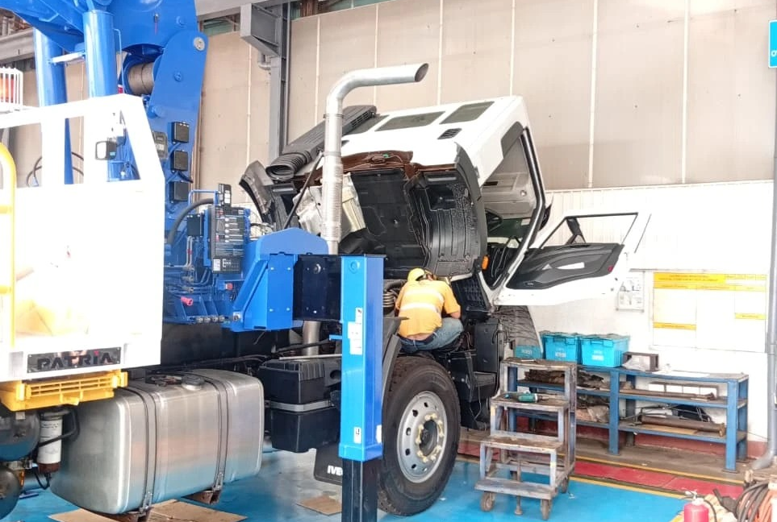
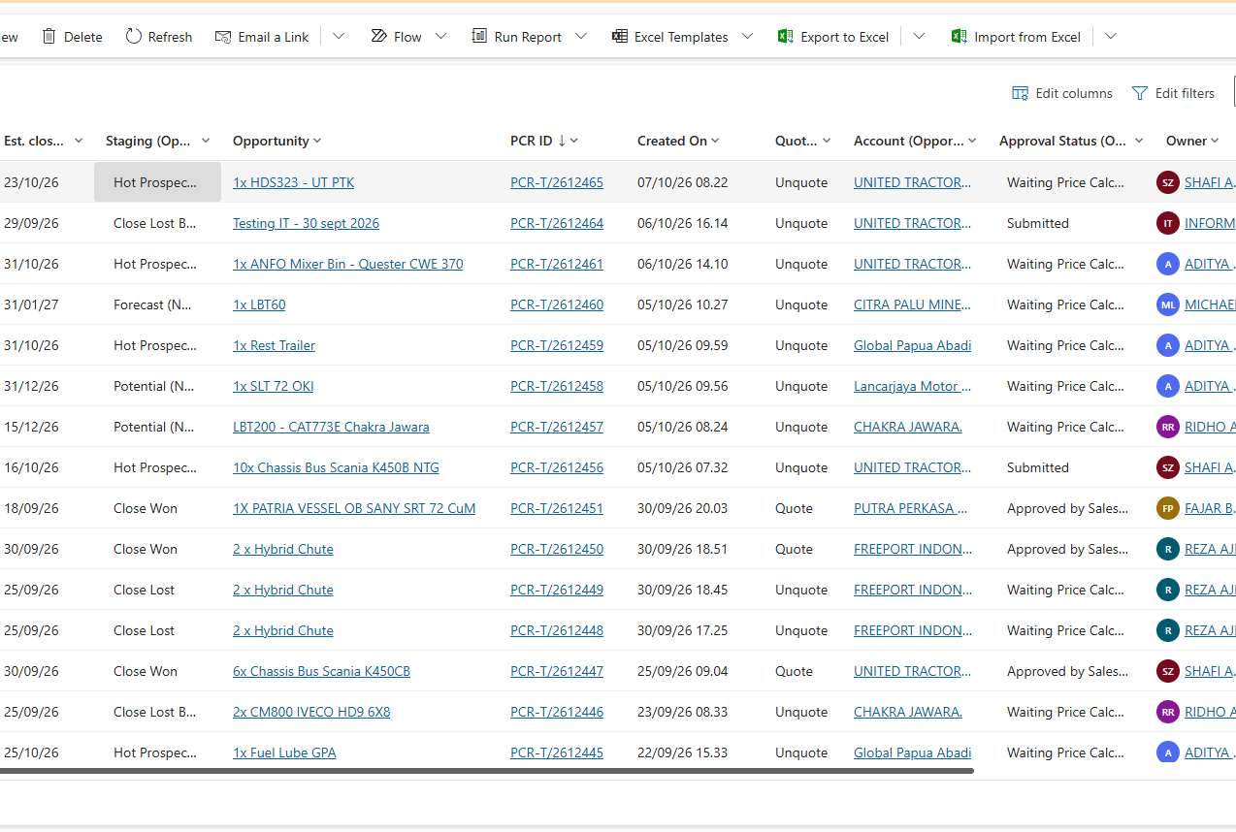

0.10
DESIGN GUIDANCE — IMAGERY & EVIDENCE
Photos prove the work: crop with purpose, caption, cite
1 · PRODUCT CUTOUT
2 · FIELD PHOTO
3 · EVIDENCE SCREENSHOT
Monitoring · plant visit · 2026
Source: CRM, Triatra
Background removed, placed on Wash, same baseline and height for all units in a row.
Crop to the action (people, unit, plant). Caption bar: what, where, when.
Crop to the part that proves the point, 0.75 pt Border frame, source under it.
4 · AVOID
Stretched images
Low resolution
Mixed styles
Decoration only
Lock the aspect ratio; crop instead of squeezing.
Use originals. Below ~150 dpi at the printed size looks blurry.
One corner style per slide: all square or all rounded.
Every photo must show the unit, the place or the result.
Source: product cutout, site photo and CRM screenshot from this review deck

Slide 12
0.11
DESIGN GUIDANCE — PAGE TYPES
Eight page types cover the whole 6-month review
01 Cover
02 Agenda
03 Section divider
04 Content · 2 columns
Template title slide; title, prepared for, date
Numbered list, one line per section
Orange panel left, section number + list
Message left, evidence right (4 + 8)
05 KPI dashboard
06 Process / timeline
07 Evidence gallery
08 Appendix · Thank you
Stat row on top, chart or table below
Steps or timeframe table, status chips
3–4 photos or screenshots with captions
List of appendices, closing slide
Source: Triatra Template PPT 2026 V3; design references collected for this guide

Slide 13
0.12
DESIGN GUIDANCE — STORYLINE
Recommended flow for the 6-month review: who I am, where I work, what I did, what is next
00 Personal
01 Company
02 Site
03 Organization
04 Roles
05 Execution
06 Project
07 Next 6 months
About me, onboarding
Group, business lines, industries
Operations map
Structure, my position
Products, strategic vs supply chain
Strategic + supply chain with evidence
Problem, analysis, result
Learnings, plan, support needed
2
2
1
1
2
3–4
6–8
2
slides
slides
slides
slides
slides
slides
slides
slides
WHAT EACH PART MUST ANSWER
KEY TAKEAWAY
1
Personal & Company
Spend most slides on Execution and Project: that is where reviewers judge the six months. Company and organization slides only set the context.
Do I understand the company I joined and where my products fit?
2
Roles & Execution
What did I do every month, and what is the evidence?
3
Project
NOTE
ASK
What problem did I solve, with which data, and what changed?
Target 25–30 main slides for a 30-minute slot, about one minute per slide. Move detail to the appendix.
End with one clear request: the decision, approval or support you need from the reviewers.
4
Next 6 months
What will I deliver next, and what support do I need?
Source: Triatra Template PPT 2026 V3; design references collected for this guide

Slide 14
0.13
DESIGN GUIDANCE — WRITING & NUMBERS
Short sentences, real numbers, one format for every figure
1 · HEADLINES: TOPIC → MESSAGE
3 · NUMBER FORMATS
AVOID
USE
Currency, table
Rp 1.240.000.000
Market Overview
→
Medium and Heavy cranes are 41% of units but 64% of import value
Currency, text
Rp 1,24 M · Rp 650 jt
Price Comparison
→
F.lli Ferrari is cheaper head to head in five tm classes
25–35 tm · 30,4 tm
Unit / capacity
Monitoring
31 units · 1 unit
→
Regular plant follow-up keeps each PO on its agreed RFD date
Count
Percent
41% · +23% · −14%
Work Challenges
→
Last-minute quote requests are the main risk to lead time
Date
14 Aug 2026
2 · TEXT RULES
Period
Jan 2023 – Aug 2026
Max 6 bullets per box, ideally one line each; no full stops on fragments.
Quarter / month
Q3 2026 · Oct 2026
Max ~40 words per box. If more is needed, it belongs in the appendix.
Estimate
7441C* — *estimate, note it
Define an abbreviation once: Request for Delivery (RFD).
NOTE
One language per deck (English); keep product and form names as in the system.
Use the en dash (–) for ranges and the minus sign (−) for drops. Round only in text; tables keep the full figure so totals add up.
Names: full name + role on first mention, short name after.
Source: Triatra Template PPT 2026 V3; design references collected for this guide

Slide 15
0.14
DESIGN GUIDANCE — PRE-SEND CHECKLIST
Fifteen checks before the deck goes to the reviewers
1 · STORY
2 · DESIGN
3 · DATA
Subtitles alone tell the 6-month story
Every content slide uses '8_Custom Layout'
Every chart and table has a source line
One message per slide
Arial only; sizes from the type scale
Numbers match between slides and appendix
Agenda matches the section dividers
Colours only from the palette
Formats follow the number rules
Last slide states the ask / next step
Body stays inside x 45–915, y 75–505 pt
Charts and tables are native, not pictures
Appendix holds the detail, not the main deck
Photos sharp, cropped, not stretched
Spelling and names checked
4 · FILE NAMING & VERSIONS
NEDP_6M_Review_TiberiasSimu_v03_2026-10-13.pptx
Program + topic
Owner
Version
Date
Same prefix for every file of the review
Who presents the deck
v01, v02 … raise it on every sent copy
ISO date, so files sort by time
KEY TAKEAWAY Send a PDF to read and the PPTX to edit; keep the PPTX file version on the cover up to date.
Source: Triatra Template PPT 2026 V3; design references collected for this guide

