Slide 1
New Employee Development Program
MID YEAR REVIEW​
Tiberias Krisgaharu Simu (P0126010)

Slide 2
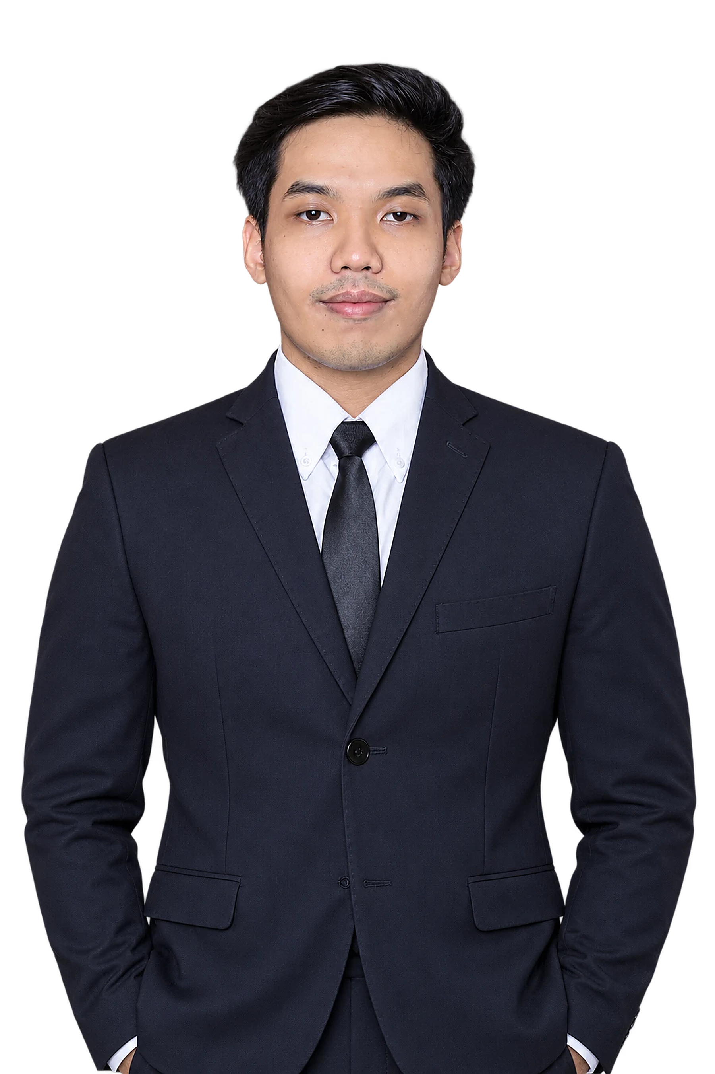





My Education & Working Experience
Holla! I’m Ibe
My position is Marketing Strategic 2 Associate, from Marketing Unit & Strategic
Education
Universitas Sanata Dharma, Yogyakarta
Bachelor (S1) · Management · Faculty of Economics
Working Experiences
PT Triatra Sineria Pratama
2026 - now
Marketing Strategic 2 Associate
Outlier
2023 - 2025
Team Lead Data Annotator
Krishma International
2021 – 2023
Marketing Coordinator
Organization
HMJM Universitas Sanata Dharma
2021 – 2022
President

Slide 3
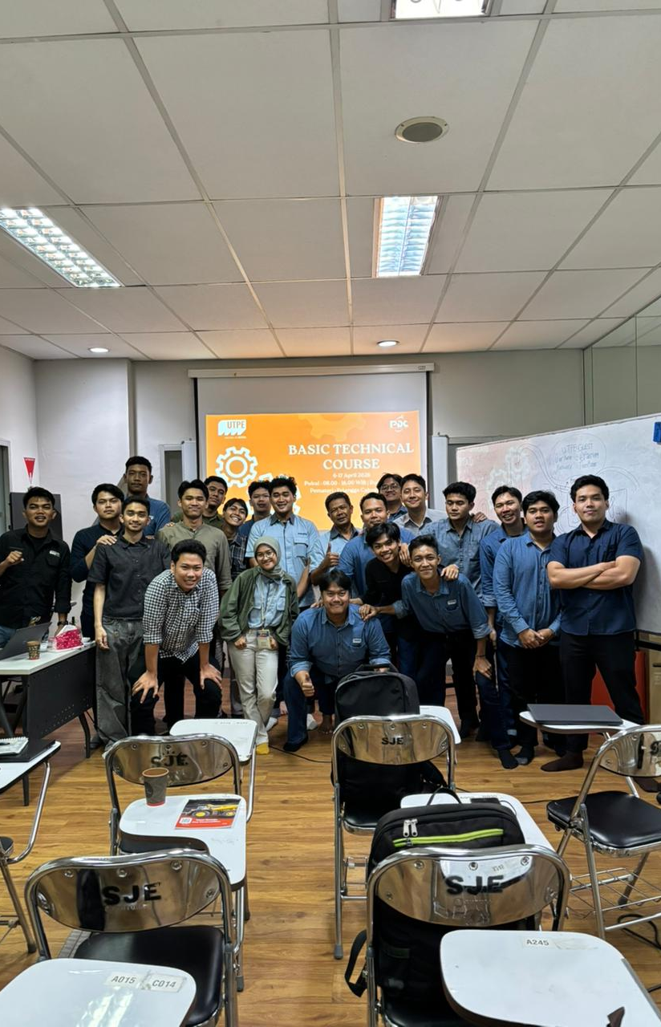
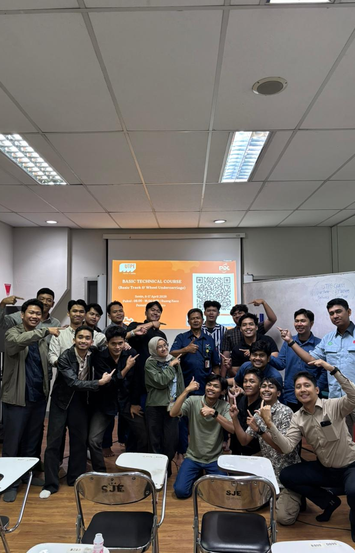
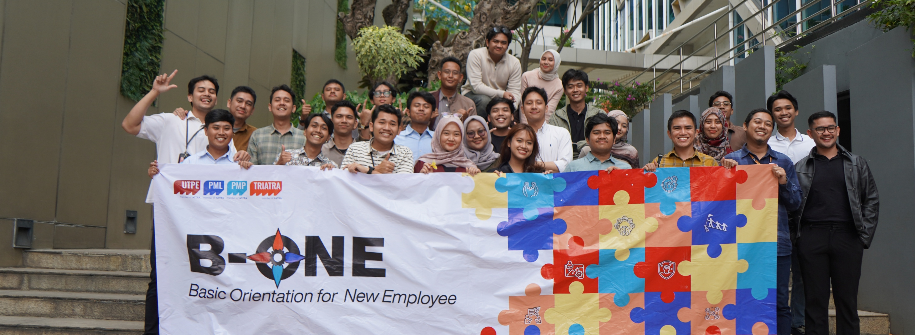
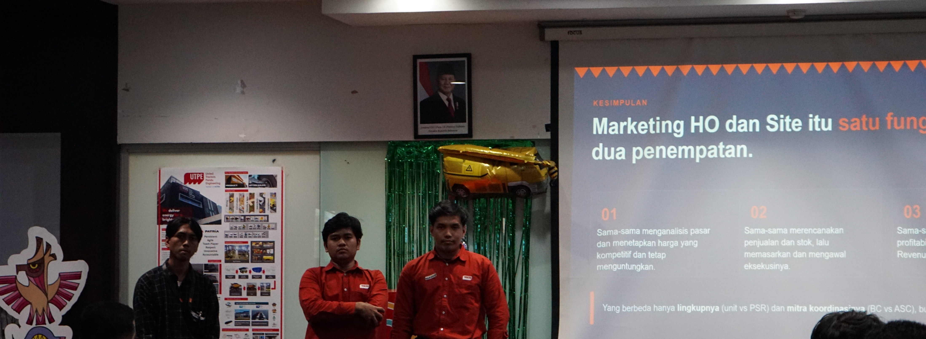
Development program
My on boarding journey
DONE
DONE
NOW
NEXT
NEXT
Basic Technical Course
B-One · Orientation
Mid Year Review
1 Year Review
1,5 Year Review
What I Learned
What I Learned
Engine basics
Electrical system
Axle, wheel and suspension
Final drive and undercarriage
8 Astra competencies
AI at work
Teamwork
Corporate bootcamp

Slide 4


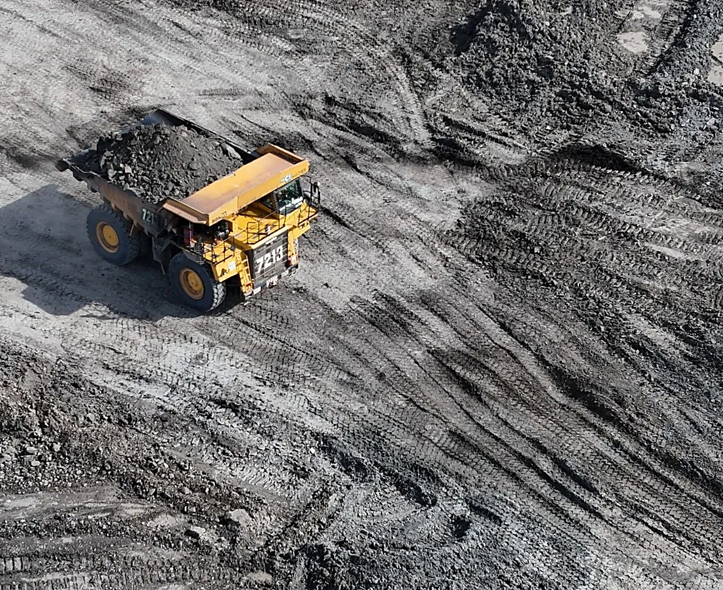






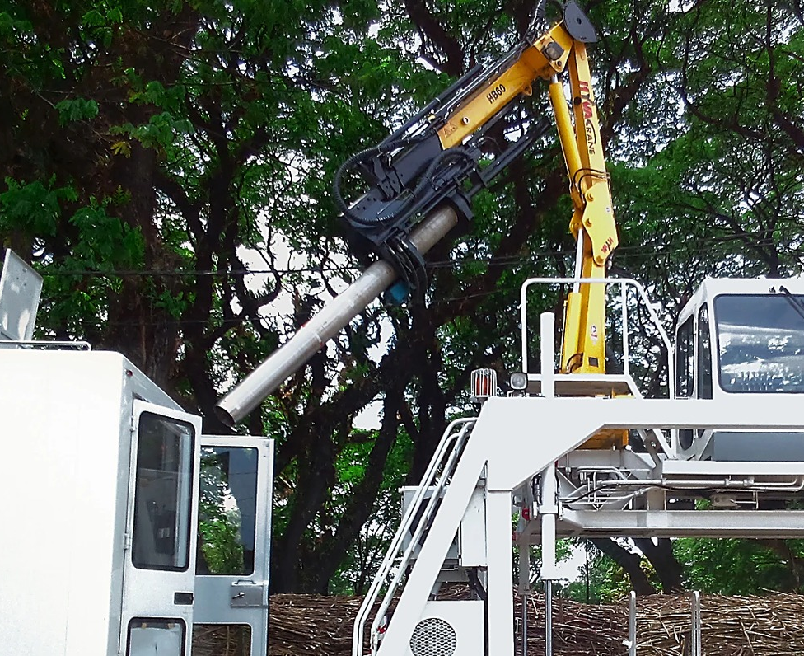
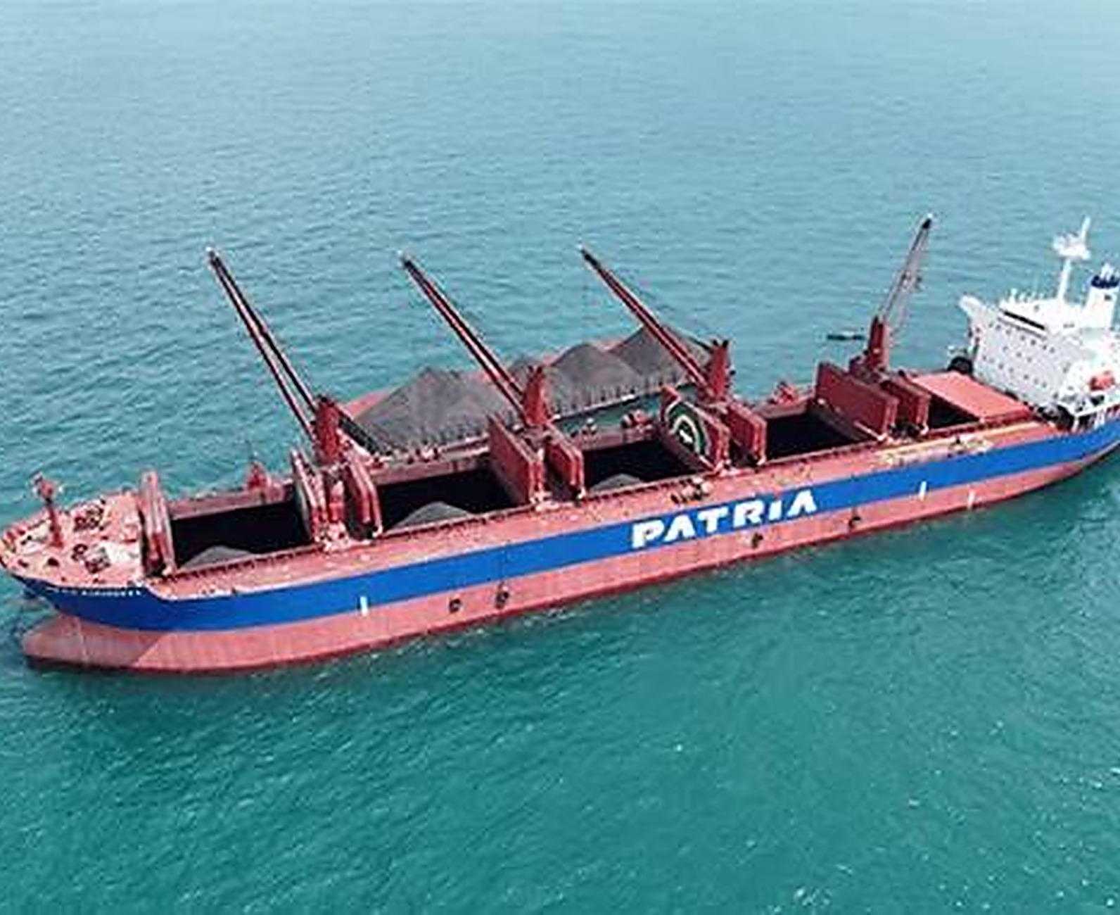


NEDP 6-MONTH REVIEW · COMPANY PROFILE
Company profile
CORPORATE ENTITY STRUCTURE
INDUSTRY COVERAGE
Astra International
Heavy Equipment, Mining, Construction and Energy
United Tractors
Construction machinery
UTPE
Engineering solution and marine
01 Coal and mineral mining
02 Construction
MY COMPANY
NEW · 2025
Distribution and trading
Ship owner and operator
Ship building and repair
WHAT TRIATRA DOES
Distributor of PATRIA and ULTRA products for mining, construction, agriculture, forestry and maritime. Sells units and full after-sales support.
Unit
Parts, components and services
Trader of UTPE units, local and export
Maintenance and remanufacturing
03 Forestry and agro-industry
04 Maritime
NEDP MID YEAR REVIEW 2026 · TIBERIAS K. SIMU
04 / 18

Slide 5

Quote
Site Operation/
Head Office in Jakarta, 6 Site Operations and 9 Site Representatives.
Head Office
Site Operation
Site Representative
13
4
12
14
9
11
8
10
7
3
5
6
16
2
1
15
# | SITE | TYPE | ADDRESS
1 | Head Office | Head office | Jl. Raya Bekasi KM 22, Cakung, Jakarta Timur
2 | Jakarta | Operation | Jl. Raya Bekasi KM 22, Cakung, Jakarta Timur
3 | Tanjung Enim | Rep. | Jl. Lingga Raya 10, Muara Enim, Sumatera Selatan
4 | Pekanbaru | Rep. | Jl. Soekarno Hatta KM 3,5 No. 151, Riau
5 | Banjarmasin | Rep. | Jl. Ahmad Yani KM 13,5 Gambut, Kalimantan Selatan
6 | Sungai Danau | Rep. | Ds. Karang Indah, Angsana, Tanah Bumbu, Kalsel
7 | Tanjung Tabalong | Operation | Jl. A. Yani KM 7,5 Maburai, Tabalong, Kalsel
8 | Batu Kajang | Rep. | Jl. Negara KM 140, Batu Sopang, Paser, Kaltim
# | SITE | TYPE | ADDRESS
9 | Muara Teweh | Rep. | Jl. Ahmad Yani No. 85, Barito Utara, Kalteng
10 | Balikpapan | Operation | Jl. Jend. Sudirman No. 844, Balikpapan, Kaltim
11 | Melak | Rep. | Hauling Road Trubaindo, Kutai Barat, Kaltim
12 | Tabang | Rep. | Workshop Buma Km 6, Hauling Road, Kaltim
13 | Tanjung Redeb | Operation. | Jl. Gunung Panjang No. 101B, Berau, Kaltim
14 | Sangatta | Operation | Jl. HDRS Tango Delta KPC, Kutai Timur, Kaltim
15 | Sumbawa | Rep. | Memco Area Tongo, Sekongkang, Sumbawa Barat, NTB
16 | Timika | Operation | Jl. Kuala Tembaga E-4, Kuala Kencana, Papua

Slide 6
Quote
Organizational Structure
Head Office in Jakarta, 6 Site Operations and 9 Site Representatives.
Ceisar Centiaga
DIRECTOR IN CHARGE
Ricardo Tanada
Marketing Communication
MKT UNIT & STRATEGIC DIV HEAD
Karina Audina E. · Adinda Siti K. (Marcomm) · Rahma (Graphic Designer)
Kresnanto A.W.
Ignatius Indrawan S.
Ugik Praseno
Kresnanto A.W.
MKT STRATEGIC 1 HEAD
MKT STRATEGIC 2 DEPUTY HEAD
MKT STRATEGIC 3 HEAD
APPLICATION ENGINEERING HEAD
Satrio F.R.
Ervin Bahar P.
Baihaqi
Agi Yogiansyah
Big Suppeq, Big Vessel, Bucket
Medium Vessel, Man Hauler, Bus Scania
Mineral Processing, EPC
Offroad Trailer (SST, SDT, LBT), Big Vessel
M. Fawwaz J.
Tiberias K.S. ◄ ME
Yuda Prana
M. Sugeng Riadi
Cabin, Forestry, Agro, Forklift, Towerlamp, Pump
Small Suppeq, Truck Others
Maritime, Renewable Energy
Supporting Equipment (WT, FT, LT), Mixer, EV
Eurico
Celine
Angger Suryo Prastowo
Mining / Non-mining Trailer, Overseas Zone
Ultra Product Support
Manhauler, Towerlamp, Industrial (Crane truck, Tire handler)
Nandu Narpati
Hanifa
Muhammad Fadlan
Admin
Automation, EV
On-road Trailer (FBT, SCT), Medium Vessel, Crusher, Bucket
Fitri Royani
Admin

Slide 7
Marketing Strategic 2 Associate
“My Roles and
My Responsibility.”

Slide 8
Roles and Responsibility /
Where I Involved
In the Supply Chain?
Pre Sales
Sales
After Sales
Gather Voice of customer Identify customer & competitor Ensure offering spec, price, and lead time inline with customer requirement Monitor SLA in offering to customer | Verify order completeness (PO, PJB, DP) Maintain and monitoring orders Ensure proper billing inline with plan | Monitor unit performance follow up problem ensure the problem is not repeated in other order Gather customer feedback
Coordination with | Coordination with: | Coordination with:
Business Consultant Application Engineering Marketing Unit UTPE | Business Consultant Application Engineering Marketing Unit UTPE Finance Triatra | Business Consultant Application Engineering Marketing Unit UTPE Finance Triatra
What is my specific
unit product?
Small Suppeq | Truck Others
Water Truck | Crane Truck
Fuel Truck | Mixer Truck
Lube Truck | Stemming Truck
Specifically in mining and construction industry

Slide 9
Roles and Responsibility /
Where I Involved
In the Strategic Marketing?
Pre Sales
Sales
After Sales
Gather Voice of customer Identify customer & competitor Ensure offering spec, price, and lead time inline with customer requirement Monitor SLA in offering to customer | Verify order completeness (PO, PJB, DP) Maintain and monitoring orders Ensure proper billing inline with plan | Monitor unit performance follow up problem ensure the problem is not repeated in other order Gather customer feedback
Coordination with | Coordination with: | Coordination with:
Business Consultant Application Engineering Marketing Unit UTPE | Business Consultant Application Engineering Marketing Unit UTPE Finance Triatra | Business Consultant Application Engineering Marketing Unit UTPE Finance Triatra
What is my specific
unit product?
Small Suppeq | Truck Others
Water Truck | Crane Truck
Fuel Truck | Mixer Truck
Lube Truck | Stemming Truck
Specifically in mining and construction industry

Slide 10
Roles and Responsibility /
Where I Involved
In the Strategic marketing?
Step | Item | Key point | Supporting data
4C | Change | HYVA has left; value sits in Medium + Heavy | Triatra has no crane brand since HYVA stopped. Medium + Heavy = 41% of units, 64% of value (2023 – 2026). Heavy units 12 → 17 → 35 (2023 – 2025).
 | Competitor | Two leaders, one per class | Medium: Sany Palfinger, 38% of value. Heavy: Palfinger, 66% of value; PK 53002 alone sold 39 of 65 units (2023 – 2026).
 | Customer | Medium buys on price, Heavy buys on quality | China brands take 73% of Medium value; European brands take 85% of Heavy value. 88% go on trucks ≥ 24 t GVW (mining, construction).
 | Company | Partner two brands to serve both buyers | XCMG for price-oriented buyers. F.lli Ferrari for quality-oriented buyers.
STP | Segmentation | Two classes, ten 5-tm tiers | Medium 25 – 45 tm: 196 units, Rp 156 M. Heavy > 45 tm: 65 units, Rp 115 M.
 | Targeting | Take share from the Top 1 model in each tier | Medium: Sany Palfinger SPK32080, SPK36080, SPK42502. Heavy: Palfinger PK 53002, PK 76002, PK 88002.
 | Positioning | Two clear promises | XCMG: same capacity, lower price (SQZ365.4 −9% vs SPK36080). Ferrari: European features, cheaper where it wins (−23% at 25 – 30 tm, −32% at 45 – 50 tm) and faster delivery from China stock (~14 weeks).
4P | Product | Offer Ferrari models that beat the Top 1 on features | Red Power (more working range), SDV (less boom flex), Magic Touch (auto open/stow): Sany Palfinger has none. PB, RS, ECM: equal to Palfinger.
 | Price | Negotiate a better price with Ferrari and XCMG | Ferrari: lower price on 746 A4 (+48%), 9601CR A8 (+85%), 990R (+79%). XCMG: Triatra special price on SQZ325.4 and SQZ365.4.
 | Place | Negotiate stock to cut lead time | Ferrari stocks 268 A4 and FBR450R A4 in China (14-week lead time) and main components in Malaysia. XCMG via GM Tractors.
 | Promotion | Sell a ready-to-work package | Crane + flatdeck + installation (+2-year warranty on Ferrari). Exhibitions and customer visits with a Marcom sales kit.

Slide 11
Quote
Project Charter /
What is the background, the objective and the benefit?
Project name
Indonesia Folding Crane Market Strategy
Background
Hyva cranes has discontinued their crane production
Objective
Mapping total imported folding crane (2023 – 26) in Indonesia Targeted on ton meter class that have the most value, knowing the competitor brands and whics model is the best (4C) Pick top 1 competittors model in every ton meter subclass (STP) Set Product, Price, Place and Promotion for challenger model (4P)
Project Scope
Market Study For Indonesian Folding Crane specific on price and specification
KPI / Metric
Mapping total market size of Medium & Heavy cranes by tm class, brand and model (2023 – 2026) Competitive dynamics, stocking strategy, value differentiators
Support Requirements
Business Consultant, Marketing Communication, Application Enginnering, UTPE
Project Timeframe
Activity | 2026 |  |  |  |  |  |  | 2027
 | Jun | Jul | Aug | Sep | Oct | Nov | Dec | Jan | Feb | Mar
Market study (4C)
STP and challenger choice
Negotiate with Ferrari and XCMG
Sales kit with Marcom
Exhibition and customer visits
Quotation → PO → first unit sold
Benefit of Project
Gives Managements and sales a clear answer per tm class: which brand, which model, at what price that have complete competitiveness
Project Team
Executive Sponsor : David Advisor : Ceisar Centiaga Owner : Ricardo Tanada Coordinator : Ignatius Indrawan Sumawinata Project Lead : Tiberias Krisgaharu Simu Team Member : Marketing Unit · Application Engineering, UTPE Business Consultant
Project Approval
Lead
Coordinator
Advisor
Executive Sponsor
Date:
Date:
Date:
Date:
Tiberias Krisgaharu Simu
Ignatius Indrawan
Ricardo Tanada
Ricardo Tanada

Slide 12
Quote
How big the market is?
And who's lead the market?
Indonesian Import Folding Crane 23-26/
Triatra Need To Focus on Medium and Heavy class
Medium and Heavy class contribute 62% (Rp 208,3 Bio out of Rp 337,2 Bio) of the total market size from 2023 to 2026, while their transactions are just 38% (293 units out of 764 units) of the total imported quantity.
Imported folding cranes by class per year, 2023 – 2026
Imported folding cranes by class per year, 2023 – 2026
Light fell from 109 to 52–53 units after 2023, while Heavy more than doubled to 39 units in 2025
(17% of that year).
39% of total import comes from light and small class
62% of total value or 208,3 Bio comes from Medium and Heavy class
Avg Sales (Unit) Light & Small Class
118 Units in Avg
Avg Sales (Unit) Medium & Heavy class
80 Units in Avg
>
61% of total import comes from light and small class
38% of total value is
comes from light and small
Light (< 8 tm)
Small (8–25 tm)
Medium (25–45 tm)
Heavy (> 45 tm)
Light (< 8 tm)
Small (8–25 tm)
Medium (25–45 tm)
Heavy (> 45 tm)
Application Engineering makes ton meter class classification to make easier identification class
Selling Less but gain more value

Slide 13




Quote
Did Medium and Heavy class still the leader? And who's lead the market?
Indonesian Import Folding Crane 2025
Triatra Need To Focus on Medium and Heavy class
In 2025, Medium and Heavy imports reached 99 units (Rp 75,4 Bio) out of 227 units (Rp 112,6 Bio). Three brands cover 82% of Medium and 85% of Heavy units.
Market 2025: focus on Medium & Heavy
Medium & Heavy 2025: who holds the market
Units by brand
3 brands holds 82% of Unit
18% of Unit
44% of total import comes from light and small class
99 Units
67% of total Vaue comes from Medium and Heavy Class
99 Units
>
Value by brand
3 brands holds 85% of Unit
Others 15%
3 brands holds 81% of value
Others 19%
Light +
Small
excluded
3 brands = 86% of value
Others 14%
Medium | Heavy
Sany Palfinger, XCMG and Palfinger holds 82% of units and 81% of value | Palfinger, Amco Veba and XCMG holds 86% of value and 85% of units
Light (< 8 tm)
Small (8–25 tm)
Medium (25–45 tm)
Heavy (> 45 tm)

Slide 14
Quote
Which tiers hold the value?
Which models do we fight?
Medium Class: Where to Focus/
Medium: focus on 30–40 tm, where two tiers hold 69% of Medium value
Take on HIAB X-CLX 388 with FBR350R A4 and Palfinger PK 41002 with 7441C.
69%
of Medium value sits in 30–35 tm (34%) and 35–40 tm (34%)
14–25%
F.lli Ferrari is cheaper than the top 1 model in both tiers
2
models to beat, HIAB X-CLX 388 and Palfinger PK 41002, with equal or better features
% of Medium import value by tier, and top 1 model
Head to head
Top 1 model | F.lli Ferrari | Equal features | Ferrari only
HIAB X-CLX 388 (34 tm) Rp 1.460.000.000 | FBR350R A4 Rp 1.090.000.000 25% cheaper | • Radio remote control | • Magic Touch auto fold • Dynamic Load Diagram • Double linkage, power boost* • Electronic control (HIAB: manual)
Palfinger PK 41002 (38 tm) Rp1.440.000.000 | 7441C (44 tm) Rp 1.240.000.000 14% cheaper | Double linkage (Red Power = Power Link Plus) Power boost (PPB = HPLS) Elektronik (ECM = Paltronic) Stabilitas (Dynamic Load Diagram = HPSC) | • Magic Touch auto fold
69% of Medium value
142 of 214 units
>
Source: Crane Market GVW Pairing v11 (Noir), Jan 2023 – 14 Aug 2026; Hyva excluded; tier by original max lifting moment. Prices as on the Medium table slide (Rp 17.803/USD, incl. duty and import tax; 7441C estimate). Features: Hiab, Palfinger and F.lli Ferrari product pages and brochures; HIAB X-CLX 388 is manual control with optional remote. *Not yet verified on the FBR350R A4 datasheet.

Slide 15
Quote
Which tiers hold the value?
Which models do we fight?
Heavy Class: Where to Focus/
Heavy: focus on 45–55 tm, where two tiers hold 87% of Heavy value
Take on Amco Veba V950 and Palfinger PK 53002 with one model, FBR450R A4.
87%
of Heavy value sits in 45–50 tm (26%) and 50–55 tm (60%)
23–32%
FBR450R A4 is cheaper than the top 1 model in both tiers
1
model covers both tiers, only 4 tm smaller than PK 53002
% of Heavy import value by tier, and top 1 model
Head to head
Top 1 model | F.lli Ferrari | Equal features | Ferrari only
Amco Veba V950 (46 tm) Rp 1.990.000.000 | FBR450R A4 (46 tm) Rp 1.350.000.000 32% cheaper | • Double linkage • Power boost • Electronic control • Magic Touch auto fold | • Fast boom extension (RS) • Smooth Descent Valve: less boom bounce
Palfinger PK 53002 (50 tm) Rp 1.760.000.000 | FBR450R A4 (46 tm) Rp 1.350.000.000 23% cheaper | • Double linkage • Power boost • Fast boom extension • Boom damping (SDV = AOS) • Electronic control • Auto fold | • No extra feature • Wins on price • 4 tm smaller (46 vs 50 tm)
87% of Heavy value
59 of 68 units
>
Source: Crane Market GVW Pairing v11 (Noir), Jan 2023 – 14 Aug 2026; Hyva excluded; tier by original max lifting moment. Competitor price = highest import unit price × Rp 17.803/USD × (1 + 5% duty) × (1 + PPN 11% + PPh 22 2.5%). FBR450R A4 = TSP price list Rev1 Jun 2026 less 13.6% TSP margin and 3% warranty; 45.5 tm, shown rounded. Features: Amco Veba, Palfinger and F.lli Ferrari brochures and earlier feature comparison.

Slide 16
Quote
How do we win in each tier?
Marketing Mix (4P)/
Win with European features at a lower price, and stock close to Indonesia
Three F.lli Ferrari models cover four tiers: 69% of Medium value and 87% of Heavy value.
 | Medium 30–35 tm | Medium 35–40 tm | Heavy 45–50 tm | Heavy 50–55 tm
Target (top 1 model) | HIAB X-CLX 388 (34 tm) 34% of Medium value | Palfinger PK 41002 (38 tm) 34% of Medium value | Amco Veba V950 (46 tm) 26% of Heavy value | Palfinger PK 53002 (50 tm) 60% of Heavy value
Product | FBR350R A4 • Magic Touch auto fold • Dynamic Load Diagram • Electronic control (HIAB is manual) | 7441C (44 tm) • 6 tm more capacity • Same key features as PK 41002 | FBR450R A4 (46 tm) • Fast boom extension • Smooth Descent Valve | FBR450R A4 (46 tm) • Same key features as PK 53002 • 4 tm smaller
Price | Rp 1.090 Jt 25% cheaper than Rp 1.460 Jt | Rp 1.240 Jt 14% cheaper than Rp 1.440 Jt | Rp 1.350 Jt 32% cheaper than Rp 1.990 Jt | Rp 1.350 Jt 23% cheaper than Rp 1.760 Jt
Place | Ask F.lli Ferrari to keep crane units and spare parts in Malaysia, so we can deliver to Indonesia in under 14 weeks (TBC).
Promotion | Sell as a package: crane + flatdeck + installation + 2-year warranty. Show the units at exhibitions with a Marcom sales kit.
Source: Crane Market GVW Pairing v11 (Noir), Jan 2023 – 14 Aug 2026; Hyva excluded. Competitor price = highest import unit price × Rp 17.803/USD, incl. duty and import tax. F.lli Ferrari price = TSP price list Rev1 Jun 2026 less 13.6% TSP margin and 3% warranty; 7441C estimate. Malaysia stock and lead time to be confirmed with F.lli Ferrari.

