Slide 1
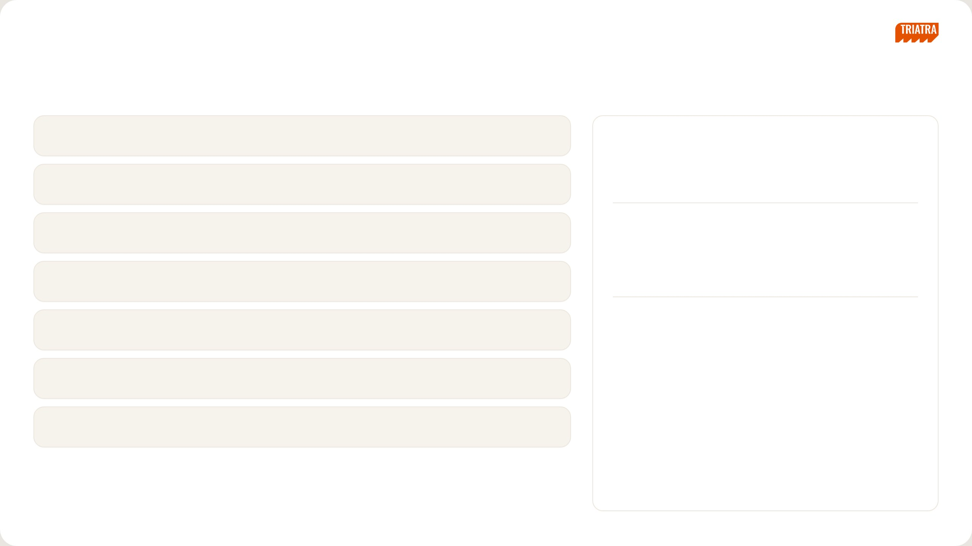
[ INTERNAL USE ONLY ]
NEDP MID YEAR REVIEW 2026
Agenda
00
Personal Information
PRESENTER / ID
Tiberias K. Simu
01
Company Profile
MARKETING STRATEGIC 2 ASSOCIATE
02
Site Operation
PRODUCTS I OWN
Small Suppeq
03
Truck Others
Organization Chart
04
Roles & Responsibility
PT Triatra Sinergia Pratama
Marketing Unit & Strategic Division
05
Job Description Execution
06
Project — F.lli Ferrari Crane Strategy
NEDP MID YEAR REVIEW 2026
01 / 31

Slide 2

[ INTERNAL USE ONLY ]
PERSONAL
Personal Information
About Me
Onboarding Journey
NEDP MID YEAR REVIEW 2026
02 / 31

Slide 3

[ INTERNAL USE ONLY ]
SECTION 01
Company Profile
Part of the UTPE Group · Distributor of PATRIA and ULTRA
NEDP MID YEAR REVIEW 2026
05 / 31

Slide 4
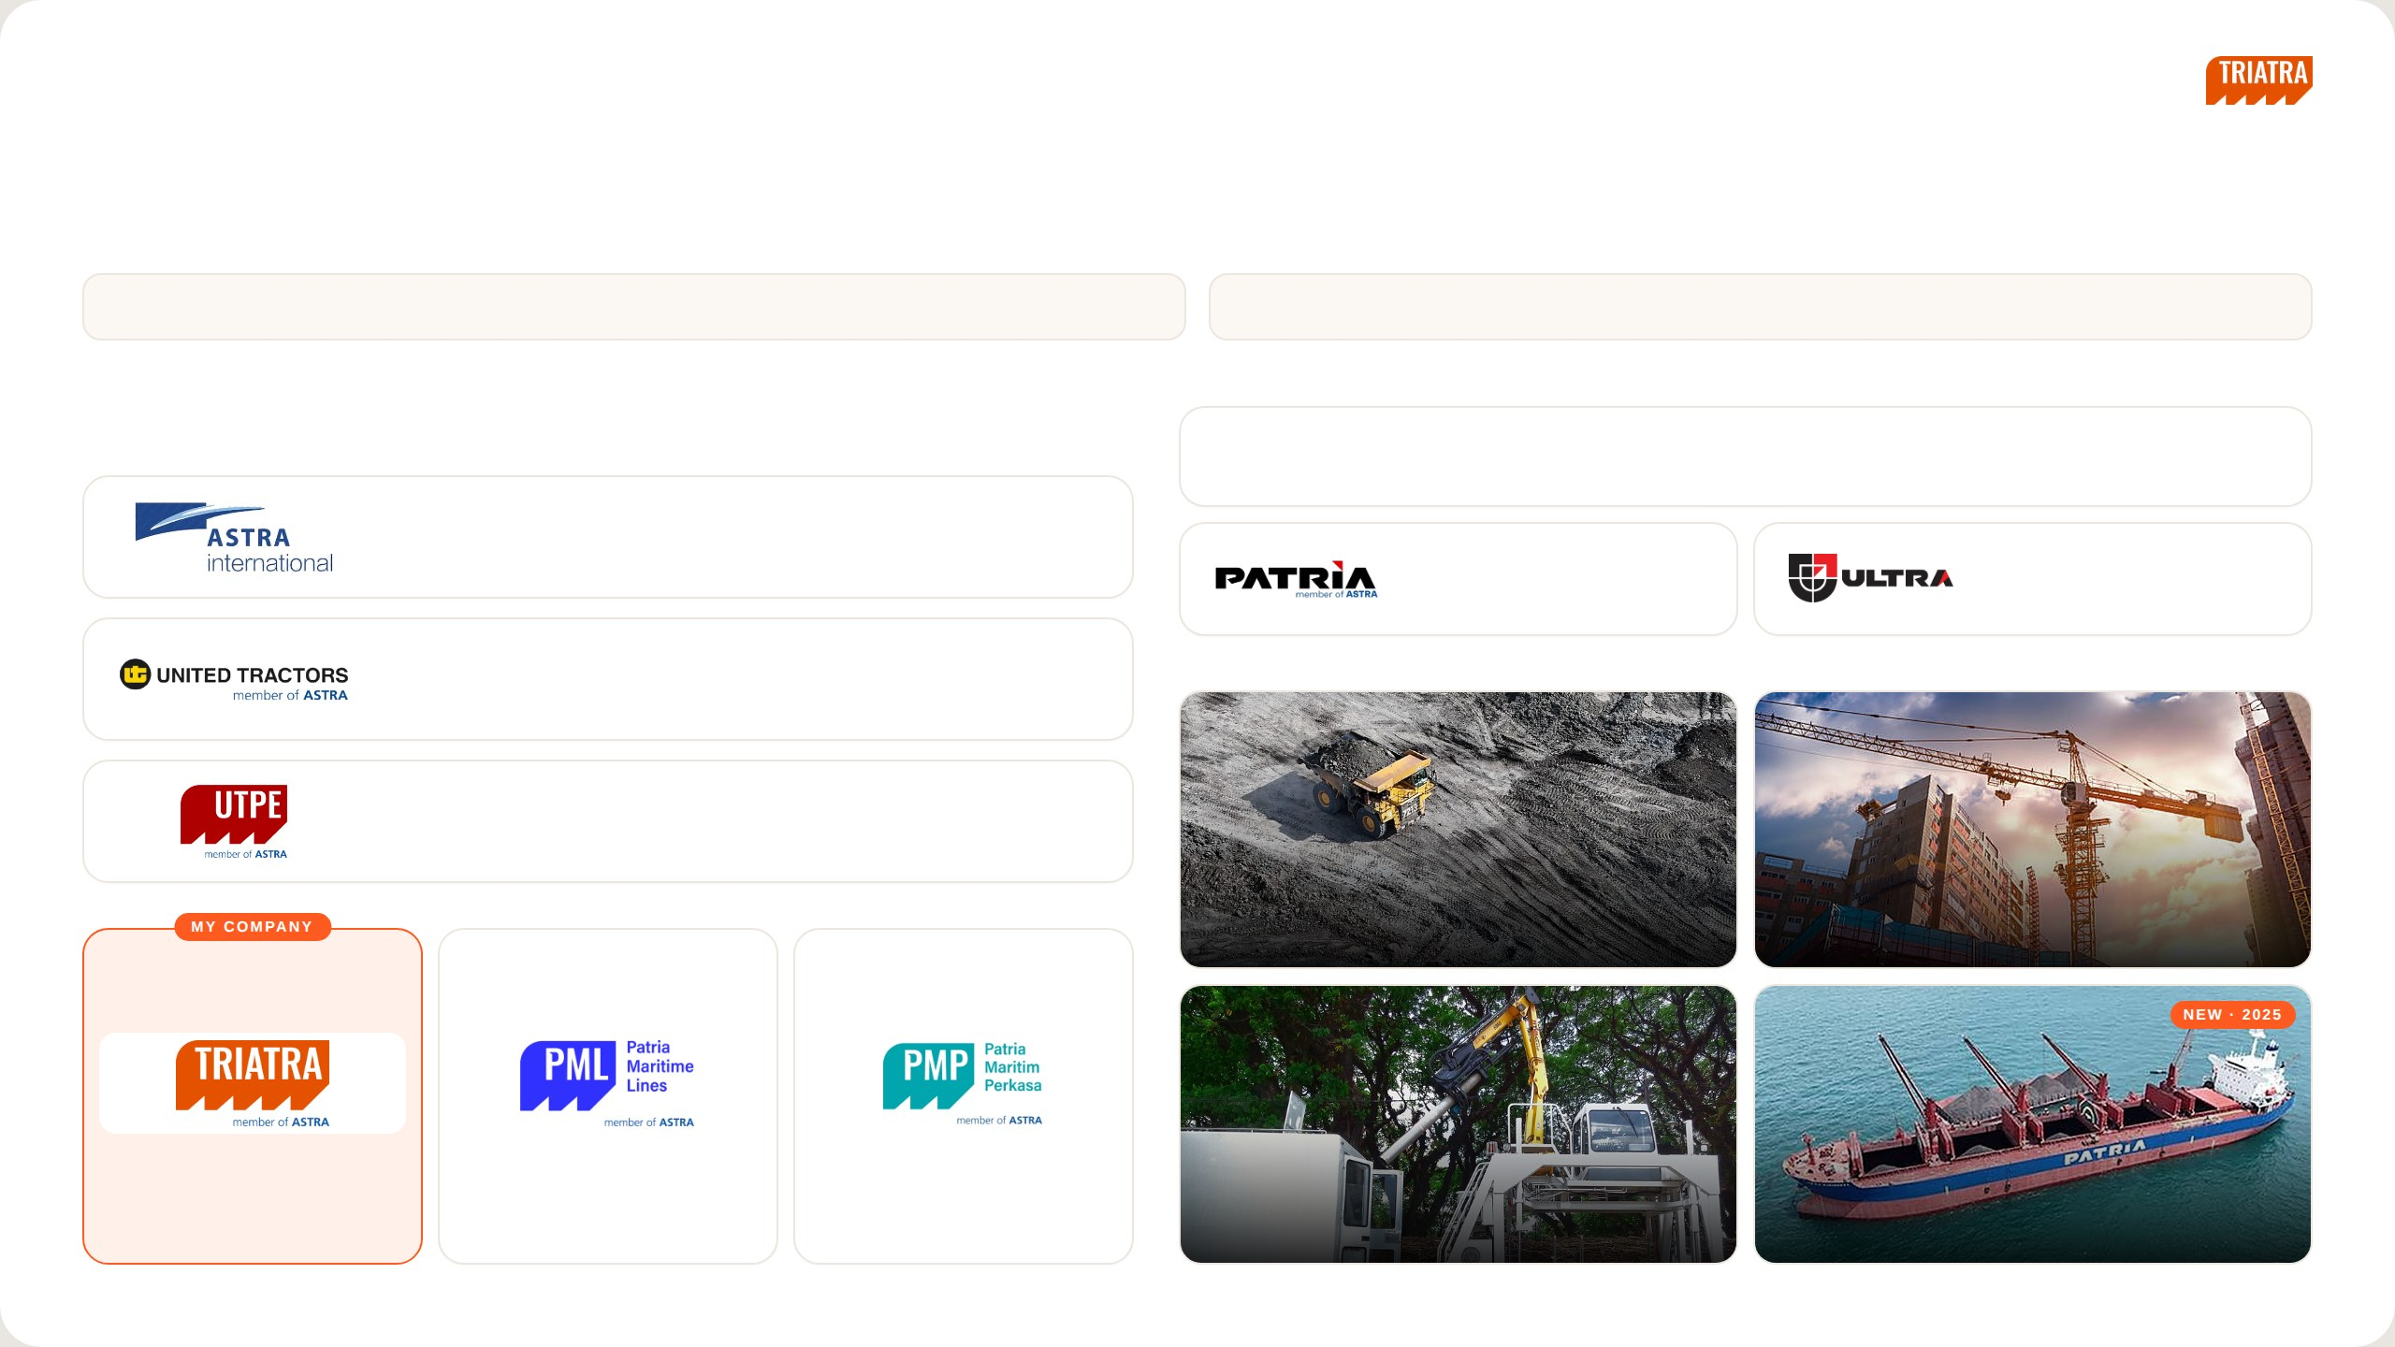
[ INTERNAL USE ONLY ]
SECTION 01 · COMPANY PROFILE
Company Profile
01 Triatra is part of the UTPE Group and AHEMCE, focusing on Distributorship and Trading.
02 Starting in 2025, Triatra develops a new business line in Marine.
CORPORATE ENTITY STRUCTURE
PT TRIATRA SINERGIA PRATAMA
PT Triatra Sinergia Pratama is one of the entities within the UTPE Group, part of the UT Group and the AHEMCE
Distributor of PATRIA and ULTRA products for mining, construction, agriculture, forestry and maritime. Triatra offers
business line of PT Astra International Tbk.
both equipment units and full after-sales support, from spare parts and remanufacturing to maintenance services.
Astra International
Astra Heavy Equipment, Mining, Construction, and Energy
Unit
Part, Component & Services
International & domestic trader of
After-sales maintenance &
UTPE units
remanufacturing
United Tractors
INDUSTRY COVERAGE
Construction Machinery
UTPE
Engineering Solution & Marine
01
02
Coal & Mineral Mining
Construction
Distributorship and Trading
Ship Owner & Operator
Ship Building and Repair
03
04
Forestry & Agroindustry
Maritime
NEDP MID YEAR REVIEW 2026
06 / 31

Slide 5

[ INTERNAL USE ONLY ]
SECTION 02
Site Operation
NEDP MID YEAR REVIEW 2026
07 / 31

Slide 6
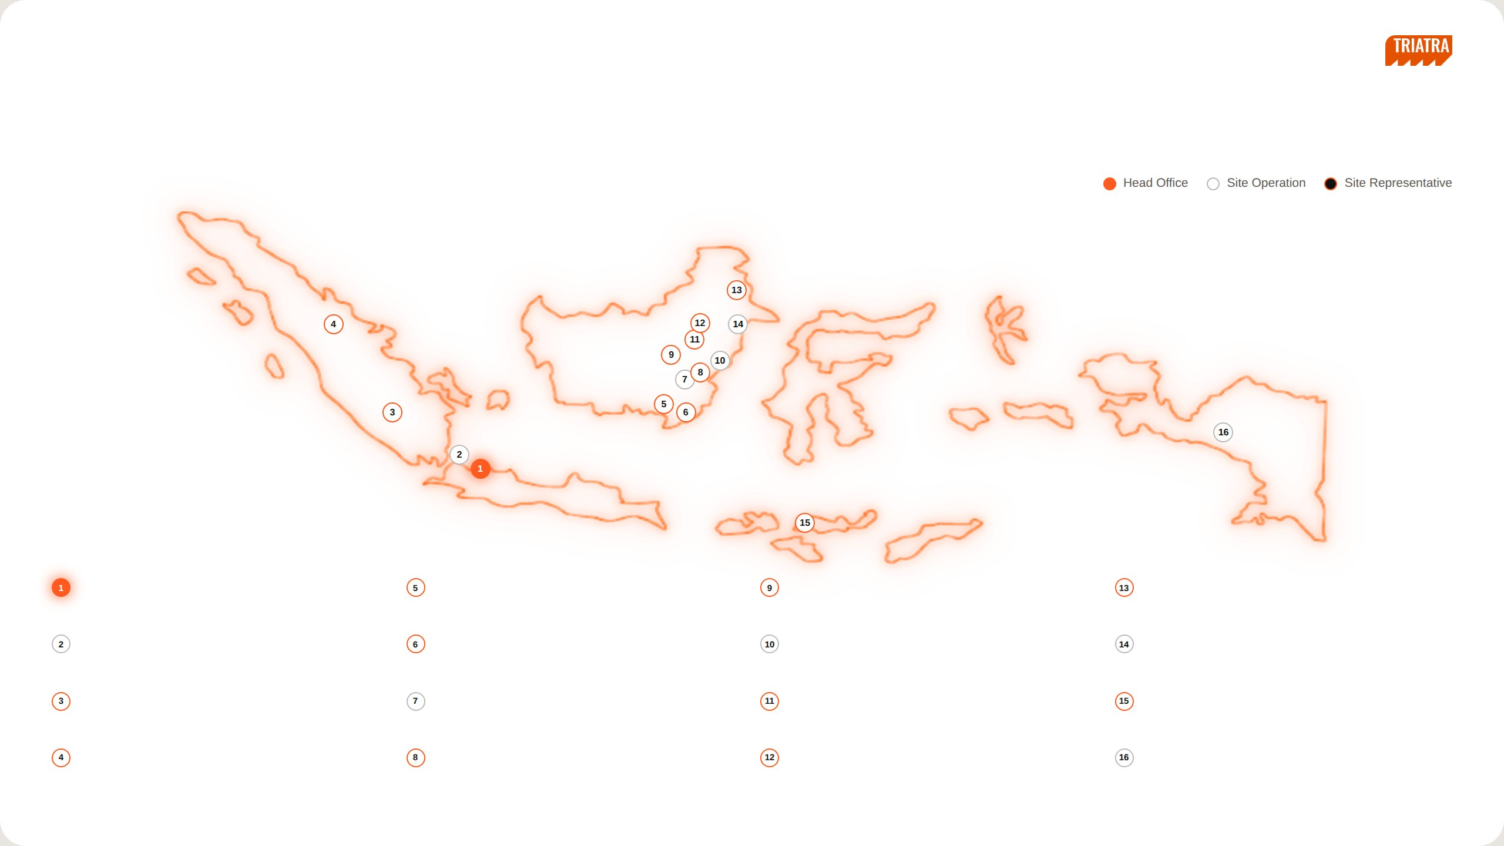
[ INTERNAL USE ONLY ]
SECTION 02 · SITE OPERATION
Site Operation & Support
Triatra covers many areas in Indonesia, with the Head Office in Jakarta, 5 Site Operations and Site Representatives.
Head Office
Banjarmasin
Muara Teweh
Tanjung Redeb
Jl. Raya Bekasi KM 22, Cakung, Jakarta Timur, 13910
Jl. Ahmad Yani KM 13,5 Gambut, Banjarmasin, Kalimantan Selatan,
Jl. Ahmad Yani No. 85, Kel. Melayu, Kab. Barito Utara, Kalimantan
Jl. Gunung Panjang RT.04 No. 101B, Kab. Berau, 77311
70652
Tengah
Jakarta
Sungai Danau
Balikpapan
Sangatta
Jl. Raya Bekasi KM 22, Cakung, Jakarta Timur, 13910
Ds. Karang Indah RT 12/RW 03, Kec. Angsana, Tanah Bambu,
Jl. Jenderal Sudirman No. 844, Balikpapan, Kalimantan Timur, 76114
Jl. HDRS Tango Delta KPC, Mine Site Sangatta, Kutai Timur, 75683
Kalimantan Selatan
Tanjung Enim
Tanjung Tabalong
Melak
Sumbawa
Jl. Lingga Raya 10, Kel. Muara Enim, Sumatera Selatan, 31711
Jl. A. Yani KM 7,5 Maburai, Kec. Murung Pudak, Kab. Tabalong,
D/A PT Tambang Raya Usaha Tama, Hauling Road Trubaindo, Muara
Memco Area Tongo, Sekongkang, West Sumbawa, Nusa Tenggara
Kalimantan Selatan
Lawa, Kutai Barat, Kalimantan Timur
Barat, 84457
Pekanbaru
Batu Kajang
Tabang
Timika
Jl. Soekarno Hatta KM 3,5 No. 151, Pekanbaru, Riau, 28291
Jl. Negara KM 140 Batukajang, Kec. Batu Sopang, Kab. Paser,
Site Indonesia Pratama, Workshop Buma Km 6, Hauling Road
Jl. Kuala Tembaga E-4 LIP Kuala Kencana, Timika, 99920
Kalimantan Timur
Baratabang, Kec. Muara
NEDP MID YEAR REVIEW 2026
08 / 31

Slide 7

[ INTERNAL USE ONLY ]
SECTION 03
Organization Chart
NEDP MID YEAR REVIEW 2026
09 / 31

Slide 8
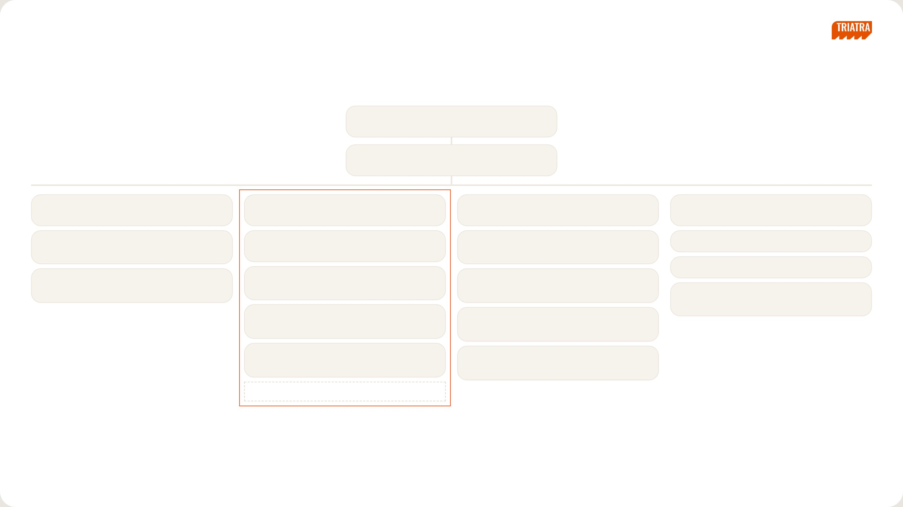
[ INTERNAL USE ONLY ]
SECTION 03 · ORGANIZATION CHART
Organization Structure
Ceisar Centiaga
DIRECTOR IN CHARGE
Ricardo Tanada
MKT UNIT & STRATEGIC DIV HEAD
Kresnanto A.W.
Ricardo Tanada (c)
Ugik Praseno
Marketing Communication
MKT STRATEGIC 1 HEAD
MKT STRATEGIC 2 HEAD
MKT STRATEGIC 3 HEAD
MARCOMM
Satrio F.R.
Ignatius Indrawan S.
Baihaqi
Karina Audina E.
Big Suppeq, Big Vessel, Bucket
DEPUTY HEAD
Mineral Processing, EPC
Ervin Bahar P.
Adinda Siti K.
M. Fawwaz J.
Yuda Prana
Cabin, Forestry, Agro, Forklift, Towerlamp, Pump
Medium Vessel, Man Hauler, Bus Scania
Maritime, Renewable Energy
Rahma
Tiberias K.S. ◄ ME
Graphic Designer
Celine
Small Suppeq, Truck Others
Ultra Product Support
Eurico
Hanifa
Mining / Non-mining Trailer, Overseas Zone
Automation, EV
Nandu Narpati — Admin
NEDP MID YEAR REVIEW 2026
10 / 31

Slide 9

[ INTERNAL USE ONLY ]
SECTION 04
Roles & Responsibility
A — Position & Products
B — Strategic vs Supply Chain
NEDP MID YEAR REVIEW 2026
11 / 31

Slide 10
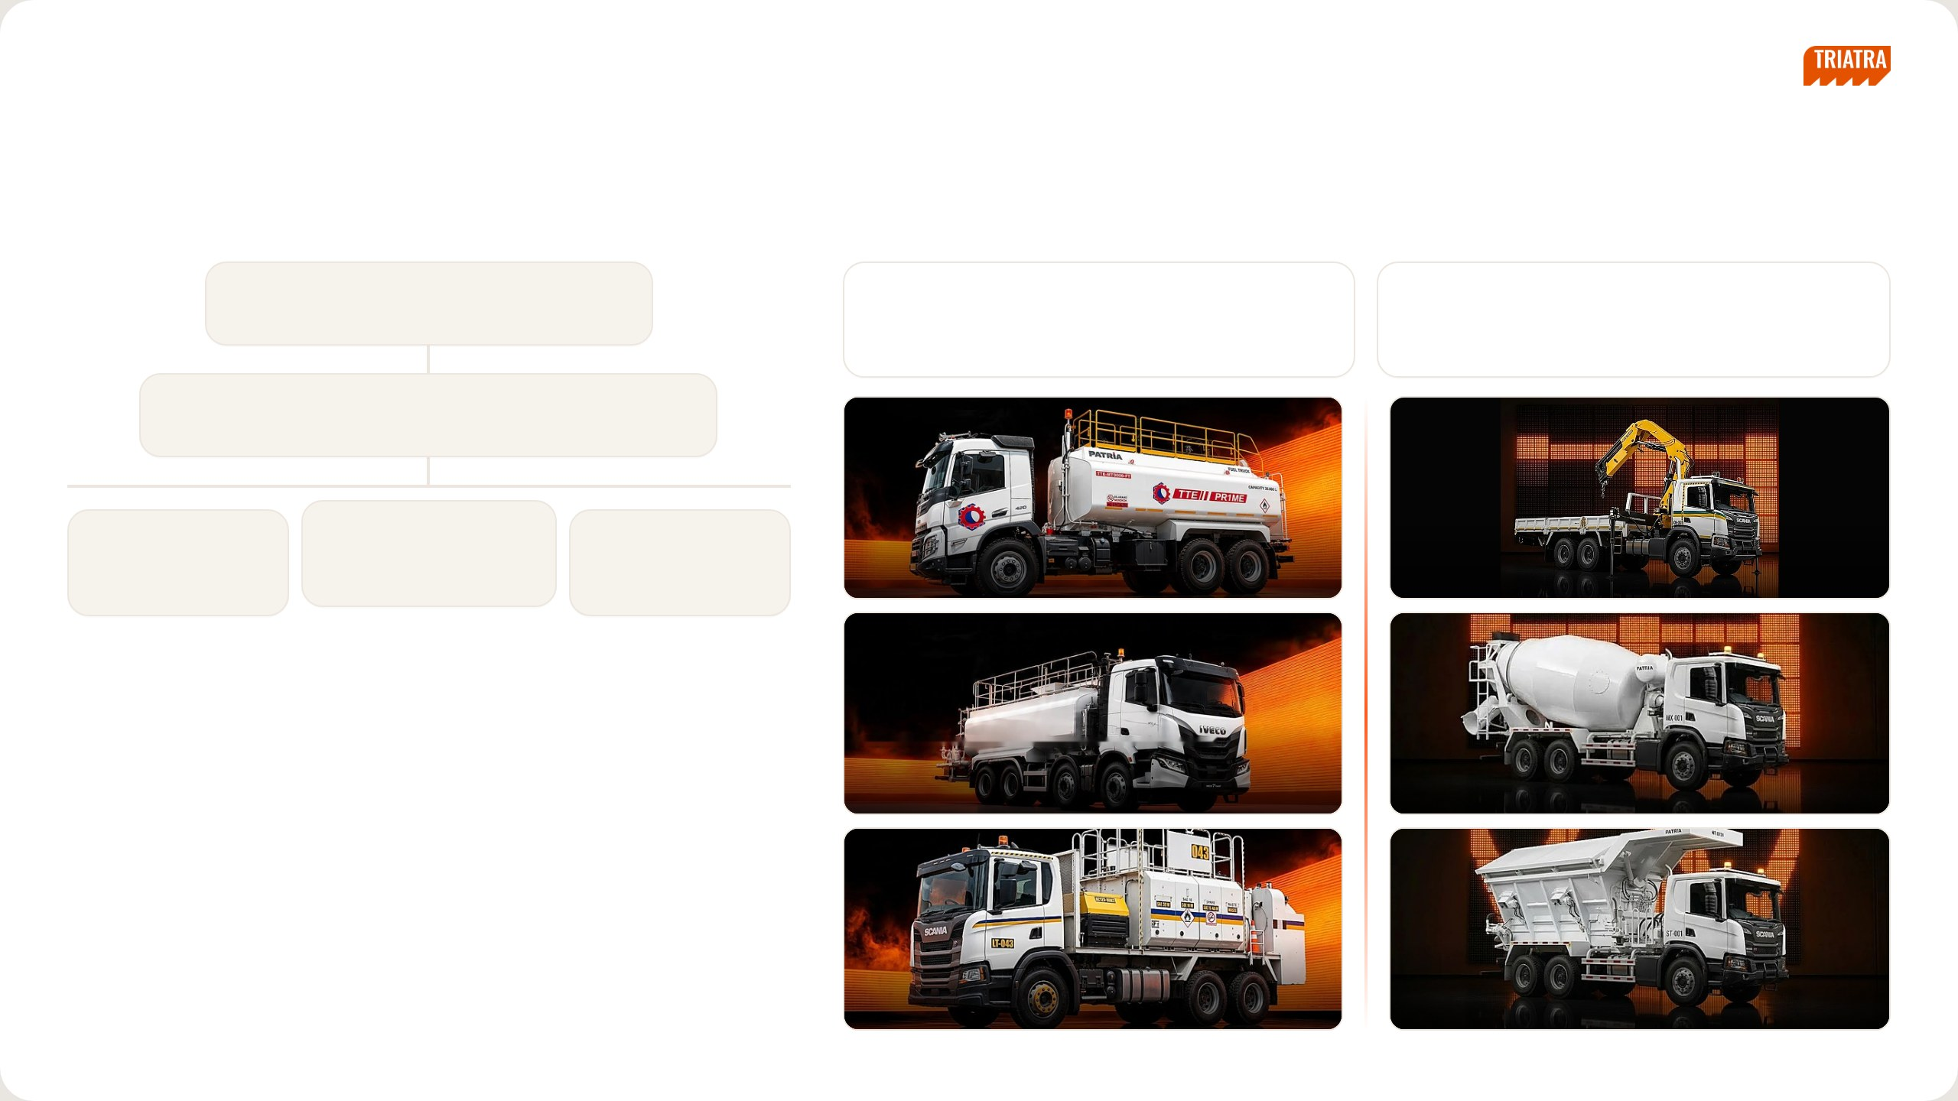
[ INTERNAL USE ONLY ]
SECTION 04 · ROLES & RESPONSIBILITY · A
Position & Products
REPORTING LINE
MY PRODUCTS
Ricardo Tanada
Small Suppeq
Truck Others
DEPT HEAD (CONCURRENT)
Water Truck (WT20, WT35), Lube Truck (LT08), Fuel Truck
Mining Crane, Fire Truck, Mixer Truck, Tyre Truck, Steaming
(FT20) and similar supporting units
Truck and other special-purpose trucks
Ignatius Indrawan Sumawinata
DEPUTY HEAD
Ervin Bahar P.
Tiberias K. Simu
Eurico
Medium Vessel, Man
Small Suppeq, Truck Others
Trailer, Overseas Zone
Hauler, Bus Scania
Fuel Truck (FT)
Crane Truck
ASSOCIATES
Water Truck (WT)
Mixer Truck
Lube Truck (LT)
Stemming Truck
NEDP MID YEAR REVIEW 2026
12 / 31

Slide 11
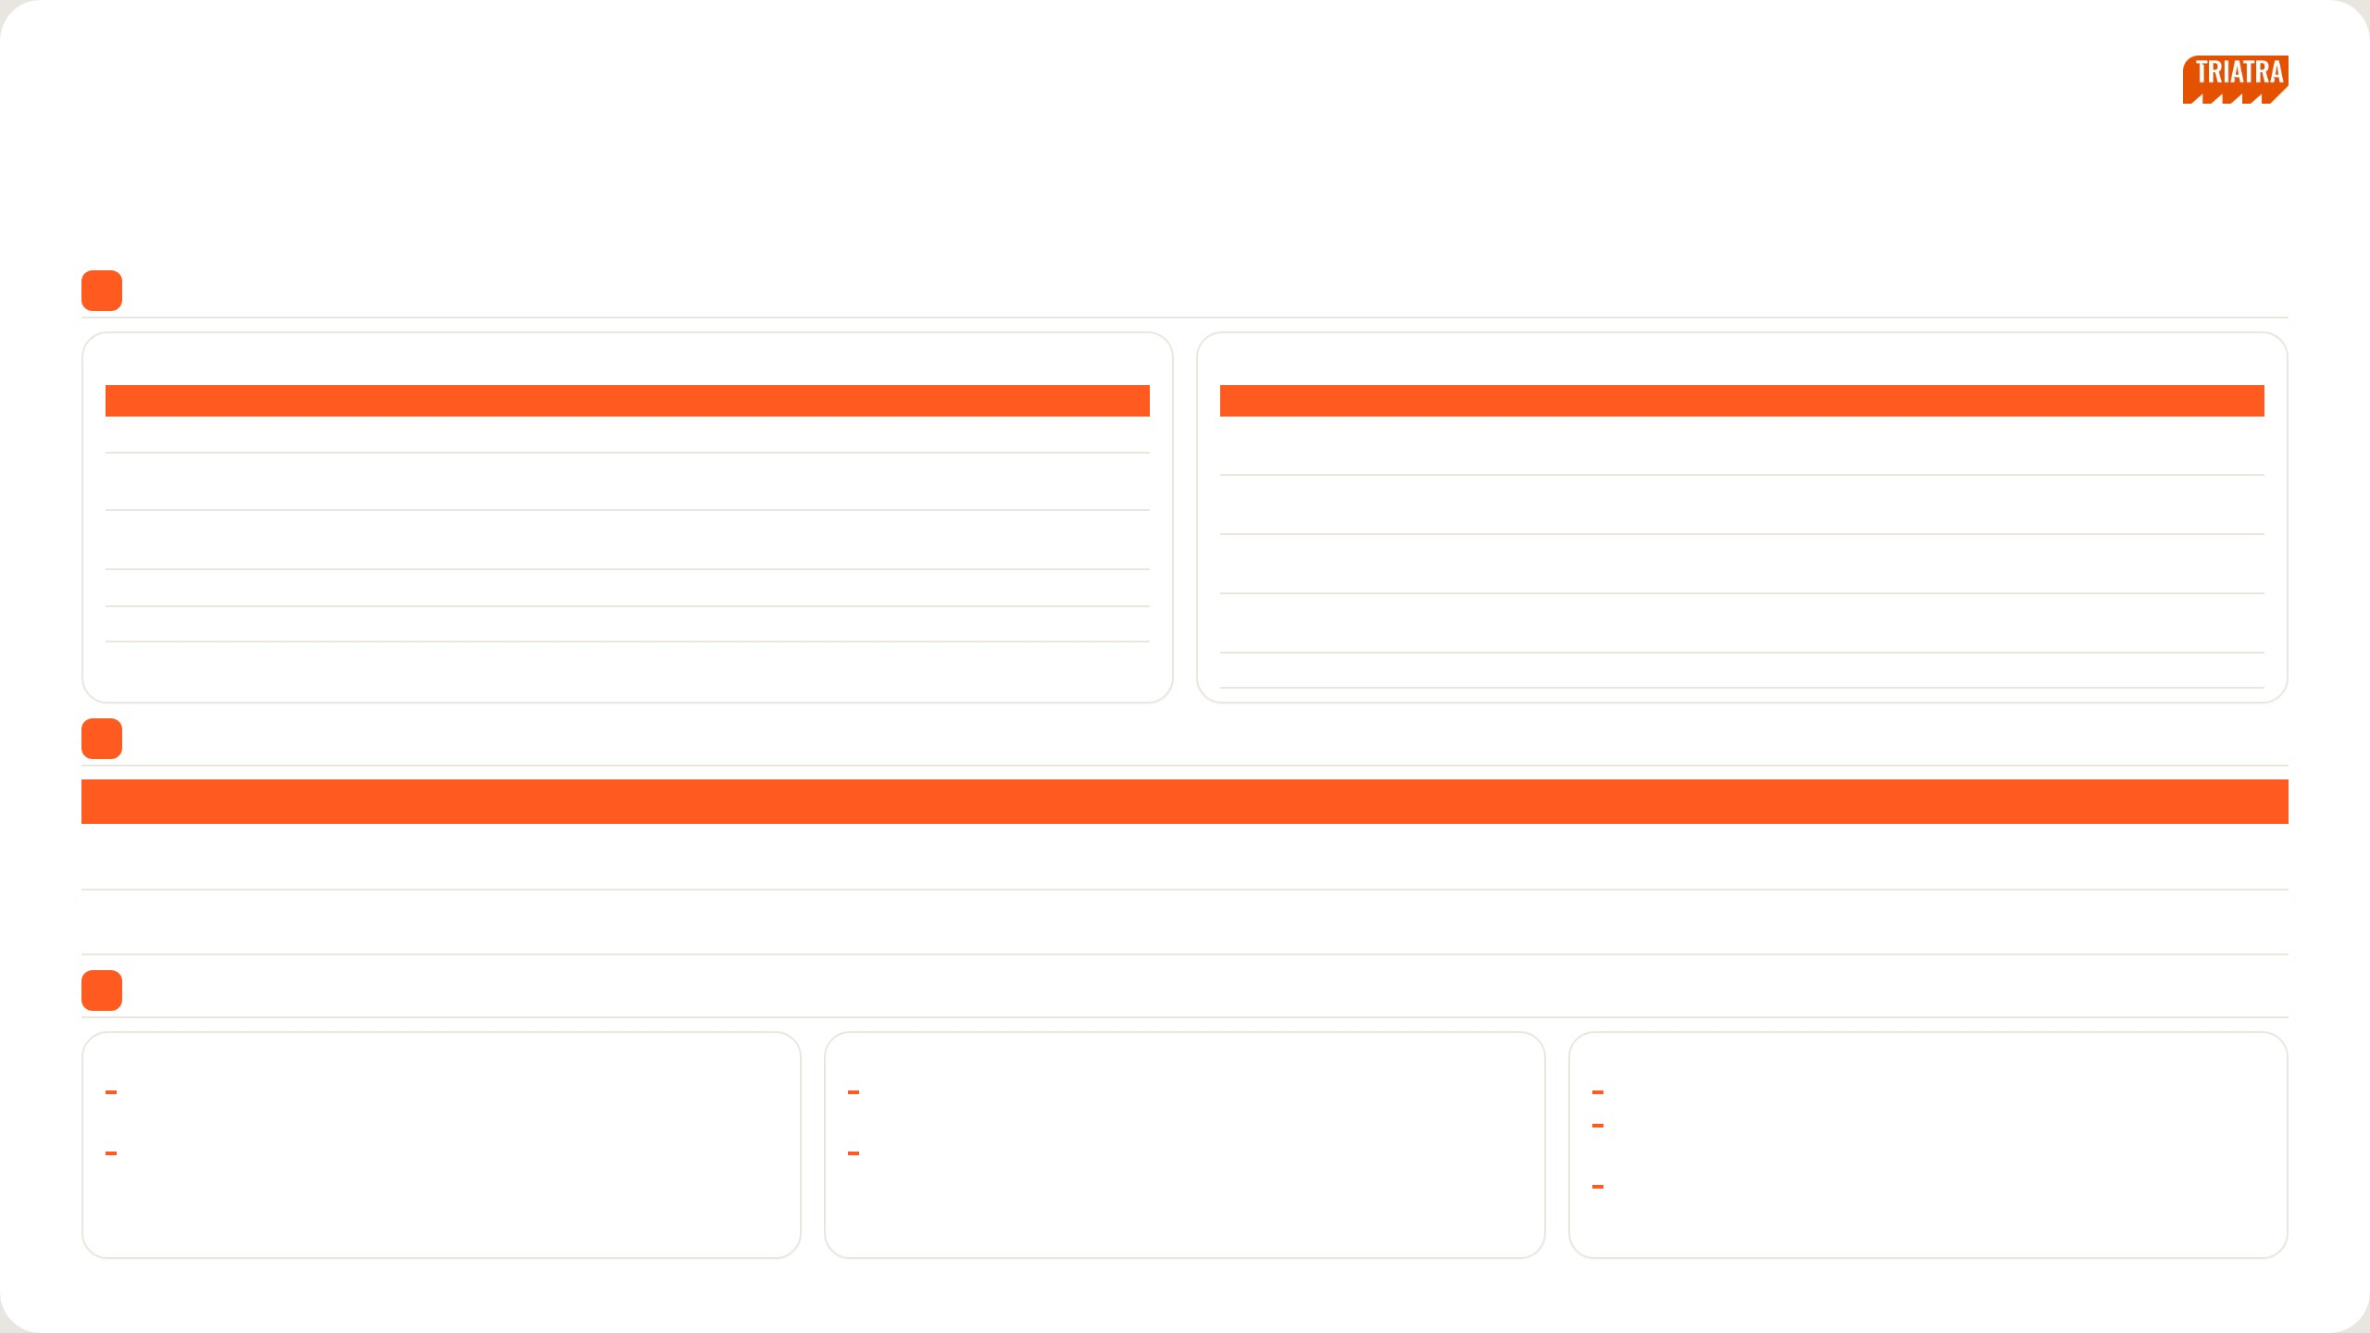
[ INTERNAL USE ONLY ]
SECTION 04 · ROLES & RESPONSIBILITY · B
Strategic vs Supply Chain
1
Strategic vs Supply Chain
A. STRATEGIC
Sets the direction · for management decisions
B. SUPPLY CHAIN
Runs the transaction · for operations
EXAMPLE ACTIVITIES
END RESULT
EXAMPLE ACTIVITIES
END RESULT
Pricing & Market Analysis: price & market analysis simulation
Basis for the pricing strategy
Demand Check: rising demand in PCR, buying reason, location,
Clear demand before quoting
Market Study & Program Development: market data, competitor
Market size / share, segmentation, positioning & targeting
priority, expected price
mapping, new product analysis, summary
Preliminary Drawing Review: unit function, critical components,
Critical price / lead-time items identified
Market Program for Support Sales: sales tools (pamphlet), campaign
Programs ready for the sales team
Application Engineering
& project showcase, event support
Request Quote to UTE: full data, standard GP 13.6%, SLA, result into
Quote ready for the sales team
Performance Reporting: PICA analysis, billing report
Input for performance evaluation & management decisions
PCR
Innovation & Development: innovation project & development
Innovation framework; field conditions documented
Close Won → CPO: PO / PJB in CRM, QFD, RFD = PO Interco due
PO Interco issued
date, approval route
Monitoring: production follow-up, QFD vs actual, painting style, FAT
Unit delivered on RFD; billing documents complete
2
SIPOC
SUPPLIER
INPUT
PROCESS
OUTPUT
CUSTOMER
SUPPLY CHAIN
BC / Sales, UTE (Patria), non-Patria
PCR demand, preliminary drawing, PO /
Quote request → close won → PO Interco → production
Quotation, PO Interco, BAST / BAPB, invoice
Sales team, end customer,
vendors, forwarders
PJB, QFD
monitoring → billing
Finance
STRATEGIC
CRM, sales & GP data, market sources,
Market data, competitor specs, price
Market study, price analysis, sales programs, GP & PICA
Market study, CRM price list, sales tools, GP
Management / BOD, Sales
UTPE
history, GP results
reporting
/ PICA report
team
3
Dimensions, Working Relationships & Work Challenges
Dimensions
Working Relationships
Work Challenges
Financial: non-Patria procurement budget, COGS per unit, target margin per
Internal: Sales & Marketing, Warehouse, Finance & Accounting, Legal,
Push UTPE marketing to send unit price quotes quickly
PO
Procurement
Push UTPE marketing and escalate to superiors when production problems
Non-financial: vendors & customers, documents verified, report frequency,
External: customers, Patria & non-Patria vendors, forwarders, UTPE
threaten the timeline
meetings & site visits
Sudden customer quote requests that need a price in a very short time
NEDP MID YEAR REVIEW 2026
13 / 31

Slide 12

[ INTERNAL USE ONLY ]
SECTION 05
Job Description Execution
A — Strategic
B — Supply Chain
NEDP MID YEAR REVIEW 2026
14 / 31

Slide 13
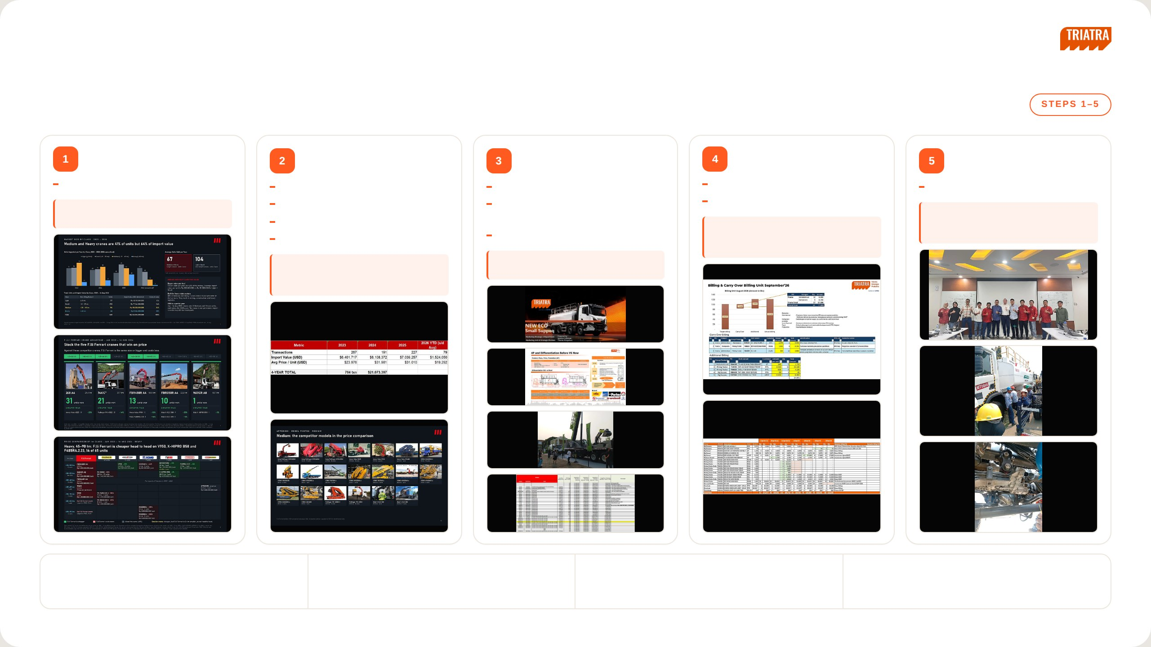
[ INTERNAL USE ONLY ]
SECTION 05 · JOB DESCRIPTION EXECUTION · A
Strategic
Pricing & Market Analysis
Market Study & Program
Market Program for
Performance Reporting
Innovation &
Development
Support Sales
Development
Price & market analysis simulation
Collect market data
Sales tools (pamphlet)
PICA analysis
Innovation project & development
END RESULT
Map competitor products
Campaign, portfolio & project
Billing report
END RESULT
Basis for the pricing strategy
Analyse new product development
showcase
END RESULT
Innovation framework; field conditions
Write the market study summary
Event support (mining expo)
Input for performance evaluation &
documented
END RESULT
management decisions
END RESULT
Programs ready for the sales team
Market size / share, segmentation,
positioning & targeting
DELIVERABLES
DEPARTMENTS INVOLVED
CHALLENGES
IMPROVEMENTS
Market study report, competitor mapping, sales tools, GP
Sales, Marketing Communication, Marketing Parts, UTPE,
Keeping market data current, validating competitor data,
Standard report template, automate market data updates,
and performance report
Finance
tight timelines
review competitor data regularly
NEDP MID YEAR REVIEW 2026
15 / 31

Slide 14
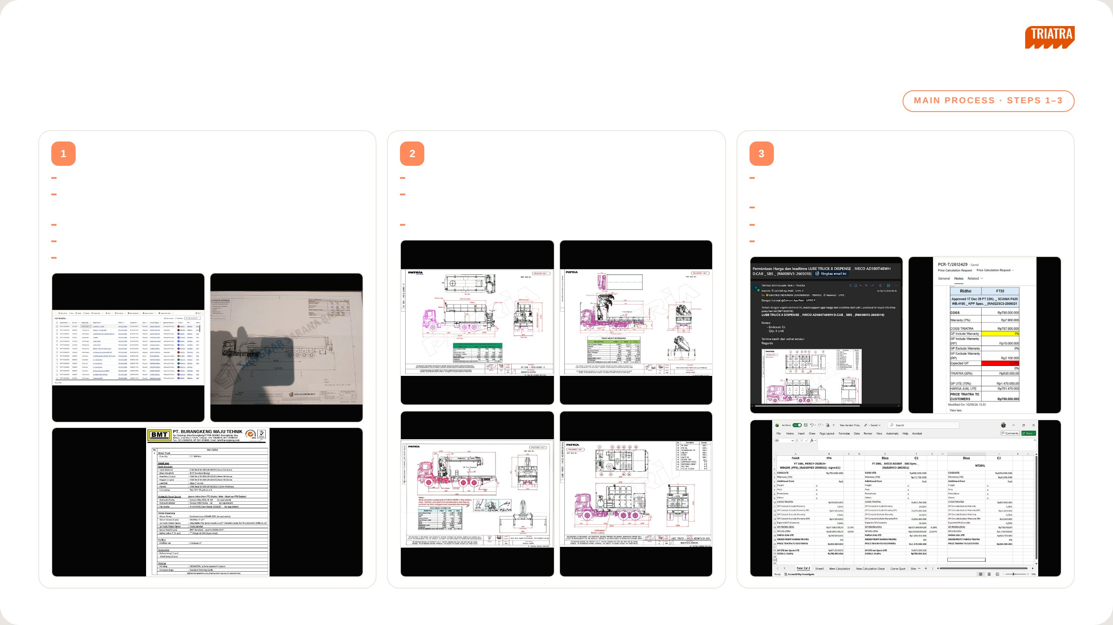
[ INTERNAL USE ONLY ]
SECTION 05 · JOB DESCRIPTION EXECUTION · B
Supply Chain (1/2)
Demand Check
Preliminary Drawing Review
Request Quote to UTE
Look at which demands are rising in PCR
Check what the unit does and how it works
Attach the preliminary drawing, expected price and lead time, end
Clarify with the Business Consultant why the customer is buying —
Check the main components and find which ones are critical on price or
customer name and expected delivery so UTE has the full picture
expansion, new business or replacement
lead time
Check the standard GP (13.6%, the price before negotiation)
Check where the project is located
Consult Application Engineering to understand the unit in more depth
Check the SLA and escalate if it takes too long
Check whether the customer wants it fast or cheap
Enter the quote result into PCR
Check the expected price and when the PO is likely to come
NEDP MID YEAR REVIEW 2026
16 / 31

Slide 15
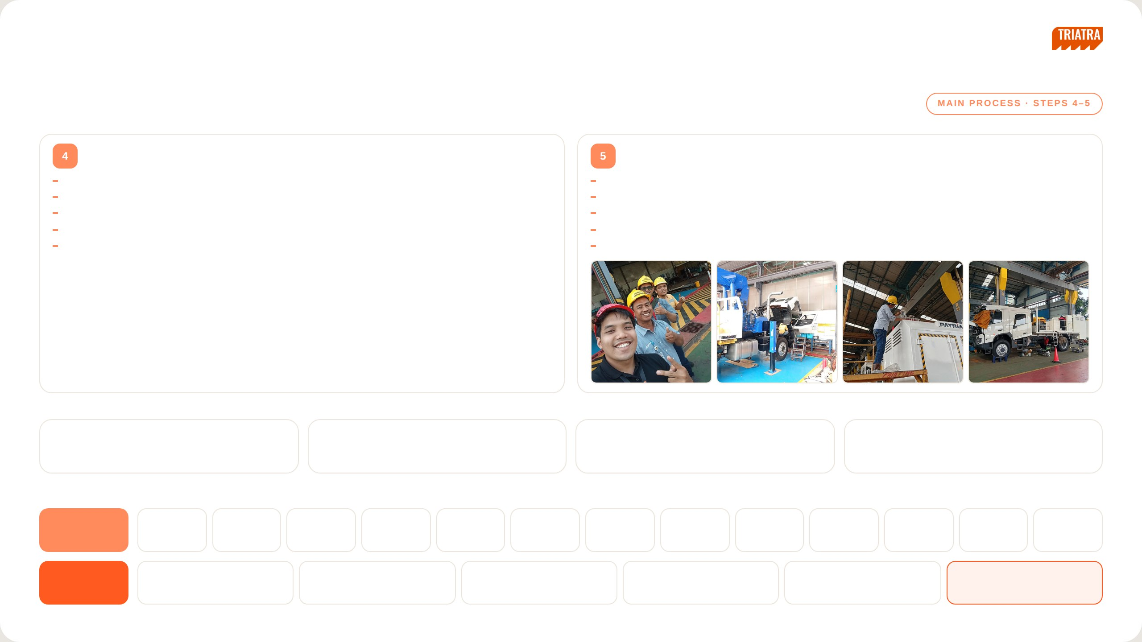
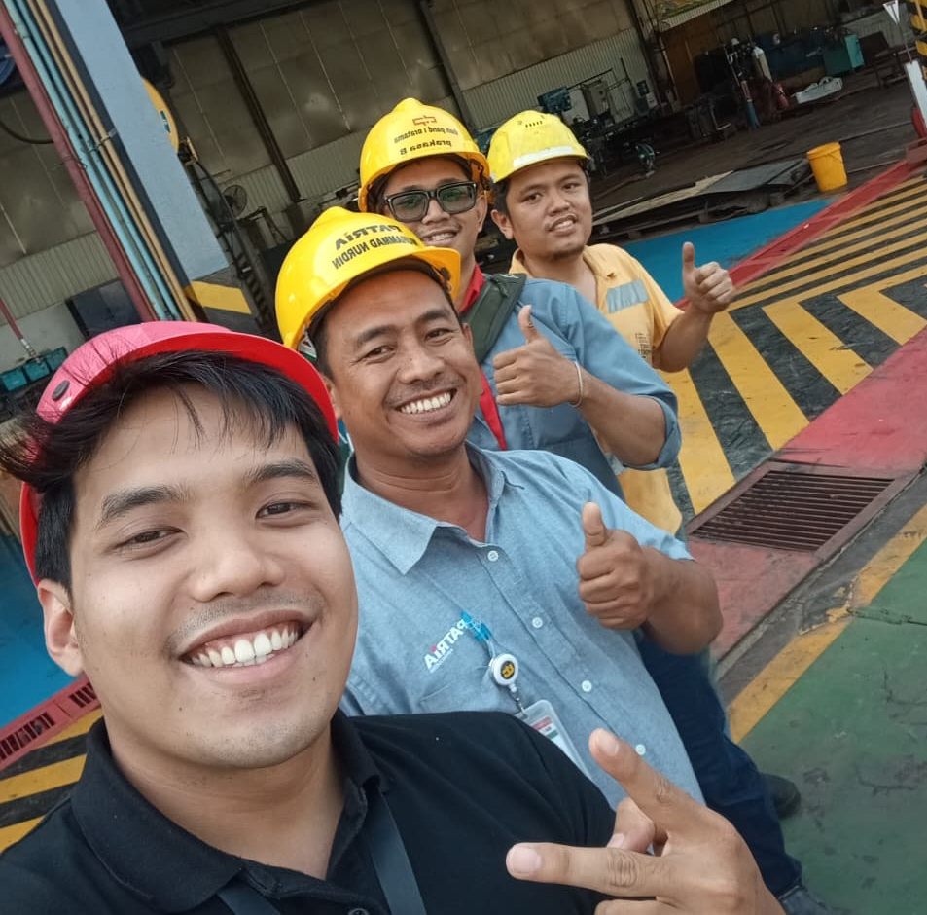
[ INTERNAL USE ONLY ]
SECTION 05 · JOB DESCRIPTION EXECUTION · B
Supply Chain (2/2)
Close Won → CPO
Monitoring
Check the PO, preliminary drawing and PJB in CRM
Follow production regularly and update sales — visit the plant or request photos from Nandu
Request QFD from UTE and collect special requests and painting style from the Business Consultant
Compare the QFD plan against actual production
The RFD date from QFD becomes the due date of the PO Interco
Escalate any production issue that puts the agreed RFD at risk
Close won route: Sales Manager → Marketing Associate → Marketing Manager → GM Marketing
Request and track painting style at least one month before RFD
PO Interco approval: Marketing Manager → GM Marketing → Marketing Director
Join the customer FAT together with the Business Consultant
INTERNAL MONITORING
1. Pipeline–OSPO Dashboard
2. Staging Pipeline in CRM
3. Quote Price Dashboard
4. Billing Progress
Build it and update it every month.
No preliminary yet means the deal is still far off; once there
Track the detail, average SLA and initial price of quotes
Check whether it sits in production, UTE administration or
is one, validate it and request a quote from UTPE.
from UTE.
Triatra administration, and escalate any blockage.
BILLING PROCESS CHAIN
AT UTE
1
2
3
4
5
6
7
8
9
10
11
12
13
PO Interco
PRO
PR
PO
Drawing
BOM
LPPB
PB
Fabrication
Assembly
QC passed
GR Teco
GI
AT TRIATRA
1
2
3
4
5
6
GR
DO / TO
GI
BAST
BAST approval
Invoice
NEDP MID YEAR REVIEW 2026
17 / 31

Slide 16

[ INTERNAL USE ONLY ]
SECTION 06
Project
A — Market Overview
B — Price Comparison
C — F.lli Ferrari Advantage
D — Appendix
NEDP MID YEAR REVIEW 2026
18 / 31

Slide 17


F.lli Ferrari
Market Strategy
Indonesia truck-mounted knuckle boom crane import market
Jan 2023 – Aug 2026
PT Triatra Sinergia Pratama · October 2026

Slide 18
[ INTERNAL USE ONLY ]
SECTION 06 · PROJECT
Market Overview
A — Market Overview
B — Price Comparison
C — F.lli Ferrari Advantage
D — Appendix
NEDP MID YEAR REVIEW 2026
19 / 31

Slide 19


MARKET SIZE BY CLASS · 2023 – 2026
[ INTERNAL USE ONLY ]
Medium and Heavy cranes are 41% of units but 64% of import value
Units Imported per Year by Class, 2023 – 2026 (2026 annualised)
Average Units Sold per Year
67
104
Medium + Heavy
target classes · units / year
Light + Small
non-target classes · units / year
*2026 annualised (Jan – 14 Aug × 1.61); average of 4 years.
MEDIUM AND HEAVY CARRY THE VALUE
Bigger value per deal
Fewer units per year, but 64% of the money. Average import value per unit is Rp 803.000.000 vs Rp 311.000.000 for Light + Small.
Built for heavy-duty sectors
88% of Medium and Heavy cranes need a truck with GVW of 24 t or more. They work in mining, construction and heavy logistics.
2026 is a partial year
Jan – 14 Aug 2026 shows only 12 Medium and 1 Heavy units, well below the 2025 pace. The cause is not yet known; import records may still be incomplete.
Total Units and Import Value by Class, 2023 – 14 Aug 2026
Class | Max Lifting Moment | Units | Import value (IDR, before tax) | Share of value
Light | ≤ 8 tm | 177 | Rp 40.118.000.000 | 12%
Small | > 8 – 25 tm | 200 | Rp 77.241.000.000 | 24%
Medium | > 25 – 45 tm | 196 | Rp 118.328.000.000 | 36%
Heavy | > 45 tm | 65 | Rp 91.154.000.000 | 28%
Total |  | 638 | Rp 326.841.000.000 | 100%
Source: Indonesia import records, HS 84269100 + 84264900, Jan 2023 – 14 Aug 2026; truck-mounted knuckle boom cranes only, Zoomlion and Hyva excluded. Values converted at USD 1 = Rp 17.803 (JISDOR, 23 Sep 2026). *2026 annualised: Jan – 14 Aug units × 1.61.
01

Slide 20
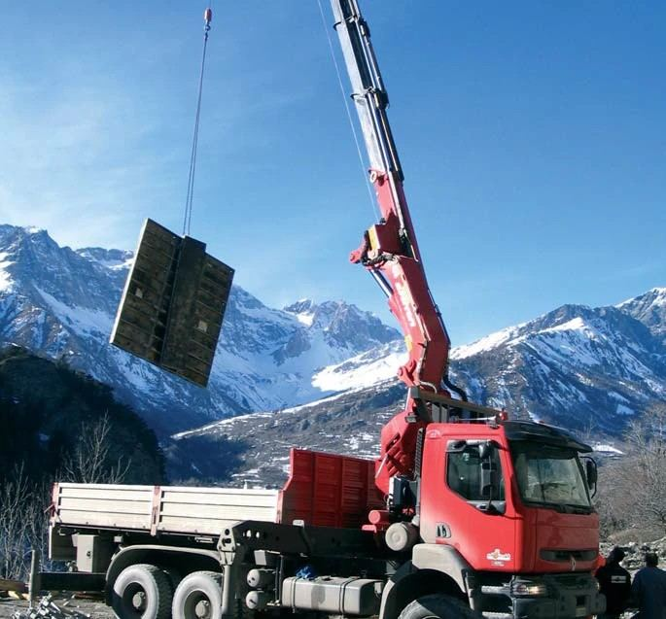
2025 Focus
Who leads the Medium and Heavy classes in 2025, and with which models
2025 is the latest full year in the data.
2

Slide 21
BRAND LEADERS · 2025
[ INTERNAL USE ONLY ]
2025: Sany Palfinger leads Medium (47% of value), Palfinger leads Heavy (62%)
Scope: 2025 only (one full year), so figures are smaller than the 2023 – 2026 totals. Sany Palfinger is the Sany–Palfinger joint venture; its cranes are made in China.
MEDIUM · > 25 – 45 tm
HEAVY · > 45 tm
Medium Class: Units and Import Value by Brand, 2025
Heavy Class: Units and Import Value by Brand, 2025
Bars = units (smallest → largest). Label = units and import value (IDR, before tax).
Bars = units (smallest → largest). Label = units and import value (IDR, before tax).
30 units
Rp 13.226.000.000
54 units
Rp 28.006.000.000
22 units
Rp 29.738.000.000
35 units
Rp 48.034.000.000
14 units
Rp 7.197.000.000
7 units
Rp 11.065.000.000
5 units
Rp 2.714.000.000
5 units
Rp 4.869.000.000
4 units
Rp 4.647.000.000
1 unit
Rp 1.235.000.000
1 unit
Rp 1.349.000.000
Amco Veba
Palfinger
XCMG
Sany Palfinger
Total Medium
Sany Palfinger
Fassi
XCMG
Amco Veba
Palfinger
Total Heavy
Medium Class: Top 3 Brands by Import Value, 2025
Heavy Class: Top 3 Brands by Import Value, 2025
# | Brand | Units | Import value (IDR, before tax) | Share of class value
1 | Sany Palfinger | 30 | Rp 13.226.000.000 | 47%
2 | XCMG | 14 | Rp 7.197.000.000 | 26%
3 | Palfinger | 5 | Rp 4.869.000.000 | 17%
# | Brand | Units | Import value (IDR, before tax) | Share of class value
1 | Palfinger | 22 | Rp 29.738.000.000 | 62%
2 | Amco Veba | 7 | Rp 11.065.000.000 | 23%
3 | XCMG | 4 | Rp 4.647.000.000 | 10%
Source: Indonesia import records, HS 84269100 + 84264900, Jan 2023 – 14 Aug 2026; truck-mounted knuckle boom cranes only, Zoomlion and Hyva excluded. Values converted at USD 1 = Rp 17.803.
03

Slide 22




MODELS OF THE BRAND LEADERS · 2025
[ INTERNAL USE ONLY ]
In 2025, each leader sells one main model; PK 53002 alone is 63% of Heavy units
MEDIUM · > 25 – 45 tm
Top model
Other models
Sany Palfinger: Units Sold by Model, Medium, 2025
XCMG: Units Sold by Model, Medium, 2025
Palfinger: Units Sold by Model, Medium, 2025
SPK42502 ties SPK32080 on units; ranked higher on value.
SQZ325.4 ties KSQZ300.3 on units; ranked higher on value.
HEAVY · > 45 tm
Top model
Other models
Palfinger: Units Sold by Model, Heavy, 2025
Amco Veba: Units Sold by Model, Heavy, 2025
XCMG: Units Sold by Model, Heavy, 2025
One model = 100% of Palfinger's Heavy units.
One model = 100% of Amco Veba's Heavy units.
Tie on units; GSQZ880.6 highlighted (higher value). Both are 86 – 88 tm.
Source: Indonesia import records, HS 84269100 + 84264900, Jan 2023 – 14 Aug 2026; truck-mounted knuckle boom cranes only, Zoomlion and Hyva excluded. Top 3 brands by 2025 import value per class (previous slide); up to 3 models shown per brand; top model = most units, ties broken by import value.
04

Slide 23
[ INTERNAL USE ONLY ]
SECTION 06 · PROJECT
Price Comparison
A — Market Overview
B — Price Comparison
C — F.lli Ferrari Advantage
D — Appendix
NEDP MID YEAR REVIEW 2026
23 / 31

Slide 24

PRICE COMPARISON BY tm CLASS · JAN 2023 – 14 AUG 2026 · MEDIUM · 1 OF 2
[ INTERNAL USE ONLY ]
Medium, 25–35 tm: F.lli Ferrari is cheaper head to head on V825, X-CLX 388 and X-CLX 328, 41 of 111 units
tm class | F.lli Ferrari | 88 units | 36 units | 33 units | 29 units | 10 units
>25–30 tm 49 units | 268 A4 25.4 tm Rp 500.000.000 /unit |  | V825 −23% 25.6 tm · 31 units Rp 650.000.000 /unit | KSQZ300.3 −3% 30 tm · 15 units Rp 510.000.000 /unit smaller crane
 |  |  |  | SQ12ZK3Q ±0% 30 tm · 2 units Rp 500.000.000 /unit
 |  |  |  | KSQZ300.4 −12% 30 tm · 1 unit Rp 570.000.000 /unit smaller crane
>30–35 tm 62 units | FBR350R A4 32.8 tm Rp 1.090.000.000 /unit | SPK32080 +107% 30.4 tm · 33 units Rp 530.000.000 /unit | V933 +30% 31.9 tm · 4 units Rp 840.000.000 /unit | GSQZ330.4 +40% 33 tm · 4 units Rp 780.000.000 /unit | PK 32080 C ±0% 30.4 tm · 8 units Rp 1.090.000.000 /unit | X-CLX 388 −25% 34.3 tm · 9 units Rp 1.460.000.000 /unit
 |  |  |  | SQZ325.4 +98% 32.5 tm · 3 units Rp 550.000.000 /unit |  | X-CLX 328 −2% 30.3 tm · 1 unit Rp 1.120.000.000 /unit
F.lli Ferrari is cheaper
F.lli Ferrari costs more
About the same (±0%)
Smaller crane: cheaper, but F.lli Ferrari is 2+ tm smaller, so not head to head.
Each model: F.lli Ferrari price difference; tm and units Jan 2023 – 14 Aug 2026; price per unit. Zoomlion and Hyva excluded. Competitors: highest import unit price of the model, Jan 2023 – 14 Aug 2026, × Rp 17.803/USD (JISDOR 23 Sep 2026) + import duty (0% China – ACFTA; 5% Europe, assumed) + PPN 11% + PPh 22 2.5%, before distributor margin. F.lli Ferrari: crane price from the TSP price list Rev1, June 2026 (column K minus column J), less the 13.6% TSP margin and 3% warranty. 990R: TSP price less Rp 168.000.000 cargo deck and install, then the same deductions. 9601CR A8: UTPE quote of 15 Sep 2026, crane only, no deduction; 50.7 tm per its load chart. 7441C is an estimate. Prices rounded to Rp 10.000.000.
06

Slide 25
PRICE COMPARISON BY tm CLASS · JAN 2023 – 14 AUG 2026 · MEDIUM · 2 OF 2
[ INTERNAL USE ONLY ]
Medium, 35–45 tm: F.lli Ferrari is cheaper head to head on PK 41002, 21 of 85 units
tm class | F.lli Ferrari | 88 units | 36 units | 33 units | 29 units
>35–40 tm 66 units | 7441C 37.7 tm · estimate Rp 1.240.000.000 /unit | SPK36080 +88% 36 tm · 37 units Rp 660.000.000 /unit |  | KSQZ400.4 +66% 40 tm · 2 units Rp 750.000.000 /unit | PK 41002 −14% 38.4 tm · 21 units Rp 1.440.000.000 /unit
 |  |  |  | GSQZ400.4 +76% 40 tm · 2 units Rp 700.000.000 /unit
 |  |  |  | SQZ365.4 +107% 36.5 tm · 2 units Rp 600.000.000 /unit
 |  |  |  | SQZ400 +109% 40 tm · 1 unit Rp 600.000.000 /unit
 |  |  |  | KSQZ365.4 +129% 36.5 tm · 1 unit Rp 540.000.000 /unit
>40–45 tm 19 units | 746 A4 43.4 tm Rp 1.420.000.000 /unit | SPK42502 +48% 42.5 tm · 18 units Rp 960.000.000 /unit | V946B +12% 44.2 tm · 1 unit Rp 1.270.000.000 /unit
F.lli Ferrari is cheaper
F.lli Ferrari costs more
About the same (±0%)
Smaller crane: cheaper, but F.lli Ferrari is 2+ tm smaller, so not head to head.
Each model: F.lli Ferrari price difference; tm and units Jan 2023 – 14 Aug 2026; price per unit. Zoomlion and Hyva excluded. Competitors: highest import unit price of the model, Jan 2023 – 14 Aug 2026, × Rp 17.803/USD (JISDOR 23 Sep 2026) + import duty (0% China – ACFTA; 5% Europe, assumed) + PPN 11% + PPh 22 2.5%, before distributor margin. F.lli Ferrari: crane price from the TSP price list Rev1, June 2026 (column K minus column J), less the 13.6% TSP margin and 3% warranty. 990R: TSP price less Rp 168.000.000 cargo deck and install, then the same deductions. 9601CR A8: UTPE quote of 15 Sep 2026, crane only, no deduction; 50.7 tm per its load chart. 7441C is an estimate. Prices rounded to Rp 10.000.000.
07

Slide 26

PRICE COMPARISON BY tm CLASS · JAN 2023 – 14 AUG 2026 · HEAVY
[ INTERNAL USE ONLY ]
Heavy, 45–90 tm: F.lli Ferrari is cheaper head to head on V950, X-HIPRO B58 and F485RA.2.23, 14 of 65 units
tm class | F.lli Ferrari | 42 units | 12 units | 7 units | 2 units | 1 unit | 1 unit
>45–50 tm 17 units | FBR450R A4 45.5 tm Rp 1.350.000.000 /unit |  | V950 −32% 45.9 tm · 12 units Rp 1.990.000.000 /unit | GSQZ460.4 +66% 46 tm · 3 units Rp 810.000.000 /unit | EFFER 525H −10% 50 tm · 1 unit Rp 1.510.000.000 /unit smaller crane | F485RA.2.23 −16% 47 tm · 1 unit Rp 1.610.000.000 /unit
>50–55 tm 40 units | 9601CR A8 50.7 tm Rp 3.260.000.000 /unit | PK 53002 +85% 50.1 tm · 39 units Rp 1.760.000.000 /unit |  |  | X-HIPRO B58 −3% 50.93 tm · 1 unit Rp 3.370.000.000 /unit
>55–60 tm 0 units | FBR660R A4 58.8 tm Rp 2.030.000.000 /unit | No imports of this size in 2023 – 2026
>60–65 tm 1 unit | 9661C 63.2 tm Price not yet known |  |  |  |  |  | SPK61502 no price 61.5 tm · 1 unit Rp 1.400.000.000 /unit
>70–75 tm 2 units | 990R 74 tm Rp 4.110.000.000 /unit | PK 76002 EH D +80% 71.6 tm · 2 units Rp 2.290.000.000 /unit
>80–85 tm 1 unit | No F.lli Ferrari model largest is 990R, 74 tm | PK 88002 EH C +85% 81.6 tm · 1 unit Rp 2.220.000.000 /unit
>85–90 tm 4 units | No F.lli Ferrari model largest is 990R, 74 tm |  |  | GSQZ880.6 +211% 88 tm · 2 units Rp 1.320.000.000 /unit
 |  |  |  | GSQZ860.6 +212% 86 tm · 2 units Rp 1.320.000.000 /unit
F.lli Ferrari is cheaper
F.lli Ferrari costs more
About the same (±0%)
Smaller crane: cheaper, but F.lli Ferrari is 2+ tm smaller, so not head to head.
Each model: F.lli Ferrari price difference; tm and units Jan 2023 – 14 Aug 2026; price per unit. Zoomlion and Hyva excluded. Competitors: highest import unit price of the model, Jan 2023 – 14 Aug 2026, × Rp 17.803/USD (JISDOR 23 Sep 2026) + import duty (0% China – ACFTA; 5% Europe, assumed) + PPN 11% + PPh 22 2.5%, before distributor margin. F.lli Ferrari: crane price from the TSP price list Rev1, June 2026 (column K minus column J), less the 13.6% TSP margin and 3% warranty. 990R: TSP price less Rp 168.000.000 cargo deck and install, then the same deductions. 9601CR A8: UTPE quote of 15 Sep 2026, crane only, no deduction; 50.7 tm per its load chart. 7441C is an estimate. Prices rounded to Rp 10.000.000.
08

Slide 27
[ INTERNAL USE ONLY ]
SECTION 06 · PROJECT
F.lli Ferrari Advantage
A — Market Overview
B — Price Comparison
C — F.lli Ferrari Advantage
D — Appendix
NEDP MID YEAR REVIEW 2026
27 / 31

Slide 28
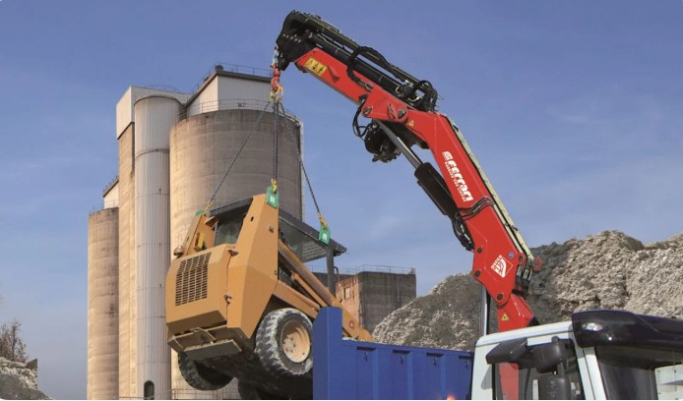
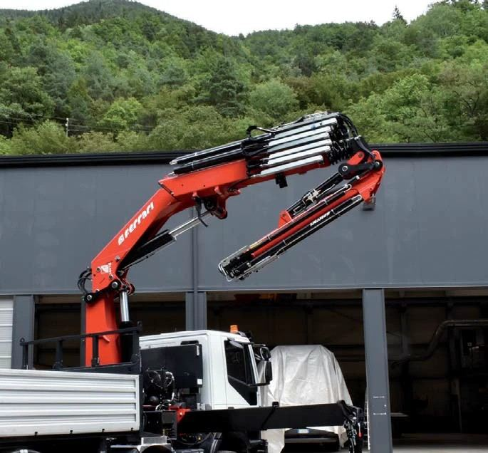

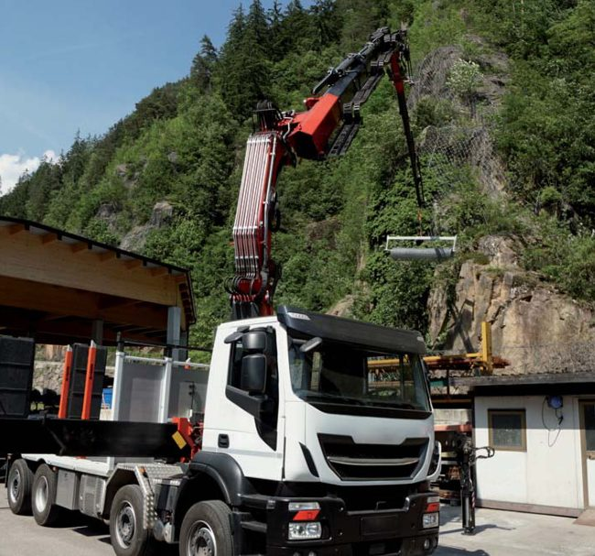
F.LLI FERRARI CRANE ADVANTAGE · JAN 2023 – 14 AUG 2026
[ INTERNAL USE ONLY ]
Stock the five F.lli Ferrari cranes that win on price
Against these competitor cranes, F.lli Ferrari is the same size or bigger and costs less.
>25–30 tm
>30–35 tm
>35–40 tm
>40–45 tm
>45–50 tm
>50–55 tm
>60–65 tm
>70–75 tm
>80–85 tm
>85–90 tm
268 A4
25.4 tm
7441C*
37.7 tm
FBR450R A4
45.5 tm
FBR350R A4
32.8 tm
9601CR A8
50.7 tm
31 units won
21 units won
13 units won
10 units won
1 units won
CHEAPER THAN
CHEAPER THAN
CHEAPER THAN
CHEAPER THAN
CHEAPER THAN
Amco Veba V825 · 31
−23%
Palfinger PK 41002 · 21
−14%
Amco Veba V950 · 12
−32%
Hiab X-CLX 388 · 9
−25%
Hiab X-HIPRO B58 · 1
−3%
Fassi F485RA.2.23 · 1
−16%
Hiab X-CLX 328 · 1
−2%
Units won = Jan 2023 – 14 Aug 2026 imports of the rival model. Head to head = F.lli Ferrari is cheaper and not more than 2 tm smaller; ±0% is not counted. * 7441C price is an estimate. Competitors: highest import unit price of the model, Jan 2023 – 14 Aug 2026, × Rp 17.803/USD (JISDOR 23 Sep 2026) + import duty (0% China – ACFTA; 5% Europe, assumed) + PPN 11% + PPh 22 2.5%, before distributor margin. F.lli Ferrari: crane price from the TSP price list Rev1, June 2026 (column K minus column J), less the 13.6% TSP margin and 3% warranty. 990R: TSP price less Rp 168.000.000 cargo deck and install, then the same deductions. 9601CR A8: UTPE quote of 15 Sep 2026, crane only, no deduction; 50.7 tm per its load chart. 7441C is an estimate. Prices rounded to Rp 10.000.000.
09

Slide 29


[ INTERNAL USE ONLY ]
PROJECT CHARTER
F.lli Ferrari Market Strategy
PROJECT NAME
PROJECT TIMEFRAME
F.lli Ferrari Market Strategy
Activity
2026
2027
BACKGROUND
Jun
Jul
Aug
Sep
Oct
Nov
Dec
Jan
Feb
Mar
Triatra distributes F.lli Ferrari truck-mounted knuckle boom cranes in Indonesia. From Jan 2023 to Aug 2026, Indonesia imported 638 knuckle boom cranes; Medium and Heavy cranes (above 25 tm) are 41% of units but 64% of import value, led by Sany Palfinger and Palfinger. F.lli Ferrari is cheaper than European rivals in five tm classes, but costs more than Chinese brands. This project is initiated to give a structured assessment of where F.lli Ferrari can compete, which cranes to stock and how to position them, so the F.lli Ferrari line grows on a sound, data-based footing.
Planning – Framework
Observation, Study, and Review
Analysis and Formulation
Reporting and Evaluation
OBJECTIVES
1. Map Indonesia's knuckle boom crane market by Max Lifting Moment (tm) class, brand and model
2. Compare F.lli Ferrari head to head with every competitor model on price, size and features
3. Define which F.lli Ferrari cranes Triatra should stock and how to position them
BENEFIT OF PROJECT
Give Triatra a clear, data-based basis to choose which F.lli Ferrari cranes to stock, and to target the tm classes and customers where F.lli Ferrari wins on price and quality.
PROJECT SCOPE
PROJECT TEAM
F.LLI FERRARI CRANES, MEDIUM AND HEAVY CLASS (> 25 tm)
Executive Sponsor
Advisor
Coordinator
Project Lead
Team Member
: Ricardo Tanada
: Ricardo Tanada/Ignatius Indrawan
: Ignatius Indrawan
: Tiberias Krisgaharu Simu
: Yohannes Eurico Christanto, Muhammad Fawwaz Jauharin
1. Market size & brand leaders
2. Price comparison by 5-tm class
3. F.lli Ferrari crane advantage
4. Stock & positioning strategy
5. Implementation timeline & sales plan
KPI / METRIC
TARGET
1. Market map by tm class, brand and model (2023 – 2026)
2. Competitor price and specification benchmark
3. List of F.lli Ferrari cranes that win head to head
4. Stock recommendation per tm class
5. Implementation timeline and sales plan
Delivered the F.lli Ferrari market strategy in March 2027
PROJECT APPROVAL
Lead
Date:
Coordinator
Date:
Advisor
Date:
Executive Sponsor
Date:
SUPPORT REQUIRED
Marketing and Sales; United Tractors Pandu Engineering (UTPE); F.lli Ferrari Italia
Tiberias Krisgaharu Simu
Ignatius Indrawan
Ricardo Tanada
Ricardo Tanada
F.LLI FERRARI MARKET STRATEGY · PROJECT CHARTER
01 / 01

Slide 30
[ INTERNAL USE ONLY ]
SECTION 06 · PROJECT
Appendix
A — Market Overview
B — Price Comparison
C — F.lli Ferrari Advantage
D — Appendix
NEDP MID YEAR REVIEW 2026
29 / 31

Slide 31
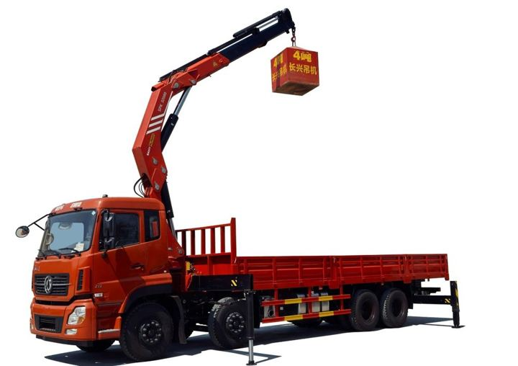


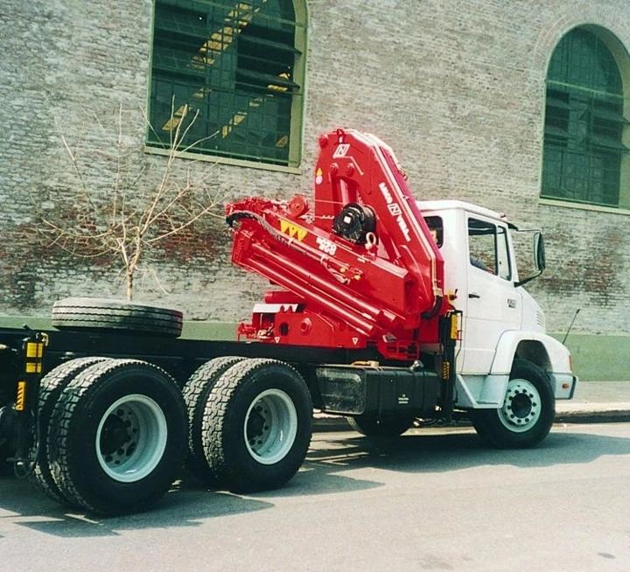
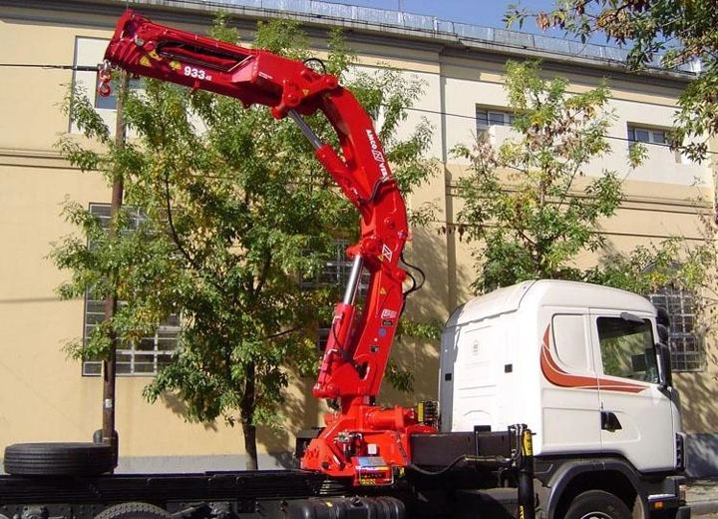
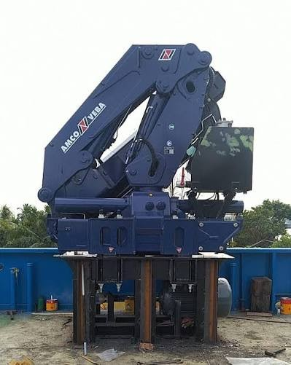
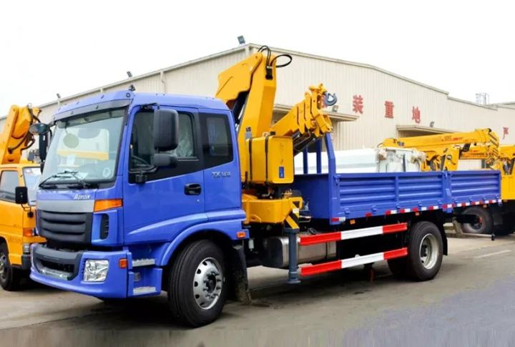
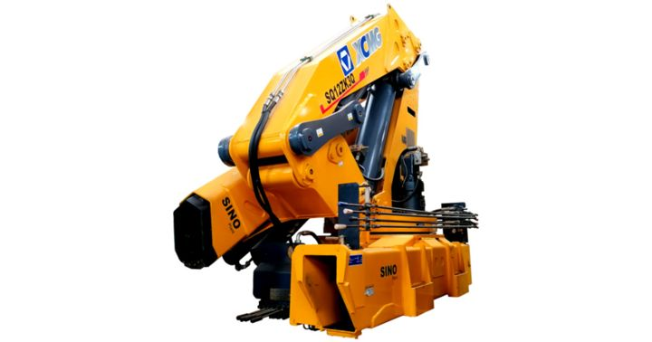
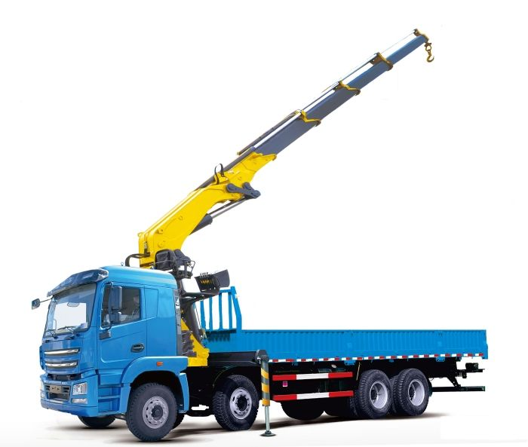


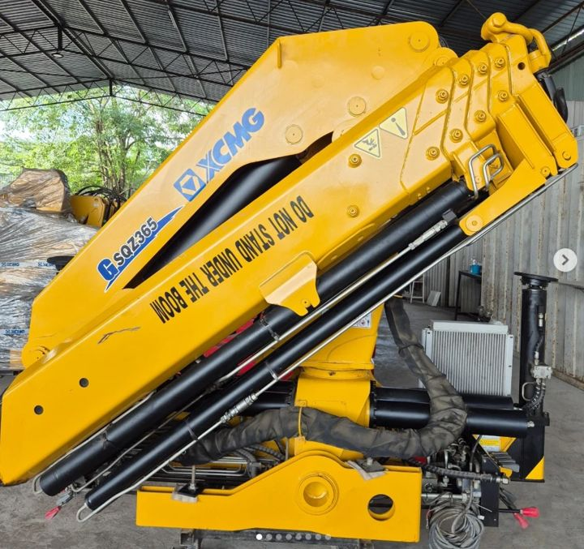

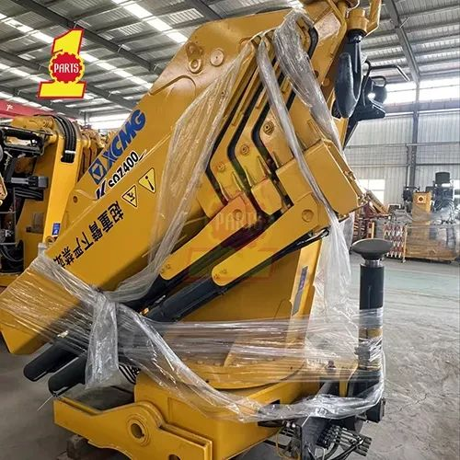
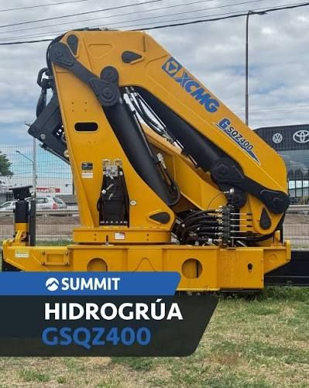
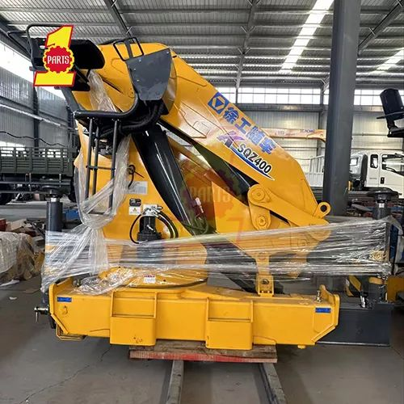

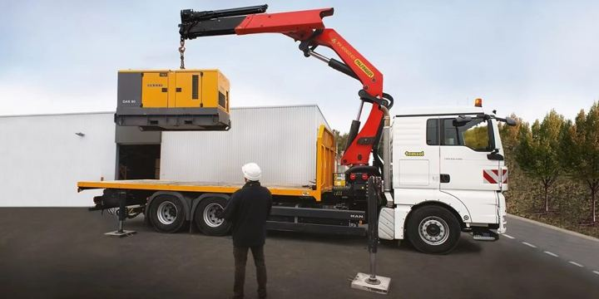
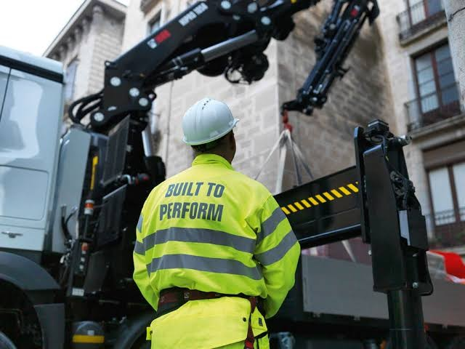
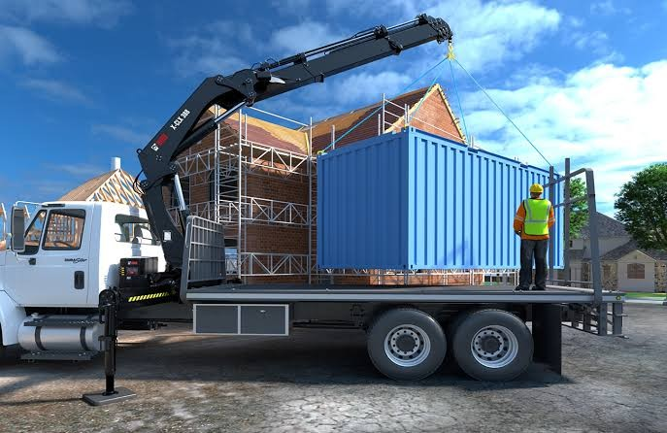
APPENDIX · MODEL PHOTOS · MEDIUM
[ INTERNAL USE ONLY ]
Medium: the competitor models in the price comparison
Sany Palfinger SPK32080
30.4 tm · 33 units
Sany Palfinger SPK36080
36 tm · 37 units
Sany Palfinger SPK42502
42.5 tm · 18 units
Amco Veba V825
25.6 tm · 31 units
Amco Veba V933
31.9 tm · 4 units
Amco Veba V946B
44.2 tm · 1 unit
XCMG KSQZ300.3
30 tm · 15 units
XCMG SQ12ZK3Q
30 tm · 2 units
XCMG KSQZ300.4
30 tm · 1 unit
XCMG SQZ325.4
32.5 tm · 3 units
XCMG GSQZ330.4
33 tm · 4 units
XCMG SQZ365.4
36.5 tm · 2 units
XCMG KSQZ365.4
36.5 tm · 1 unit
XCMG KSQZ400.4
40 tm · 2 units
XCMG GSQZ400.4
40 tm · 2 units
XCMG SQZ400
40 tm · 1 unit
Palfinger PK 32080 C
30.4 tm · 8 units
Palfinger PK 41002
38.4 tm · 21 units
Hiab X-CLX 328
30.3 tm · 1 unit
Hiab X-CLX 388
34.3 tm · 9 units
F.lli Ferrari photos: TSP and pocket catalogue 2026. Competitor photos: supplied by TSP; for identification only.
10

Slide 32

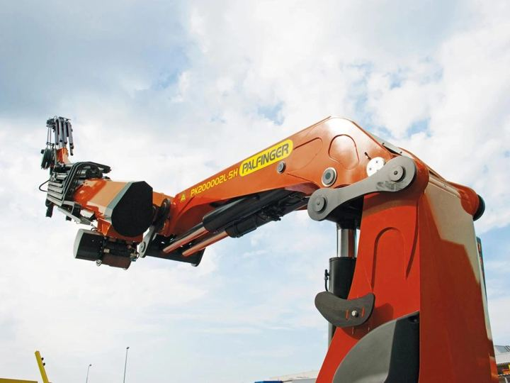
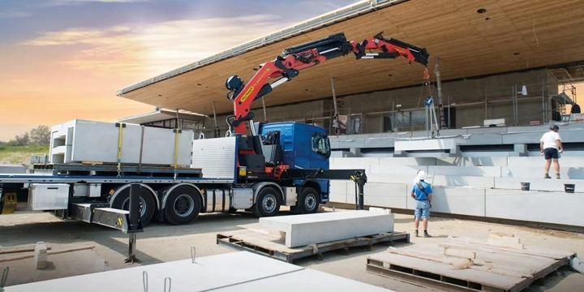


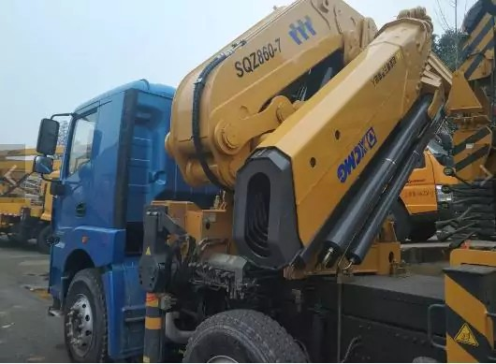
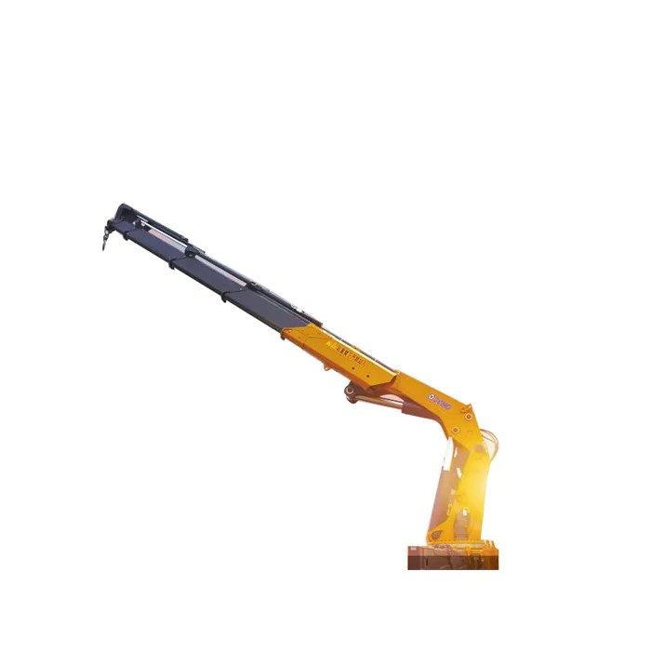
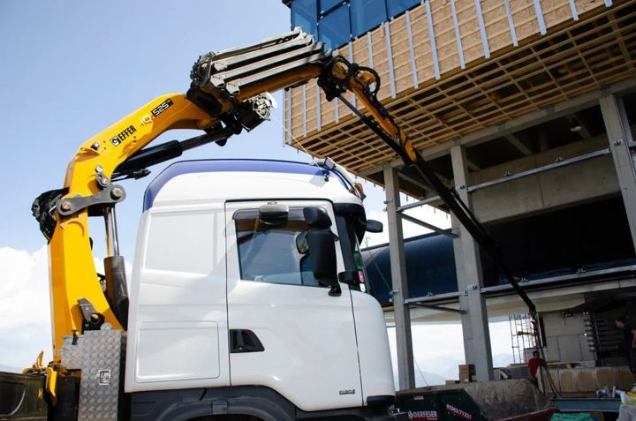
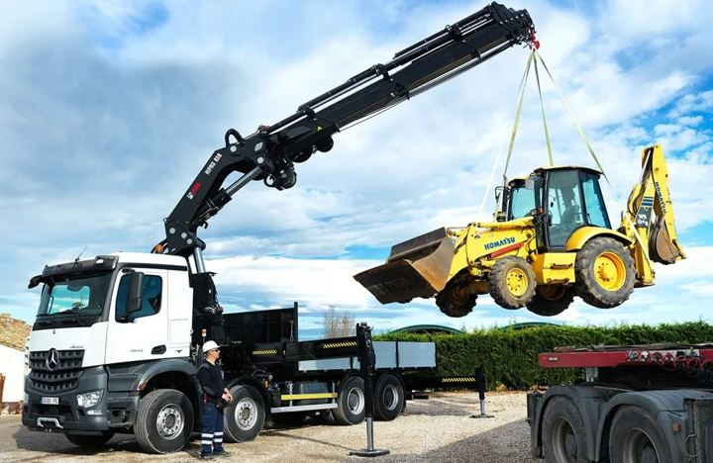
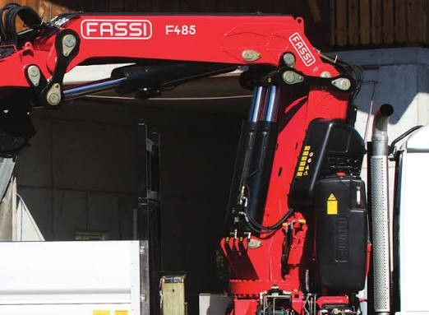
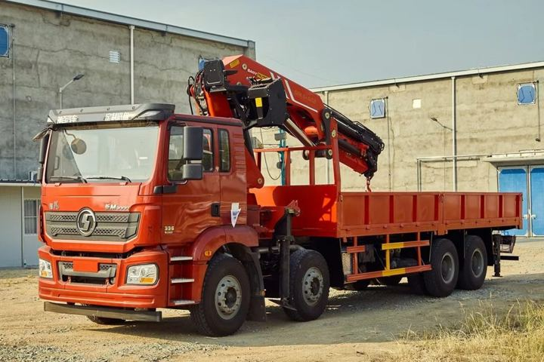
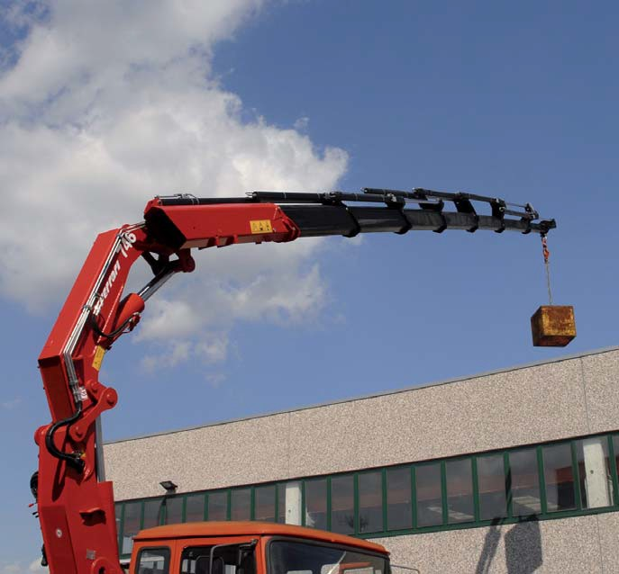
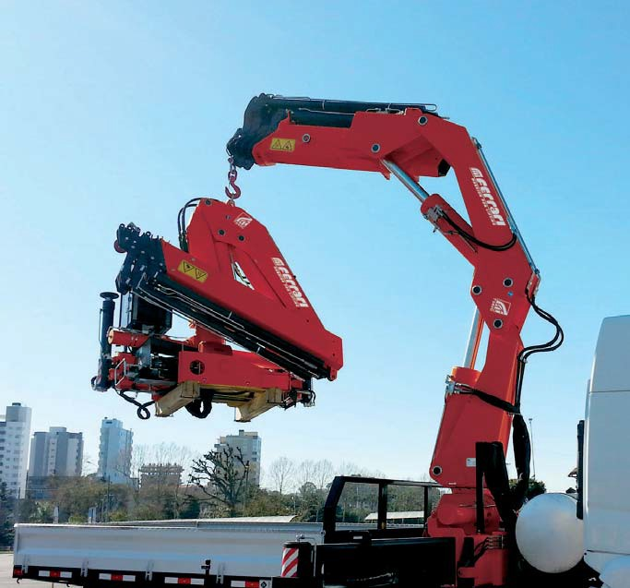
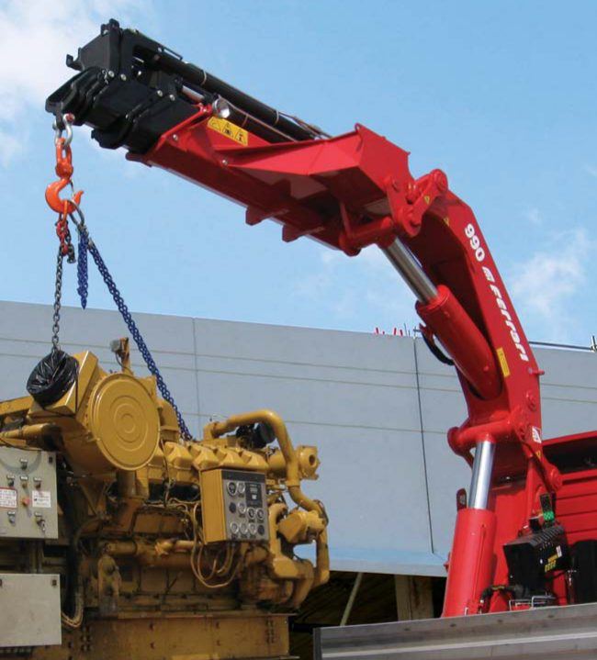
APPENDIX · MODEL PHOTOS · HEAVY AND F.LLI FERRARI
[ INTERNAL USE ONLY ]
Heavy competitor models and the F.lli Ferrari models in the comparison
Palfinger PK 53002
50.1 tm · 39 units
Palfinger PK 76002 EH D
71.6 tm · 2 units
Palfinger PK 88002 EH C
81.6 tm · 1 unit
Amco Veba V950
45.9 tm · 12 units
XCMG GSQZ460.4
46 tm · 3 units
XCMG GSQZ860.6
86 tm · 2 units
XCMG GSQZ880.6
88 tm · 2 units
Hiab EFFER 525H
50 tm · 1 unit
Hiab X-HIPRO B58
50.93 tm · 1 unit
Fassi F485RA.2.23
47 tm · 1 unit
Sany Palfinger SPK61502
61.5 tm · 1 unit
F.lli Ferrari 268 A4
25.4 tm
F.lli Ferrari FBR350R A4
32.8 tm
F.lli Ferrari 7441C
37.7 tm
F.lli Ferrari 746 A4
43.4 tm
F.lli Ferrari FBR450R A4
45.5 tm
F.lli Ferrari 9601CR A8
50.7 tm
F.lli Ferrari FBR660R A4
58.8 tm
F.lli Ferrari 990R
74 tm
F.lli Ferrari photos: TSP and pocket catalogue 2026. Competitor photos: supplied by TSP; for identification only.
11

