Slide 1

DESIGN GUIDANCE · V1 · 13 OCT 2026
NEDP 6-MONTH REVIEW · SLIDE STANDARD
A calm, clear standard for the six-month review.
A design guidance that brings the calm, editorial style of the Bitwise website to every slide of the review deck: serif headlines, quiet neutrals, one confident green.
START HERE
SEE COMPONENTS
NOW IN USE
→
NEDP6M Tiberias K. Simu · Review deck
PT TRIATRA SINERGIA PRATAMA · MARKETING UNIT & STRATEGIC DIVISION

Slide 2
NEDP 6-MONTH REVIEW · DESIGN GUIDANCE
CONTENTS
Everything you need, in one place.
Four parts, read top to bottom the first time; afterwards jump straight to the page you need.
FOUNDATIONS
COMPONENTS
LAYOUTS
APPLICATION
03
Design DNA
12
Slide anatomy
19
Page types
22
Writing & voice
04
Typefaces
13
Buttons, links, tags
20
Dark sections
23
Numbers & formats
05
Type scale
14
Cards
21
Applied example
24
Draft → final workflow
06
Type details
15
Section patterns
25
Pre-send checklist
07
Neutral colours
16
Charts
08
Brand & accent colours
17
Tables
09
Colour in use
18
Imagery
10
Space, radius, elevation
11
Grid
NEDP MID YEAR REVIEW 2026 · DESIGN GUIDANCE
02

Slide 3
NEDP 6-MONTH REVIEW · DESIGN GUIDANCE
WHY THIS STYLE
Professional slides, managed like a fund.
Bitwise explains a complicated market to cautious investors. A 6-month review has the same job: explain a lot of work to busy reviewers, clearly.
Editorial serif headlines
Quiet neutrals, one green
Space does the work
Headlines are set in a light serif with one phrase in italic. It reads like a research note, not a sales pitch.
Almost everything is slate grey on white. Green is used only for actions, highlights and the focus series in a chart.
Large margins, one idea per block and centred section intros. Nothing is boxed unless it must be grouped.
THE STYLE IN THREE WORDS
Calm. Clear. Credible.
READ THE RULES
NEDP MID YEAR REVIEW 2026 · DESIGN GUIDANCE
03

Slide 4
NEDP 6-MONTH REVIEW · DESIGN GUIDANCE
FOUNDATIONS · TYPEFACES
Two families: a serif to speak, a sans to explain.
Bitwise pairs the serif 'Items' with the grotesk 'Neue Montreal'. Both are licensed web fonts, so the deck uses the closest fonts every Office computer already has.
Aa
Georgia
Aa
Arial
Headlines, card titles, big numbers
Kickers, body, labels, buttons, tables
ROLE
ROLE
Replaces Bitwise 'Items' (serif, weight 350–500)
Replaces Bitwise 'Neue Montreal' (sans, 400 / 550 / 650)
WEIGHTS
WEIGHTS
Regular 400 · Italic 400
Regular 400 · Bold 700
RULE
RULE
Regular + Italic only. Never bold.
Regular for text, Bold for kickers, labels, buttons.
ABCDEFGHIJKLMNOPQRSTUVWXYZ
abcdefghijklmnopqrstuvwxyz 0123456789 Rp % –
ABCDEFGHIJKLMNOPQRSTUVWXYZ
abcdefghijklmnopqrstuvwxyz 0123456789 Rp % –
If fonts may be installed: 'Newsreader Light' or 'Fraunces' come closest to Items, and 'Inter' or 'Manrope' to Neue Montreal (all free, Google Fonts). Embed them when saving (File › Options › Save › Embed fonts).
NEDP MID YEAR REVIEW 2026 · DESIGN GUIDANCE
04

Slide 5
NEDP 6-MONTH REVIEW · DESIGN GUIDANCE
FOUNDATIONS · TYPE SCALE
Nine sizes, no more.
Sizes are set for a 13.33 × 7.5 in slide. Web values from Bitwise are shown for reference (16 px ≈ 11 pt on a slide).
STYLE
SAMPLE
FONT · SIZE · WEIGHT
TRACKING · LEADING
WEB REF
Clear by design
Display
Georgia 36 Regular
-0.5 · 1.0
48–64 px
H1 · slide title
Professional funds
Georgia 24 Regular
0 · 1.1
32 px
H2 · section
Why the price wins
Georgia 18 Regular
0 · 1.2
24 px
H3 · card title
Crypto Market Review
Georgia 13 Regular
0.2 · 1.25
16 px Items
Kicker
WHY BITWISE
Arial 8.5 Bold CAPS
+1.5 · 1.0
16 px 550 +2
Lede
One sentence that frames the slide.
Arial 10.5 Regular
0 · 1.3
18 px
Body
Short paragraphs, slate 12.
Arial 10 Regular
0 · 1.45
16 px 400
Meta · label
Research • Oct 8, 2026
Arial 8.5 Bold
0 · 1.2
14 px 550
Button · source
VIEW ALL
Arial 7.5 Bold CAPS
+0.6 · 1.0
12 px 550 +0.8
NEDP MID YEAR REVIEW 2026 · DESIGN GUIDANCE
05

Slide 6
NEDP 6-MONTH REVIEW · DESIGN GUIDANCE
FOUNDATIONS · TYPE DETAILS
Small rules that make it feel like Bitwise.
ITALIC, NOT BOLD, FOR EMPHASIS
SENTENCE CASE HEADLINES
TRACKED CAPS FOR KICKERS
Crypto is complicated. We make it clear.
Professional funds managed by experts
INVESTMENTS
In serif headlines, put the one idea that matters in italic. Never bold a serif.
Capitalise only the first word and names. CAPS are only for kickers, labels and buttons.
Kickers sit 12–16 pt above the headline, slate 11, tracking +1.5 pt.
SHORT LINES
LEADING
NUMBERS IN SERIF
Max ~70 characters per line
1.0 · 1.25 · 1.45
67 units / year
Body text never spans the full slide. Cap paragraphs at 2/3 of the width.
Headlines 1.0–1.1, card titles 1.25, body 1.45 (Bitwise: 1, 1.25, 1.5).
Key figures use Georgia, ink colour; the unit follows in small sans.
NEDP MID YEAR REVIEW 2026 · DESIGN GUIDANCE
06

Slide 7
NEDP 6-MONTH REVIEW · DESIGN GUIDANCE
FOUNDATIONS · NEUTRAL COLOURS
Sixteen greys carry almost everything.
The Bitwise 'slate' scale: a cool, slightly blue grey. Light steps for surfaces and lines, dark steps for text and dark sections.
Slate 1
Slate 2
Slate 3
Slate 4
Slate 5
Slate 6
Slate 7
Slate 8
#FCFCFD
#F9FAFB
#F0F2F4
#EBEDEF
#E6E8EB
#E0E3E6
#D7DBDF
#C1C8CD
Page alt
Wash / section
Card hover
Hairline
Divider
Border
Border strong
Disabled
Slate 9
Slate 10
Slate 11
Slate 12
Slate 13
Slate 14
Slate 15
Slate 16
#889096
#7D868C
#697177
#4D555C
#252D31
#1C262C
#11181C
#020304
Placeholder
Icon
Kicker · muted
Body text
Ink soft
Dark button
Ink · dark section
Black
NEDP MID YEAR REVIEW 2026 · DESIGN GUIDANCE
07

Slide 8
NEDP 6-MONTH REVIEW · DESIGN GUIDANCE
FOUNDATIONS · BRAND & ACCENT COLOURS
One confident green, used sparingly.
Bitwise green (hue 146°) marks actions and the focus of a chart. Accents come from the same Radix-style scales and are reserved for status and extra chart series.
BRAND GREEN SCALE
Green 100
Green 200
Green 300
Green 400
Green 500
Green 600
Green 800
#E5FFF1
#E1F9EC
#83E7AE
#39DB7F
#22C96A
#0DA54F
#076932
Green 500 primary button, highlight, focus series · Green 800 hover, green text on white · Green 100–200 tinted note background
ACCENTS · STATUS & CHART SERIES
Amber #FFC53D
Red #E5484D
Blue #0090FF
Purple #8E4EC6
Orange #E55200
Warning · on going
Risk · price higher
Second series · info
Third series
Triatra logo only
BRAND BRIDGE · TRIATRA
The Triatra logo stays in its own orange and is never recoloured. Orange is not used anywhere else in the deck, so the logo and the green never compete. If the reviewers require Triatra orange as the accent, swap Green 500 → #E55200 and Green 800 → #80350E everywhere; every other rule stays the same.
NEDP MID YEAR REVIEW 2026 · DESIGN GUIDANCE
08

Slide 9
NEDP 6-MONTH REVIEW · DESIGN GUIDANCE
FOUNDATIONS · COLOUR IN USE
Mostly white, slate text, a touch of green.
PROPORTION ON A LIGHT SLIDE
70% White / Slate 1–2
22% Slate 11–15 text
6%
Lines and borders 6% · green 2%: one button, one highlight or one focus series per slide.
LIGHT AND DARK SECTIONS
LIGHT · DEFAULT
DARK · COVER, DIVIDERS, CLOSING
Most slides are light.
Use dark rarely.
White background, Slate 15 headline, Slate 12 body.
Slate 15 → #23343C gradient, white headline, Slate 8 body.
PRIMARY
OUTLINE
DO AND DON'T
DO
DON'T
DO
DON'T
Green only on the action or the focus
Green headlines, green boxes, green everything
Accents only to mean something (risk, warning)
Rainbow categories in one chart
NEDP MID YEAR REVIEW 2026 · DESIGN GUIDANCE
09

Slide 10
NEDP 6-MONTH REVIEW · DESIGN GUIDANCE
FOUNDATIONS · SPACE, RADIUS, ELEVATION
A 4-point system, soft corners, barely-there shadows.
SPACING SCALE (BITWISE SPACE-1 … SPACE-15, IN PT)
4 pt
8 pt
12 pt
16 pt
24 pt
32 pt
48 pt
64 pt
80 pt
inside chip
icon ↔ text
gutter
card padding
block gap
title ↔ body
section gap
slide margin top
hero padding
CORNER RADIUS
0 · tables, photos in grids
3 pt · buttons, chips
6 pt · inputs, small cards
10 pt · cards, panels
20 pt · large hero panels
ELEVATION
Flat + hairline
Card shadow
Wash panel
Default card: white, Slate 6 border 0.75 pt
Floating callout on photos or dark hero
Slate 2 fill, no border, groups a section
NEDP MID YEAR REVIEW 2026 · DESIGN GUIDANCE
10

Slide 11
NEDP 6-MONTH REVIEW · DESIGN GUIDANCE
FOUNDATIONS · GRID
Twelve columns, wide margins.
Margins 48 pt left and right, 16 pt gutters. Section intros are centred; content is left-aligned on the grid.
1
2
3
4
5
6
7
8
9
10
11
12
12
Hero, full chart, table
6
6
Text + image
4
4
4
Why columns, three cards
3
3
3
3
Stat row, four cards
5
7
Lede + evidence
8
4
Chart + takeaway
NEDP MID YEAR REVIEW 2026 · DESIGN GUIDANCE
11

Slide 12
NEDP 6-MONTH REVIEW · DESIGN GUIDANCE
COMPONENTS · SLIDE ANATOMY
Every content slide, same frame.
1
2
1
Logo
NEDP 6-MONTH REVIEW · SECTION
Triatra logo, 18 pt high, top-left at 48 / 22 pt.
3
KICKER
4
Headline with one italic idea
5
Lede sentence in slate 12, max two lines.
2
Utility bar
BODY
864 × 350 pt
Deck · section in 7 pt bold caps, right-aligned; hairline at 50 pt.
6
3
Kicker
Section name, 8.5 pt bold caps, Slate 11, at 68 pt.
4
Headline
Georgia 24, one italic phrase, sentence case, at 84 pt.
5
Lede
Optional. Arial 10.5, Slate 12, at 122 pt, ≤ 2 lines.
7
6
Body
FOOTER · DECK NAME
From 150 to 500 pt. Everything sits on the 12-column grid.
7
Footer
Hairline at 512 pt, deck name left, page number right.
NEDP MID YEAR REVIEW 2026 · DESIGN GUIDANCE
12

Slide 13
NEDP 6-MONTH REVIEW · DESIGN GUIDANCE
COMPONENTS · BUTTONS, LINKS, TAGS
Small, tracked, and always meaningful.
In a deck, buttons are labels for the next step or the decision you ask for. Keep the Bitwise shapes: 3 pt radius, 7.5 pt bold caps, +0.6 tracking.
BUTTONS
INVEST NOW
CREATE ACCOUNT
LEARN MORE
LOG IN
START INVESTING
Primary · the one action
Dark · neutral action
Outline · secondary
Ghost · tertiary
On dark: primary or outline
LINKS
VIEW ALL →
READ MORE →
Inline link in a sentence uses Green 800.
META LINE
Research • Oct 8, 2026
Supply chain • Step 4 of 5 • Jun 2026
STATUS TAGS
DONE
ON GOING
AT RISK
NOT STARTED
NEW
Rule Max one primary (green) button per slide. Status tags always use the same four words and colours through the whole deck.
NEDP MID YEAR REVIEW 2026 · DESIGN GUIDANCE
13

Slide 14
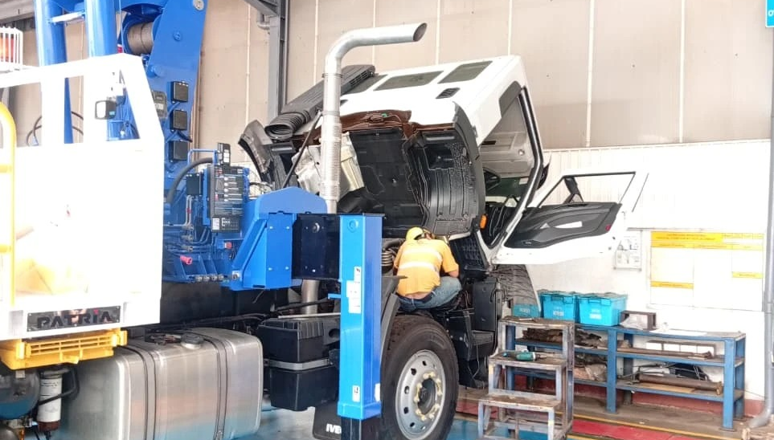
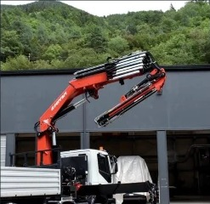
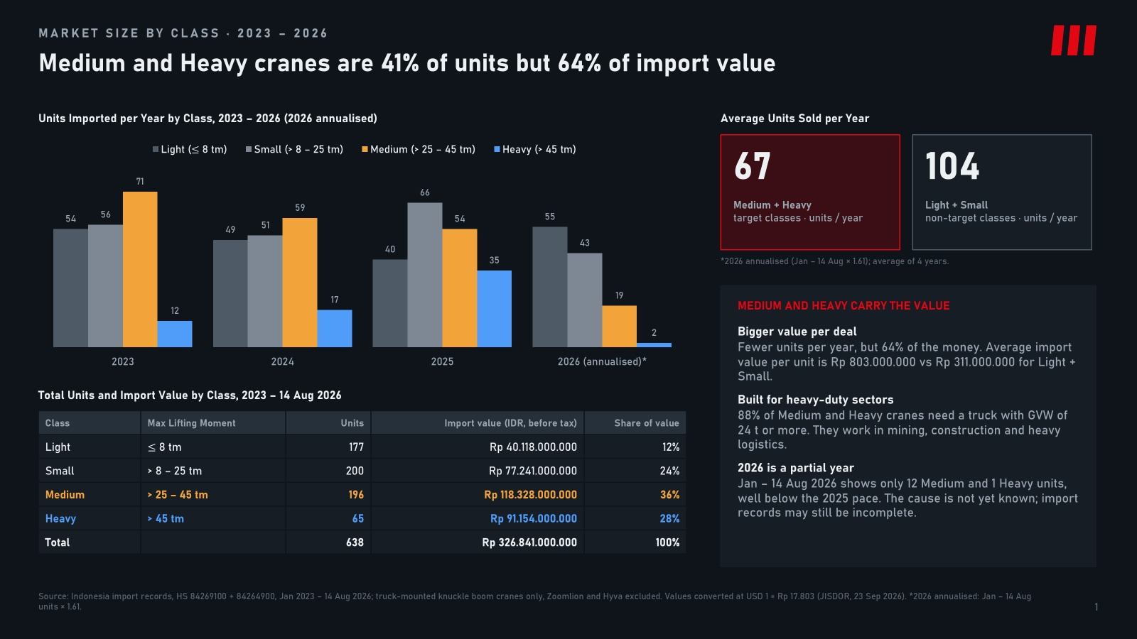
NEDP 6-MONTH REVIEW · DESIGN GUIDANCE
COMPONENTS · CARDS
Cards that read like research notes.
Recommended to stock
7441C F.lli Ferrari · 37.7 tm
→
CALLOUT CARD · floats on photos
268 A4
25.4 tm · 31 units
−23%
Monitoring • Jun 2026
Project • Aug 2026
Strategic • May 2026
7441C
37.7 tm · 21 units
−14%
Plant visit keeps the RFD on track
F.lli Ferrari wins on price
Pricing & market analysis
FBR450R
45.5 tm · 13 units
−32%
Weekly follow-up with UTE production and photo updates to sales.
Five cranes beat competitors head to head in their tm class.
Price simulation and competitor mapping for the sales team.
LIST ROW · ticker style
READ MORE →
READ MORE →
READ MORE →
INSIGHT CARD · image 8 pt radius · meta · serif title · one-line description · link
67
units / year, Medium + Heavy
64%
of import value
5
classes where F.lli Ferrari wins
NEDP MID YEAR REVIEW 2026 · DESIGN GUIDANCE
14

Slide 15
NEDP 6-MONTH REVIEW · DESIGN GUIDANCE
COMPONENTS · SECTION PATTERNS
Four patterns lifted straight from Bitwise.
INVESTMENTS
Managed exposure to a growing world of crane opportunities.
Track record
Broad suite
Strong team
Two or three lines of proof under each dot.
Two or three lines of proof under each dot.
Two or three lines of proof under each dot.
Centred kicker + serif headline open a section. Optional one-line lede.
A · SECTION INTRO
B · WHY COLUMNS (title · dot on line · text)
BACKED BY LEADING INSTITUTIONS
Let us take the next step together.
LOGO
LOGO
LOGO
LOGO
LOGO
LOGO
Logos in one row, same height, greyscale or original colours — never mixed.
Closing band: the one decision or support you ask the reviewers for.
APPROVE PLAN
SEE APPENDIX
C · LOGO STRIP
D · CTA BAND (dark)
NEDP MID YEAR REVIEW 2026 · DESIGN GUIDANCE
15

Slide 16
NEDP 6-MONTH REVIEW · DESIGN GUIDANCE
COMPONENTS · CHARTS
One green series, everything else slate.
Native PowerPoint charts only. The focus series is Green 500; comparison series use Slate 8 and Slate 12.
SERIES ORDER
1 Focus / Triatra
2 Main comparison
3 Others
4 Extra series 1
5 Extra series 2
6 Negative / risk only
RULES
Headline states the insight
Labels on bars; no gridlines, no axis
Axis starts at zero; no 3D, no shadow
Numbers in Georgia, labels in Arial
Source line under every chart
Units imported per year. *2026 = Jan–14 Aug. Source: Indonesia import records (example from the F.lli Ferrari study).
NEDP MID YEAR REVIEW 2026 · DESIGN GUIDANCE
16

Slide 17
NEDP 6-MONTH REVIEW · DESIGN GUIDANCE
COMPONENTS · TABLES
Tables like a fund list: light, ruled, right-aligned.
TICKER | PRODUCT | CLASS | UNITS | PRICE | VS COMPETITOR
268 A4 | F.lli Ferrari knuckle boom | 25–30 tm | 31 | Rp 500 jt | −23%
7441C | F.lli Ferrari knuckle boom | 35–40 tm | 21 | Rp 1.240 jt | −14%
FBR450R A4 | F.lli Ferrari knuckle boom | 45–50 tm | 13 | Rp 1.350 jt | −32%
FBR350R A4 | F.lli Ferrari knuckle boom | 30–35 tm | 10 | Rp 1.090 jt | −25%
9601CR A8 | F.lli Ferrari knuckle boom | 50–55 tm | 1 | Rp 3.260 jt | −3%
Example rows from the F.lli Ferrari price comparison. Source: TSP price list, import records.
Header
Rows
Alignment
Highlight
7.5 pt bold caps, Slate 11, tracking +0.6, 1 pt Slate 15 rule under it.
Hairline Slate 5, no fills, no vertical lines. 26 pt row height.
Text left, numbers right. First column bold ink as the 'ticker'.
Only the decision column in Green 800; risks in Red 9.
NEDP MID YEAR REVIEW 2026 · DESIGN GUIDANCE
17

Slide 18
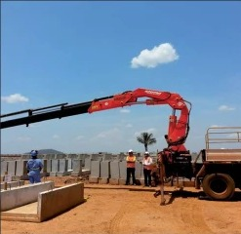

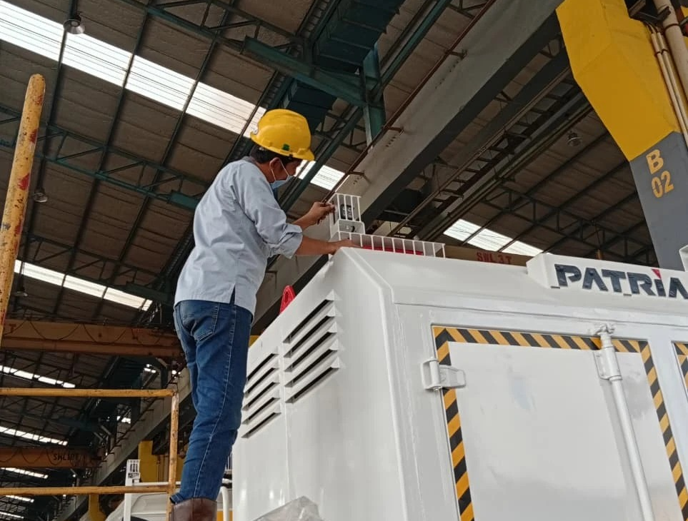
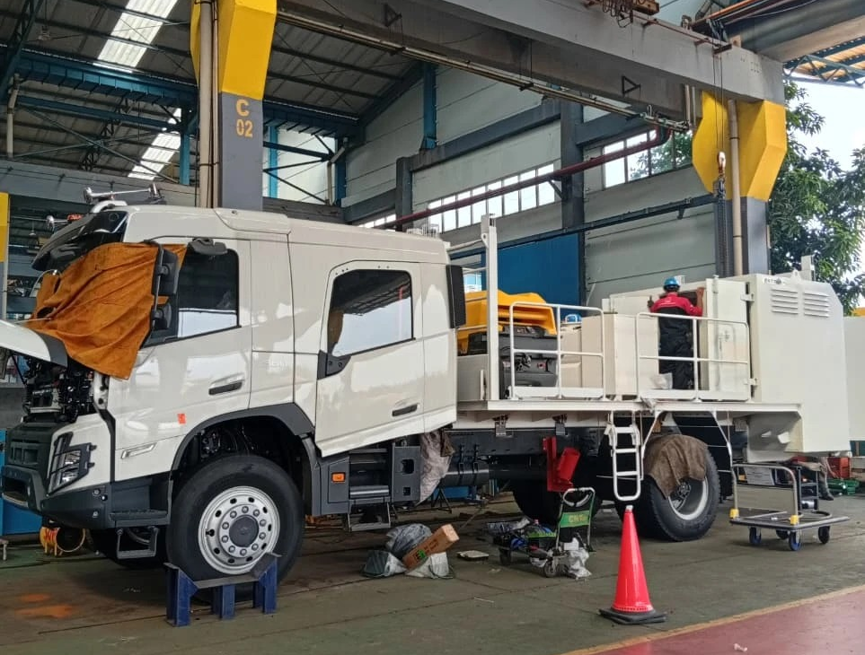
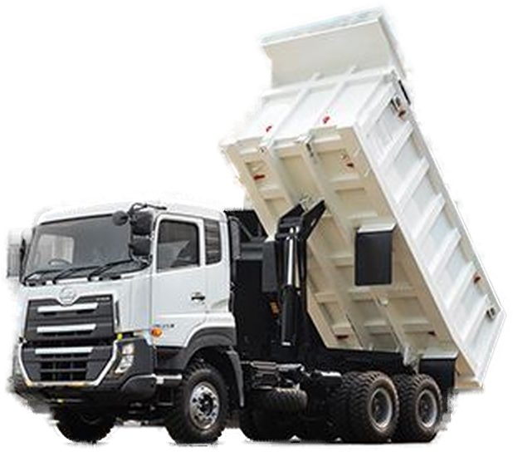
NEDP 6-MONTH REVIEW · DESIGN GUIDANCE
COMPONENTS · IMAGERY
Photos with purpose, treated the same way.
Plant visit
Painting check
Customer FAT
Jun 2026 · UTE plant
Jun 2026 · UTE plant
Jun 2026 · UTE plant
HERO PHOTO
Dark gradient keeps the headline readable.
Product cutouts sit on Slate 2, same baseline and height across a row.
F.lli Ferrari 7441C →
Radius
Overlay
Caption
Quality
8–10 pt on single photos; 0 inside dense grids.
Slate 15 gradient, 85% → 0%, only under text.
Serif title + sans meta line under the photo.
Originals only, never stretched, ≥ 150 dpi.
NEDP MID YEAR REVIEW 2026 · DESIGN GUIDANCE
18

Slide 19
NEDP 6-MONTH REVIEW · DESIGN GUIDANCE
LAYOUTS · PAGE TYPES
Eight page types cover the whole review.
Cover · dark hero
Agenda · link columns
Section divider · dark
Section intro · why
Kicker, serif title, lede, two buttons, callout card
Sections as footer-style link columns
Kicker, serif title, photo panel right
Centred kicker + headline, why columns
Insights · cards
Data · chart + table
Product list
Closing · CTA
Three cards: photo, meta, serif title
Chart left, ticker-style rows right
Ticker rows: code, name, class, value
Dark band, the one decision, buttons
NEDP MID YEAR REVIEW 2026 · DESIGN GUIDANCE
19

Slide 20
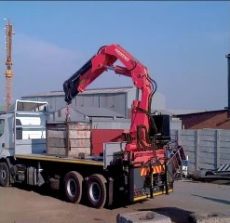
NEDP 6-MONTH REVIEW · LAYOUTS · DARK SECTION DIVIDER
SECTION 06 · F.LLI FERRARI CRANE STRATEGY
Where the price wins, and where it does not.
Market overview, price comparison by tm class, the F.lli Ferrari advantage and the appendix.
A Market overview
B Price comparison
C F.lli Ferrari advantage
5 cranes cheaper head to head →
D Appendix
NEDP MID YEAR REVIEW 2026 · DESIGN GUIDANCE
20

Slide 21
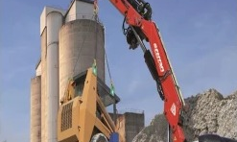
NEDP 6-MONTH REVIEW · SECTION 06 · PROJECT
LAYOUTS · APPLIED EXAMPLE
Five F.lli Ferrari cranes win on price.
Same size or bigger, lower price than the market leaders in their tm class (Jan 2023 – 14 Aug 2026).
5
−3% to −32%
76
cranes cheaper head to head
price gap vs the leader
units won by these five models
F.lli Ferrari • 25–30 tm
F.lli Ferrari • 35–40 tm
F.lli Ferrari • 45–50 tm
F.lli Ferrari • 30–35 tm
268 A4
7441C
FBR450R A4
FBR350R A4
31 units won
21 units won
13 units won
10 units won
−23% vs Amco Veba V825
−14% vs Palfinger PK 41002
−32% vs Amco Veba V950
−25% vs Hiab X-CLX 388
SEE COMPARISON →
SEE COMPARISON →
SEE COMPARISON →
SEE COMPARISON →
NEDP MID YEAR REVIEW 2026 · DESIGN GUIDANCE
21

Slide 22
NEDP 6-MONTH REVIEW · DESIGN GUIDANCE
APPLICATION · WRITING & VOICE
Complicated work, explained simply.
Bitwise voice: confident, plain English, no hype. Headlines carry the message; the body only proves it.
TOPIC → MESSAGE
VOICE RULES
Market Overview
→
Medium and Heavy cranes are 41% of units but 64% of value
Short sentences, active voice
One idea per headline
Price Comparison
→
F.lli Ferrari is cheaper in five tm classes
Numbers instead of adjectives
Monitoring
→
Plant follow-up keeps every PO on its agreed RFD date
Define an abbreviation once: Request for Delivery (RFD)
English throughout; system names as they appear
Work Challenges
→
Last-minute quotes are the main risk to lead time
No hype words: 'very', 'huge', 'amazing'
THE HEADLINE TEST
Read only the headlines from first to last slide. If they tell the whole 6-month story, the deck works.
NEDP MID YEAR REVIEW 2026 · DESIGN GUIDANCE
22

Slide 23
NEDP 6-MONTH REVIEW · DESIGN GUIDANCE
APPLICATION · NUMBERS & FORMATS
One format for every figure.
CURRENCY · TABLE
Rp 1.240.000.000
DATE
14 Aug 2026
CURRENCY · TEXT
Rp 1,24 M · Rp 650 jt
PERIOD
Jan 2023 – Aug 2026
CAPACITY
25–35 tm · 30,4 tm
QUARTER / MONTH
Q3 2026 · Oct 2026
COUNT
31 units · 1 unit
ESTIMATE
7441C* (*estimate, noted)
PERCENT / CHANGE
41% · +23% · −14%
NOTE
En dash (–) for ranges, minus sign (−) for drops. Round only in running text; tables keep the full figure so totals add up.
NEDP MID YEAR REVIEW 2026 · DESIGN GUIDANCE
23

Slide 24
NEDP 6-MONTH REVIEW · DESIGN GUIDANCE
APPLICATION · DRAFT → FINAL
How your draft becomes the final deck.
You keep the content and order; the design pass applies this guide. Five steps, in this order.
01
02
03
04
05
Map
Message
Rebuild
Evidence
Check
Tag each draft slide with one page type (p. 19).
Rewrite the title as a message headline + kicker.
Move content onto the grid using the components.
Swap screenshots for native charts/tables; add sources.
Run the checklist; export PDF + PPTX.
WHAT STAYS YOURS
WHAT THE DESIGN PASS CHANGES
✓ Order of sections and slides
→ Fonts, sizes, colours, spacing
✓ Facts, numbers and wording of results
→ Position and size of every element
✓ Photos and evidence you chose
→ Headlines rewritten as messages (you approve)
→ Charts and tables rebuilt natively
NEDP MID YEAR REVIEW 2026 · DESIGN GUIDANCE
24

Slide 25
NEDP 6-MONTH REVIEW · DESIGN GUIDANCE
APPLICATION · PRE-SEND CHECKLIST
Sixteen checks before it goes out.
STORY
TYPE
COLOUR & LAYOUT
DATA
Headlines alone tell the story
Georgia + Arial only
Slate + one green only
Native charts and tables
One message per slide
Italic emphasis, never bold serif
Max one primary button
Source under every figure
Agenda matches dividers
Kickers in tracked caps
Everything on the 12-col grid
Formats follow p. 23
Closing states the decision
Body ≥ 9 pt, sources ≥ 8 pt
Footer and page number present
Numbers match the appendix
FILE NAMING
NEDP_6M_Review_TiberiasSimu_v03_2026-10-13.pptx
Send the PDF to read and the PPTX to edit. Raise the version on every copy you send.
READY TO SEND
NEDP MID YEAR REVIEW 2026 · DESIGN GUIDANCE
25

Slide 26
NEXT STEP
Send the draft. We make it clear.
Share the draft PPT with its content and order. Each slide will be rebuilt with this guidance: type, colour, grid, components.
SHARE DRAFT
ASK A QUESTION
PREPARED BY TIBERIAS K. SIMU · MARKETING STRATEGIC 2 ASSOCIATE · PT TRIATRA SINERGIA PRATAMA
Style reference: Bitwise Asset Management website (typography, colour tokens, components). Fonts substituted with Georgia and Arial.

