Slide 1
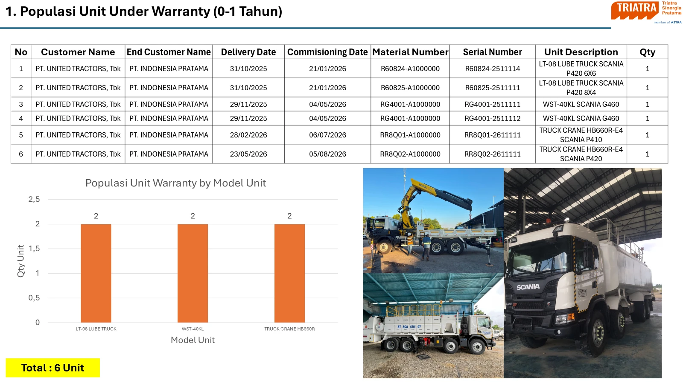
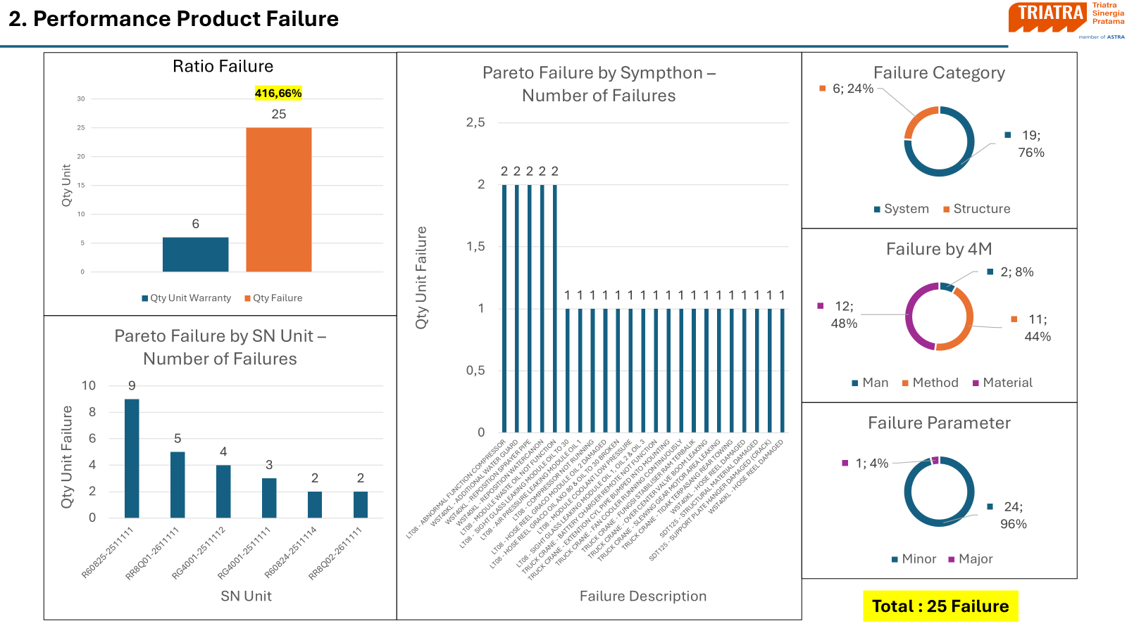
Quote
What happens after the unit is delivered?
After Sales/
After delivery, I track every unit under warranty and analyse each failure
6 units under warranty and 25 failures recorded; most are minor and can be fixed at the source.
1. Units Under Warranty
2. Product Failure Analysis
• 6 units under warranty (0–1 year): 2 lube trucks, 2 water trucks, 2 truck cranes
• Delivery and commissioning dates tracked per serial number
• Unit performance followed up with the end customer
• 25 failures on 6 units: 96% minor, 76% system-related
• Pareto by unit and by symptom shows where problems repeat (R60825: 9 failures)
• Cause by 4M: material 48%, method 44%, man 8%
• Findings shared with UTE so the same problem does not repeat
Photos: warranty unit population report and product failure analysis.

