Slide 1

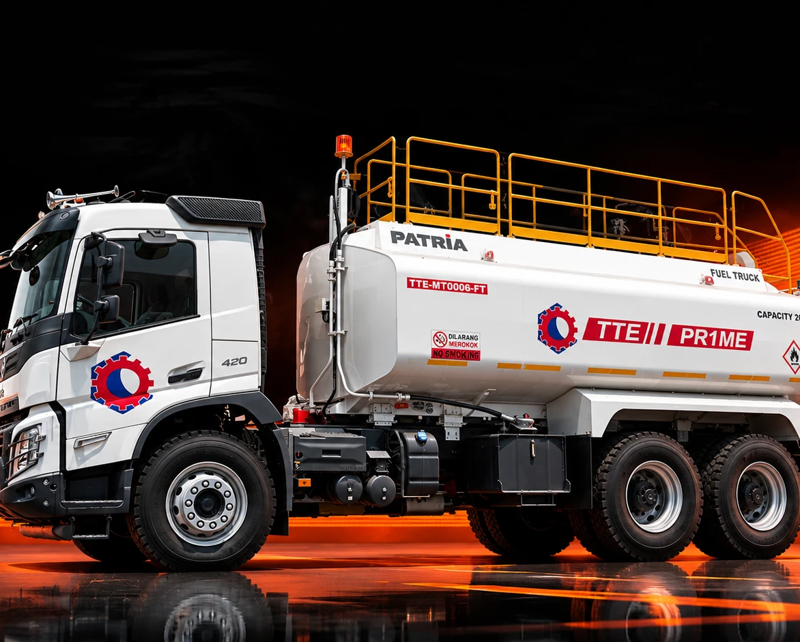
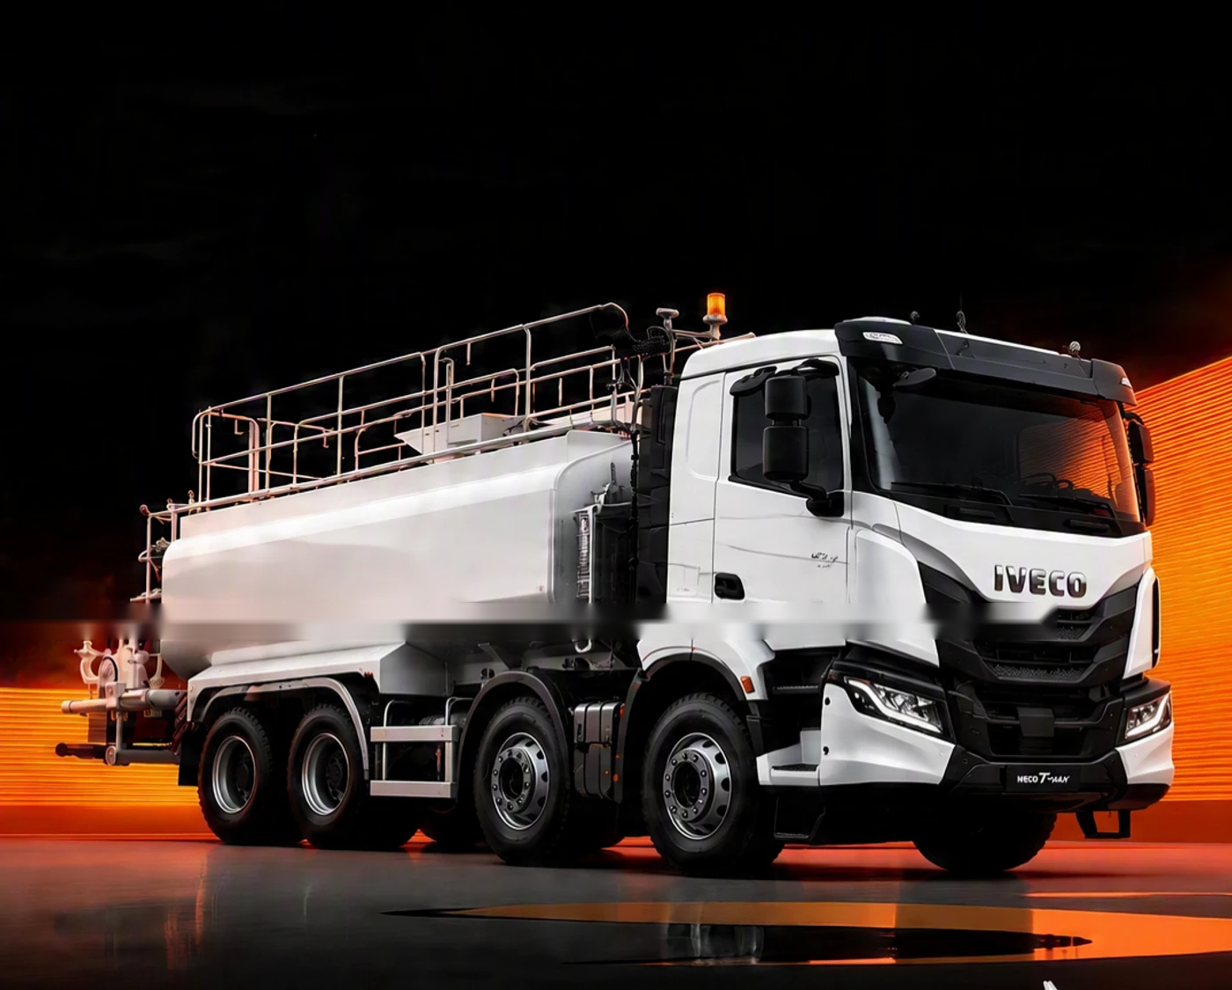
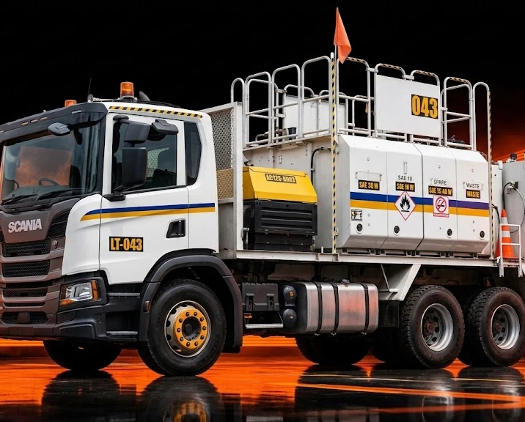
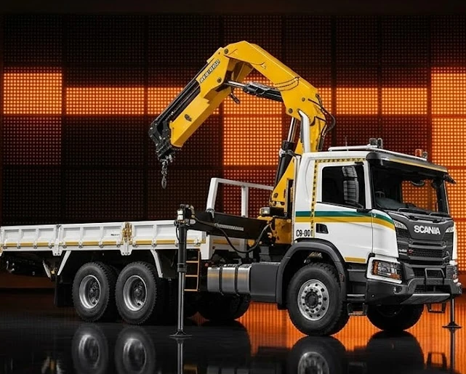
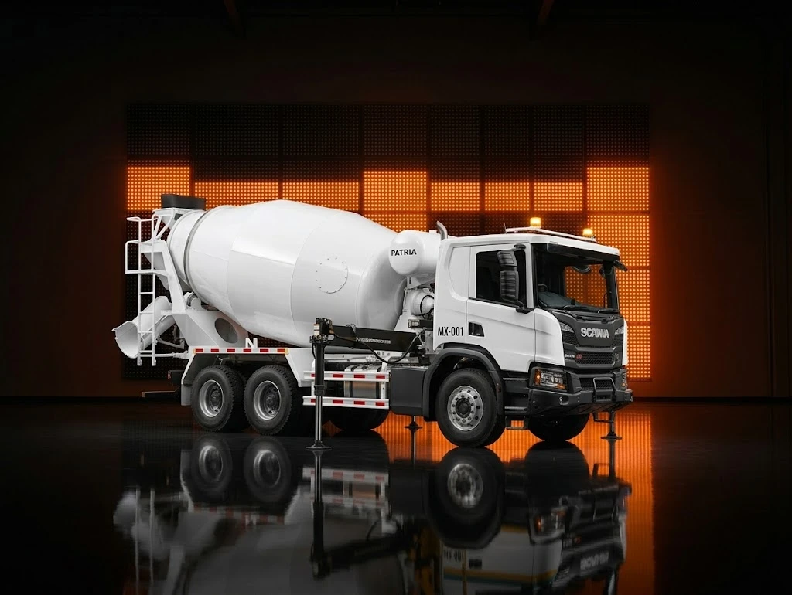
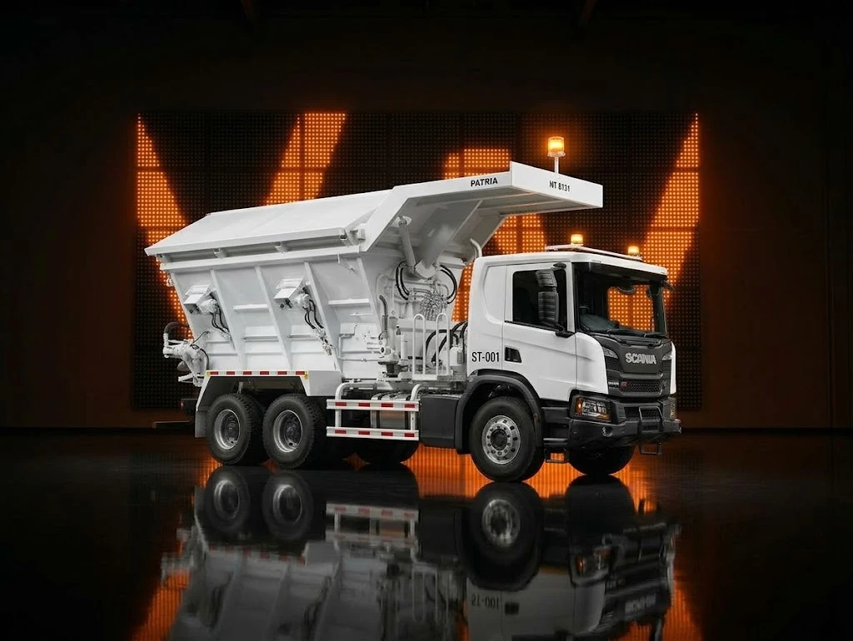
NEDP 6-MONTH REVIEW · ROLES & RESPONSIBILITY · SUPPLY CHAIN
ROLES & RESPONSIBILITY · SUPPLY CHAIN
I take every order from inquiry to delivery for two product lines
Five steps from customer inquiry to factory acceptance test (FAT), for Small Suppeq and Truck Others.
01 Inquiry & opportunity
02 Preliminary
03 Pricing / Quotation
04 Negotiation & CPO
05 Production & Delivery
PIC
PIC
PIC
PIC
PIC
Business Consultant
Application Engineering
Marketing Unit
Business Consultant
Application Engineering
Marketing Unit Triatra
Marketing Unit Triatra
Marketing Unit UTPE
Business Consultant
Marketing Unit Triatra
Marketing Unit UTPE
Business Consultant
Marketing Unit Triatra
Marketing Unit UTPE
Warehouse
DETAIL
DETAIL
DETAIL
DETAIL
DETAIL
Check spec and buying reason
Check project location
Check target price and lead time
Check urgency and PO date
Lead / opportunity in CRM
Repeat order or new drawing?
Request drawing in iServe; MKU Head assigns AE (same day)
AE drawing: repeat 1 day, minor 3 days, major 5 days
Check unit function and critical parts
Handle customer revisions
Request quote to UTPE: drawing, target price, lead time, customer info
UTPE quote: price/COGS, lead time, validity
Input standard price; check standard GP
Submit PCR for approval
Watch SLA; escalate if late
Revise lead time and spec if asked
Check PO / PJB vs drawing
Validate order; fill SAP condition type
DP request or confirm order → SO
Extend PN, master data, sharing profit
PO interco: MKU Manager → GM → Director
Build follows QFD
Weekly progress to BC
Escalate major problems
FAT and QC at warehouse
Delivery plan; BAST and SPB signed
UNITS I HANDLE · SMALL SUPPEQ
UNITS I HANDLE · TRUCK OTHERS
Fuel truck
Water truck
Lube truck
Crane truck
Mixer truck
Stemming truck
NEDP MID YEAR REVIEW 2026 · TIBERIAS K. SIMU
07 / 18

