Slide 1
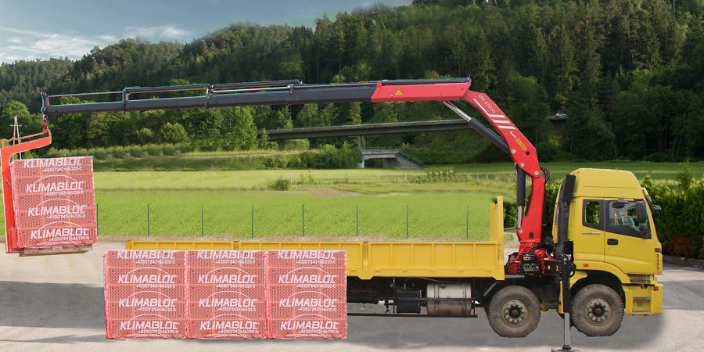
MARKET BRIEF FOR F.LLI FERRARI
The most popular
folding cranes in
Indonesia
Top 3 – 5 models in every tm class, 2023 – 2026
636 cranes imported · Rp 321,8 Bio · ~188 units a year
PT Triatra Sinergia Pratama · Marketing Strategic

Slide 2
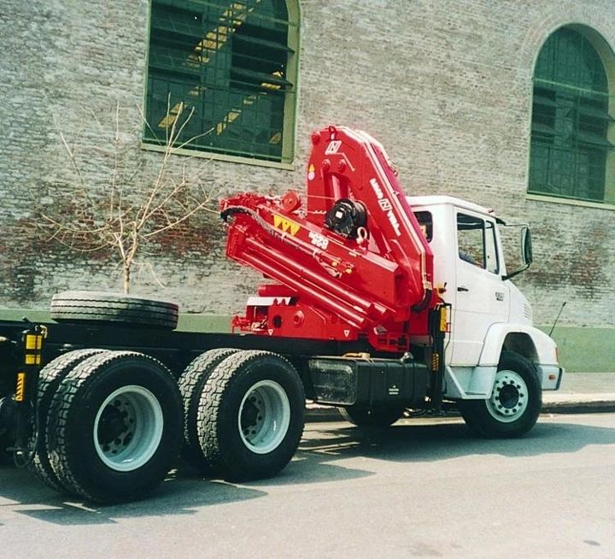
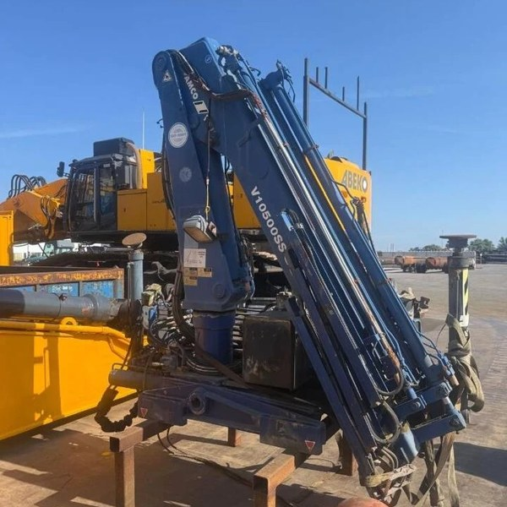


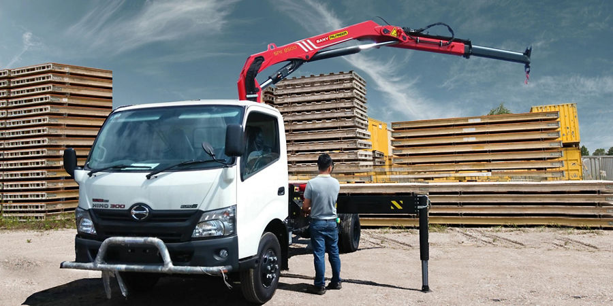
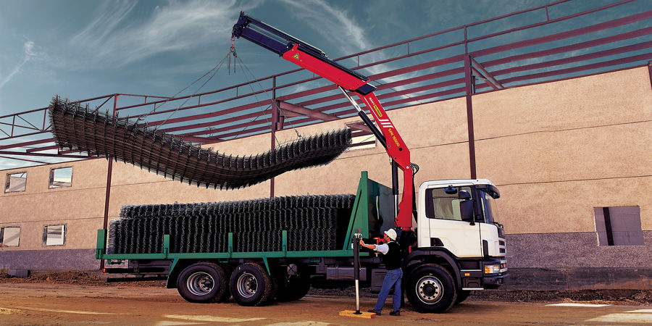
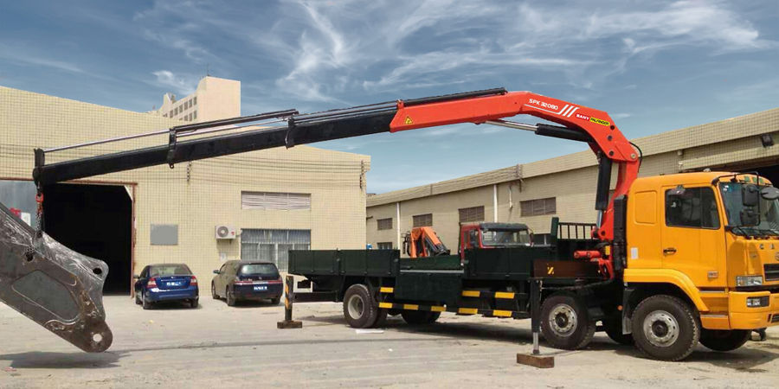
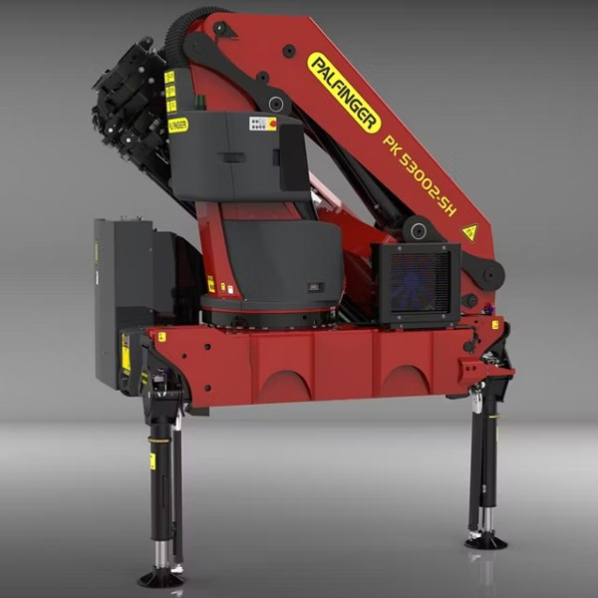
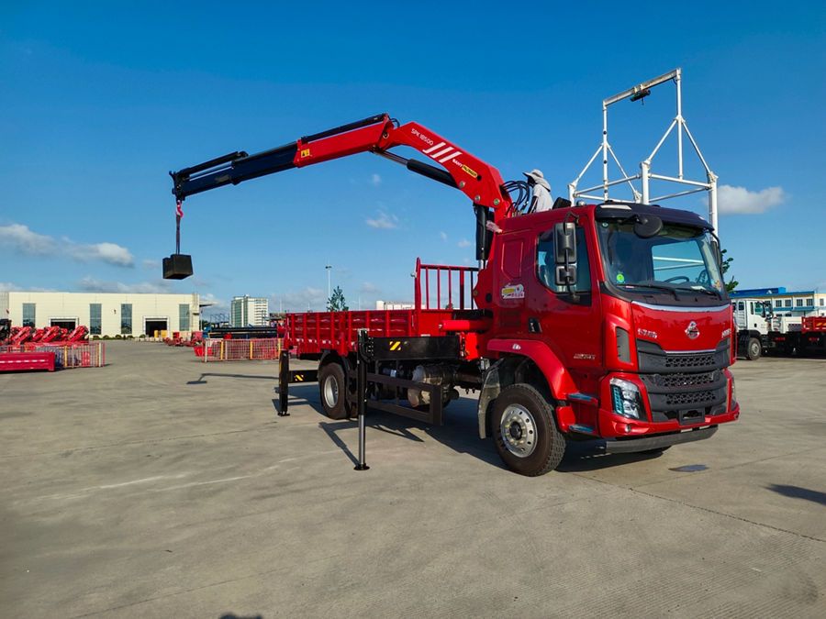
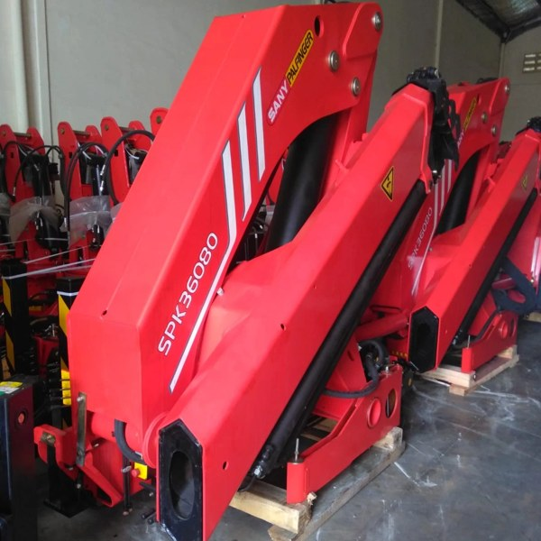
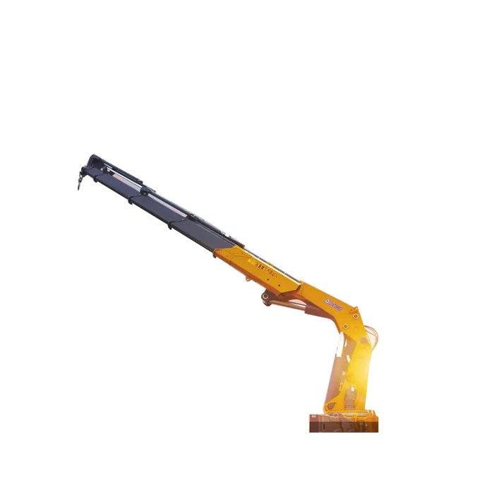
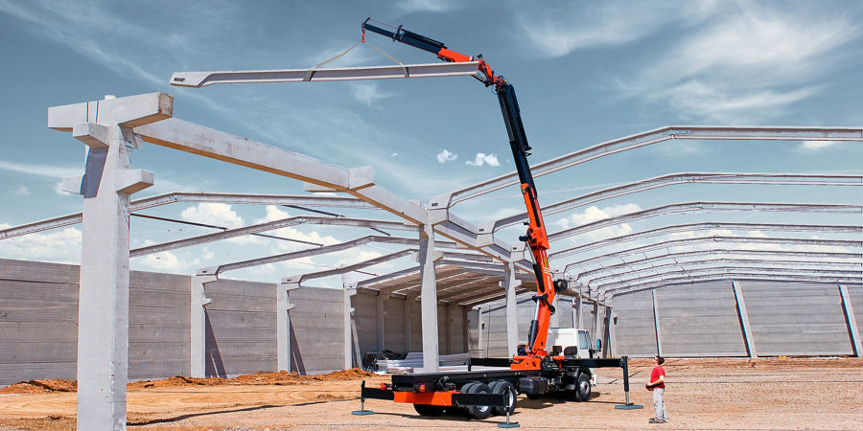
Every class has a clear #1 model
2
Most popular model in each tm class, by units imported 2023 – 2026
Light · 174 units
Small · 184 units
Medium · 213 units
Heavy · 65 units
≤ 5 tm 6 units
8–10 tm 3 units
25–30 tm 49 units
45–50 tm 17 units
Palfinger
Fassi
Amco Veba
Amco Veba
PK 5001
F85B.24
V825
V950
3 units · 50%
1 units · 33%
31 units · 63%
12 units · 71%
Rp 265 Jt /unit
Rp 342 Jt /unit
Rp 517 Jt /unit
Rp 1.575 Jt /unit
5–8 tm 168 units
10–15 tm 56 units
30–35 tm 75 units
50–55 tm 40 units
Sany Palfinger
Sany Palfinger
Sany Palfinger
Palfinger
SPK8500
SPK15500
SPK32080
PK 53002
91 units · 54%
24 units · 43%
33 units · 44%
39 units · 98%
Rp 185 Jt /unit
Rp 275 Jt /unit
Rp 390 Jt /unit
Rp 1.361 Jt /unit
15–20 tm 38 units
35–40 tm 66 units
85–90 tm 4 units
Sany Palfinger
Sany Palfinger
XCMG
SPK18500
SPK36080
GSQZ880.6
8 units · 21%
34 units · 52%
2 units · 50%
Rp 324 Jt /unit
Rp 433 Jt /unit
Rp 1.162 Jt /unit
20–25 tm 87 units
40–45 tm 23 units
Sany Palfinger
Sany Palfinger
SPK23500
SPK42502
70 units · 80%
18 units · 78%
Rp 334 Jt /unit
Rp 693 Jt /unit
Source: Indonesia import records (Crane Market GVW Pairing v11), 2023 – 2026 (2026 partial year). Folding cranes only. Units = units imported; price = average import price per unit × Rp 17.803/USD, before duty and tax. Photos: manufacturer websites and brochures.

Slide 3
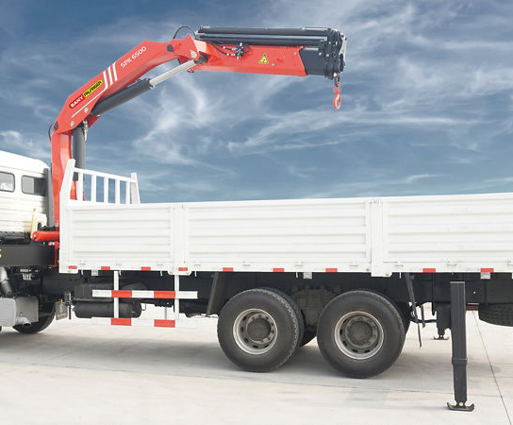
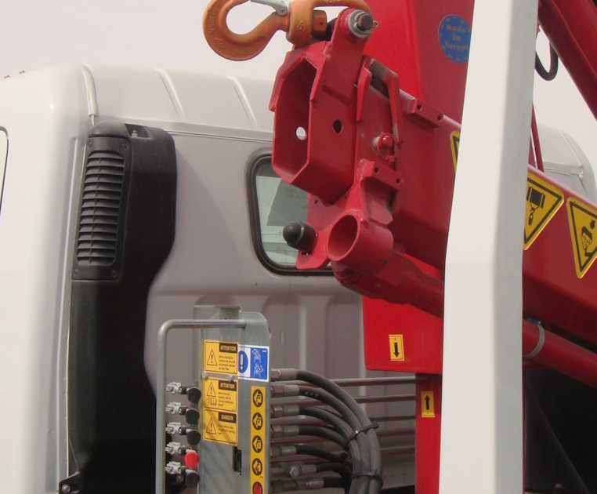

Light (≤ 8 tm): Sany Palfinger SPK8500 is the volume model
3
Top models by units imported, 2023 – 2026 · Light class
LIGHT
#1
#2
#3
≤ 5 tm
6 units
Bob-Lift
imported 2023 – 26
photo to follow
photo to follow
photo to follow
Palfinger
Fassi
Bob-Lift
PK 5001
M30
GKB08ZA3
3 units · 50% of class
2 units · 33% of class
1 units · 17% of class
F.lli Ferrari size:
315, 350, 543
Rp 265 Jt /unit
Rp 165 Jt /unit
Rp 53 Jt /unit
LIGHT
#1
#2
#3
#4
#5
5–8 tm
168 units
imported 2023 – 26
photo to follow
photo to follow
Sany Palfinger
Palfinger
Sany Palfinger
XCMG
Amco Veba
SPK8500
PK 8501
SPK6500
KSQZ68.2
V806
91 units · 54% of class
34 units · 20% of class
19 units · 11% of class
9 units · 5% of class
8 units · 5% of class
F.lli Ferrari size:
563, 563R
Rp 185 Jt /unit
Rp 404 Jt /unit
Rp 148 Jt /unit
Rp 149 Jt /unit
Rp 211 Jt /unit
Source: Indonesia import records (Crane Market GVW Pairing v11), 2023 – 2026 (2026 partial year). Folding cranes only. Units = units imported; price = average import price per unit × Rp 17.803/USD, before duty and tax. Photos: manufacturer websites and brochures.

Slide 4

Small (8 – 15 tm): SPK15500 leads 10–15 tm
4
Top models by units imported, 2023 – 2026 · Small class
SMALL
#1
#2
#3
8–10 tm
3 units
Bob-Lift
imported 2023 – 26
photo to follow
photo to follow
photo to follow
Fassi
Fassi
Bob-Lift
F85B.24
F85B.0.22
GKB5ZA2
1 units · 33% of class
1 units · 33% of class
1 units · 33% of class
F.lli Ferrari size:
6108
Rp 342 Jt /unit
Rp 336 Jt /unit
Rp 171 Jt /unit
SMALL
#1
#2
#3
#4
#5
10–15 tm
56 units
imported 2023 – 26
photo to follow
photo to follow
photo to follow
photo to follow
Sany Palfinger
Amco Veba
Palfinger
XCMG
XCMG
SPK15500
V816
PK 15500
GSQZ105.4
SQ5ZK3
24 units · 43% of class
9 units · 16% of class
6 units · 11% of class
4 units · 7% of class
3 units · 5% of class
F.lli Ferrari size:
6148, 5148
Rp 275 Jt /unit
Rp 351 Jt /unit
Rp 497 Jt /unit
Rp 230 Jt /unit
Rp 241 Jt /unit
Source: Indonesia import records (Crane Market GVW Pairing v11), 2023 – 2026 (2026 partial year). Folding cranes only. Units = units imported; price = average import price per unit × Rp 17.803/USD, before duty and tax. Photos: manufacturer websites and brochures.

Slide 5
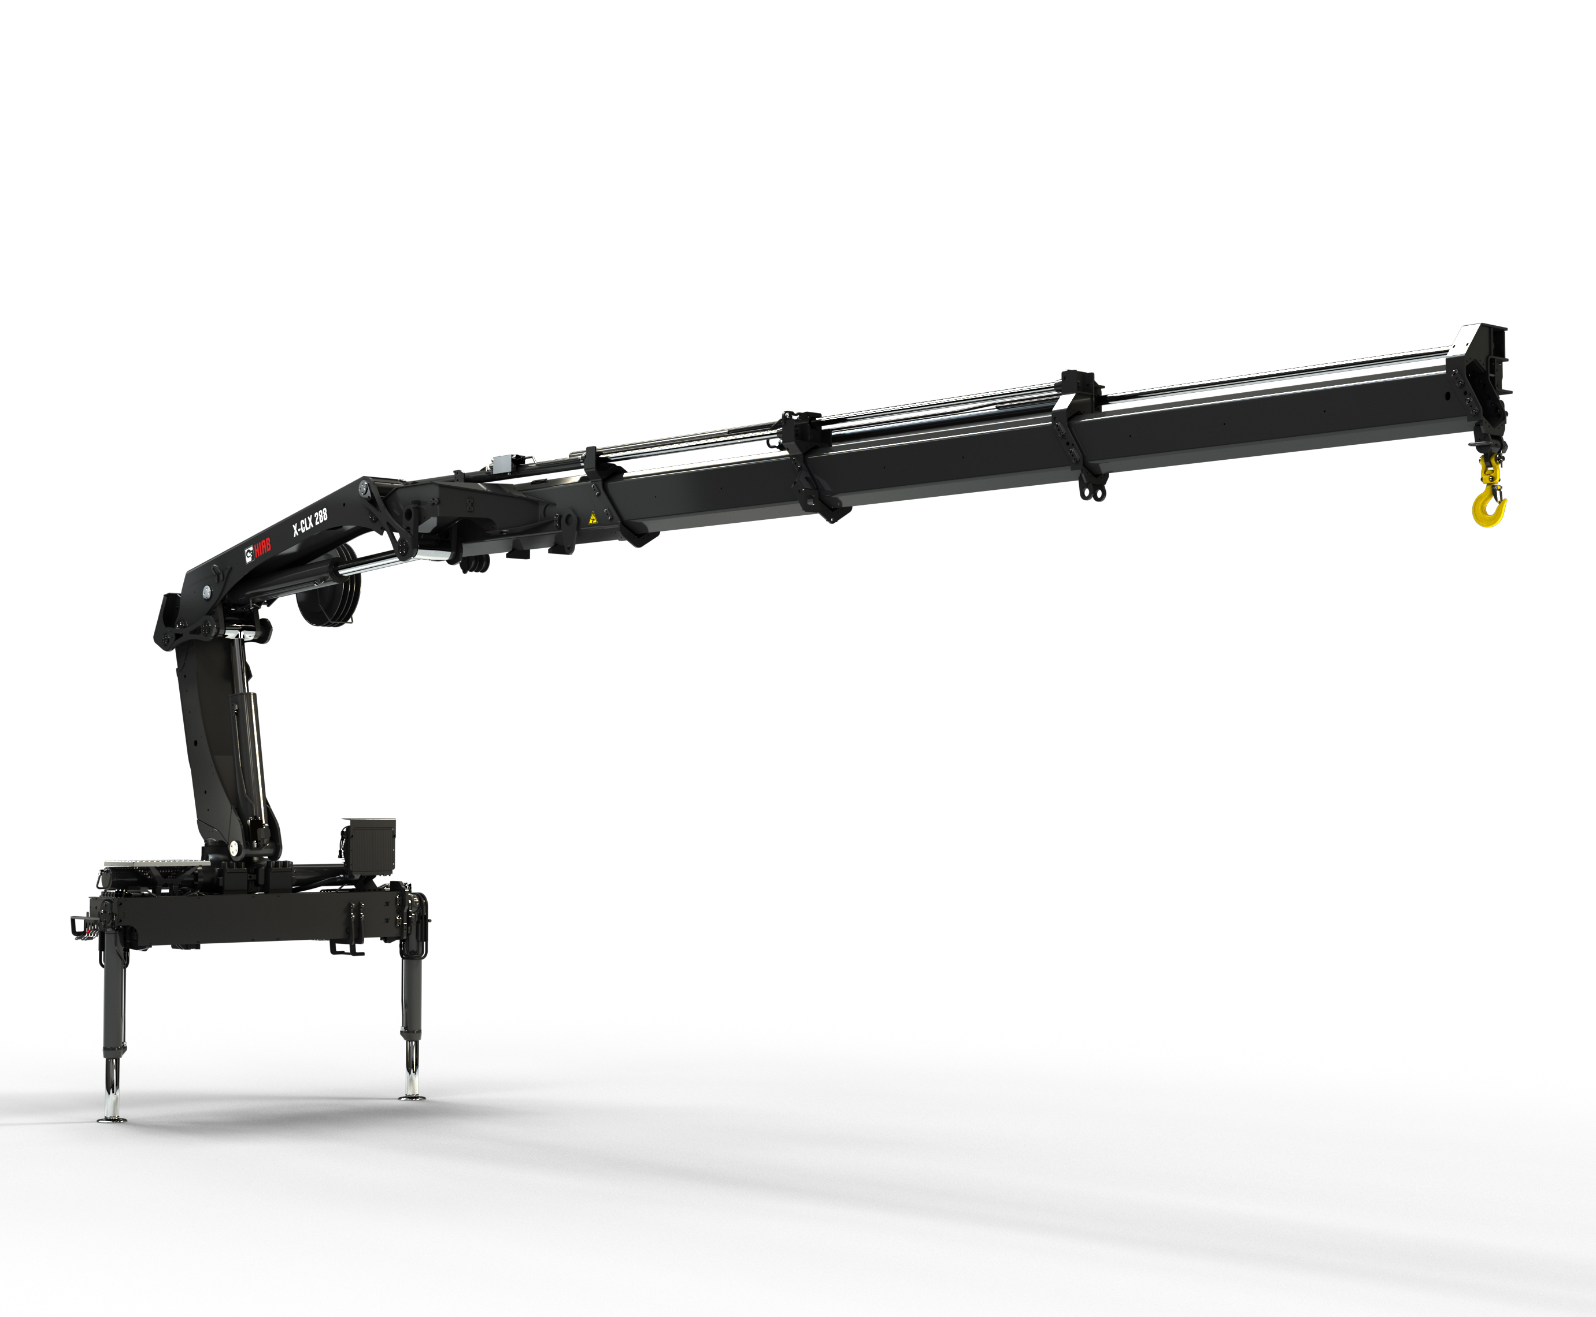

Small (15 – 25 tm): SPK23500 is 70 of 87 units at 20–25 tm
5
Top models by units imported, 2023 – 2026 · Small class
SMALL
#1
#2
#3
#4
#5
15–20 tm
38 units
imported 2023 – 26
photo to follow
photo to follow
photo to follow
photo to follow
Sany Palfinger
XCMG
XCMG
XCMG
XCMG
SPK18500
GSQZ160.4
KSQZ200.3
GSQZ200.4
GSQZ200.3
8 units · 21% of class
6 units · 16% of class
4 units · 11% of class
4 units · 11% of class
4 units · 11% of class
F.lli Ferrari size:
178, 6238
Rp 324 Jt /unit
Rp 365 Jt /unit
Rp 381 Jt /unit
Rp 334 Jt /unit
Rp 304 Jt /unit
SMALL
#1
#2
#3
#4
#5
20–25 tm
87 units
PM Cranes
imported 2023 – 26
photo to follow
photo to follow
photo to follow
Sany Palfinger
Palfinger
HIAB
HIAB
PM Cranes
SPK23500
PK 23500
X-CLX 288
X-CL 23
PM9024
70 units · 80% of class
6 units · 7% of class
3 units · 3% of class
3 units · 3% of class
3 units · 3% of class
F.lli Ferrari size:
6248, 258, 258R, 268
Rp 334 Jt /unit
Rp 732 Jt /unit
Rp 747 Jt /unit
Rp 512 Jt /unit
Rp 335 Jt /unit
Source: Indonesia import records (Crane Market GVW Pairing v11), 2023 – 2026 (2026 partial year). Folding cranes only. Units = units imported; price = average import price per unit × Rp 17.803/USD, before duty and tax. Photos: manufacturer websites and brochures.

Slide 6
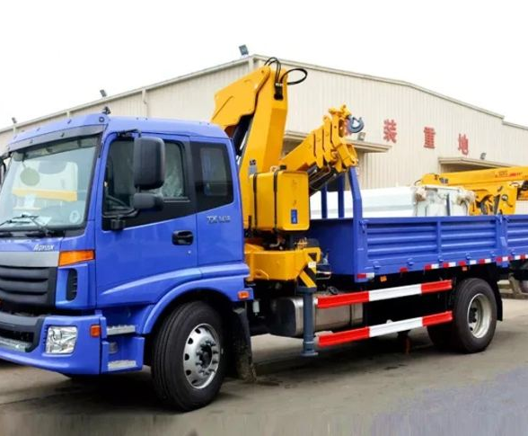
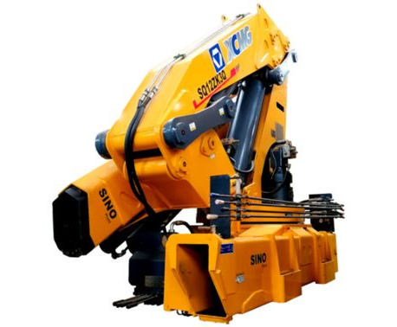
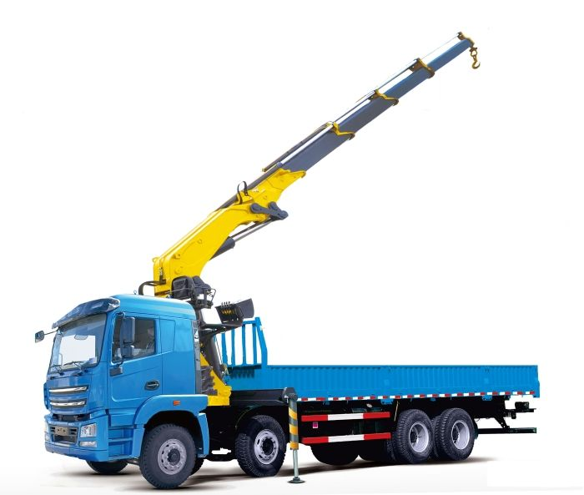
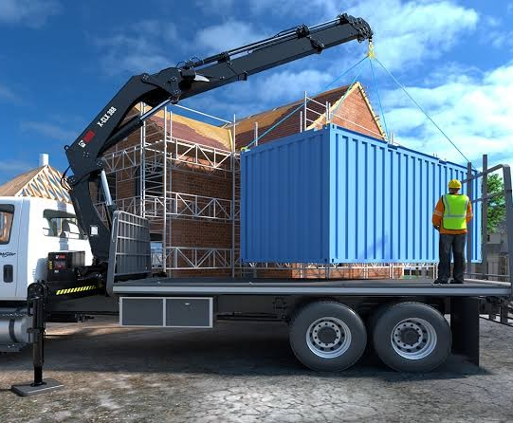
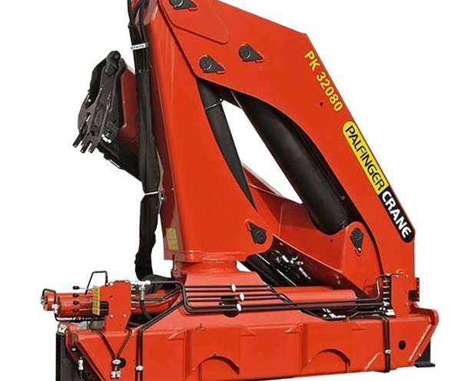
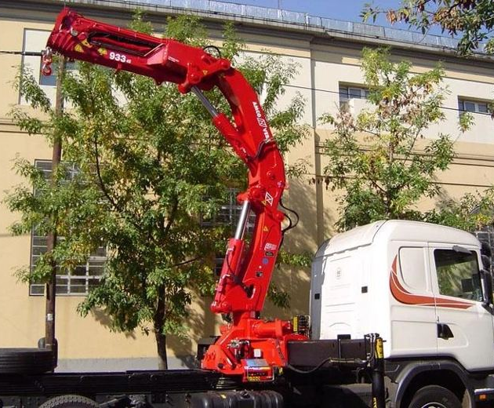
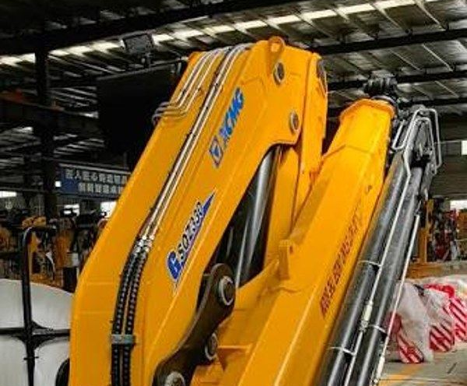
Medium (25 – 35 tm): Amco Veba V825 and Sany Palfinger SPK32080 lead
6
Top models by units imported, 2023 – 2026 · Medium class
MEDIUM
#1
#2
#3
#4
25–30 tm
49 units
imported 2023 – 26
Amco Veba
XCMG
XCMG
XCMG
V825
KSQZ300.3
SQ12ZK3
KSQZ300.4
31 units · 63% of class
15 units · 31% of class
2 units · 4% of class
1 units · 2% of class
F.lli Ferrari size:
258
Rp 517 Jt /unit
Rp 432 Jt /unit
Rp 440 Jt /unit
Rp 501 Jt /unit
MEDIUM
#1
#2
#3
#4
#5
30–35 tm
75 units
imported 2023 – 26
Sany Palfinger
HIAB
Palfinger
Amco Veba
XCMG
SPK32080
X-CLX 388
PK 32080
V933
GSQZ330.4
33 units · 44% of class
21 units · 28% of class
8 units · 11% of class
4 units · 5% of class
4 units · 5% of class
F.lli Ferrari size:
FBR350, FBR350R, 934, 934R
Rp 390 Jt /unit
Rp 762 Jt /unit
Rp 881 Jt /unit
Rp 699 Jt /unit
Rp 613 Jt /unit
Source: Indonesia import records (Crane Market GVW Pairing v11), 2023 – 2026 (2026 partial year). Folding cranes only. Units = units imported; price = average import price per unit × Rp 17.803/USD, before duty and tax. Photos: manufacturer websites and brochures.

Slide 7
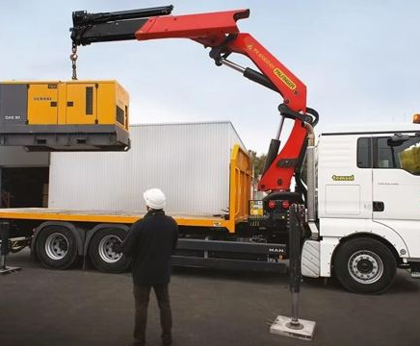
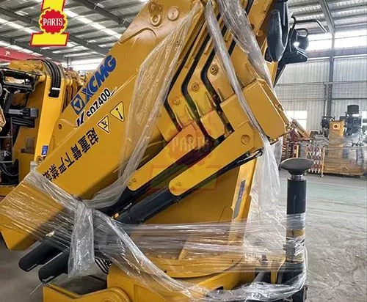
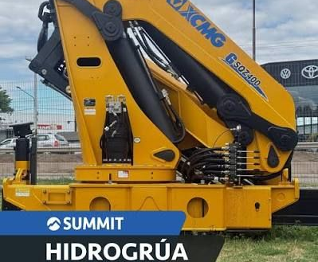

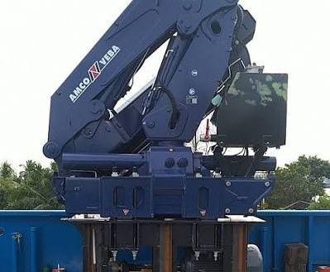
Medium (35 – 45 tm): Sany Palfinger SPK36080 and SPK42502 lead
7
Top models by units imported, 2023 – 2026 · Medium class
MEDIUM
#1
#2
#3
#4
#5
35–40 tm
66 units
imported 2023 – 26
photo to follow
Sany Palfinger
Palfinger
Sany Palfinger
XCMG
XCMG
SPK36080
PK 41002
SPK38080
KSQZ400.4
GSQZ400.4
34 units · 52% of class
21 units · 32% of class
3 units · 5% of class
2 units · 3% of class
2 units · 3% of class
Rp 433 Jt /unit
Rp 1.103 Jt /unit
Rp 410 Jt /unit
Rp 623 Jt /unit
Rp 620 Jt /unit
MEDIUM
#1
#2
#3
40–45 tm
23 units
imported 2023 – 26
photo to follow
Sany Palfinger
HIAB
Amco Veba
SPK42502
477
V946
18 units · 78% of class
4 units · 17% of class
1 units · 4% of class
F.lli Ferrari size:
746
Rp 693 Jt /unit
Rp 472 Jt /unit
Rp 1.068 Jt /unit
Source: Indonesia import records (Crane Market GVW Pairing v11), 2023 – 2026 (2026 partial year). Folding cranes only. Units = units imported; price = average import price per unit × Rp 17.803/USD, before duty and tax. Photos: manufacturer websites and brochures.

Slide 8
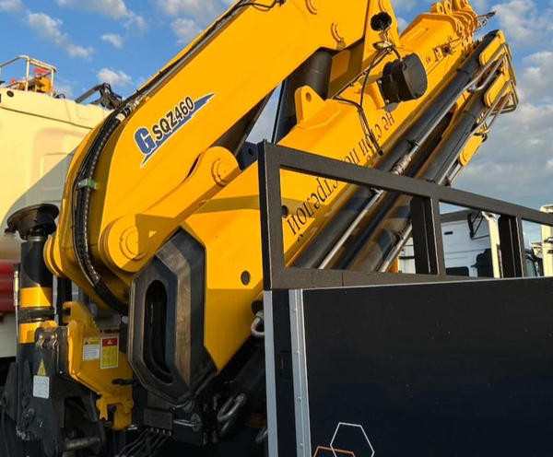
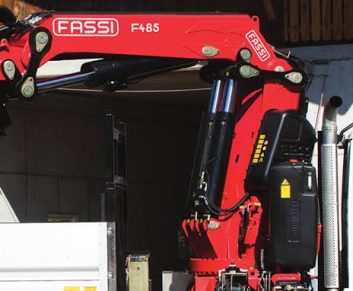
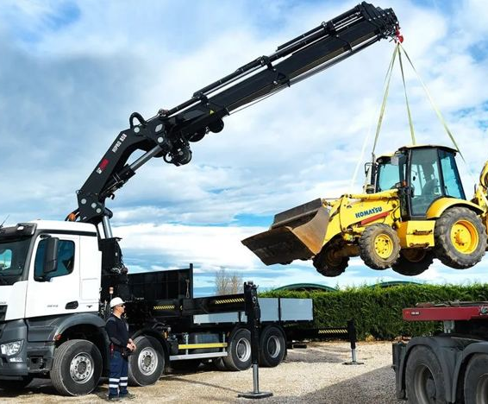
Heavy (45 – 55 tm): Amco Veba V950 and Palfinger PK 53002 lead
8
Top models by units imported, 2023 – 2026 · Heavy class
HEAVY
#1
#2
#3
45–50 tm
17 units
imported 2023 – 26
Amco Veba
XCMG
Fassi
V950
GSQZ460.4
F485RA.2.23
12 units · 71% of class
3 units · 18% of class
1 units · 6% of class
F.lli Ferrari size:
FBR450, FBR450R, 749R
Rp 1.575 Jt /unit
Rp 716 Jt /unit
Rp 1.349 Jt /unit
HEAVY
#1
#2
50–55 tm
40 units
imported 2023 – 26
Palfinger
HIAB
PK 53002
X-HIPRO B58
39 units · 98% of class
1 units · 2% of class
F.lli Ferrari size:
FBR450R, 9601CR
Rp 1.361 Jt /unit
Rp 2.824 Jt /unit
Source: Indonesia import records (Crane Market GVW Pairing v11), 2023 – 2026 (2026 partial year). Folding cranes only. Units = units imported; price = average import price per unit × Rp 17.803/USD, before duty and tax. Photos: manufacturer websites and brochures.

Slide 9
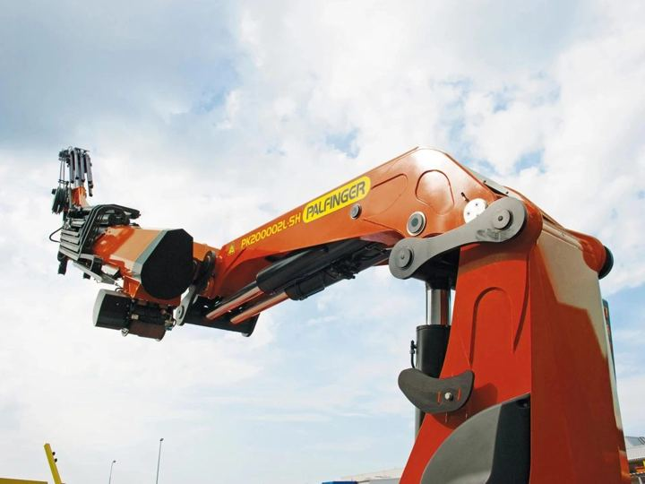
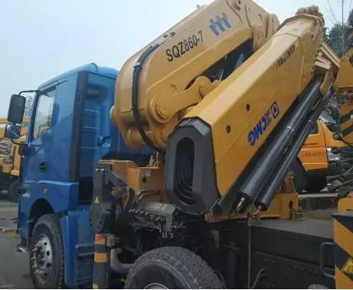
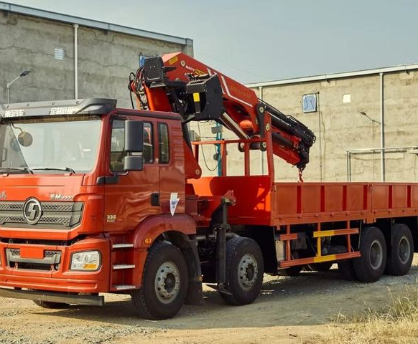
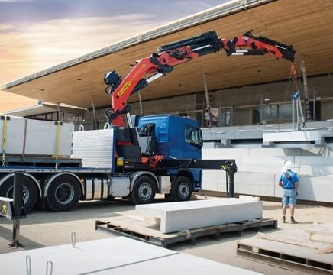
Heavy (> 55 tm): small volumes, Palfinger and XCMG
9
All models above 55 tm, 2023 – 2026 · Heavy class
HEAVY
#1
#2
#3
#4
#5
> 55 tm
8 units
imported 2023 – 26
Palfinger
XCMG
XCMG
Sany Palfinger
Palfinger
PK 76002
GSQZ880.6
GSQZ860.6
SPK61502
PK 88002
2 units · 25% of class
2 units · 25% of class
2 units · 25% of class
1 units · 12% of class
1 units · 12% of class
F.lli Ferrari size:
9661C, 990R
Rp 1.918 Jt /unit
Rp 1.162 Jt /unit
Rp 1.161 Jt /unit
Rp 1.235 Jt /unit
Rp 1.863 Jt /unit
Only 8 units above 55 tm in four years: one or two units per model.
These are project sales, quoted one by one.
Source: Indonesia import records (Crane Market GVW Pairing v11), 2023 – 2026 (2026 partial year). Folding cranes only. Units = units imported; price = average import price per unit × Rp 17.803/USD, before duty and tax. Photos: manufacturer websites and brochures.

