Slide 1
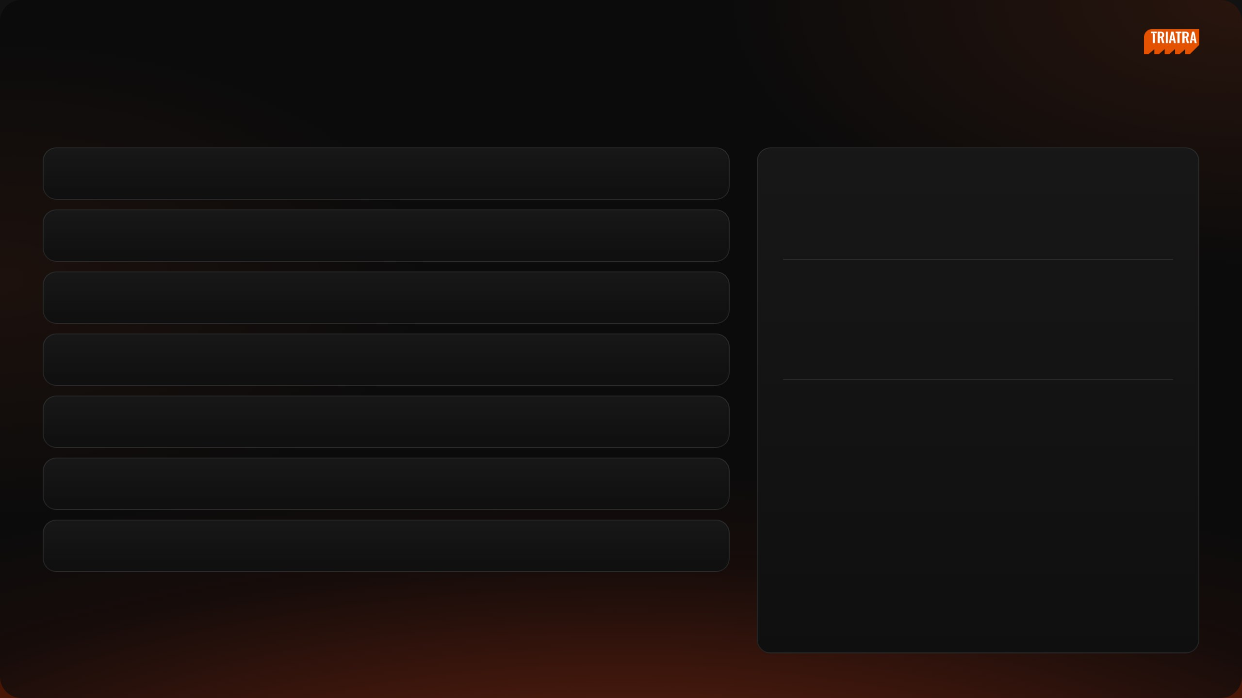
[ INTERNAL USE ONLY ]
NEDP MID YEAR REVIEW 2026
Agenda
00
Personal Information
PRESENTER / ID
Tiberias K. Simu
01
Company Profile
MARKETING STRATEGIC 2 ASSOCIATE
02
Site Operation
PRODUCTS I OWN
Small Suppeq
03
Truck Others
Organization Chart
04
Roles & Responsibility
PT Triatra Sinergia Pratama
Marketing Unit & Strategic Division
05
Job Description Execution
06
Project — F.lli Ferrari Crane Strategy
NEDP MID YEAR REVIEW 2026
01 / 31

Slide 2

[ INTERNAL USE ONLY ]
PERSONAL
Personal Information
About Me
Onboarding Journey
NEDP MID YEAR REVIEW 2026
02 / 31

Slide 3

[ INTERNAL USE ONLY ]
PERSONAL INFORMATION
About Me
PROFILE
Education
Tiberias Krisgaharu Simu
Universitas Sanata Dharma, Yogyakarta
Bachelor (S1) · Management · Faculty of Economics
PT Triatra Sinergia Pratama
Work Experience
POSITION
PT Triatra Sinergia Pratama
Marketing Strategic 2 Associate
Marketing Strategic 2 Associate
2026 – now
DIVISION
Marketing Unit & Strategic
Outlier
2023 – 2025
Team Lead Data Annotator
PRODUCTS
Small Suppeq · Truck Others
Krishma International
2021 – 2023
Marketing Coordinator
PLACE, DATE OF BIRTH
Kupang, 22 April 2001
Organization
PHONE
HMJM Universitas Sanata Dharma
2021 – 2022
0822 7222 2463
President
NEDP MID YEAR REVIEW 2026
03 / 31

Slide 4
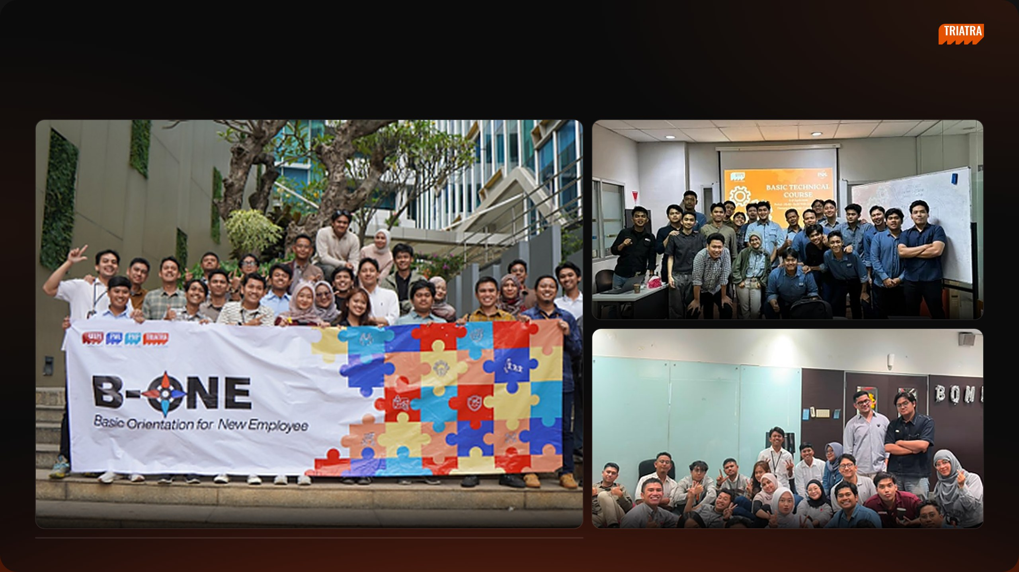
[ INTERNAL USE ONLY ]
PERSONAL INFORMATION
Onboarding Journey
Basic Technical Course
B-ONE · Basic Orientation for New Employee
Batch gathering
Marketing HO presentation
NEDP MID YEAR REVIEW 2026
04 / 31

Slide 5

[ INTERNAL USE ONLY ]
SECTION 01
Company Profile
Part of the UTPE Group · Distributor of PATRIA and ULTRA
NEDP MID YEAR REVIEW 2026
05 / 31

Slide 6
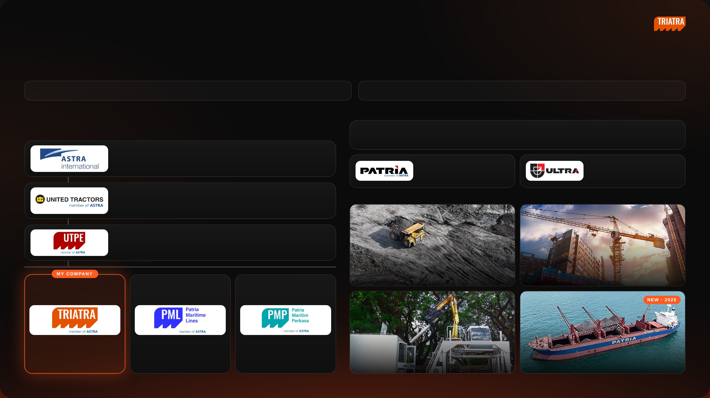
[ INTERNAL USE ONLY ]
SECTION 01 · COMPANY PROFILE
Company Profile
01 Triatra is part of the UTPE Group and AHEMCE, focusing on Distributorship and Trading.
02 Starting in 2025, Triatra develops a new business line in Marine.
CORPORATE ENTITY STRUCTURE
PT TRIATRA SINERGIA PRATAMA
PT Triatra Sinergia Pratama is one of the entities within the UTPE Group, part of the UT Group and the AHEMCE
Distributor of PATRIA and ULTRA products for mining, construction, agriculture, forestry and maritime. Triatra offers
business line of PT Astra International Tbk.
both equipment units and full after-sales support, from spare parts and remanufacturing to maintenance services.
Astra International
Astra Heavy Equipment, Mining, Construction, and Energy
Unit
Part, Component & Services
International & domestic trader of
After-sales maintenance &
UTPE units
remanufacturing
United Tractors
INDUSTRY COVERAGE
Construction Machinery
UTPE
Engineering Solution & Marine
01
02
Coal & Mineral Mining
Construction
Distributorship and Trading
Ship Owner & Operator
Ship Building and Repair
03
04
Forestry & Agroindustry
Maritime
NEDP MID YEAR REVIEW 2026
06 / 31

Slide 7

[ INTERNAL USE ONLY ]
SECTION 02
Site Operation
NEDP MID YEAR REVIEW 2026
07 / 31

Slide 8
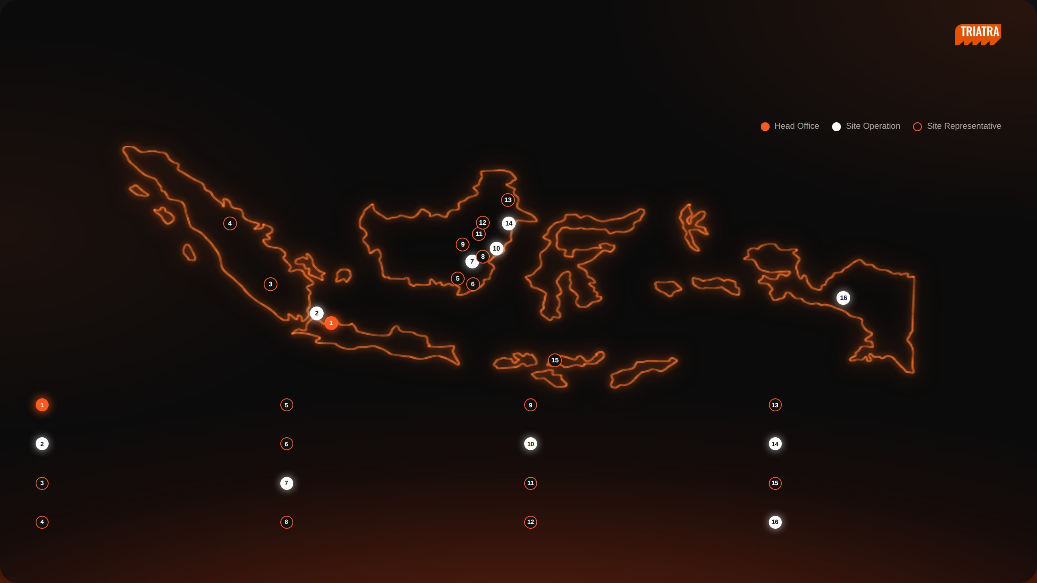
[ INTERNAL USE ONLY ]
SECTION 02 · SITE OPERATION
Site Operation & Support
Triatra covers many areas in Indonesia, with the Head Office in Jakarta, 5 Site Operations and Site Representatives.
Head Office
Banjarmasin
Muara Teweh
Tanjung Redeb
Jl. Raya Bekasi KM 22, Cakung, Jakarta Timur, 13910
Jl. Ahmad Yani KM 13,5 Gambut, Banjarmasin, Kalimantan Selatan,
Jl. Ahmad Yani No. 85, Kel. Melayu, Kab. Barito Utara, Kalimantan
Jl. Gunung Panjang RT.04 No. 101B, Kab. Berau, 77311
70652
Tengah
Jakarta
Sungai Danau
Balikpapan
Sangatta
Jl. Raya Bekasi KM 22, Cakung, Jakarta Timur, 13910
Ds. Karang Indah RT 12/RW 03, Kec. Angsana, Tanah Bambu,
Jl. Jenderal Sudirman No. 844, Balikpapan, Kalimantan Timur, 76114
Jl. HDRS Tango Delta KPC, Mine Site Sangatta, Kutai Timur, 75683
Kalimantan Selatan
Tanjung Enim
Tanjung Tabalong
Melak
Sumbawa
Jl. Lingga Raya 10, Kel. Muara Enim, Sumatera Selatan, 31711
Jl. A. Yani KM 7,5 Maburai, Kec. Murung Pudak, Kab. Tabalong,
D/A PT Tambang Raya Usaha Tama, Hauling Road Trubaindo, Muara
Memco Area Tongo, Sekongkang, West Sumbawa, Nusa Tenggara
Kalimantan Selatan
Lawa, Kutai Barat, Kalimantan Timur
Barat, 84457
Pekanbaru
Batu Kajang
Tabang
Timika
Jl. Soekarno Hatta KM 3,5 No. 151, Pekanbaru, Riau, 28291
Jl. Negara KM 140 Batukajang, Kec. Batu Sopang, Kab. Paser,
Site Indonesia Pratama, Workshop Buma Km 6, Hauling Road
Jl. Kuala Tembaga E-4 LIP Kuala Kencana, Timika, 99920
Kalimantan Timur
Baratabang, Kec. Muara
NEDP MID YEAR REVIEW 2026
08 / 31

Slide 9

[ INTERNAL USE ONLY ]
SECTION 03
Organization Chart
NEDP MID YEAR REVIEW 2026
09 / 31

Slide 10
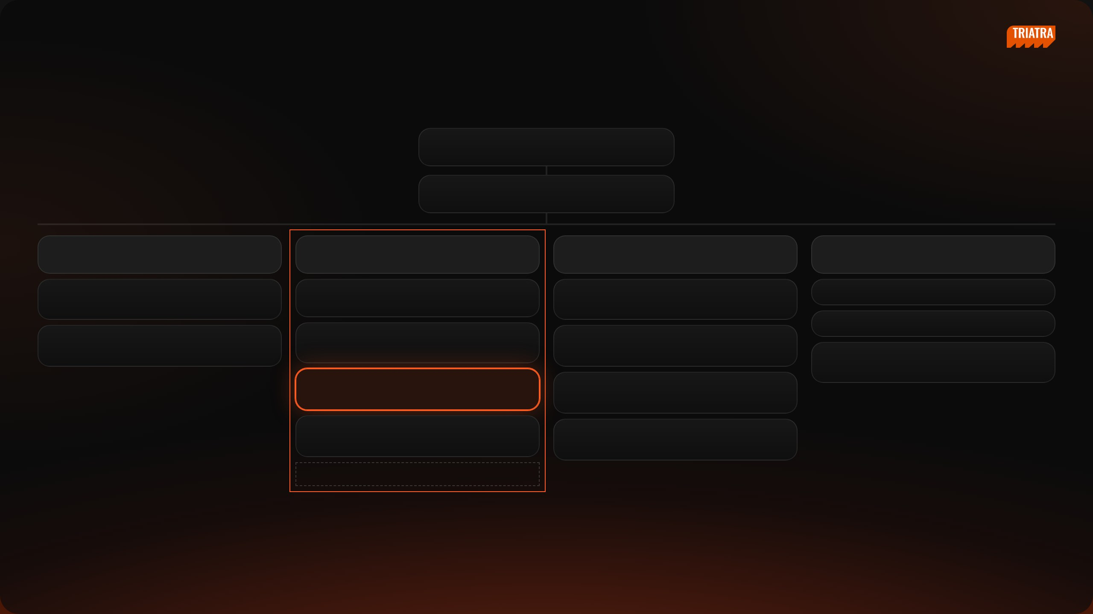
[ INTERNAL USE ONLY ]
SECTION 03 · ORGANIZATION CHART
Organization Structure
Ceisar Centiaga
DIRECTOR IN CHARGE
Ricardo Tanada
MKT UNIT & STRATEGIC DIV HEAD
Kresnanto A.W.
Ricardo Tanada (c)
Ugik Praseno
Marketing Communication
MKT STRATEGIC 1 HEAD
MKT STRATEGIC 2 HEAD
MKT STRATEGIC 3 HEAD
MARCOMM
Satrio F.R.
Ignatius Indrawan S.
Baihaqi
Karina Audina E.
Big Suppeq, Big Vessel, Bucket
DEPUTY HEAD
Mineral Processing, EPC
Ervin Bahar P.
Adinda Siti K.
M. Fawwaz J.
Yuda Prana
Cabin, Forestry, Agro, Forklift, Towerlamp, Pump
Medium Vessel, Man Hauler, Bus Scania
Maritime, Renewable Energy
Rahma
Tiberias K.S. ◄ ME
Graphic Designer
Celine
Small Suppeq, Truck Others
Ultra Product Support
Eurico
Hanifa
Mining / Non-mining Trailer, Overseas Zone
Automation, EV
Nandu Narpati — Admin
NEDP MID YEAR REVIEW 2026
10 / 31

Slide 11

[ INTERNAL USE ONLY ]
SECTION 04
Roles & Responsibility
A — Position & Products
B — Strategic vs Supply Chain
NEDP MID YEAR REVIEW 2026
11 / 31

Slide 12
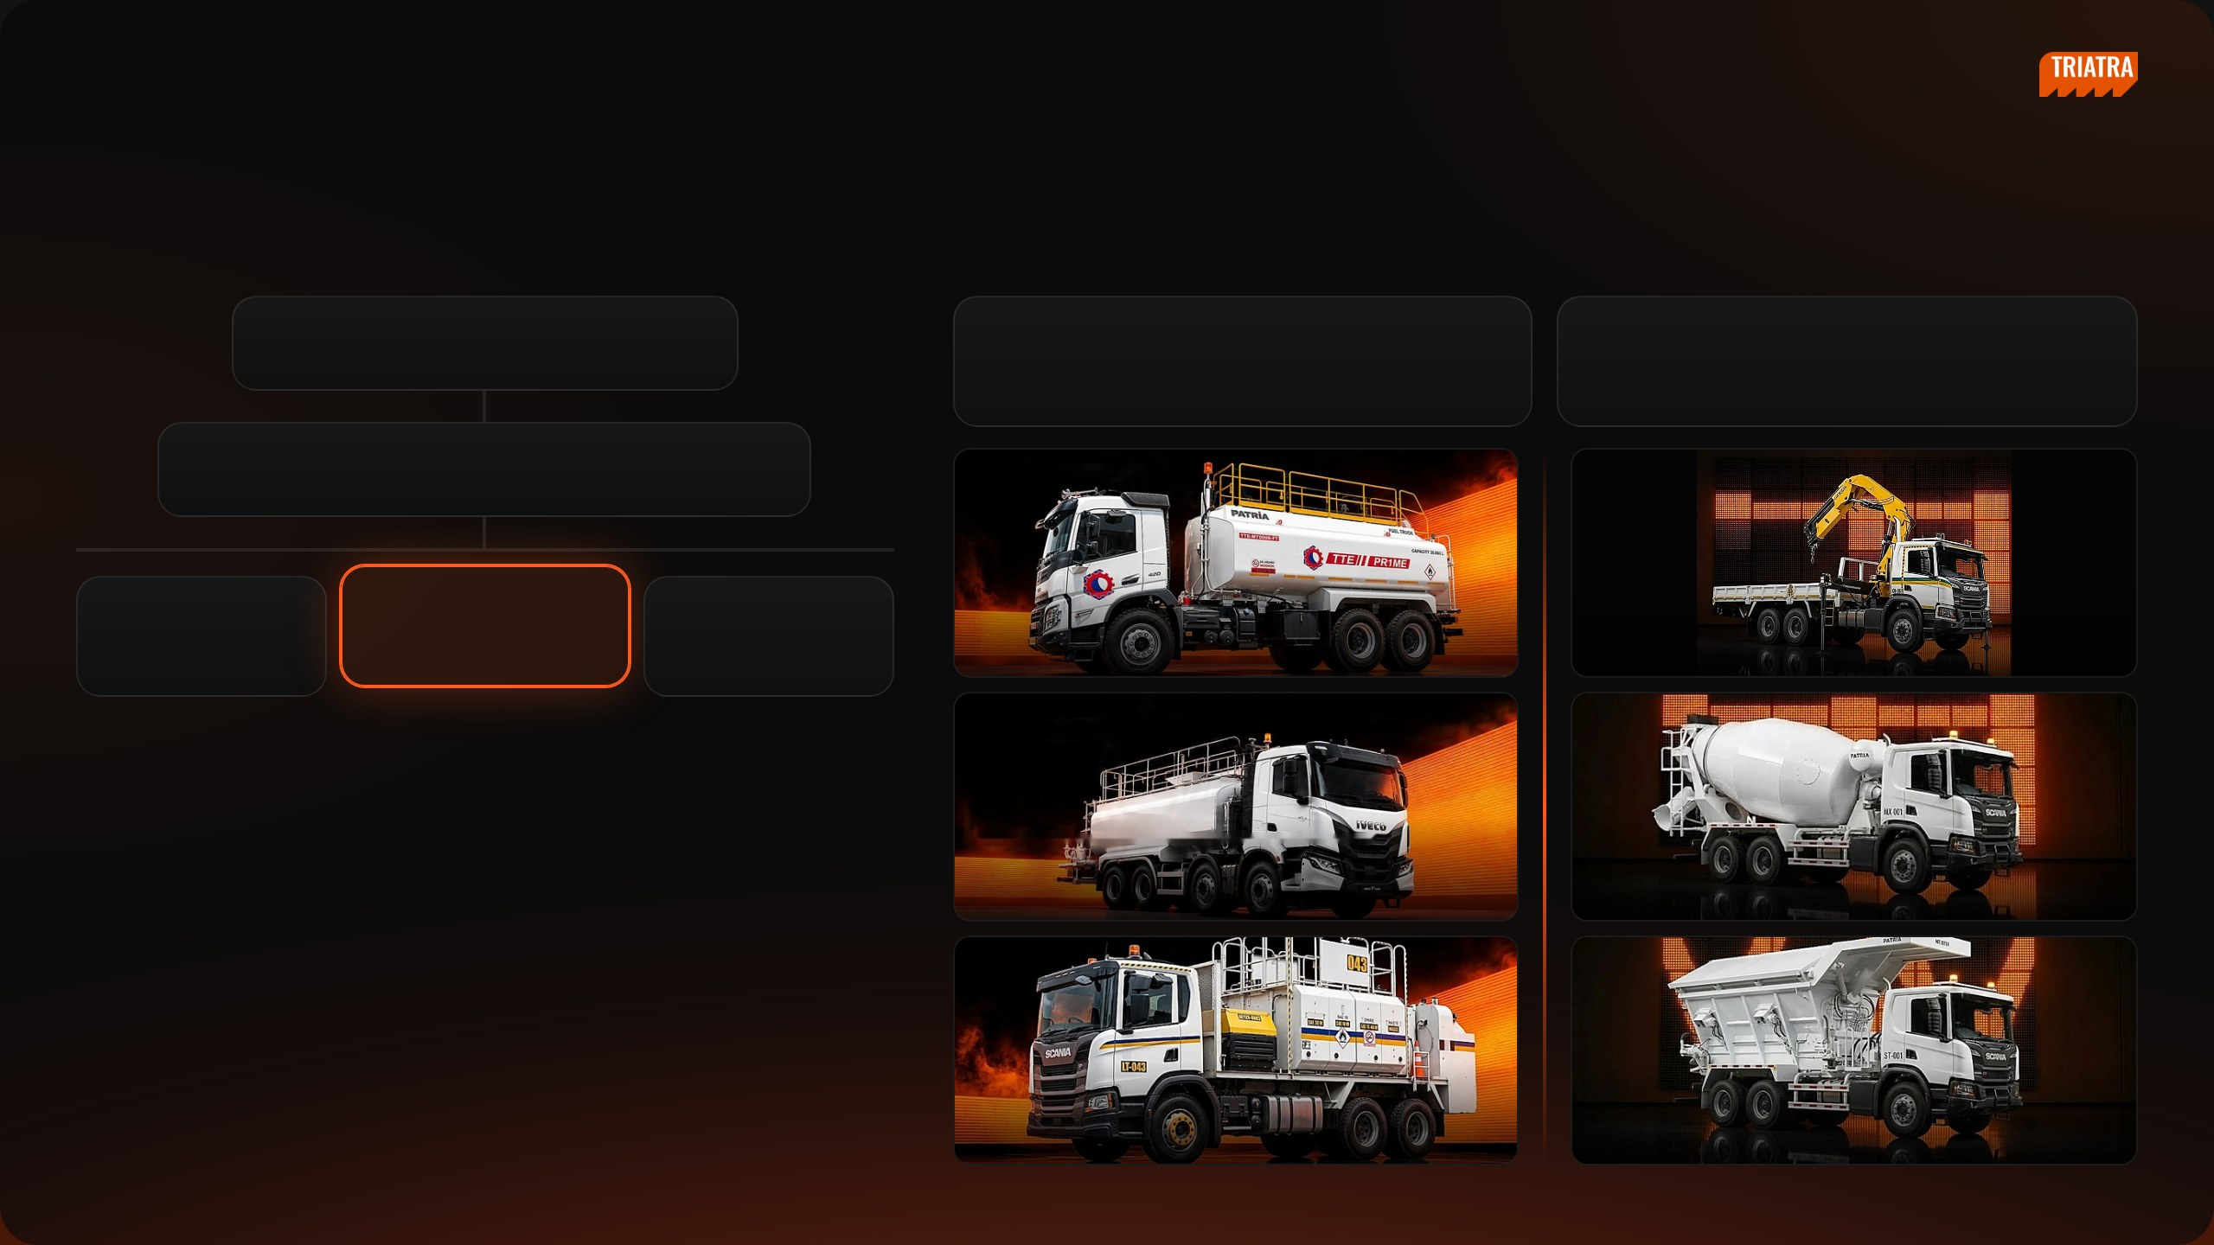
[ INTERNAL USE ONLY ]
SECTION 04 · ROLES & RESPONSIBILITY · A
Position & Products
REPORTING LINE
MY PRODUCTS
Ricardo Tanada
Small Suppeq
Truck Others
DEPT HEAD (CONCURRENT)
Water Truck (WT20, WT35), Lube Truck (LT08), Fuel Truck
Mining Crane, Fire Truck, Mixer Truck, Tyre Truck, Steaming
(FT20) and similar supporting units
Truck and other special-purpose trucks
Ignatius Indrawan Sumawinata
DEPUTY HEAD
Ervin Bahar P.
Tiberias K. Simu
Eurico
Medium Vessel, Man
Small Suppeq, Truck Others
Trailer, Overseas Zone
Hauler, Bus Scania
Fuel Truck (FT)
Crane Truck
ASSOCIATES
Water Truck (WT)
Mixer Truck
Lube Truck (LT)
Stemming Truck
NEDP MID YEAR REVIEW 2026
12 / 31

Slide 13

[ INTERNAL USE ONLY ]
SECTION 04 · ROLES & RESPONSIBILITY · B
Strategic vs Supply Chain
1
Strategic vs Supply Chain
A. STRATEGIC
Sets the direction · for management decisions
B. SUPPLY CHAIN
Runs the transaction · for operations
EXAMPLE ACTIVITIES
END RESULT
EXAMPLE ACTIVITIES
END RESULT
Pricing & Market Analysis: price & market analysis simulation
Basis for the pricing strategy
Demand Check: rising demand in PCR, buying reason, location,
Clear demand before quoting
Market Study & Program Development: market data, competitor
Market size / share, segmentation, positioning & targeting
priority, expected price
mapping, new product analysis, summary
Preliminary Drawing Review: unit function, critical components,
Critical price / lead-time items identified
Market Program for Support Sales: sales tools (pamphlet), campaign
Programs ready for the sales team
Application Engineering
& project showcase, event support
Request Quote to UTE: full data, standard GP 13.6%, SLA, result into
Quote ready for the sales team
Performance Reporting: PICA analysis, billing report
Input for performance evaluation & management decisions
PCR
Innovation & Development: innovation project & development
Innovation framework; field conditions documented
Close Won → CPO: PO / PJB in CRM, QFD, RFD = PO Interco due
PO Interco issued
date, approval route
Monitoring: production follow-up, QFD vs actual, painting style, FAT
Unit delivered on RFD; billing documents complete
2
SIPOC
SUPPLIER
INPUT
PROCESS
OUTPUT
CUSTOMER
SUPPLY CHAIN
BC / Sales, UTE (Patria), non-Patria
PCR demand, preliminary drawing, PO /
Quote request → close won → PO Interco → production
Quotation, PO Interco, BAST / BAPB, invoice
Sales team, end customer,
vendors, forwarders
PJB, QFD
monitoring → billing
Finance
STRATEGIC
CRM, sales & GP data, market sources,
Market data, competitor specs, price
Market study, price analysis, sales programs, GP & PICA
Market study, CRM price list, sales tools, GP
Management / BOD, Sales
UTPE
history, GP results
reporting
/ PICA report
team
3
Dimensions, Working Relationships & Work Challenges
Dimensions
Working Relationships
Work Challenges
Financial: non-Patria procurement budget, COGS per unit, target margin per
Internal: Sales & Marketing, Warehouse, Finance & Accounting, Legal,
Push UTPE marketing to send unit price quotes quickly
PO
Procurement
Push UTPE marketing and escalate to superiors when production problems
Non-financial: vendors & customers, documents verified, report frequency,
External: customers, Patria & non-Patria vendors, forwarders, UTPE
threaten the timeline
meetings & site visits
Sudden customer quote requests that need a price in a very short time
NEDP MID YEAR REVIEW 2026
13 / 31

Slide 14

[ INTERNAL USE ONLY ]
SECTION 05
Job Description Execution
A — Strategic
B — Supply Chain
NEDP MID YEAR REVIEW 2026
14 / 31

Slide 15
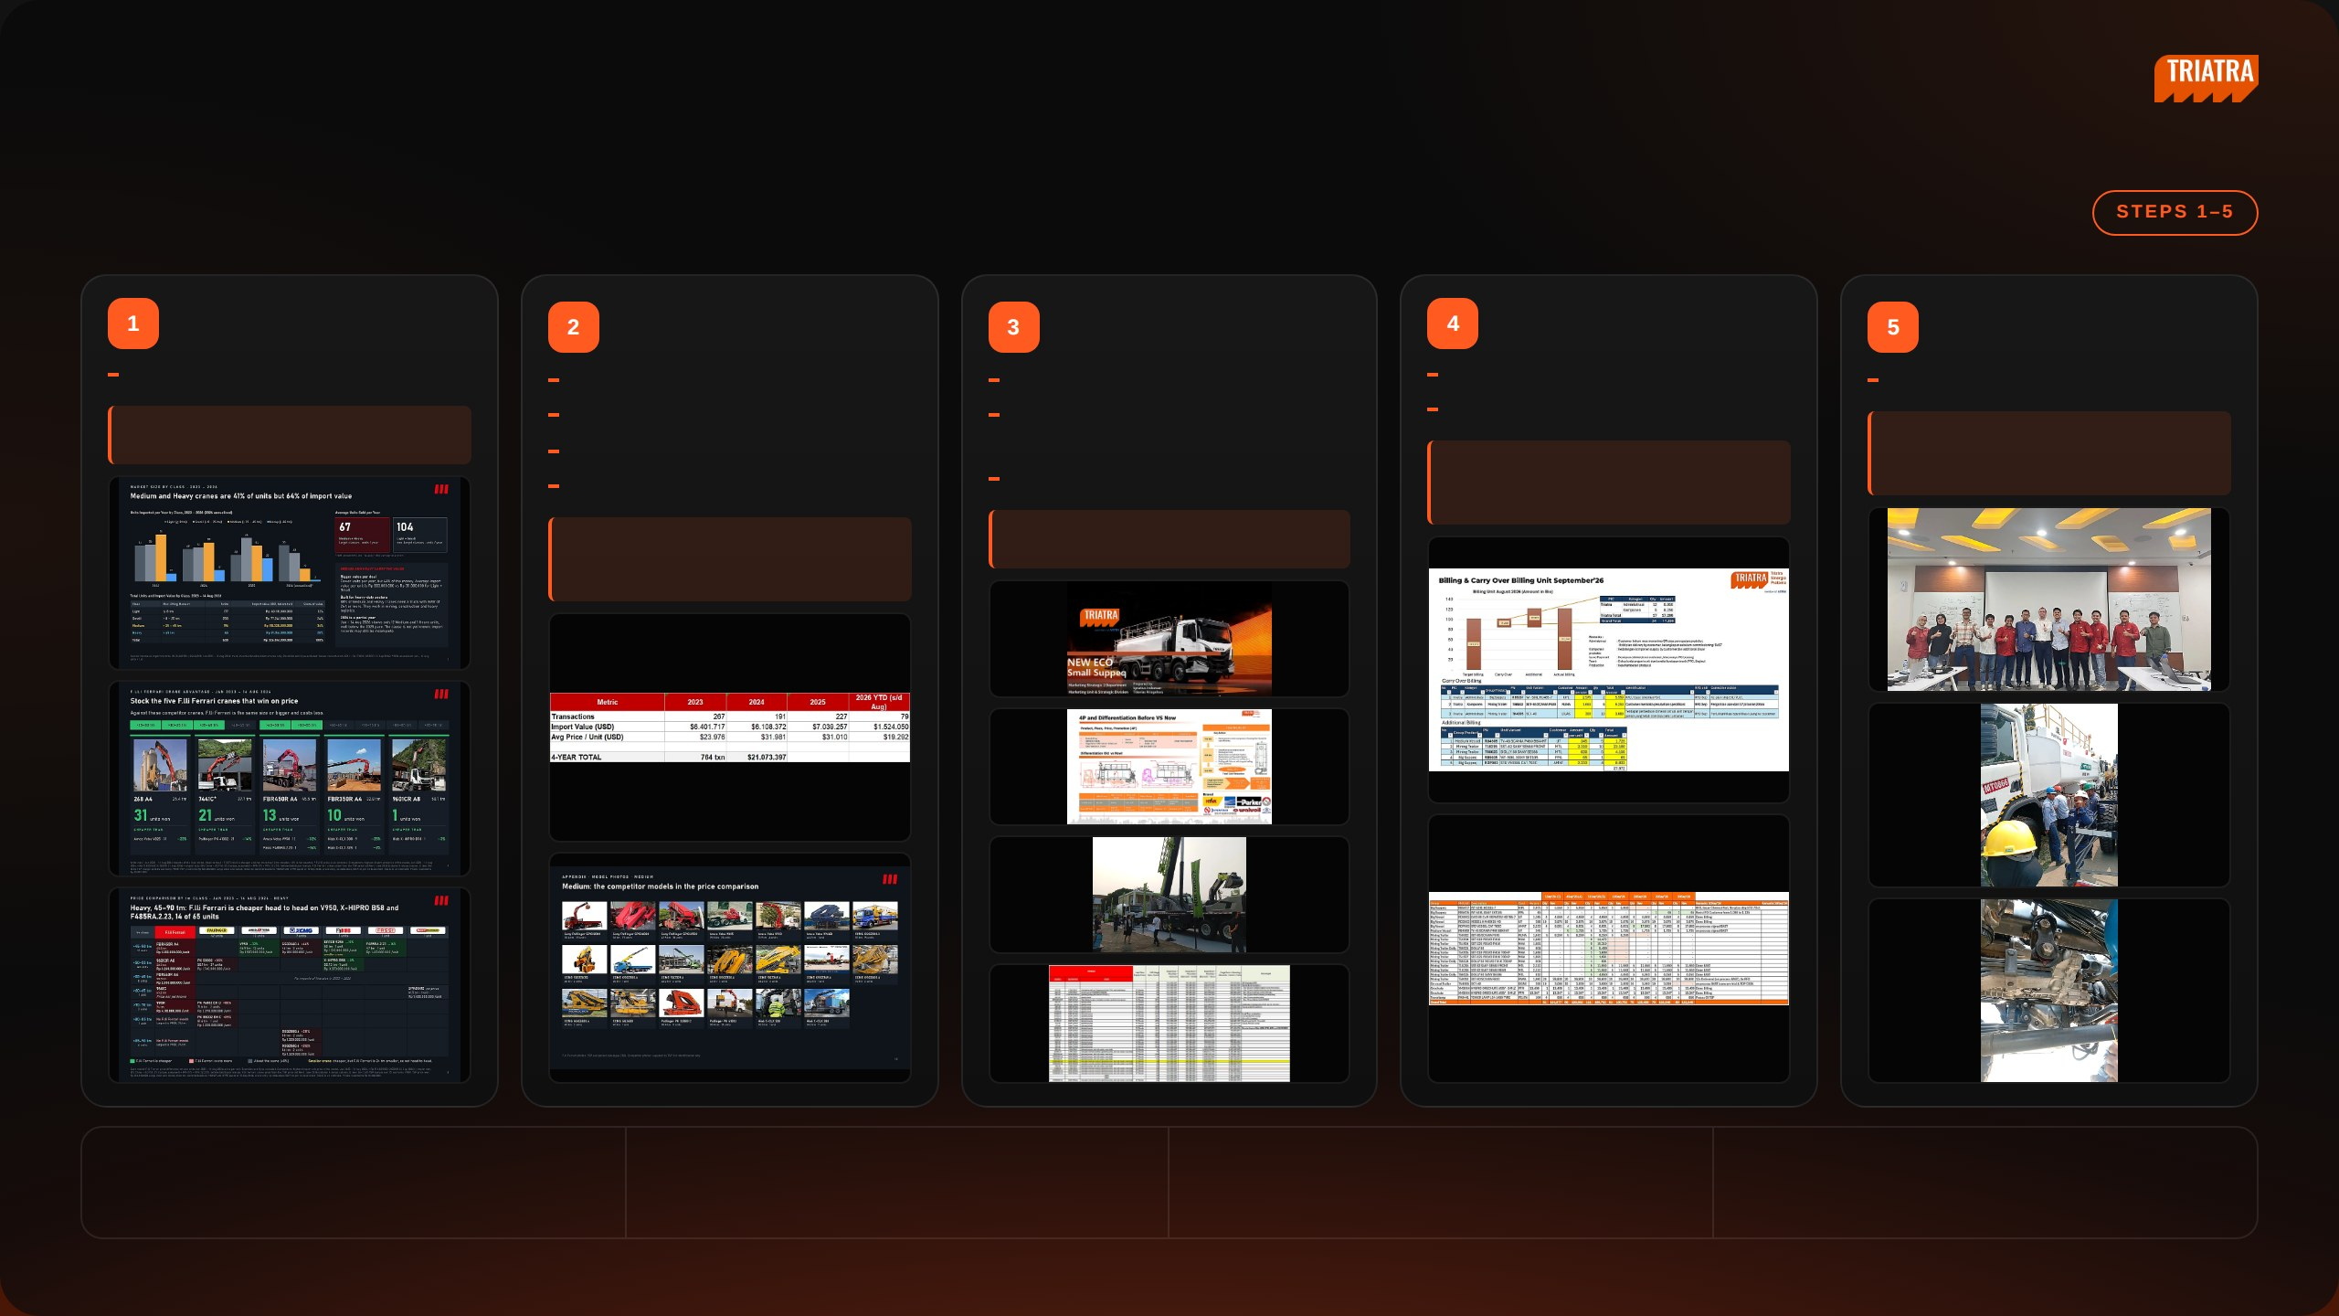
[ INTERNAL USE ONLY ]
SECTION 05 · JOB DESCRIPTION EXECUTION · A
Strategic
Pricing & Market Analysis
Market Study & Program
Market Program for
Performance Reporting
Innovation &
Development
Support Sales
Development
Price & market analysis simulation
Collect market data
Sales tools (pamphlet)
PICA analysis
Innovation project & development
END RESULT
Map competitor products
Campaign, portfolio & project
Billing report
END RESULT
Basis for the pricing strategy
Analyse new product development
showcase
END RESULT
Innovation framework; field conditions
Write the market study summary
Event support (mining expo)
Input for performance evaluation &
documented
END RESULT
management decisions
END RESULT
Programs ready for the sales team
Market size / share, segmentation,
positioning & targeting
DELIVERABLES
DEPARTMENTS INVOLVED
CHALLENGES
IMPROVEMENTS
Market study report, competitor mapping, sales tools, GP
Sales, Marketing Communication, Marketing Parts, UTPE,
Keeping market data current, validating competitor data,
Standard report template, automate market data updates,
and performance report
Finance
tight timelines
review competitor data regularly
NEDP MID YEAR REVIEW 2026
15 / 31

Slide 16
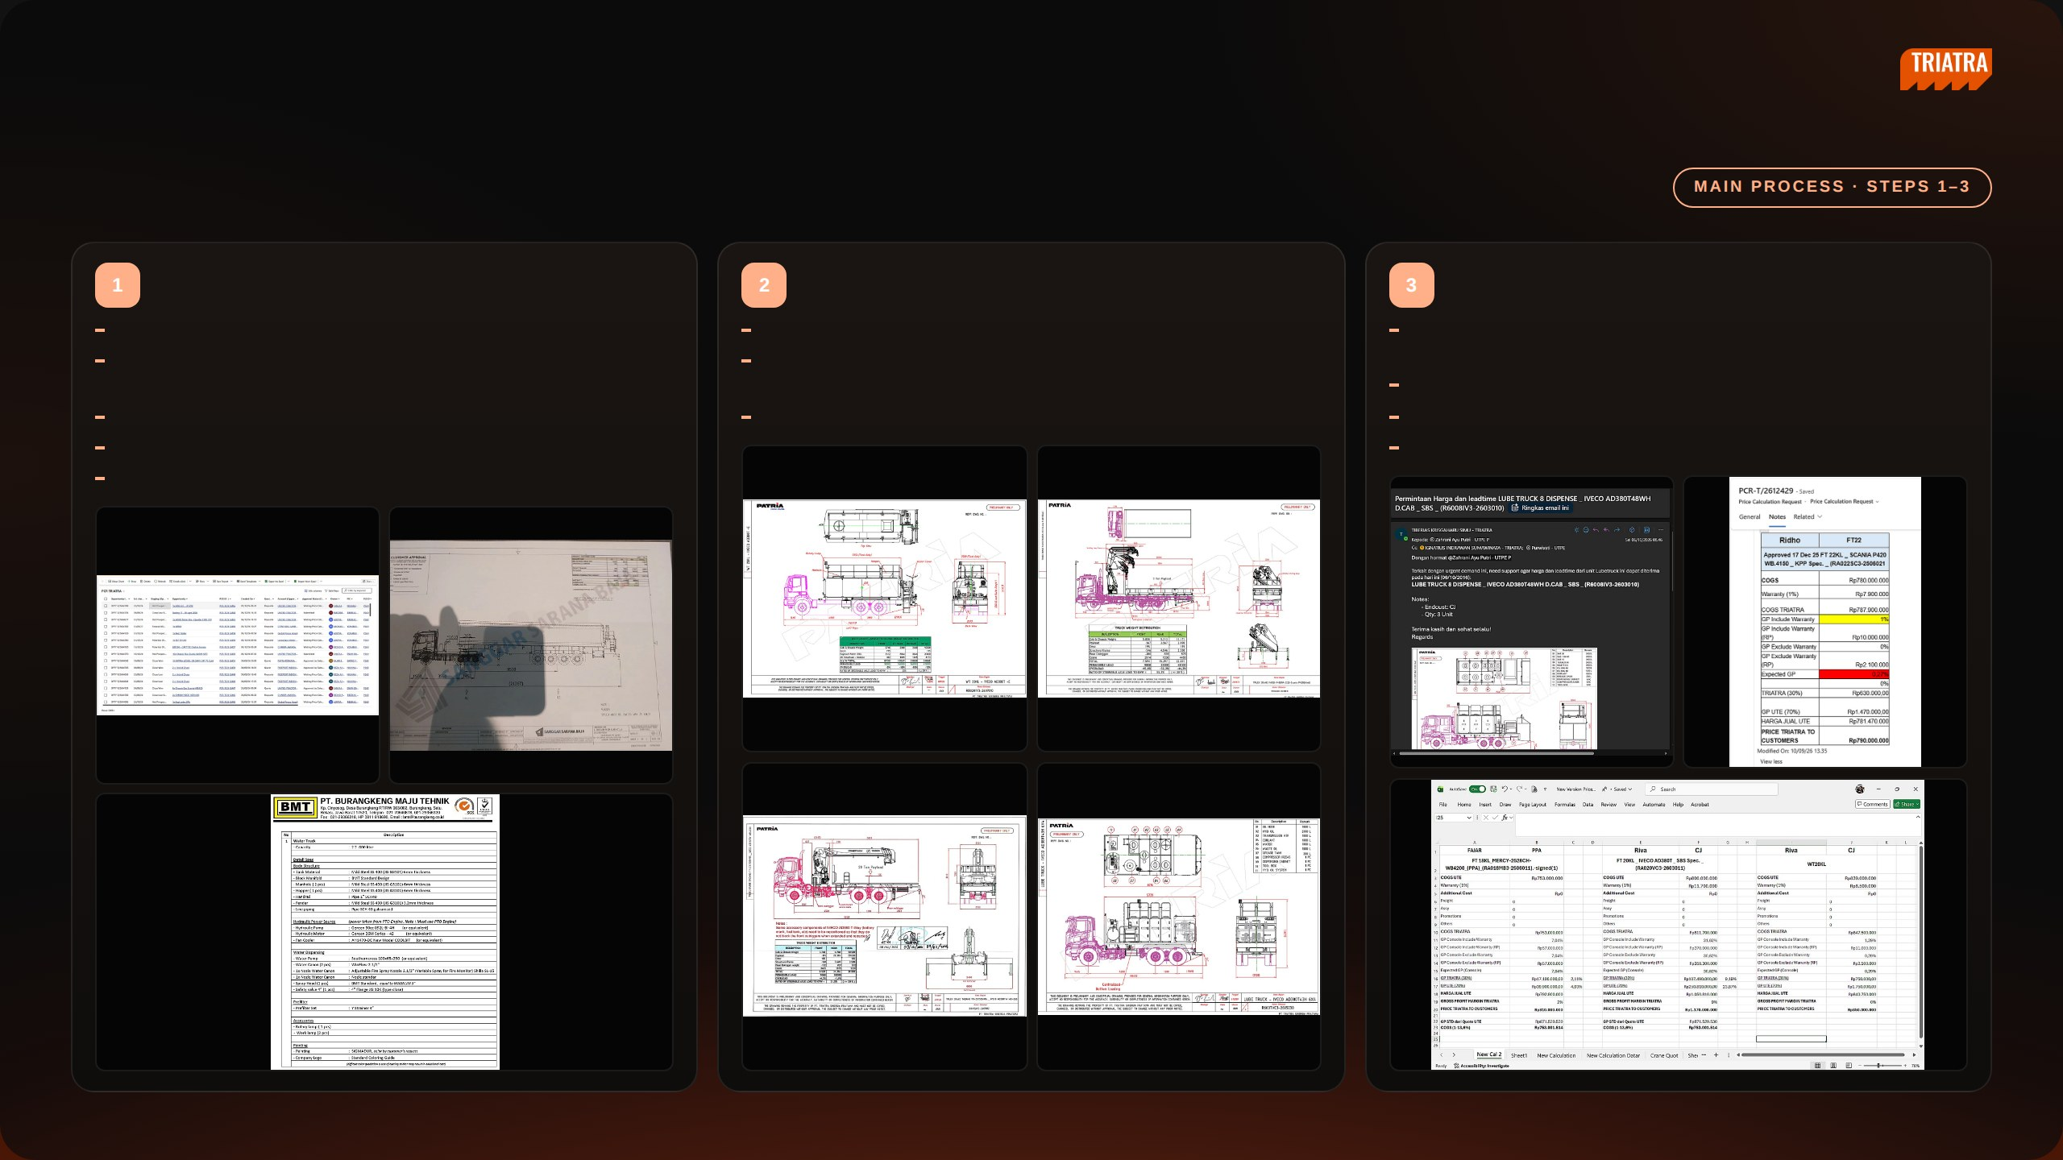
[ INTERNAL USE ONLY ]
SECTION 05 · JOB DESCRIPTION EXECUTION · B
Supply Chain (1/2)
Demand Check
Preliminary Drawing Review
Request Quote to UTE
Look at which demands are rising in PCR
Check what the unit does and how it works
Attach the preliminary drawing, expected price and lead time, end
Clarify with the Business Consultant why the customer is buying —
Check the main components and find which ones are critical on price or
customer name and expected delivery so UTE has the full picture
expansion, new business or replacement
lead time
Check the standard GP (13.6%, the price before negotiation)
Check where the project is located
Consult Application Engineering to understand the unit in more depth
Check the SLA and escalate if it takes too long
Check whether the customer wants it fast or cheap
Enter the quote result into PCR
Check the expected price and when the PO is likely to come
NEDP MID YEAR REVIEW 2026
16 / 31

Slide 17
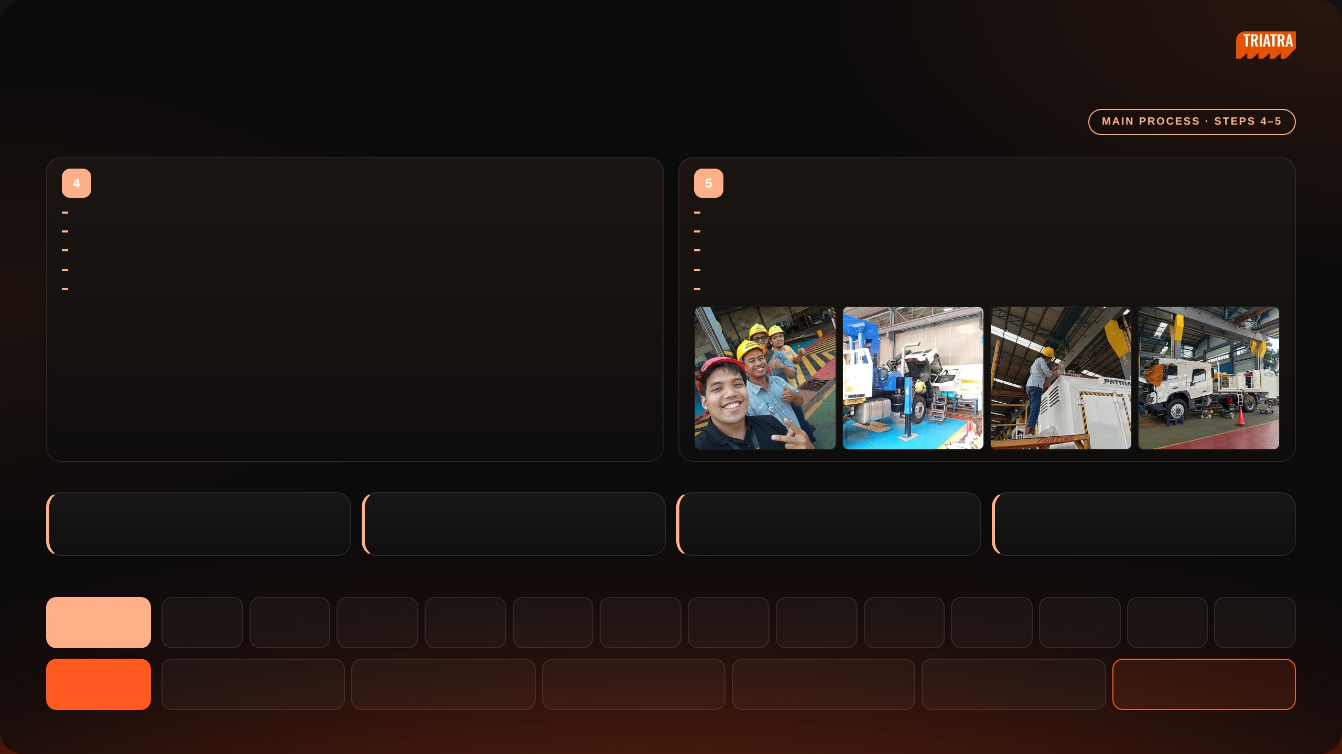
[ INTERNAL USE ONLY ]
SECTION 05 · JOB DESCRIPTION EXECUTION · B
Supply Chain (2/2)
Close Won → CPO
Monitoring
Check the PO, preliminary drawing and PJB in CRM
Follow production regularly and update sales — visit the plant or request photos from Nandu
Request QFD from UTE and collect special requests and painting style from the Business Consultant
Compare the QFD plan against actual production
The RFD date from QFD becomes the due date of the PO Interco
Escalate any production issue that puts the agreed RFD at risk
Close won route: Sales Manager → Marketing Associate → Marketing Manager → GM Marketing
Request and track painting style at least one month before RFD
PO Interco approval: Marketing Manager → GM Marketing → Marketing Director
Join the customer FAT together with the Business Consultant
INTERNAL MONITORING
1. Pipeline–OSPO Dashboard
2. Staging Pipeline in CRM
3. Quote Price Dashboard
4. Billing Progress
Build it and update it every month.
No preliminary yet means the deal is still far off; once there
Track the detail, average SLA and initial price of quotes
Check whether it sits in production, UTE administration or
is one, validate it and request a quote from UTPE.
from UTE.
Triatra administration, and escalate any blockage.
BILLING PROCESS CHAIN
AT UTE
1
2
3
4
5
6
7
8
9
10
11
12
13
PO Interco
PRO
PR
PO
Drawing
BOM
LPPB
PB
Fabrication
Assembly
QC passed
GR Teco
GI
AT TRIATRA
1
2
3
4
5
6
GR
DO / TO
GI
BAST
BAST approval
Invoice
NEDP MID YEAR REVIEW 2026
17 / 31

Slide 18

[ INTERNAL USE ONLY ]
SECTION 06
Project
A — Market Overview
B — Price Comparison
C — F.lli Ferrari Advantage
D — Appendix
NEDP MID YEAR REVIEW 2026
18 / 31

Slide 19
[ INTERNAL USE ONLY ]
SECTION 06 · PROJECT
Market Overview
A — Market Overview
B — Price Comparison
C — F.lli Ferrari Advantage
D — Appendix
NEDP MID YEAR REVIEW 2026
19 / 31

Slide 20
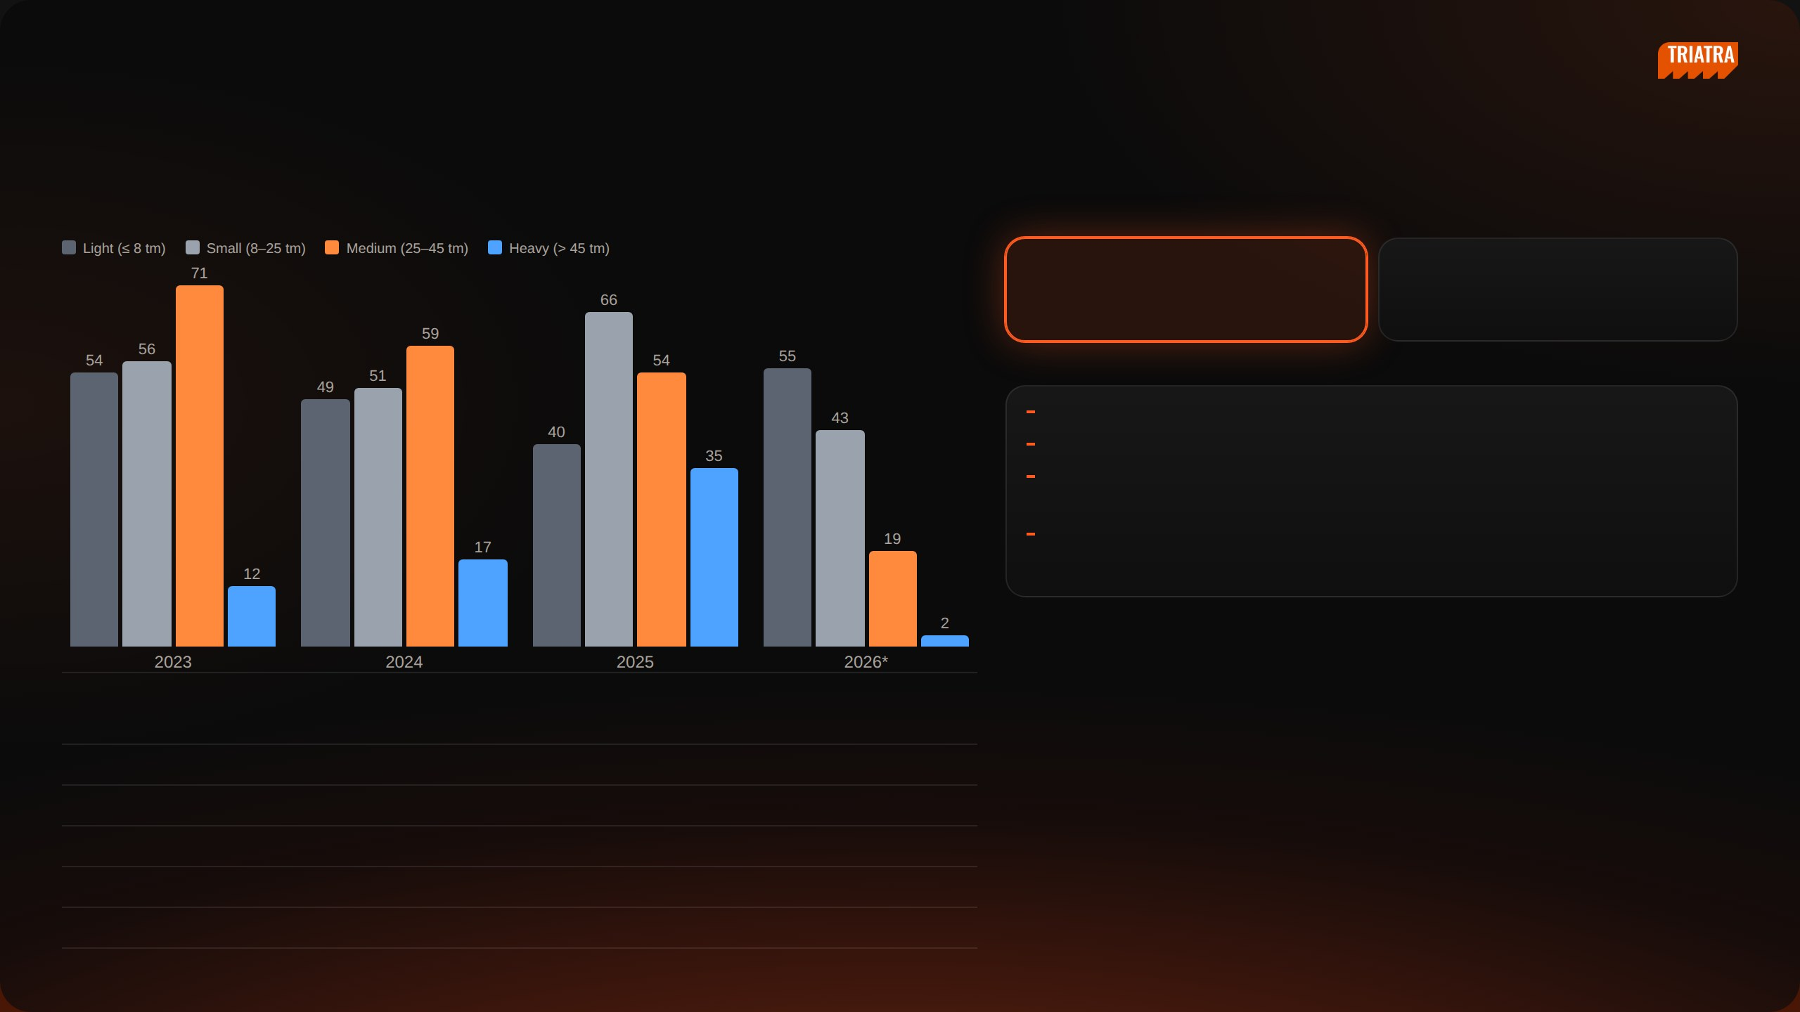
[ INTERNAL USE ONLY ]
SECTION 06 · PROJECT · F.LLI FERRARI CRANE STRATEGY
Market Size by Class
UNITS IMPORTED PER YEAR BY CLASS · 2023 – 2026*
AVERAGE UNITS PER YEAR
67
104
Medium + Heavy · target classes
Light + Small · non-target
KEY POINTS
Medium + Heavy: 41% of units, 64% of import value
Value per unit: Rp 803 Jt vs Rp 311 Jt for Light + Small
Use: 88% of Medium & Heavy cranes need a truck GVW ≥ 24 t — mining,
construction, heavy logistics
2026 is partial: only 12 Medium and 1 Heavy unit to 14 Aug; import records may
be incomplete
*2026 annualised (Jan – 14 Aug × 1.61). Source: Indonesia import records HS 84269100 + 84264900; truck-mounted
knuckle boom cranes; Zoomlion & Hyva excluded; USD 1 = Rp 17.803.
TOTAL UNITS & IMPORT VALUE · 2023 – 14 AUG 2026
CLASS
LIFTING MOMENT
UNITS
IMPORT VALUE (IDR)
SHARE
Light
≤ 8 tm
177
Rp 40.118.000.000
12%
Small
8 – 25 tm
200
Rp 77.241.000.000
24%
Medium
25 – 45 tm
196
Rp 118.328.000.000
36%
Heavy
> 45 tm
65
Rp 91.154.000.000
28%
Total
638
Rp 326.841.000.000
100%
NEDP MID YEAR REVIEW 2026
20 / 31

Slide 21
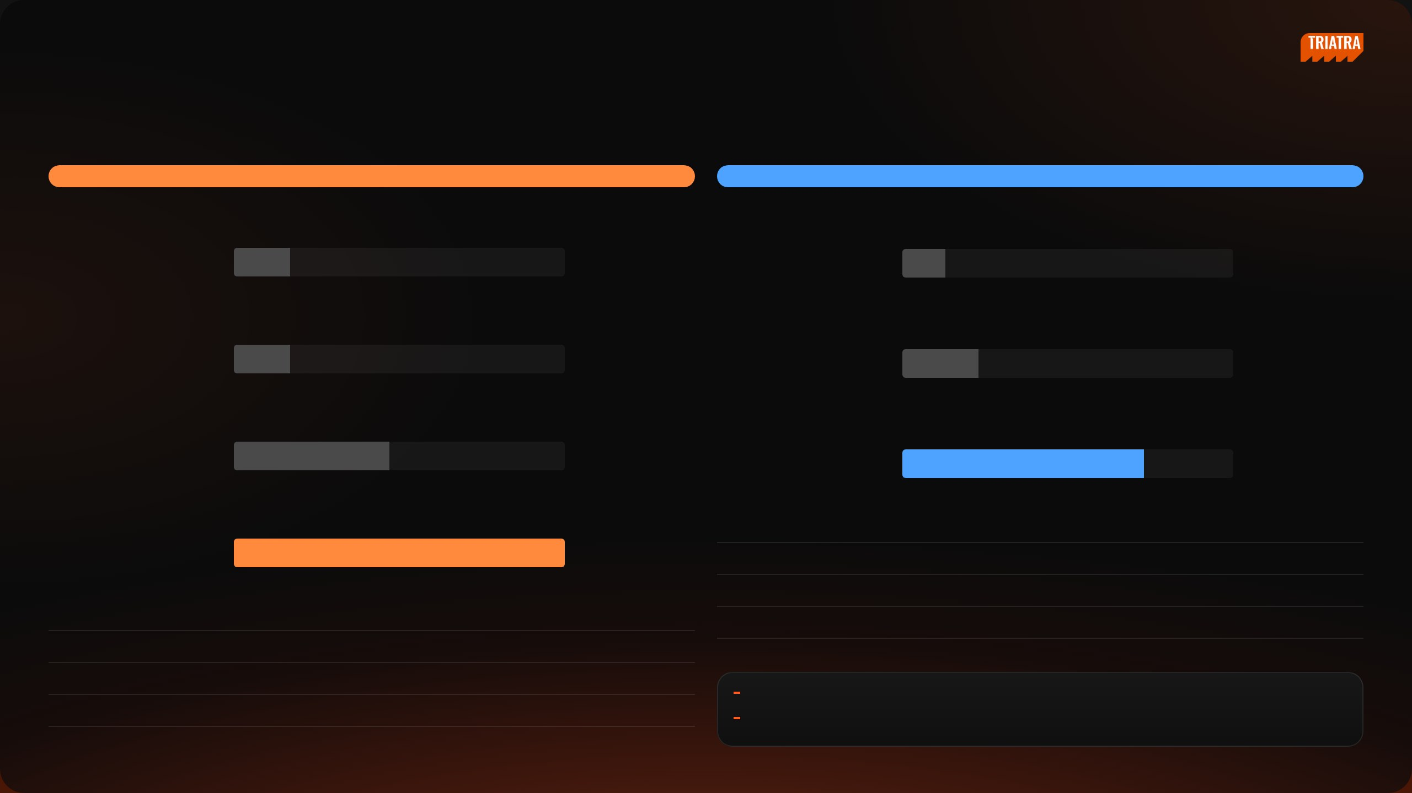
[ INTERNAL USE ONLY ]
SECTION 06 · PROJECT · F.LLI FERRARI CRANE STRATEGY
Brand Leaders · 2025
MEDIUM · 25 – 45 tm
HEAVY · > 45 tm
UNITS & IMPORT VALUE BY BRAND · 2025
UNITS & IMPORT VALUE BY BRAND · 2025
Amco Veba
5 · Rp 2,7 M
XCMG
4 · Rp 4,6 M
Palfinger
5 · Rp 4,9 M
Amco Veba
7 · Rp 11,1 M
XCMG
14 · Rp 7,2 M
Palfinger
22 · Rp 29,7 M
#
BRAND
UNITS
IMPORT VALUE (IDR)
SHARE
Sany Palfinger
30 · Rp 13,2 M
1
Palfinger
22
Rp 29.738.000.000
62%
2
Amco Veba
7
Rp 11.065.000.000
23%
#
BRAND
UNITS
IMPORT VALUE (IDR)
SHARE
3
XCMG
4
Rp 4.647.000.000
10%
1
Sany Palfinger
30
Rp 13.226.000.000
47%
Total Heavy 2025: 35 units · Rp 48,0 M. Sany Palfinger = Sany–Palfinger JV, made in China.
2
XCMG
14
Rp 7.197.000.000
26%
Both leaders are well ahead of the next brand in value
3
Palfinger
5
Rp 4.869.000.000
17%
Scope: 2025 only, so figures are smaller than the 2023 – 2026 totals
Total Medium 2025: 54 units · Rp 28,0 M
NEDP MID YEAR REVIEW 2026
21 / 31

Slide 22

[ INTERNAL USE ONLY ]
SECTION 06 · PROJECT · F.LLI FERRARI CRANE STRATEGY
Models of the Brand Leaders · 2025
MEDIUM · 25 – 45 tm · units sold by model
Sany Palfinger
XCMG
Palfinger
SPK36080 · 36 tm
14
GSQZ330.4 · 33 tm
4
PK 32080 C · 30.4 tm
4
SPK42502 · 42.5 tm
6
SQZ325.4 · 32.5 tm
3
PK 41002 EH C · 38.4 tm
1
SPK32080 · 30.4 tm
6
KSQZ300.3 · 30 tm
3
HEAVY · > 45 tm · units sold by model
XCMG
Palfinger
Amco Veba
GSQZ880.6 · 88 tm
2
PK 53002 SH B · 50.1 tm
22
V950 · 45.9 tm
7
GSQZ860.6 · 86 tm
2
Each leader relies on one main model; PK 53002 alone is 63% of Heavy units in 2025
NEDP MID YEAR REVIEW 2026
22 / 31

Slide 23
[ INTERNAL USE ONLY ]
SECTION 06 · PROJECT
Price Comparison
A — Market Overview
B — Price Comparison
C — F.lli Ferrari Advantage
D — Appendix
NEDP MID YEAR REVIEW 2026
23 / 31

Slide 24
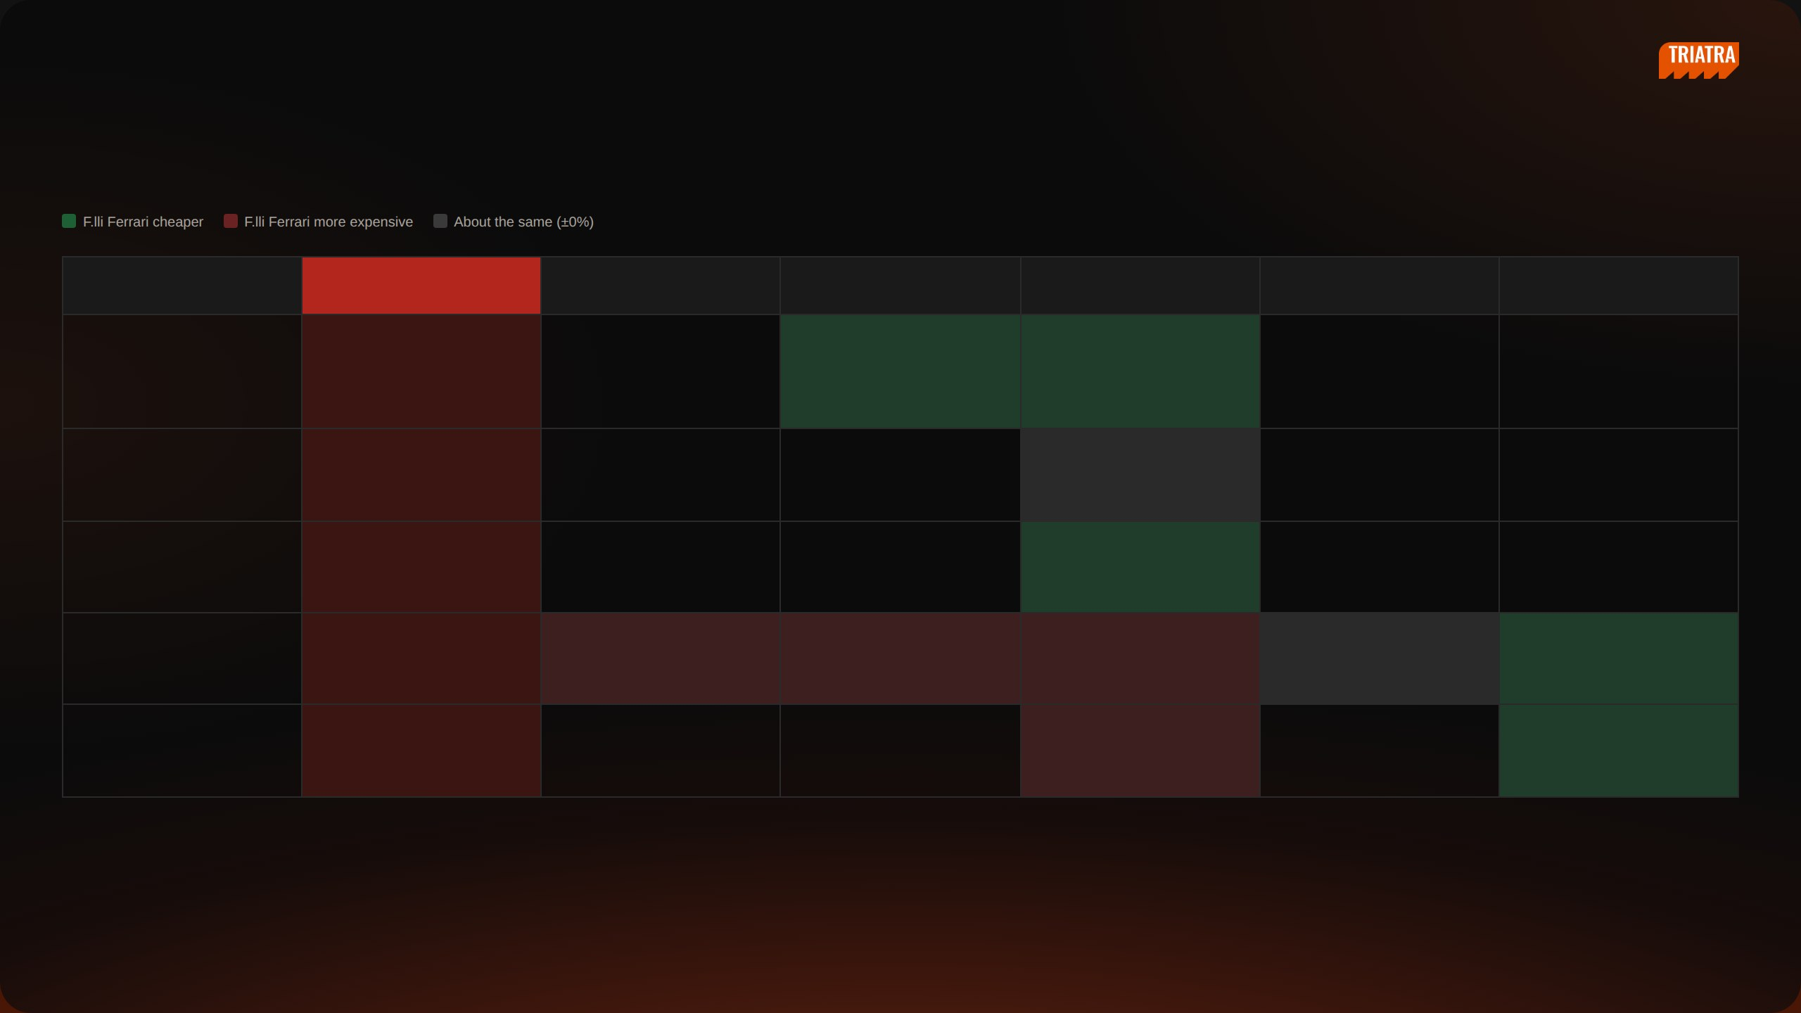
[ INTERNAL USE ONLY ]
SECTION 06 · PROJECT · F.LLI FERRARI CRANE STRATEGY
Price Comparison · Medium 25 – 35 tm
tm class
F.lli Ferrari
Sany Palfinger
Amco Veba
XCMG
Palfinger
Hiab
88 units
36 units
33 units
29 units
10 units
>25–30 tm
268 A4
V825 −23%
KSQZ300.3 −3%
49 units
25.4 tm
25.6 tm · 31 units
30 tm · 15 units · smaller
Rp 500 Jt
Rp 650 Jt
crane
Rp 510 Jt
SQ12ZK3Q ±0%
30 tm · 2 units
Rp 500 Jt
KSQZ300.4 −12%
30 tm · 1 unit · smaller crane
Rp 570 Jt
>30–35 tm
FBR350R A4
SPK32080 +107%
V933 +30%
GSQZ330.4 +40%
PK 32080 C ±0%
X-CLX 388 −25%
62 units
32.8 tm
30.4 tm · 33 units
31.9 tm · 4 units
33 tm · 4 units
30.4 tm · 8 units
34.3 tm · 9 units
Rp 1.090 Jt
Rp 530 Jt
Rp 840 Jt
Rp 780 Jt
Rp 1.090 Jt
Rp 1.460 Jt
SQZ325.4 +98%
X-CLX 328 −2%
32.5 tm · 3 units
30.3 tm · 1 unit
Rp 550 Jt
Rp 1.120 Jt
Competitor: highest import unit price 2023 – 14 Aug 2026 × Rp 17.803/USD + import duty + PPN 11% + PPh 22 2.5%, before distributor margin. F.lli Ferrari: TSP price list Rev1 (Jun 2026) less 13.6% margin and 3% warranty. Rounded to Rp 10 Jt.
NEDP MID YEAR REVIEW 2026
24 / 31

Slide 25
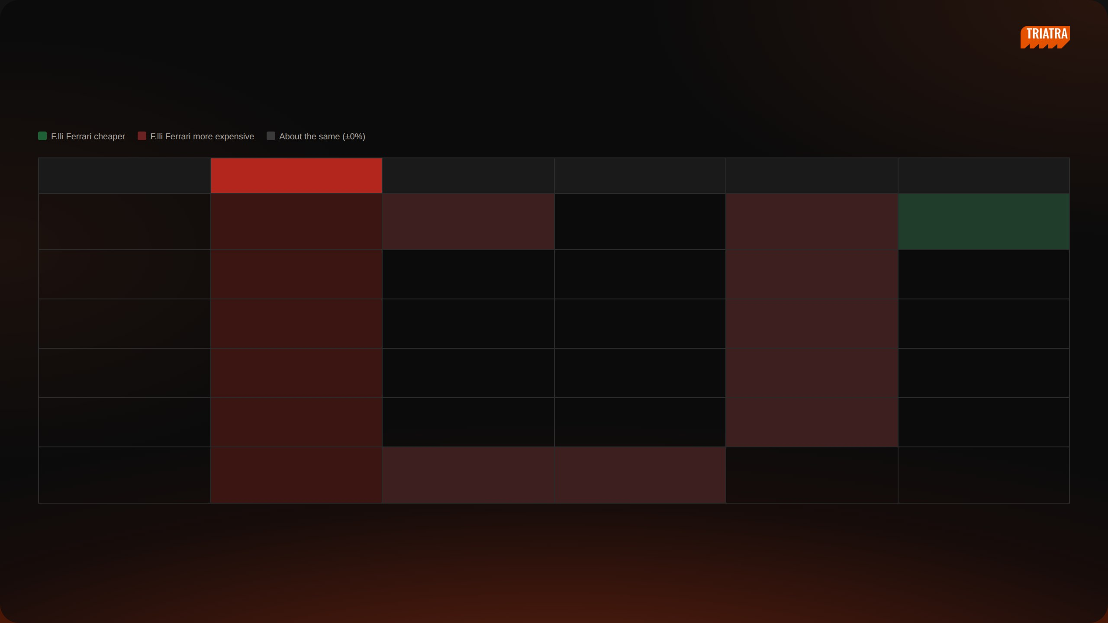
[ INTERNAL USE ONLY ]
SECTION 06 · PROJECT · F.LLI FERRARI CRANE STRATEGY
Price Comparison · Medium 35 – 45 tm
tm class
F.lli Ferrari
Sany Palfinger
Amco Veba
XCMG
Palfinger
88 units
36 units
33 units
29 units
>35–40 tm
7441C
SPK36080 +88%
KSQZ400.4 +66%
PK 41002 −14%
66 units
37.7 tm · estimate
36 tm · 37 units
40 tm · 2 units
38.4 tm · 21 units
Rp 1.240 Jt
Rp 660 Jt
Rp 750 Jt
Rp 1.440 Jt
GSQZ400.4 +76%
40 tm · 2 units
Rp 700 Jt
SQZ365.4 +107%
36.5 tm · 2 units
Rp 600 Jt
SQZ400 +109%
40 tm · 1 unit
Rp 600 Jt
KSQZ365.4 +129%
36.5 tm · 1 unit
Rp 540 Jt
>40–45 tm
746 A4
SPK42502 +48%
V946B +12%
19 units
43.4 tm
42.5 tm · 18 units
44.2 tm · 1 unit
Rp 1.420 Jt
Rp 960 Jt
Rp 1.270 Jt
Competitor: highest import unit price 2023 – 14 Aug 2026 × Rp 17.803/USD + import duty + PPN 11% + PPh 22 2.5%, before distributor margin. F.lli Ferrari: TSP price list Rev1 (Jun 2026) less 13.6% margin and 3% warranty. Rounded to Rp 10 Jt.
NEDP MID YEAR REVIEW 2026
25 / 31

Slide 26
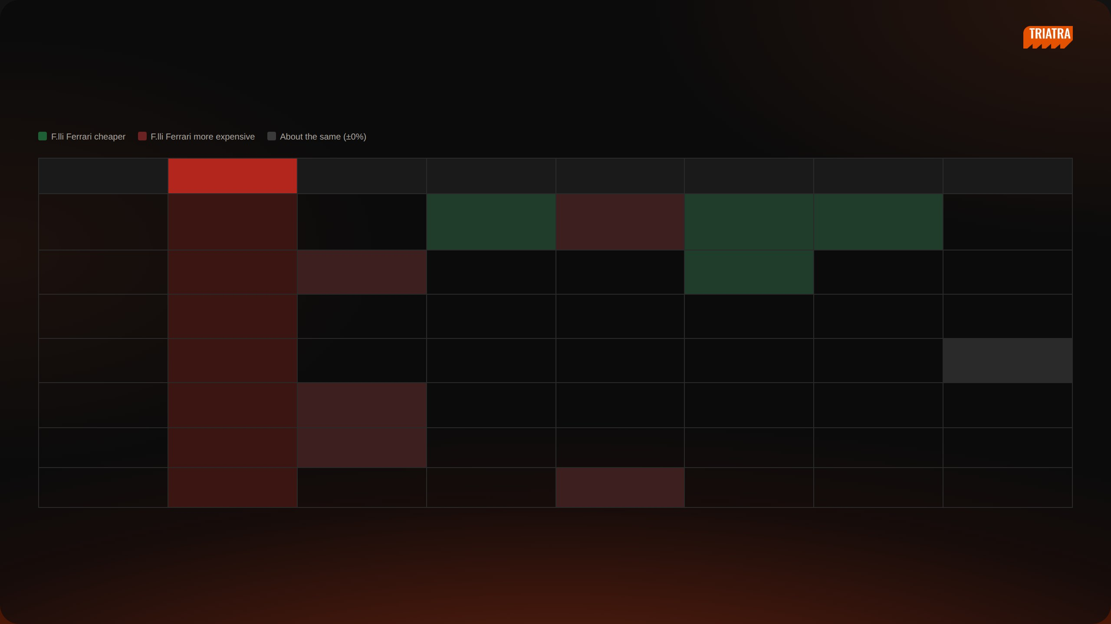
[ INTERNAL USE ONLY ]
SECTION 06 · PROJECT · F.LLI FERRARI CRANE STRATEGY
Price Comparison · Heavy 45 – 90 tm
tm class
F.lli Ferrari
Palfinger
Amco Veba
XCMG
Hiab
Fassi
Sany Palfinger
42 units
12 units
7 units
2 units
1 unit
1 unit
>45–50 tm
FBR450R A4
V950 −32%
GSQZ460.4 +66%
EFFER 525H −10%
F485RA.2.23 −16%
17 units
45.5 tm
45.9 tm · 12 units
46 tm · 3 units
50 tm · 1 unit · smaller
47 tm · 1 unit
Rp 1.350 Jt
Rp 1.990 Jt
Rp 810 Jt
crane
Rp 1.610 Jt
Rp 1.510 Jt
>50–55 tm
9601CR A8
PK 53002 +85%
X-HIPRO B58 −3%
40 units
50.7 tm
50.1 tm · 39 units
50.93 tm · 1 unit
Rp 3.260 Jt
Rp 1.760 Jt
Rp 3.370 Jt
>55–60 tm
FBR660R A4
0 units
58.8 tm
Rp 2.030 Jt
>60–65 tm
9661C
SPK61502 no price
1 unit
63.2 tm
61.5 tm · 1 unit
Price not yet known
Rp 1.400 Jt
>70–75 tm
990R
PK 76002 EH D +80%
2 units
74 tm
71.6 tm · 2 units
Rp 4.110 Jt
Rp 2.290 Jt
>80–85 tm
No F.lli Ferrari model
PK 88002 EH C +85%
1 unit
81.6 tm · 1 unit
Rp 2.220 Jt
>85–90 tm
No F.lli Ferrari model
GSQZ880.6 / 860.6 +211%
4 units
86–88 tm · 4 units
Rp 1.320 Jt
Competitor: highest import unit price 2023 – 14 Aug 2026 × Rp 17.803/USD + import duty + PPN 11% + PPh 22 2.5%, before distributor margin. F.lli Ferrari: TSP price list Rev1 (Jun 2026) less 13.6% margin and 3% warranty. Rounded to Rp 10 Jt.
NEDP MID YEAR REVIEW 2026
26 / 31

Slide 27
[ INTERNAL USE ONLY ]
SECTION 06 · PROJECT
F.lli Ferrari Advantage
A — Market Overview
B — Price Comparison
C — F.lli Ferrari Advantage
D — Appendix
NEDP MID YEAR REVIEW 2026
27 / 31

Slide 28
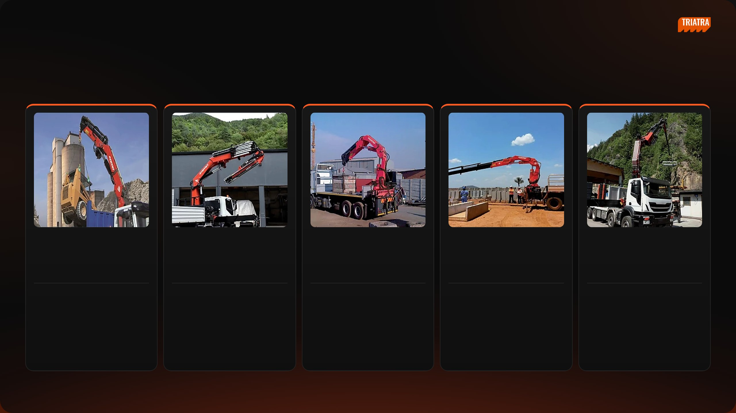
[ INTERNAL USE ONLY ]
SECTION 06 · PROJECT · F.LLI FERRARI CRANE STRATEGY
F.lli Ferrari Crane Advantage
FIVE F.LLI FERRARI CRANES · SAME SIZE OR BIGGER AND LOWER PRICE THAN THESE COMPETITORS · JAN 2023 – 14 AUG 2026
268 A4
25.4 tm
7441C*
37.7 tm
FBR450R A4
45.5 tm
FBR350R A4
32.8 tm
9601CR A8
50.7 tm
31
21
13
10
1
units won
units won
units won
units won
units won
CHEAPER THAN
CHEAPER THAN
CHEAPER THAN
CHEAPER THAN
CHEAPER THAN
Amco Veba V825 · 31 −23%
Palfinger PK 41002 · 21 −14%
Amco Veba V950 · 12 −32%
Hiab X-CLX 388 · 9 −25%
Hiab X-HIPRO B58 · 1 −3%
Fassi F485RA.2.23 · 1 −16%
Hiab X-CLX 328 · 1 −2%
Units won = imports of the rival model. Head to head = F.lli Ferrari cheaper and not more than 2 tm smaller. *7441C price is an estimate.
NEDP MID YEAR REVIEW 2026
28 / 31

Slide 29
[ INTERNAL USE ONLY ]
SECTION 06 · PROJECT
Appendix
A — Market Overview
B — Price Comparison
C — F.lli Ferrari Advantage
D — Appendix
NEDP MID YEAR REVIEW 2026
29 / 31

Slide 30
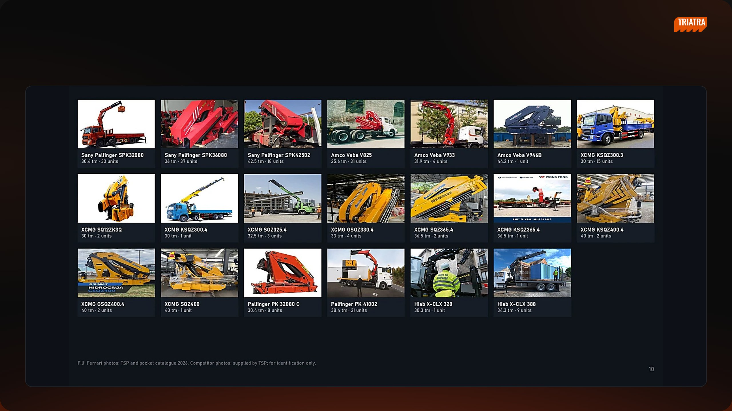
[ INTERNAL USE ONLY ]
SECTION 06 · PROJECT · F.LLI FERRARI CRANE STRATEGY
Appendix · Model Photos · Medium
NEDP MID YEAR REVIEW 2026
30 / 31

Slide 31
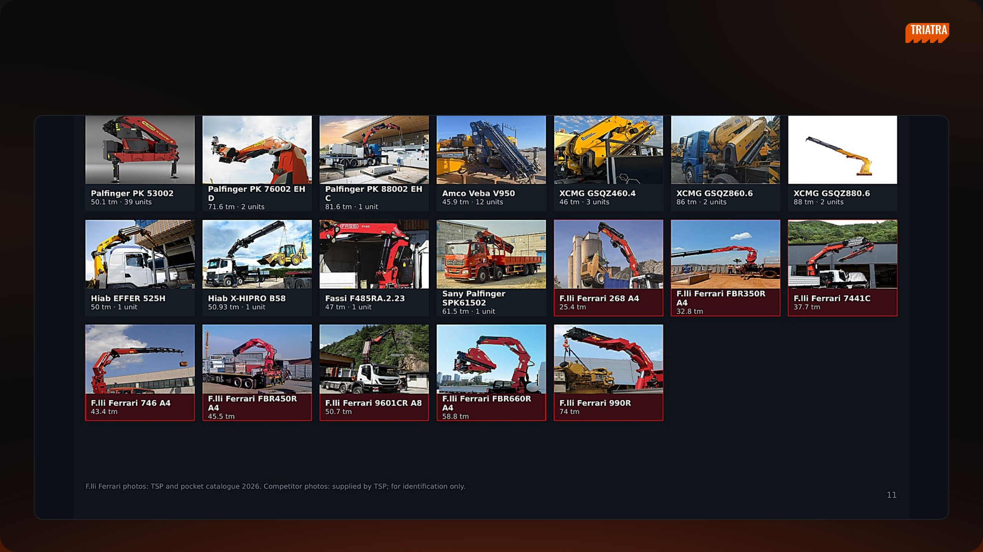
[ INTERNAL USE ONLY ]
SECTION 06 · PROJECT · F.LLI FERRARI CRANE STRATEGY
Appendix · Model Photos · Heavy & F.lli Ferrari
NEDP MID YEAR REVIEW 2026
31 / 31

