Slide 1

PART 01 · PERSONAL
Who I am and what I bring to Triatra.
About me · Onboarding · Company · Role · Project
NEDP MID YEAR REVIEW 2026
01 / 18

Slide 2
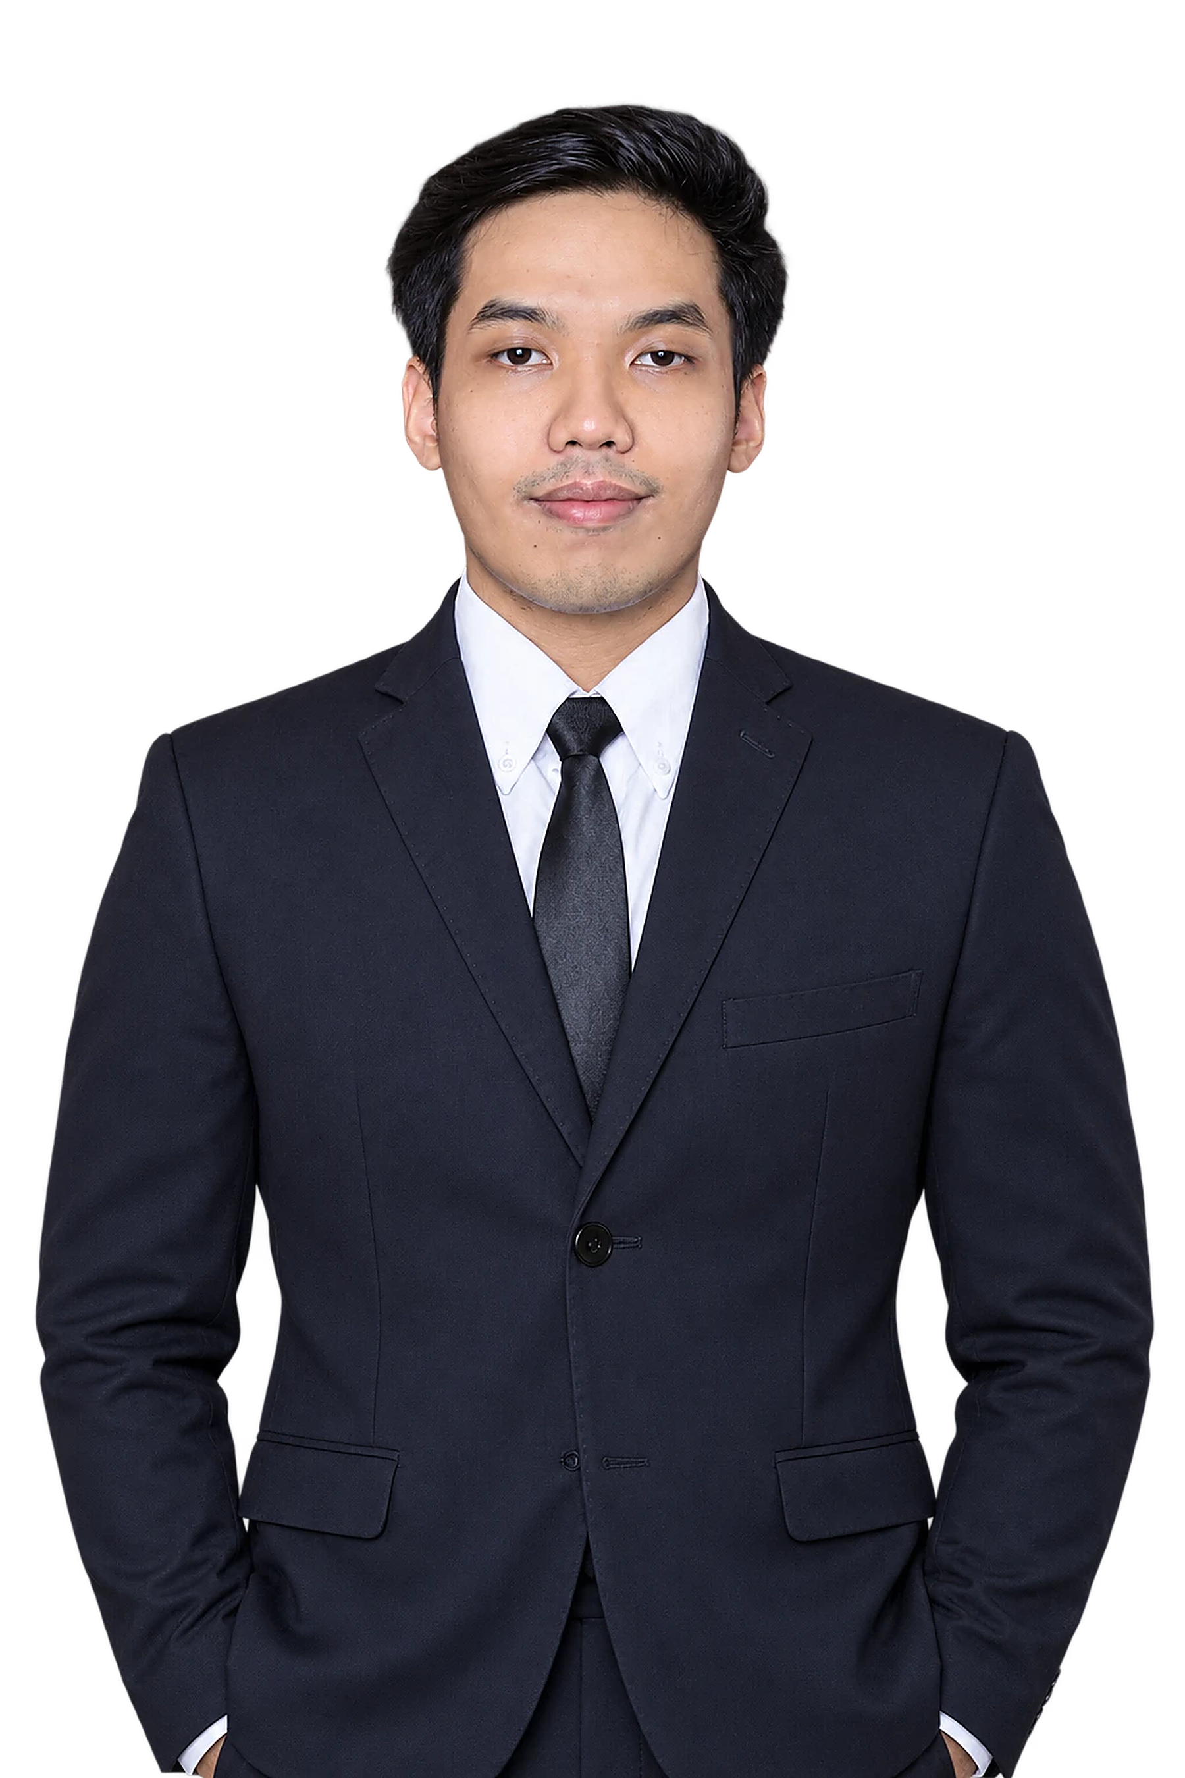





NEDP 6-MONTH REVIEW · PERSONAL INFORMATION
PERSONAL INFORMATION
A management graduate now running Small Suppeq and Truck Others
PROFILE
EDUCATION
Tiberias Krisgaharu Simu
Universitas Sanata Dharma, Yogyakarta
PT Triatra Sinergia Pratama
Bachelor (S1) · Management · Faculty of Economics
POSITION
Marketing Strategic 2 Associate
WORK EXPERIENCE
PT Triatra Sinergia Pratama
2026 – now
DIVISION
Marketing Unit & Strategic
Marketing Strategic 2 Associate
PRODUCTS
Small Suppeq · Truck Others
Outlier
2023 – 2025
Team Lead Data Annotator
PLACE, DATE OF BIRTH
Kupang, 22 April 2001
Krishma International
Marketing Coordinator
2021 – 2023
PHONE
0822 7222 2463
ORGANIZATION
HMJM Universitas Sanata Dharma
2021 – 2022
President
NEDP MID YEAR REVIEW 2026 · TIBERIAS K. SIMU
02 / 18

Slide 3
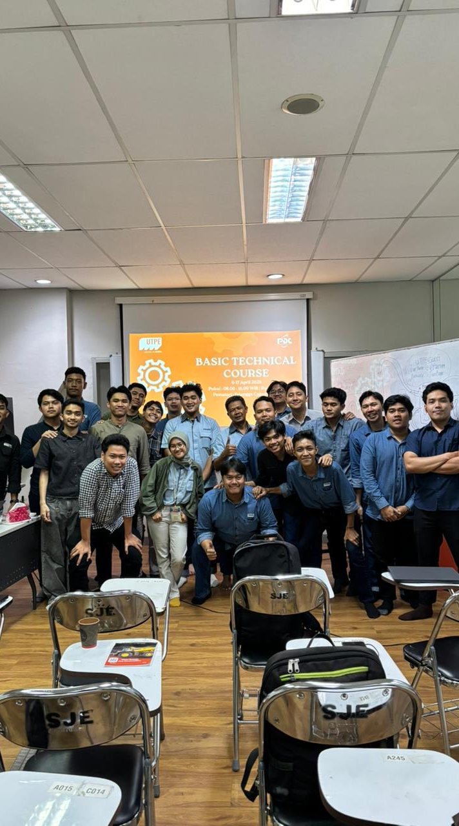
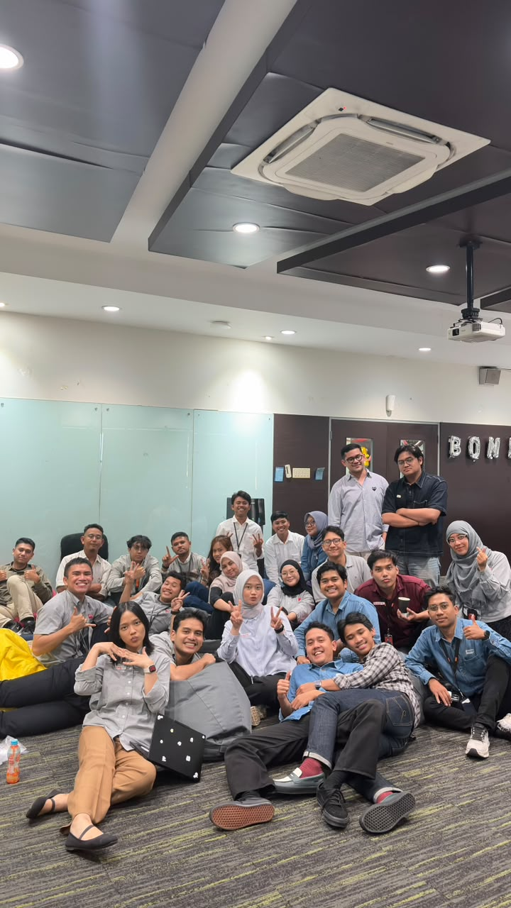
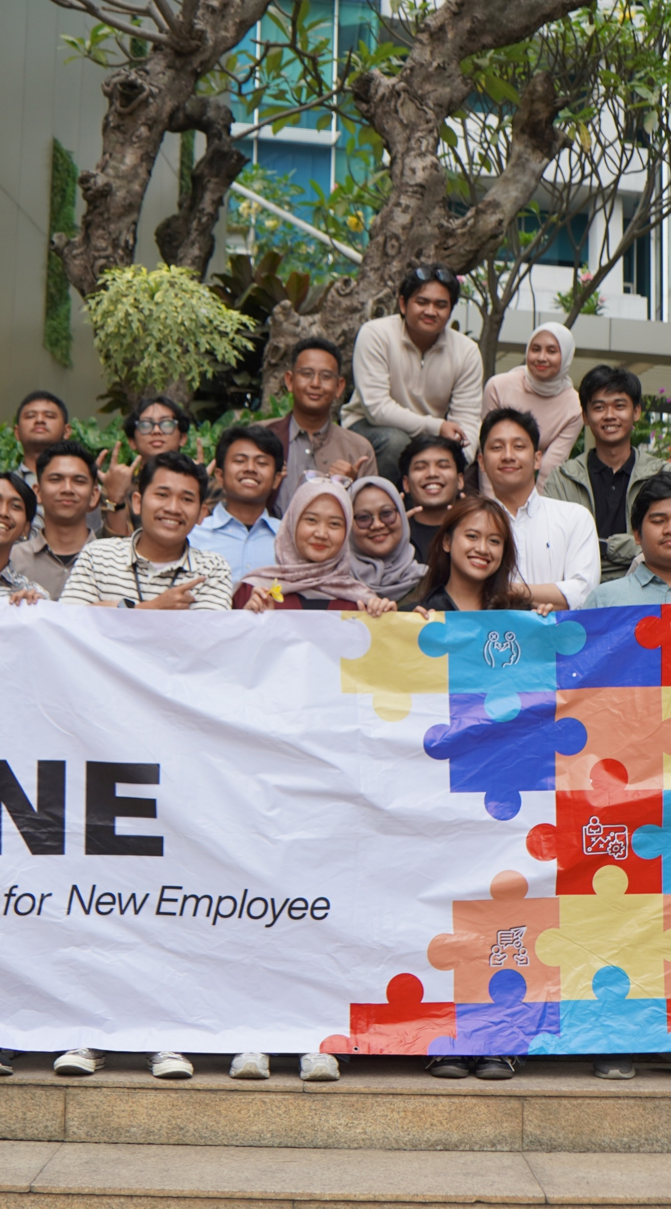
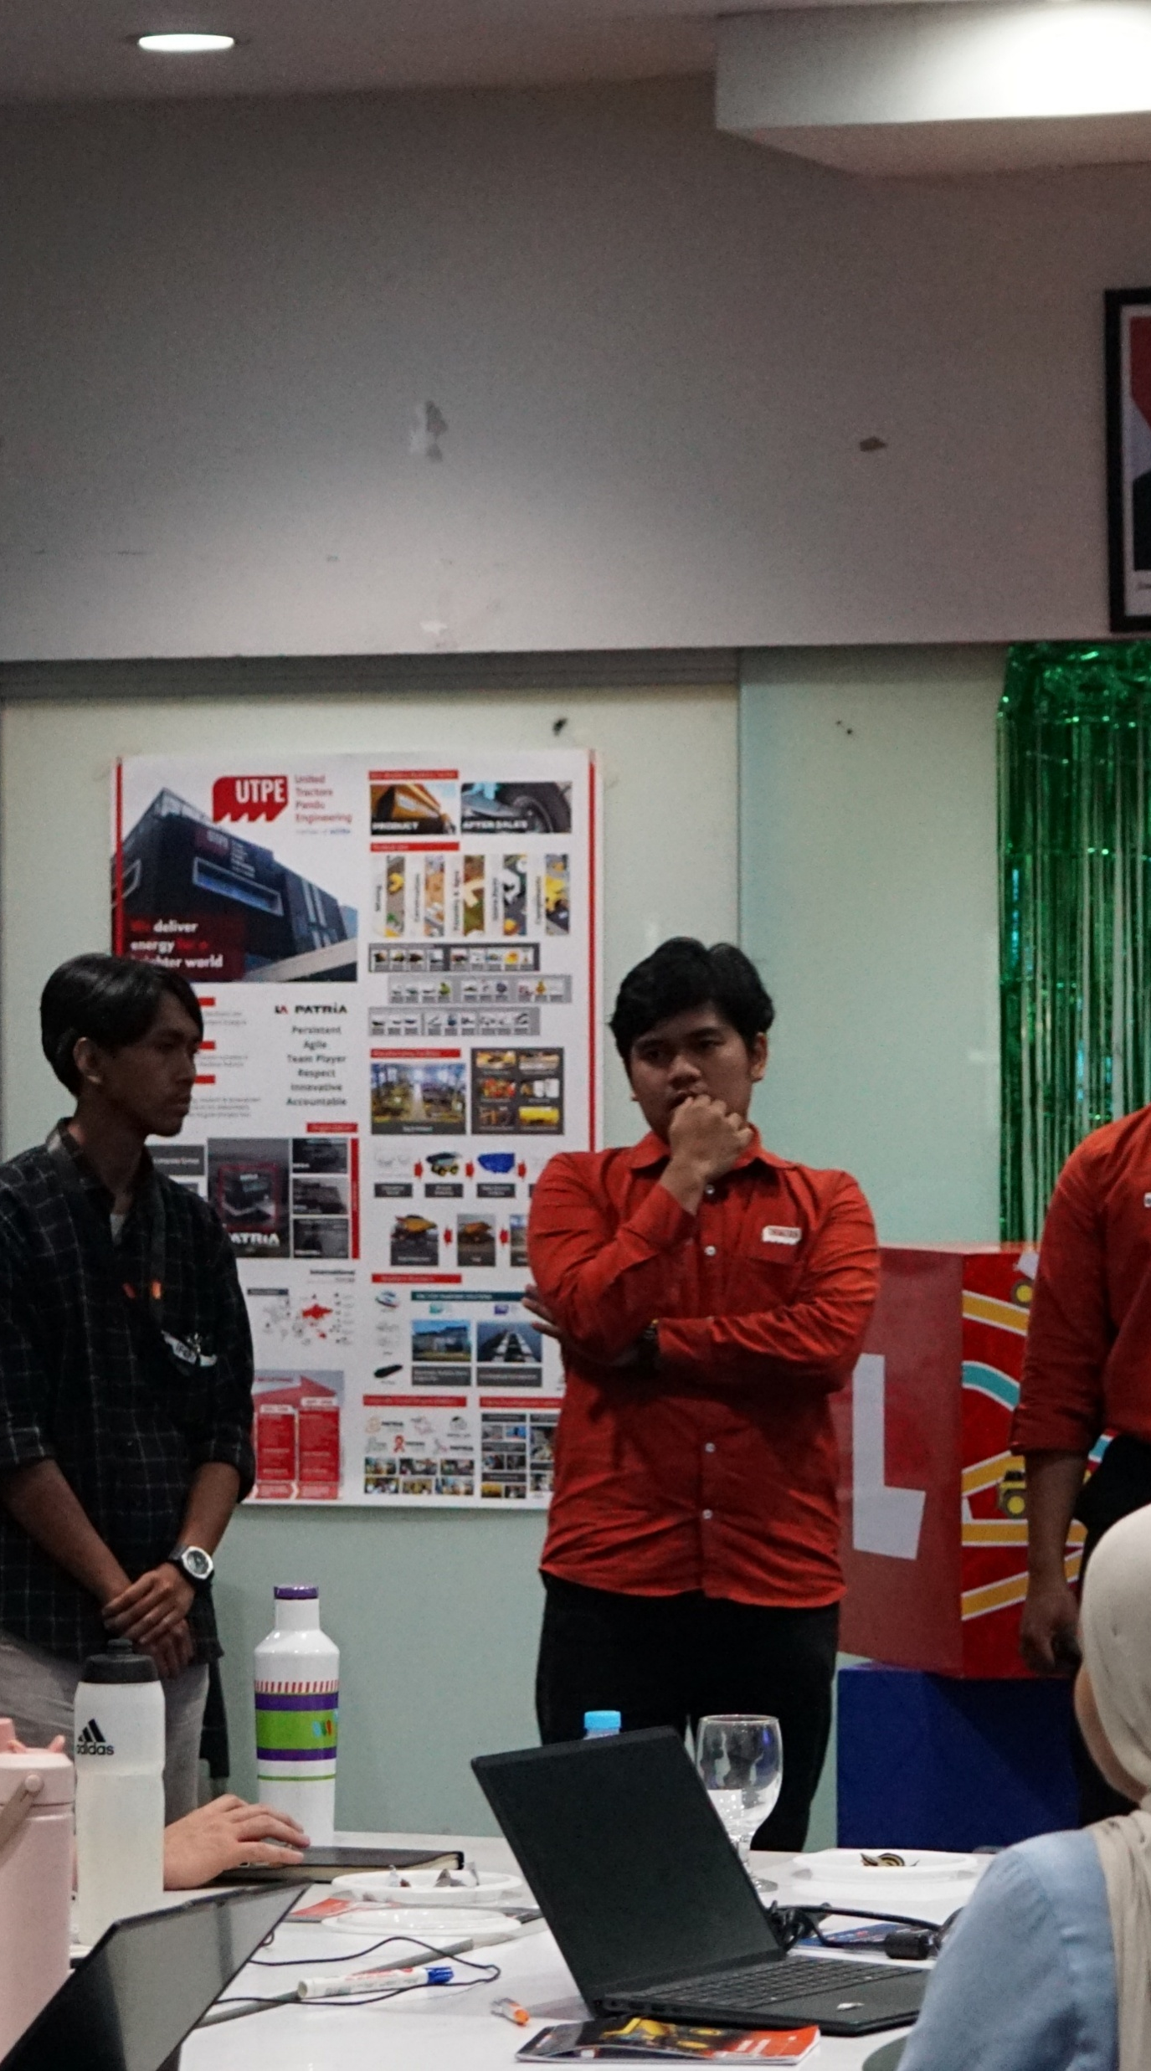
NEDP 6-MONTH REVIEW · ONBOARDING JOURNEY
ONBOARDING JOURNEY
Two programs built my base; AHEMCE comes next
Basic Technical Course
DONE
B-One · Orientation
DONE
AHEMCE
NEXT
Astra Heavy Equipment, Mining, Construction and Energy
WHAT I LEARNED
WHAT I LEARNED
WHAT I WILL LEARN
Engine basics
Electrical system
Axle, wheel and suspension
Final drive and undercarriage
8 Astra competencies
AI at work
Teamwork
Corporate bootcamp
Heavy equipment
Mining
Contracting
Energy
NEDP MID YEAR REVIEW 2026 · TIBERIAS K. SIMU
03 / 18

Slide 4

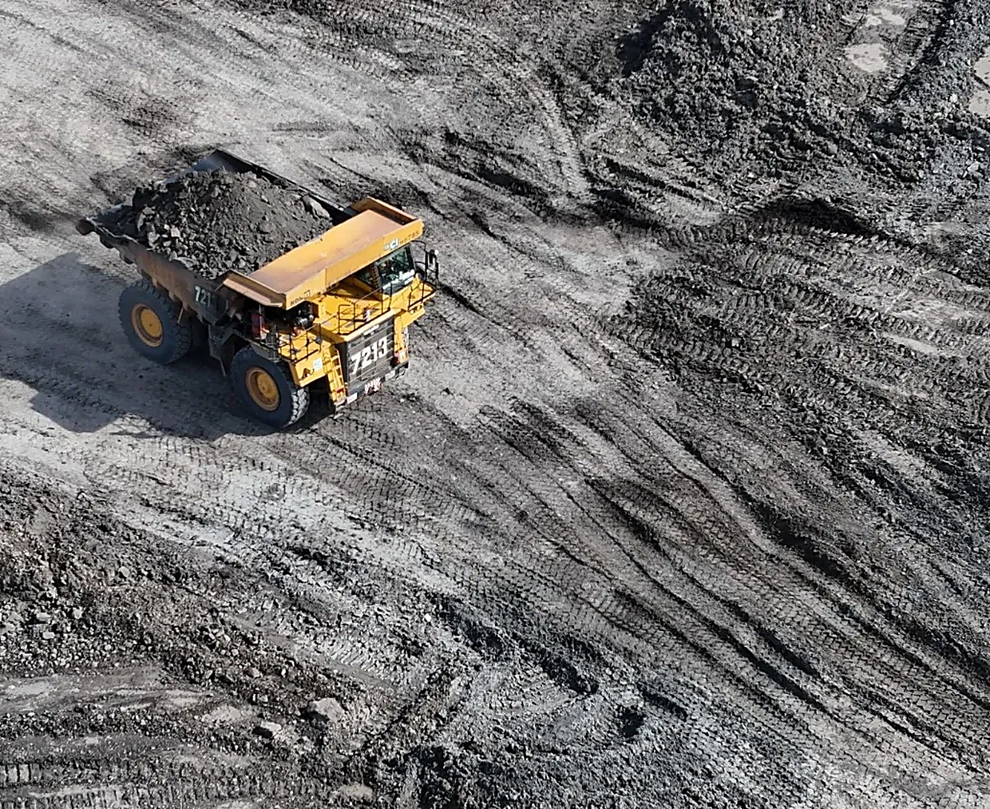






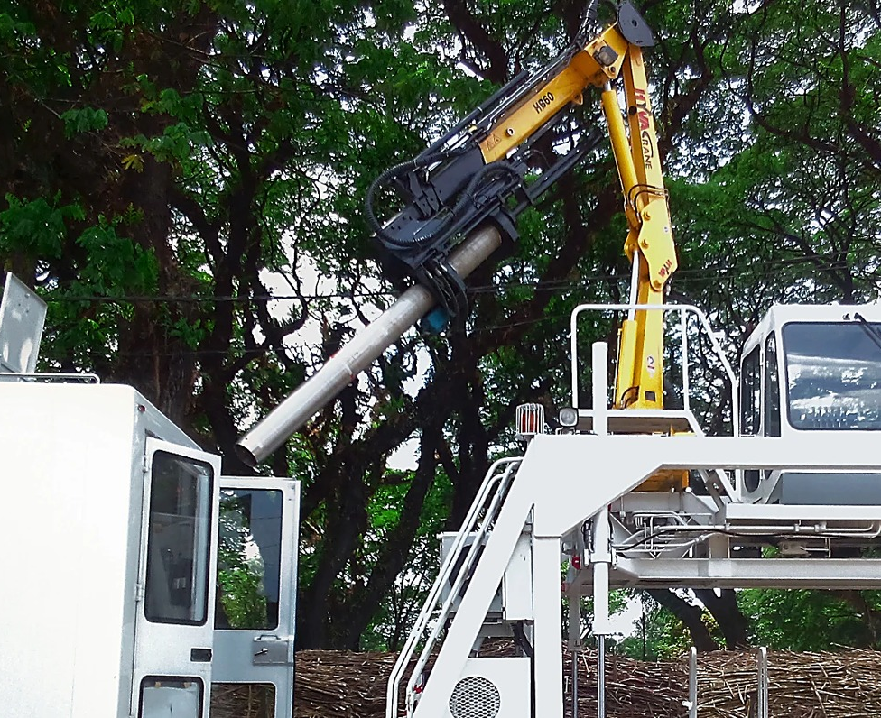
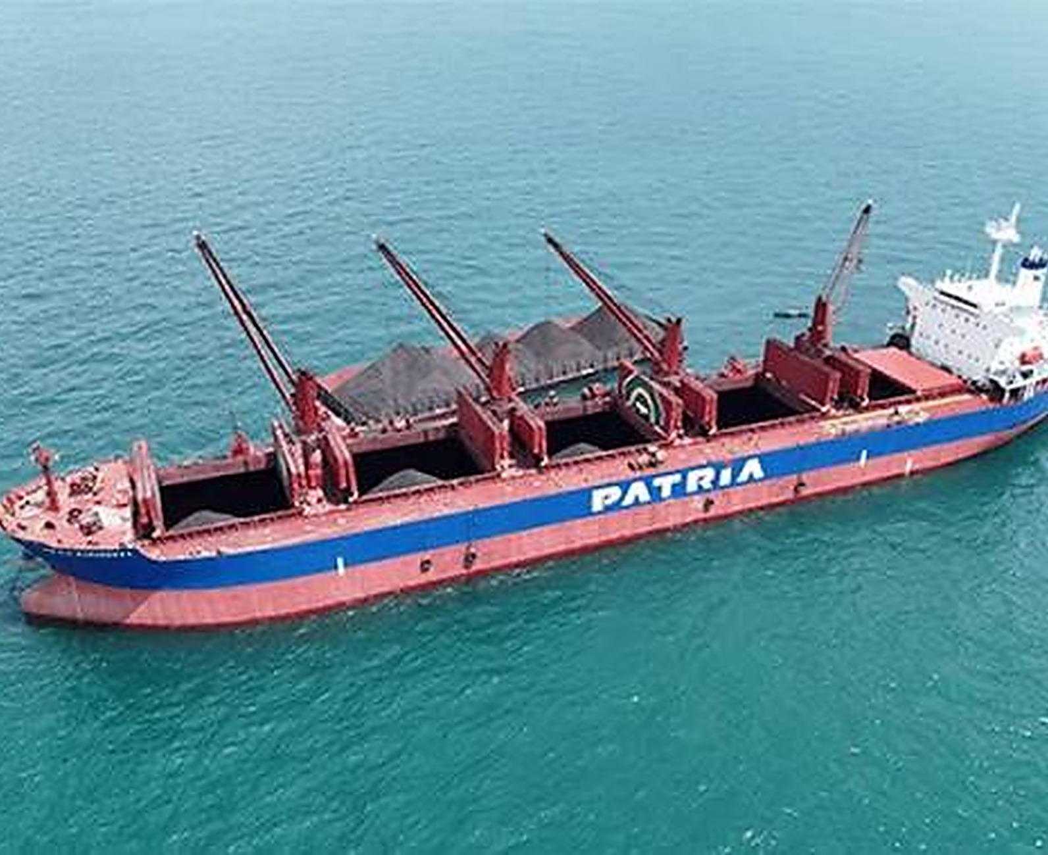


NEDP 6-MONTH REVIEW · COMPANY PROFILE
COMPANY PROFILE
Triatra sells PATRIA and ULTRA to four industries for the UTPE group
CORPORATE ENTITY STRUCTURE
INDUSTRY COVERAGE
Astra International
Heavy Equipment, Mining, Construction and Energy
United Tractors
Construction machinery
UTPE
Engineering solution and marine
01 Coal and mineral mining
02 Construction
MY COMPANY
NEW · 2025
Distribution and trading
Ship owner and operator
Ship building and repair
WHAT TRIATRA DOES
Distributor of PATRIA and ULTRA products for mining, construction, agriculture, forestry and maritime. Sells units and full after-sales support.
Unit
Parts, components and services
Trader of UTPE units, local and export
Maintenance and remanufacturing
03 Forestry and agro-industry
04 Maritime
NEDP MID YEAR REVIEW 2026 · TIBERIAS K. SIMU
04 / 18

Slide 5

NEDP 6-MONTH REVIEW · SITE OPERATION
SITE OPERATION
Triatra serves customers from 16 points across Indonesia
Head Office in Jakarta, 6 Site Operations and 9 Site Representatives.
Head Office
Site Operation
Site Representative
13
4
12
14
11
9
10
7
8
3
5
6
16
2
1
15
# | SITE | TYPE | ADDRESS
1 | Head Office | Head office | Jl. Raya Bekasi KM 22, Cakung, Jakarta Timur
2 | Jakarta | Operation | Jl. Raya Bekasi KM 22, Cakung, Jakarta Timur
3 | Tanjung Enim | Rep. | Jl. Lingga Raya 10, Muara Enim, Sumatera Selatan
4 | Pekanbaru | Rep. | Jl. Soekarno Hatta KM 3,5 No. 151, Riau
5 | Banjarmasin | Rep. | Jl. Ahmad Yani KM 13,5 Gambut, Kalimantan Selatan
6 | Sungai Danau | Rep. | Ds. Karang Indah, Angsana, Tanah Bumbu, Kalsel
7 | Tanjung Tabalong | Operation | Jl. A. Yani KM 7,5 Maburai, Tabalong, Kalsel
8 | Batu Kajang | Rep. | Jl. Negara KM 140, Batu Sopang, Paser, Kaltim
# | SITE | TYPE | ADDRESS
9 | Muara Teweh | Rep. | Jl. Ahmad Yani No. 85, Barito Utara, Kalteng
10 | Balikpapan | Operation | Jl. Jend. Sudirman No. 844, Balikpapan, Kaltim
11 | Melak | Rep. | Hauling Road Trubaindo, Kutai Barat, Kaltim
12 | Tabang | Rep. | Workshop Buma Km 6, Hauling Road, Kaltim
13 | Tanjung Redeb | Rep. | Jl. Gunung Panjang No. 101B, Berau, Kaltim
14 | Sangatta | Operation | Jl. HDRS Tango Delta KPC, Kutai Timur, Kaltim
15 | Sumbawa | Rep. | Memco Area Tongo, Sekongkang, Sumbawa Barat, NTB
16 | Timika | Operation | Jl. Kuala Tembaga E-4, Kuala Kencana, Papua
NEDP MID YEAR REVIEW 2026 · TIBERIAS K. SIMU
05 / 18

Slide 6
NEDP 6-MONTH REVIEW · ORGANIZATION
ORGANIZATION
I work in Marketing Strategic 2, under Ignatius Indrawan S.
Ceisar Centiaga
DIRECTOR IN CHARGE
Ricardo Tanada
MKT UNIT & STRATEGIC DIV HEAD
Kresnanto A.W.
Ricardo Tanada (c)
Ugik Praseno
Marketing Communication
MKT STRATEGIC 1 HEAD
MKT STRATEGIC 2 HEAD
MKT STRATEGIC 3 HEAD
MARCOMM
Satrio F.R.
Ignatius Indrawan S.
Baihaqi
Karina Audina E.
Big Suppeq, Big Vessel, Bucket
DEPUTY HEAD
Mineral Processing, EPC
Marcomm
M. Fawwaz J.
Ervin Bahar P.
Yuda Prana
Adinda Siti K.
Cabin, Forestry, Agro, Forklift, Towerlamp, Pump
Medium Vessel, Man Hauler, Bus Scania
Maritime, Renewable Energy
Marcomm
Tiberias K.S. ◄ ME
Celine
Rahma
Small Suppeq, Truck Others
Ultra Product Support
Graphic Designer
Eurico
Hanifa
Mining / Non-mining Trailer, Overseas Zone
Automation, EV
Nandu Narpati
Admin
NEDP MID YEAR REVIEW 2026 · TIBERIAS K. SIMU
06 / 18

Slide 7
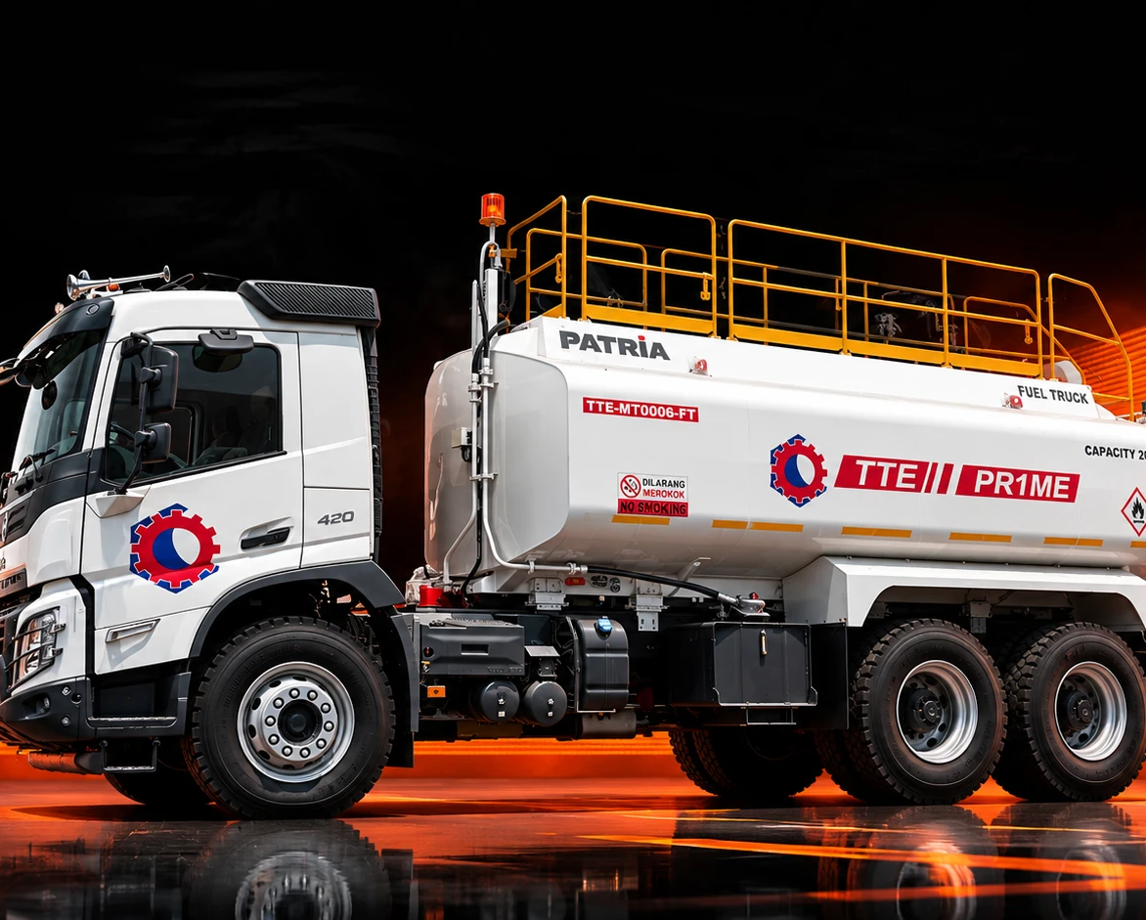
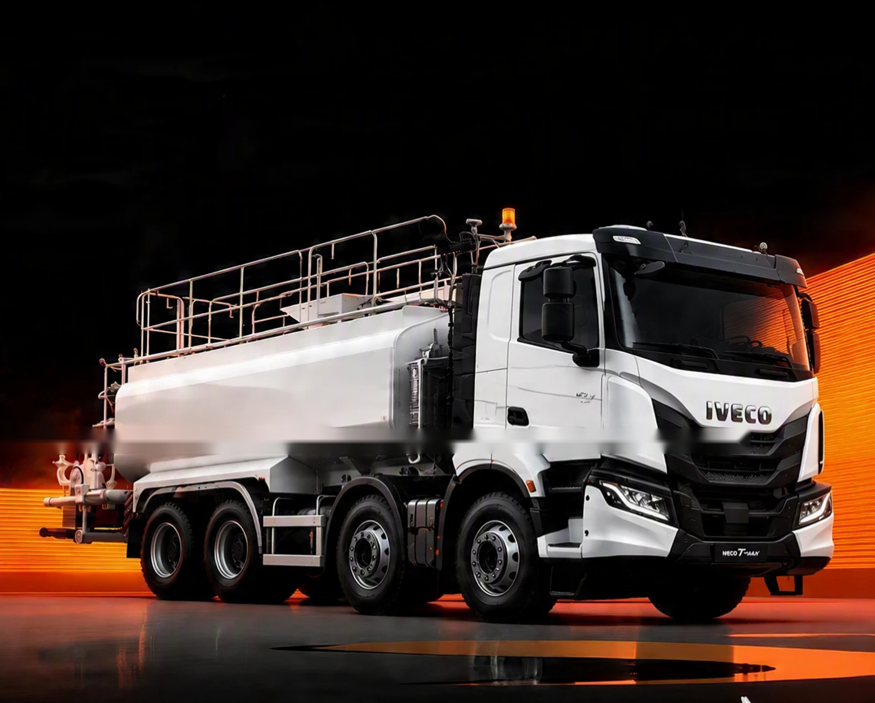
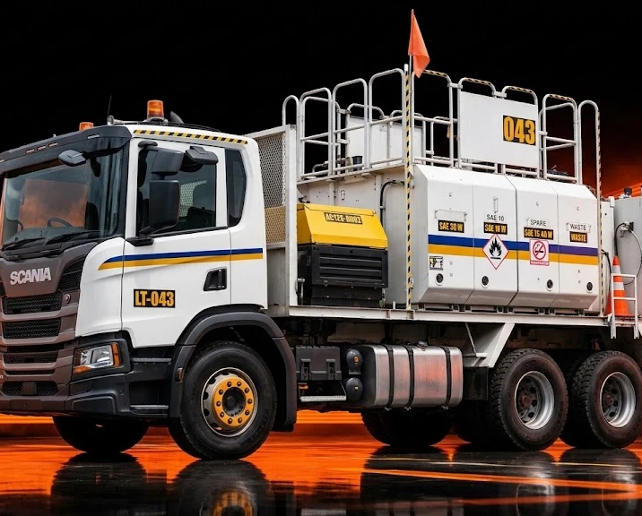
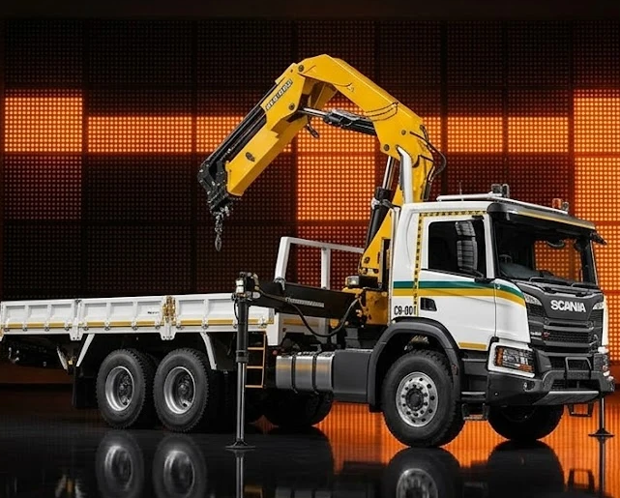
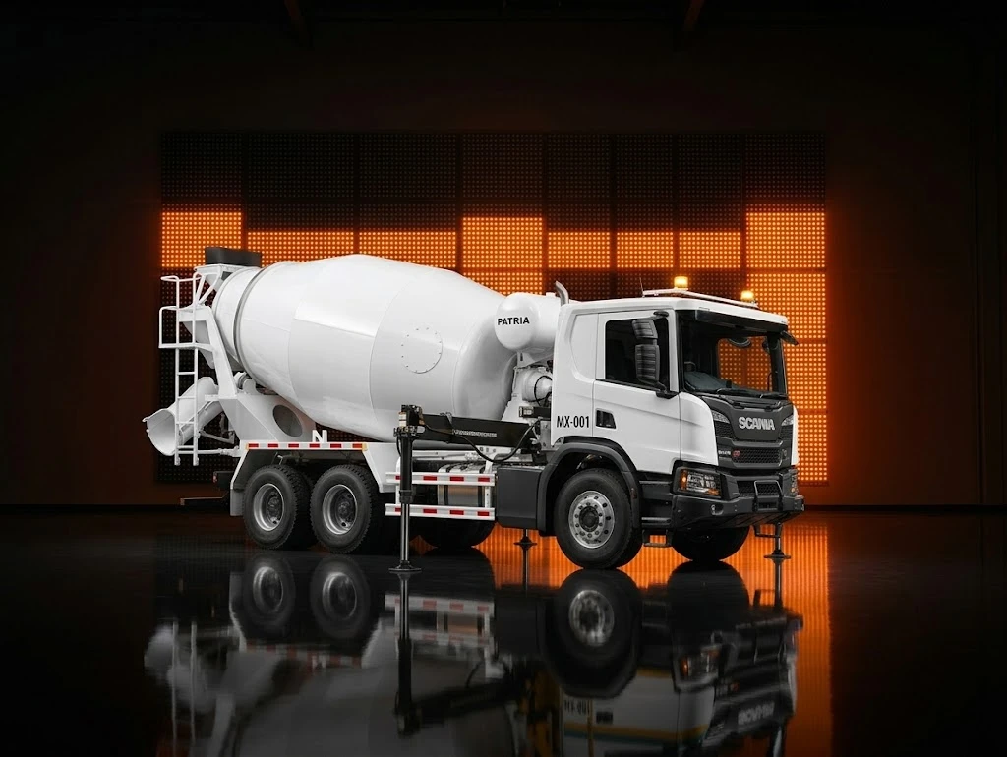
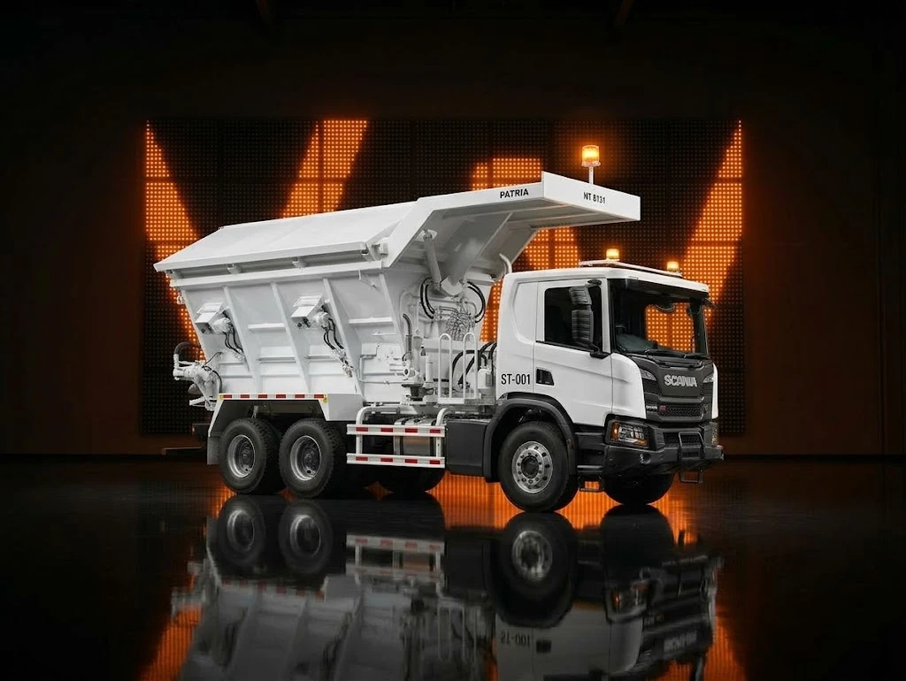
NEDP 6-MONTH REVIEW · ROLES & RESPONSIBILITY · SUPPLY CHAIN
ROLES & RESPONSIBILITY · SUPPLY CHAIN
I take every order from inquiry to delivery for two product lines
Five steps from customer inquiry to factory acceptance test (FAT), for Small Suppeq and Truck Others.
01 Inquiry & opportunity
02 Preliminary
03 Pricing / Quotation
04 Negotiation & CPO
05 Production
PIC
PIC
PIC
PIC
PIC
Business Consultant
Application Engineering
Marketing Unit
Business Consultant
Application Engineering
Marketing Unit Triatra
Marketing Unit Triatra
Marketing Unit UTPE
Business Consultant
Marketing Unit Triatra
Marketing Unit UTPE
Business Consultant
Marketing Unit Triatra
Marketing Unit UTPE
DETAIL
DETAIL
DETAIL
DETAIL
DETAIL
Check spec
Check buying reason
Check project location
Check expected price and lead time
Check urgency and expected PO date
Check if repeat order or new preliminary
Check unit function
Check main components: find the critical ones for price and lead time
Request quote from UTE with preliminary, expected price, expected lead time and customer info
Check UTE standard GP (signed by marketing associate and manager = standard GP)
Check actual SLA (repeat, minor, major); escalate to the superior if too long
Fill PCR in CRM
Check PO / PJB
Check PO matches the preliminary
Request PN
Request QFD and painting style
CPO: Sales Manager → Mkt Unit Triatra → Mkt Unit Manager → GM Marketing Triatra
PO interco approval: Mkt Unit Triatra → GM Mkt Unit → Director Mkt Unit Triatra
Make sure production follows the QFD
Weekly production update to BC
Escalate major production problems
Oversee FAT and report issues to Marketing Unit UTPE
UNITS I HANDLE · SMALL SUPPEQ
UNITS I HANDLE · TRUCK OTHERS
Fuel truck
Water truck
Lube truck
Crane truck
Mixer truck
Stemming truck
NEDP MID YEAR REVIEW 2026 · TIBERIAS K. SIMU
07 / 18

Slide 8
NEDP 6-MONTH REVIEW · STRATEGIC · 4C → STP → 4P
STRATEGIC · 4C → STP → 4P
Partner F.lli Ferrari for quality buyers and XCMG for price buyers
Step | Item | Key point | Supporting data
4C | Change | HYVA has left; value sits in Medium + Heavy | Triatra has no crane brand since HYVA stopped. Medium + Heavy = 41% of units, 64% of value (2023 – 2026). Heavy units 12 → 17 → 35 (2023 – 2025).
 | Competitor | Two leaders, one per class | Medium: Sany Palfinger, 38% of value. Heavy: Palfinger, 66% of value; PK 53002 alone sold 39 of 65 units (2023 – 2026).
 | Customer | Medium buys on price, Heavy buys on quality | China brands take 73% of Medium value; European brands take 85% of Heavy value. 88% go on trucks ≥ 24 t GVW (mining, construction).
 | Company | Partner two brands to serve both buyers | XCMG for price-oriented buyers. F.lli Ferrari for quality-oriented buyers.
STP | Segmentation | Two classes, ten 5-tm tiers | Medium 25 – 45 tm: 196 units, Rp 156 M. Heavy > 45 tm: 65 units, Rp 115 M.
 | Targeting | Take share from the Top 1 model in each tier | Medium: Sany Palfinger SPK32080, SPK36080, SPK42502. Heavy: Palfinger PK 53002, PK 76002, PK 88002.
 | Positioning | Two clear promises | XCMG: same capacity, lower price (SQZ365.4 −9% vs SPK36080). Ferrari: European features, cheaper where it wins (−23% at 25 – 30 tm, −32% at 45 – 50 tm) and faster delivery from China stock (~14 weeks).
4P | Product | Offer Ferrari models that beat the Top 1 on features | Red Power (more working range), SDV (less boom flex), Magic Touch (auto open/stow): Sany Palfinger has none. PB, RS, ECM: equal to Palfinger.
 | Price | Negotiate a better price with Ferrari and XCMG | Ferrari: lower price on 746 A4 (+48%), 9601CR A8 (+85%), 990R (+79%). XCMG: Triatra special price on SQZ325.4 and SQZ365.4.
 | Place | Negotiate stock to cut lead time | Ferrari stocks 268 A4 and FBR450R A4 in China (14-week lead time) and main components in Malaysia. XCMG via GM Tractors.
 | Promotion | Sell a ready-to-work package | Crane + flatdeck + installation (+2-year warranty on Ferrari). Exhibitions and customer visits with a Marcom sales kit.
NEDP MID YEAR REVIEW 2026 · TIBERIAS K. SIMU
08 / 18

Slide 9
NEDP 6-MONTH REVIEW · PROJECT CHARTER
PROJECT CHARTER
Sell the first Ferrari and XCMG challenger cranes by March 2027
PROJECT NAME
PROJECT TIMEFRAME
Multi-brand Crane Challenger: F.lli Ferrari and XCMG
Activity | 2026 |  |  |  |  |  |  | 2027
 | Jun | Jul | Aug | Sep | Oct | Nov | Dec | Jan | Feb | Mar
Market study (4C)
STP and challenger choice
Negotiate with Ferrari and XCMG
Sales kit with Marcom
Exhibition and customer visits
Quotation → PO → first unit sold
BACKGROUND
HYVA stopped making cranes, so Triatra has no crane brand. From Jan 2023 to Aug 2026 Indonesia imported 638 knuckle boom cranes; Medium and Heavy (> 25 tm) are 41% of units but 64% of value, led by Sany Palfinger (Medium) and Palfinger (Heavy). This project puts a challenger brand against the Top 1 of each tm tier.
OBJECTIVES
1. Map Medium and Heavy cranes by tm tier, brand and model (4C)
2. Pick one challenger per tier: XCMG for price buyers, Ferrari for quality buyers (STP)
3. Set Product, Price, Place and Promotion per tier and sell the first unit (4P)
BENEFIT OF PROJECT
Triatra gets a crane brand for every Medium and Heavy tier again: XCMG for price buyers, Ferrari for quality buyers, with a clear 4P to win units from the Top 1.
PROJECT SCOPE · MEDIUM AND HEAVY CLASS (> 25 TM)
PROJECT TEAM
1. Market size and brand leaders 2. Top 1 vs challenger per tier 3. Feature and price comparison
4. Brand negotiation (Ferrari, XCMG) 5. Sales kit, exhibition and first sale
Executive sponsor
: Ricardo Tanada
Advisor
: Ricardo Tanada / Ignatius Indrawan
KPI / METRIC
TARGET
Coordinator
: Ignatius Indrawan
Project lead
: Tiberias Krisgaharu Simu
1. 4C, STP, 4P approved (Aug 2026)
2. Ferrari and XCMG terms signed (Dec 2026)
3. Sales kit ready (Dec 2026)
4. Quotations sent (Feb 2027)
5. First unit sold (Mar 2027)
First Ferrari or XCMG challenger crane sold by March 2027
Team members
: Marketing Unit · Application Engineering · UTPE · Business Consultant
PROJECT APPROVAL
Lead
Coordinator
Advisor
Executive Sponsor
Date:
Date:
Date:
Date:
SUPPORT REQUIRED
Marcom (sales kit, exhibition) · F.lli Ferrari (stock, parts, price) · XCMG (special price) · UTPE
Tiberias Krisgaharu Simu
Ignatius Indrawan
Ricardo Tanada
Ricardo Tanada
NEDP MID YEAR REVIEW 2026 · TIBERIAS K. SIMU
09 / 18

Slide 10
NEDP 6-MONTH REVIEW · STUDY · MARKET SIZE
STUDY · MARKET SIZE
Focus on Medium and Heavy: 64% of value from 41% of units
UNITS IMPORTED PER YEAR BY CLASS · 2023 – 2026*
67
104
Medium + Heavy units / year · target
Light + Small units / year · not target
KEY POINTS
Medium + Heavy: 41% of units, 64% of import value
Value per unit: Rp 803 jt vs Rp 311 jt for Light + Small
88% of Medium and Heavy cranes go on trucks GVW ≥ 24 t: mining, construction, heavy logistics
2026 is partial: only 12 Medium and 1 Heavy unit to 14 Aug
TOTAL UNITS AND IMPORT VALUE · 2023 – 14 AUG 2026
CLASS | LIFTING MOMENT | UNITS | IMPORT VALUE (IDR) | SHARE
Light | ≤ 8 tm | 177 | Rp 40.118.000.000 | 12%
Small | 8 – 25 tm | 200 | Rp 77.241.000.000 | 24%
Medium | 25 – 45 tm | 196 | Rp 118.328.000.000 | 36%
Heavy | > 45 tm | 65 | Rp 91.154.000.000 | 28%
Total |  | 638 | Rp 326.841.000.000 | 100%
*2026 annualised (Jan – 14 Aug × 1.61). Source: Indonesia import records HS 84269100 + 84264900; truck-mounted knuckle boom cranes; Zoomlion and Hyva excluded; USD 1 = Rp 17.803.
NEDP MID YEAR REVIEW 2026 · TIBERIAS K. SIMU
10 / 18

Slide 11
NEDP 6-MONTH REVIEW · STUDY · BRAND LEADERS 2025
STUDY · BRAND LEADERS 2025
Two leaders to beat: Sany Palfinger in Medium, Palfinger in Heavy
MEDIUM · 25 – 45 TM
HEAVY · > 45 TM
IMPORT VALUE BY BRAND · 2025 · RP M
IMPORT VALUE BY BRAND · 2025 · RP M
# | BRAND | UNITS | IMPORT VALUE (IDR) | SHARE
1 | Sany Palfinger | 30 | Rp 13.226.000.000 | 47%
2 | XCMG | 14 | Rp 7.197.000.000 | 26%
3 | Palfinger | 5 | Rp 4.869.000.000 | 17%
# | BRAND | UNITS | IMPORT VALUE (IDR) | SHARE
1 | Palfinger | 22 | Rp 29.738.000.000 | 62%
2 | Amco Veba | 7 | Rp 11.065.000.000 | 23%
3 | XCMG | 4 | Rp 4.647.000.000 | 10%
Total Medium 2025: 54 units · Rp 28,0 M. Sany Palfinger = Sany–Palfinger JV, made in China.
Total Heavy 2025: 35 units · Rp 48,0 M.
Both leaders are far ahead of the next brand in value: Sany Palfinger 1.8× XCMG in Medium, Palfinger 2.7× Amco Veba in Heavy.
Scope is 2025 only, so figures are smaller than the 2023 – 2026 totals.
NEDP MID YEAR REVIEW 2026 · TIBERIAS K. SIMU
11 / 18

Slide 12
NEDP 6-MONTH REVIEW · STP · MEDIUM CLASS 25–45 TM · 1 / 2
STP · MEDIUM CLASS 25–45 TM · 1 / 2
Medium: target Sany Palfinger with XCMG at 30–40 tm and Ferrari at 25–30 tm
Medium Class Crane
TM Class | Market Size |  | Top 1 Competitor |  |  |  |  | Challenger
 | Qty | Market Share | Brand | Type | Qty | Share | Price/unit | Brand | Type | Price/Unit
25 – 30 | 49 | 19% | Amco Veba* | V825 | 31 | 69% | Rp 650.000.000 | Ferrari | 268 A4 | Rp 500.000.000
30 – 35 | 62 | 31% | Sany Palfinger | SPK32080 | 33 | 36% | Rp 530.000.000 | XCMG | SQZ325.4 | Rp 550.000.000
35 – 40 | 66 | 38% | Sany Palfinger | SPK36080 | 37 | 41% | Rp 660.000.000 | XCMG | SQZ365.4 | Rp 600.000.000
40 – 45 | 19 | 12% | Sany Palfinger | SPK42502 | 18 | 93% | Rp 960.000.000 | Ferrari | 746 A4 | Rp 1.420.000.000
SEGMENTATION
TARGETING
POSITIONING
Medium class split into 4 tm tiers. 30–40 tm holds 65% of Medium units (128 of 196) and 69% of value.
Top 1 model of each tier: Sany Palfinger at 30–45 tm. At 25–30 tm Sany Palfinger has no model, so Amco Veba V825 is the target.
XCMG: same capacity as Sany Palfinger at a lower price. Ferrari 268 A4: European features, 23% cheaper than Amco Veba V825.
Period Jan 2023 – 14 Aug 2026. Market share = tier value / class value; value = units × highest import unit price per model (estimate, incl. duty & tax). Top 1 share = Top 1 model value / tier value. * Top 1 brand has no model in this tier: next-largest brand shown. Fill: green = challenger cheaper, yellow = up to +30%, red = over +30%.
NEDP MID YEAR REVIEW 2026 · TIBERIAS K. SIMU
12 / 18

Slide 13
NEDP 6-MONTH REVIEW · 4P · MEDIUM CLASS 25–45 TM · 2 / 2
4P · MEDIUM CLASS 25–45 TM · 2 / 2
Medium: XCMG wins on price; renegotiate Ferrari before selling 40–45 tm
Medium Class Crane
TM Class | Challenger |  |  | Product |  | Price | Place |  | Promotion
 | Brand | Type | Price/Unit | Special features
 |  |  |  | Equal features | Winning features |  | Competitor | Challenger
25 – 30 | Ferrari | 268 A4 | Rp 500.000.000 | Linkage: Ferrari Red Power = Amco Veba Articulated Powerlink Power boost: Ferrari PB = Amco Veba AVPS Electronic control: Ferrari ECM = Amco Veba EBB Auto fold: Ferrari Magic Touch = Amco Veba Magic Touch | Extension speed: Ferrari RS; Amco Veba: none Oscillation: Ferrari SDV (Smooth Descent Valve: less boom flex and dynamic load); Amco Veba: none | −23% vs Top 1 | Made in Europe | Ferrari stocks units in China (~14 weeks) and parts in Malaysia | Crane + flatdeck + installation + 2-year warranty; exhibition with Marcom sales kit
30 – 35 | XCMG | SQZ325.4 | Rp 550.000.000 | Electronic control: XCMG Load limiter* = Sany Palfinger Paltronic 50 | No extra named feature. Needs a special price to beat Sany Palfinger (now +4%) | +4% vs Top 1 | Made in China | Negotiate special price with XCMG | Crane + flatdeck + installation; exhibition with Marcom sales kit
35 – 40 | XCMG | SQZ365.4 | Rp 600.000.000 | Electronic control: XCMG Load limiter* = Sany Palfinger Paltronic 50 | No extra named feature. Wins on price: −9% vs Sany Palfinger | −9% vs Top 1 | Made in China | Negotiate special price with XCMG | Crane + flatdeck + installation; exhibition with Marcom sales kit
40 – 45 | Ferrari | 746 A4 | Rp 1.420.000.000 | Power boost: Ferrari PB = Sany Palfinger HPLS (MH) Extension speed: Ferrari RS = Sany Palfinger High speed ext. (ROU) Electronic control: Ferrari ECM = Sany Palfinger Paltronic 50 | Linkage: Ferrari Red Power; Sany Palfinger: none Oscillation: Ferrari SDV (Smooth Descent Valve: less boom flex and dynamic load); Sany Palfinger: none Auto fold: Ferrari Magic Touch (opens and stows the crane automatically); Sany Palfinger: none | +48% vs Top 1 | Made in China | Negotiate price with Ferrari. Ferrari stocks units in China (~14 weeks) and parts in Malaysia | Crane + flatdeck + installation + 2-year warranty; exhibition with Marcom sales kit
Green = challenger cheaper than Top 1
Yellow = up to +30%
Red = over +30%: negotiate price with F.lli Ferrari
Price = challenger price vs Top 1 model price. Equal features = both brands have the system (challenger name = Top 1 name). Winning features = only the challenger has it. * XCMG feature names to be verified with the XCMG datasheet.
NEDP MID YEAR REVIEW 2026 · TIBERIAS K. SIMU
13 / 18

Slide 14
NEDP 6-MONTH REVIEW · STP · HEAVY CLASS > 45 TM · 1 / 3
STP · HEAVY CLASS > 45 TM · 1 / 3
Heavy: Ferrari is the only challenger and is cheaper only at 45–50 tm
Heavy Class Crane
TM Class | Market Size |  | Top 1 Competitor |  |  |  |  | Challenger
 | Qty | Market Share | Brand | Type | Qty | Share | Price/unit | Brand | Type | Price/Unit
45 – 50 | 17 | 26% | Amco Veba* | V950 | 12 | 81% | Rp 1.990.000.000 | Ferrari | FBR450R A4 | Rp 1.350.000.000
50 – 55 | 40 | 63% | Palfinger | PK 53002 | 39 | 95% | Rp 1.760.000.000 | Ferrari | 9601CR A8 | Rp 3.260.000.000
60 – 65 | 1 | 1% | Sany Palfinger* | SPK61502 | 1 | 100% | Rp 1.400.000.000 | Ferrari | 9661C | TBC
70 – 75 | 2 | 4% | Palfinger | PK 76002 EH D | 2 | 100% | Rp 2.290.000.000 | Ferrari | 990R | Rp 4.110.000.000
80 – 85 | 1 | 2% | Palfinger | PK 88002 EH C | 1 | 100% | Rp 2.220.000.000 | Ferrari | TBC (price list) | TBC
85 – 90 | 4 | 5% | XCMG | GSQZ880.6 | 2 | 50% | Rp 1.320.000.000 | No challenger | – | –
SEGMENTATION
TARGETING
POSITIONING
Heavy class split into 6 tm tiers. 50–55 tm holds 62% of Heavy units (40 of 65), almost all Palfinger PK 53002.
Top 1 model of each tier: Palfinger at 50–55, 70–75 and 80–85 tm. Amco Veba (45–50) and Sany Palfinger (60–65) where Palfinger has no model.
Ferrari: the same European features as Palfinger, delivered faster from stock in China (~14 weeks) against Europe-built leaders.
Period Jan 2023 – 14 Aug 2026. Market share = tier value / class value; value = units × highest import unit price per model (estimate, incl. duty & tax). Top 1 share = Top 1 model value / tier value. * Top 1 brand has no model in this tier: next-largest brand shown. Fill: green = challenger cheaper, yellow = up to +30%, red = over +30%.
NEDP MID YEAR REVIEW 2026 · TIBERIAS K. SIMU
14 / 18

Slide 15
NEDP 6-MONTH REVIEW · 4P · HEAVY CLASS 45–65 TM · 2 / 3
4P · HEAVY CLASS 45–65 TM · 2 / 3
Heavy 45–65 tm: Ferrari matches or beats the leader on features
Heavy Class Crane
TM Class | Challenger |  |  | Product |  | Price | Place |  | Promotion
 | Brand | Type | Price/Unit | Special features
 |  |  |  | Equal features | Winning features |  | Competitor | Challenger
45 – 50 | Ferrari | FBR450R A4 | Rp 1.350.000.000 | Linkage: Ferrari Red Power = Amco Veba Articulated Powerlink Power boost: Ferrari PB = Amco Veba AVPS Electronic control: Ferrari ECM = Amco Veba EBB Auto fold: Ferrari Magic Touch = Amco Veba Magic Touch | Extension speed: Ferrari RS; Amco Veba: none Oscillation: Ferrari SDV (Smooth Descent Valve: less boom flex and dynamic load); Amco Veba: none | −32% vs Top 1 | Made in Europe | Ferrari stocks units in China (~14 weeks) and parts in Malaysia | Crane + flatdeck + installation + 2-year warranty; exhibition with Marcom sales kit
50 – 55 | Ferrari | 9601CR A8 | Rp 3.260.000.000 | Linkage: Ferrari Red Power = Palfinger Power Link Plus Power boost: Ferrari PB = Palfinger HPLS Extension speed: Ferrari RS = Palfinger High Speed Extension Oscillation: Ferrari SDV = Palfinger AOS Electronic control: Ferrari ECM = Palfinger PALTRONIC 150 Auto fold: Ferrari Magic Touch = Palfinger P-Fold | No extra named feature. Wins on delivery: stock in China (~14 weeks) vs Palfinger built in Europe | +85% vs Top 1 | Made in Europe | Negotiate price with Ferrari. Ferrari stocks units in China (~14 weeks) and parts in Malaysia | Crane + flatdeck + installation + 2-year warranty; exhibition with Marcom sales kit
60 – 65 | Ferrari | 9661C | TBC | Power boost: Ferrari PB = Sany Palfinger HPLS (MH) Extension speed: Ferrari RS = Sany Palfinger High speed ext. (ROU) Electronic control: Ferrari ECM = Sany Palfinger Paltronic 50 | Linkage: Ferrari Red Power; Sany Palfinger: none Oscillation: Ferrari SDV (Smooth Descent Valve: less boom flex and dynamic load); Sany Palfinger: none Auto fold: Ferrari Magic Touch (opens and stows the crane automatically); Sany Palfinger: none | TBC | Made in China | Ferrari stocks units in China (~14 weeks) and parts in Malaysia | Crane + flatdeck + installation + 2-year warranty; exhibition with Marcom sales kit
Green = challenger cheaper than Top 1
Yellow = up to +30%
Red = over +30%: negotiate price with F.lli Ferrari
Price = challenger price vs Top 1 model price. Equal features = both brands have the system (challenger name = Top 1 name). Winning features = only the challenger has it. * XCMG feature names to be verified with the XCMG datasheet.
NEDP MID YEAR REVIEW 2026 · TIBERIAS K. SIMU
15 / 18

Slide 16
NEDP 6-MONTH REVIEW · 4P · HEAVY CLASS 70–90 TM · 3 / 3
4P · HEAVY CLASS 70–90 TM · 3 / 3
Heavy 70–90 tm: same features as Palfinger, so win on delivery time
Heavy Class Crane
TM Class | Challenger |  |  | Product |  | Price | Place |  | Promotion
 | Brand | Type | Price/Unit | Special features
 |  |  |  | Equal features | Winning features |  | Competitor | Challenger
70 – 75 | Ferrari | 990R | Rp 4.110.000.000 | Linkage: Ferrari Red Power = Palfinger Power Link Plus Power boost: Ferrari PB = Palfinger HPLS Extension speed: Ferrari RS = Palfinger High Speed Extension Oscillation: Ferrari SDV = Palfinger AOS Electronic control: Ferrari ECM = Palfinger PALTRONIC 150 Auto fold: Ferrari Magic Touch = Palfinger P-Fold | No extra named feature. Wins on delivery: stock in China (~14 weeks) vs Palfinger built in Europe | +79% vs Top 1 | Made in Europe | Negotiate price with Ferrari. Ferrari stocks units in China (~14 weeks) and parts in Malaysia | Crane + flatdeck + installation + 2-year warranty; exhibition with Marcom sales kit
80 – 85 | Ferrari | TBC (price list) | TBC | Linkage: Ferrari Red Power = Palfinger Power Link Plus Power boost: Ferrari PB = Palfinger HPLS Extension speed: Ferrari RS = Palfinger High Speed Extension Oscillation: Ferrari SDV = Palfinger AOS Electronic control: Ferrari ECM = Palfinger PALTRONIC 150 Auto fold: Ferrari Magic Touch = Palfinger P-Fold | No extra named feature. Wins on delivery: stock in China (~14 weeks) vs Palfinger built in Europe | TBC | Made in Europe | Ferrari stocks units in China (~14 weeks) and parts in Malaysia | Crane + flatdeck + installation + 2-year warranty; exhibition with Marcom sales kit
85 – 90 | No challenger | – | – | – | – | – | Made in China | – | –
Green = challenger cheaper than Top 1
Yellow = up to +30%
Red = over +30%: negotiate price with F.lli Ferrari
Price = challenger price vs Top 1 model price. Equal features = both brands have the system (challenger name = Top 1 name). Winning features = only the challenger has it. * XCMG feature names to be verified with the XCMG datasheet.
NEDP MID YEAR REVIEW 2026 · TIBERIAS K. SIMU
16 / 18

Slide 17
NEDP 6-MONTH REVIEW · CONCLUSION
CONCLUSION
Partner with F.lli Ferrari and XCMG; keep Fassi for Petrosea
XCMG
F.lli Ferrari
Fassi
MEDIUM · PRICE BUYERS
HEAVY · QUALITY BUYERS · PLUS 25–30 AND 40–45 TM
KEY ACCOUNT
TM | MODEL | VS TOP 1
30 – 35 | SQZ325.4 vs SPK32080 | +4%
35 – 40 | SQZ365.4 vs SPK36080 | −9%
TM | MODEL | VS TOP 1
25 – 30 | 268 A4 vs V825 | −23%
40 – 45 | 746 A4 vs SPK42502 | +48%
45 – 50 | FBR450R A4 vs V950 | −32%
50 – 55 | 9601CR A8 vs PK 53002 | +85%
60 – 65 | 9661C vs SPK61502 | TBC
70 – 75 | 990R vs PK 76002 EH D | +79%
80 – 85 | TBC (price list) vs PK 88002 EH C | TBC
Petrosea buys Fassi only
Keep Fassi supply for this account
Outside the Ferrari + XCMG challenger plan
30–40 tm is 65% of Medium units and 69% of value
Ask XCMG for a special price at both tiers
Partnership terms needed: GM Tractors is XCMG's official distributor in Indonesia
Bundle crane + flatdeck + installation; exhibitions with Marcom sales kit
Negotiate price at the red tiers: 40–45, 50–55 and 70–75 tm
Stock units in China (~14 weeks) and parts in Malaysia
Bundle + 2-year warranty; exhibitions with Marcom sales kit
DECISIONS NEEDED
01
02
03
Approve partnership talks with F.lli Ferrari and XCMG
Mandate Ferrari price and stock negotiation
Budget for exhibitions and Marcom sales kit
NEDP MID YEAR REVIEW 2026 · TIBERIAS K. SIMU
17 / 18

Slide 18
THANK YOU
Questions and feedback are welcome.
Tiberias Krisgaharu Simu · Marketing Strategic 2 Associate · PT Triatra Sinergia Pratama
NEDP MID YEAR REVIEW 2026
18 / 18

