Slide 1
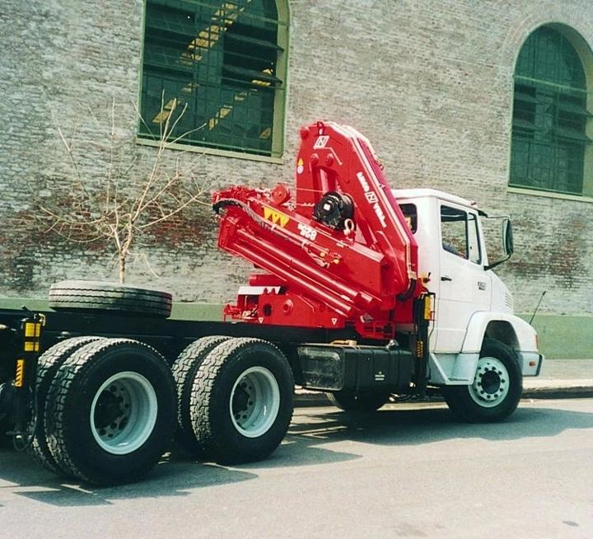
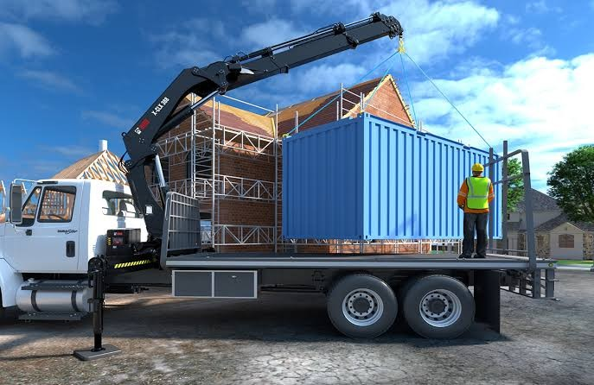
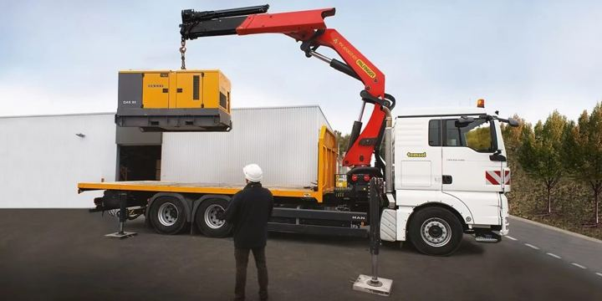
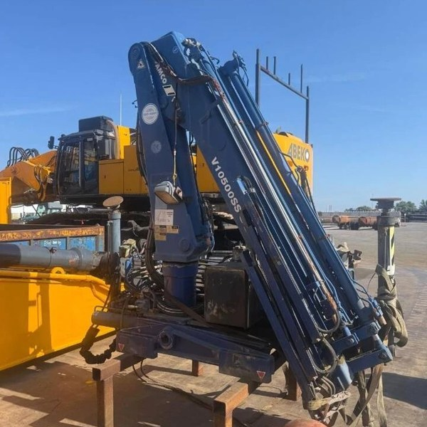
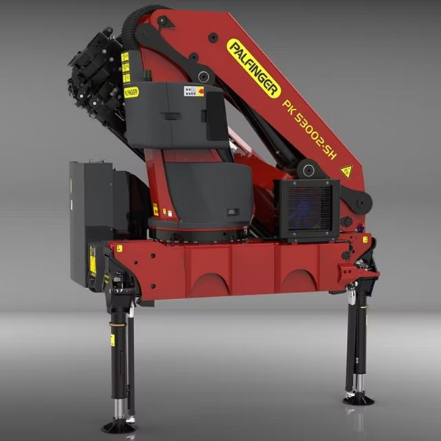
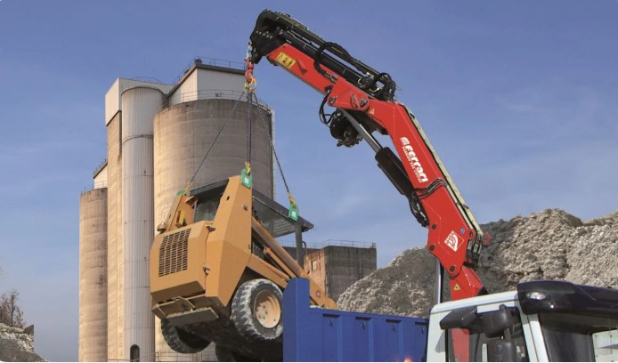
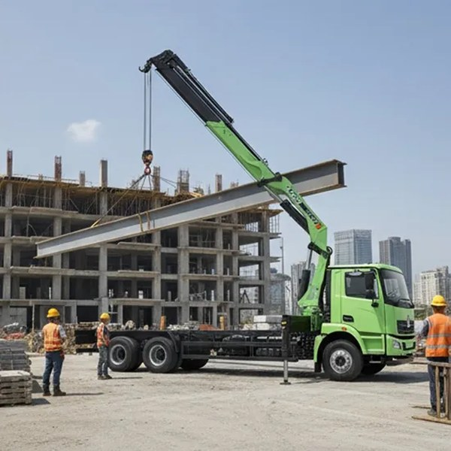

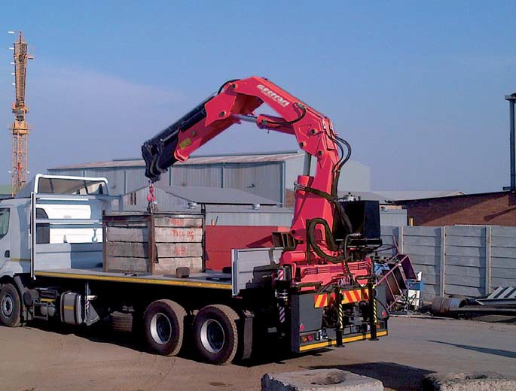
Quote
Appendix: Crane Photos (1/2)/
What do the leader and
our challenger look like?
Head to head: the class leader next to the crane we offer against it
Medium and Heavy tm classes where we have a challenger. Light and Small photos not yet available (models not in the photo library).
Medium 25–30 tm
Medium 30–35 tm
Medium 35–40 tm
Heavy 45–50 tm
Heavy 50–55 tm
LEADER
LEADER
LEADER
LEADER
LEADER
Amco Veba V825
HIAB X-CLX 388
Palfinger PK 41002
Amco Veba V950
Palfinger PK 53002
Leader · Rp 517 Jt
Leader · Rp 762 Jt
Leader · Rp 1.103 Jt
Leader · Rp 1.575 Jt
Leader · Rp 1.361 Jt
OUR CRANE
OUR CRANE
OUR CRANE
OUR CRANE
OUR CRANE
F.lli Ferrari 258 A3
XCMG SQZ325.4
XCMG KSQZ365.4
F.lli Ferrari FBR450 A4
F.lli Ferrari FBR450R A4
Rp 455 Jt · photo: 268 A4, same 8 Series
Rp 484 Jt
Rp 478 Jt
Rp 1.251 Jt · photo: FBR450R A4
Rp 1.408 Jt
Photos: brand brochures and websites, collected for the F.lli Ferrari market strategy deck. Prices per unit as on the class map slides (competitors = average import price × Rp 17.803/USD; F.lli Ferrari = price list June 2026, K − I, less 13.6% TSP GP).

Slide 2
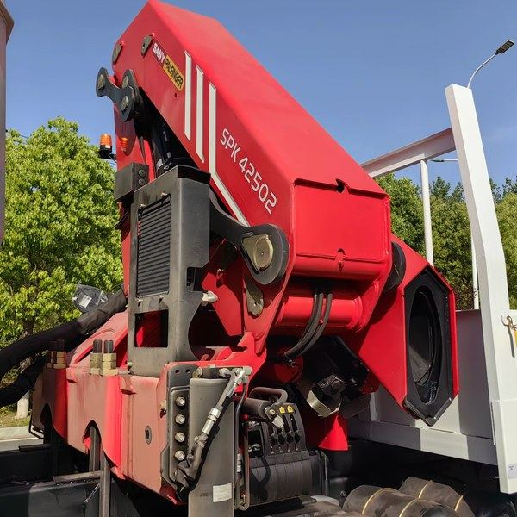
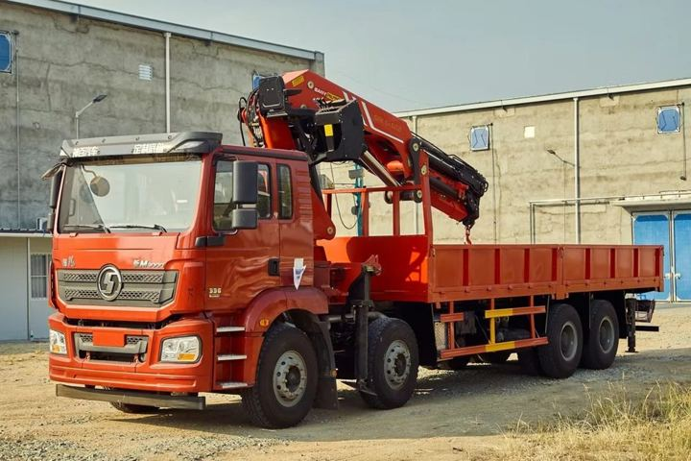
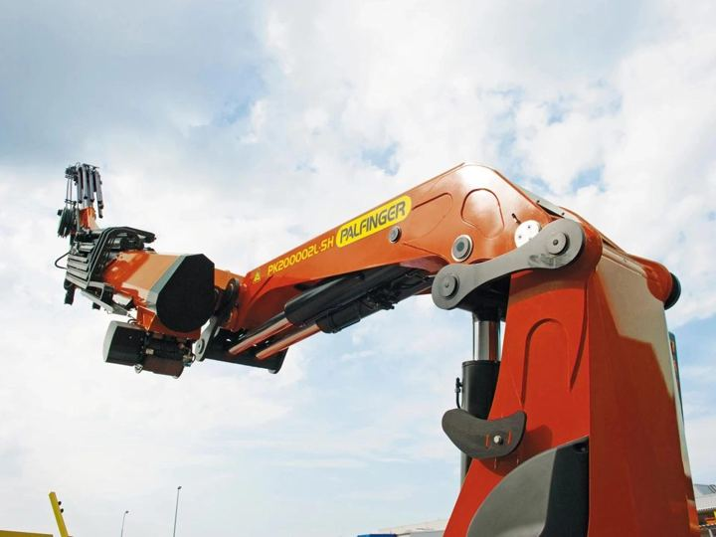
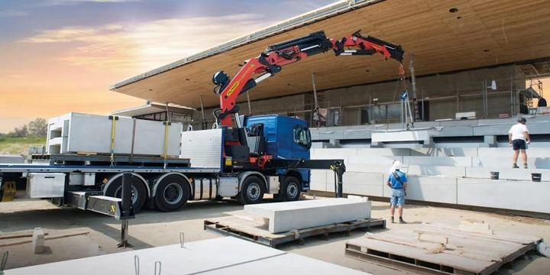
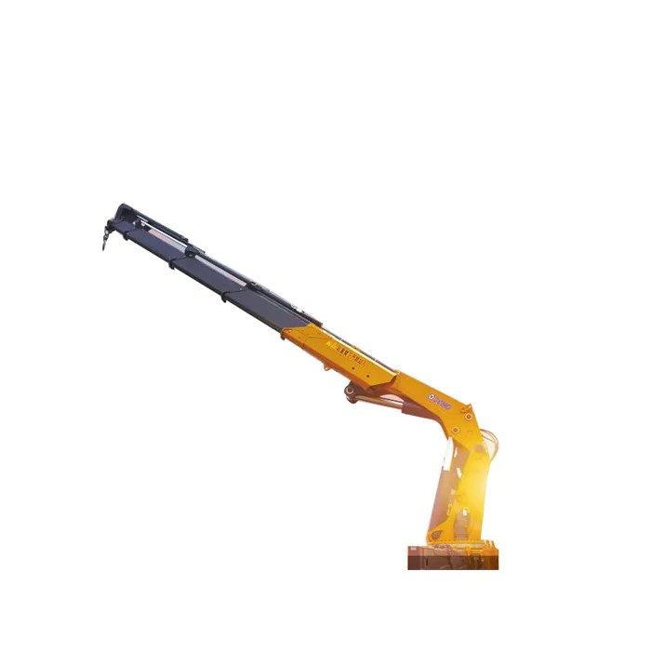
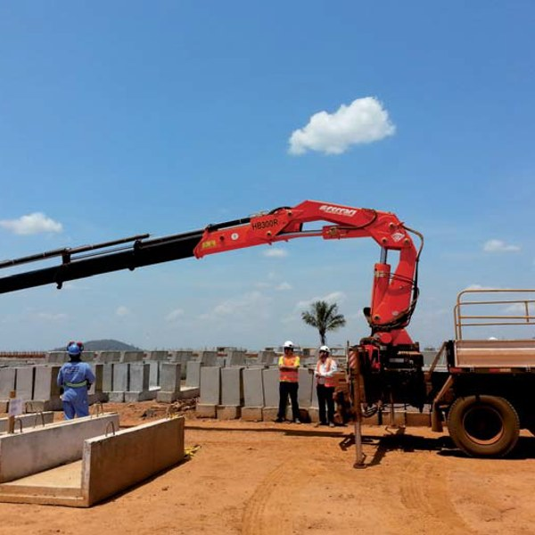
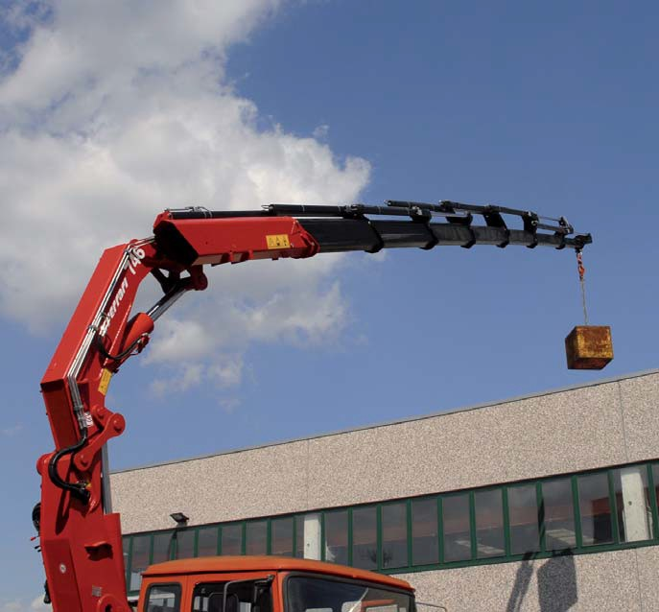
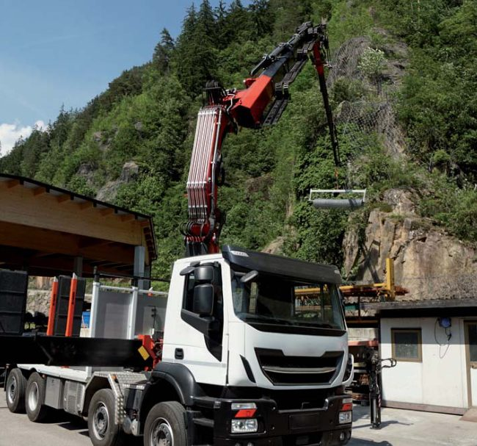
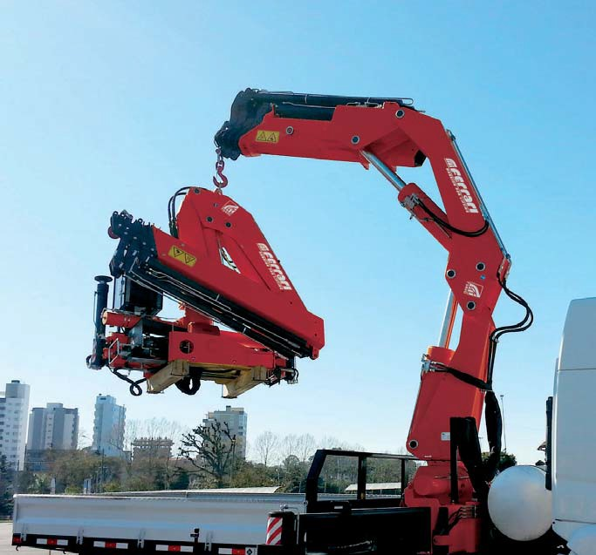
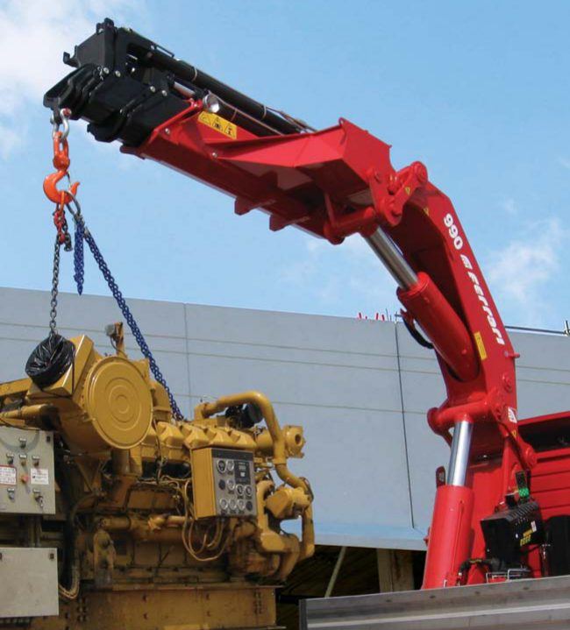
Quote
Appendix: Crane Photos (2/2)/
Which other cranes
did we look at?
Other class leaders, and F.lli Ferrari models we checked but did not pick
Leaders of classes with no cheaper challenger yet, and F.lli Ferrari models that are more than 30% above the leader in their class.
Class leaders with no challenger yet
Sany Palfinger SPK42502
Sany Palfinger SPK61502
Palfinger PK 76002
Palfinger PK 88002
XCMG GSQZ880.6
Medium 40–45 tm · Rp 693 Jt
Heavy 60–65 tm · Rp 1.235 Jt
Heavy 70–75 tm · Rp 1.918 Jt
Heavy 80–85 tm · Rp 1.863 Jt
Heavy 85–90 tm · Rp 1.162 Jt
F.lli Ferrari models checked, not picked
F.lli Ferrari FBR350R A4
F.lli Ferrari 746 A4
F.lli Ferrari 9601CR A8
F.lli Ferrari FBR660R A4
F.lli Ferrari 990R
Medium 30–35 · +49% vs X-CLX 388
Medium 40–45 · +113% vs SPK42502
Heavy 50–55 · +140% vs PK 53002
Heavy 55–60 · no import demand
Heavy 70–75 · +121% vs PK 76002
Photos: brand brochures and websites. Prices per unit as on the class map slides. % = F.lli Ferrari price vs the class leader (price list June 2026, K − I, less 13.6% TSP GP; 9601CR A8 = UTPE quote; 990R = TSP price less deck & install, less 13.6%).

