Slide 1
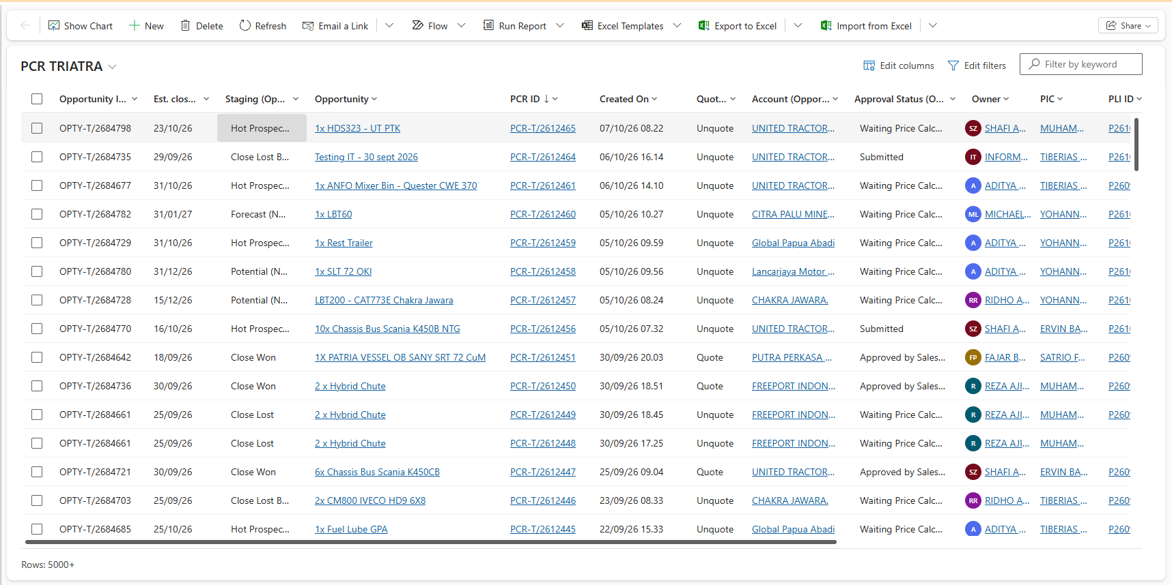
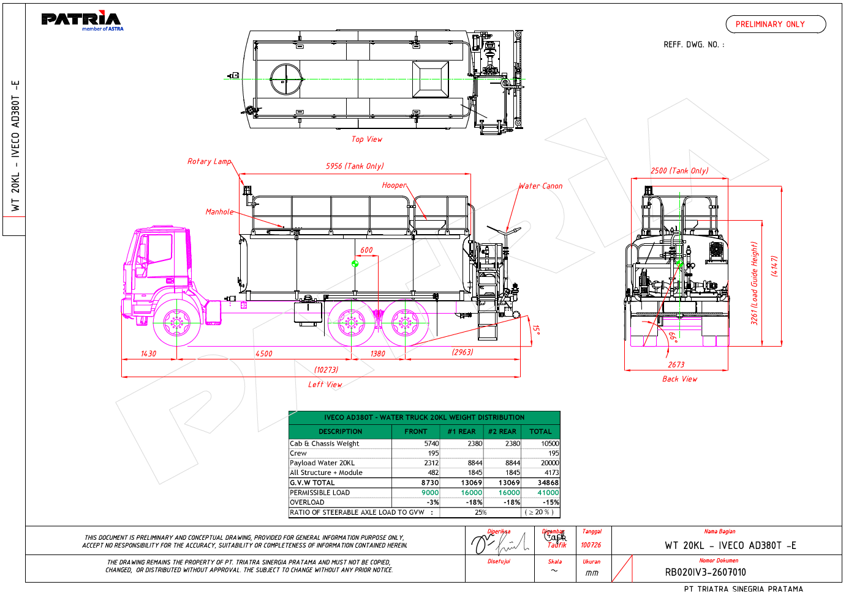
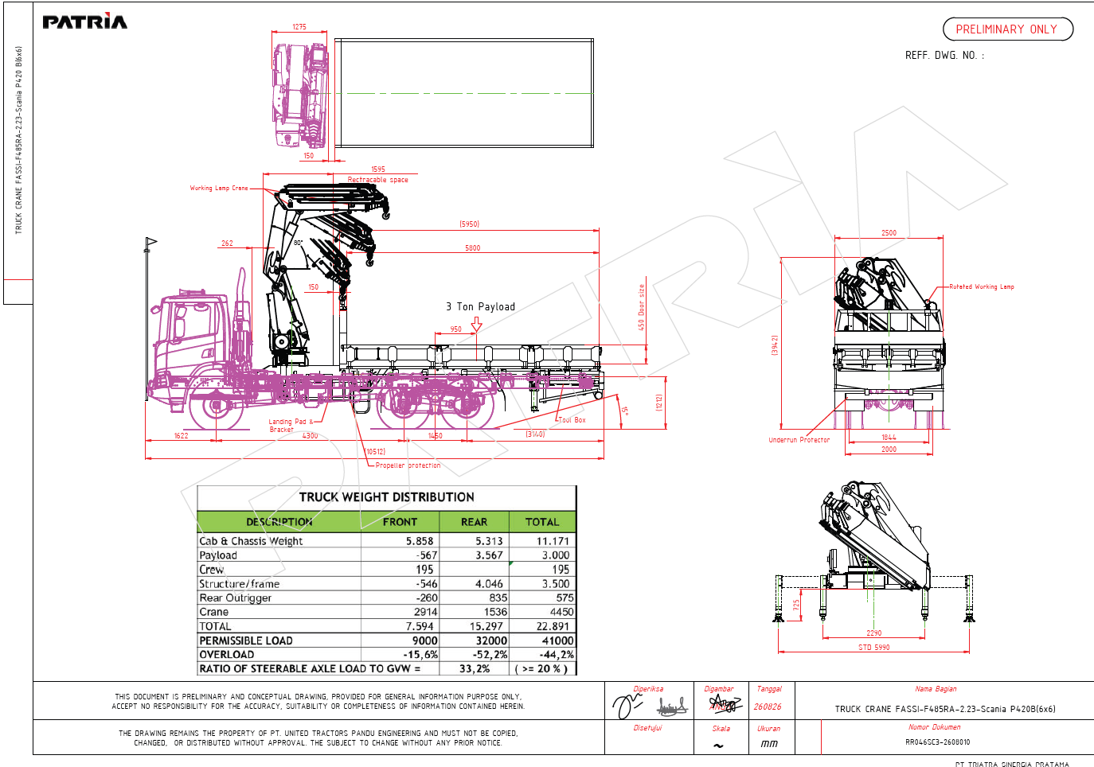
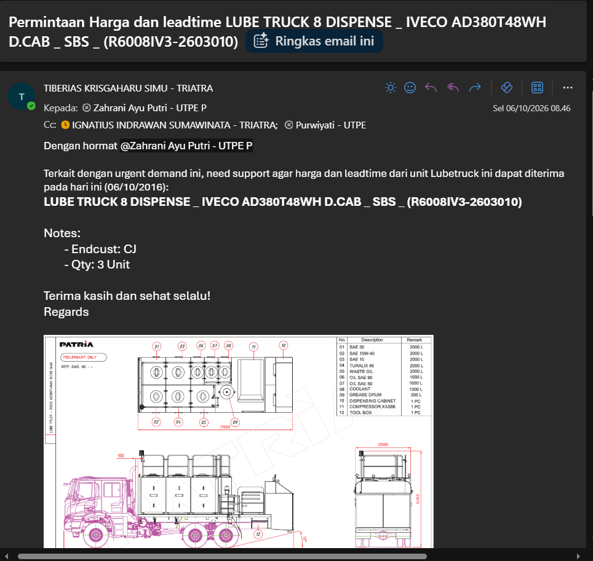
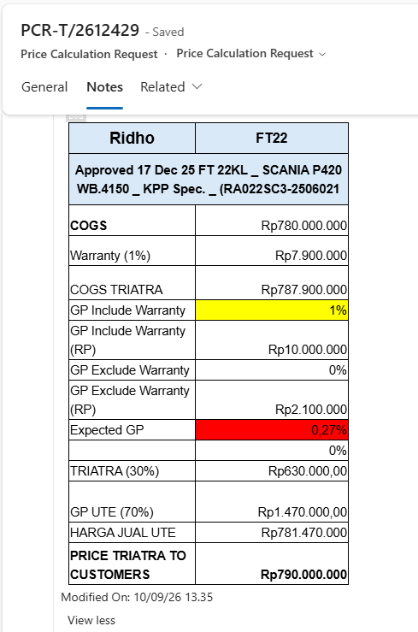
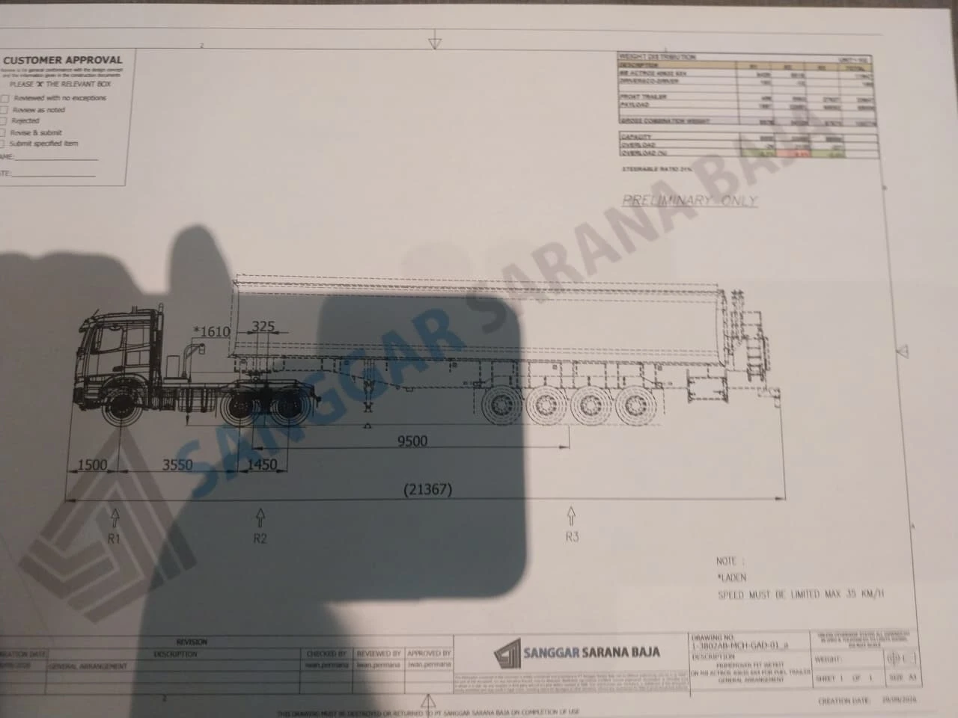
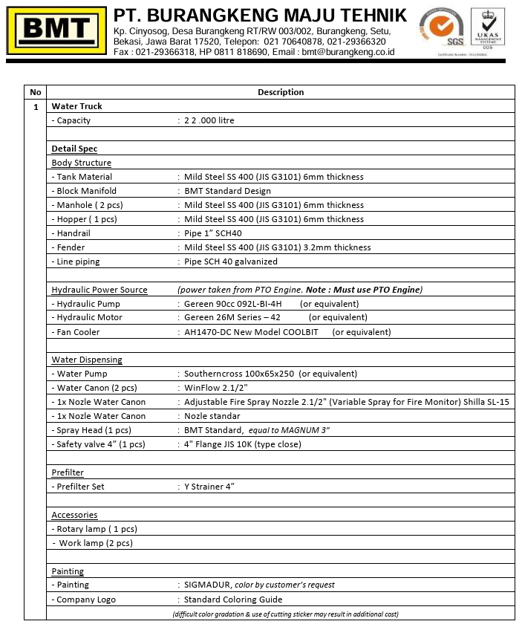
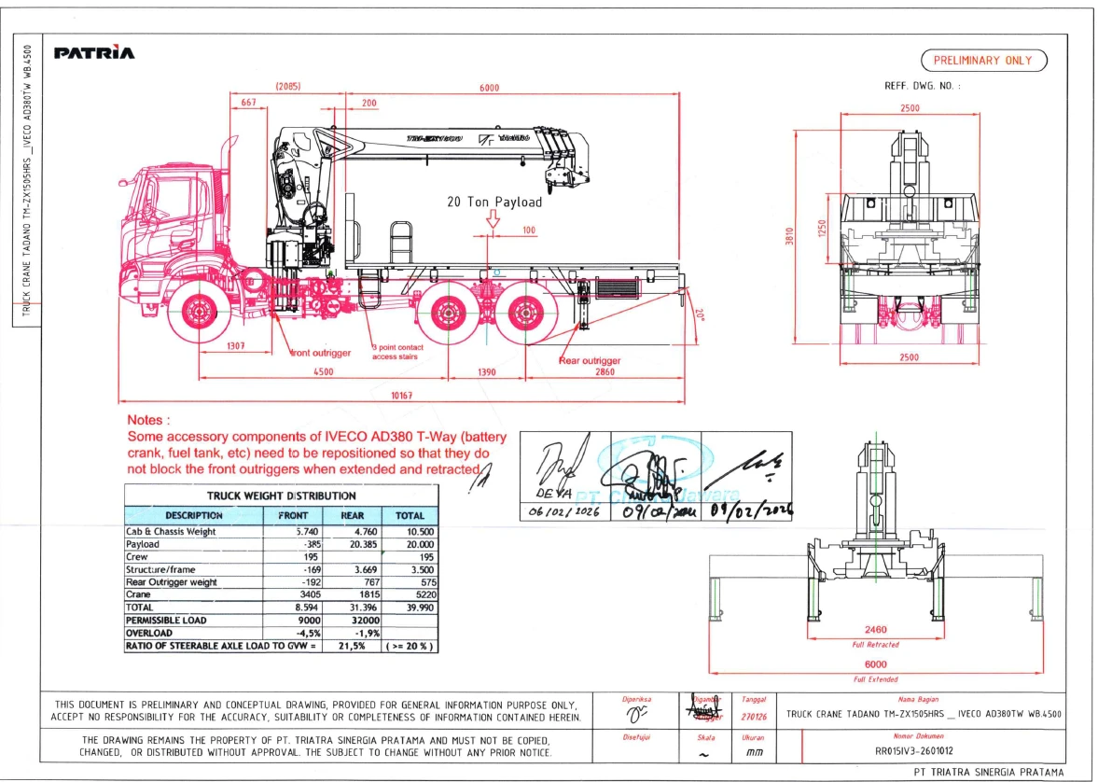
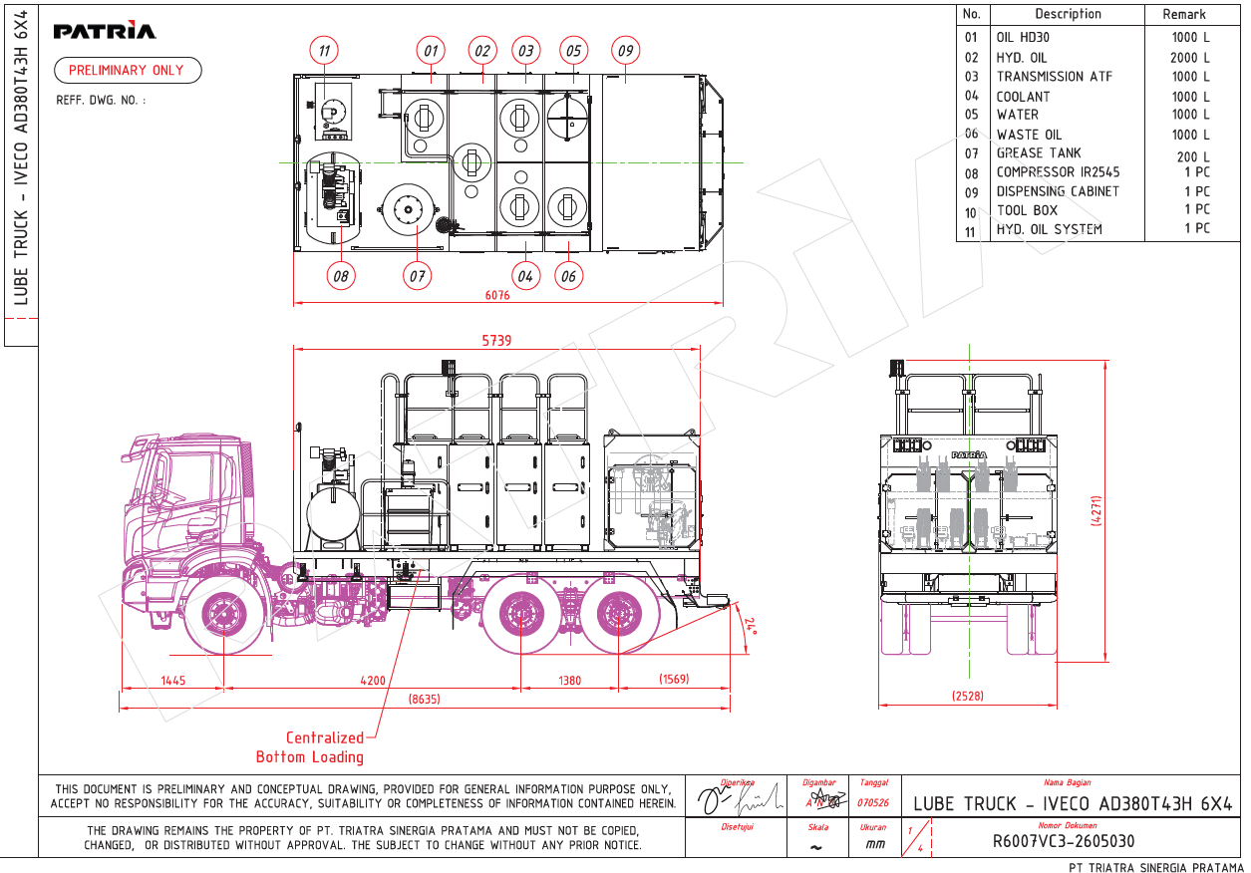
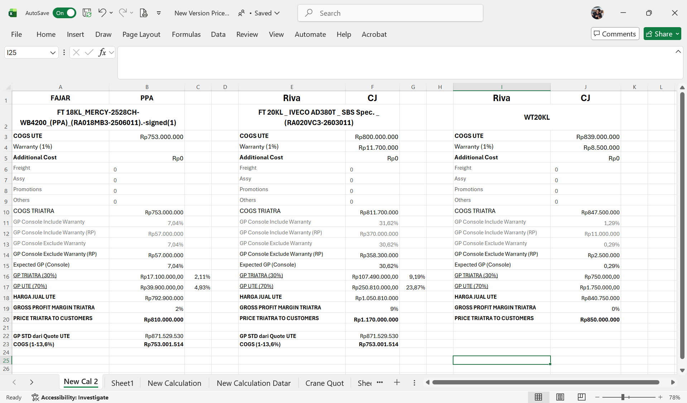
Quote
What do I do before the PO comes in?
Pre Sales/
Before the PO, I check the demand, review the drawing and get the price from UTE
Three steps that turn a customer need into a quote the Business Consultant can send.
1. Demand Check
2. Preliminary Drawing Review
3. Request Quote to UTE
• Spot which demands are rising in PCR
• Why the customer buys: expansion, new business or replacement (with the Business Consultant)
• Project location, and whether the customer wants it fast or cheap
• Expected price and when the PO may come
• What the unit does and how it works
• Main parts that drive the price or the lead time
• Details checked with Application Engineering
• Drawing, target price, lead time, end customer and delivery date sent to UTE
• Standard GP check (13.6%) before any negotiation
• SLA tracked; escalated when it runs late
• Quote result entered into PCR
Photos: my own work files (PCR in CRM, unit drawings, quote request to UTE, price calculation).

