Slide 1


F.lli Ferrari
Market Strategy
Indonesia truck-mounted knuckle boom crane import market
Jan 2023 – Aug 2026
PT Triatra Sinergia Pratama · September 2026

Slide 2
1 · WHICH CLASS SHOULD WE ENTER?
Medium and Heavy: 38% of units but 62% of import value — our target classes
Units Imported per Year by Class, 2023 – 2026 (2026 annualised)
Average Units Sold per Year
75
127
Medium + Heavy
target classes · units / year
Light + Small
non-target classes · units / year
*2026 annualised (Jan – 14 Aug × 1.61); average of 4 years.
WHY MEDIUM AND HEAVY
Bigger value per deal
Fewer units per year, but 62% of the money. Average import value per unit is Rp 791.000.000 vs Rp 305.000.000 for Light + Small.
Clear buyer profile
89% of Medium and Heavy cranes need a truck with GVW of 24 t or more, so buyers are heavy truck fleet operators: mining, construction and heavy logistics.
Trend: enter with focus
Medium falls every year (74 → 70 → 60 → 23*). Heavy peaked in 2025 (38 units) but runs at ~3 in 2026. Target existing European-brand buyers rather than expect market growth.
Total Units and Import Value by Class, 2023 – 14 Aug 2026, and Unit Trend
Class | Max Lifting Moment | Units | Import value (IDR, before tax) | Share of value | Units 2025 vs 2023 | Units 2026* vs 2025
Light | ≤ 8 tm | 248 | Rp 53.749.000.000 | 14% | ▼ −51% | ▲ +4%
Small | > 8 – 25 tm | 223 | Rp 89.679.000.000 | 24% | ▲ +10% | ▼ −40%
Medium | > 25 – 45 tm | 218 | Rp 130.041.000.000 | 35% | ▼ −19% | ▼ −62%
Heavy | > 45 tm | 73 | Rp 100.040.000.000 | 27% | ▲ +138% | ▼ −92%
Total |  | 762 | Rp 373.508.000.000 | 100%
Source: Indonesia import records, HS 84269100 + 84264900, Jan 2023 – 14 Aug 2026; truck-mounted knuckle boom cranes only, Zoomlion excluded. Values converted at USD 1 = Rp 17.803 (JISDOR, 23 Sep 2026). *2026 annualised: Jan – 14 Aug units × 1.61.
1

Slide 3
2 · WHO LEADS THE TARGET CLASSES? (2025 ONLY)
2025: Sany Palfinger leads Medium (42% of value), Palfinger leads Heavy (57%)
Scope: 2025 only (one full year). Figures are therefore smaller than the 2023 – 2026 totals on slide 1.
MEDIUM · > 25 – 45 tm
HEAVY · > 45 tm
Medium Class: Units and Import Value by Brand, 2025
Heavy Class: Units and Import Value by Brand, 2025
Bars = units (smallest → largest). Label = units and import value (IDR, before tax).
Bars = units (smallest → largest). Label = units and import value (IDR, before tax).
30 units
Rp 13.226.000.000
60 units
Rp 31.322.000.000
22 units
Rp 29.738.000.000
38 units
Rp 51.806.000.000
14 units
Rp 7.197.000.000
7 units
Rp 11.065.000.000
5 units
Rp 2.714.000.000
5 units
Rp 4.869.000.000
4 units
Rp 4.647.000.000
5 units
Rp 2.340.000.000
1 unit
Rp 1.235.000.000
1 unit
Rp 1.349.000.000
3 units
Rp 3.772.000.000
1 unit
Rp 977.000.000
Hyva
Hiab
Amco Veba
Palfinger
XCMG
Sany Palfinger
Total Medium
Sany Palfinger
Fassi
Hyva
XCMG
Amco Veba
Palfinger
Total Heavy
Medium Class: Top 3 Brands by Import Value, 2025
Heavy Class: Top 3 Brands by Import Value, 2025
# | Brand | Units | Import value (IDR, before tax) | Share of class value
1 | Sany Palfinger | 30 | Rp 13.226.000.000 | 42%
2 | XCMG | 14 | Rp 7.197.000.000 | 23%
3 | Palfinger | 5 | Rp 4.869.000.000 | 16%
# | Brand | Units | Import value (IDR, before tax) | Share of class value
1 | Palfinger | 22 | Rp 29.738.000.000 | 57%
2 | Amco Veba | 7 | Rp 11.065.000.000 | 21%
3 | XCMG | 4 | Rp 4.647.000.000 | 9%
Source: Indonesia import records, HS 84269100 + 84264900, Jan 2023 – 14 Aug 2026; truck-mounted knuckle boom cranes only, Zoomlion excluded. Values converted at USD 1 = Rp 17.803.
2

Slide 4




3 · WHICH MODELS DO THE LEADERS SELL? (2025)
Winner models, plus two Medium runner-ups, are Ferrari's benchmarks
MEDIUM · > 25 – 45 tm
Winner model
Runner-up, added to head-to-head
Other models
Sany Palfinger: Units Sold by Model, Medium, 2025
XCMG: Units Sold by Model, Medium, 2025
Palfinger: Units Sold by Model, Medium, 2025
SPK42502 ties SPK32080 on units; ranked higher on value.
SQZ325.4 ties KSQZ300.3 on units; ranked higher on value.
HEAVY · > 45 tm
Winner model
Other models
Palfinger: Units Sold by Model, Heavy, 2025
Amco Veba: Units Sold by Model, Heavy, 2025
XCMG: Units Sold by Model, Heavy, 2025
One model = 100% of Palfinger's Heavy units.
One model = 100% of Amco Veba's Heavy units.
Tie on units; GSQZ880.6 highlighted (higher value). Both are 86 – 88 tm.
Source: Indonesia import records, HS 84269100 + 84264900, Jan 2023 – 14 Aug 2026; truck-mounted knuckle boom cranes only, Zoomlion excluded. Top 3 brands by 2025 import value per class (slide 2); up to 3 models shown per brand; winner = most units, ties broken by import value.
3

Slide 5






4 · HEAD-TO-HEAD — MEDIUM CLASS
Medium: FBR350 R is priced on par with Palfinger, with better build and faster supply
MEDIUM · > 25 – 45 tm
Medium Class (> 25 – 45 tm): Ferrari FBR350 R vs Competitor Models
SPK36080
SPK42502
GSQZ330.4
SQZ325.4
PK 32080 C
FBR350 R
Winner model, 2025
Runner-up, 2025
Winner model, 2025
Runner-up, 2025
Winner model, 2025
Ferrari offer
Max Lifting Moment | 34.8 tm | 42.5 tm | 33.8 tm | 32.5 tm | 30.4 tm | ~35 tm*
Price per unit, crane only (IDR, incl. tax) | Rp 440.000.000 | Rp 740.000.000 | Rp 700.000.000 | Rp 550.000.000 | Rp 1.090.000.000 | Rp 1.120.000.000
Price position | Low — China mass production | Low — China mass production | Low — China mass production | Low — China mass production | High — Europe-made | On par with Palfinger (+3%)
Quality | China design, heavier, no EN 12999 | China design, heavier, no EN 12999 | China design, heavier, no EN 12999 | China design, heavier, no EN 12999 | EU design, EN 12999, high-strength steel | EU design, EN 12999, high-strength steel + one-piece cast base
Leadtime | Fast — China factory and stock | Fast — China factory and stock | Fast — China factory and stock | Fast — China factory and stock | Europe and China factories | Fast — China factory and stock
Support | Poor — no after-sales support | Poor — no after-sales support | Poor — no after-sales support | Poor — no after-sales support | Good — many service points in Indonesia | Good — parts stock in Malaysia, 24/7 team, fly-in mechanics
FERRARI-ONLY FEATURES — NO COMPETITOR EQUIVALENT
WHY FERRARI
High-strength special steel (900 N/mm²) — no competitor publishes a comparable figure.
One-piece cast base — +50% strength vs welded (Ferrari data); Palfinger uses KTL surface coating instead.
Chinese rivals are cheaper but have no EN 12999 and no after-sales support. Against Palfinger, Ferrari costs about the same yet adds special steel, a one-piece cast base, China stock and 24/7 support — what mining fleets value more than price.
Prices rounded to Rp 10.000.000. Competitors: 2025 average import unit price (Excel) × Rp 17.803/USD (JISDOR 23 Sep 2026) + import duty (0% China – ACFTA; 5% Europe – MFN, assumed), PPN 11%, PPh 22 2.5% — import cost before distributor margin, so their price to customers is higher. Ferrari: selling price to customers, incl. tax. *FBR350 R lifting moment inferred from the model name, pending spec sheet.
4

Slide 6


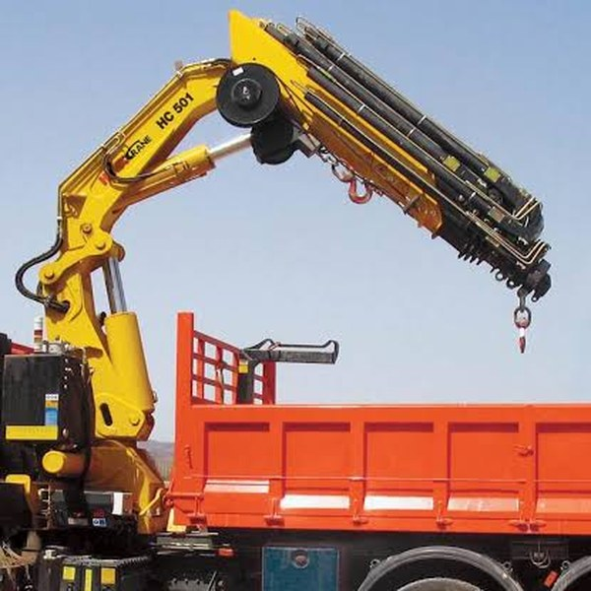

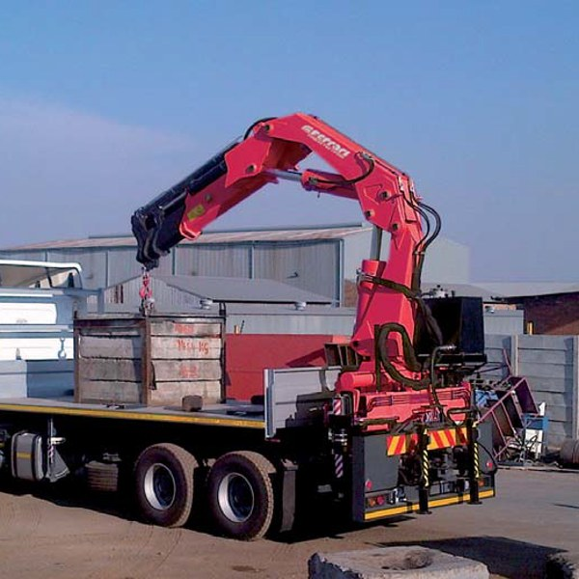

5 · HEAD-TO-HEAD — HEAVY CLASS
Heavy: FBR450 R E4 matches Palfinger's price and undercuts Amco Veba
HEAVY · > 45 tm
Heavy Class (> 45 tm): Ferrari FBR450 R E4 vs Competitor Models
PK 53002 SH B
V950
HC501X
GSQZ460.4
FBR450 R E4
Winner model, 2025
Winner model, 2025
Added: #4 brand, 2025
Added: last import 2023
Ferrari offer
Max Lifting Moment | 50.1 tm | 46 tm | 50 tm | 46 tm | 45.5 tm
Price per unit, crane only (IDR, incl. tax) | Rp 1.610.000.000 | Rp 1.880.000.000 | Rp 1.260.000.000 | Rp 810.000.000 | Rp 1.600.000.000
Price position | High — Austrian brand premium | Highest — made in Italy | Mid — made in Italy | Low — China mass production | On par with Palfinger, below Amco Veba
Quality | EU design, EN 12999, high-strength steel | EU (Italy) design, EN 12999, high-strength steel | EU (Italy) design, EN 12999, high-strength steel | China design, heavier, no EN 12999 | EU design, EN 12999, high-strength steel + one-piece cast base
Leadtime | Europe and China factories | Built in Italy — longer leadtime | Built in Italy — longer leadtime | Fast — China factory and stock | Fast — China factory and stock
Support | Good — many service points in Indonesia | Moderate — Hyva dealer network | Moderate — Hyva dealer network | Poor — no after-sales support | Good — parts stock in Malaysia, 24/7 team, fly-in mechanics
Why these four? Palfinger and Amco Veba each sold only one Heavy model in 2025, so there is no runner-up. We add Hyva HC501X (#4 brand by value, slide 2) and XCMG GSQZ460.4 (46 tm) — XCMG's 2025 winners GSQZ880.6/860.6 are 86 – 88 tm, not a like-for-like rival.
FERRARI-ONLY FEATURES — NO COMPETITOR EQUIVALENT
WHY FERRARI
High-strength special steel (900 N/mm²) — no competitor publishes a comparable figure.
One-piece cast base — +50% strength vs welded (Ferrari data); Palfinger uses KTL surface coating instead.
At Rp 1.600.000.000, Ferrari is on par with Palfinger and below Amco Veba — the brands most Heavy buyers choose — at the same EN 12999 standard. Hyva and XCMG are cheaper but sell few units; against them Ferrari leads with 900 N/mm² steel, a one-piece cast base and faster supply from China stock.
Prices rounded to Rp 10.000.000. Competitors: 2025 average import unit price (Excel) × Rp 17.803/USD (JISDOR 23 Sep 2026) + import duty (0% China – ACFTA; 5% Europe – MFN, assumed), PPN 11%, PPh 22 2.5% — import cost before distributor margin, so their price to customers is higher. Ferrari: selling price to customers, incl. tax. HC501X: 2025 average of 2 units. GSQZ460.4: 2023 average (no import in 2024 – 2025).
5

Slide 7
6 · STOCK RECOMMENDATION
Stock FBR350 R and FBR450 R E4 for buyers who already pay for European quality
MEDIUM · > 25 – 45 tm
HEAVY · > 45 tm
STOCK
STOCK
Ferrari FBR350 R
Ferrari FBR450 R E4
15 of 60
29 of 38
Medium units in 2025 bought from European brands (Palfinger, Amco Veba, Hiab)
Heavy units in 2025 bought from Palfinger and Amco Veba
Target buyer
Palfinger PK 32080 C and other European-brand customers.
Target buyer
Palfinger PK 53002 SH B (22 units) and Amco Veba V950 (7 units) customers.
Why we win
Same price level as Palfinger (Rp 1.120.000.000 vs Rp 1.090.000.000), plus special steel, cast base, China stock and 24/7 support.
Why we win
Palfinger price level, below Amco Veba (Rp 1.600.000.000 vs Rp 1.610.000.000 and Rp 1.880.000.000) with the same EN 12999 standard.
Do not chase
Sany Palfinger and XCMG buyers (44 of 60 units) on price — Ferrari cannot match their cost.
Watch out
45.5 tm is below PK 53002 SH B and HC501X (50 tm), and Hyva is cheaper (Rp 1.260.000.000) — lead with material, supply and support.
Source: Indonesia import records, HS 84269100 + 84264900, Jan 2023 – 14 Aug 2026; truck-mounted knuckle boom cranes only, Zoomlion excluded. Prices as on slides 4 – 5 (IDR, incl. tax).
6

