Slide 1


F.lli Ferrari
Market Strategy
Indonesia truck-mounted knuckle boom crane import market
Jan 2023 – Aug 2026
PT Triatra Sinergia Pratama · September 2026

Slide 2
MARKET SIZE BY CLASS · 2023 – 2026
Medium and Heavy cranes are 42% of units but 65% of import value
Units Imported per Year by Class, 2023 – 2026 (2026 annualised)
Average Units Sold per Year
71
104
Medium + Heavy
target classes · units / year
Light + Small
non-target classes · units / year
*2026 annualised (Jan – 14 Aug × 1.61); average of 4 years.
MEDIUM AND HEAVY CARRY THE VALUE
Bigger value per deal
Fewer units per year, but 65% of the money. Average import value per unit is Rp 788.000.000 vs Rp 315.000.000 for Light + Small.
Built for heavy-duty sectors
89% of Medium and Heavy cranes need a truck with GVW of 24 t or more. They work in mining, construction and heavy logistics.
2026 is a partial year
Jan – 14 Aug 2026 shows only 12 Medium and 1 Heavy units, well below the 2025 pace. The cause is not yet known; import records may still be incomplete.
Total Units and Import Value by Class, 2023 – 14 Aug 2026
Class | Max Lifting Moment | Units | Import value (IDR, before tax) | Share of value
Light | ≤ 8 tm | 177 | Rp 40.118.000.000 | 12%
Small | > 8 – 25 tm | 203 | Rp 79.518.000.000 | 24%
Medium | > 25 – 45 tm | 211 | Rp 126.338.000.000 | 37%
Heavy | > 45 tm | 65 | Rp 91.154.000.000 | 27%
Total |  | 656 | Rp 337.128.000.000 | 100%
Source: Indonesia import records, HS 84269100 + 84264900, Jan 2023 – 14 Aug 2026; truck-mounted knuckle boom cranes only, Zoomlion and Hyva excluded. Values converted at USD 1 = Rp 17.803 (JISDOR, 23 Sep 2026). *2026 annualised: Jan – 14 Aug units × 1.61.
1

Slide 3
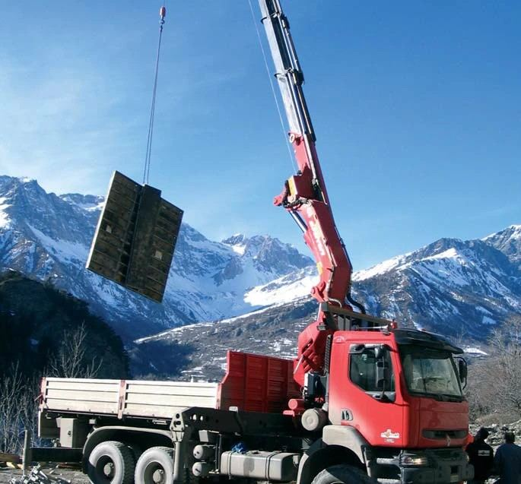
2025 Focus
Who leads the Medium and Heavy classes in 2025, and with which models
2025 is the latest full year in the data.
2

Slide 4
BRAND LEADERS · 2025
In 2025, Sany Palfinger leads Medium with 44% of value and Palfinger leads Heavy with 62%
Scope: 2025 only (one full year), so figures are smaller than the 2023 – 2026 totals. Sany Palfinger is the Sany–Palfinger joint venture; its cranes are made in China.
MEDIUM · > 25 – 45 tm
HEAVY · > 45 tm
Medium Class: Units and Import Value by Brand, 2025
Heavy Class: Units and Import Value by Brand, 2025
Bars = units (smallest → largest). Label = units and import value (IDR, before tax).
Bars = units (smallest → largest). Label = units and import value (IDR, before tax).
30 units
Rp 13.226.000.000
59 units
Rp 30.345.000.000
22 units
Rp 29.738.000.000
35 units
Rp 48.034.000.000
14 units
Rp 7.197.000.000
7 units
Rp 11.065.000.000
5 units
Rp 2.714.000.000
5 units
Rp 4.869.000.000
4 units
Rp 4.647.000.000
5 units
Rp 2.340.000.000
1 unit
Rp 1.235.000.000
1 unit
Rp 1.349.000.000
Hiab
Amco Veba
Palfinger
XCMG
Sany Palfinger
Total Medium
Sany Palfinger
Fassi
XCMG
Amco Veba
Palfinger
Total Heavy
Medium Class: Top 3 Brands by Import Value, 2025
Heavy Class: Top 3 Brands by Import Value, 2025
# | Brand | Units | Import value (IDR, before tax) | Share of class value
1 | Sany Palfinger | 30 | Rp 13.226.000.000 | 44%
2 | XCMG | 14 | Rp 7.197.000.000 | 24%
3 | Palfinger | 5 | Rp 4.869.000.000 | 16%
# | Brand | Units | Import value (IDR, before tax) | Share of class value
1 | Palfinger | 22 | Rp 29.738.000.000 | 62%
2 | Amco Veba | 7 | Rp 11.065.000.000 | 23%
3 | XCMG | 4 | Rp 4.647.000.000 | 10%
Source: Indonesia import records, HS 84269100 + 84264900, Jan 2023 – 14 Aug 2026; truck-mounted knuckle boom cranes only, Zoomlion and Hyva excluded. Values converted at USD 1 = Rp 17.803.
3

Slide 5




MODELS OF THE BRAND LEADERS · 2025
In 2025, each leader sells one main model; PK 53002 alone is 63% of Heavy units
MEDIUM · > 25 – 45 tm
Top model
Other models
Sany Palfinger: Units Sold by Model, Medium, 2025
XCMG: Units Sold by Model, Medium, 2025
Palfinger: Units Sold by Model, Medium, 2025
SPK42502 ties SPK32080 on units; ranked higher on value.
SQZ325.4 ties KSQZ300.3 on units; ranked higher on value.
HEAVY · > 45 tm
Top model
Other models
Palfinger: Units Sold by Model, Heavy, 2025
Amco Veba: Units Sold by Model, Heavy, 2025
XCMG: Units Sold by Model, Heavy, 2025
One model = 100% of Palfinger's Heavy units.
One model = 100% of Amco Veba's Heavy units.
Tie on units; GSQZ880.6 highlighted (higher value). Both are 86 – 88 tm.
Source: Indonesia import records, HS 84269100 + 84264900, Jan 2023 – 14 Aug 2026; truck-mounted knuckle boom cranes only, Zoomlion and Hyva excluded. Top 3 brands by 2025 import value per class (previous slide); up to 3 models shown per brand; top model = most units, ties broken by import value.
4

Slide 6
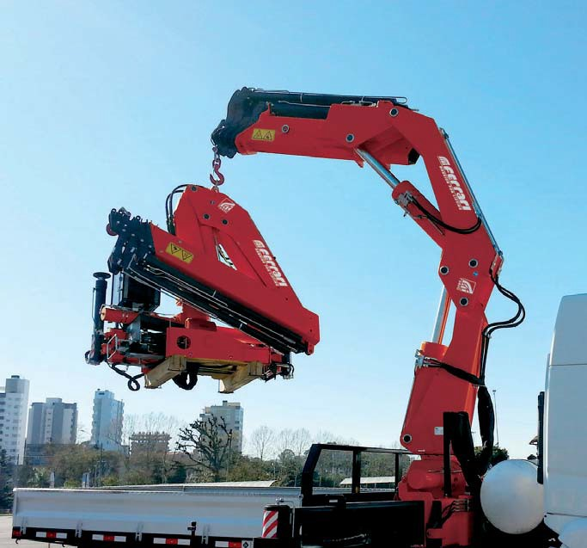
F.lli Ferrari Crane Positioning
Every brand and model in each 5-tm class, next to the F.lli Ferrari crane we would offer
Jan 2023 – 14 Aug 2026 · all prices at import-cost level
5

Slide 7

PRICE COMPARISON BY tm CLASS · JAN 2023 – 14 AUG 2026 · MEDIUM · 1 OF 2
Medium, 25–35 tm: F.lli Ferrari is cheaper head to head on V825 and X-CLX 328, 32 of 122 units
tm class | F.lli Ferrari | 88 units · Rp 41.270.000.000 | 36 units · Rp 19.890.000.000 | 33 units · Rp 16.240.000.000 | 29 units · Rp 30.210.000.000 | 25 units · Rp 18.720.000.000
>25–30 tm 49 units | 268 A4 25.4 tm Rp 500.000.000 |  | V825 25.6 tm −19% 31 units · Rp 16.030.000.000 Rp 620.000.000 per unit | KSQZ300.3 30 tm +2% 15 units · Rp 6.470.000.000 Rp 490.000.000 per unit
 |  |  |  | SQ12ZK3Q 30 tm ±0% 2 units · Rp 880.000.000 Rp 500.000.000 per unit
 |  |  |  | KSQZ300.4 30 tm −12% 1 unit · Rp 500.000.000 Rp 570.000.000 per unit smaller crane
>30–35 tm 73 units | FBR350R A4 32.8 tm Rp 1.090.000.000 | SPK32080 30.4 tm +147% 33 units · Rp 12.860.000.000 Rp 440.000.000 per unit | V933 31.9 tm +31% 4 units · Rp 2.800.000.000 Rp 830.000.000 per unit | GSQZ330.4 33 tm +57% 4 units · Rp 2.450.000.000 Rp 700.000.000 per unit | PK 32080 C 30.4 tm +4% 8 units · Rp 7.050.000.000 Rp 1.050.000.000 per unit | X-CLX 388 34.3 tm +15% 20 units · Rp 15.900.000.000 Rp 950.000.000 per unit
 |  |  |  | SQZ325.4 32.5 tm +99% 3 units · Rp 1.450.000.000 Rp 550.000.000 per unit |  | X-CLX 328 30.3 tm −2% 1 unit · Rp 940.000.000 Rp 1.120.000.000 per unit
F.lli Ferrari is cheaper
F.lli Ferrari costs more
Smaller crane: cheaper, but the F.lli Ferrari model has at least 2 tm less, so it is not a head-to-head match.
Units and import value (before tax): Jan 2023 – 14 Aug 2026; Zoomlion and Hyva excluded. Competitors: average import unit price, Jan 2023 – 14 Aug 2026, × Rp 17.803/USD (JISDOR 23 Sep 2026) + import duty (0% China – ACFTA; 5% Europe, assumed) + PPN 11% + PPh 22 2.5%, before distributor margin. F.lli Ferrari: crane price from the TSP price list Rev1, June 2026 (column K minus column J), less the 13.6% TSP margin and 3% warranty. 990R: TSP price less Rp 168.000.000 cargo deck and install, then the same deductions. 9601CR A8: UTPE quote of 15 Sep 2026, crane only, no deduction; 50.7 tm per its load chart. 7441C is an estimate. Prices rounded to Rp 10.000.000.
6

Slide 8
PRICE COMPARISON BY tm CLASS · JAN 2023 – 14 AUG 2026 · MEDIUM · 2 OF 2
Medium, 35–45 tm: F.lli Ferrari is cheaper head to head on PK 41002, 21 of 89 units
tm class | F.lli Ferrari | 88 units · Rp 41.270.000.000 | 36 units · Rp 19.890.000.000 | 33 units · Rp 16.240.000.000 | 29 units · Rp 30.210.000.000 | 25 units · Rp 18.720.000.000
>35–40 tm 66 units | 7441C 37.7 tm · estimate Rp 1.240.000.000 | SPK36080 36 tm +154% 37 units · Rp 15.940.000.000 Rp 490.000.000 per unit |  | KSQZ400.4 40 tm +76% 2 units · Rp 1.250.000.000 Rp 710.000.000 per unit | PK 41002 38.4 tm −5% 21 units · Rp 23.170.000.000 Rp 1.310.000.000 per unit
 |  |  |  | GSQZ400.4 40 tm +76% 2 units · Rp 1.240.000.000 Rp 700.000.000 per unit
 |  |  |  | SQZ365.4 36.5 tm +120% 2 units · Rp 1.000.000.000 Rp 570.000.000 per unit
 |  |  |  | SQZ400 40 tm +109% 1 unit · Rp 520.000.000 Rp 600.000.000 per unit
 |  |  |  | KSQZ365.4 36.5 tm +129% 1 unit · Rp 480.000.000 Rp 540.000.000 per unit
>40–45 tm 23 units | 746 A4 43.4 tm Rp 1.420.000.000 | SPK42502 42.5 tm +81% 18 units · Rp 12.470.000.000 Rp 790.000.000 per unit | V946B 44.2 tm +12% 1 unit · Rp 1.070.000.000 Rp 1.270.000.000 per unit |  |  | 477 EP-5 42 tm +152% 4 units · Rp 1.890.000.000 Rp 560.000.000 per unit
F.lli Ferrari is cheaper
F.lli Ferrari costs more
Smaller crane: cheaper, but the F.lli Ferrari model has at least 2 tm less, so it is not a head-to-head match.
Units and import value (before tax): Jan 2023 – 14 Aug 2026; Zoomlion and Hyva excluded. Competitors: average import unit price, Jan 2023 – 14 Aug 2026, × Rp 17.803/USD (JISDOR 23 Sep 2026) + import duty (0% China – ACFTA; 5% Europe, assumed) + PPN 11% + PPh 22 2.5%, before distributor margin. F.lli Ferrari: crane price from the TSP price list Rev1, June 2026 (column K minus column J), less the 13.6% TSP margin and 3% warranty. 990R: TSP price less Rp 168.000.000 cargo deck and install, then the same deductions. 9601CR A8: UTPE quote of 15 Sep 2026, crane only, no deduction; 50.7 tm per its load chart. 7441C is an estimate. Prices rounded to Rp 10.000.000.
7

Slide 9

PRICE COMPARISON BY tm CLASS · JAN 2023 – 14 AUG 2026 · HEAVY
Heavy, 45–90 tm: F.lli Ferrari is cheaper head to head on V950, X-HIPRO B58 and F485RA.2.23, 14 of 65 units
tm class | F.lli Ferrari | 42 units · Rp 58.780.000.000 | 12 units · Rp 18.900.000.000 | 7 units · Rp 6.790.000.000 | 2 units · Rp 4.090.000.000 | 1 unit · Rp 1.350.000.000 | 1 unit · Rp 1.240.000.000
>45–50 tm 17 units | FBR450R A4 45.5 tm Rp 1.350.000.000 |  | V950 45.9 tm −28% 12 units · Rp 18.900.000.000 Rp 1.880.000.000 per unit | GSQZ460.4 46 tm +66% 3 units · Rp 2.150.000.000 Rp 810.000.000 per unit | EFFER 525H 50 tm −10% 1 unit · Rp 1.270.000.000 Rp 1.510.000.000 per unit smaller crane | F485RA.2.23 47 tm −16% 1 unit · Rp 1.350.000.000 Rp 1.610.000.000 per unit
>50–55 tm 40 units | 9601CR A8 50.7 tm Rp 3.260.000.000 | PK 53002 50.1 tm +101% 39 units · Rp 53.080.000.000 Rp 1.620.000.000 per unit |  |  | X-HIPRO B58 50.93 tm −3% 1 unit · Rp 2.820.000.000 Rp 3.370.000.000 per unit
>55–60 tm 0 units | FBR660R A4 58.8 tm Rp 2.030.000.000 | No imports of this size in 2023 – 2026
>60–65 tm 1 unit | 9661C 63.2 tm Price not yet known |  |  |  |  |  | SPK61502 61.5 tm no price 1 unit · Rp 1.240.000.000 Rp 1.400.000.000 per unit
>70–75 tm 2 units | 990R 74 tm Rp 4.110.000.000 | PK 76002 EH D 71.6 tm +80% 2 units · Rp 3.840.000.000 Rp 2.290.000.000 per unit
>80–85 tm 1 unit | No F.lli Ferrari model largest is 990R, 74 tm | PK 88002 EH C 81.6 tm +85% 1 unit · Rp 1.860.000.000 Rp 2.220.000.000 per unit
>85–90 tm 4 units | No F.lli Ferrari model largest is 990R, 74 tm |  |  | GSQZ880.6 88 tm +211% 2 units · Rp 2.320.000.000 Rp 1.320.000.000 per unit
 |  |  |  | GSQZ860.6 86 tm +212% 2 units · Rp 2.320.000.000 Rp 1.320.000.000 per unit
F.lli Ferrari is cheaper
F.lli Ferrari costs more
Smaller crane: cheaper, but the F.lli Ferrari model has at least 2 tm less, so it is not a head-to-head match.
Units and import value (before tax): Jan 2023 – 14 Aug 2026; Zoomlion and Hyva excluded. Competitors: average import unit price, Jan 2023 – 14 Aug 2026, × Rp 17.803/USD (JISDOR 23 Sep 2026) + import duty (0% China – ACFTA; 5% Europe, assumed) + PPN 11% + PPh 22 2.5%, before distributor margin. F.lli Ferrari: crane price from the TSP price list Rev1, June 2026 (column K minus column J), less the 13.6% TSP margin and 3% warranty. 990R: TSP price less Rp 168.000.000 cargo deck and install, then the same deductions. 9601CR A8: UTPE quote of 15 Sep 2026, crane only, no deduction; 50.7 tm per its load chart. 7441C is an estimate. Prices rounded to Rp 10.000.000.
8

Slide 10
F.LLI FERRARI CRANE ADVANTAGE BY tm CLASS · JAN 2023 – 14 AUG 2026
Head to head, F.lli Ferrari is cheaper on 67 of 276 units, all against European brands
Class | tm class | Units | F.lli Ferrari model | F.lli Ferrari price | Units won head to head | Cheaper than | Standard features | Leadtime
Medium | >25–30 tm | 49 | 268 A4 | Rp 500.000.000 | 31 of 49 | V825 −19%, KSQZ300.4 −12% (smaller crane) | Piston pump | 14 wk · China
Medium | >30–35 tm | 73 | FBR350R A4 | Rp 1.090.000.000 | 1 of 73 | X-CLX 328 −2% | Piston pump, oil cooler, rear stabilisers | 27 wk · Brazil
Medium | >35–40 tm | 66 | 7441C | Rp 1.240.000.000 (est.) | 21 of 66 | PK 41002 −5% | Specification as 7000 New Age series | –
Medium | >40–45 tm | 23 | 746 A4 | Rp 1.420.000.000 | 0 of 23 | None | Piston pump, oil cooler, rear stabilisers | 25 wk · Italy
Heavy | >45–50 tm | 17 | FBR450R A4 | Rp 1.350.000.000 | 13 of 17 | V950 −28%, EFFER 525H −10% (smaller crane), F485RA.2.23 −16% | Remote control, piston pump, oil cooler, rear stabilisers | 27 wk · Brazil
Heavy | >50–55 tm | 40 | 9601CR A8 | Rp 3.260.000.000 | 1 of 40 | X-HIPRO B58 −3% | Remote control, piston pump, oil cooler, endless slewing | 18 wk
Heavy | >60–65 tm | 1 | 9661C | Not yet known | 0 of 1 | No price yet | Specification as 7000 New Age series | –
Heavy | >70–75 tm | 2 | 990R | Rp 4.110.000.000 | 0 of 2 | None | Remote control, piston pump, endless slewing | –
Heavy | >80–85 tm | 1 | No model (largest 990R) | – | 0 of 1 | None | – | –
Heavy | >85–90 tm | 4 | No model (largest 990R) | – | 0 of 4 | None | – | –
F.LLI FERRARI CRANE ADVANTAGE IN EVERY tm CLASS
Designed to EN 12999
The European standard for loader cranes, the same one Palfinger, Hiab and Amco Veba follow.
900 N/mm² special steel
High-strength steel: a lighter crane that leaves more payload on the truck.
One-piece cast base
About 50% stronger than a welded base (F.lli Ferrari data).
Rich standard kit
Piston pump and oil cooler on FBR, 700 and 9000 models; remote control on FBR450R, FBR660R, 749R, 9601CR and 990R.
Head to head = the F.lli Ferrari model is about the same size or bigger. Smaller crane = cheaper, but not counted. Competitors: average import unit price, Jan 2023 – 14 Aug 2026, × Rp 17.803/USD (JISDOR 23 Sep 2026) + import duty (0% China – ACFTA; 5% Europe, assumed) + PPN 11% + PPh 22 2.5%, before distributor margin. F.lli Ferrari: crane price from the TSP price list Rev1, June 2026 (column K minus column J), less the 13.6% TSP margin and 3% warranty. 990R: TSP price less Rp 168.000.000 cargo deck and install, then the same deductions. 9601CR A8: UTPE quote of 15 Sep 2026, crane only, no deduction; 50.7 tm per its load chart. 7441C is an estimate. Prices rounded to Rp 10.000.000.
9

Slide 11
WHAT TSP SHOULD DO
Sell FBR450R A4 and 268 A4 against European cranes, lead with quality against Chinese brands, and rework the 9601CR A8 price
1
Win on price against European cranes
2
Sell quality against Chinese brands
3
Heavy above 50 tm
268 A4 vs Amco Veba V825: −19%, 31 units
7441C (est.) vs Palfinger PK 41002: −5%, 21 units
FBR450R A4 vs Amco Veba V950: −28%, 12 units
FBR350R A4 vs Hiab X-CLX 328: −2%, 1 unit
9601CR A8 vs Hiab X-HIPRO B58: −3%, 1 unit
FBR450R A4 vs Fassi F485RA.2.23: −16%, 1 unit
Sany Palfinger and XCMG sell for less on 15 of 16 models (F.lli Ferrari −12% to +212%).
They hold 129 of 276 Medium and Heavy units (47%).
Lead with EN 12999, special steel, the cast base and the standard kit.
9601CR A8 (50.7 tm) matches PK 53002 on size, but costs +101%. PK 53002 sold 39 units, the most of any Heavy model.
990R (74 tm) costs +80% against PK 76002 EH D. Above 75 tm F.lli Ferrari has no model.
9661C (63.2 tm) has no price yet.
Before launch, confirm: the 7441C and 9661C prices, the 5% import duty on European cranes, and TSP's own freight and clearance cost per unit.
Units = Jan 2023 – 14 Aug 2026 imports, Medium + Heavy, all models. Competitors: average import unit price, Jan 2023 – 14 Aug 2026, × Rp 17.803/USD (JISDOR 23 Sep 2026) + import duty (0% China – ACFTA; 5% Europe, assumed) + PPN 11% + PPh 22 2.5%, before distributor margin. F.lli Ferrari: crane price from the TSP price list Rev1, June 2026 (column K minus column J), less the 13.6% TSP margin and 3% warranty. 990R: TSP price less Rp 168.000.000 cargo deck and install, then the same deductions. 9601CR A8: UTPE quote of 15 Sep 2026, crane only, no deduction; 50.7 tm per its load chart. 7441C is an estimate. Prices rounded to Rp 10.000.000.
10

Slide 12
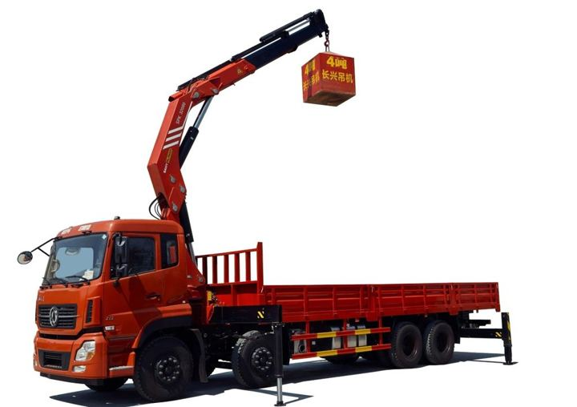


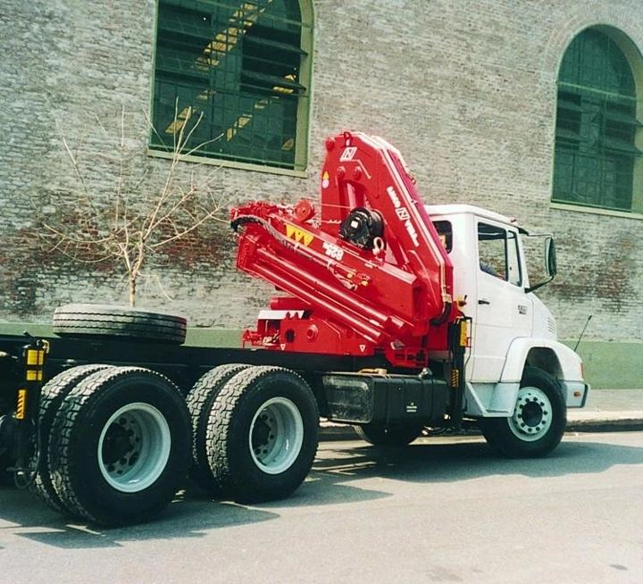
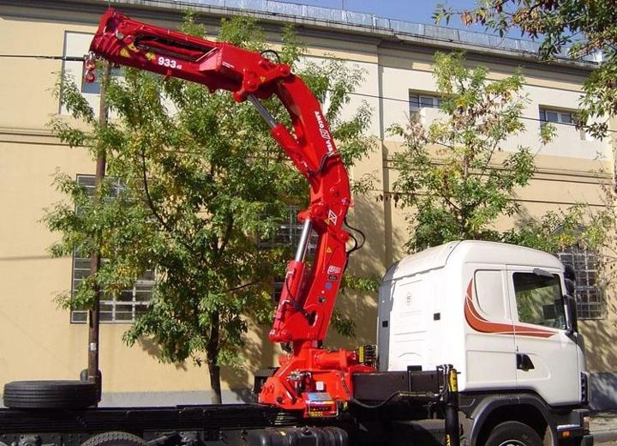
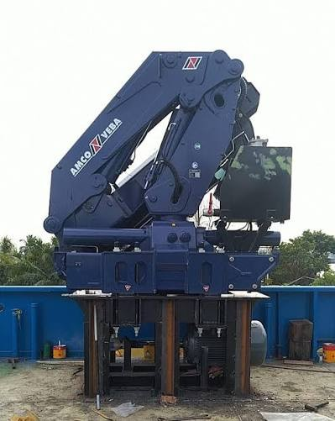
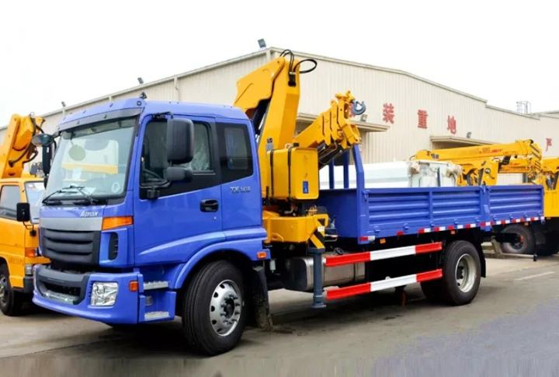
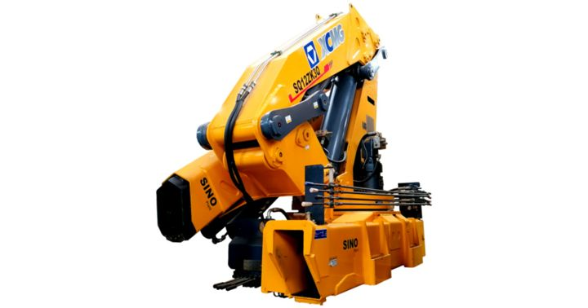
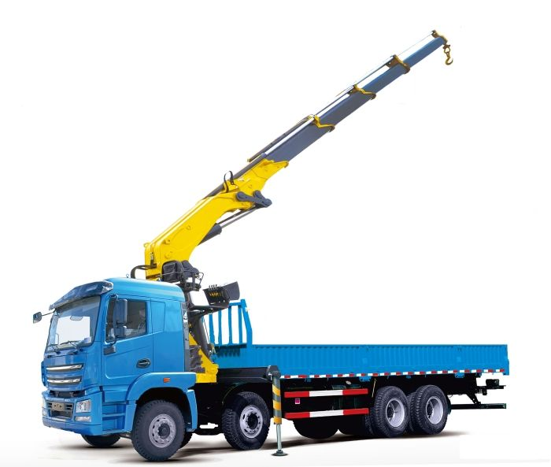


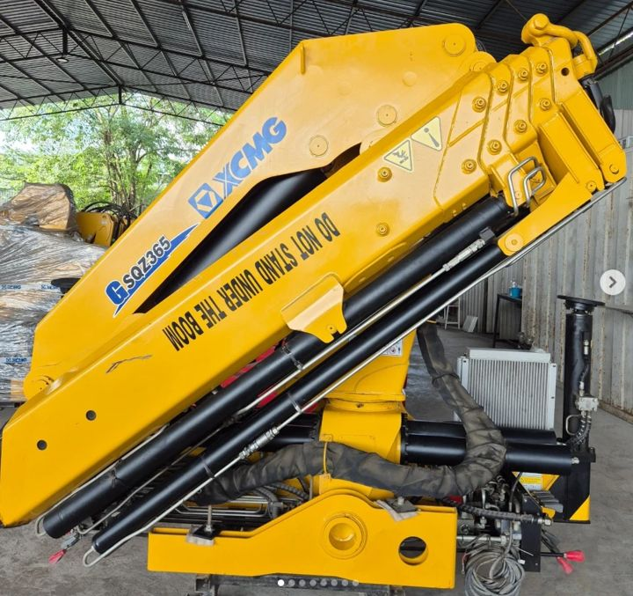
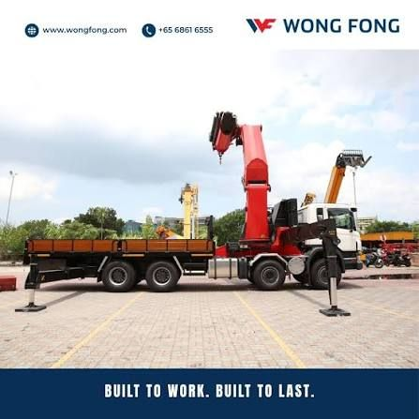
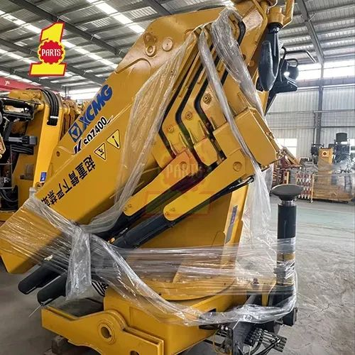
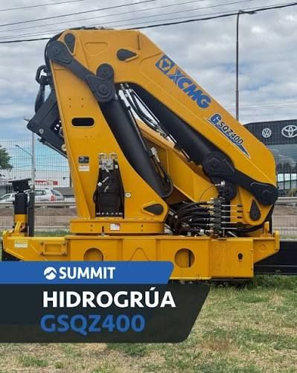
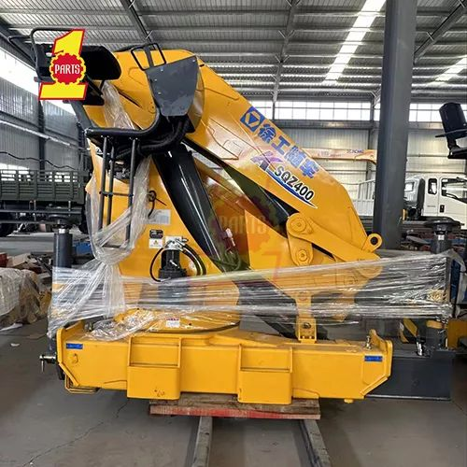

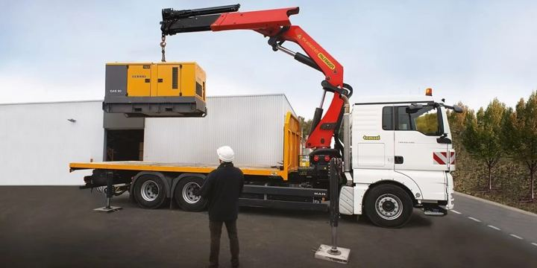
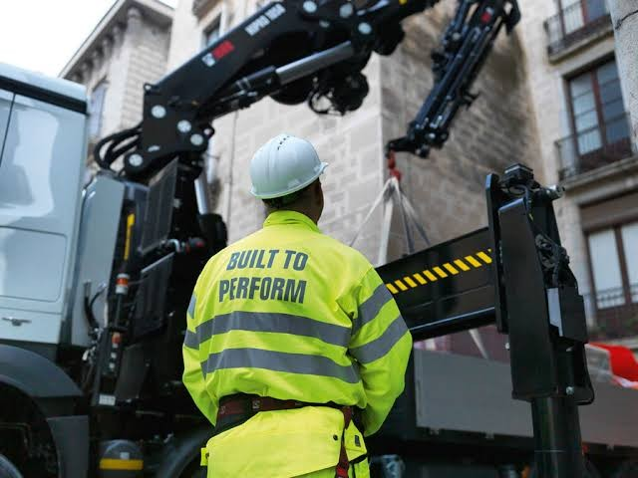
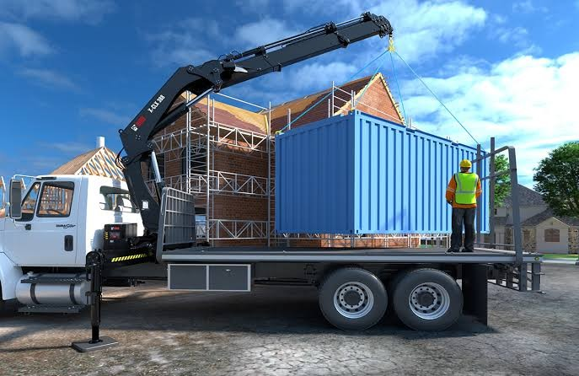
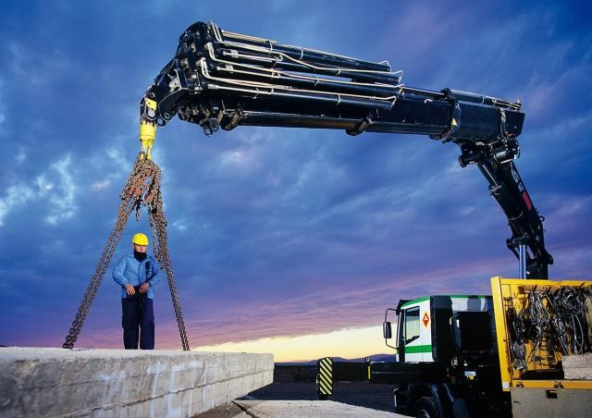
APPENDIX · MODEL PHOTOS · MEDIUM
Medium: the competitor models in the price comparison
Sany Palfinger SPK32080
30.4 tm · 33 units
Sany Palfinger SPK36080
36 tm · 37 units
Sany Palfinger SPK42502
42.5 tm · 18 units
Amco Veba V825
25.6 tm · 31 units
Amco Veba V933
31.9 tm · 4 units
Amco Veba V946B
44.2 tm · 1 unit
XCMG KSQZ300.3
30 tm · 15 units
XCMG SQ12ZK3Q
30 tm · 2 units
XCMG KSQZ300.4
30 tm · 1 unit
XCMG SQZ325.4
32.5 tm · 3 units
XCMG GSQZ330.4
33 tm · 4 units
XCMG SQZ365.4
36.5 tm · 2 units
XCMG KSQZ365.4
36.5 tm · 1 unit
XCMG KSQZ400.4
40 tm · 2 units
XCMG GSQZ400.4
40 tm · 2 units
XCMG SQZ400
40 tm · 1 unit
Palfinger PK 32080 C
30.4 tm · 8 units
Palfinger PK 41002
38.4 tm · 21 units
Hiab X-CLX 328
30.3 tm · 1 unit
Hiab X-CLX 388
34.3 tm · 20 units
Hiab 477 EP-5
42 tm · 4 units
F.lli Ferrari photos: TSP and pocket catalogue 2026. Competitor photos: supplied by TSP; for identification only.
11

Slide 13

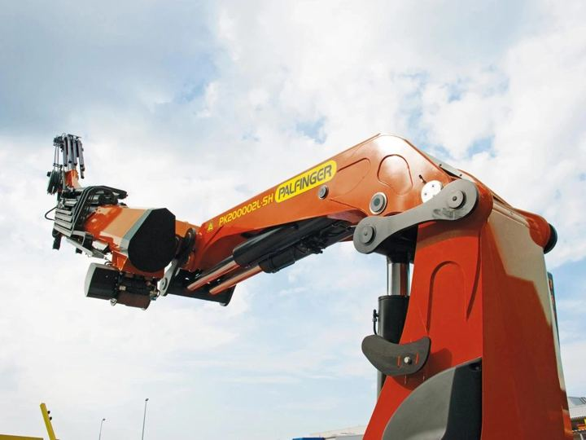
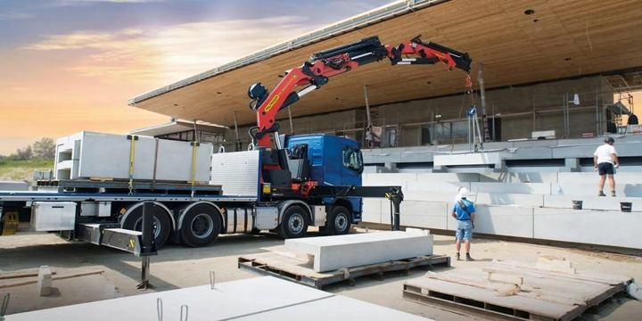


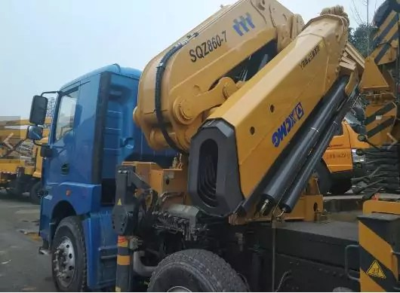
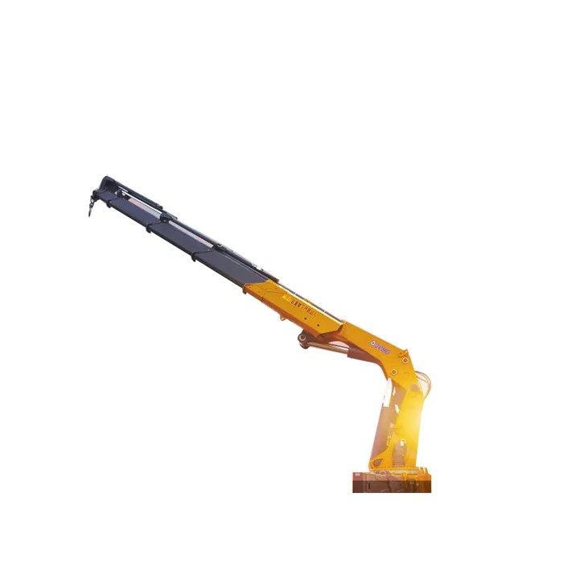
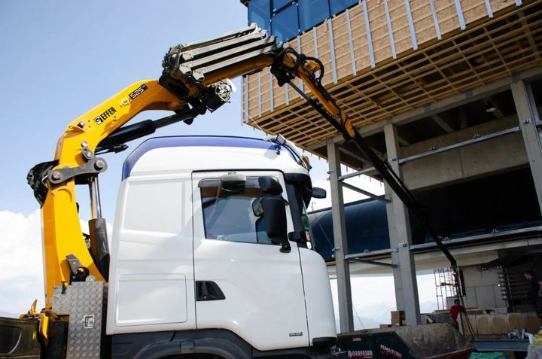
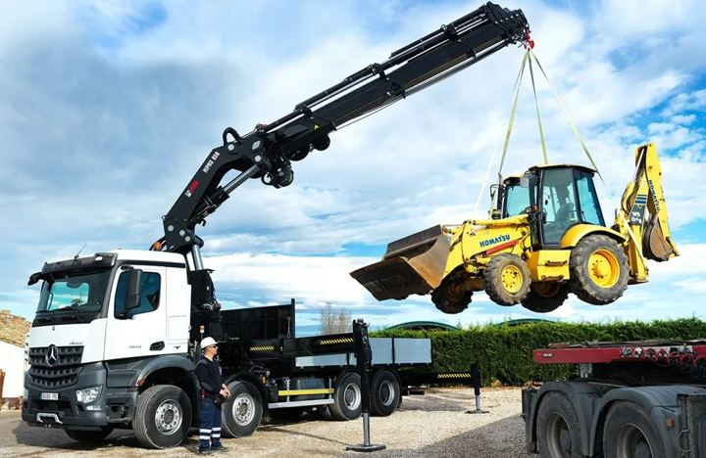
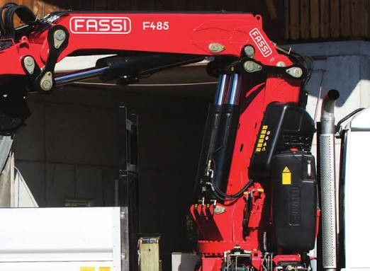
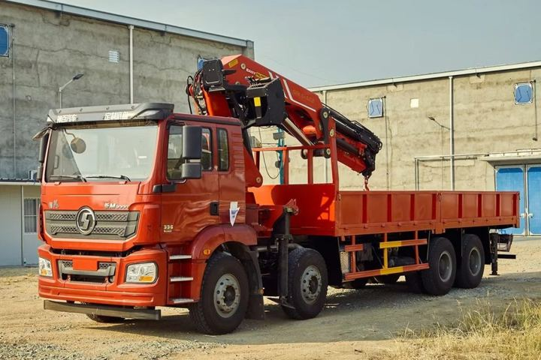
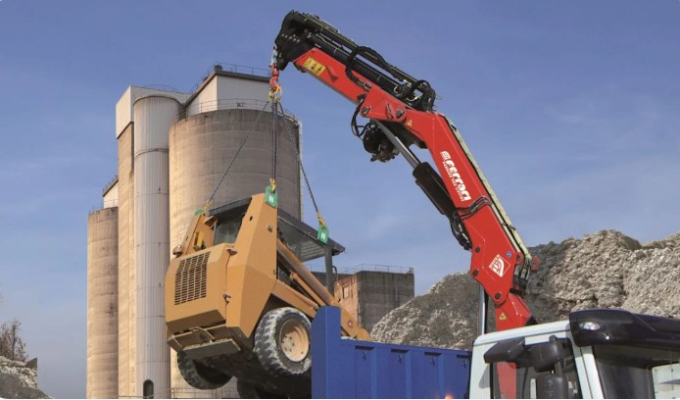

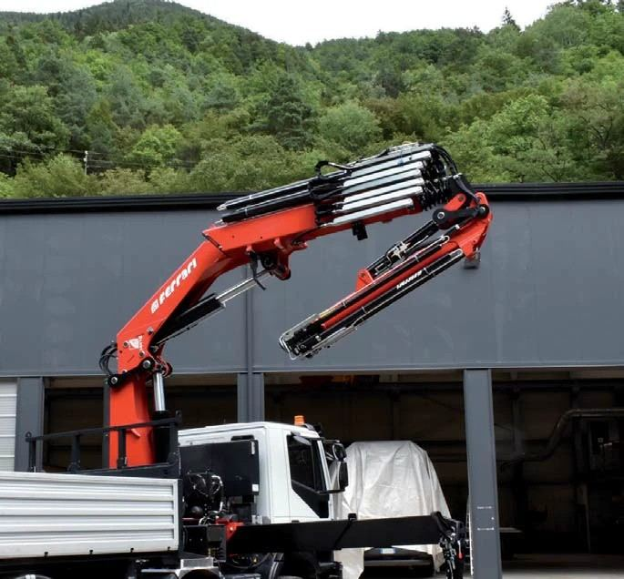
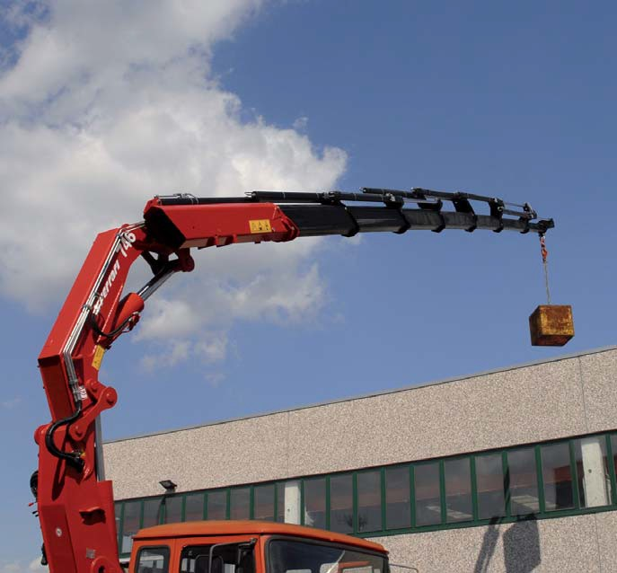
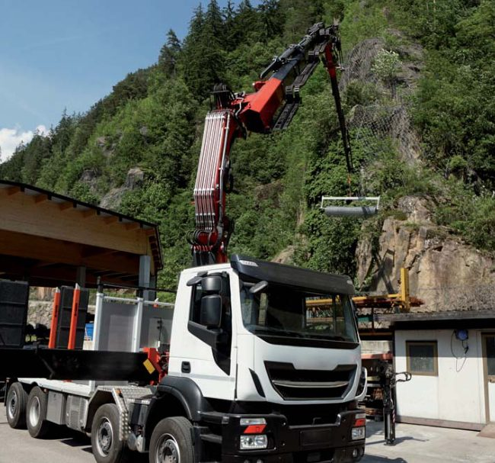
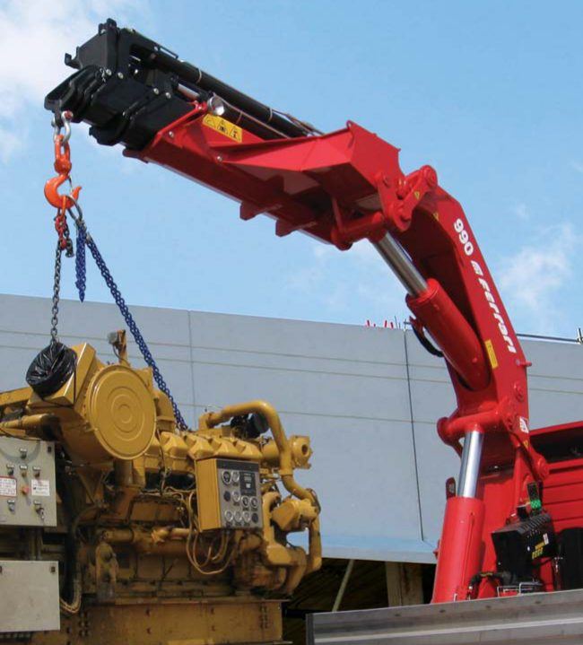
APPENDIX · MODEL PHOTOS · HEAVY AND F.LLI FERRARI
Heavy competitor models and the F.lli Ferrari models in the comparison
Palfinger PK 53002
50.1 tm · 39 units
Palfinger PK 76002 EH D
71.6 tm · 2 units
Palfinger PK 88002 EH C
81.6 tm · 1 unit
Amco Veba V950
45.9 tm · 12 units
XCMG GSQZ460.4
46 tm · 3 units
XCMG GSQZ860.6
86 tm · 2 units
XCMG GSQZ880.6
88 tm · 2 units
Hiab EFFER 525H
50 tm · 1 unit
Hiab X-HIPRO B58
50.93 tm · 1 unit
Fassi F485RA.2.23
47 tm · 1 unit
Sany Palfinger SPK61502
61.5 tm · 1 unit
F.lli Ferrari 268 A4
25.4 tm
F.lli Ferrari FBR350R A4
32.8 tm
F.lli Ferrari 7441C
37.7 tm
F.lli Ferrari 746 A4
43.4 tm
F.lli Ferrari FBR450R A4
45.5 tm
F.lli Ferrari 9601CR A8
50.7 tm
F.lli Ferrari FBR660R A4
58.8 tm
F.lli Ferrari 990R
74 tm
F.lli Ferrari photos: TSP and pocket catalogue 2026. Competitor photos: supplied by TSP; for identification only.
12

