Slide 1
Measuring Openstack Performance SPEC Cloud IaaS 2016 Benchmark Nicholas Wakou Dell Open Source Solutions Openstack summit April 2016

Slide 2


Presenters
Nicholas Wakou is a Principal Performance Engineer with the Dell Open Source Solutions.
Douglas Shakshober (Shak) is a Senior Consulting Engineer and Director of the Performance Engineering team at Red Hat.

Slide 3
Agenda
Introduce SPEC & SPEC Cloud
Benchmark Goals
Benchmark Model
Workload Control
Benchmark Workloads
Benchmark Phases
Benchmark Metrics
FDR High Level Report Summary
Possible Next Steps
3

Slide 4

SPEC
The Standard Performance Evaluation Corporation (SPEC) is a non-profit organization that establishes, maintains and endorses standardized benchmarks to evaluate performance for the newest generation of computing systems. Its membership comprises 130 leading computer hardware and software vendors, educational institutions, research organizations, and government agencies worldwide.
www.spec.org

Slide 5
SPEC Cloud
SPEC Cloud Committee Charter
Define benchmark standard
Identify workloads
Determine Run rules

Slide 6
SPEC Cloud IaaS 2016 Benchmark Goals
Measure performance of Infrastructure-as-a-Service (IaaS) Clouds.
Measure both control and data plane
Control: management operations, e.g., Instance provisioning time
Data: virtualization, network performance, runtime performance
Use workloads that
resemble “real” customer applications
benchmarks the cloud, not the application
Produce metrics (“elasticity”, “scalability”, “provisioning time”) which allow comparison.
6
Notes:
No micro benchmarks or functional verification tests.
Minimum machines part of cloud: 4 (with appropriate specs for these machines)
The default parameters of running a background job to rebalance load may interfere with how an application is scaled.

Slide 7
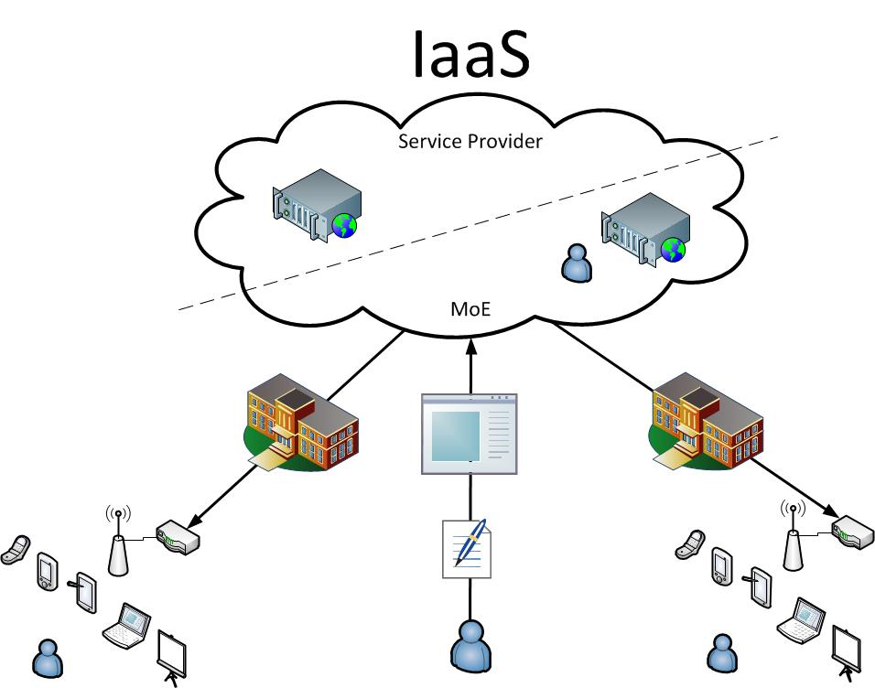
Benchmark Model
Infrastructure as a Service (IaaS)
White Box (Private Cloud)
Black Box (Public Cloud)

Slide 8
Basic Terminology
Instance = Virtual Machine, Bare Metal, Container
White-box Cloud (e.g., Private Cloud)
A Cloud in which all software and hardware details are known and under the control of the experimenter.
Black box Cloud (e.g., Public Cloud)
The exact hardware details may not be known.
Billing details are usually known.
Instance (AI)= Set of Instances (VMs) + Application code => ready to run a single workload.

Slide 9
Benchmark and Workload Control
Baseline driver
CloudBench
Orchestrator
Elasticity + Scalability driver
CBTOOL API
Cloud
API
Report generator
Benchmark Harness
Cloud SUT
Group of boxes represents an application instance. Different color within a group indicates workload generators/ different VM sizes.
Minimum of 4 nodes in the cloud,
Two AIs (1 x YCSB, 1 Kmeans)
with a minimum of one run each.
Benchmark Harness. It comprises of Cloud Bench (CBTOOL) and baseline/elasticity drivers, and report generators. CBTOOL creates application instances in a cloud and collects metrics. It is driven by baseline and scalability driver to execute the baseline and elasticity + scalability phases of the benchmark, respectively.
For white-box clouds the benchmark harness is outside the SUT. For black-box clouds, it can be in the same location or campus.
9

Slide 10
Workloads: YCSB Application Instance
YCSB VM
Cassandra VMs

Slide 11
Workloads: KMeans Application Instance
Hadoop Namenode/ HiBench
Hadoop data node VMs

Slide 12
Life cycle of an application instance
Data gen. time
Completion time
AI prov. time
VM prov. time
AI provision request
VMs created for AI
App ready to receive request
Start test
End test
Application started
Start data gen. phase
Data. gen phase completed
Report data to cbtool
Delete AI
AI run 1
Time line is not according to scale

Slide 13
Benchmark phases - Baseline
Determine the performance of a single Application Instance, establishing QoS criteria for both provisioning and runtime performance.
AI = stream of 5 runs
KMeans baseline AI
YCSB baseline AI

Slide 14
Benchmark phases - Elasticity
Measure performance against baseline (“Elasticity”) and total work done (“Scalability”) when multiple workloads are run concurrently.
YCSB
KMeans
Max AI
Stopping condition
time

Slide 15
Stopping Conditions
20% AIs fail to provision
10% AIs have errors in any run
Max number of AIs set by Cloud Provider
50% AIs have QoS violations
KMeans completion time ≤ 3.33x Baseline phase
YCSB Throughput ≥ Baselinethroughput / 3
YCSB Read Response Time ≤ 20 x BaselineReadResponse Time
YCSB Insert Response Time ≤ 20 x BaselineInsertResponse Time

Slide 16
Benchmark Metrics 1/2
Scalability
Measures the total amount of work performed by a group of AIs running in a Cloud. Scalability is reported as a unit-less number and is the aggregate of workload metrics across all valid AIs normalized by workload metrics from a reference platform obtained during development of the benchmark.
It answers the question: How much more work gets done if N, instead of one (1) AI are deployed?
Elasticity
Measures how close to perfect linearity the scalability of the cloud is by comparing the average performance of all Application Instances against the established baseline.
Elasticity is expressed as a percentage.
An ideal cloud would post 100% for the Elasticity score
16

Slide 17
Benchmark Metrics 2/2
Mean Instance Provisioning Time
Measures the interval between sending the Instance creation request to the cloud and the moment when such Instance responds to netcat probe on port 22.
Application Instance Performance
Measures K-Means/Hadoop (completion time) and YCSB/Cassandra (throughput) performance for each run of the cycle on each AI.
AI Run Success
Measures the percentage of runs across all Application Instances that completed without any error as reported by the Load Generator.
AI Provisioning success
Measures the percentage of Application Instances that where provisioned without any errors.
17

Slide 18
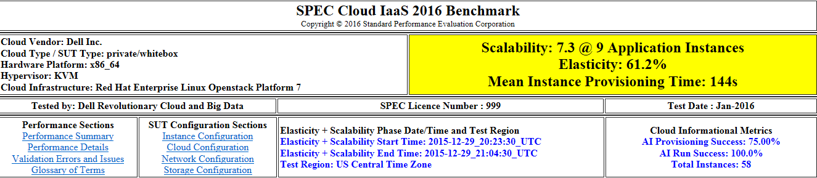
SPEC Cloud IaaS 2016 High Level Report Summary

Slide 19
Possible Next Steps
Incorporate wider industry feedback on SPEC Cloud IaaS 2016 Benchmark.
IaaS clouds (items not considered for the current benchmark)
Cross data center / region / availability zone performance
Explicit measurement of object storage performance
Management operations performance
e.g., live migration times, snapshot times
Metrics on each API
HTTP workloads, measure cross data center network performance (public clouds)
PaaS or SaaS clouds for potential SPEC Cloud PaaS or SPEC Cloud SaaS
19

