Slide 1
Group Members :- Mihir Hajare U23AI092 Meraj Alam U23AI094 Anshul Reddy Kotha U23AI107
Aspect Detection from
Multilingual Reviews

Slide 2
Project Overview
The project aims to detect specific aspects (e.g., battery, camera, performance)
mentioned in mobile product reviews written in multiple languages.
It focuses solely on extracting aspect terms, not classifying sentiment.
The system processes multilingual datasets including Hindi, Marathi, Telugu,
and English.
Natural Language Processing (NLP) techniques such as tokenization,
POS dftagging, and sequence labeling are used.
The outcome enables deeper analysis of user concerns across diverse
linguistic regions for mobile product improvement.

Slide 3
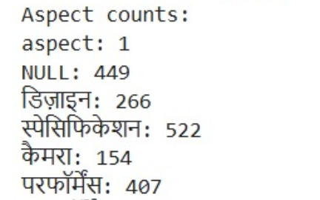
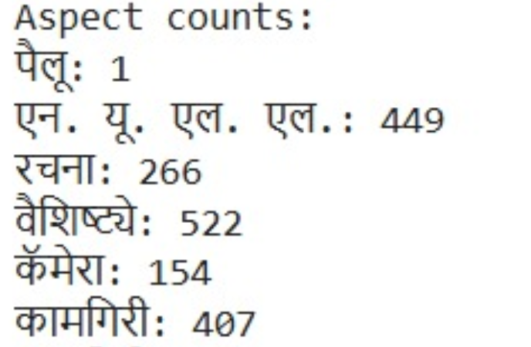
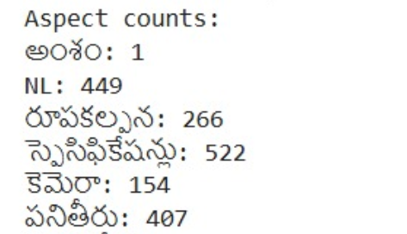
Aspects
Total aspect count - 6

Slide 4





🧠 Main AI & NLP Concepts Used
Multilingual Language Detection: via FastText, trained to identify languages.
Speech-to-Text (ASR): via OpenAI Whisper, limited here to Hindi transcription
Text Vectorization: converting text into numerical features using word and character vectorizers.
Aspect Classification: using a Support Vector Machine (SVM) classifier trained per language.
Web Service Interface: with Flask serving routes for user interaction.

Slide 5
Dataset Creation
Used hugging face model¹ to convert the hindi dataset² into new datasets of Marathi , Telugu.
Telugu and Marathi datasets serve as new data for aspect detection model.
We use Kaggle , (due to GPU limitations) , load the model , training of the model (Indic trans v2 indic - indic)
For model refer https://huggingface.co/ai4bharat/indictrans2-indic-indic-dist-320M
For this refer https://github.com/Pruthwik/Aspect-Based-Sentiment-Analysis

Slide 6
Flowchart
Start
Preprocessing (Audio input) / (Text input)
Language Detection
(FastText Classification)
Load the Model
Aspect – Detection
Save the output
Error Handling
End

Slide 7
Input Preprocessing
Text Input:
The model starts by receiving input in text form (either transcribed audio or direct text upload).
If the input is audio, it is first transcribed into text using the Whisper model.
Text Cleaning:
The text is processed to remove any unnecessary characters, whitespace, and special symbols to prepare it for feature extraction.
The text is split into individual words (or tokens), which are then analyzed separately to capture their meaning.
For audio files:
-- FFmpeg converts audio to WAV format.
-- Whisper transcribes Hindi/Marathi/Telugu speech to text.
For both text and transcribed input:
-- FastText detects the language (Hindi, Marathi, or Telugu)
-- Based on the language, specific SVM classifiers and TF vectorizers
(word and character level) are loaded.
Sentiment prediction is then performed using SciPy for feature combination.

Slide 8
Language Detection
Important points to be noted:
No transliteration is performed. The input (whether audio or text) is expected to be in native scripts (e.g., Devanagari for Hindi).
Whisper transcribes directly into Hindi script, not Romanized Hindi.
The FastText model and SVM classifiers are trained on text in native scripts, so transliteration is not needed or used.
FastText is trained on a variety of language data and can often identify languages even when not in their native script, especially for commonly Romanized languages like Hindi etc.

Slide 9
Feature Extraction & Aspect Prediction
Word-Level TF Extraction:
Each word in the input text is converted into numerical features using Term Frequency (TF), which counts word occurrences and normalizes them by the total number of words.
This helps capture the importance of each word for sentiment analysis.
Character-Level TF Extraction:
In addition to word-level features, the model also extracts character-level features, capturing sub-word structures like prefixes and suffixes.
This helps handle variations in word forms, including misspellings.
Combining Features:
Both word-level and character-level TF features are combined into a single feature
vector using scipy.sparse.hstack(), creating a richer representation of the text.

Slide 10
Aspect Prediction Using SVM Classifier
SVM Classifier:
The combined feature vector is passed into a pre-trained SVM (Support Vector Machine) classifier, which categorizes the text into aspects: camera , body , or perfection etc.
Why SVM?
SVM is ideal for text classification tasks as it works well with high-dimensional data and identifies the optimal separation between aspect classes.
Prediction Process:
For each line or word in the input, the model predicts a aspect class based on patterns learned during training, producing a final aspect output.

Slide 11
Output Generation: Storing Predictions
Generating Predictions:
After aspect prediction, the output is a list of predicted sentiment labels (camera, body , or
battery) for each line or word in the text.
These predictions are stored in a text file (test-predictions.txt).
Storing the predictions in a text file allows for easy access and download.
It also provides a simple way for users to review the results of the sentiment analysis.
Making the File Available:
The generated test-predictions.txt file is made available for download via the Flask API.
The user can download the file and use it for further analysis or review.

Slide 12
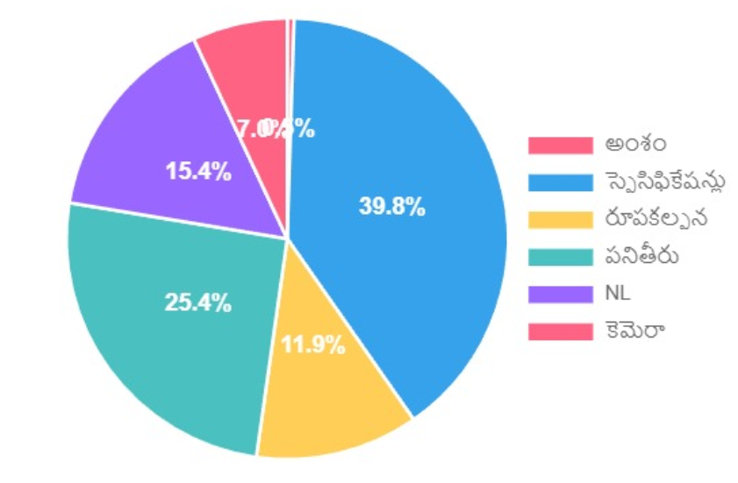
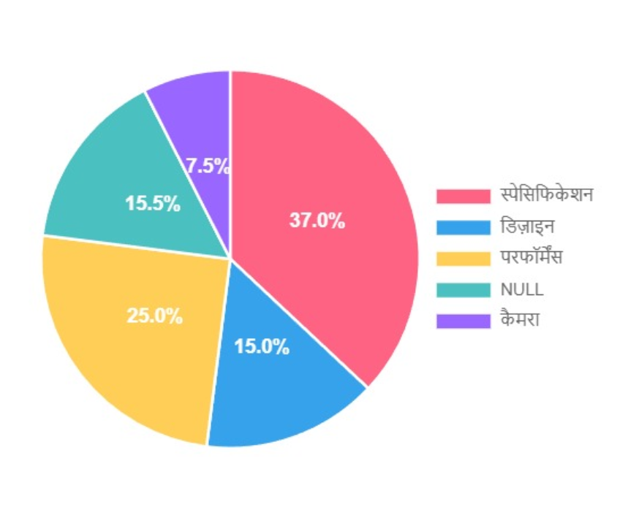
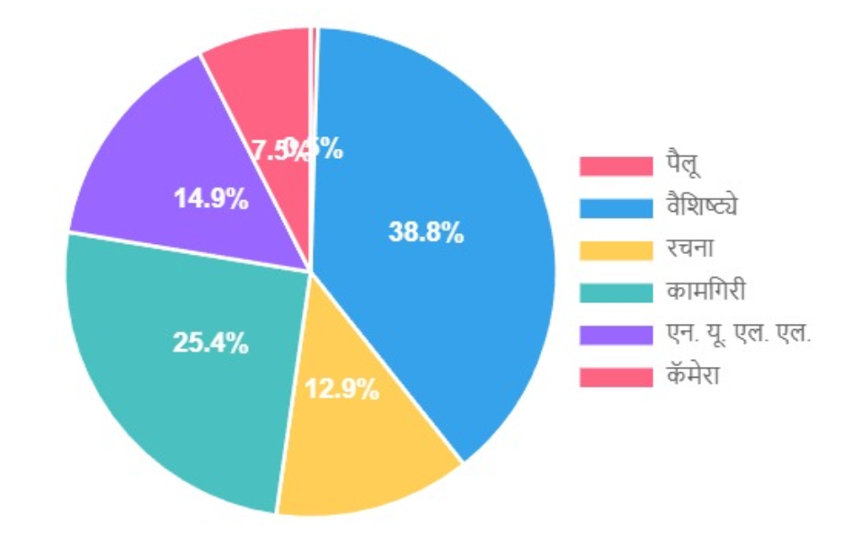
Visual Representation of Testing Data
Telugu Model
Hindi Model
Marathi Model

Slide 13
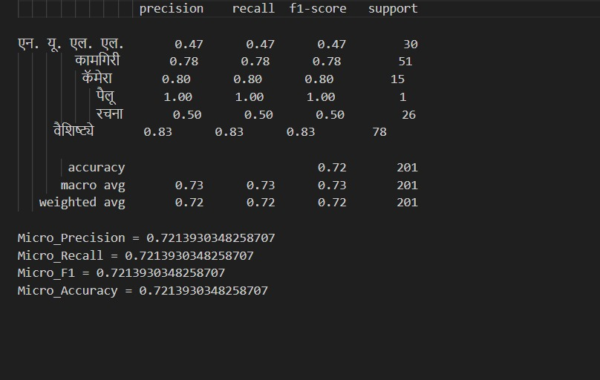
High-Accuracy Performance on Multilingual Aspect Detection
Only for depiction purpose , we have shown for hindi model (training data).

Slide 14
Thank You

