Slide 1

Application of optical instruments
Determination of concentration of sugar solution.

Slide 2
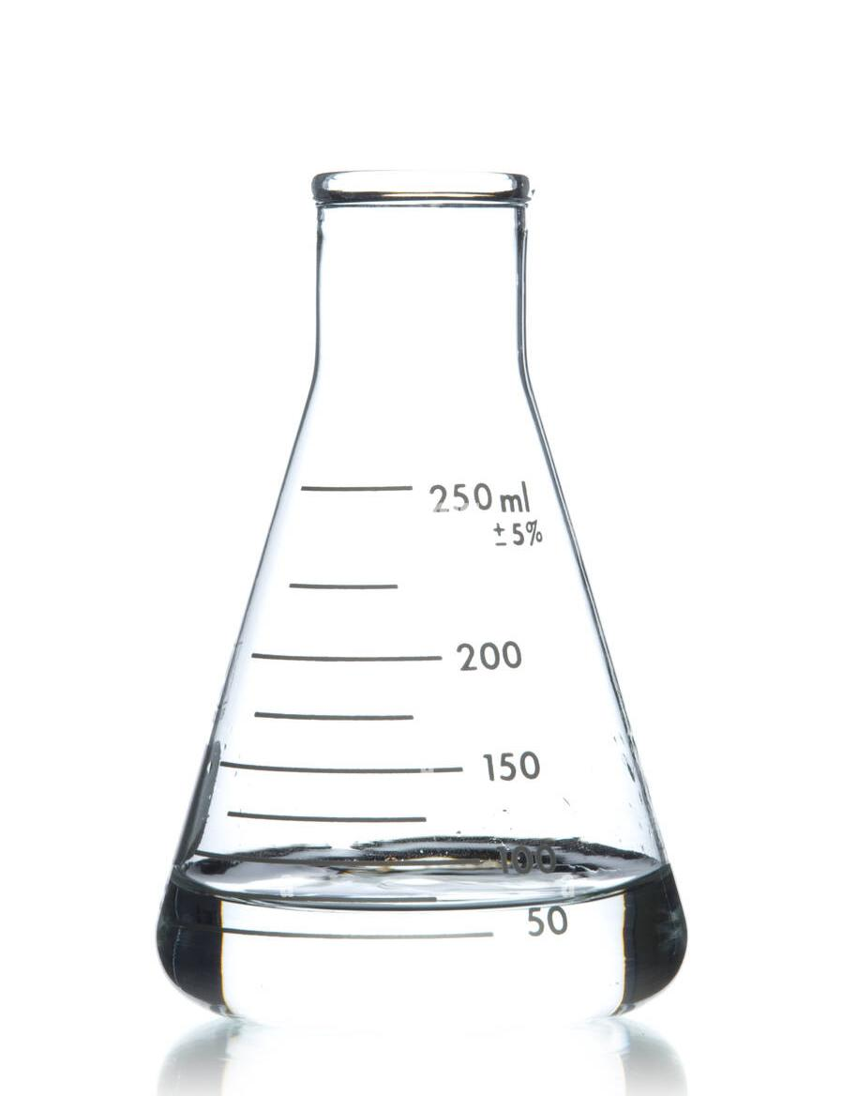
Objective
The objective of the project was to determine the sugar concentration of the given solution by linear optical measurements and to estimate the concentration of sugar in unknown concentrations by the inferences made. This project involves measuring the concentration of sugar dissolved in a liquid by using a laser pointer and a hollow prism. Refraction or the bending of light is the key used to measure the sugar concentration in the liquid with the laser pointer. The relationship between the refractive indices and the sugar concentrations of the samples was found to be linear.

Slide 3
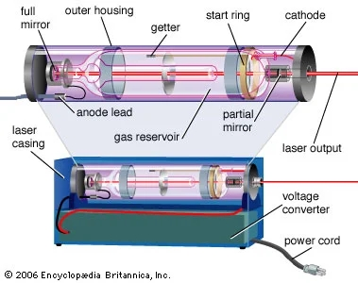
Laser
A laser is a device that emits light through a process of optical amplification based on the stimulated emission of electromagnetic radiation. The word “laser” is an acronym for “light amplification by stimulated emission of radiation”.

Slide 4
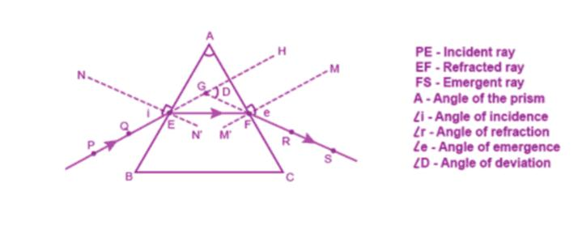
Refraction through prism
As per Snell’s law, light travelling from a rarer medium to a denser medium bends towards the normal, and vice versa. Glass is denser than air, and thus, when a ray of light falls on the surface of the prism, it bends towards the normal. According to the diagram, ray PE falls on the surface of the prism and bends towards the normal NE. Snell’s Law looks like this: Index of refraction of material 1 × sin(angle of incidence)= Index of refraction of material 2 × sin(angle of refraction) n1 sin θ1= n2 sin θ2 n1 = index of refraction of material 1 (no units, since it is a ratio) θ1 = angle of incidence (degrees or radians) n2 = index of refraction of material 2 (no units, since it is a ratio) θ2 = angle of refraction (degrees or radians) Snell’s Law tells us that the greater the difference between the indices of refraction of two materials, the more the light bends.

Slide 5
Angle of minimum deviation
The angle of minimum deviation, θmd, which is the smallest possible angle between the incident ray and emergent ray and occurs when the light passes through the prism, is parallel to the base of the prism. From θmd, we can calculate the index of refraction by applying Snell’s Law twice (once for each time the light wave changes mediums), and then using algebra, trigonometric identities, and the fact that the prism is equilateral. N = nair × sin[0.5(θmd + θp)] / sin(0.5θp) n = index of refraction of solution (no units, since it is a ratio) nair = index of refraction of air (no units, since it is a ratio) θmd = angle of minimum deviation (degrees or radians)
θp = apex angle of prism (degrees or radians)
θp is the apex angle of the prism, or the angle between the sides of the prism. Since the prism is an equilateral triangle, the apex angle is 60°. Substituting 60° for θp,
n = nair × sin[0.5(θmd + 60°)] / sin(30°)
n = 1.00028 × sin[0.5(θmd + 60°)] / 0.5
n = 2.00056 × sin[0.5(θmd + 60°)]
n = index of refraction of solution (unit less, since it is a ratio)
θmd = angle of minimum deviation (degrees)
With the index of refractive index known, a relation between the former and the concentration can be determined.

Slide 6
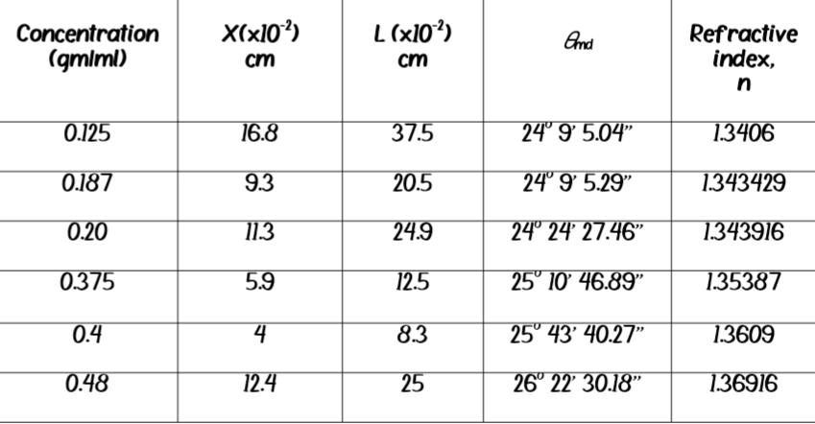
Observation
By measuring the angle of minimum deviation from the chart dram, we calculate the refractive index and hence the concentration.

Slide 7
Inference
The above methods are capable of determining the sugar concentrations up-to certain accuracy. From the data available, unknown concentration, whose any of the above characteristic is known, can be calculated from the analysis made. Concentration of the sugar solution has a linear relationship with their refractive indices.

Slide 8
Applications
This method is intended for use by small commercial sugar cane farmers who would want to establish some small sugar refineries. Water quality monitoring is another application, which is a major factor in safeguarding public health and a key input in agriculture. This method can be employed in determining of sugar concentration in fruit juices for medical purposes also.

Slide 9
Drawbacks
Lasers are expensive.
Requires time.
Thermal effects while using laser may lead to power off.
Difficulty in measuring due to the wide refraction of the emergent ray .
This method requires any optical data of the solution to finds its concentration.

Slide 10
Thank you
This project was done by,
Arun K A (Captain)
Godwin B Menachery (Leader)
Anand P (Member)
Anjaly Varghese (Member)

