Slide 1

IT2312 / IT SERVICE MANAGEMENT
IT Service Systems
Economics
Roles, Responsibilities & Service Culture
Classroom reporting • Godwyn Neri

Slide 2
LEARNING ROADMAP
From roles to service culture
01 People & roles
03 Needs & capability
05 Team & ecosystem
07 Service culture
02 Service Manager
04 Governance
06 Economics
IT2312 • GODWYN NERI

Slide 3

PEOPLE BEFORE PROCESS
Technology enables.
People deliver.
ITSM succeeds when accountability is visible, decisions have owners, and teams understand the customer outcome—not only the ticket. Roles turn frameworks into repeatable behavior.
Clarity → trust → consistent service

Slide 4

THE SERVICE MANAGER
Executive leadership
for service value
Connects business strategy to service management practice. Balances customer value, risk, cost, capability, and continual improvement across the service lifecycle.
Translate strategy into measurable service outcomes
BUSINESS ACUMEN • FRAMEWORK STEWARDSHIP • DECISION RIGHTS

Slide 5
DETERMINING SERVICE NEEDS / CUSTOMER
Start with three questions
Requirements are incomplete until value, experience, and evidence are explicit.
01
02
03
What does the customer value?
What experience do they expect?
How will success be measured?

Slide 6
DETERMINING SERVICE NEEDS / IT
Promise only what
the system can sustain
01 What can IT reliably deliver?
Capability is the honest intersection of people, process, technology, suppliers, capacity, and funding.
02 What must change to close the gap?

Slide 7
SERVICE TRANSITION + SERVICE OPERATION
Govern change. Restore service.
The Service Manager protects stability while enabling improvement—using risk-based change decisions and disciplined incident leadership.
Assess risk
Authorize change
Review outcome
Coordinate response
Restore + learn

Slide 8
COLLABORATIVE GOVERNANCE
One service. Shared stewardship.
The Service Sponsor secures authority and investment. The Service Team converts direction into design, execution, measurement, and improvement.
SERVICE SPONSOR
Direction • funding • escalation
Design
Operate
Measure
Improve

Slide 9

OUTSIDE THE ORG CHART
External roles shape
service outcomes
Customers define value. Suppliers extend capability. Regulators set boundaries. Partners and consultants contribute expertise. Clear interfaces, contracts, escalation paths, and shared measures keep the ecosystem accountable.
Manage the relationship—not only the contract.

Slide 10
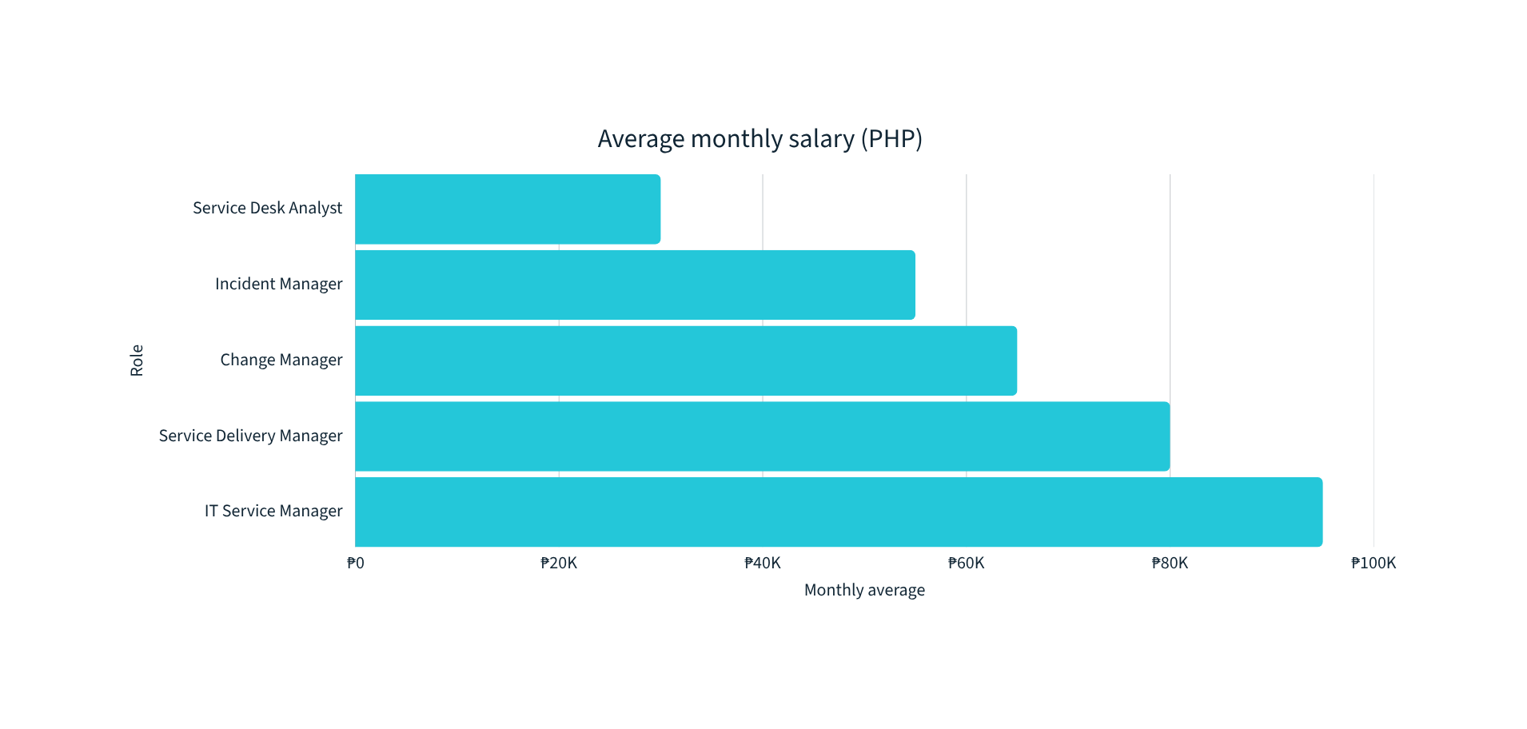
PHILIPPINES / JOBSTREET DATA 2023
ITSM salary benchmarks
Illustrative monthly averages; role scope, location, certification, and industry materially affect offers.
Source: Jobstreet salary insights, 2023. Values rounded for classroom comparison.

Slide 11

THE SERVICE CULTURE FRAMEWORK
Culture is how service
happens when no one
is watching.
Shared values and daily behaviors determine whether teams listen, own outcomes, collaborate, learn, and improve. Process documents cannot compensate for a mindset that avoids responsibility.
MINDSET → BEHAVIOR → EXPERIENCE

Slide 12
SERVICE CULTURE / INFLUENCES 01—02
Reputation outside. Truth inside.
Culture is simultaneously a market signal and an operating system.
01
02
Brand perception
Operational alignment
Every interaction becomes evidence of reliability, empathy, and competence.
Honest reporting exposes constraints early—before hidden work becomes customer failure.

Slide 13
SERVICE CULTURE / INFLUENCES 03—04
Belonging builds resilience
Strong cultures keep capable people—and help the organization adapt before change becomes crisis.
EMPLOYEE ADVOCACY
ORGANIZATIONAL AGILITY
People stay where
service work matters.
Learning turns disruption
into adaptation.

Slide 14
SYNTHESIS + CLASSROOM DISCUSSION
Great service is an
economic and human system.
DISCUSS
VALUE • OWNERSHIP
CAPABILITY • CULTURE
Clear ownership aligns investment, capability, behavior, and customer value. Service culture makes that alignment repeatable—even under pressure.
01 Where is ownership unclear in a service you use?
02 Which culture behavior would improve it fastest?
THANK YOU / GODWYN NERI

