Slide 1

ESCM and Powershell
Overview
Fujitsu Enabling Software Technology
15.02.2018

Slide 2
Overview
ESCM Platform
Powershell
adapter
Business Logic
EJBs, Web Services
Glassfish Application Server
PostgreSQL DB
Powershell Process
Powershell Process
Office365
Cloud
HyperV Manager
Windows Server 2016

Slide 3
Generic Components installed on Windows Server 2016
Postgres + Glassfish + Java + Tomcat
ESCM Core (17.4., which supports Windows)
ESCM Powershell Connector
Powershell Modules
HyperV Management (enabled for user)
Office365 Management

Slide 4
Service Specific Components for HyperV
One user defined attribute (UDA) for multi-tenancy (HV_TENANT) used in scripts do separate between customers
XML-files for technical services
Basic parameter set
Can be extended
Powershell scripts for creation, deletion, update, check status…
ISO files to boot VM

Slide 5
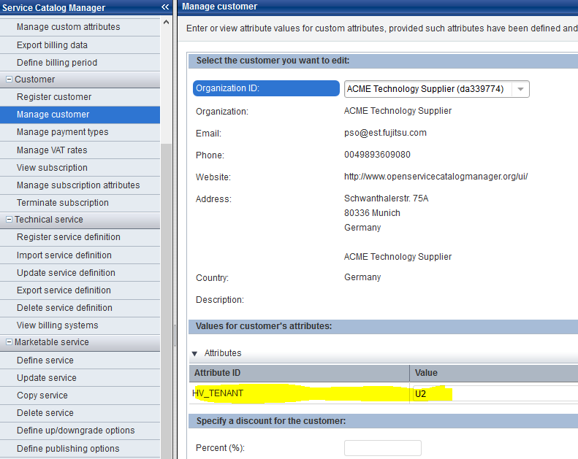
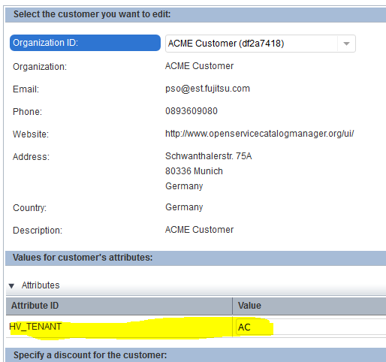
UDA used for VM separation in names, network and VM files (1 of 2)

Slide 6
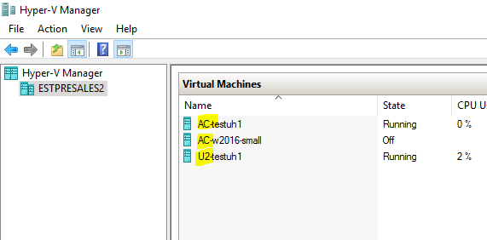
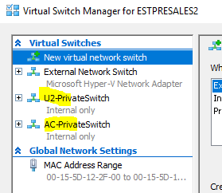
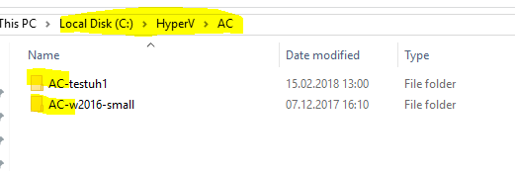
UDA used for VM separation in names, network and VM files (2 of 2)

Slide 7
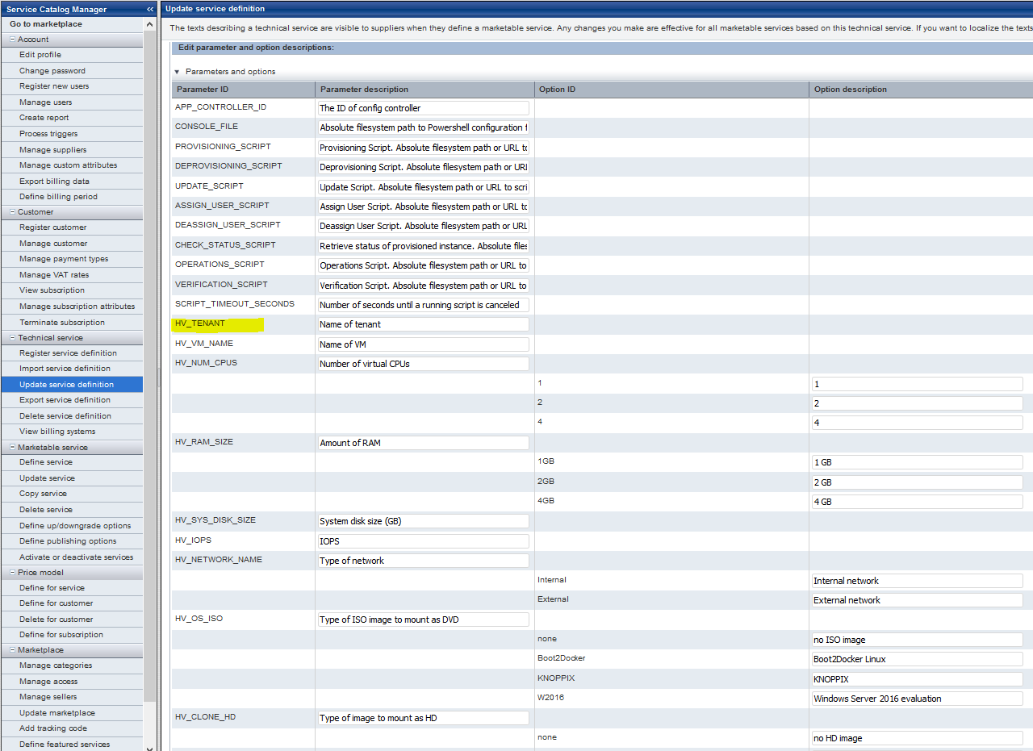
Technical Service Parameter
Generic for Connector (to specify scripts)
Specific for service (to define business parameters)

Slide 8
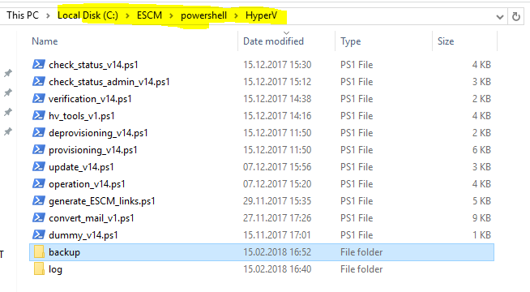
HyperV Powershell Scripts
Scripts per action type
Include for all scripts
Log dir for all scripts

Slide 9
Create VM (provisioning.ps1)
Checks if VM already exists
Creates private network switch (if not exist)
Creates VM including disk, disk folder
Sets CPU, Memory, IOPS, Metering, ..
Create VM note
Starts VM

Slide 10
Check VM Status (check_status.ps1)
Retrives VM infos
Creates HTML table to be displayed in HyperV tab

Slide 11
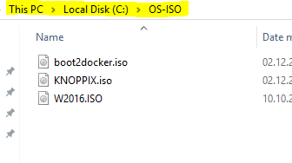
ISO Files to boot VM

