Slide 1

ZIU
Organizing the unorganized fashion industry

Slide 2
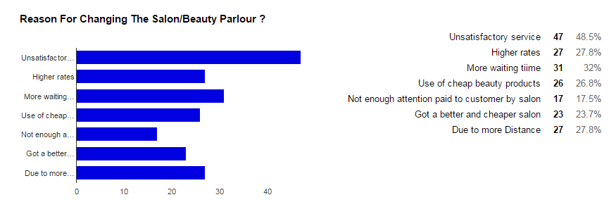
The Problem
Our Solution
1)Connecting beauty, spa and salon vendors to the people living around their locality and offering the best deals for different services offered by beauty spa and salon vendors to the customers.
2)We want to make the business of salon and spa more transparent and there is a need to encourage more competition in this market. As competition goes high, quality goes up and rates go down.
3)With improving lifestyle of people, there is a need for such a service by a large section of the population so we will connect every Smartphone user who wants to avail the best deals offered by vendors in his city.
4)Every vendor who wants his/her services to be accessible to anyone with a smart-phone can list his service on our website.
5)Our platform will solve the uncertainty the customer use to face while going to a salon. Our app will display the rush hours and avg waiting time so that the customer reach only at his appointed time.

Slide 3
Current Alternatives
Our current competitors are majorly vyomo.com and ziffi.com.
Difference between Them and Us:
1)They are not single platform. They provide multiple services of other businesses too.
2)They work more like a information website while in our model we will provide cheaper rates and deals to our customer along with the images of services they are opting.
3) Our platform will provide Deals on existing salons of customers so they don’t necessarily need to change their salon and also customer can compare rates from other salons too and select the best for him.
4)Our platform will bring you to your favorite salon but now at a much discounted rates.
Our platform would also be “cleaner” and will have lesser Carbon Footprints because:-
1)We will be using Cloud Computing Services because it consume 77% Fewer Servers and 84% Less Power.
2) Due to less consumption of resources, the Carbon Emissions by are reduced by 88%.
3) With prior appointment with salon, the customer can plan his trip doing other jobs on his way. Hence less transportation and less
pollution.
4)Our vendors will also offer Cab services to customers in same area. Sharing of taxi will result in less carbon emissions and lesser
pollution.

Slide 4
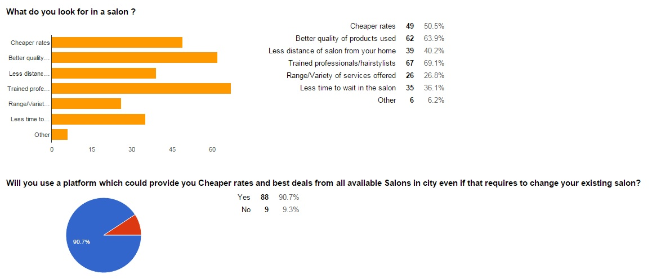
Product / Service / Offering

Slide 5
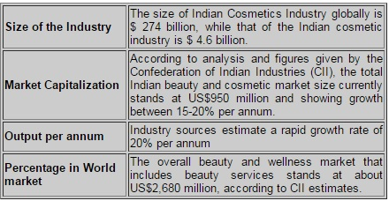
Market Opportunity
WHOM WILL OUR PLATFORM SERVE?
Customers who are short on time type, and e-commerce is convenient.
The beauty aficionado type, who knows what they is going to buy. For this bracket of customers, the offering is very wide.
There are beauty newbie who don’t know what they are looking for. For this bracket, our latest styles and trends will help them set their mood and mind.

Slide 6
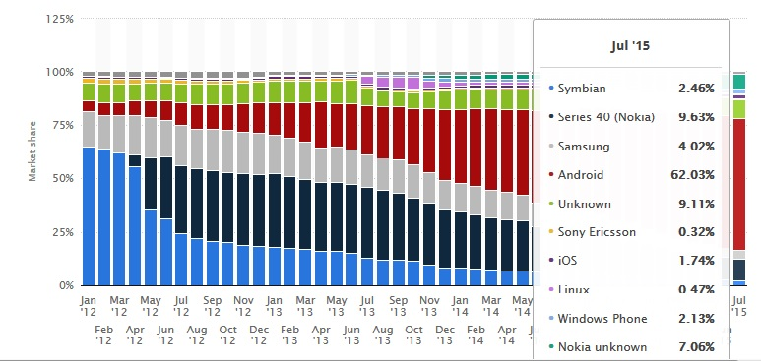
Competition
Existing in a space of an industry worth $4.8billions with an avg growth of 18% annually, we target the 62% of the users who use internet services and are on android.
We will offer the deals and rates no one else can offer. Along with this, we will also show exclusive deals to our customers based on then past trends of them. With the deals we will add a latest trends where customer can select the styles they like.
Our competitors do not offer services with transparency nor they offer discounts on price stated. Our platform will provide Deals on existing salons of customers so they don’t have to change their salon and can compare rates from other salons. Our platform will also encourage competition among the salons they will offer better services and less rates due to us. Hence profit of customer is that they will receive better deals and profit of vendor is that they will receive ,more customer coz of us.

Slide 7
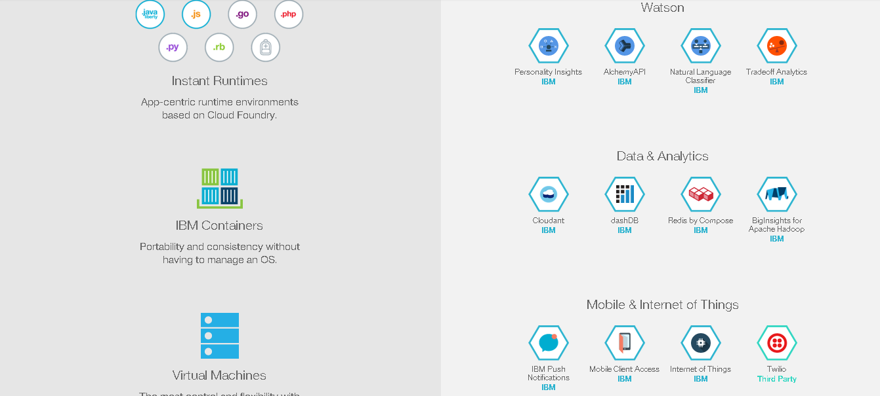
Service Used By App
My Sql Service :- For Fetching The Images & Text Json Script In The App.
Push Notification :- For Important Messages To show To A User.

Slide 8
Revenue Model
Our platform focuses majorly on Youths. But anyone who want to look trendy and use our platform can avail the services from there. We will offer deals for both men and women. The deals will be more female centred as they spend more on beauty services.
Sources through which Ziu will earn:-
Charges will vary from Rs.1000 to Rs.10000 monthly for listing a salon depending on the grade of city and lifestyle.
Three months after listing we will charge 20 % commission on booking along with listing charge.
Ziu will run time to time campaign for individual Salon Business in different part of the cities for promotion. Then Ziu will earn 50 % revenue from that salon.
In case salon do not want to list services, they can still advertise through our platform.
We can also export the trend’s details to beauty companies generating additional revenue.
We will also sell beauty products through our platform.
We will also link cab services to our platform to allow customer book a cab directly through our platform.

Slide 9
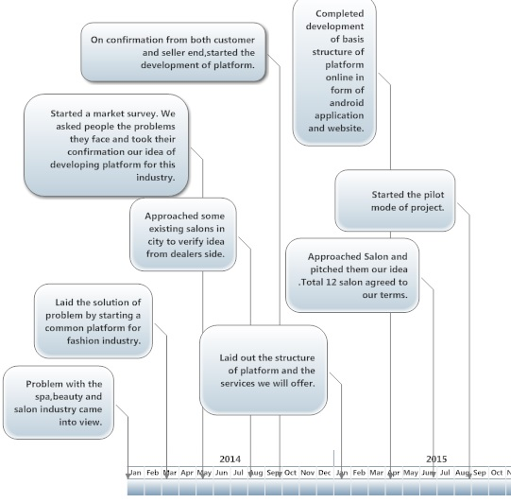
Momentum / Traction

Slide 10
Market Approach & Growth
We will acquire customers in following ways:-
Create trends on facebook and site for various haircuts and moustache by asking people to like and comment for their favourite cuts.
Organize competitions on facebook and give away free service vouchers as prize.
Marketing the product digitally through Facebook, advertisements, blogs, emails and text messages.
Give free vouchers on signup on site.
Offering deals and discounts on the trending styles.
Offering special beauty and bridal packages at discounted rates which will be available exclusively at site.
Offering ‘On-Wheels’ parlor for special events like marriages, parties and functions.
Boosting the sales by creating marketing events like #createatrend and salon carnivals.
Word-of-Mouth approach i.e. satisfaction to customer .
Why people will buy what we want to sell and whom we plan to sell.
With fast changing trends and styles, everyone wants to stay ahead. Our app will give them the services that makes them stand out of the crowd.
With the explosion of mobility by apps like flipkart, zomato, OLA etc. people need an app for the beauty segment too.
The best deals in the city will attract various people to use the app

Slide 11
Team + Advisors
Team Profile:-
1) Sanchit Goel(CTO):- International hackathon winner( asian champion).
2) Sunny Bansal(Marketing manager):- Marketing Head, Fest committee, MIET Meerut.
3)Yasachandra Bansal(COO):- Designed Wireframe for PMO.
Our Advisors:-
1) Mrs. Ranjula Jain:- Owner of Reflection salon chain (Beauty consultant) Guide for beauty spa industry
2) Dr.Vipin Gupta:- Director of MBA dept.
Co-Director,Global Management Centre, College of Business and Public Administration,
California State University - San Bernardino
3) Mrs.Bhakti Jain Gupta:- Owner of craft options (start-up consultant)
4) Dr. Ajay Singh:- EDC Head ,MIET Incubation Cell, Meerut

Slide 12
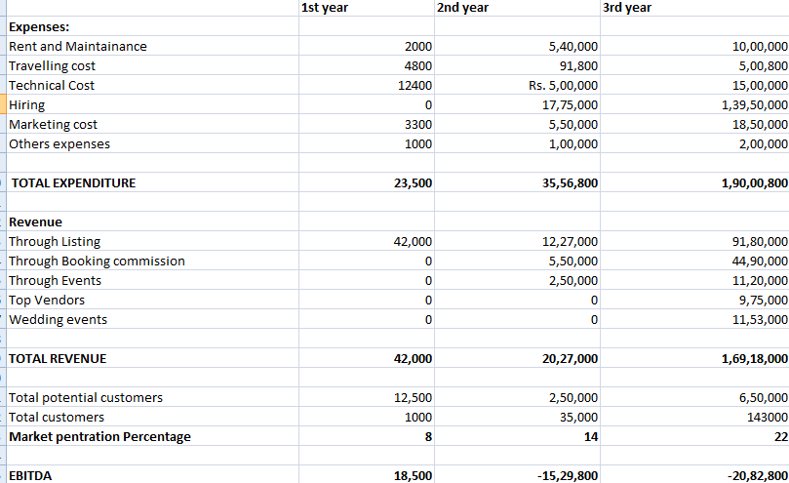
Financials

Slide 13
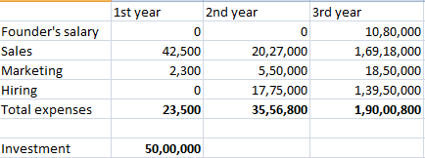
Investment
Tech and equipment details:-
1st Year :-120 $ (i.e. 8000 Rs)
2nd Year :- AWS m3.2 xlarge- 4660.32 $ (i.e. approx 3,00,000 Rs)
3rd Year :- AWS d2.4 xlarge - 24,177.6 $ (i.e. approx 15,00,000 Rs)
Investment Seeking:- 50 lakhs for next 3 years.

