Slide 1
Vulkan Renderer
Senne Goeminne

Slide 2
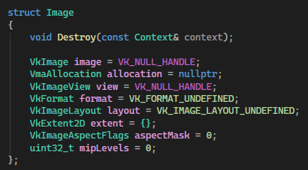
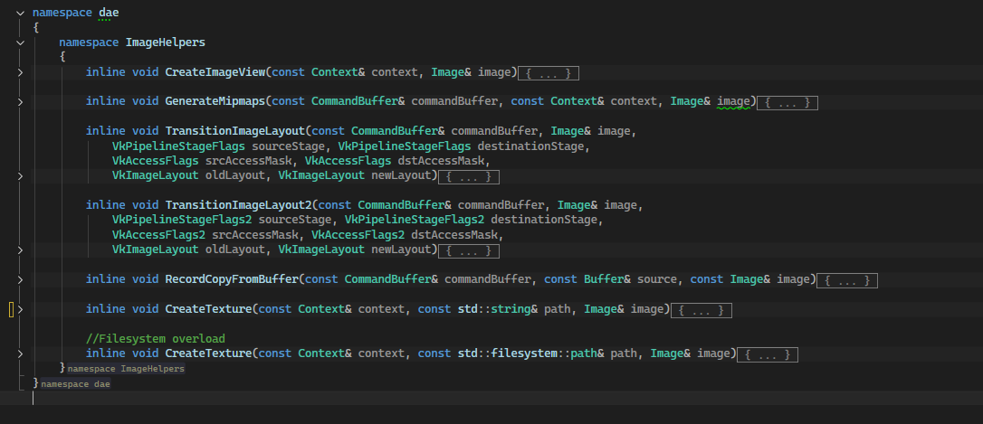
Core Architecture
General Rule: structs as data wrappers with helper functions
Groups related data
Stateless objects, passed explicitly when needed
Exception: class when private data is required

Slide 3
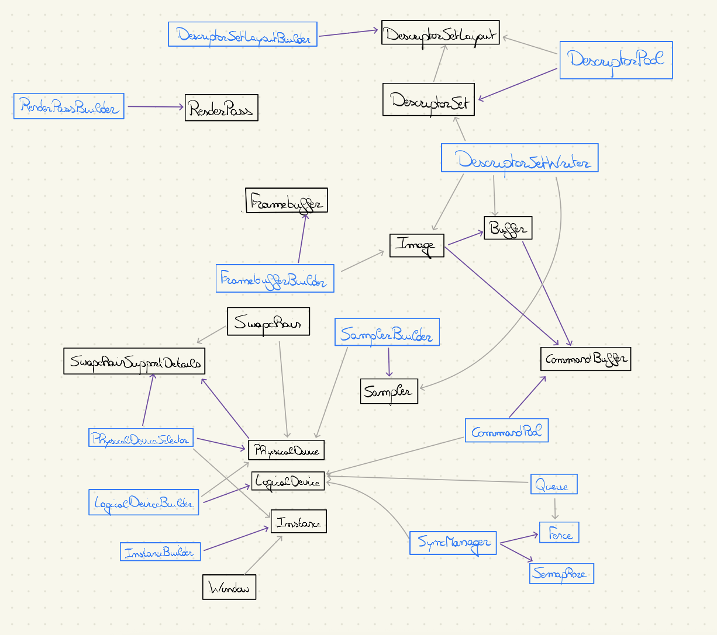
Diagram
Black = Structs
Blue = Classes
Purple = Creation
Gray = Dependency

Slide 4
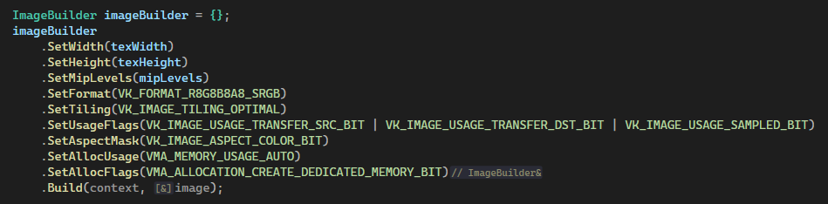
Object Creation : Builder Pattern
Complex resources
Many parameters / dependencies
RenderPass, Image, Core components, …

Slide 5
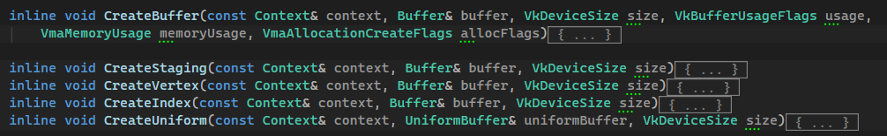
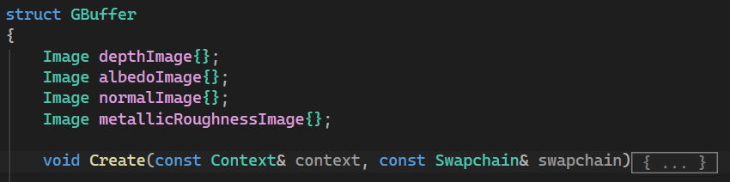
Object Creation : Create method
Few dependencies
More straightforward setup
Buffer, Swapchain, SyncManager, G Buffer, …

Slide 6
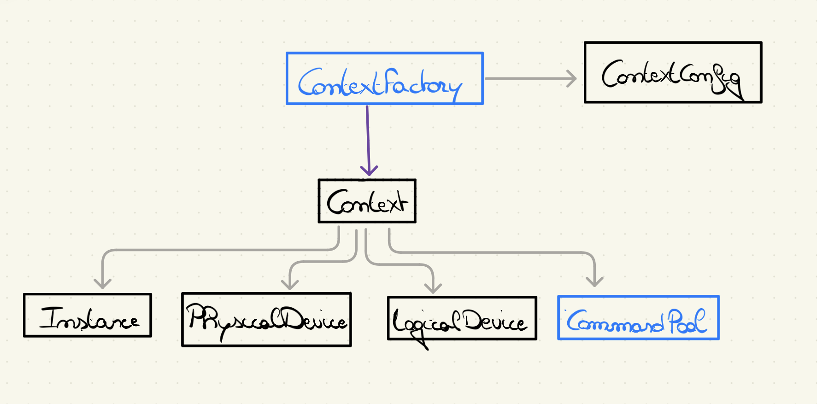
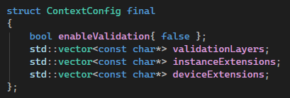
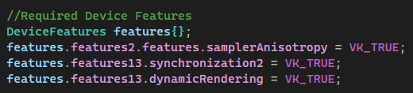
Core : Context
Centralizes Core Components
Passed to every function
Config allows easy expansion
DeviceFeatures struct

Slide 7

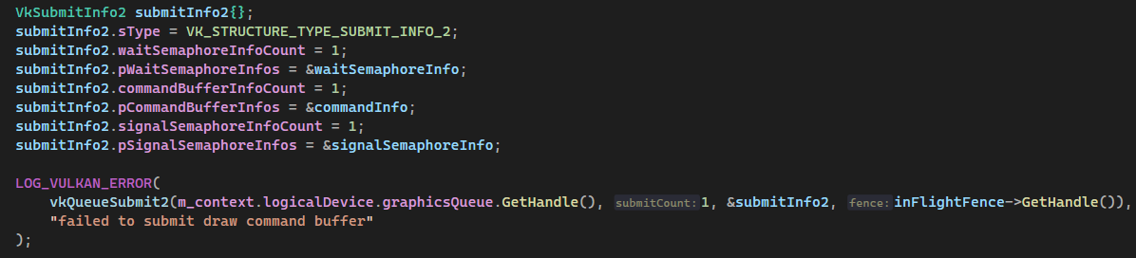
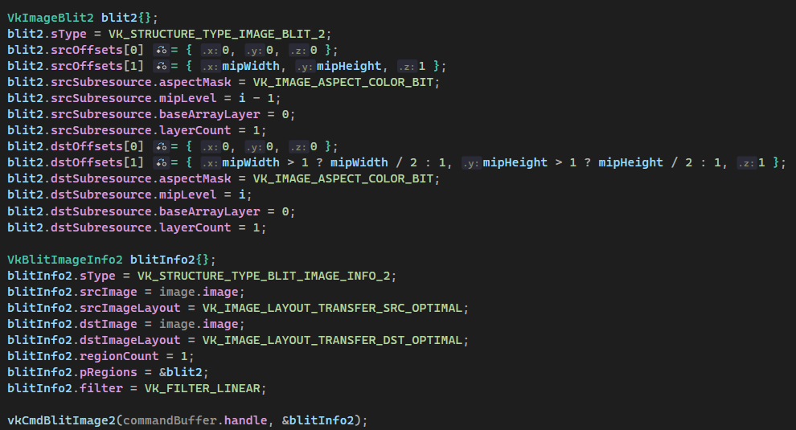
Modern Vulkan – Sync 2
Barriers
Queue Submits
Image Blits (not part of Sync2)

Slide 8
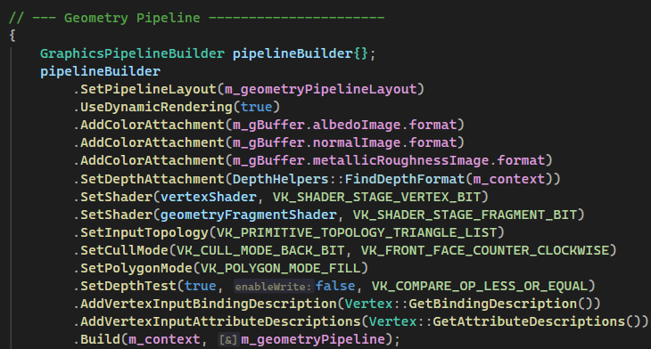
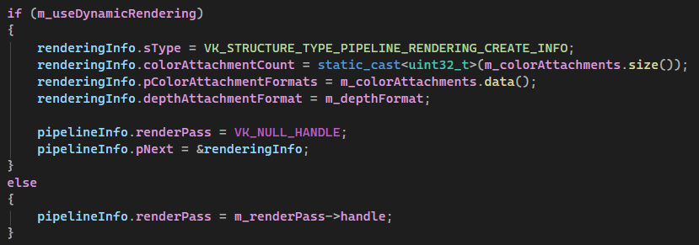
Modern Vulkan – Dynamic Rendering
Toggle in Builder
Still allows Renderpasses

Slide 9
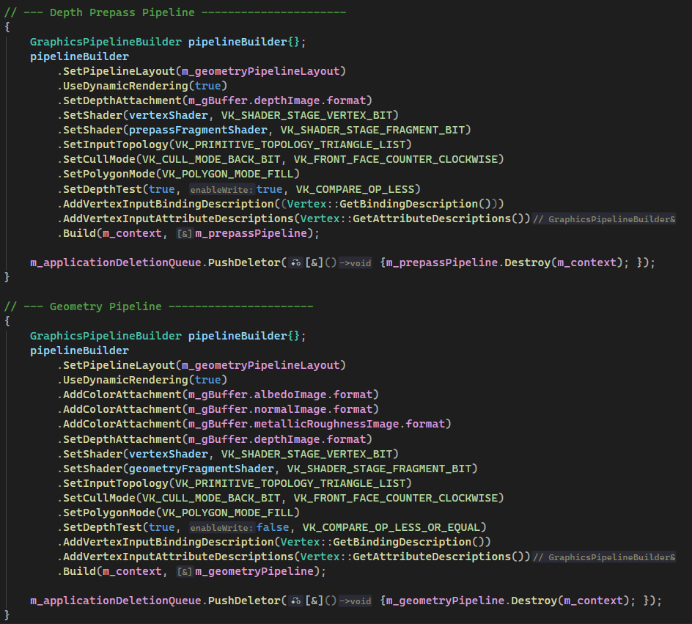
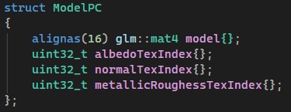
Depth Prepass & Geometry Pipeline
Same PipelineLayout
Global Descriptor Set (Textures)
Per Frame Descriptor Sets (View Proj)
Per Model Push Constants

Slide 10
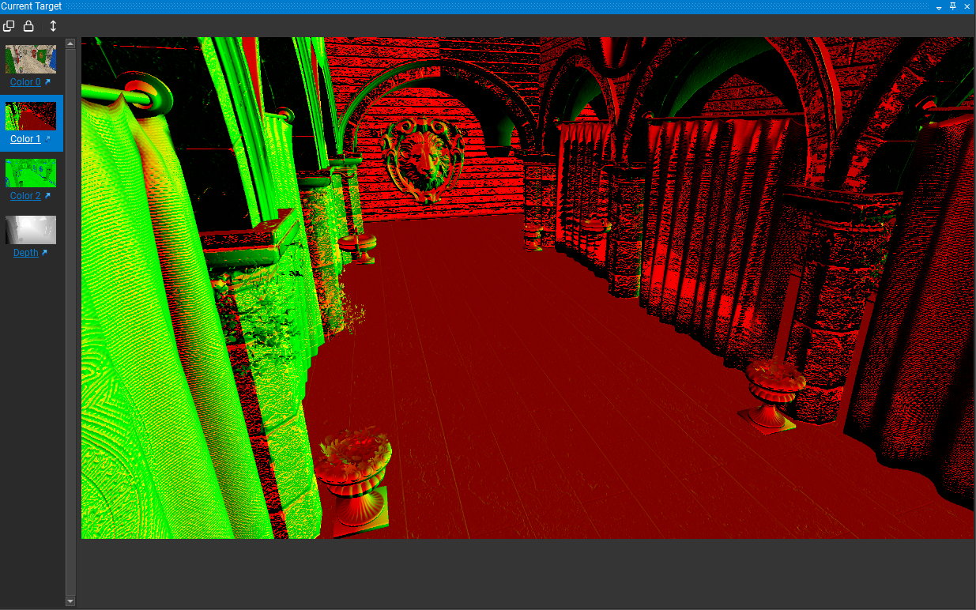
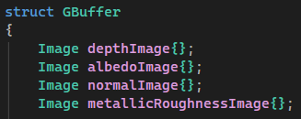
G Buffer
Albedo Image : 8 bit SRGB
Normals: 16 bit SFLOAT
(2 channel) (spherical packing)
Metallic & Roughness : 8 bit UNORM
Depth Image

Slide 11
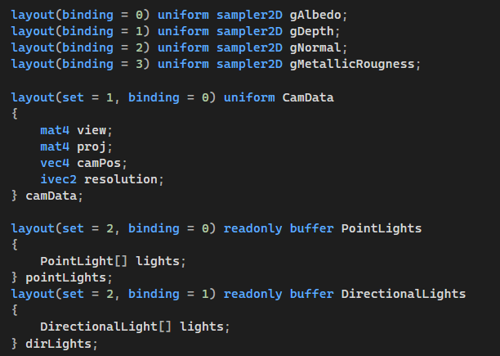
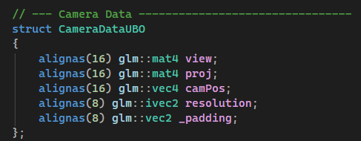
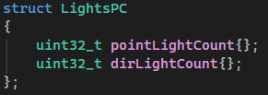
Deferred Pipeline
Samples from G Buffer
(global descriptor set)
Camera Data UBO
( per frame descriptor set)
Lights UBO’s & Push Constants
Outputs to HDR Image

Slide 12
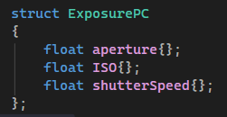

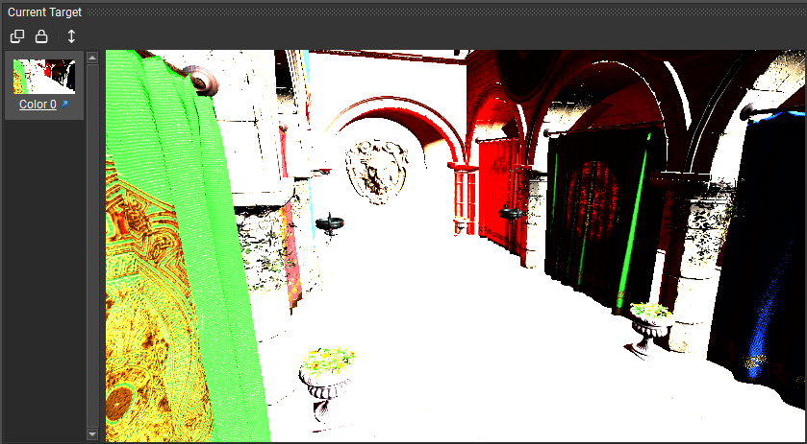
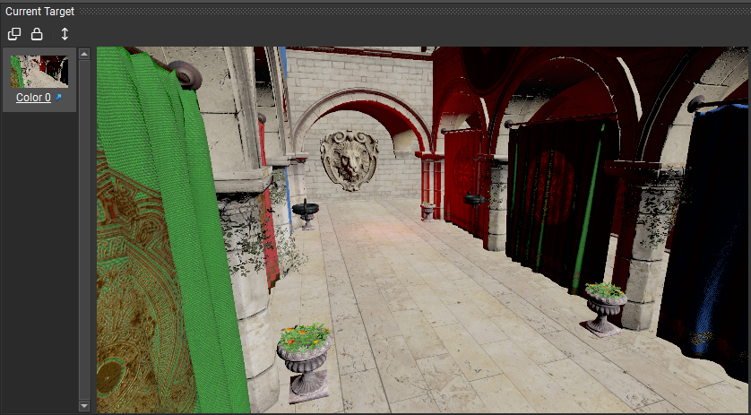
Blitting Pass
Samples HDR Image
PushConstant for Camera specs
Reinhard Tone Mapping

Slide 13
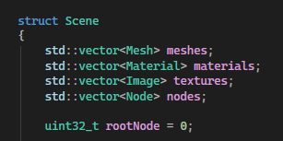
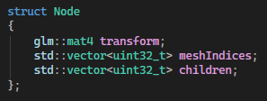
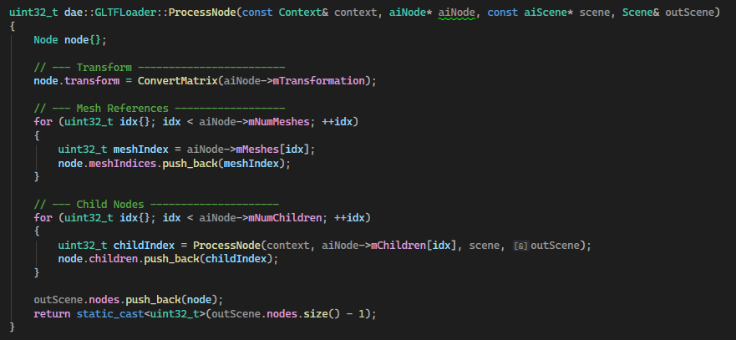

Scene Data
Parsed from GLTF file
Scene holds all data (avoids duplication)
Resources are referenced using indices
Materials vector passed in Mesh RecordDraw

Slide 14
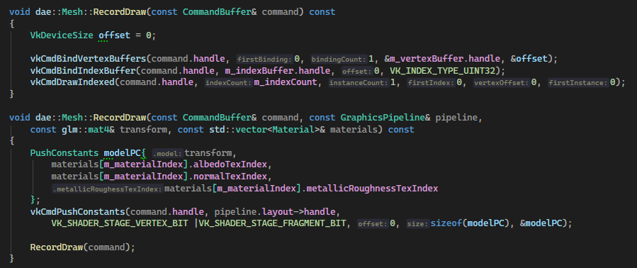
Record Draw
Reference to Materials vector
Binds Push Constants for every Mesh
  Model matrix
  Albedo Tex index
  Normal Map index
  Metallic Roughness index

Slide 15
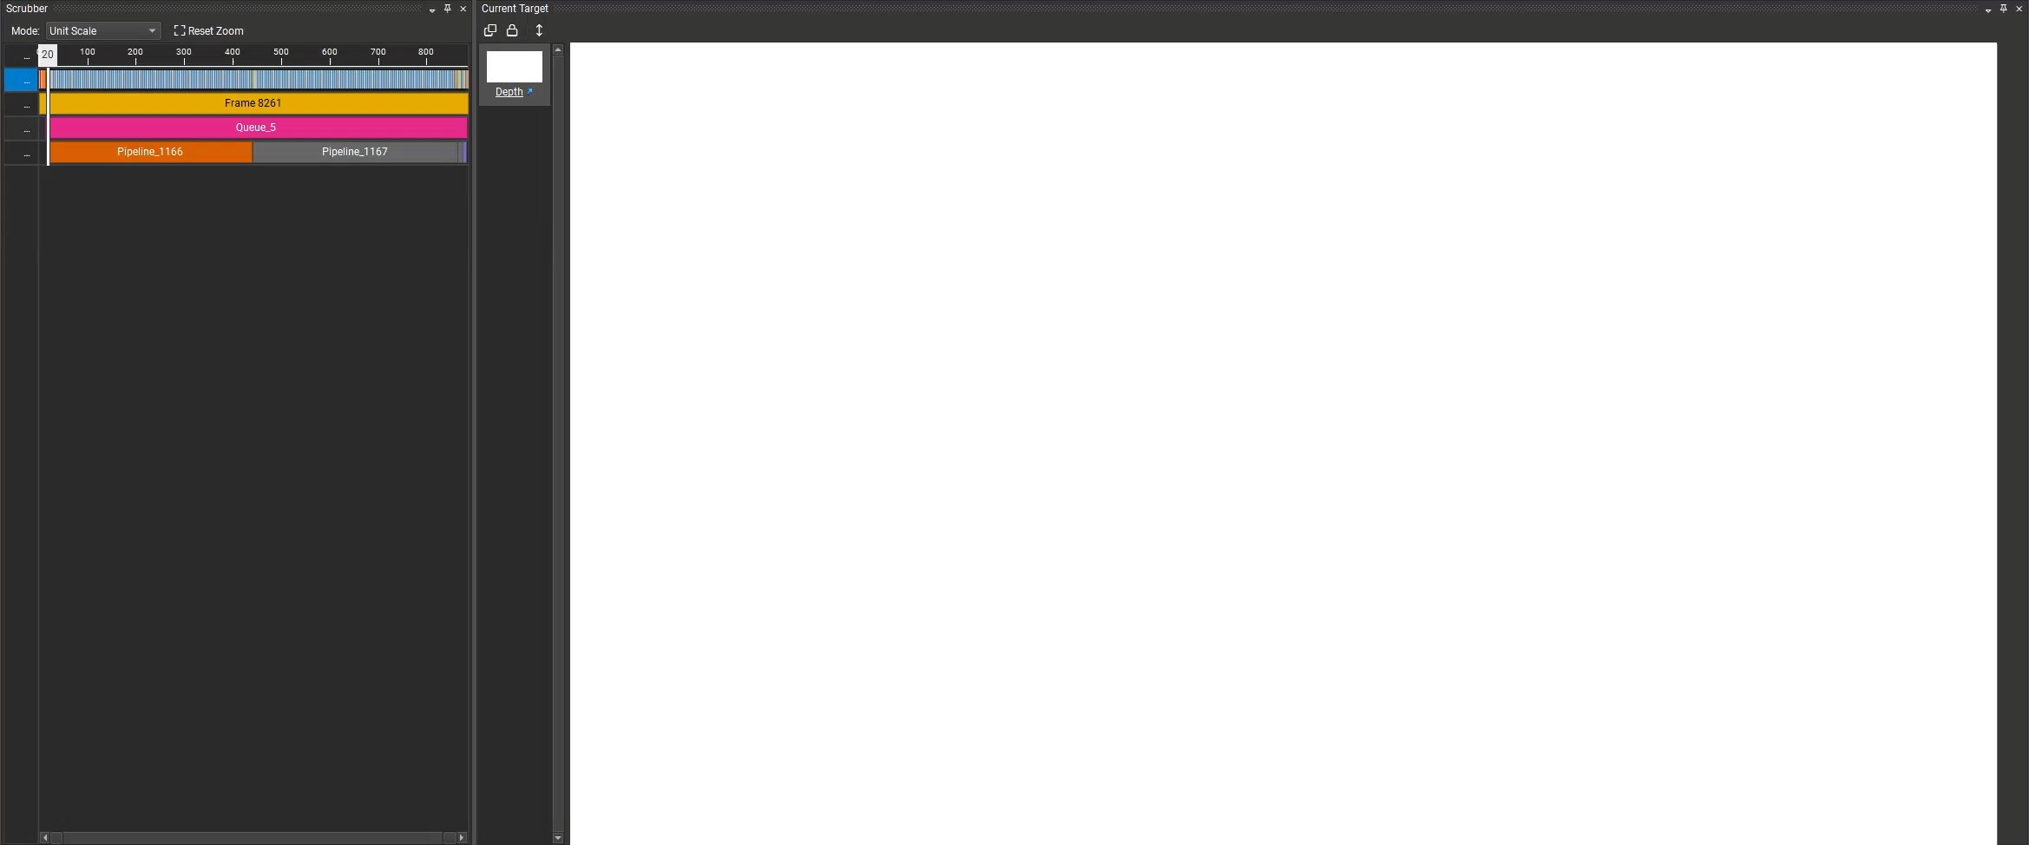
Timeline

Slide 16
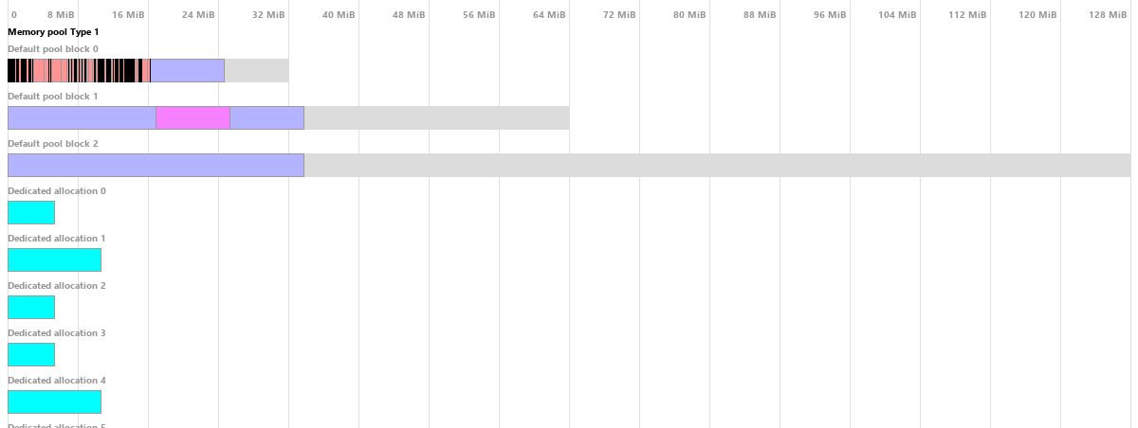
VMA output

Slide 17
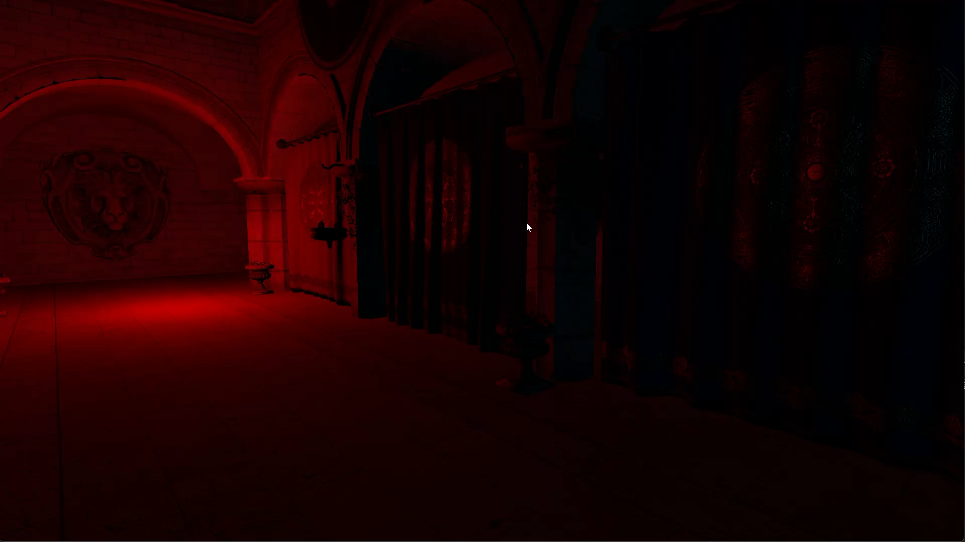

Slide 18
Thank You!

