Slide 1
Building A Retro-Style Space Invaders Game
A Beginner Level Approach by
Shoayeb Ahmed Nabil
ID: 2423044042
Taihan Ibn Altaf
ID: 2422477642
Gofran Yusuf
ID:2422305042

Slide 2
Steps To Develop Space Invaders
Basic game structure
Creating game window
Setting up the game loop
Creating spaceships
Implementing shooting
Detecting Collision
Adding scoring system
Adding health
Quitting game

Slide 3
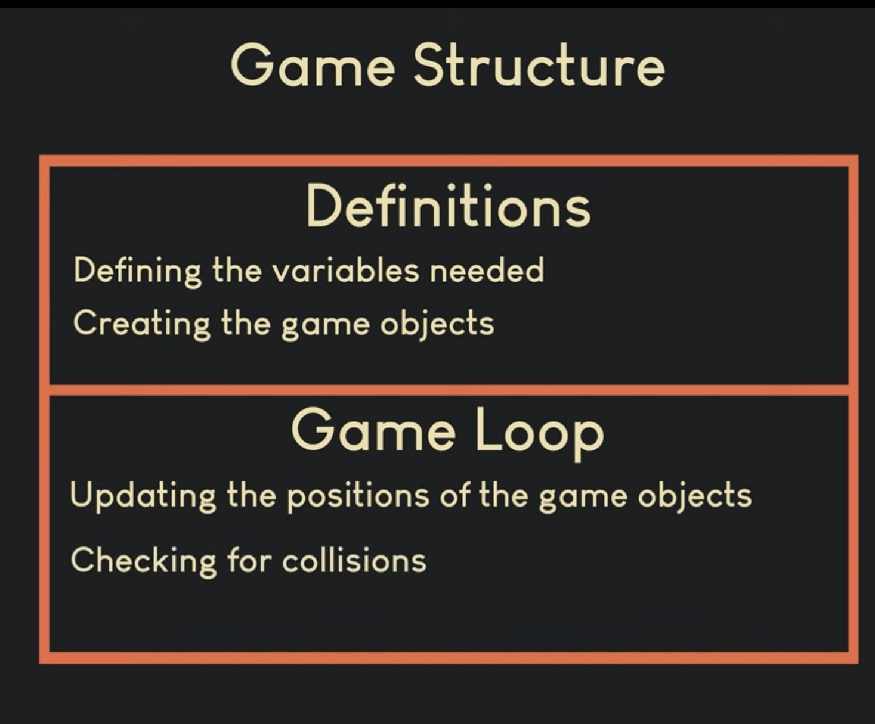
Basic Game Structure
Image courtesy:
programmingwithnick.com

Slide 4
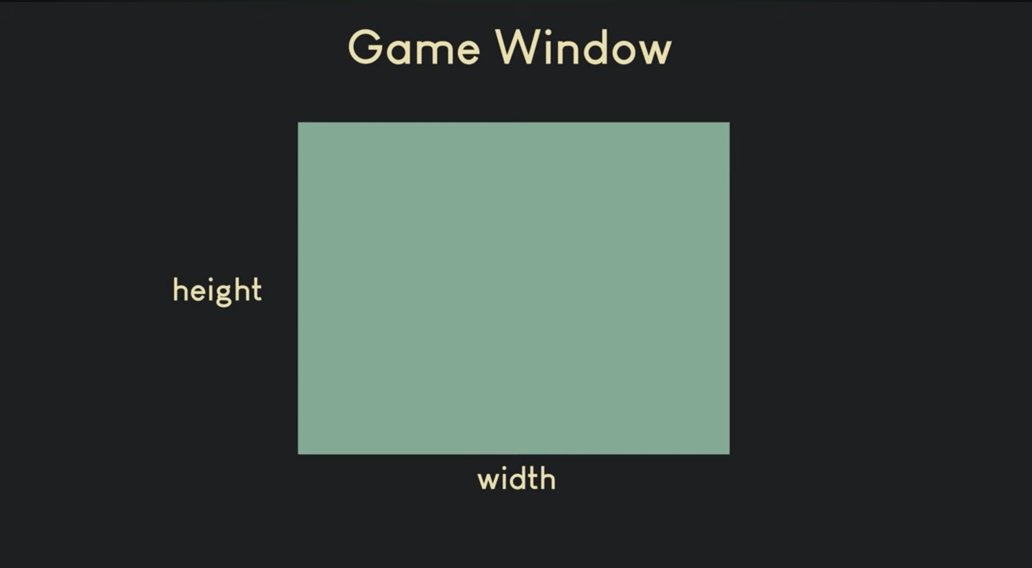
Creating Game Window
Image courtesy:
programmingwithnick.com

Slide 5
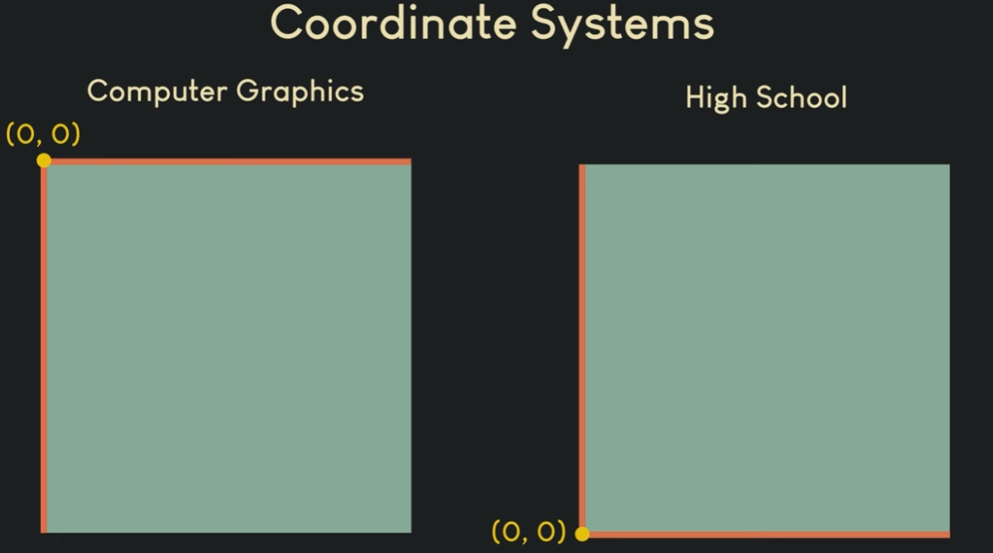

Slide 6
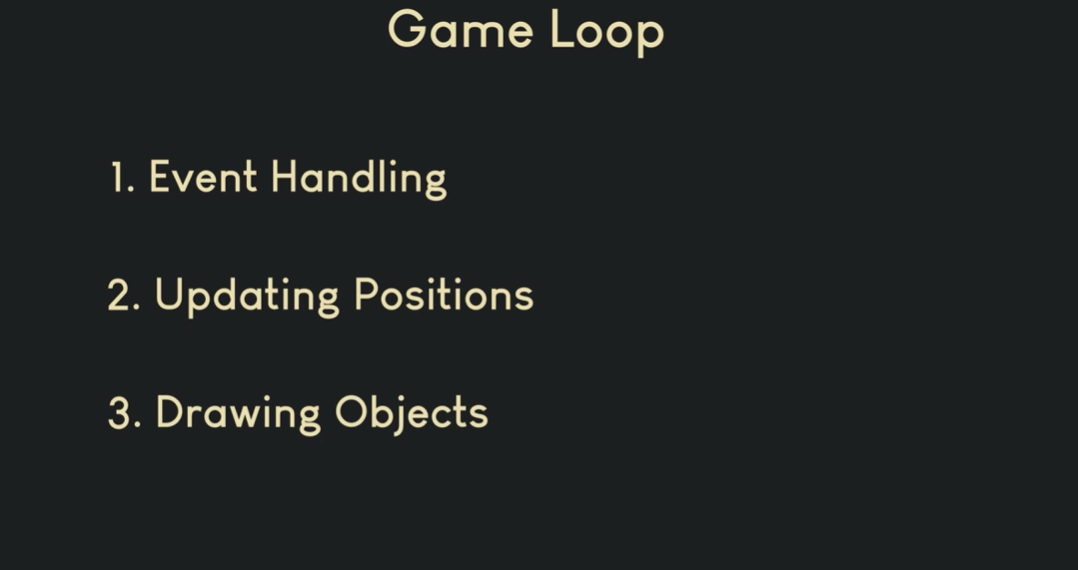
Setting Up the Game Loop

Slide 7
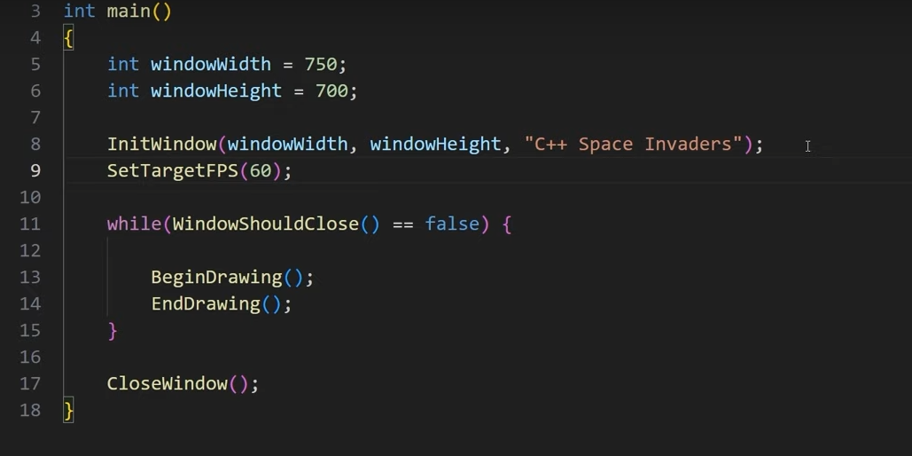
Code Snippet
Creating Game Window and Setting Up the Game Loop

Slide 8
Gameplay Mechanics
Player Movement:
The player can move left and right using the arrow keys.
The player has 3 lives to survive enemy attacks.
Shooting:
The player can shoot bullets by pressing the spacebar.
Bullet collisions with enemies cause them to be destroyed and increase the player's score.
Enemies:
Enemies move horizontally and change direction when hitting the screen edges.
Enemies shoot bullets randomly at the player.

Slide 9
Gameplay Flow
Initialize Game Elements:
Set up the player, enemies, and bullets arrays.
Game Loop:
Update player movement based on keyboard input.
Update enemy movement and handle enemy shooting.
Handle player shooting and bullet movement.
Check for collisions (player bullets with enemies and enemy bullets with the player).
Update score and display game status.
End Game:
Display "GAME OVER" when the player loses all lives.

Slide 10
Game Features
Graphics:
Simple 2D graphics using Raylib functions like DrawTriangle, DrawRectangle and DrawCircle.
Colorful rendering with different shapes for the player, enemies, and bullets.
Collision Detection:
The game checks for collisions between bullets and enemies, as well as player collisions with enemy bullets.
CheckCollisionCircle Rec is used for detecting collisions between circular bullets and rectangular enemies.
Score and Game Over:
The score increases each time an enemy is hit.
The game ends when the player loses all lives.

Slide 11
Main Game Loop
The main game loop handles:
Input for player movement and shooting.
Updates for enemy movement and shooting.
Collision detection and scoring.
Drawing the game elements (player, enemies, bullets, score).

Slide 12
Acknowledgements
Raylib for providing an easy-to-use graphics library for game development.
programmingwithnick.com for providing valuable resources for game development.

Slide 13
Any questions or feedback are highly appreciated.

Slide 14
Thanks so much! It’s been a pleasure presenting to you.

