Slide 1
AGILE PLAN
1/8

Slide 2
SCRUM and where to find him
Short meetings on daily bases
3 weeks sprint
Trello for keeping track of tasks
Slack for communication
2/8

Slide 3
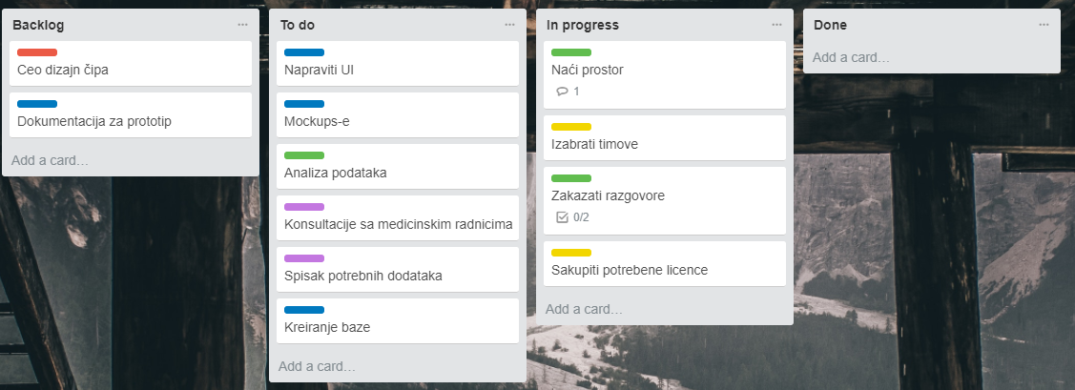
1. WEEK
3/8

Slide 4
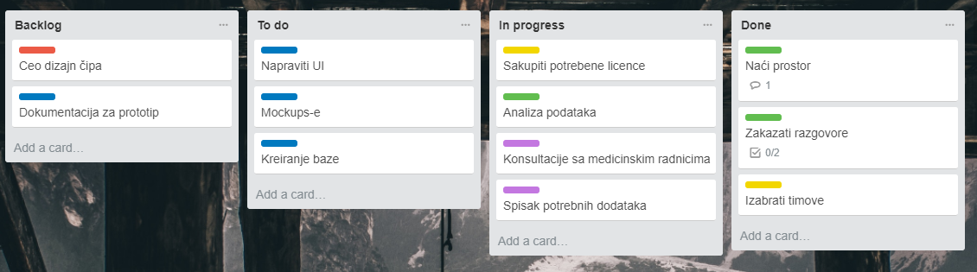
2. WEEK
4/8

Slide 5
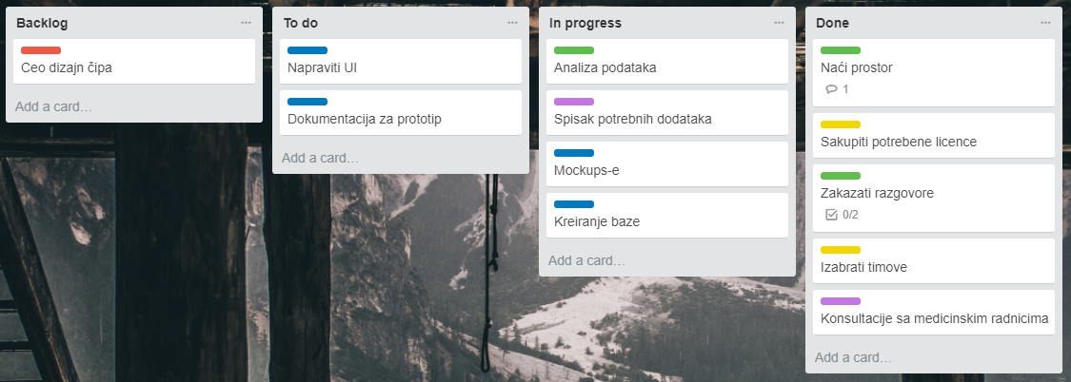
3. WEEK
5/8

Slide 6
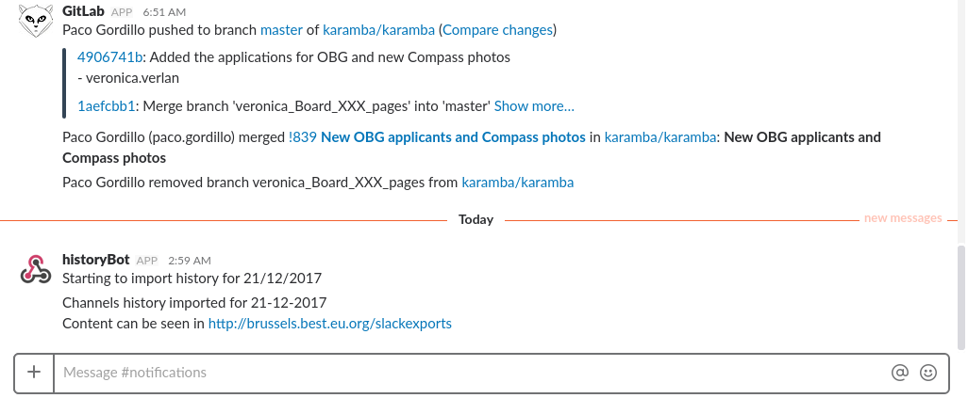
6/8

Slide 7
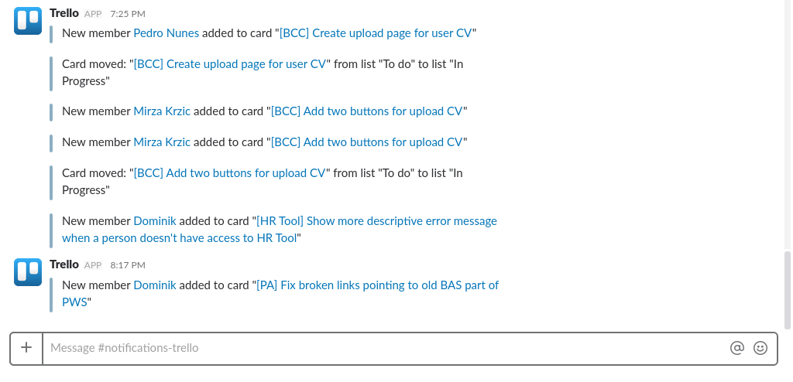
7/8

Slide 8
LINKS FOR TRELLO
1. Week: https://trello.com/b/oAgSfOCT/asil-lets-work-week-1
2. Week: https://trello.com/b/BaIAnu0m/asil-lets-work-week-2
3. Week: https://trello.com/b/HZXDzI2r/asil-lets-work-week-3
8/8

