Slide 1

IBM PBEL Virtual Internship 2026 In Artificial Intelligence Under the guidance of Shweta Mam Topic – Fake News Detection Using Machine Learning Presented by- Aditya Singh B.tech (CSE) adityasinghuit013@gmail.com Batch 8

Slide 2
INTRODUCTION
Fake news refers to false or misleading information presented as genuine news.
It spreads rapidly through social media, news websites, and messaging platforms.
The increasing volume of online content makes manual verification difficult.
Machine Learning (ML) enables automatic classification of news as Real or Fake.
Natural Language Processing (NLP) helps analyze the textual content of news articles.
The goal is to develop an accurate and efficient fake news detection system.
Visual: An illustration showing "Real News" vs. "Fake News" or a news feed with AI.

Slide 3
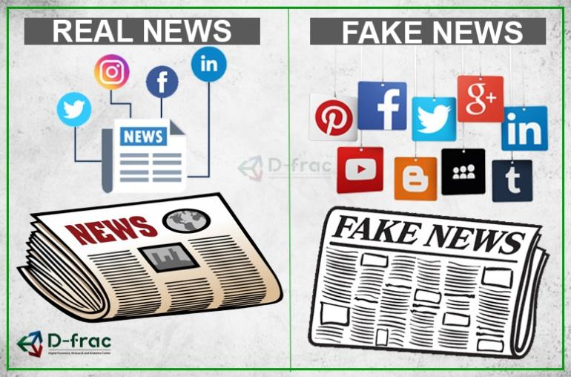
Problem Statement
Fake news spreads quickly and reaches millions of people within minutes.
Manual fact-checking is time-consuming and not scalable.
False information can influence public opinion, elections, and financial markets.
There is a need for an automated system that can detect fake news accurately.

Slide 4

Objectives
Collect and preprocess news datasets.
Remove unnecessary text and clean the data.
Convert text into numerical features using TF-IDF Vectorization.
Train a Machine Learning model.
Predict whether a news article is Real or Fake.
Evaluate model performance using different metrics

Slide 5
Technologies Used
🐍 Python: Core programming language
📊 Pandas: Data loading and Preprocessing
🔢 NumPy: Numerical Computations
📝 NLTK: Natural language Processing (NLP)
📈 TF-IDF Vectorizer: Feature extraction from text
📉 Matplotlib: Data Visualization
📒 Jupyter Notebook: Development and experimentation

Slide 6

Dataset Description
A publicly available Fake News Dataset was used to train and evaluate the machine learning model.
The dataset consists of real and fake news articles collected from various online news sources.
Each news record contains important information such as the title, article text, subject, and publication date.
The dataset provides labeled data, where each article is classified as Real or Fake, making it suitable for supervised machine learning.
Before model training, the dataset was cleaned by removing unnecessary characters, punctuation, and stop words.
The processed dataset was divided into training and testing sets to evaluate the model's performance effectively.

Slide 7
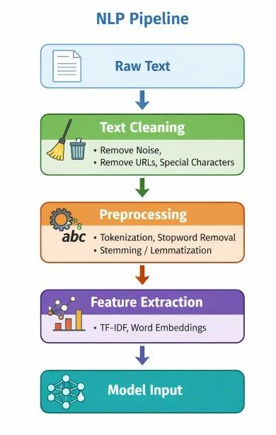
Methodology
Collected labeled news articles from the dataset.
Preprocessed textual data using NLP techniques.
Extracted features using TF-IDF Vectorization. Trained the classification model on the processed data.
Predicted whether news articles are Real or Fake.
Evaluated the model using Accuracy, Precision, Recall, and F1-Scor

Slide 8
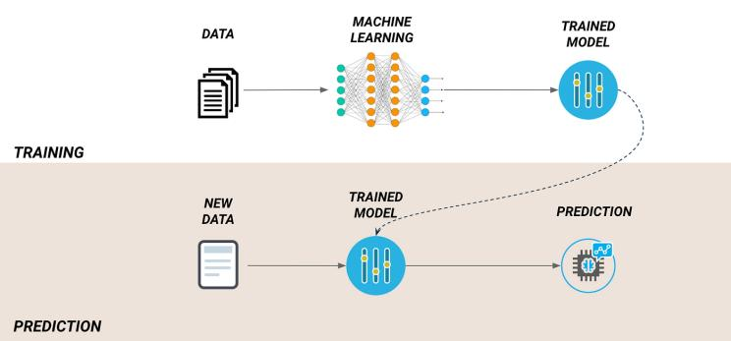
Machine Learning Model
Model Selection:
The project uses a Logistic Regression algorithm for fake news classification.
Logistic Regression is a supervised learning algorithm suitable for binary classification problems.
It classifies news articles into two categories: Real or Fake.
The model is trained using features extracted through TF-IDF Vectorization.
After training, the model predicts the authenticity of unseen news articles with high accuracy.

Slide 9
Results & Performance
Prediction Results:
The trained model successfully classified news articles as Real or Fake.
Machine Learning effectively identified patterns in textual data.
The model produced fast and reliable predictions on unseen news articles.
TF-IDF feature extraction improved the overall classification performance.
Performance Evaluation:
The model was evaluated using the following metrics:
Accuracy – Measures the overall correctness of predictions.
Precision – Indicates how many predicted fake news articles were actually fake.
Recall – Measures the model's ability to identify fake news correctly.
F1-Score – Provides a balanced evaluation of Precision and Recall.

Slide 10
Conclusion & Future Scope
Conclusion:
Successfully developed a Machine Learning-based Fake News Detection System.
Applied Natural Language Processing (NLP) techniques for text preprocessing.
Used TF-IDF Vectorization to convert textual data into numerical features.
Trained a Machine Learning model to classify news articles as Real or Fake.
The proposed system provides accurate, efficient, and automated fake news detection, helping reduce the spread of misinformation.
Future Scope:
Improve accuracy using advanced Deep Learning models such as LSTM and BERT.
Support multilingual fake news detection.
Develop a web or mobile application for real-time news verification.
Integrate with social media platforms to identify misleading content automatically.
Expand the system to detect fake images, videos, and multimedia content.

Slide 11
THANK YOU

