Slide 1
Are Our Conceptions on Education Actually True?

Slide 2
Common Education Assumptions
White people are the most educated
Office jobs require the most education
Men are more educated than women
The private sector is more educated than the public sector
Unmarried or divorced people are more educated because they have more time

Slide 3
Hypothesis
Since we have data on all these common conceptions on education I wanted to see if they held true
Surely if we hear about some of these realities being issues and others just make sense then the data will back this up

Slide 4
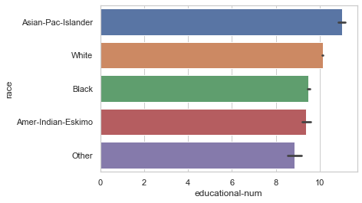
Education by Race

Slide 5
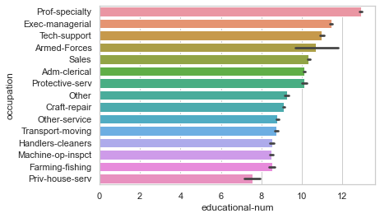
Education by Occupation Type

Slide 6
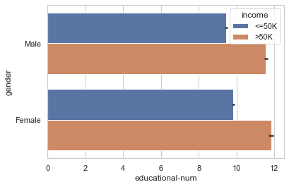
Education by Gender

Slide 7
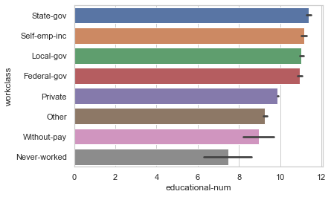
Occupation by Work Sector/Class

Slide 8
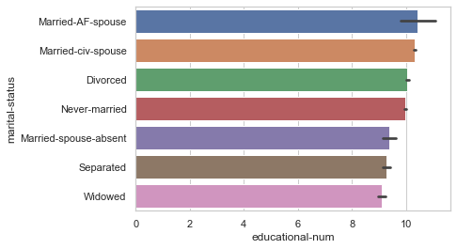
Education by Marital Status

Slide 9
Conclusion
As it turns out while some conceptions are backed up by data others aren’t
Sometimes there are little discrepancies in what we assume as well
If I had more time I would love to research why some of these findings occurred in this particular dataset or if they truly hold in the real world as well

