Slide 1
CS305 Computer Networks
Final Project Presentation

Slide 2
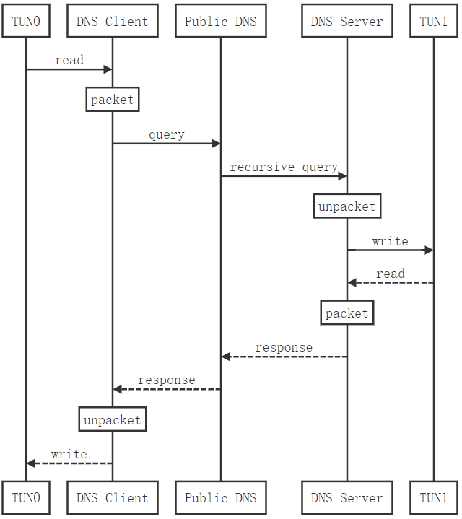
Packet IP datagram into DNS packet

Slide 3
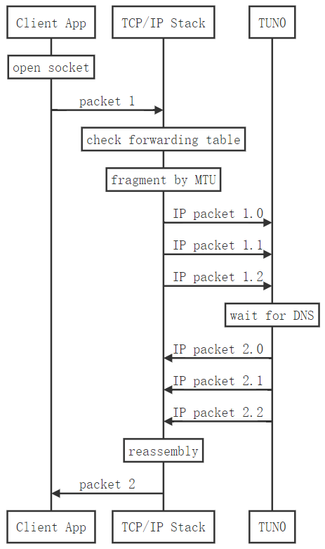
Fragmentation and reassembly

Slide 4
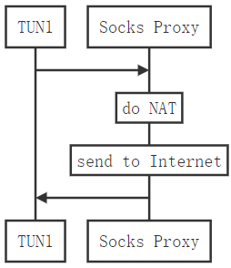
NAT

Slide 5
The challenges
encoding, Use hex, base64, base62
asymmetry, client polling (use msg, fetch)
fragmentation, set MTU
Low performance

Slide 6
How to delivery IP datagram?
IP datagram was put in the domain region of DNS txt query.
Question: DNS domain only can contain [A-Za-z0-9\-]. How?
Encode with hexadecimal?
Too large: 100 bytes IP datagram became 200 bytes of string.
Encode: Base 62.
Base encode without plus (+) and equal(/).
Another question: single direction from client to server. But server cannot process too fast, what if DNS returned earlier than server IP datagram?

Slide 7
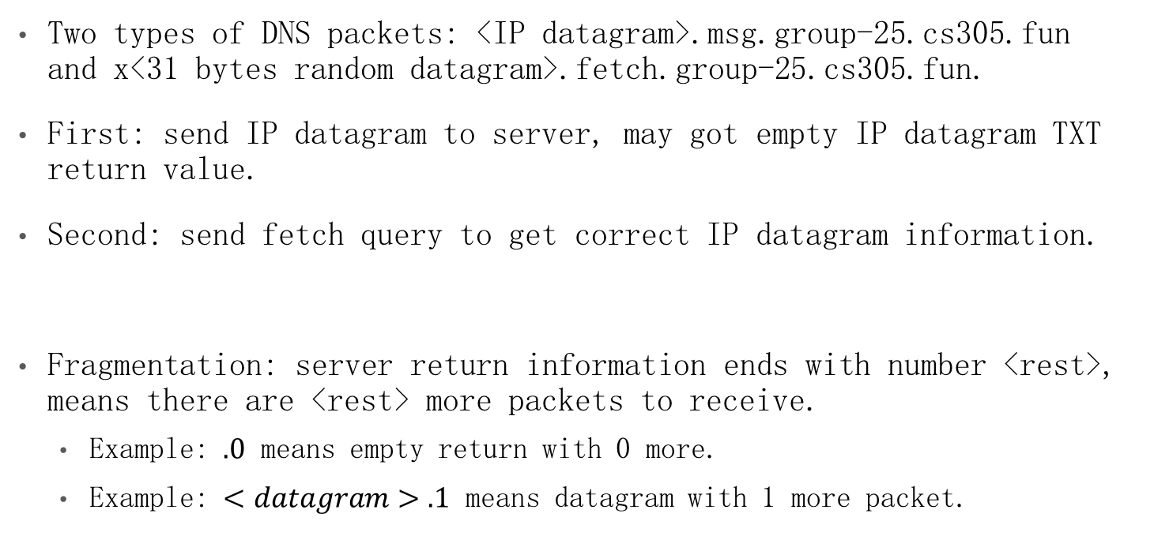
Solution with roll polling
Two types of DNS packets: <IP datagram>.msg.group-25.cs305.fun and x<31 bytes random datagram>.fetch.group-25.cs305.fun.
First: send IP datagram to server, may got empty IP datagram TXT return value.
Second: send fetch query to get correct IP datagram information.
Fragmentation: server return information ends with number <rest>, means there are <rest> more packets to receive.
Example: $.0$ means empty return with 0 more.
Example: $<datagram>.1$ means datagram with 1 more packet.

Slide 8
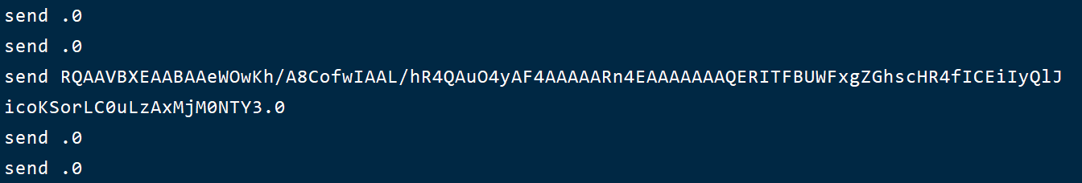
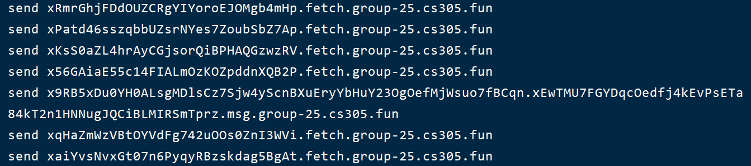
Fragmentation and reassembly

Slide 9
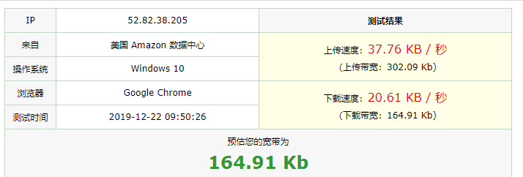
Efficiency measurement

Slide 10
Bonus
提高性能，使用 base62x 代替 hex，使 MTU 从 100 扩大为 150
提高便利性，安装脚本，启动脚本，参数可在配置文件中修改

Slide 11
Thanks!
Any questions?

