Slide 1

Comparative Analysis of Data Analytics Offerings and Capabilities
Notes:
1

Slide 2
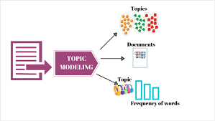

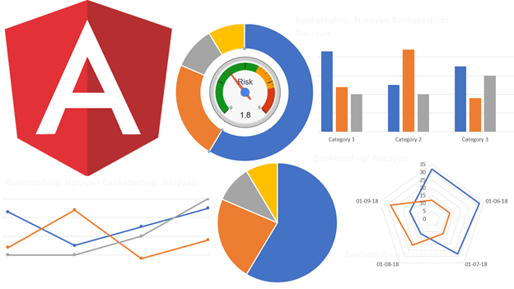







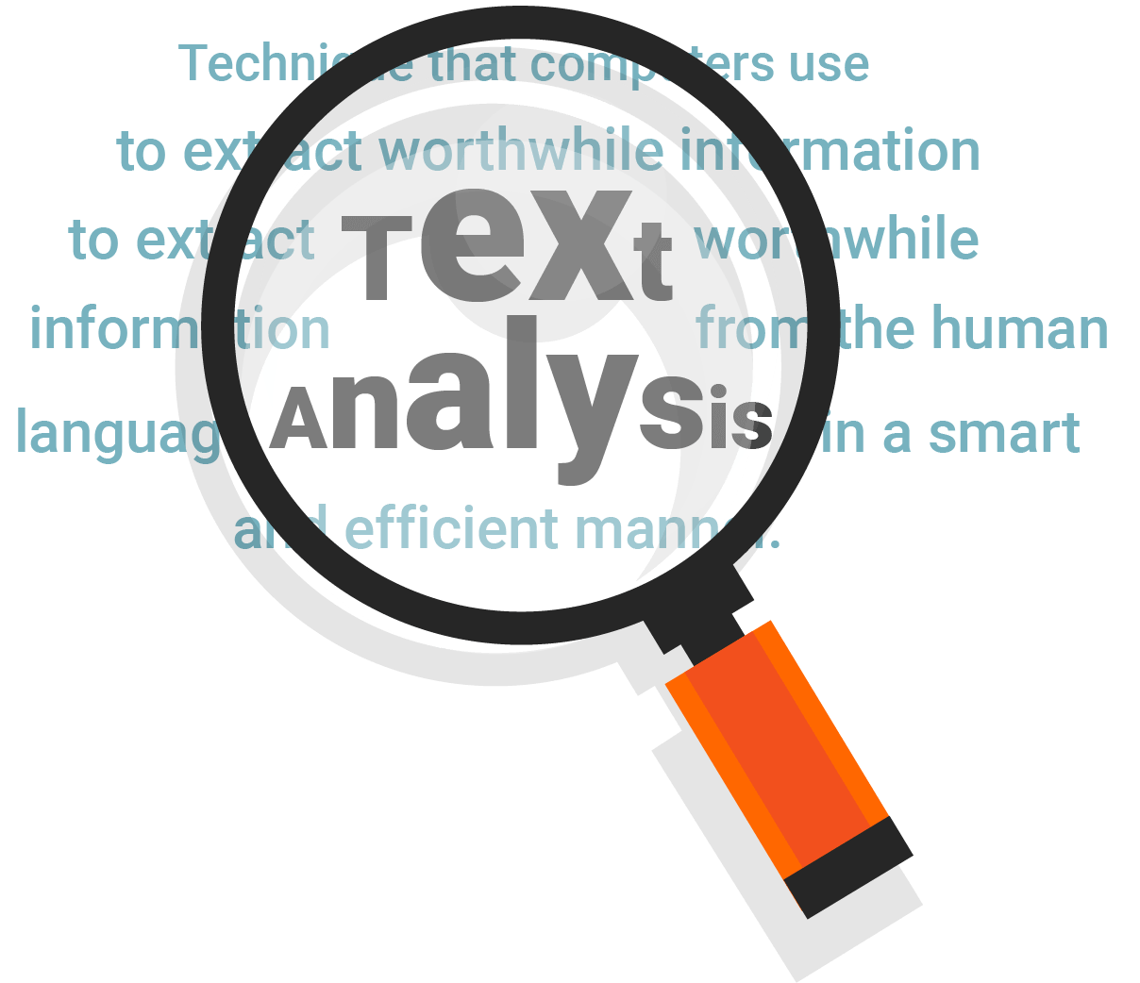

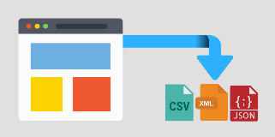
Methodology
03 Topic Categorization
04 Visualization/Insights
02 Data Cleansing and Text Analysis
01 Data Collection
Notes:
1. Data about AI/ML capabilities of given companies is gathered from various sources in an unstructured format using web scraping techniques. LinkedIn, Career Website and Job postings
2. Data Cleansing is done using Natural Language Processing techniques where the unstructured data is converted to meaningful words. Word clouds are formed on top of cleaned data
3. Based on the significance of words present in data, we built a topic model which would cluster words in different groups.
4. Using the topic model and our intuition we create 2 maps of different domains for competitors and one for Atos
2

Slide 3
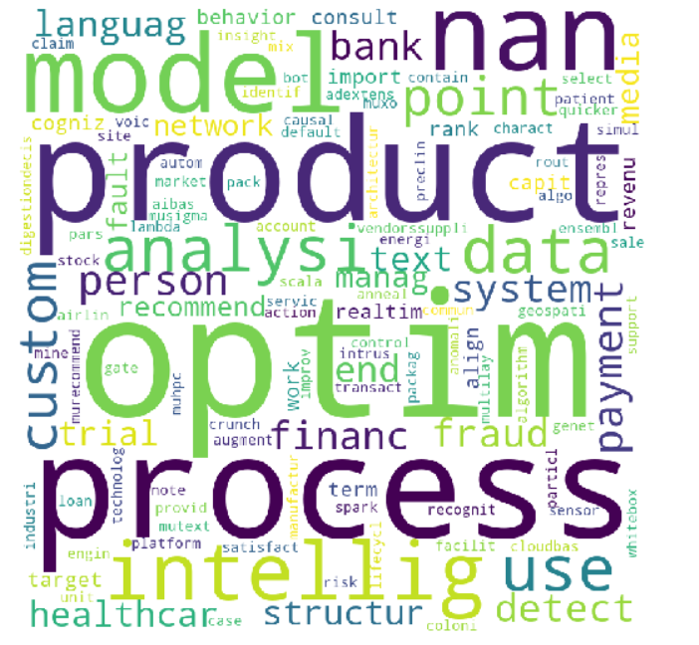
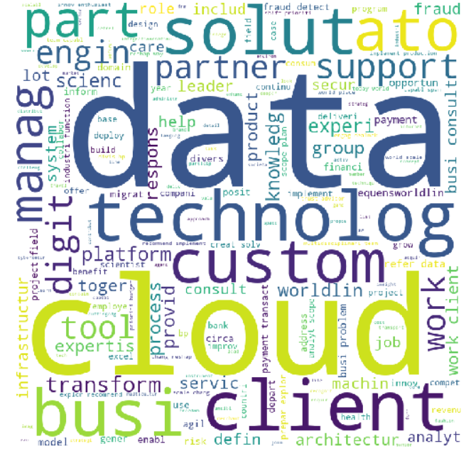
Atos vs. Competitors - Comparison
COMPETITORS
ATOS
Thank you
Notes:
3

Slide 4
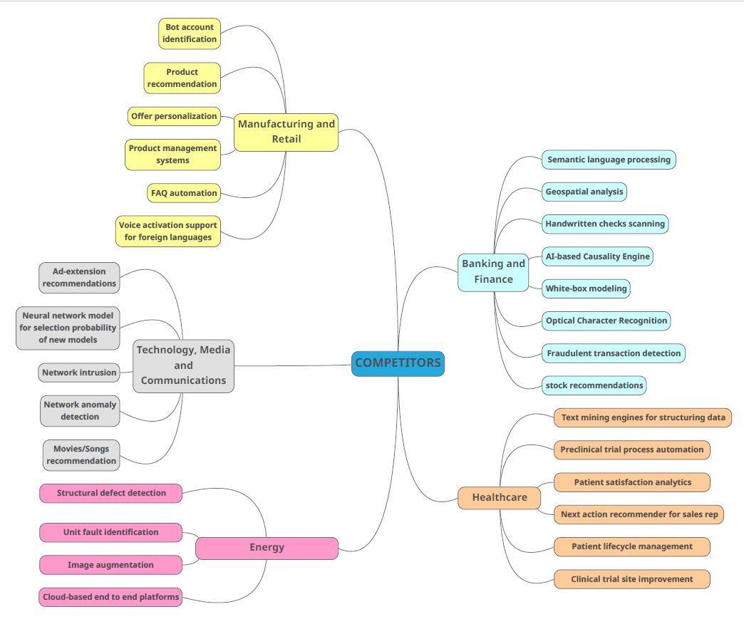
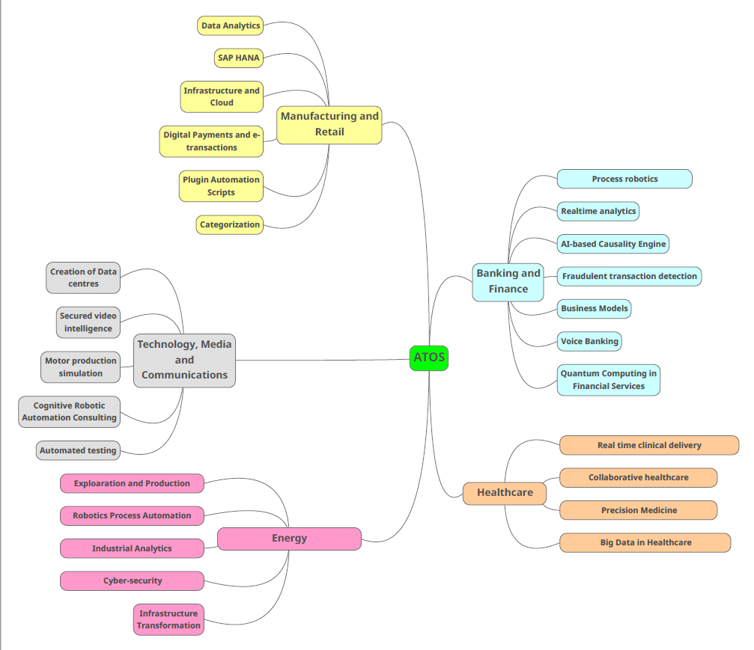
Overview – Atos and Competitors
Thank you
Notes:
4

Slide 5

Thank you!
Thank you
Notes:
5

