Slide 1

Comparative Analysis of Data Analytics Offerings and Capabilities
Notes:
1

Slide 2
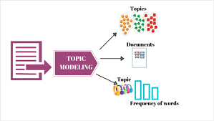

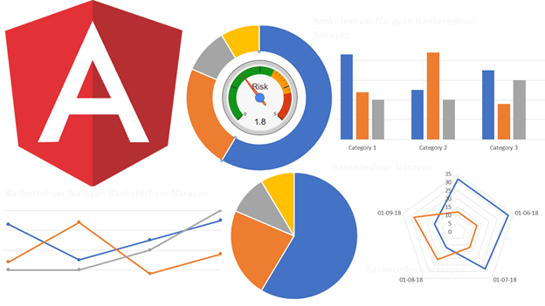




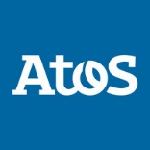


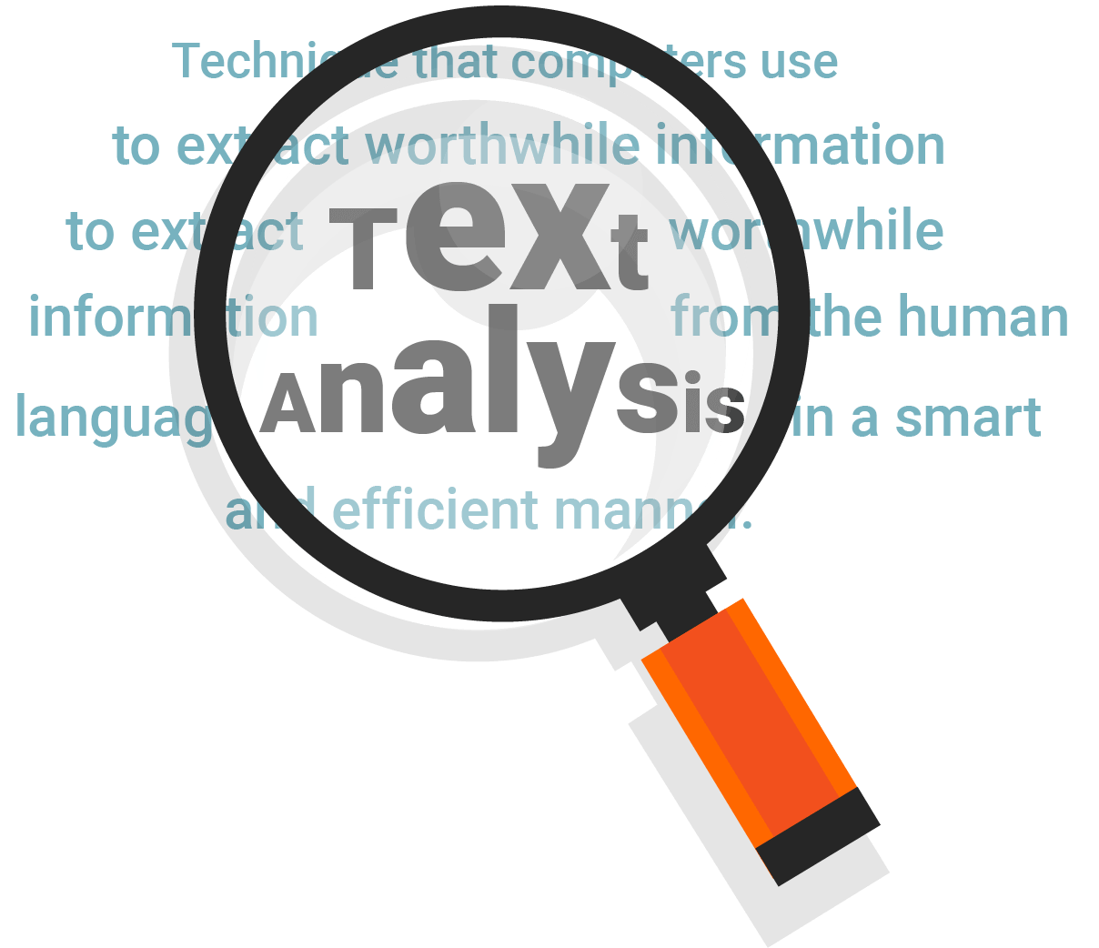


Methodology
03 Topic Categorization
04 Visualization/Insights
02 Data Cleansing and Text Analysis
01 Data Collection
Notes:
1. Data about AI/ML capabilities of given companies is gathered from various sources in an unstructured format using web scraping techniques. LinkedIn, Career Website and Job postings
2. Data Cleansing is done using Natural Language Processing techniques where the unstructured data is converted to meaningful words. Word clouds are formed on top of cleaned data
3. Based on the significance of words present in data, we built a topic model which would cluster words in different groups.
4. Using the topic model and our intuition we create 2 maps of different domains for competitors and one for Atos
2

Slide 3






Impact of AI in Various Industries
Most revenue generating projects undertaken by consulting companies in 2019
Notes:
Banks use it to detect fraud and predict changes in the stock markets
Insurance companies employ AI to help them produce policy quotes and assess claims
It’s helping police forces to identify suspects from grainy CCTV images
Machines with the capability to identify images are helping doctors spot disease
Algorithms that use machine learning – one of the leading branches of AI – are helping self-driving cars to navigate our complex roads
And it is helping firms make decisions about who to hire and fire
3

Slide 4
AI is expected to increase revenue by over 70% across industries
Importance and Impact of AI to Industries
% Importance/Increase

Slide 5



Atos’ competitors provide an array of services that include control of payments, optimization of revenue, etc
Operations intelligence
Product intelligence
Fraud intelligence
Customer intelligence
Test design and automation
Defect analysis
Agile project management
Natural language processing
Optical character
Fraud Intelligence
RPA capabilities of assist edge

Slide 6
Atos’ competitors provide an array of services that include control of payments, optimization of revenue, etc
muXo - optimization using genetic algorithms,, ant colony and particle swarms
Applications - airline gate optimization, route optimization
Wipro HOLMES - front to back digital workforce for IT development
Applications -
Offers services across IT and project management.
Infosys NIA - RPA capabilities of AssistEdge, natural language processing (NLP)
Applications - forecasting revenue, customer behavior and fraud

Slide 7
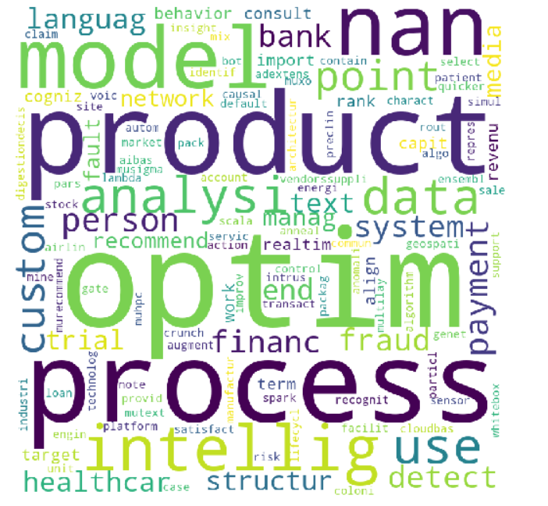
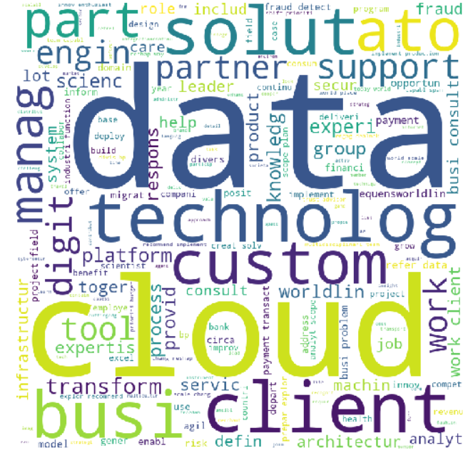
Atos vs. Competitors - Comparison
COMPETITORS
ATOS
Thank you
Notes:
7

Slide 8
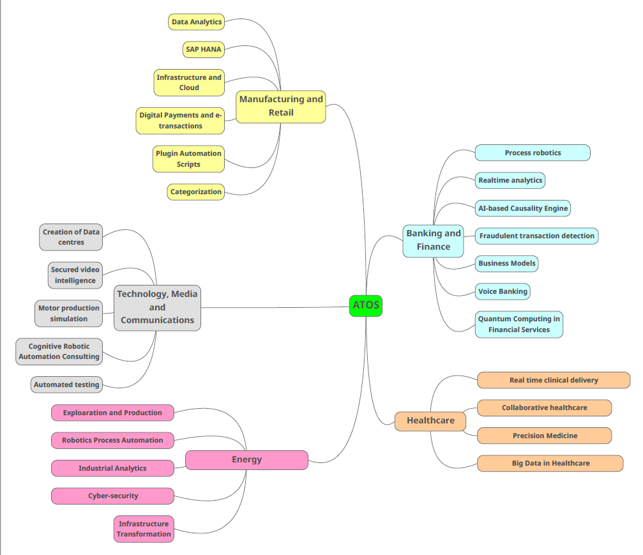
Overview - Atos
Thank you
Notes:
8

Slide 9
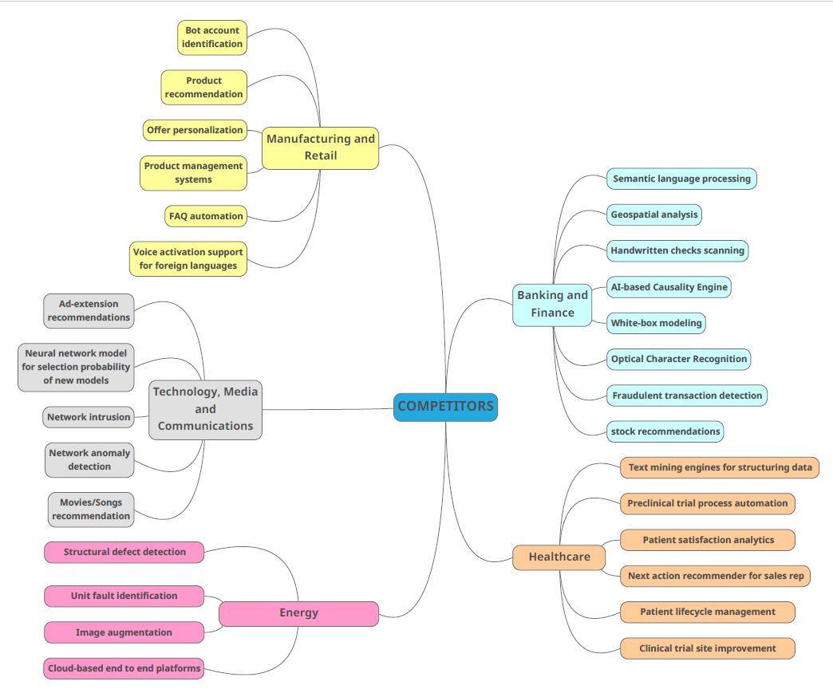
Overview - Competitors
Thank you
Notes:
9

Slide 10
Healthcare
Competitors
Atos
Patient Satisfaction Analytics
01
Real time clinical delivery
Text mining engines for structuring data
02
Collaborative healthcare
Patient lifecycle management
03
Precision Medicine
Preclinical trial process automation
04
BigData in Healthcare
Notes:
10

Slide 11
Technology, Media and Communications
Competitors
Atos
Ad-extension recommendations
01
Creation of Data Centries
02
Secured video Intelligence
Neural network model
03
Motor production simulation
Network intrusion
Network anomaly detection
04
Cognitive Robotic automation consulting
Notes:
11

Slide 12

Thank you!
Thank you
Notes:
12

