Slide 1
SAT and ACT Analysis
Oscar Goh

Slide 2
Background
The ACT was created by an education professor at the University of Iowa named Everett Franklin Lindquist in 1959 as a competition to SAT. It was administered to 75460 students in the first year it was created. It gained popularity and grew the number to over a million in 1972.
By 2015, ACT has surpassed SAT as the most popular college admissions test.
In 2016, a new format of SAT with less confusing question phrasing and trigonometry in the math section was released.

Slide 3
Problem statement
To make recommendation of a State to the College Board to increase the participation rate in SAT.

Slide 4
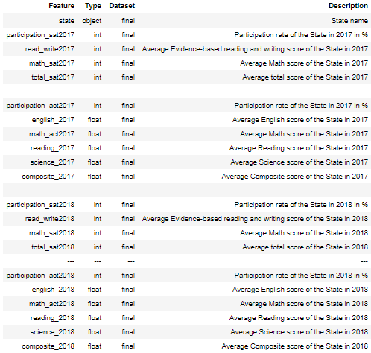
Data
Data of SAT and ACT in years 2017 and 2018 are used for this analysis.

Slide 5
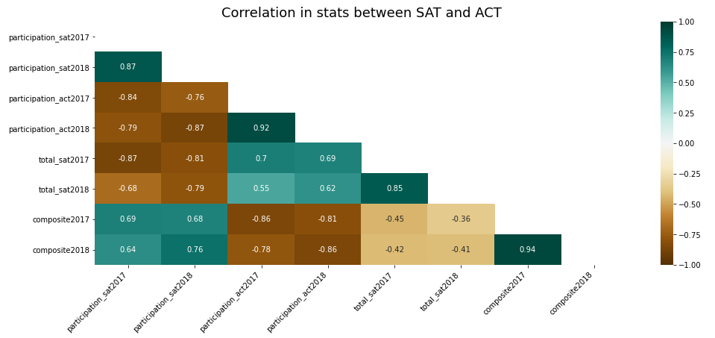
Exploring the correlation in participation rates and test scores between SAT and ACT

Slide 6
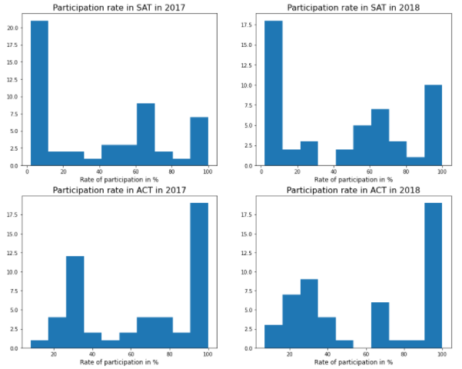
Exploring the correlation in participation rates in 2017 and 2018 between SAT and ACT
Distributions are bimodal with high distribution in both extremes

Slide 7
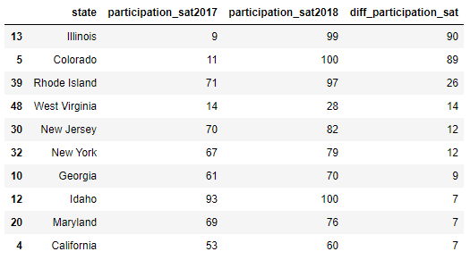
Highest improvements in participation rate in SAT
Bigger increment in participation rate possible in States with lower participation rate

Slide 8
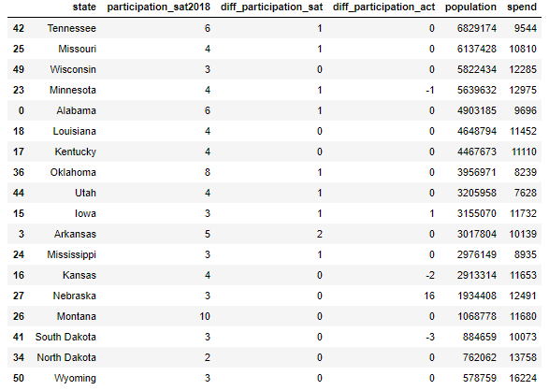
participation rate, population, spending per pupil
Exploring key factors leading to final choice of State

Slide 9
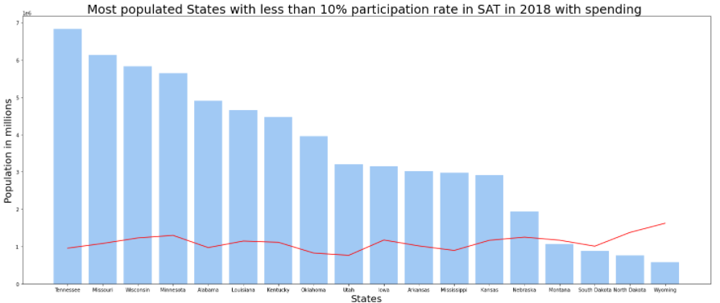
participation rate, population, spending per pupil

Slide 10


Conclusion and recommendation
State of choice: Minnesota
States with lower participation rate in SAT so growth potential is higher as there will be more room for conversion.
States with relatively higher population. Higher population equates to a wider target audience.
States with higher spending budget allocated per pupil implies the level of importance a State places on academic.

