Slide 1
en_US
SSTF 2021 ｜Hacker’s Playground
Tutorial Guide
RC four
Crypto

Slide 2

Cryptography and Security
Most security systems are based on cryptography.
From authentication and protection systems on your cell phone, to HTTPS, Wifi, banking, and most web based services that require a login, you use cryptographic algorithms
on a daily life whether you are aware of it or not.
It is not just about keys and data.
Cryptographic algorithms that have been proven to be secure based on mathematical models can be completely defeated by even a minor misuse.
In this tutorial,
you will learn the concept of cryptography and the attacks
that can occur if cryptographic algorithms are misused.

Slide 3
Two kinds of encryption
 | Symmetric Encryption | Asymmetric Encryption
Key | One shared key for encryption and decryption | Mathematically coupled public key and private key
Typical Key Size | 128~256 bits | 1024~3072 bits (for RSA)
Performance | High | Low, because it’s a complex mathematical computation
Main Purpose | Data Encryption | Digital Signature/Certificate
Representative Algorithms | DES, AES, RC4 | RSA, DSA, ECC

Slide 4





Two kinds of encryptions
Shared Key
Symmetric
Encryption
Hacker’s
Playground
tM5#c*q3y
VUzw^8Xn
WfU6AcwL
Hacker’s
Playground
Encryption
Decryption
Plain Text
Cipher Text
Plain Text
One key used for both encryption and decryption
Asymmetric
Encryption
Key Pair
Hacker’s
Playground
Se@K8E1$a
kez8cCaMv
cg1@FCiVq
Hacker’s
Playground
Encryption
Decryption
Plain Text
Cipher Text
Plain Text
Key Pair consisting of encryption key and decryption key

Slide 5
RC4 (a.k.a ARC4)
A representative stream cipher
Stream cipher is a branch of symmetric key cipher.
XOR-based common encryption/decryption processing
Working
Secret Key
Plain text
Cipher text
Keystream Generator
Key
Stream
XOR
Key
Stream
XOR
Key Stream
Cipher text
Plain text
Step 1. Key stream generation
Step 2-1. Encryption
Step 2-2. Decryption

Slide 6
Let’s solve
Crypto quiz!

Slide 7
Quiz #1
& solution

Slide 8

Quiz #1
Simple python code
KeyStream_From_RC4 ="<y4)ky&=zuw(8*#3*<q4Quw)o+"
RC4_CipherText ="k6cv36tb1<9ogcplby#qpT"
Can you get the plaintext?
Download the source code HERE.
Try it before you see the solution.

Slide 9
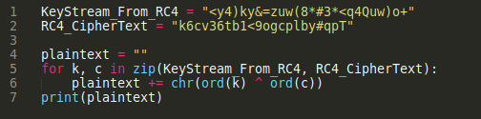

Solution for Quiz #1
It’s quite simple. To decrypt the RC4 ciphertext, just XOR it with the key stream.
And you did it!
Bytewise XORing of ciphertext and key stream

Slide 10
Quiz #2
& solution

Slide 11
Quiz #2
ARC4 module generates key stream and XOR with the input.
from Crypto.Cipher import ARC4
from binascii import hexlify
from secret import key, flag
def encrypt(data):
return ARC4.new(key).encrypt(data)
ct = b""
for ch in flag:
ct += encrypt(ch)
print("Ciphertext = ", hexlify(ct).decode())
'''
$ python3 challenge.py
Ciphertext = 6f47474c06086f47085c47085c404d08464d505c085b5c494f4d09
'''
RC4 ciphertext is given,
but key is not known.
Can you get the plaintext?
Try it before you see the solution.
HINT: You may need a little bit brute-forcing.
Download the source code HERE.

Slide 12
Solution for Quiz #2
According to the source code…
from Crypto.Cipher import ARC4
from binascii import hexlify
from secret import key, flag
def encrypt(data):
return ARC4.new(key).encrypt(data)
ct = b""
for ch in flag:
ct += encrypt(ch)
print("Ciphertext = ", hexlify(ct).decode())
'''
$ python3 challenge.py
Ciphertext = 6f47474c06086f47085c47085c404d08464d505c085b5c494f4d09
'''
The flag is not encrypted at once.
It’s split for each byte, encrypted, and put back together.
Each letter of the flag is XORed with the first byte of the key stream.
Only one byte of the key stream is used.
The entire flag data can be recovered by finding the value of the one byte.

Slide 13
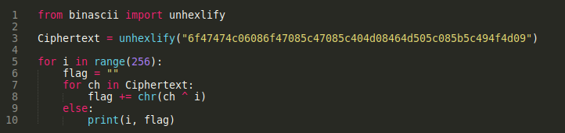

Solution for Quiz #2
Try every possible case.
1 byte is group of 8 bits, so there can be 2⁸ = 256 cases
Bytewise XORing of ciphertext and key stream
Try XORing for every possible case
We got a meaningful sentence among them.

Slide 14
Let’s practice
Solve the tutorial
challenge

Slide 15
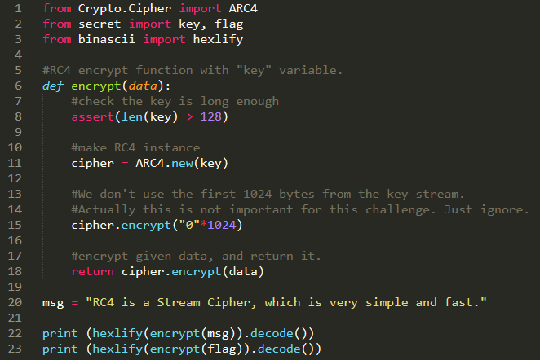
Challenge Definition
There are
one key,
unknown
two plaintexts
flag: unknown
msg: known
and two ciphertexts.
Both of them are known
Ciphertext1
Ciphertext2

Slide 16
Let’s see
✓unknown
key
Keystream Generator
✓known
✓unknown
msg
flag
Key Stream
✓unknown
XOR
XOR
Ciphertext1
✓known
Ciphertext2
✓known
Can you see? We can find the flag, even without key!
Because when a xor b = c, a xor c = b.

Slide 17
It’s an easy logic!
XOR
Ciphertext1
Key Stream
flag
✓
msg
Ciphertext2
✓
✓
Step 1. We can recover the Key Stream from the known plain text and cipher text pair.
Step 2. We can decrypt the Ciphertext2 because now we know the Key Stream.
Step 3. Now we got the flag!! :)

Slide 18
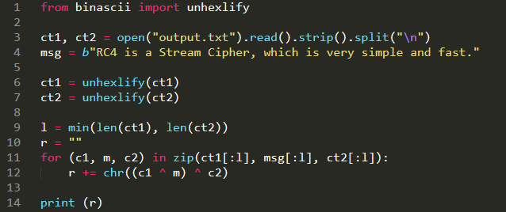
Does it really work?
Yes, it does!
Try it yourself!
Bytewise XORing of ct1, msg, and ct2

