Slide 1
en_US
SSTF 2021 ｜Hacker’s Playground
Tutorial Guide
RSA 101
Crypto

Slide 2
Do you remember?
 | Symmetric Encryption | Asymmetric Encryption
Key | One shared key for encryption and decryption | Mathematically coupled public key and private key
Typical Key Size | 128~256 bits | 1024~3072 bits (for RSA)
Performance | High | Low, because it’s a complex mathematical computation
Main Purpose | Data Encryption | Digital Signature/Certificate
Representative Algorithms | DES, AES, RC4 | RSA, DSA, ECC

Slide 3

RSA(Rivest–Shamir–Adleman)
The most widely used public-key cryptosystem.
To establish secure channels such as HTTPS(SSL/TLS), email, VPNs, or so on.
To ensure the integrity of the firmware in the devices.
For the echo systems including payment, banking, contents protection, and so many things.
Basically, RSA is a modular exponentiation operation.
${RSA}_{enc}\left(\left(K_{e},n\right),p\right)=p^{K_{e}}modn$
${RSA}_{dec}\left(\left(K_{d},n\right),c\right)=c^{K_{d}}modn$
Modular exponentiation = exponentiation + modulo operation.
Asymmetric encryption algorithm is sometimes referred to as 'public-key cryptosystem' or 'public-key infrastructure(PKI)'.

Slide 4
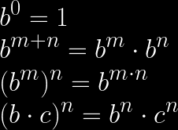


Mathematics for RSA
Exponentiation
Repeated multiplication of the base.
Usually expressed as a pow function; .
It has some identities and properties.
We only consider integer exponents and non-zero bases here.

Slide 5
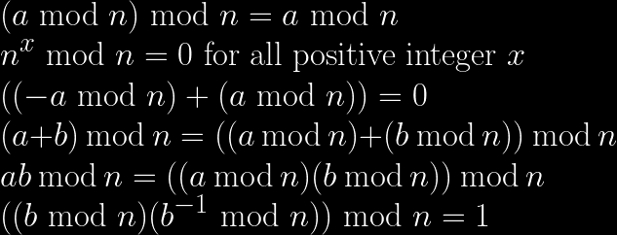
Mathematics for RSA
Modulo operation
Used to get the remainder, and usually expressed as a '%' or 'mod' operator.
modulo defines a number system consisting of the numbers to .
In that system, we can say when , and write it like this:
It also has some identities and properties.
Refer to
modular arithmetic
and Finite field.
denotes the modular multiplicative inverse, which is defined iff and are coprime.

Slide 6
Mathematics for RSA
Euler’s totient function,
Number of integers in the range , for which .
For any prime numbers , and .
Euler’s theorem
When and are coprime positive integers,
.
And some more things not covered here.
gcd(greatest common divisor)
prime number

Slide 7
RSA: Key generation
Step 1. Choose two distinct primes, and .
Refer to
NP problem.
Then and .
is a huge number, so finding or from by factorization is really difficult.
Step 2. Choose where and .
65537 is commonly used for .
And calculate , by using the Extended Euclidean algorithm.
Step 3. Now you have a RSA Key pair.
Public exponent , for encryption, and modulus will be opened to the public.
Private exponent , for decryption, and parameters and should be kept secret.
If an attacker can find one of , , or , he can decrypt any ciphertext.
In recent years, it is recommended to use Carmichael's totient function instead of Euler's totient function.

Slide 8
RSA: Encryption and decryption
Encrypting message with public key
Ciphertext
Decrypting ciphertext with private key
$∵ed≡1\left(modφ\left(n\right)\right)$
$∵Euler^{′}stheorem$
Therefore, anyone can encrypt a message, but only the owner of the private key can decrypt it.

Slide 9
RSA: Signing and verification
Generating digital signature on document with private key
Signature
In most cases, message digest, , is used instead of .
Refer to
cryptographic hash function.
Verifying on with public key
Signature is valid iff
Therefore, only the owner of the private key can generate a signature and anyone can verify it.

Slide 10
Let’s solve
Crypto quiz!

Slide 11
Quiz #1
& solution

Slide 12
Quiz #1
n = 71429248760466541506031966887517802919937362412357335088258769184139035122083
e = 65537
p = 252306102913729311695741849559437257013
ct = 61617714183432990975533017724678764406865679264090036586430429254817365860213
Download the source code HERE.
Simple python code with RSA parameters
A secret parameter, is given.
Can you decrypt ct?

Slide 13

Solution for Quiz #1
According to the RSA algorithm,
we can recover all secret parameters.
n = 71429248760466541506031966887517802919937362412357335088258769184139035122083
e = 65537
p = 252306102913729311695741849559437257013
ct = 61617714183432990975533017724678764406865679264090036586430429254817365860213
q = n // p
phi_n = (p - 1) * (q - 1)
d = pow(e, -1, phi_n)
m = pow(ct, d, n)
print(hex(m))
print(bytes.fromhex(hex(m)[2:]))
# , so we can get from and .
# calculates
# calculates
# calculates
Decryption success!
# prints in the hex representation
# prints in the bytes representation

Slide 14
Quiz #2
& solution

Slide 15
Quiz #2
from sympy import randprime, nextprime
from secret import pt
p = randprime(pow(2, 511), pow(2, 512))
q = nextprime(p)
n = p * q
e = 65537
ct = pow(pt, e, n)
print("n =", hex(n))
print("ct =", hex(ct))
'''
$ python3 challenge.py
n = 0xa28c55dd2df4f6845a1faf7755c080a... (omitted)
ct = 0x19cea145a7495409a0ab504261b80e... (omitted)
'''
RSA encryption program.
Can you get the plaintext, pt?
Try it before you see the solution.
HINT: You may need a little bit brute-forcing.
Download the source code HERE.

Slide 16
Solution for Quiz #2
from sympy import randprime, nextprime
from secret import pt
p = randprime(pow(2, 511), pow(2, 512))
q = nextprime(p)
n = p * q
e = 65537
ct = pow(pt, e, n)
print("n =", hex(n))
print("ct =", hex(ct))
'''
$ python3 challenge.py
n = 0xa28c55dd2df4f6845a1faf7755c080a... (omitted)
ct = 0x19cea145a7495409a0ab504261b80e... (omitted)
'''
In the RSA key generation,
and should be independently generated.
But here, is the smallest prime
greater than .
So , but they’ll be very close.
We can attack this point.

Slide 17
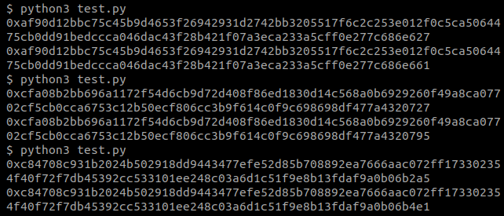
Solution for Quiz #2
Let’s generate sample RSA parameters in the same way.
from sympy import randprime, nextprime
p = randprime(pow(2, 511), pow(2, 512))
q = nextprime(p)
print(hex(p))
print(hex(q))
We can see that and are the same except for the last few bits.

Slide 18

Solution for Quiz #2
n = 0xa28c55dd2df4f6845a1faf7755c0... (omitted)
ct = 0x19cea145a7495409a0ab504261b... (omitted)
# gmpy2 is an arithmetic library for python
from gmpy2 import isqrt
p = isqrt(n) # integer square root of n
e = 65537
# simple brute-force
while n % p != 0:
p += 1
# same as Quiz #1
q = n // p
phi_n = (p - 1) * (q - 1)
d = pow(e, -1, phi_n)
m = pow(ct, d, n)
print(hex(m))
print(bytes.fromhex(hex(m)[2:]))
So we can say .
,
therefore and .
We can calculate ,
so we can easily find near by brute-force attack.
Decryption success!
There’s a mathematical method that simply finds when , but it is not covered here.

Slide 19
Let’s practice
Solve the tutorial
challenge

Slide 20
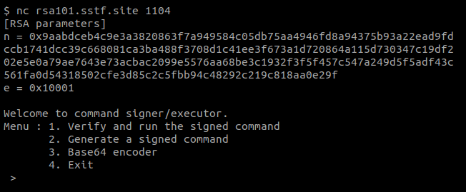


Challenge Definition
A command signer/executor
based on RSA
RSA public parameters are given.
It seems that
we can generate a signed command
and execute it.
The signer takes a base64 encoded command.

Slide 21
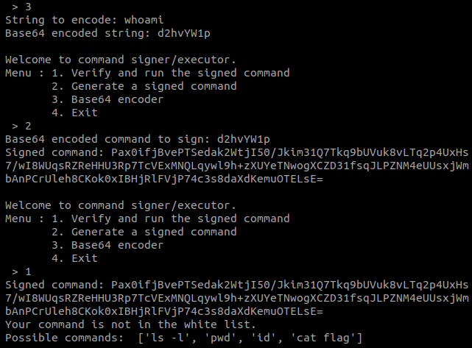
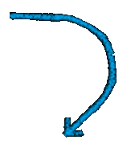

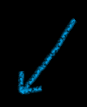
Challenge Definition
Testing a command, whoami.
Signature generation success
but execution failed.
Only commands in the white list can be executed.
cat flag is what we need.

Slide 22
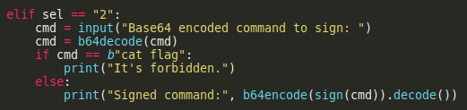
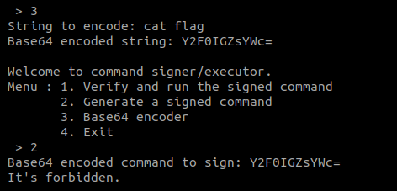
Challenge Definition
We can sign any command
except for cat flag.
So we should
make a signature of cat flag from other commands
and signatures,
without RSA private key.

Slide 23
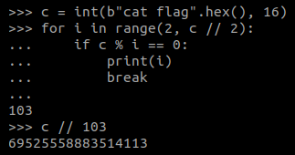
Decomposition of the command
Let .
We can generate for all .
Can you find , such that and ?
The simplest way is using factorization.
We got .

Slide 24
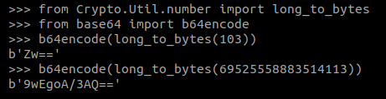
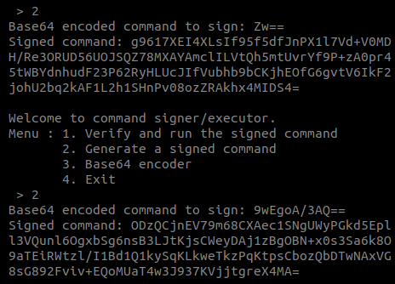
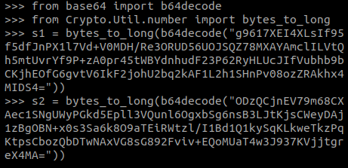
Decomposition of the command
Now we can get , respectively.

Slide 25
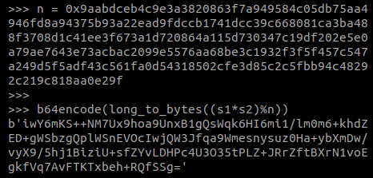
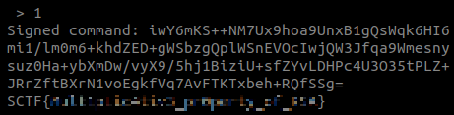
Multiplication Properties of Exponents
What happens to ?
c
We got , without private key!
Let’s make sure it works properly.
Try it yourself!

Slide 26
What if you can’t factorize ?
You can still use the same method.
Choose an integer .
Get .
Calculate by using extended Euclidean algorithm.
Get .
Now, .
!
You should adopt the appropriate padding algorithm
to prevent such attacks.

